Slide 1
Lecture 5:
Logistic Regression and Kmeans clustering
Er.Roshan Shrestha
roshan.shrestha@islingtoncollege.edu.np

Slide 2
Agenda
Logistic Regression
ROC AUC, PR AUC
Kmeans clustering

Slide 3
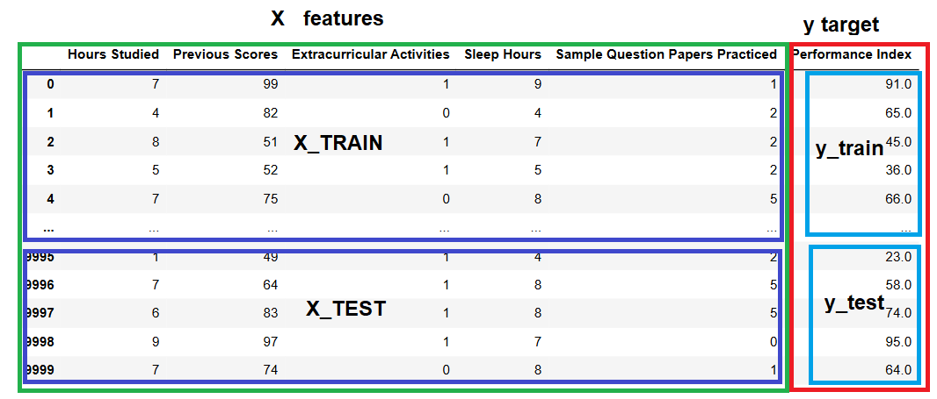

Slide 4
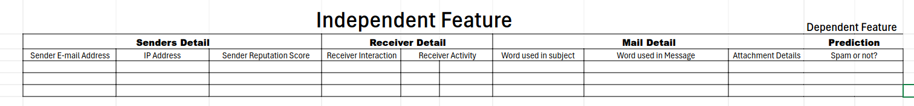
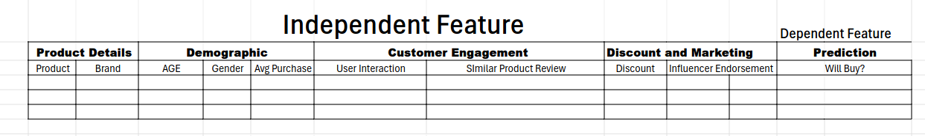
Logistic Regression comes into action
whether a customer will purchase a product or not?
based on their browsing behavior
email is spam or not
content, sender information and others
credit card companies predict whether a transaction is fraudulent
?
transaction time, login behaviour, transaction deviation,location
Loan decisions like 'approve' or 'reject' using data
income , age, collateral, loan amount, Length of employment, no of dependent , social media signals ,saving history
self-driving car deciding whether to brake or not based on the likelihood of a collision
Object type, distance to object,speed, traffic signal

Slide 5
Logistic Regression
Logistic Regression is a supervised learning algorithm used for classification tasks, where the outcome (or target variable) is categorical.
Unlike Linear Regression, which predicts continuous values, Logistic Regression predicts the probability of an outcome belonging to a particular class.
It is used when the dependent variable (target) is binary (has only two classes, e.g., yes/no, 0/1, pass/fail).
Logistic Regression models the probability of an event occurring by fitting data to a logistic function (sigmoid function).

Slide 6
logistic regression is designed for categorical outcomes and is particularly popular in binary classification tasks.
Instead of fitting a straight line (as in linear regression), logistic regression fits an S-shaped curve called the sigmoid function to the data, which constrains the output to be between 0 and 1.
sigmoid function, is used to map any real-valued number into a value between 0 and 1.
Sigmoid function creates an S-shaped curve that maps values to a probability range of [0, 1].

Slide 7

Logistic Function (Sigmoid Function):
The logistic regression model uses a logistic function (also known as a sigmoid function) to map predicted values to probabilities.
Sigmoid function is also known as the squashing function, as it takes the input from the previously hidden layer and squeezes it between 0 and 1
Z= m1x1 + m2x2 + m3x3...... mnxn+c

Slide 8
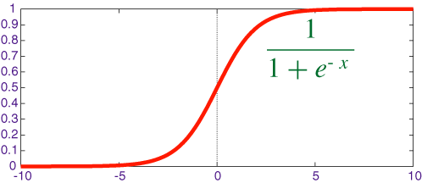
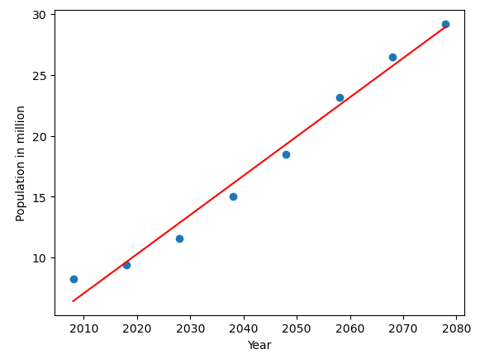
Linear Function vs Sigmoid Function
y= mx+c
23

Slide 9
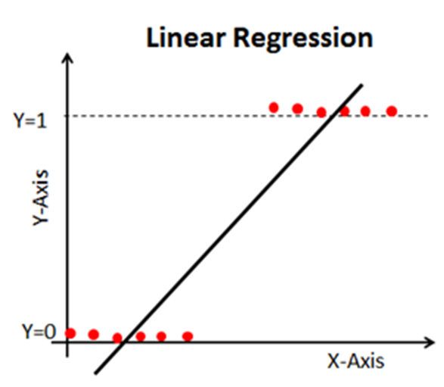
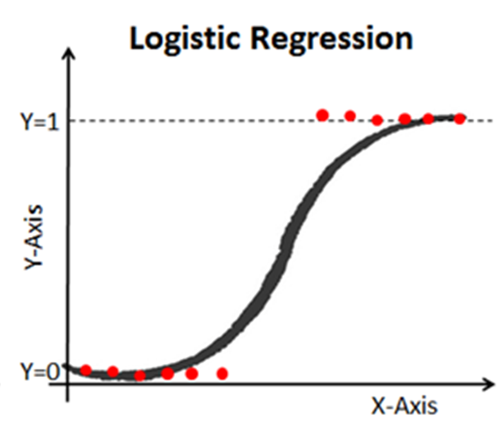

Slide 10
Types of Logistic Regression
Binomial
Multinomial
Ordinal
Binomial:
only two possible types of dependent variables, such as 0 or 1, Pass or Fail, etc.
Multinomial:
there can be 3 or more possible unordered types of the dependent variable, such as “cat”, “dogs”, or “Tiger”
Ordinal:
there can be 3 or more possible ordered types of dependent variables, such as “low”, “Medium”, or “High”.

Slide 11
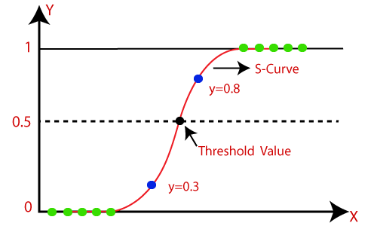

Slide 12
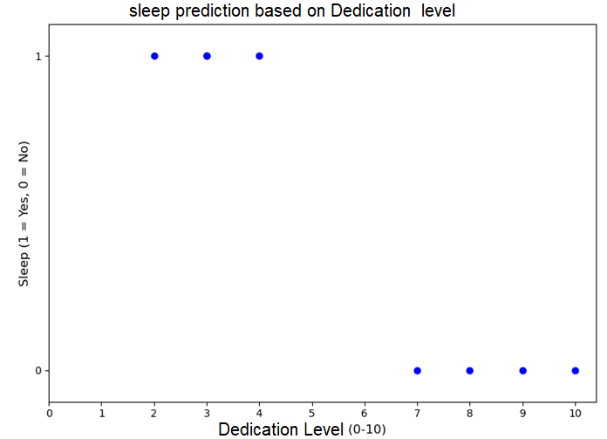
Predicting Student Sleep Behavior
Sleep = True
0.5
Sleep = False

Slide 13


σ(z) converts the output to a value between 0 and 1, representing the probability of the positive class (e.g., probability of "yes").
Probability Prediction: Logistic regression predicts the probability that the target variable belongs to the positive class:
The output probability can then be interpreted as:
P(Y=1∣X) : Probability that the outcome is 1 (positive class).
1−P(Y=1∣X): Probability that the outcome is 0 (negative class).

Slide 14
Decision Rule:
Logistic regression typically applies a threshold (default is 0.5) to classify an instance into one of two categories:
If P(Y=1∣X)>0.5, classify as 1 (positive class).
If P(Y=1∣X)≤0.5, classify as 0 (negative class).

Slide 15
Binary Classification:
Logistic Regression is typically used when the target variable has two possible outcomes (e.g., pass/fail, spam/not spam, etc.).
Probability Estimation:
The output of logistic regression is a probability score (between 0 and 1), which indicates the likelihood that the target variable belongs to a particular class.
Threshold-Based Decision: The probability output is typically converted to a binary decision using a threshold (usually 0.5).
  If the probability is above 0.5, the model predicts one class (e.g., 1 or "yes"); otherwise, it predicts the other class (e.g., 0 or "no").

Slide 16
Advantages of Logistic Regression:
predicts whether a patient has heart disease (1) or not (0) based on features like Cholesterol level and Age
Interpretability: The coefficients tell you how each feature contributes to the probability of the positive class.
Probability Output: It outputs probabilities, which can be useful for certain decision-making tasks (e.g., in healthcare).
Efficient Training: It's computationally efficient and works well with large datasets.
Feature Importance: Logistic regression shows which features are most important for making predictions.
predict whether a loan applicant will default on a loan, nuanced decision-making
Classify customers as either churn risk (1) or loyal (0) based on their browsing habits, purchase history, etc
predict whether an employee will leave the company (1) or stay (0) based on features like Salary increment percentage, Workload, Manager’s rating

Slide 17
Disadvantages of Logistic Regression:
Linear Decision Boundary: It assumes a linear relationship between the features and the log-odds of the target, which may not be suitable for more complex data.
Not Suitable for Nonlinear Problems: For datasets that have complex, non-linear decision boundaries, logistic regression may underperform.
Sensitive to Imbalanced Data: Logistic regression can struggle when the classes are heavily imbalanced, leading to biased predictions toward the majority class.
classifying customers into "High Spenders" (1) or "Low Spenders" (0) when looking at the moderate ones (forming a circular boundary )
predicts whether a policyholder will claim insurance or not Chances of claiming insurance decreases initially with driving experience, then increases slightly for older age groups (a non-linear relationship)
predict whether a patient has a rare disease (1) or not (0) based on symptoms. 10,000 patients, but only 100 have the disease (1% prevalence)

Slide 18

Suppose we want to predict whether a student will pass or fail an exam based on the number of hours they studied.
The outcome is binary: pass (1) or fail (0).
Step 1: Logistic Function
We use the logistic function to predict the probability that a student will pass:

Slide 19
Step 2: Probability Prediction
Assume we have the logistic regression model:
Let’s say after training, we find m1=−0.3,m2=−0.1,m3=0.05 and c=-0.5
sleep_hr=6 hours, question_practice=5,prev score =60
Here P(Pass)= 0.70

Slide 20


Step 2: Probability Prediction
Assume we have the logistic regression model:
Let’s say after training, we find β0=−2 and β1=1.
If a student studied for 3 hours, the probability of passing is:
This means the model predicts a 73% chance that the student will pass.

Slide 21
Step 3: Classification
Using a threshold of 0.5, since the probability of passing (0.73) is greater than 0.5, we predict that the student will pass.

Slide 22
Working Mechanism
Logistic regression calculates a weighted sum of the input features, which it passes through the sigmoid function to produce a probability.
Training:
During training, logistic regression adjusts the coefficients (weights) to minimize the difference between predicted and actual probabilities, usually using a method called maximum likelihood estimation (MLE).
Prediction:
Once trained, the model uses these coefficients to predict outcomes for new data.

Slide 23
Applications
Medical Diagnosis:
  Predicting whether a patient has a disease based on symptoms and test results.
Customer Churn Prediction:
  Determining the likelihood of a customer leaving a service.
Spam Detection:
  Classifying emails as spam or not spam based on features like keywords and sender information.
Credit Scoring:
  Assessing the probability of loan default based on financial history.

Slide 24
Evaluation Metrics for Logistic Regression
Accuracy: provides the proportion of correctly classified instances.
Accuracy=TruePositives+TrueNegatives/Total
Precision: focuses on the accuracy of positive predictions.
Precision=TruePositives/TruePositives+FalsePositive
Recall (Sensitivity or True Positive Rate): measures the proportion of correctly predicted positive instances among all actual positive instances.
Recall=TruePositives/TruePositives+FalseNegatives
F1 Score: is the harmonic mean of precision and recall.
F1Score=2∗(Precision∗Recall)/Precision+Recall

Slide 25
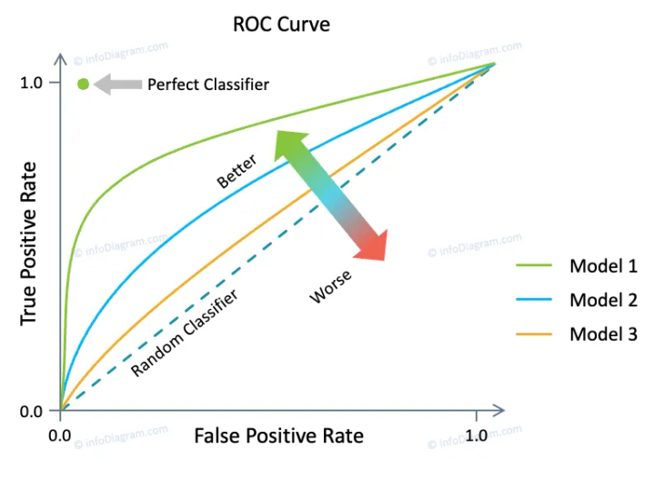
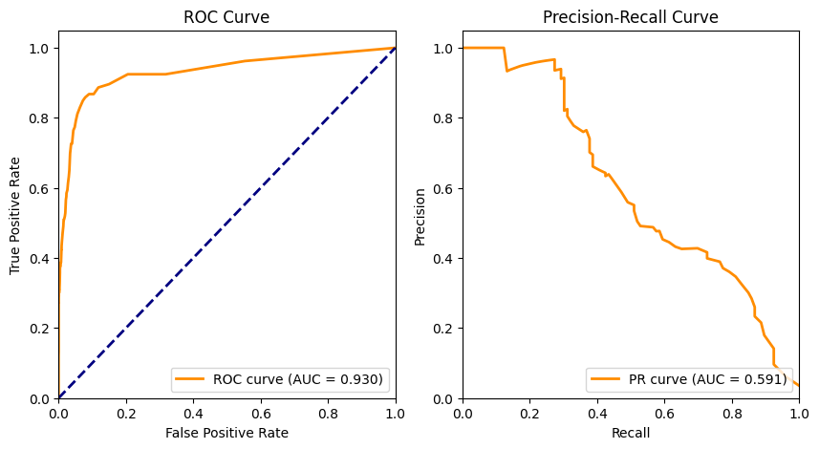
Area Under the Receiver Operating Characteristic Curve (AUC-ROC):
The ROC curve plots the true positive rate against the false positive rate at various thresholds.
measures the area under this curve, providing an aggregate measure of a model’s performance across different classification thresholds.
Area Under the Precision-Recall Curve (AUC-PR): measures the area under the precision-recall curve, providing a summary of a model’s performance across different precision-recall trade-offs.

Slide 26
Example Scenario
Suppose a hospital wants to predict whether a patient has a high risk of heart disease (1) or not (0) based on their age, cholesterol level, and blood pressure.
Step 1:
  Collect data with features like age, cholesterol level, and blood pressure, and label the target as 1 (high risk) or 0 (low risk).
Step 2:
  Train the logistic regression model on this data.
Step 3:
  For each new patient, the model calculates the probability of having high-risk heart disease. If the probability is greater than 0.5, it classifies them as high-risk.
In this way, logistic regression helps make informed, probability-based predictions for binary outcomes.

Slide 27
How Netflix figure out which groups of users prefer action movies, comedies, or dramas?
K Means clustering comes into action
Clustering, finding natural groupings
Supermarkets: which products are often bought together
uncovering hidden patterns
group animals into categories like mammals, birds, and reptiles
?
unsupervised
How cities decide the best locations for new hospitals, fire stations
location optimization
Divide people into clusters
Similarity and clusters

Slide 28
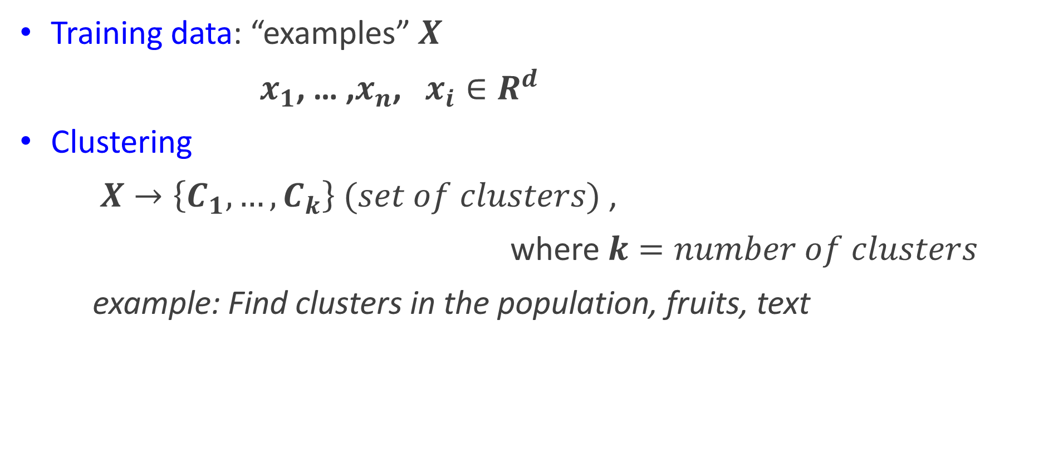
Unsupervised Learning
Training data: “examples” $X$
$x_{1}$, … ,$x_{n}$, $x_{i}∈R^{d}$
Clustering
$X→\left\{C_{1}, …, C_{k}\right\} (set of clusters)$ ,
where $k=number of clusters$
example: Find clusters in the population, fruits, text

Slide 29
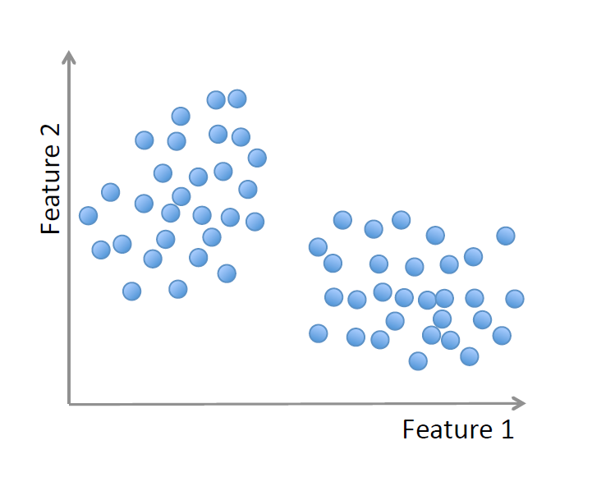
Unsupervised Learning

Slide 30
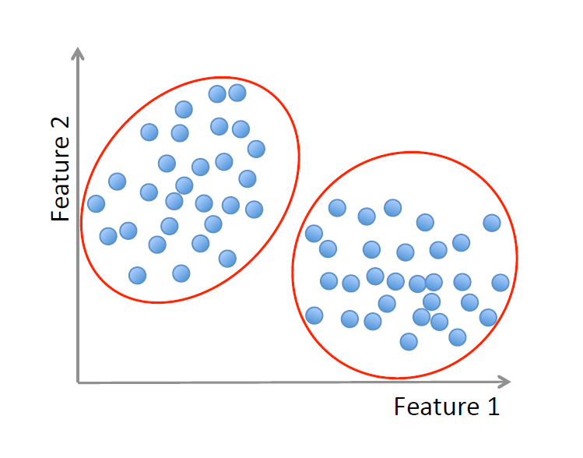
Unsupervised Learning
cluster 1
cluster 2

Slide 31
Given datapoints
Given Data Points: (sleep hr and study hr)
(5, 2)
(6, 1)
(6, 2)
(6, 3)
(10, 0)

Slide 32


Given datapoints
Given Data Points: (sleep hr and study hr)
(5, 2)
(6, 1)
(6, 2)
(6, 3)
(10, 0)
Centroid 1 (C1): (5, 2)
Centroid 2 (C2): (6, 1)
Now for (6,2),
With (5,2)=
With (6,1)=
Since both are same c1 will be selected by default

Slide 33


Given datapoints
Given Data Points: (sleep hr and study hr)
(5, 2)
(6, 1)
(6, 2)
(6, 3)
(10, 0)
Centroid 1 (C1): (5, 2) (6,2)
Centroid 2 (C2): (6, 1)
Now for (6,3)
With (5,2)=
With (6,1)=
Since distance with 5,2 is small centroid 1 is choosen

Slide 34


Given datapoints
Given Data Points: (sleep hr and study hr)
(5, 2)
(6, 1)
(6, 2)
(6, 3)
(10, 0)
Centroid 1 (C1): (5, 2) (6,2) (6,3)
Centroid 2 (C2): (6, 1)
Now for (10,0)
With (5,2)=
With (6,1)=
Centroid 2 is choosen

Slide 35


Given datapoints
Given Data Points: (sleep hr and study hr)
(5, 2)
(6, 1)
(6, 2)
(6, 3)
(10, 0)
Centroid 1 (C1): (5, 2) (6,2) (6,3)
Centroid 2 (C2): (6, 1) (10,0)
New centroid calculation by averaging

Slide 36
2nd iteration
Given Data Points: (sleep hr and study hr)
(5, 2)
(6, 1)
(6, 2)
(6, 3)
(10, 0)
Centroid 1 (C1): (5.67,2.33)
Centroid 2 (C2): (8,0.5)
For 5,2
With c1:
With c2:
So placed in centroid 1

Slide 37
Similarly,
Given Data Points: (sleep hr and study hr)
(5, 2)
(6, 1)
(6, 2)
(6, 3)
(10, 0)
Centroid 1 (C1): A,B,C,D
Centroid 2 (C2): E

Slide 38
K-Means Clustering
One of the simplest algorithms for clustering
Based on Euclidean Distance
Divides data in into K groups (clusters)
K-means clustering
unsupervised machine learning algorithm used to partition a dataset into distinct groups (or "clusters") based on the similarities of data points.
to discover patterns, group similar items, or simplify data into representative clusters without any predefined labels.

Slide 39
Usage
Grouping Similar Data:
  K-means groups data points that are close to each other into clusters, so each cluster contains data points with similar characteristics.
Pattern Discovery:
  In the absence of labeled data, K-means helps identify underlying structures or patterns within the dataset.

Slide 40
Working
Step 1: Choose the Number of Clusters K
  Before starting, decide how many clusters K you want the algorithm to create. This number is often based on domain knowledge or by experimenting.
Step 2: Initialize Cluster Centroids
  The algorithm selects K random points in the data as initial "centroids" (centers of clusters).
Step 3: Assign Data Points to the Nearest Centroid
  Each data point is assigned to the cluster with the nearest centroid based on distance (usually Euclidean distance). This forms initial clusters.
Step 4: Update Centroids
  For each cluster, the algorithm recalculates the centroid by taking the mean of all data points assigned to that cluster.

Slide 41
Step 5: Repeat Steps 3 and 4
  The assignment and updating steps are repeated until the centroids no longer move significantly, or a set number of iterations is reached.
Final Output: The algorithm returns the clusters, with each data point assigned to a particular cluster and each cluster defined by its final centroid.

Slide 42
Core Concepts in K-Means Clustering
Centroids:
Each cluster has a centroid, representing the "center" of that cluster. A centroid is the average position of all data points within a cluster.
Inertia (Within-Cluster Sum of Squares):
Inertia measures how close data points are to their respective centroids. The goal is to minimize inertia, so the data points in each cluster are as close to their centroid as possible.
Convergence:
The algorithm converges (stops) when the centroids no longer change significantly, meaning the clusters are stable.

Slide 43
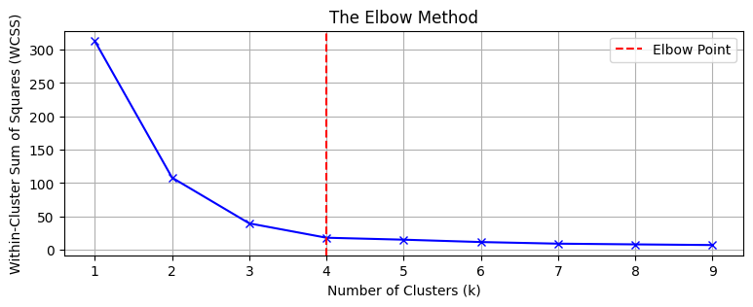
Determining Optimal Number of Clusters (K)
Elbow Method:
This method involves running K-means clustering with different values of K and plotting the inertia. The "elbow point" in the plot (where the inertia decreases sharply and then levels off) suggests an optimal K.
Silhouette Score:
The silhouette score measures how similar each data point is to its own cluster compared to other clusters. A higher score indicates a better-defined clustering structure.

Slide 44
Applications of K-Means Clustering
Customer Segmentation:
segment customers based on purchasing behavior, demographics, or other attributes to tailor their strategies.
Image Compression:
By clustering pixels in an image, K-means can reduce the number of colors used, thereby compressing the image size.
Anomaly Detection:
In fraud detection, normal and abnormal behaviors can be clustered. Points that don’t belong to any cluster are flagged as anomalies.
Document Classification:
K-means can be used to cluster similar documents or articles based on word frequency or content, even without predefined categories.

Slide 45
Advantages:
Simple and Easy to Implement:
  K-means is straightforward and computationally efficient, especially with large datasets.
Fast and Scalable:
  It can handle large amounts of data by partitioning it into manageable clusters.
Disadvantages:
Choosing K Can Be Challenging:
  It requires setting the number of clusters in advance, which might not be obvious without domain knowledge.

Slide 46
Sensitive to Initialization:
  If initial centroids are poorly chosen, K-means may converge to a suboptimal solution. Using techniques like K-means++ can help select better initial centroids.
Assumes Spherical Clusters:
  K-means works best with clusters that are circular or spherical. It may not perform well with irregular or overlapping clusters.
Sensitive to Outliers:
  Outliers can distort centroids, leading to inaccurate clustering.

Slide 47
Example Scenario
A retail company wants to segment its customers to better target marketing campaigns. They gather data on each customer’s purchase history, like frequency of purchase, total spending, and types of products bought.
Step 1:
choose k=3 clusters, assuming they want three customer segments (e.g., "High-Spenders," "Moderate-Spenders," and "Low-Spenders").
Step 2:
The algorithm initializes three centroids randomly in the dataset.
Step 3:
Each customer is assigned to the nearest centroid based on their purchase characteristics.

Slide 48
Step 4:
The centroids are recalculated based on the assigned customers, and the assignments are updated.
Step 5:
Steps 3 and 4 repeat until the clusters stabilize, resulting in three distinct customer groups.

Slide 49
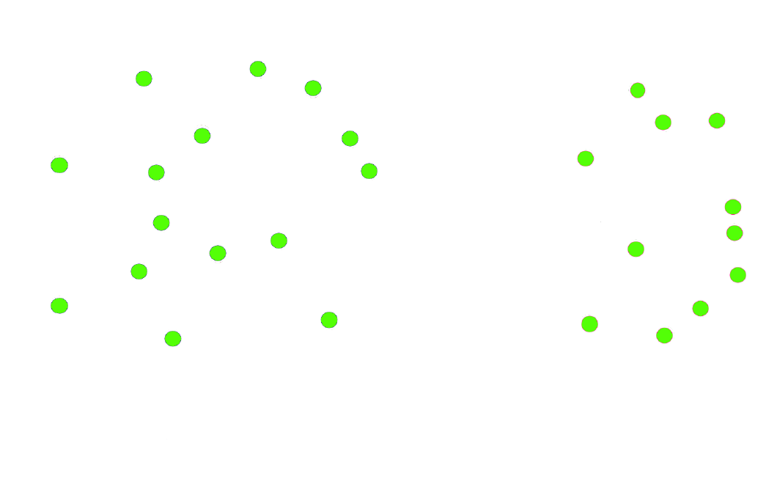
K-Means Clustering
given:
data points with no labels
goal:
divide data points into 2 groups

Slide 50
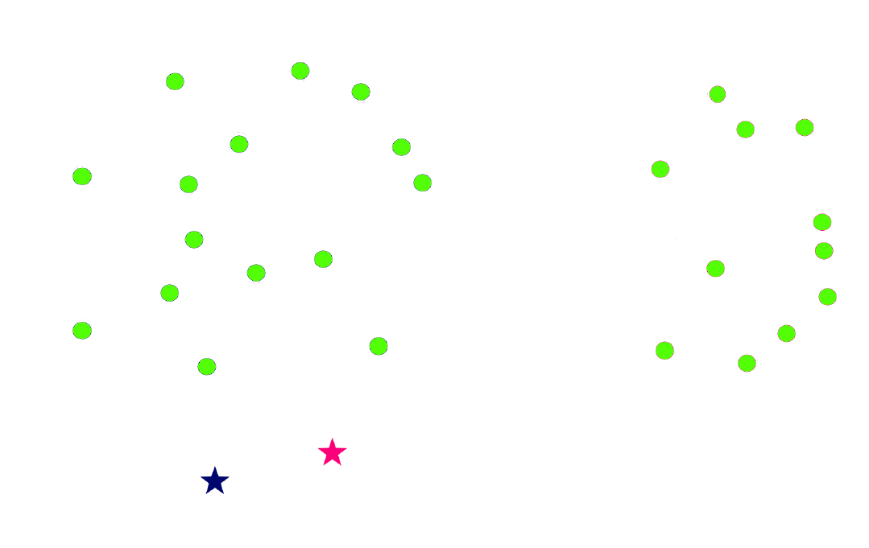
K-Means Clustering
randomly drop 2 points in the feature space
we will call them the centroids of the clusters

Slide 51
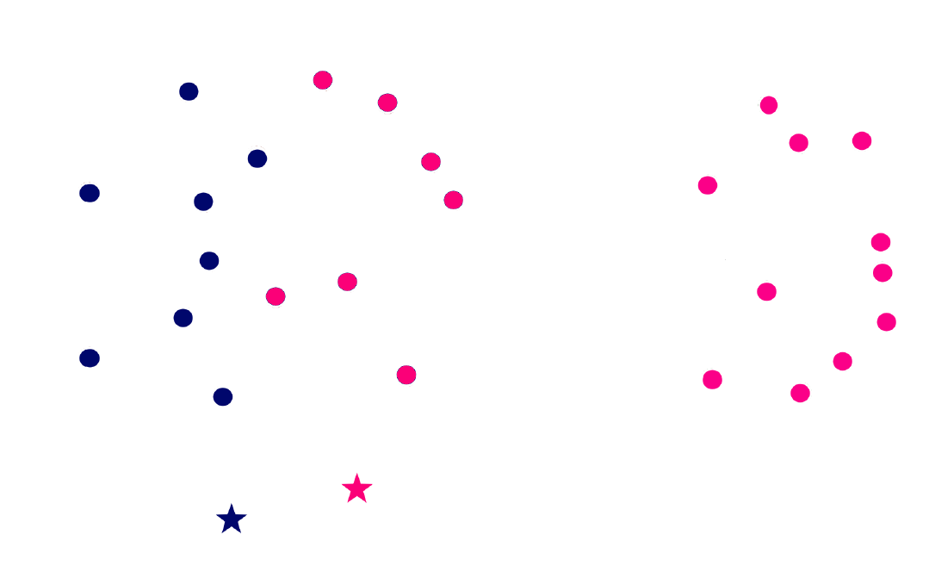
K-Means Clustering
calculate the distance between the 2 centroids and every other point
assign each point to the cluster whose centroid is closest to the point

Slide 52
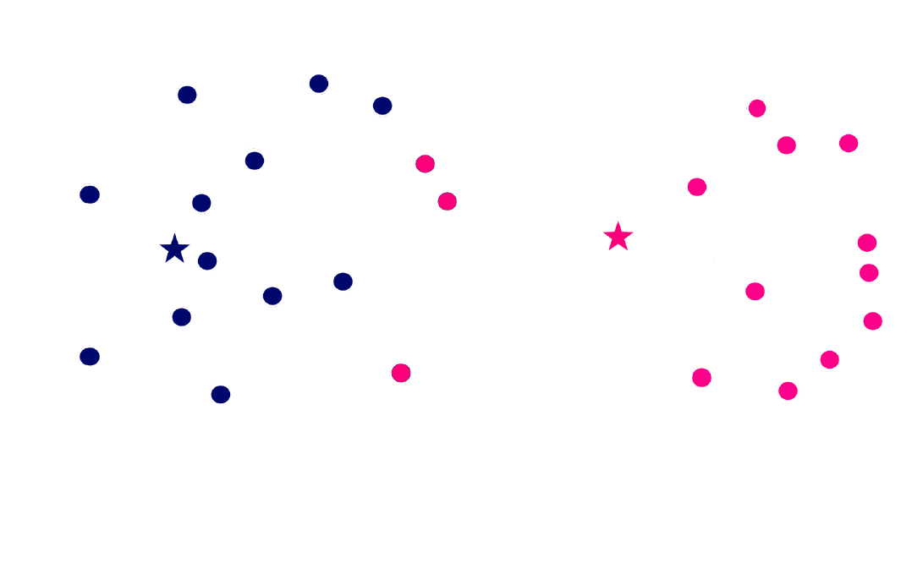
K-Means Clustering
calculate the new centroids for the 2 clusters by taking the average/mean of all the data points in respective clusters
make new cluster assignments using the updated centroids

Slide 53
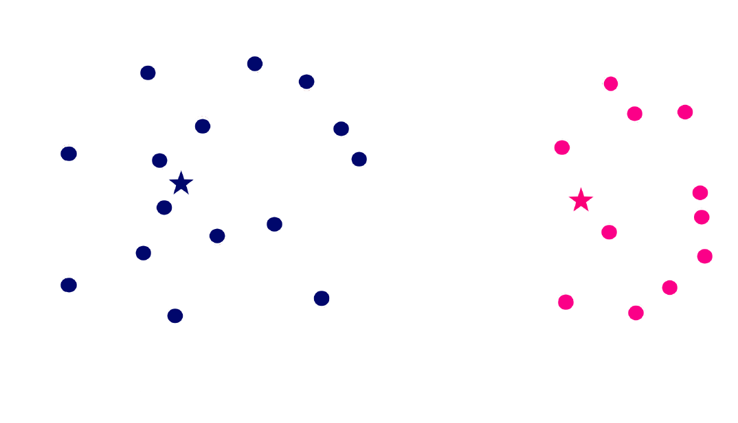
K-Means Clustering
repeat the same process until the values for the centroids stop changing/no change in the clusters

Slide 54
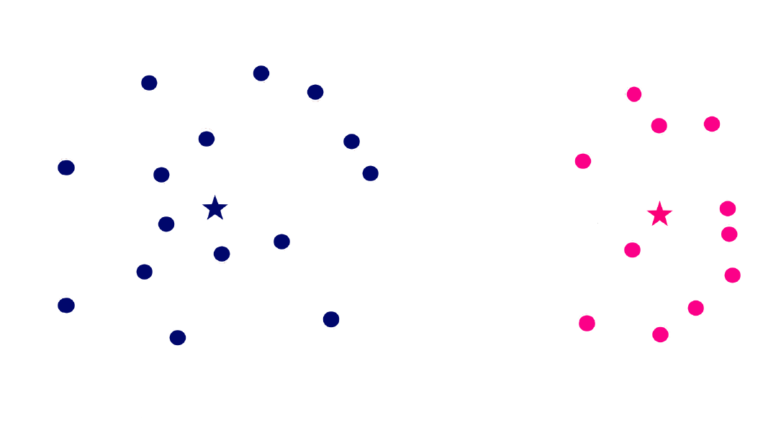
K-Means Clustering
the data points have been divided into 2 groups/clusters with their respective centroids

Slide 55
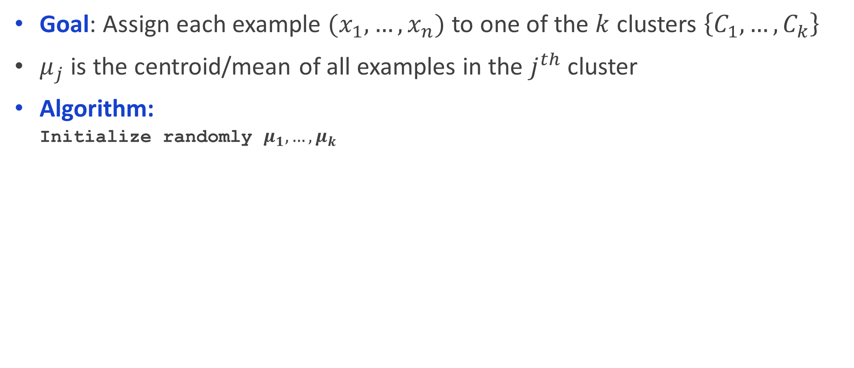
K-Means Clustering
Goal: Assign each example $(x_{1},…,x_{n})$ to one of the $k$ clusters $\left\{C_{1},…,C_{k}\right\}$
$μ_{j}$ is the centroid/mean of all examples in the $j^{th}$ cluster
Algorithm:
  Initialize randomly $μ_{1},…,μ_{k}$

Slide 56

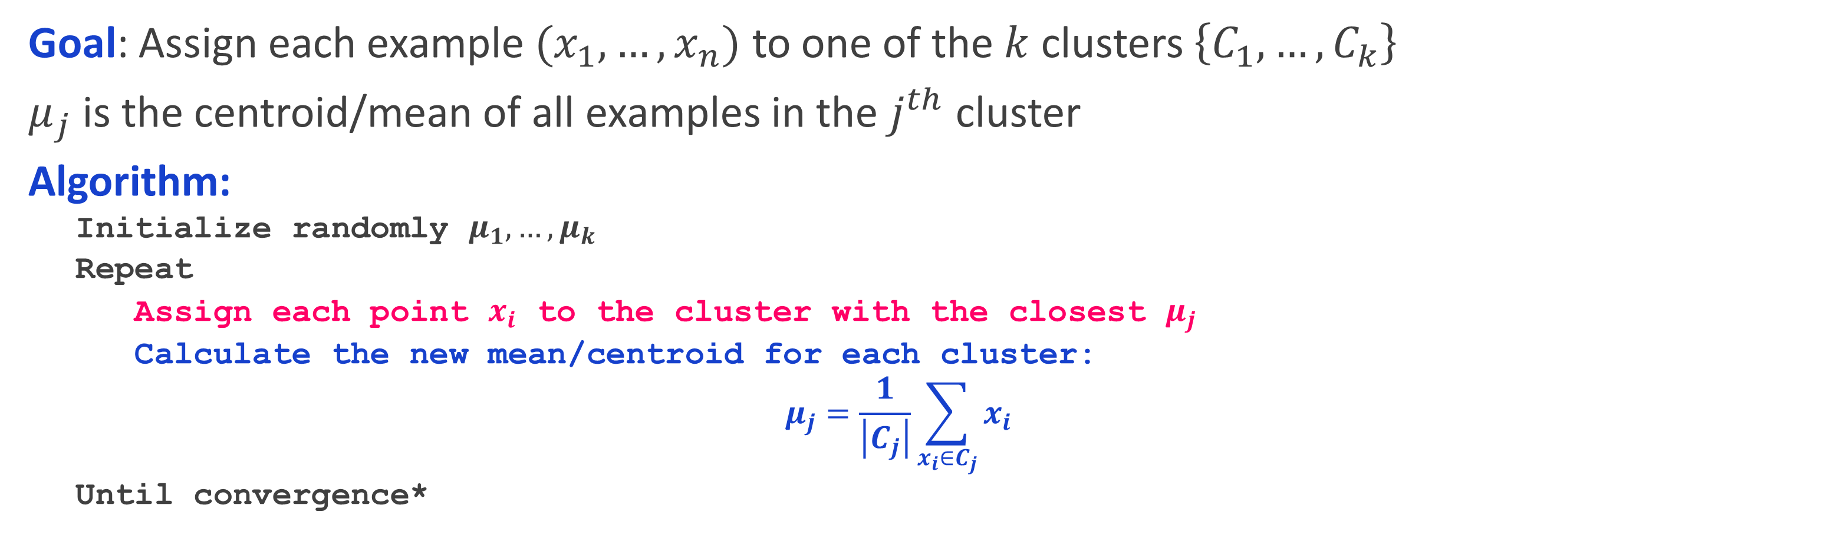
K-Means Clustering
Goal: Assign each example $(x_{1},…,x_{n})$ to one of the $k$ clusters $\left\{C_{1},…,C_{k}\right\}$
$μ_{j}$ is the centroid/mean of all examples in the $j^{th}$ cluster
Algorithm:
  Initialize randomly $μ_{1},…,μ_{k}$
  Repeat
  Assign each point $x_{i}$ to the cluster with the closest $μ_{j}$
  Calculate the new mean/centroid for each cluster:
  $$μ_{j}=\frac{1}{\left|C_{j}\right|}\sum_{x_{i}∈C_{j}}{x_{i}}$$
  Until convergence*
$$\left|C_{j}\right| is the number of$$
$$members in cluster{ C}_{j}$$

Slide 57
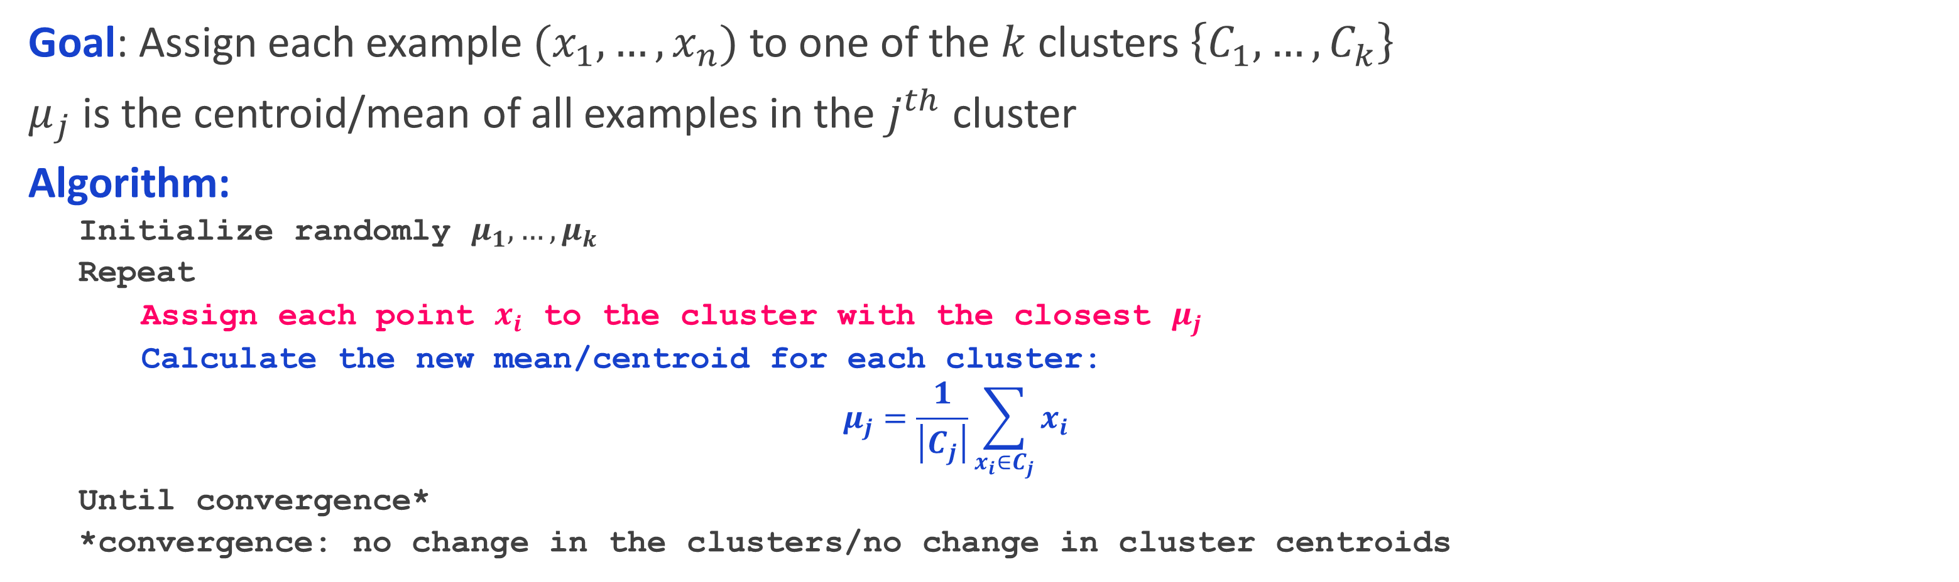
K-Means Clustering
Goal: Assign each example $(x_{1},…,x_{n})$ to one of the $k$ clusters $\left\{C_{1},…,C_{k}\right\}$
$μ_{j}$ is the centroid/mean of all examples in the $j^{th}$ cluster
Algorithm:
  Initialize randomly $μ_{1},…,μ_{k}$
  Repeat
  Assign each point $x_{i}$ to the cluster with the closest $μ_{j}$
  Calculate the new mean/centroid for each cluster:
  $$μ_{j}=\frac{1}{\left|C_{j}\right|}\sum_{x_{i}∈C_{j}}{x_{i}}$$
  Until convergence*
  *convergence: no change in the clusters/no change in cluster centroids

Slide 58
K-Means: pros and cons
+ Easy to implement
+ Intuitive
BUT…
Need to know K
Suffers from the curse of dimensionality

Slide 59
Performance
ROC AUC and PR AUC are metrics used to evaluate the performance of classification models, especially useful when dealing with imbalanced datasets.
They provide insight into how well a model distinguishes between classes.

Slide 60
ROC AUC
(Receiver Operating Characteristic - Area Under the Curve)
The ROC curve plots the True Positive Rate (TPR) against the False Positive Rate (FPR) at different threshold levels.
True Positive Rate (TPR), also called recall or sensitivity, measures the proportion of actual positives that are correctly identified.
False Positive Rate (FPR) measures the proportion of actual negatives incorrectly identified as positives.

Slide 61
ROC curve
Each point on the ROC curve represents a different decision threshold.
A perfect model would reach the top-left corner of the plot (TPR = 1, FPR = 0).
The diagonal line (from (0,0) to (1,1)) represents a model with no discrimination capability, essentially random guessing.

Slide 62
AUC (Area Under the Curve):
AUC is the area under the ROC curve, which quantifies the overall ability of the model to distinguish between positive and negative classes.
AUC ranges from 0 to 1:
1: Perfectly distinguishes between classes.
0.5: No better than random guessing (the diagonal line).
Below 0.5: Worse than random guessing, indicating that the model’s predictions are inversely related to actual labels.

Slide 63
ROC AUC is most suitable when classes are balanced.
It provides a good sense of a model’s performance across all possible thresholds.

Slide 64
PR AUC (Precision-Recall Area Under the Curve)
The PR curve plots Precision against Recall at various threshold levels.
Precision measures the proportion of positive predictions that are actually correct.
Recall (or Sensitivity) measures the proportion of actual positives correctly identified.
Each point on the PR curve represents a different decision threshold.
The curve helps show the trade-off between precision and recall for different thresholds

Slide 65
AUC for Precision-Recall Curve (PRAUC):
PR AUC is the area under the precision-recall curve.
Higher PR AUC values indicate that the model has high precision and recall, which is particularly valuable for imbalanced datasets.
PR AUC is more informative when dealing with imbalanced datasets (where the positive class is rare).
It provides a better indication of model performance on the minority class because it doesn’t consider true negatives, which can dominate in imbalanced datasets.

Slide 66
ROC AUC:
Good for balanced datasets, evaluates the model across all thresholds.
PR AUC:
Good for imbalanced datasets, highlights the model’s ability to capture the positive class effectively.

Slide 67
Example
medical test for detecting a disease, where:
Positive: The patient has the disease.
Negative: The patient does not have the disease.
True Positives (TP): 40 patients who have the disease and tested positive.
False Positives (FP): 10 patients who do not have the disease but tested positive.
True Negatives (TN): 30 patients who do not have the disease and tested negative.
False Negatives (FN): 20 patients who have the disease but tested negative.

Slide 68
True Positive Rate (TPR), also known as Recall or Sensitivity, measures the proportion of actual positives that were correctly identified by the model.
TPR=True Positives (TP)/(True Positive + False Negative)
False Positive Rate (FPR) measures the proportion of actual negatives that were incorrectly identified as positive by the model.
FPR=False Positives (FP)/(False Positive + True Negative)
In a perfect model, we’d aim for a TPR of 1 (100%) and an FPR of 0 (0%).

Slide 69
End of Lecture 5

Slide 70
Thank you !
Any questions ?

