Slide 1
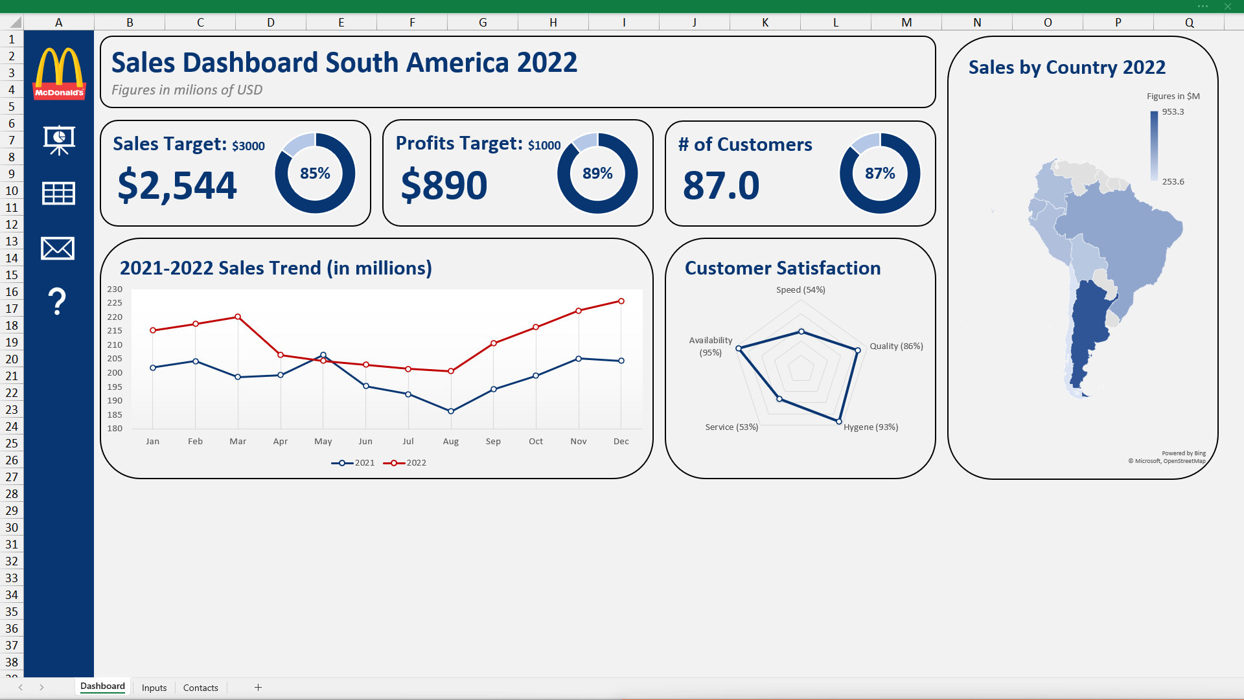
Notes:
I have created this Excel dashboard to show McDonalds sales in south America for the year 2022. With Excel, the visuals are less interactive compared to Tableau, but you can clearly see they have reached 85% of their sales target and 89% of their profits target for the year.

Slide 2
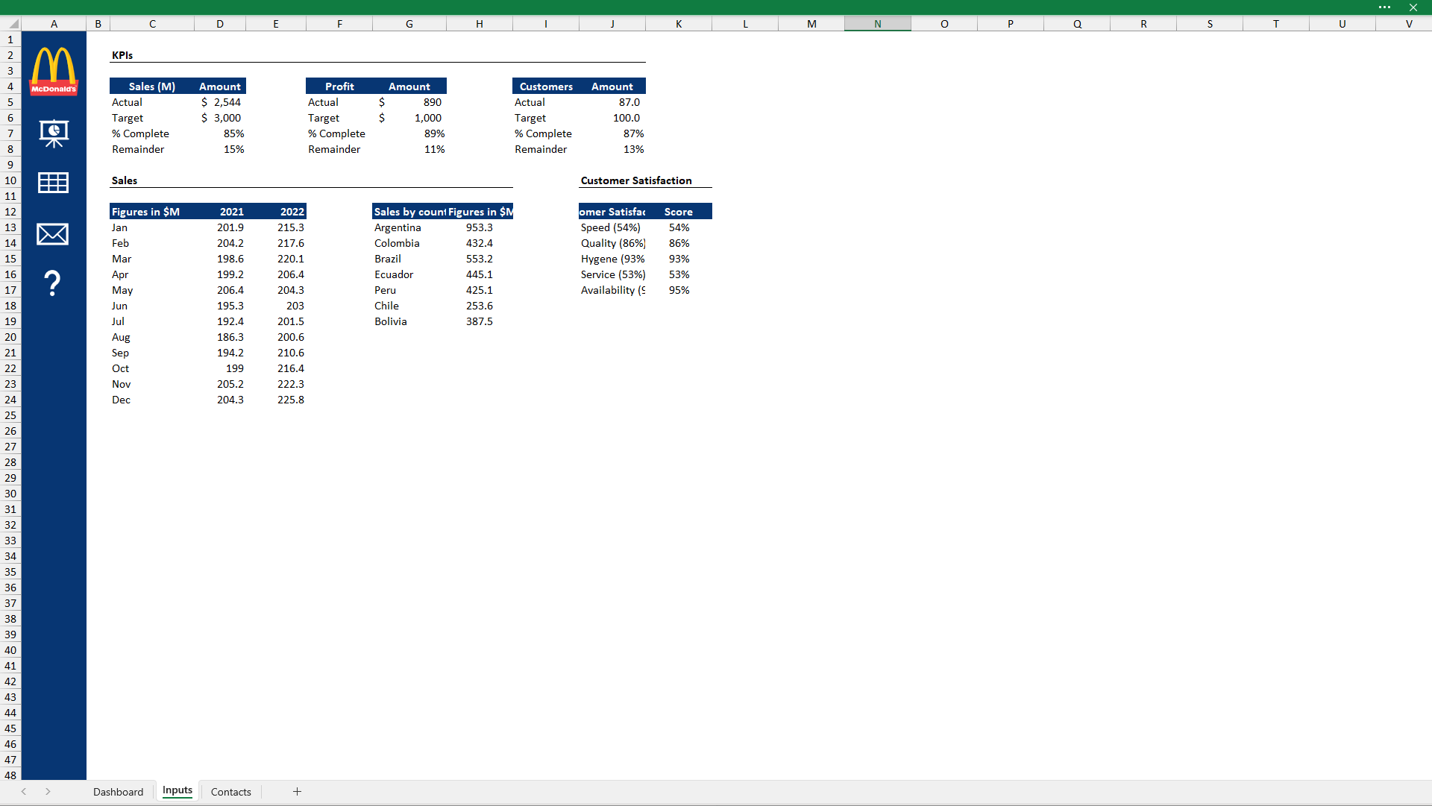
Notes:
There are a few interactions on the left using hyperlinks on this dashboard
where can you view the raw data

Slide 3
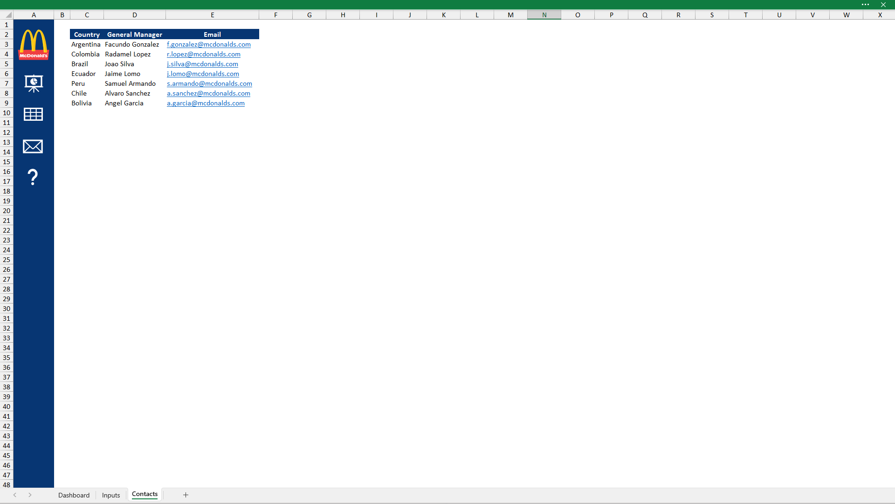
Notes:
and some important contact information.

Slide 4
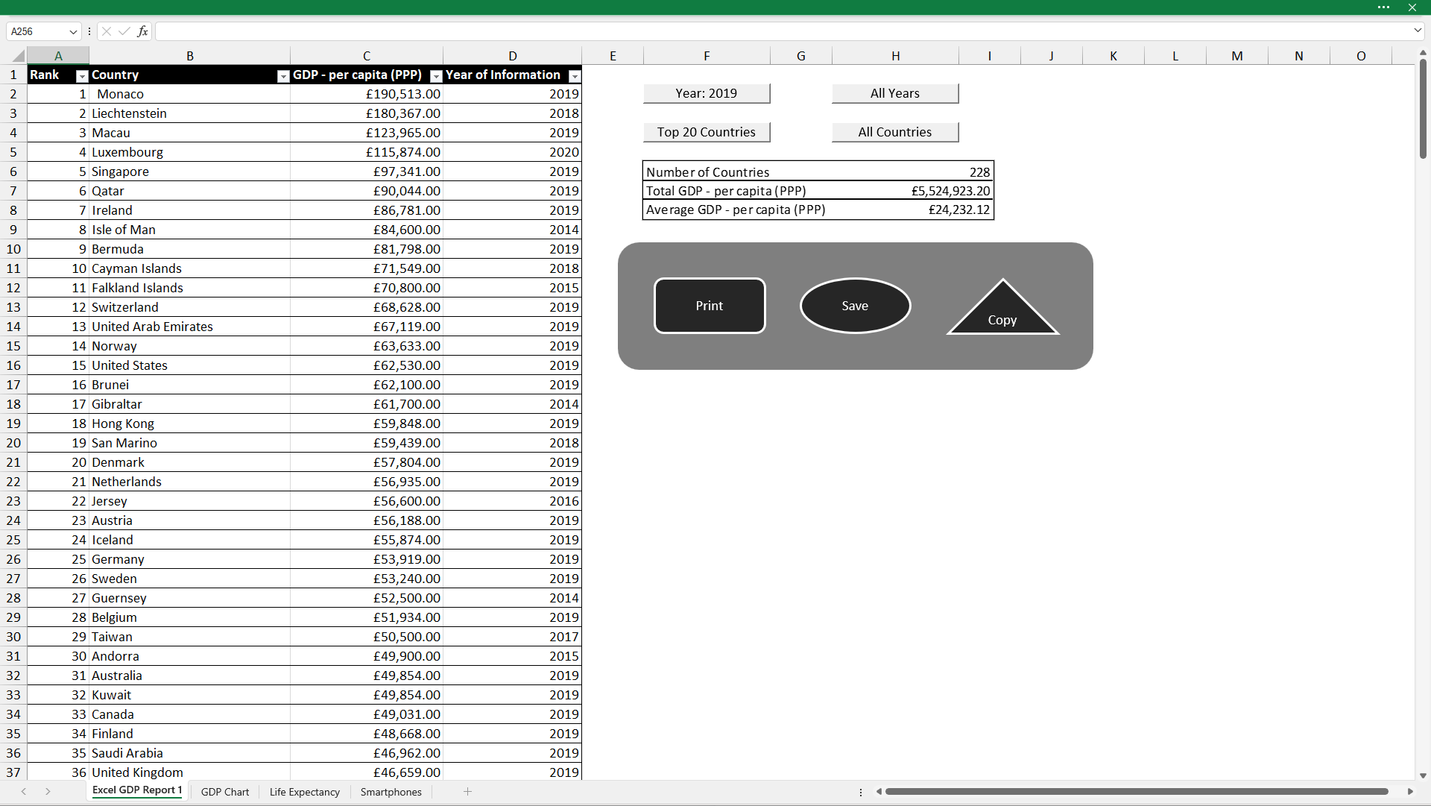
Notes:
Here is some data for the wealth of nations. The ranked GDP of the countries can be seen in this table.

Slide 5
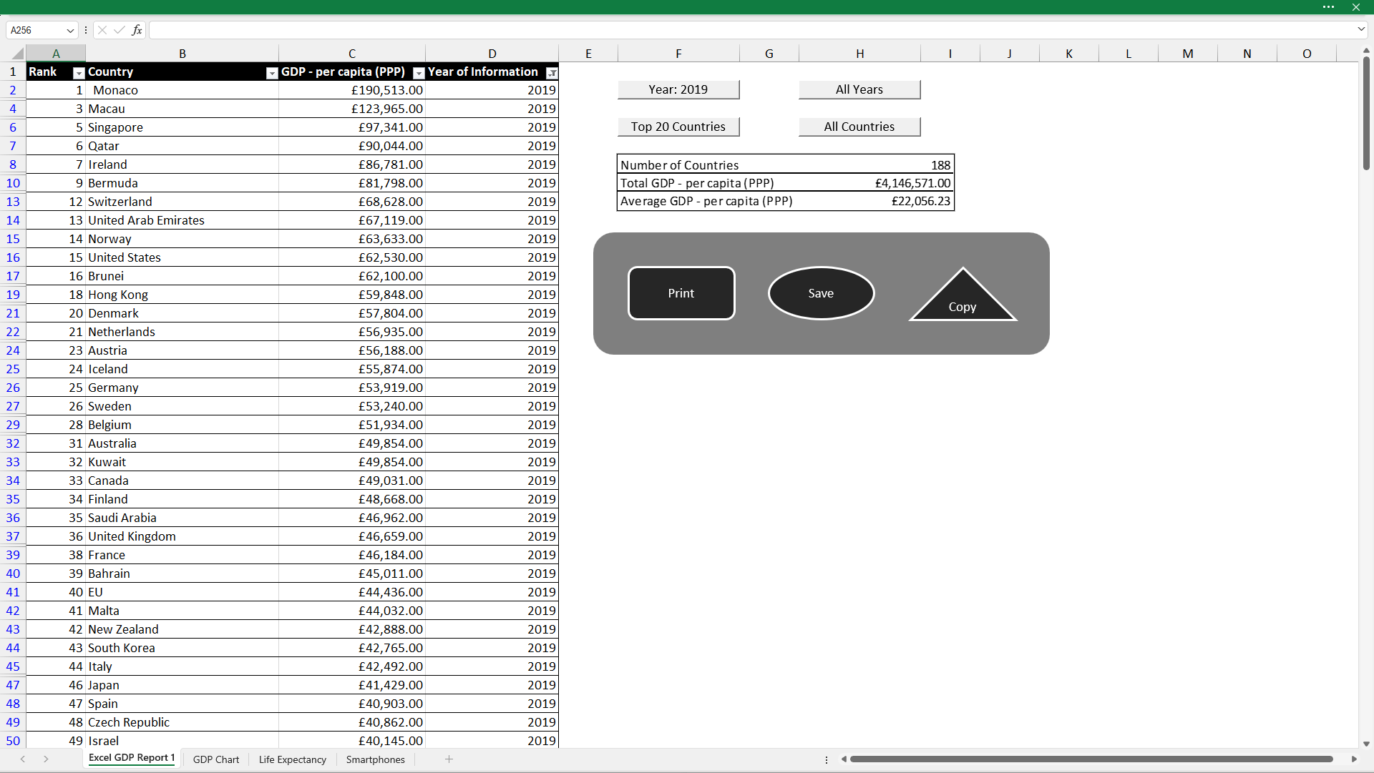
Notes:
First, I’ll filter the table by the data for the year 2019

Slide 6
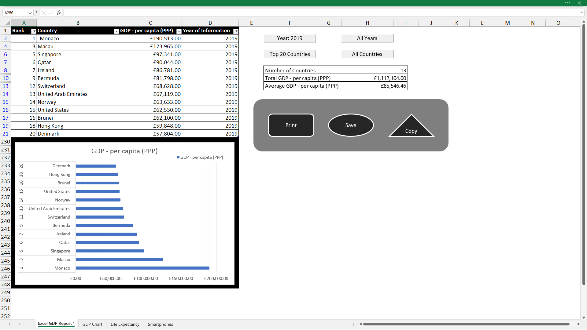
Notes:
and then filter for the top 20 countries using the macro buttons I created. This is an AND logical operation hence there are only 13 countries visible.
There is a summary table of the visible data in this table.
There is a chart representing this data to see get a better understanding of the data.

Slide 7
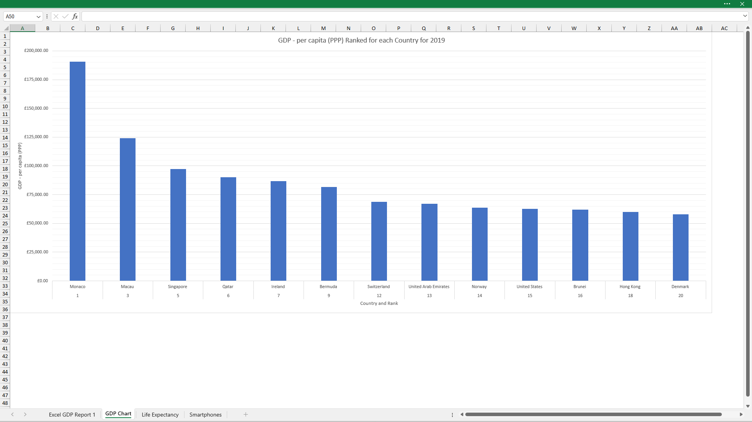
Notes:
Here is a much clearer view of the table.
As you can see, Monaco has by far the highest GDP per capita, more than 3x the country in 20th place, Denmark.

Slide 8
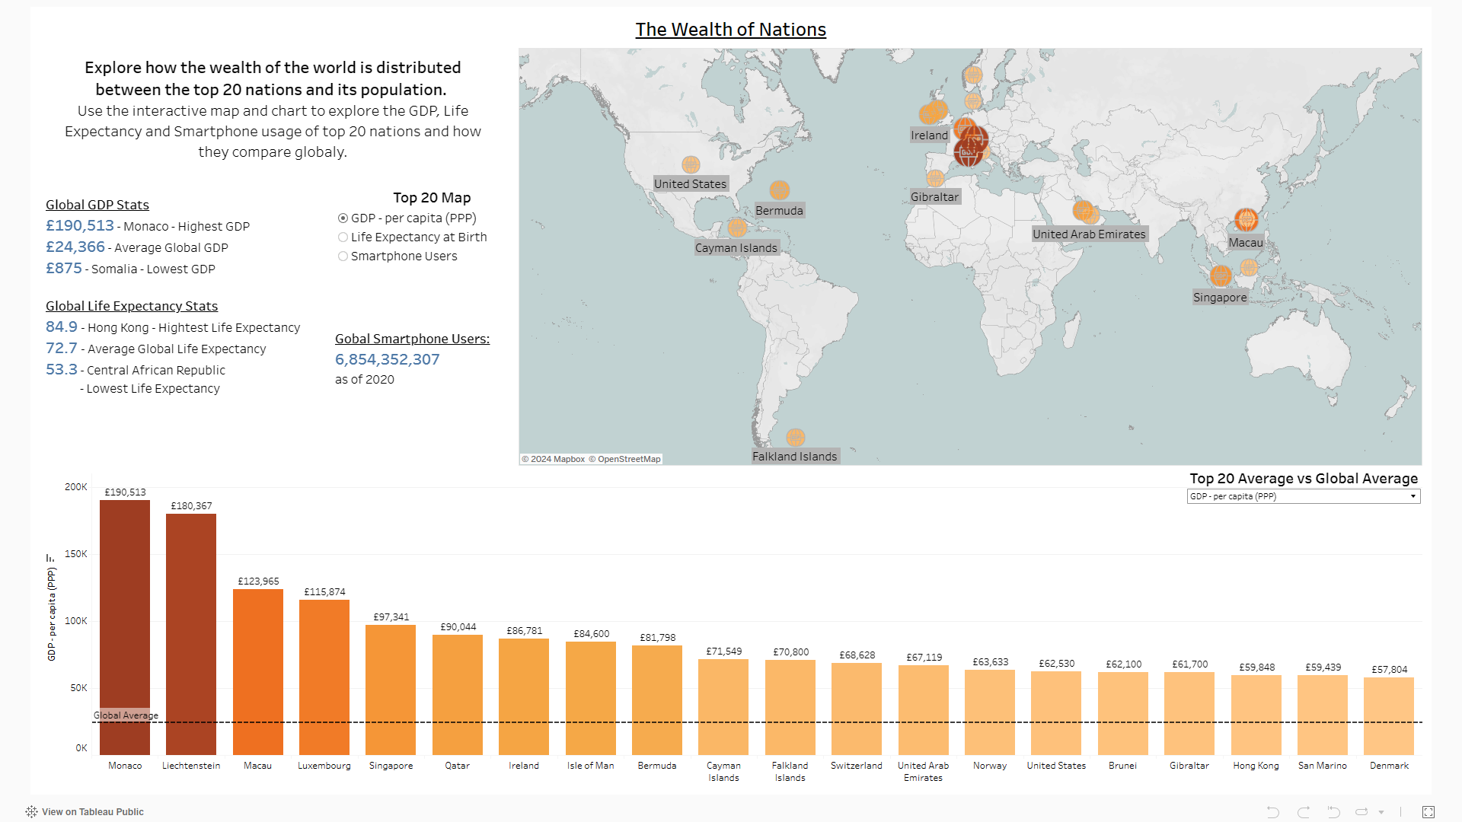
Notes:
Moving onto further visualisations for this data, in Tableau, I have created these charts and dashboards to explore the GDP, life expectancy and smartphones users for the top 20 nations and how they compare globally. I created a map and bar chart for each of the tables and then combined all the charts I created alongside some additional stats to bring the whole dashboard together.

Slide 9
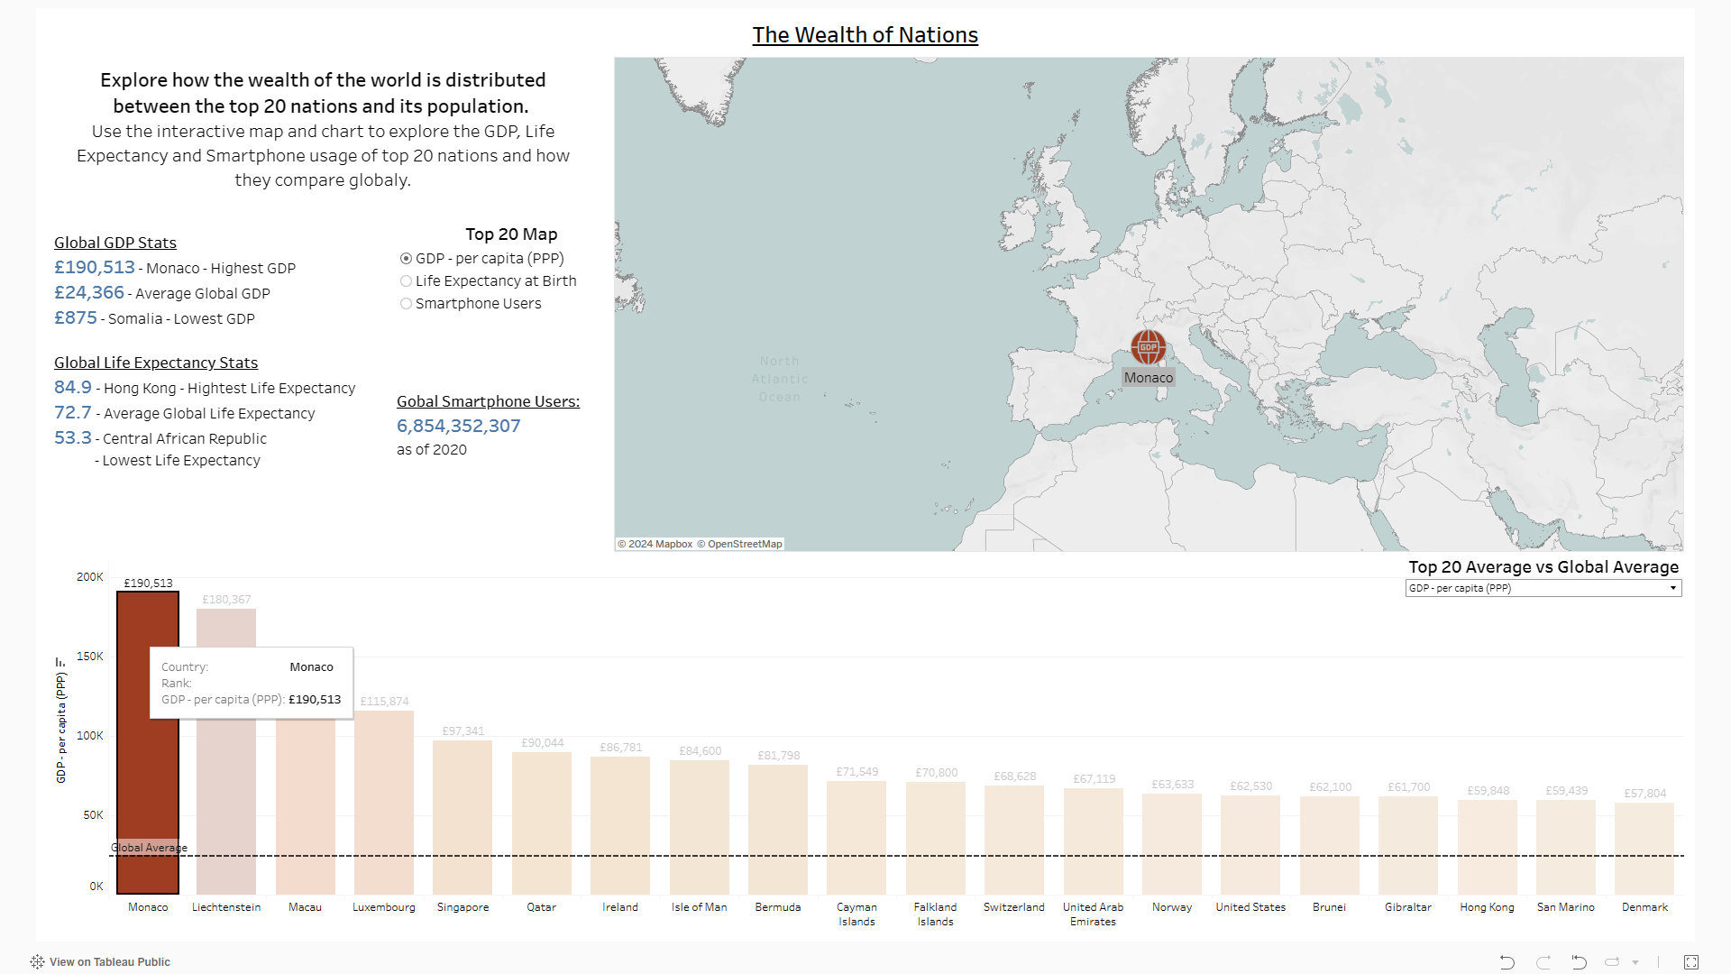
Notes:
The bar chart acts as filter to see the country more clearly on the map

Slide 10
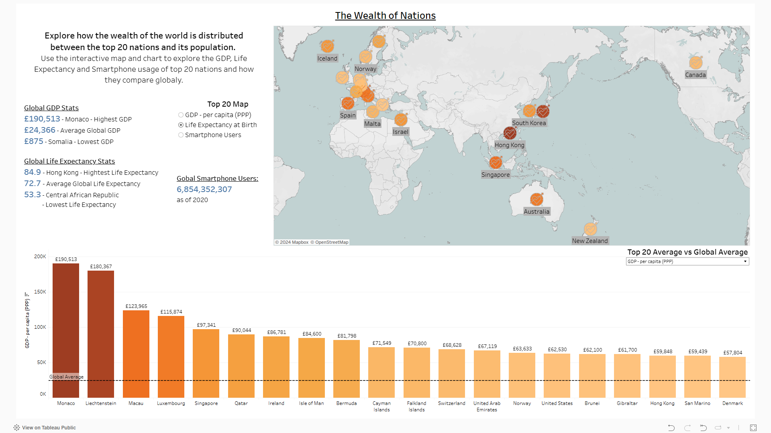

Slide 11
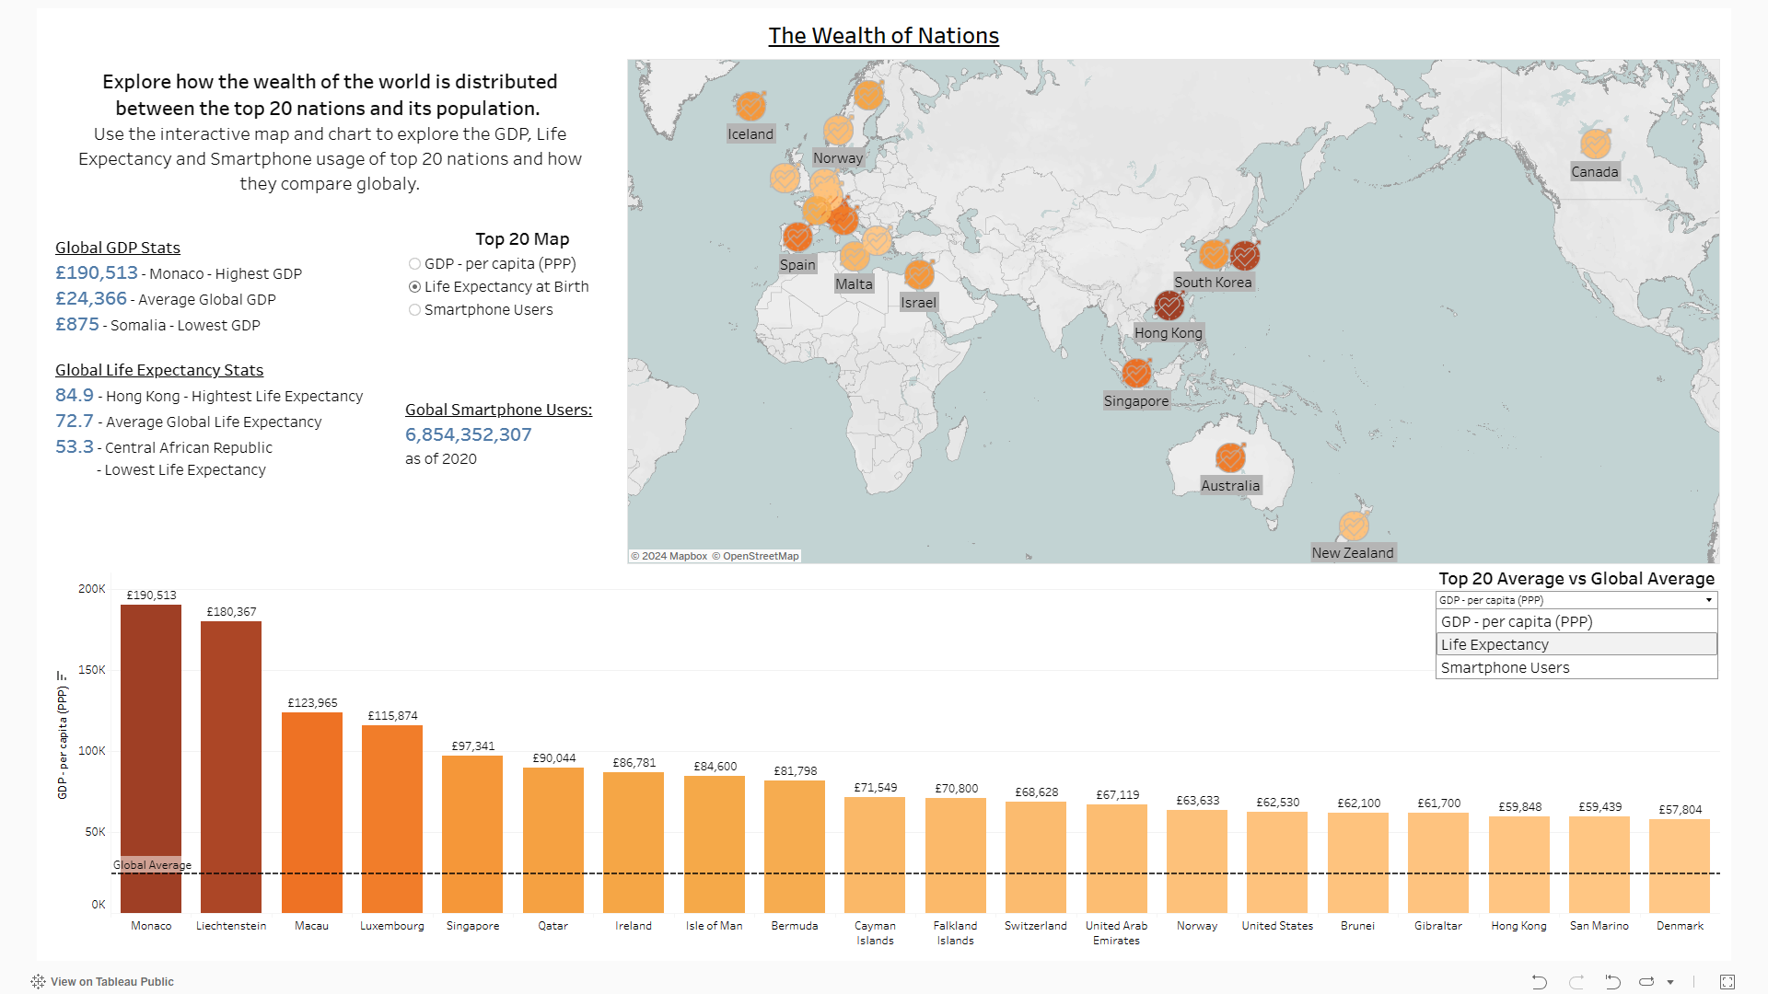

Slide 12
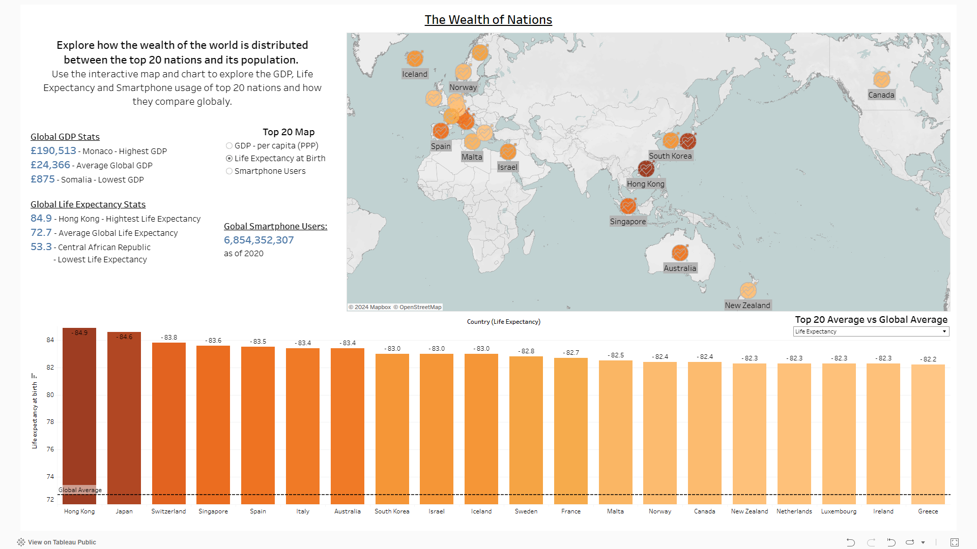

Slide 13
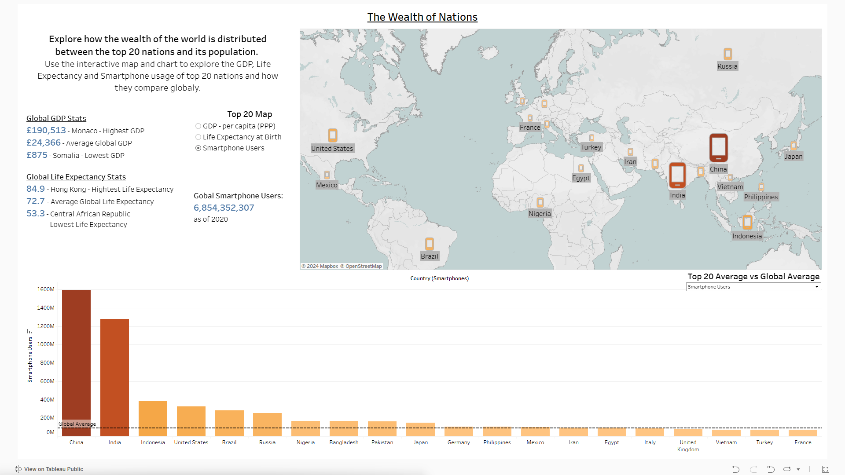

Slide 14
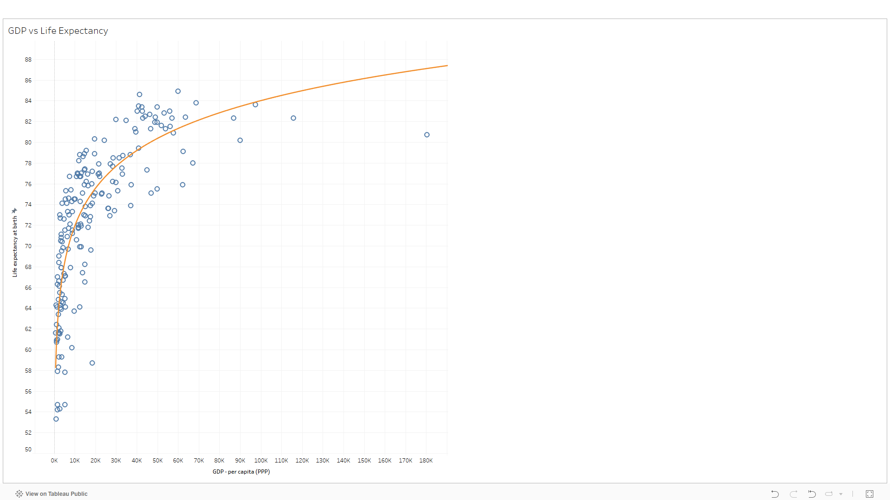
Notes:
A trend could be found in the GDP vs Life Expectancy chart, but I had to move away from just looking at the top 20, rather focus on the whole data instead.

Slide 15
LinkedIn:
www.linkedin.com/in/anish-mistry-b98079291
Website:
GitHub:
https://github.com/anish-m02/Anish-Mistry
Notes:
Here are the links to my GitHub, LinkedIn and Website
And my updated CV will be with Mike
Thank you

