Slide 1
Software Development Life Cycle(SDLC)

Slide 2
What is SDLC?
SDLC is a process followed for a software project, within a software organization. It consists of a detailed plan describing how to develop, maintain, replace and alter or enhance specific software. The life cycle defines a methodology for improving the quality of software and the overall development process.

Slide 3
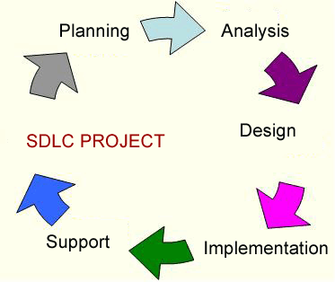
There are five Phases to the software Development life cycle:-
Planning
Analysis
Design
Implementation
Maintenance

Slide 4
Planning- The initial phase starts by defining the need. The purpose of the planning phase is to identify clearly the nature and scope of the business opportunity or problem by performing a preliminary investigation. This entails investigating their current system and what they hope to have in the future.
Analysis- In the analysis phase we get further information about what they want and build more in-depth models of what they can expect to achieve with their new system. Requirement for the software are documented and reviewed with the customer.
Design- when the project really starts to take form, We Engineers plan out all the inputs, outputs, interfaces, processes for the project and create the system design specification from this data. The requirements translated into representation of the Software that can be assessed for quality before coding begins.

Slide 5
Implementation-There are three stage of implementation a) coding : In this process design translated into a machine-readable form & if design is performed in a detailed manner, code generation can be accomplished mechanistically. b)testing : After coding team will make a prototype model to ensure that System will meet the needs of customer. c)Installation : Then after everyone Satisfied that the System is ready they will install the product and convert it into customer existing format.

Slide 6
5. Maintenance-It refers to the support phase of software development. In this final phase, the team maintains the system and updates it as necessary to keep up to date with its environment. It focuses on change associated with error correction, changes due to enhancements brought about by changing customer requirements.
Types of changes:
Correction of new bugs found (corrective)
System adjustments to environmental changes
Adjustments for users’ changing needs (adaptive)

Slide 7
Spiral Model:
A software project repeatedly passes through these phases in iterations (called Spirals in this model).The baseline spiral, starting in the planning phase, requirements are gathered and risk is assessed(commitment). Each subsequent spirals builds on the baseline spiral.
The spiral model has four phases: Planning, Risk Analysis, Engineering and Evaluation(testing &feedback).

Slide 8
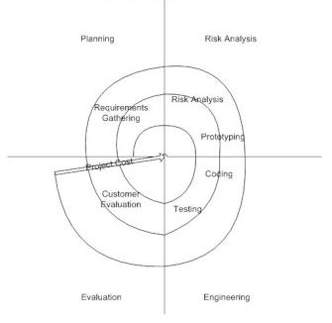

Slide 9
Advantages of Spiral model:
High amount of risk analysis hence, avoidance of Risk is enhanced.
Good for large and mission-critical projects.
Strong approval and documentation control.
Additional Functionality can be added at a later date.

Slide 10
Disadvantages of Spiral model:
Can be a costly model to use.
Risk analysis requires highly specific expertise.
Project’s success is highly dependent on the risk analysis phase.

