Slide 1
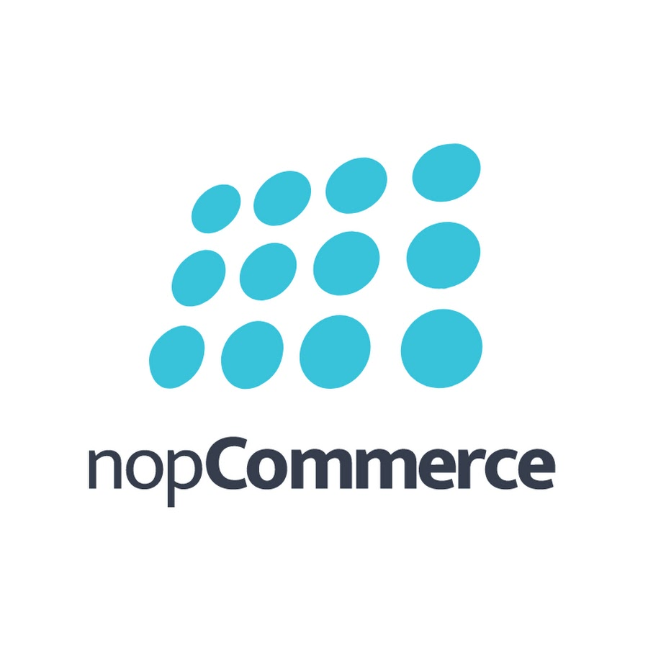
nopCommerce
Under Guidance of Mrs . Vaishali Snoawane Mam

Slide 2
INTRODUCTION
nopCommerce is a comprehensive open-source eCommerce platform where businesses can launch, manage, and grow their fully-featured online stores.
The nopCommerce platform enables merchants to build a scalable digital presence-offering powerful tools to manage product catalogs, payments, shipping, marketing, and customer engagement for B2C and B2B markets across the globel.

Slide 3
RESPONSIBITY
Assign Sub-Modules & Tasks:
Test Case Review & Guidance:
Test Execution:
Defect Reporting:

Slide 4
OVERVIEW
What is nopCommerce ?
nopCommerce is a powerful open-source eCommerce platform designed for businesses of all sizes. It allows store owners to build and manage fully customizable online stores with support for both B2C and B2B models.
nopCommerce offers a flexible and scalable digital storefront where merchants can showcase their products and customers can enjoy a smooth, secure shopping experience. The platform is built to be user-friendly, feature-rich, and responsive across all devices
Users can:
Browse products by category, brand, or custom filters
Add products to the cart and place secure orders
View detailed product descriptions, specifications, ratings, and reviews
Track orders, manage wishlists, and interact with customer service

Slide 5
MODULES
Module 1: LOGIN
Checked all the functionalities on Login page which included email-based authentication. Validated password handling and redirection to the homepage after successful login.
Module 2: Search
Verified the search functionality by entering various product keywords in the search bar. Checked the accuracy of results, auto-suggestions, filters, and redirection to the correct product detail pages.
Module 3: Add-to-cart:
Tested the "Add to Cart" functionality by selecting products from different categories. Verified cart updates, product availability in the cart.

Slide 6
Module 4: Remove cart:
Tested the ability to remove single products from the cart. Verified cart updates reflect immediately and subtotal recalculates correctly.
Module 5: Wish-List :
Validated the Wish-list feature by adding the wishlist. Ensured wishlist items were retained after login.
Module 6 : Remove wish-list:
Tested the ability to remove single products from the wish-list. Verified wishlist cart updates reflect immediately and subtotal recalculates correctly.
Module 7 : Registration:
Checked all the functionalities on the Registration page which included email-based user signup. Validated form field validations, password confirmation, and successful account creation with redirection to the login page or user dashboard.

Slide 7
Module 8: Compare-To:
Checked the product comparison feature which allows users to select multiple products. Validated comparison of product specifications, prices, and images side-by-side for easy decision-making.
Module 9:Add-Address :
Checked all functionalities on the Address page including adding, editing, and deleting billing and shipping addresses. Validated form validations, default address selection, and proper saving of address details to the user profile.
Module 10:Edit –Address
Tested the edit address functionality by updating existing billing and shipping details. Validated input field validations, saving changes, and confirmation of updated address in the user profile
Module 11: Change Currency
Tested the currency change feature allowing users to switch between available currencies. Validated accurate price updates across product listings, cart, and checkout pages after currency selection.

Slide 8
DEFECTS
While executing test cases on the nopCommerce website, I encountered several fields not functioning as expected. I documented these issues and created a defect report, clearly noting the steps to reproduce, expected vs actual results, and severity.

Slide 9
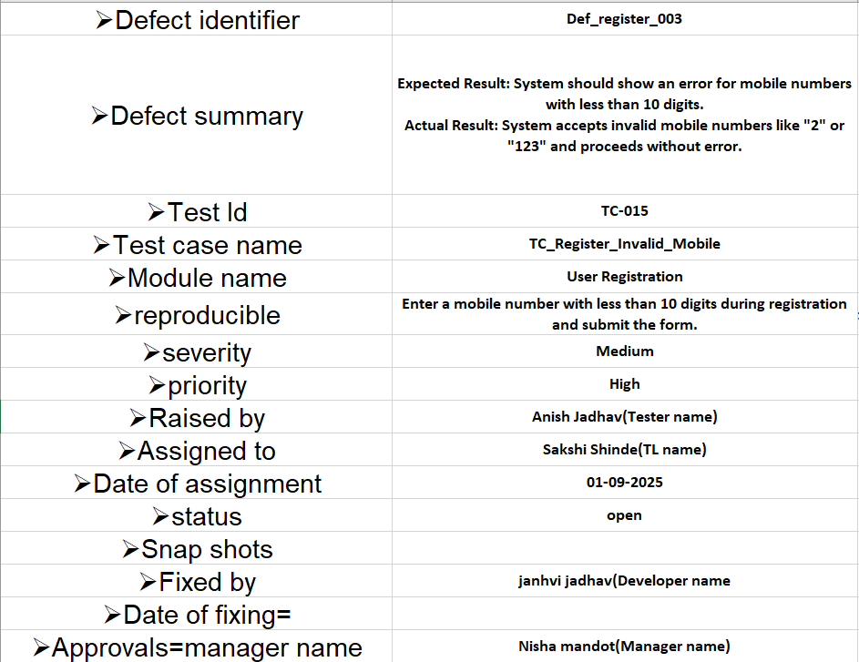

Slide 10
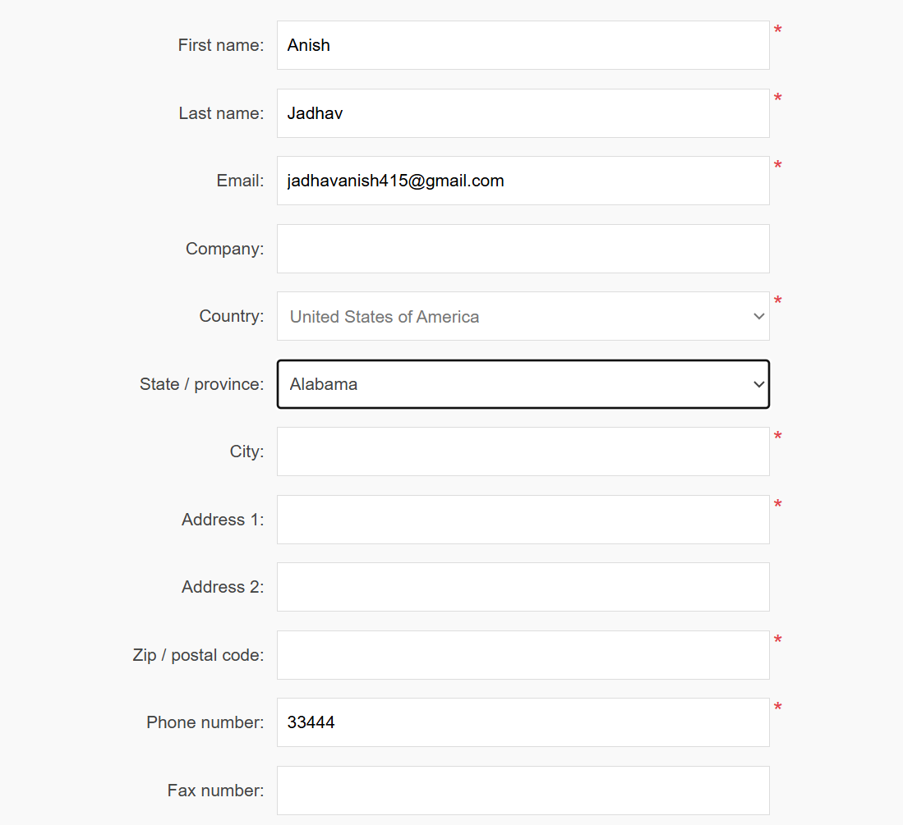

Slide 11
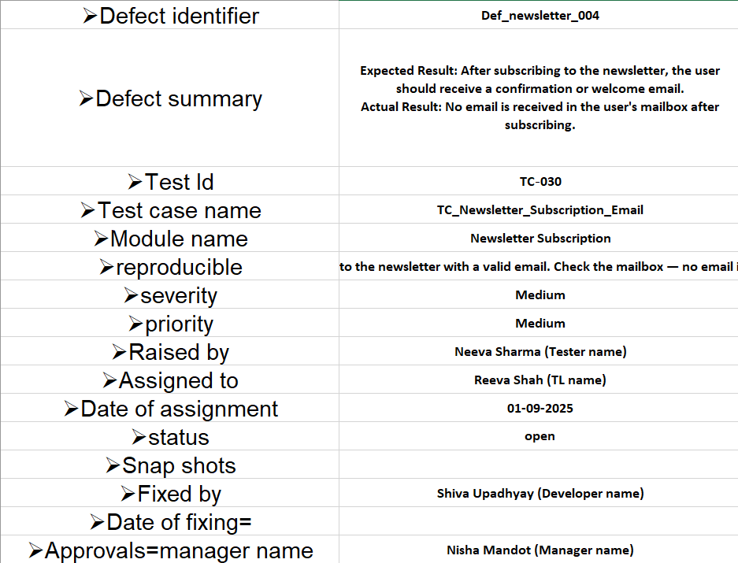

Slide 12
Challenges
Since nopCommerce uses email-based login with password authentication, handling password resets and account lockouts during testing can slow down the automation process.
Maintaining and resetting clean test data across multiple modules (cart, wishlist, login) was time-consuming and sometimes inconsistent.
Some features worked perfectly on Chrome but failed or behaved differently on Firefox or Safari, leading to additional cross-browser testing efforts.

Slide 13
Experience
I was able to identify bugs efficiently by thoroughly analyzing the functionalities.
Managing individual modules improved my time management and testing accuracy.
Continuous exploration of the application helped me write detailed and effective test cases.
Manual testing enhanced my observation skills and taught me to consider all possible user scenarios.

