Slide 1
Day 2: Blockchain Architecture & Merkle Trees

Slide 2
Day 1 REFRESHERS
Blockchain Basics
Decentralized, immutable ledger.
No central authority (e.g., banks)
Key Properties:
Immutable: Data can’t be altered.
Transparent: All transactions visible.
Chained Blocks: Each block linked via hashes.

Slide 3
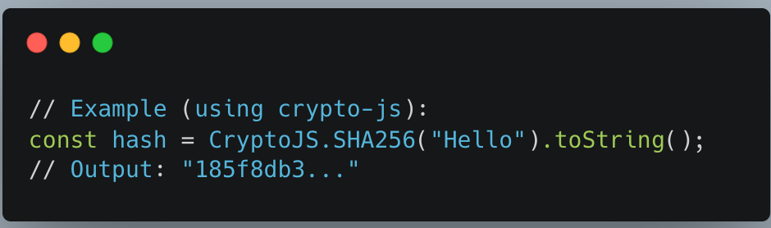
Day 1 REFRESHERS
Cryptography in Blockchain
SHA-256 Hashing:
Properties:
Deterministic (same input → same output).
One-way (can’t reverse-engineer input).
Use Case:
Blocks are chained by hashing previous block’s header.

Slide 4
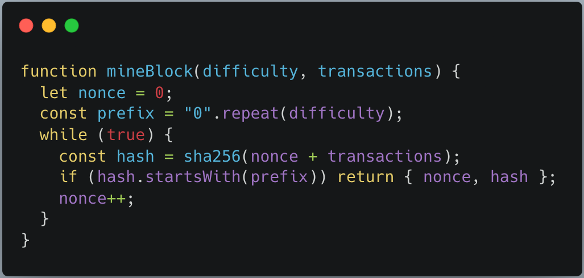
Day 1 REFRESHERS
Bitcoin Mining (PoW)
Find a hash starting with N zeros (difficulty).
How:
Miners brute-force a nonce.
Valid hash → Block added to chain.

Slide 5
Day 1 REFRESHERS
Key Takeaways
Blockchain = Decentralized database.
Mining = Solving PoW puzzles.
Nonce = Random number for hash hunting.

Slide 6
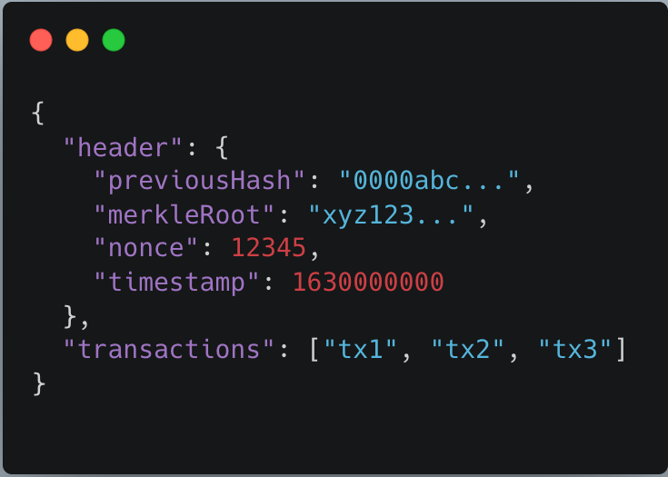
Blockchain Architecture
Key Components of a Block
Block Header:
Previous Hash: Links to the prior block (creates the chain).
Timestamp: When the block was mined.
Nonce: Proof-of-Work number
Merkle Root: Hash of all transactions
Block Body:
List of transactions.

Slide 7
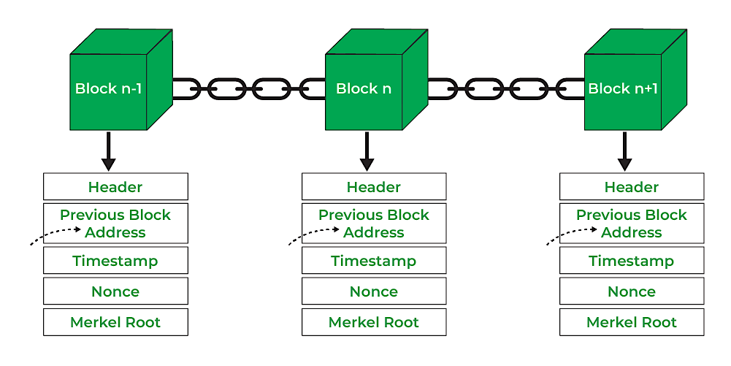
Blockchain Architecture

Slide 8
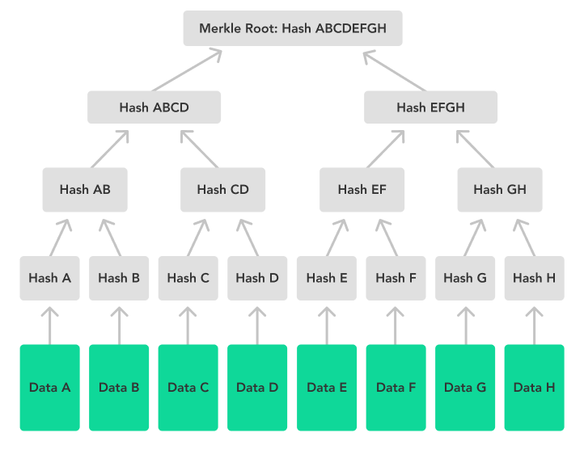
Merkle Trees

Slide 9
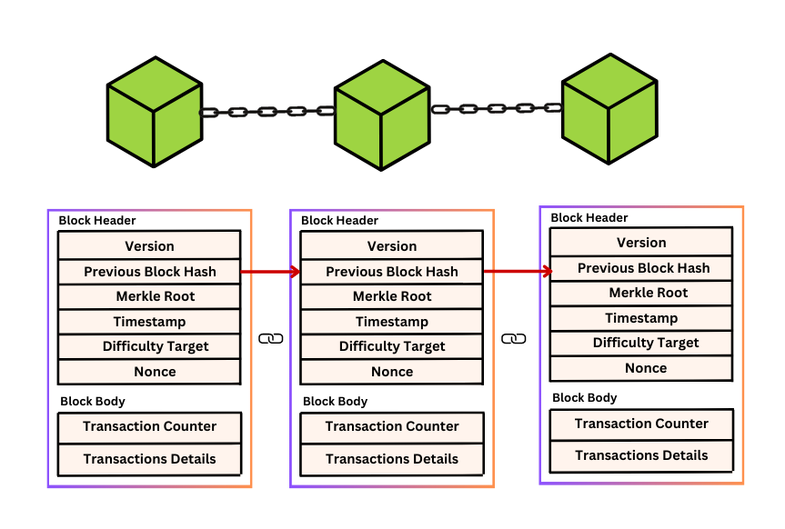
How Blockchain systems track transactions
The block contains two parts:
Block Header: Includes the Merkle root (hash summary).
Transaction List: The actual raw transaction data.

Slide 10
How Nodes Verify Transactions
Rebuilds the Merkle Tree -> From the raw transactions.
Recalculates the Merkle Root.
Compares It to the merkle root in the header.
If they match → transactions are valid and unaltered.
If not → reject the block (tampering detected).

Slide 11
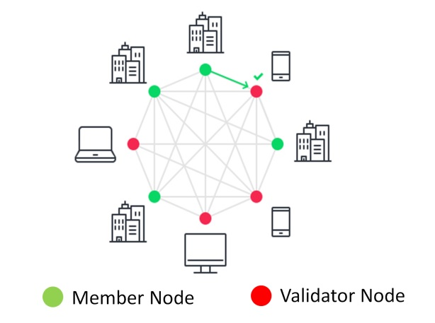
Validator node vs Member node
Validator Node | Member Node
Confirms transactions and creates blocks | Observes and uses the blockchain
Has authority to validate and secure data | No authority to validate

Slide 12
Validator Nodes
It checks to ensure transactions added to the blockchain are accurate and follow the rules. This process ensures the integrity of the blockchain. Validator nodes are important. They play a major role in keeping the network decentralized
In Proof of Stake (PoS) systems (like Ethereum now, or Solana):
You lock up some coins (this is called staking).
The network says, “Cool! You're in.” Now you're a validator.
The more you stake, the higher your chances of being picked to add the next block.
If you try to cheat, your staked coins can be slashed (you lose some).
In Proof of Work (PoW) systems (like old-school Bitcoin):
You become a validator by running special software and mining.
You solve puzzles with your computer, and if you're the first to solve it, you validate the next block.
No staking needed—just computing power and energy.

Slide 13
Member Nodes
A member node can be any node in a network, including validator nodes, but also potentially full nodes or other types of nodes.
Member nodes can participate in network operations, synchronize data, and interact with other nodes.
How they are introduced:
Anyone can become a member node by:
Downloading the blockchain software (like Bitcoin Core or Geth for Ethereum).
Connecting to the network.
How they are created:
You set up a computer or server.
Install the blockchain software.
Sync the blockchain data (download the chain).
Now you're a full node, or a member node.

Slide 14
Web RESOURCES
https://andersbrownworth.com/blockchain/blockchain

