Slide 1
Cryptography & Wallets in Blockchain
Understanding Keys, Signatures, and Secure Transactions

Slide 2
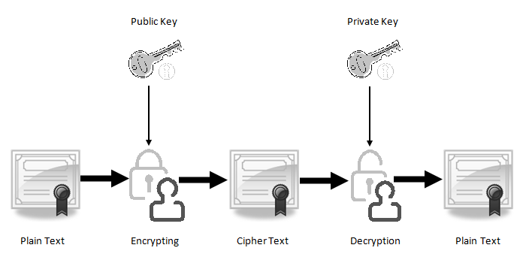
Public-Key Cryptography
Private Key: "Your secret password (64 hex chars)"
Public Key: "Derived from private key, shared openly"
Address: "Shortened public key (e.g., 0x71C7...)"

Slide 3
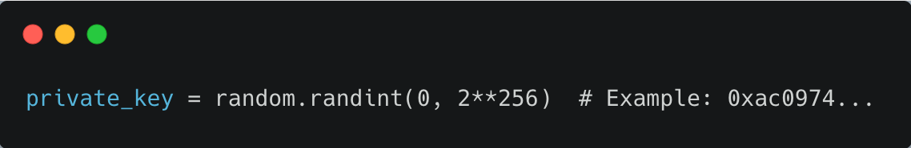
Key Derivations
Private Key Generation 🔐
When:
Created when you first set up a wallet (e.g., MetaMask, Bitcoin Core)
Generated once and must be kept secret
How:
A random 256-bit number (78 digits long!) is picked
THEN HASHED WITH ANY ALGORITHM LIKE SHA256 or keccak256

Slide 4
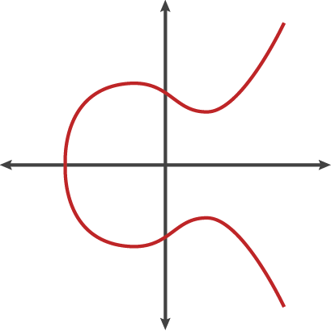
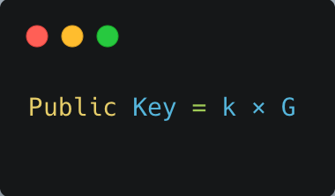
Key Derivations
Public Key Derivation
Process:
Take the private key (k).
Multiply it by a special "starting point" (G)
G is a fixed point everyone agrees on which is IN secp256k1 Curve
Scalar Multiplication
Output:
Your public key (130 hex chars).

Slide 5
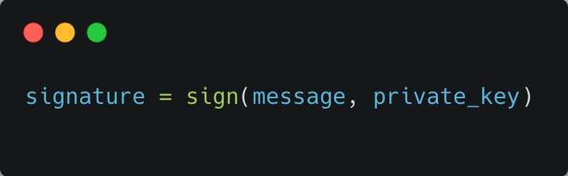
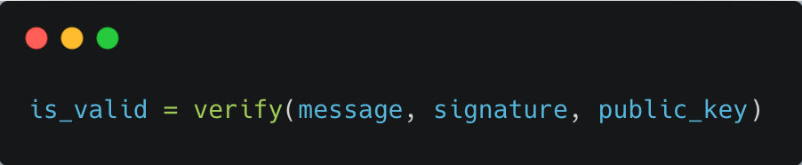
Digital Signatures
ECDSA (Elliptic Curve Digital Signature Algorithm).
Verifier knows:
m (message)
(r, s) (signature)
P (public key)
Verifier computes:
e = HASH(m)
u1 = e / s
u2 = r / s
compute: u1 * G + u2 * P = (x, y)
Check if r ≡ x
Signer has:
private key: k
public key: P = k * G
message: m
random nonce: n (random secret per message)
Signing process:
r = (n * G)
s = (e + r * k) / n
e = HASH(m)
Notice:
r comes from n * G.
s relates n, r, e, and the private key k.

Slide 6
you calculate something like u1 x G + u2 x P and expect it to "reconstruct" n x G (because r was made from n x G).
So let's plug:
Recall:
u1 = e / s
u2 = r / s
Then:
When signing, the signer defines s as:
s = (e + r x k) / n
u1 x G + u2 x P = (e/s) x G + (r/s) x P
= (e x G + r x P) / s
s x n ≡ e + r x k
n ≡ (e + r x k) / s
but P = k x G, so:
r x P = r x k x G
u1 x G + u2 x P = (e x G + r x k x G) / s
= (e + r x k) / s x G
= n x G (from above)

Slide 7
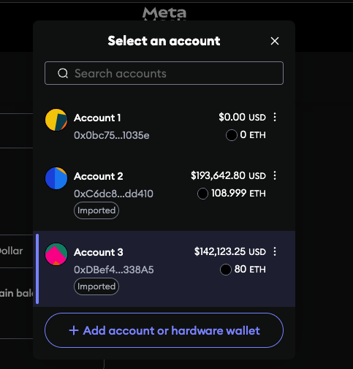
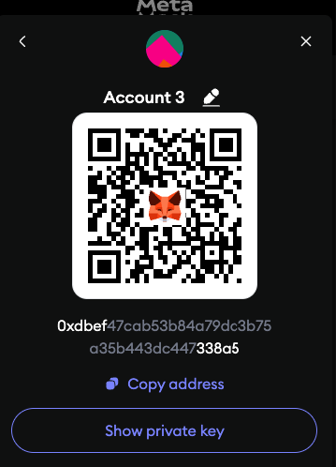
Wallet Anatomy
Private Key: "Never share!" (👀→🔒)
Public Key: "Receiving address generator"
Address: "Like your bank account number"

Slide 8
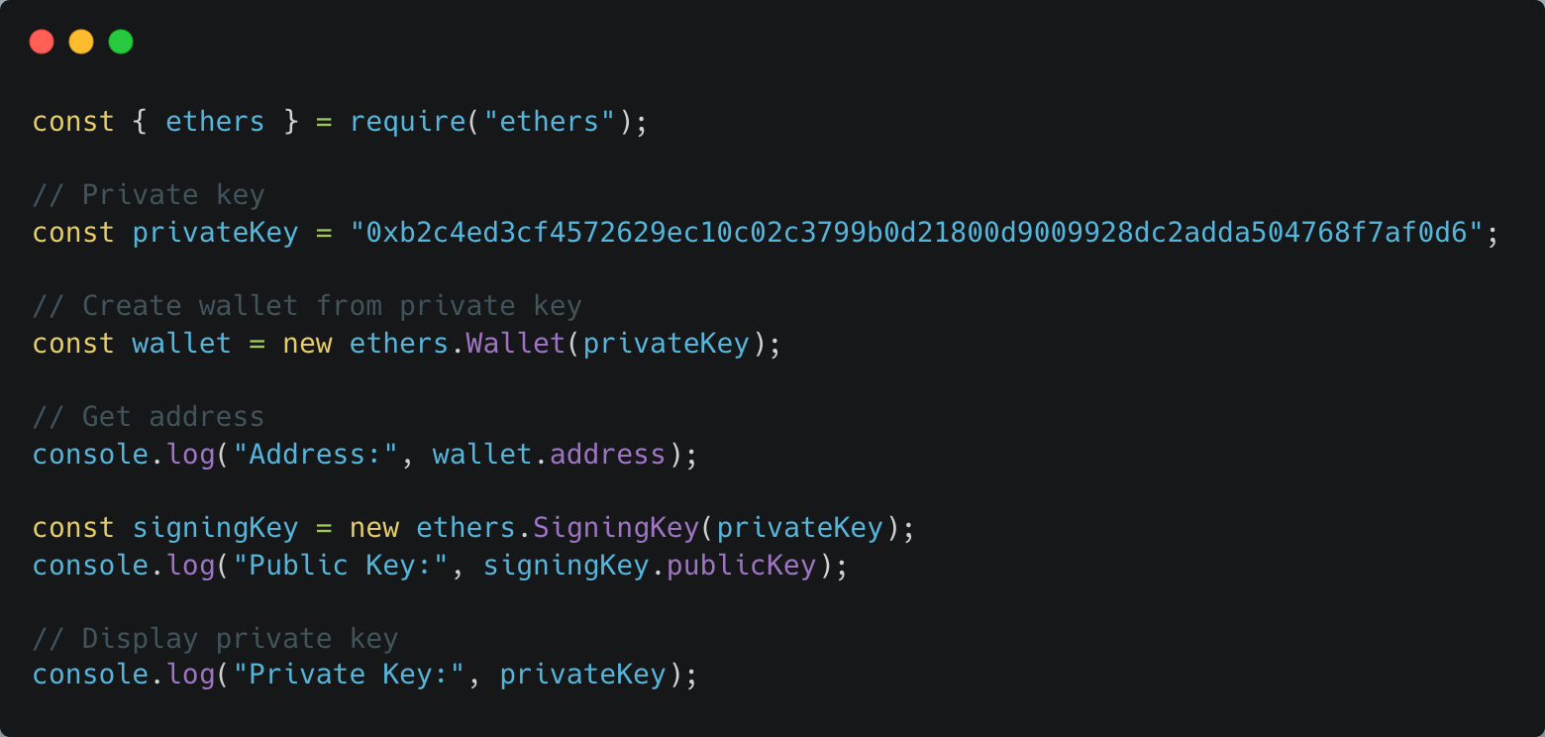
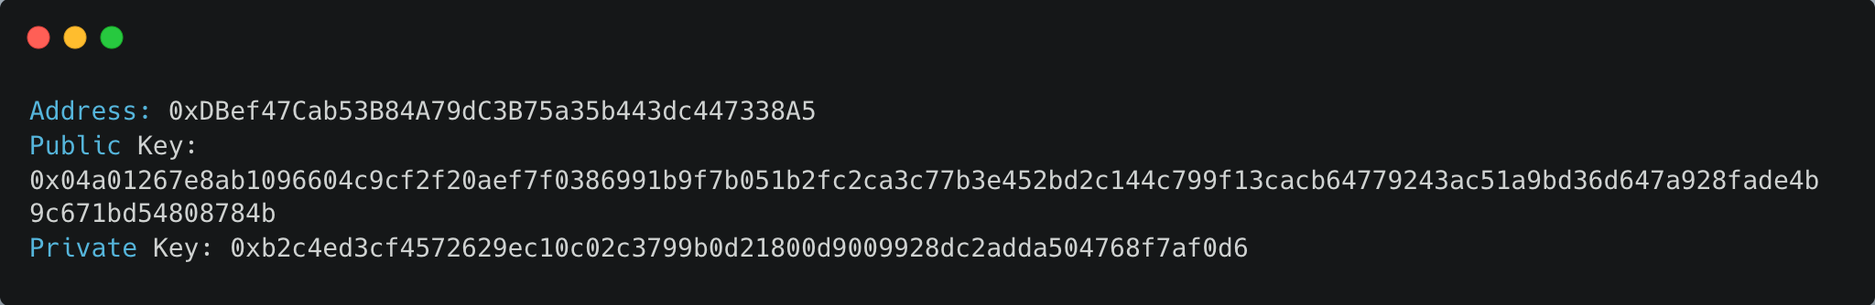
Key Decrypt

Slide 9
Wallet Types
Type | Example | Security Level
Software | MetaMask | Medium
Hardware | Ledger | High
Paper | Printed QR | Offline

Slide 10
Web Resources
https://andersbrownworth.com/blockchain/public-private-keys/signatures

