Slide 1
Pre Requisites

Slide 2
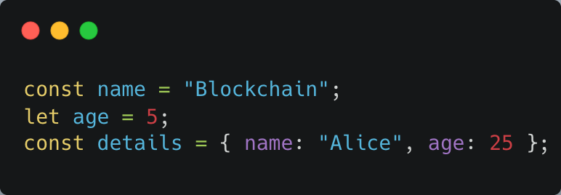
Javascript Essentials
Variables: let, const
Data types: number, string, boolean, object, array

Slide 3
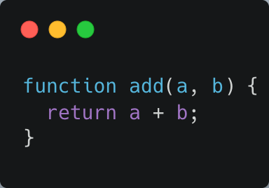
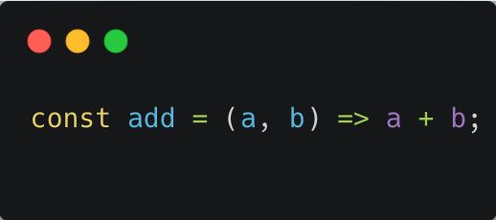
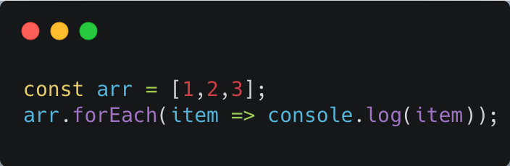
Functions & Loops

Slide 4
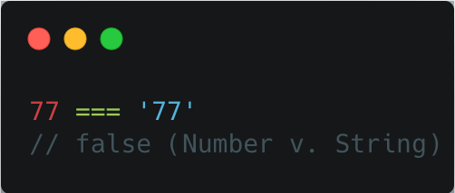
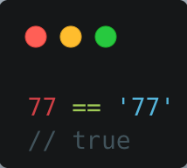
== vs === vs typeof
== (Loose Equality): This operator performs type coercion before comparing two values.
=== (Strict Equality): This operator compares both the value and the type without any type coercion.

Slide 5
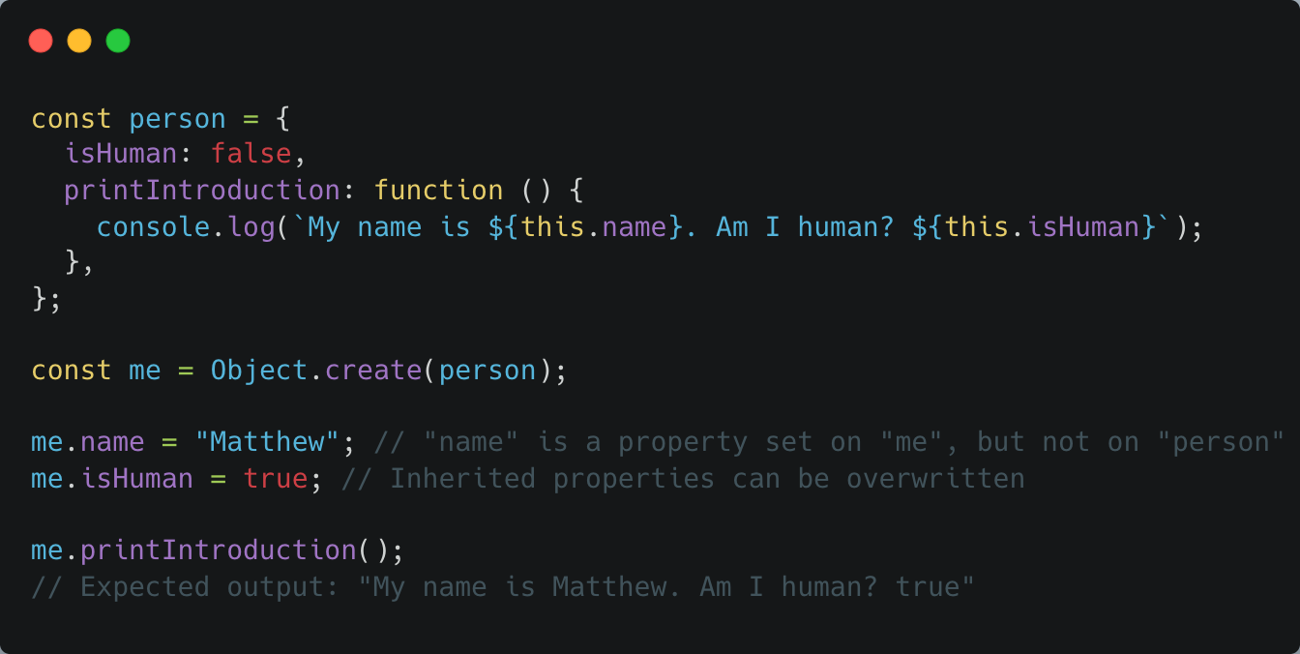
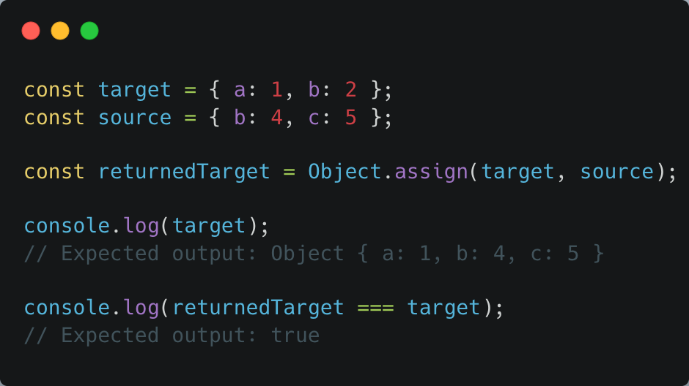
Objects

Slide 6
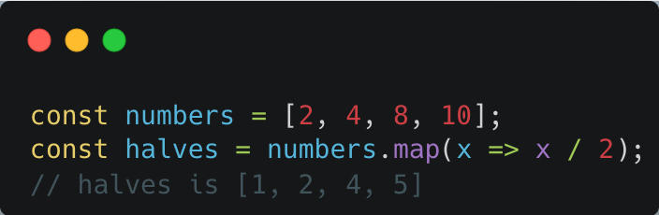
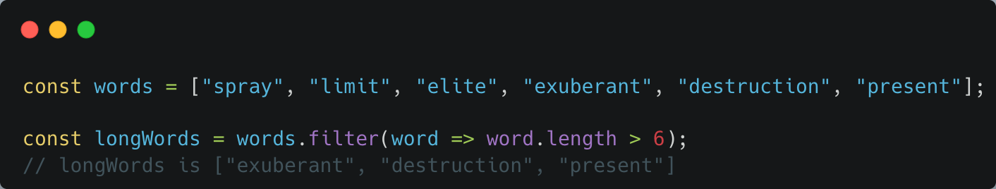
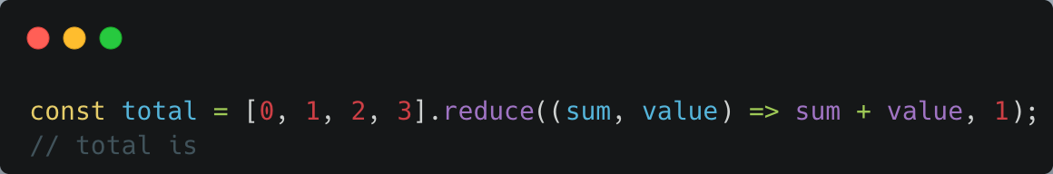
Array Functions
MAP
FILTER
REDUCE

Slide 7
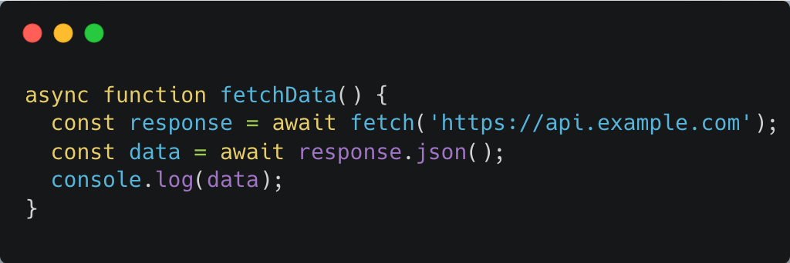
Async JavaScript

Slide 8
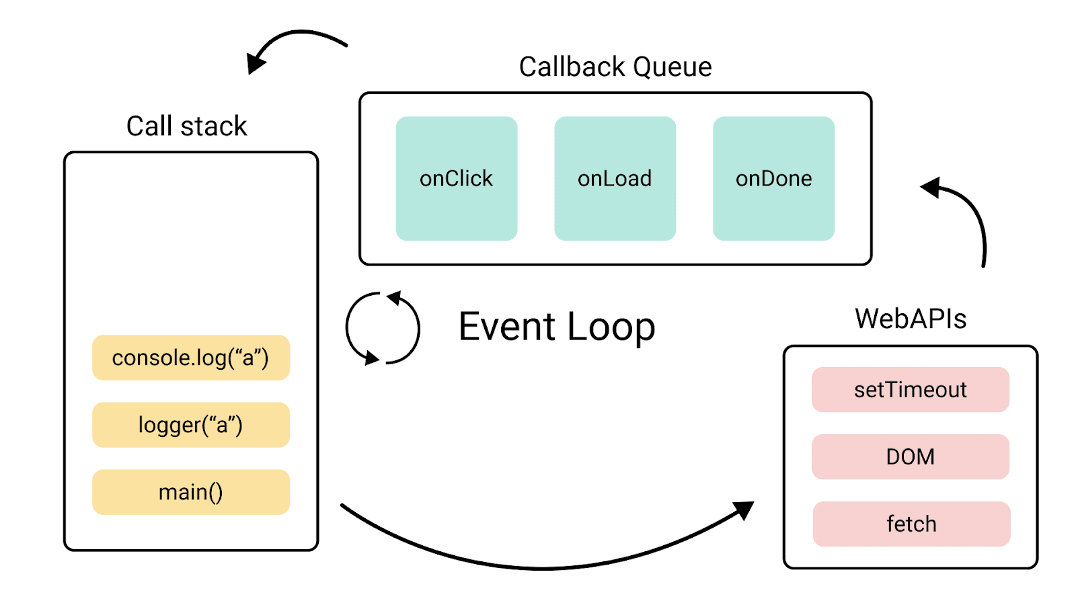
Call stack

Slide 9
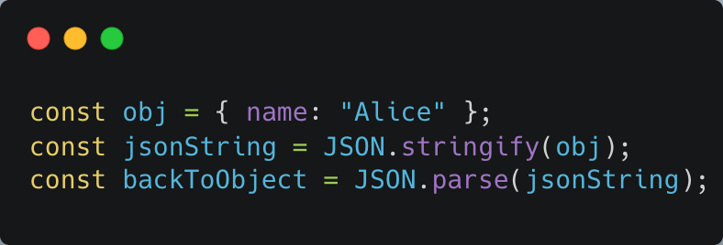
JSON
Lightweight data format.
Used in APIs and Blockchain.

Slide 10
Blockchain use cases debate by industry
Gaming
Healthcare
Finance
Supply Chain Management
Government
Art & Media
Real Estate
Automotive
Energy
Eductation

