Slide 1
Common Vulnerabilities & Exploits

Slide 2
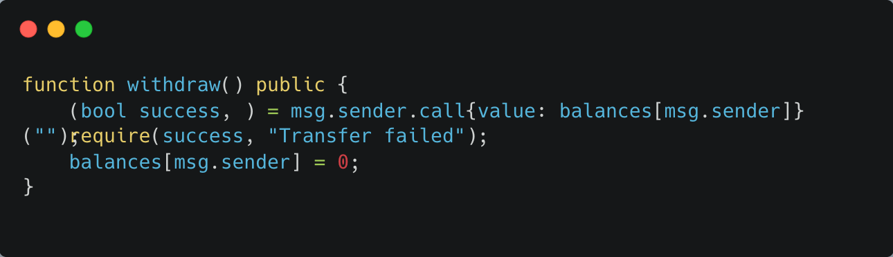
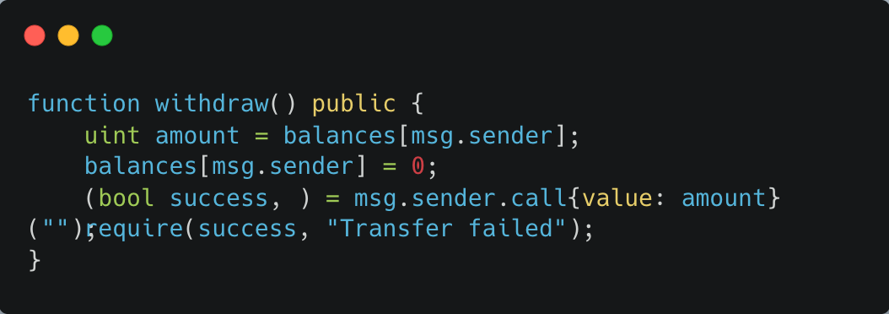
Reentrancy Attack
You give someone money from a vending machine, but before updating the machine that you gave them the snack, they press the button again and get more snacks—for free!
The DAO Hack used this trick to steal $60 million
Sends ETH before updating the balance.
Attacker calls withdraw() again inside the receive() function.
Fix: Use Checks-Effects-Interactions

Slide 3
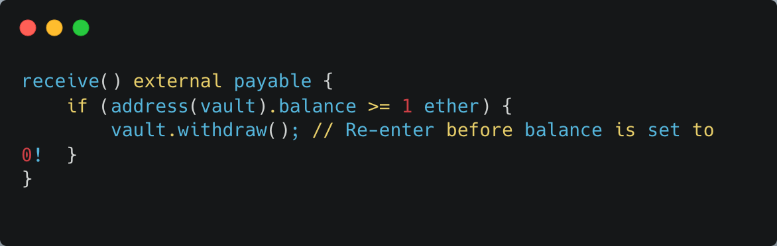
So When & Where Does the Reentrancy Happen?
A developer deploys a vulnerable contract
Example: VulnerableVault with this bad withdraw() function:
Attacker deploys their own malicious contract
The attacker writes a contract with a receive() function that is triggered when it receives ETH. Inside that function, the attacker calls withdraw() again before the original contract sets their balance to zero.
Attacker calls their own attack() function
This sends ETH to the vault, then immediately starts the malicious withdraw() process.

Slide 4
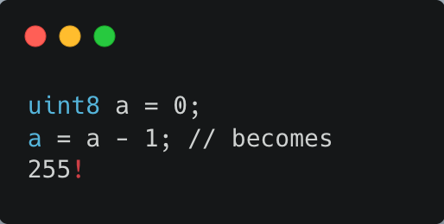
Integer Overflow/Underflow
You set your wallet to 0. Then try to subtract 1... in the old days, it became a giant number (wraps around)!
Vulnerable in Solidity < 0.8
Fix:
Use Solidity 0.8+ (auto-safety).
Use SafeMath for older versions.

Slide 5
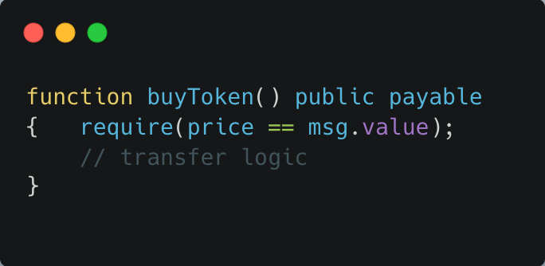
Front-Running
You tell the world you're about to buy a rare item. A sneaky person sees your message and buys it first—then sells it to you for a higher price.
In Blockchain:
Transactions are public before confirmed.
Miners or bots reorder or insert transactions for profit (common in DeFi).
Mitigations:
Use Commit-Reveal schemes.
Use off-chain order books.
Bots detect your buyToken() call and front-run it.

Slide 6
Front RUNNING - How It Works on Ethereum
You send a transaction to buy a token on a DEX (like Uniswap).
E.g., buy 100 tokens for 1 ETH.
Your transaction goes into the mempool (a public waiting area where miners/validators pick transactions).
A bot or attacker sees it in the mempool.
They:
Submit the same transaction (or a strategic one).
Set a higher gas fee to get priority.
The miner picks the higher-fee transaction first.
Result:
The attacker buys before you.
Your transaction is now more expensive or fails (slippage).
The attacker can sell back at a profit — this is called a sandwich attack.

Slide 7
How to Prevent It
Use private transactions (e.g., Flashbots, MEV-protected RPCs).
Set slippage limits in DEX trades.
Use batching or commit-reveal schemes in sensitive dApps.

Slide 8
Private Transactions (Flashbots / MEV-Protected RPCs)
Problem:
When you send a normal Ethereum transaction, it goes to the public mempool, where everyone (including bots) can see it.
Solution:
Use tools that bypass the public mempool, sending your transaction privately to miners/validators.
How:
Flashbots is a service that sends your transaction directly to miners who’ve agreed not to leak it.
MEV-Protected RPCs (like from Eden Network, Alchemy, or Flashbots Protect) act like a privacy tunnel.
Analogy:
Like handing your bid in a sealed envelope directly to the auctioneer, so no one else sees it and tries to outbid you.

Slide 9
Set Slippage Limits in DEX Trades
Problem:
If a front-runner pushes up the price before your trade executes, you could:
Overpay badly
Or get rekt with a failed transaction
Solution:
Use slippage tolerance — a % limit on how much price you're willing to accept.
Example:
In Uniswap, if you set slippage to 1%, and someone tries to manipulate the price by more than 1%, your transaction will fail instead of getting front-run.
Analogy:
You're willing to buy apples for $1 each, but you tell the seller: “If the price goes above $1.01, cancel my order.”

Slide 10
Batching / Commit-Reveal Schemes
Problem:
For things like auctions, voting, or bids, you don’t want someone to see your action and copy or counter it.
Solution:
Use commit-reveal pattern: Split your action into two phases:
Phase 1: Commit
You send a hashed version of your intent (e.g., a bid or vote), hiding the details.
Phase 2: Reveal
Later, you reveal the real value, and the system verifies that it matches your commit.

Slide 11
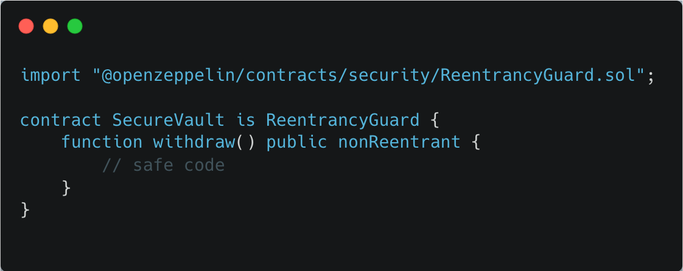
Best Practices Summary
Use Checks-Effects-Interactions
Add ReentrancyGuard:

Slide 12
Static Analysis Tools
Before launching your car into a race, you use a scanner to find hidden problems like loose bolts.
🔎 Static analysis tools = contract scanners.

Slide 13
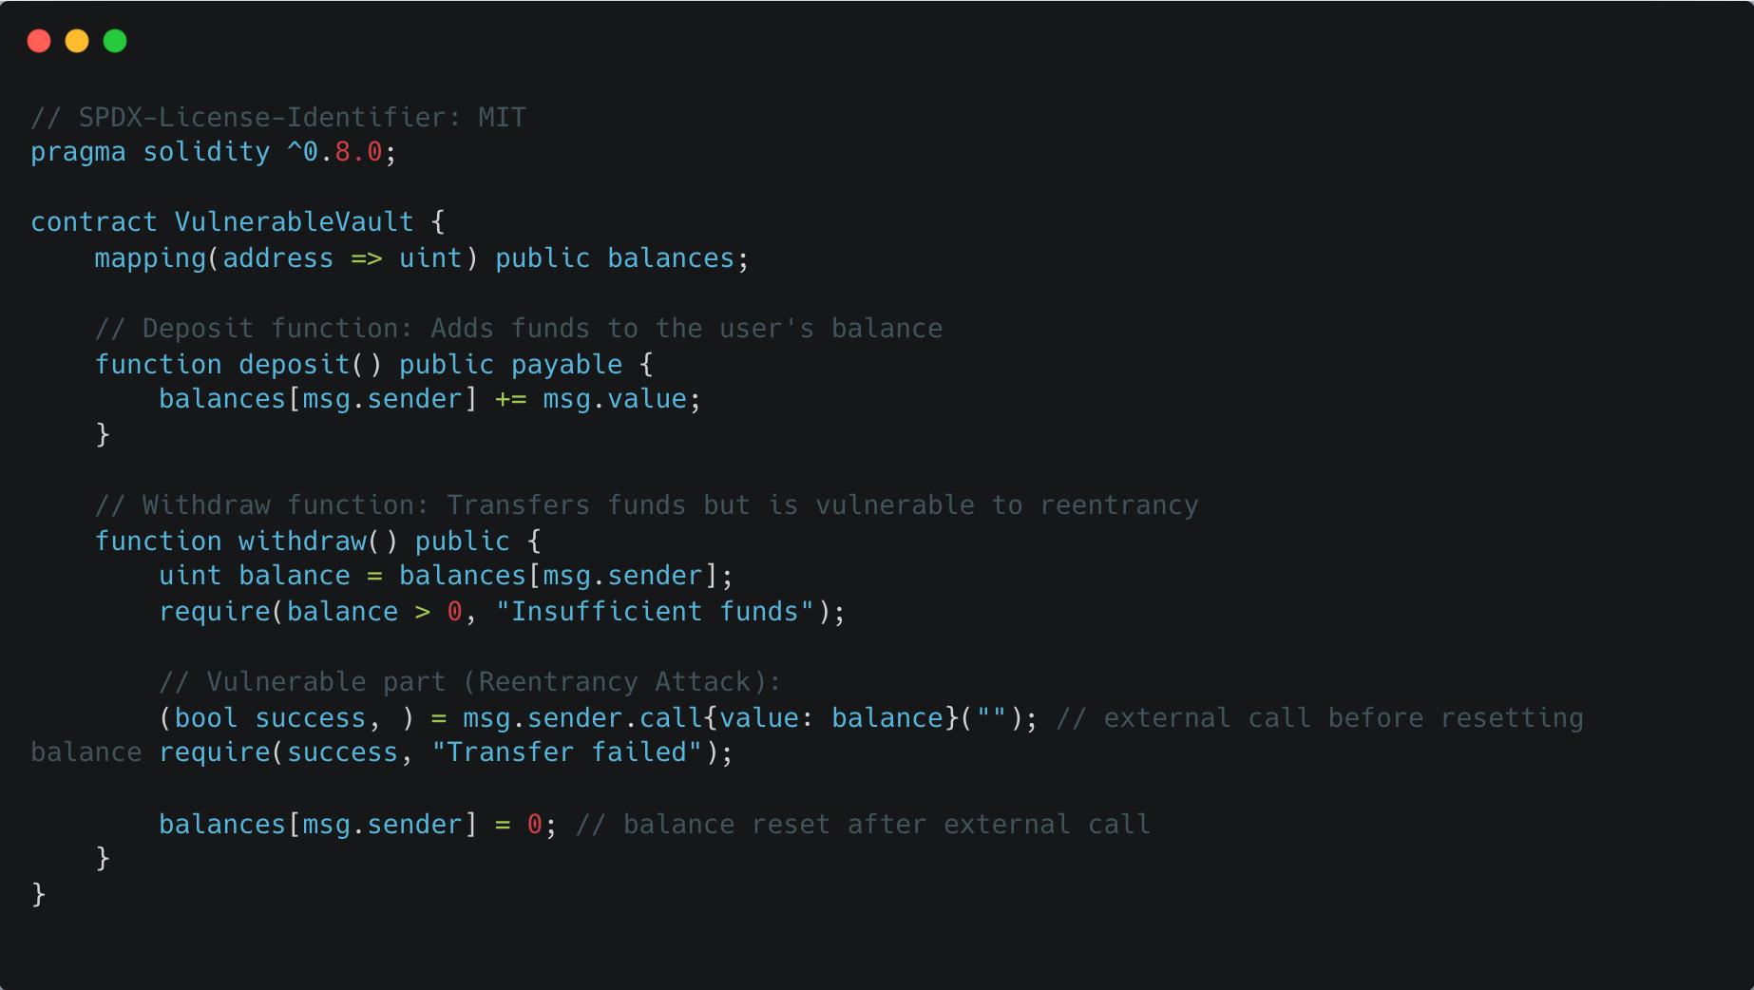
DEMO – Remix IDE – Static analyser

Slide 14
Toolset Overview
Tool | Use Case
Slither | Fast local vulnerability scanner
MythX | Deep cloud-based analysis
Remix Analyzer | Built-in warnings

