Slide 1
SCIENTIFIC CALCULATOR
SOFTWARE TESTING (18IS62)
Amruta Varsha T H 1BG20IS005
Anish Kumar 1BG20IS007
C Prajjwal 1BG20IS014
Divya Kona 1BG20IS017
Sai Bindhu G 1BG20IS045

Slide 2
Importance of Software Testing
01
Quality Assurance
02
Risk Mitigation
03
Cost Savings
Software testing is crucial for ensuring the quality and reliability of software products.
Testing helps mitigate risks associated with software like failures, security and data loss.
Early detection and resolution of defects through testing can save significant costs in the long run.
04
Compliance
05
Improvement
06
Scalability
Many industries have specific regulations and standards that software must adhere to.
Testing is an iterative process that helps teams continuously improve their software.
Testing ensures that software can handle the anticipated load and perform optimally under different scenarios.

Slide 3
Advantages of Software Testing
01
02
Improved Quality
Time Saving
Software testing helps improve the quality of the software by identifying and fixing bugs, errors, and defects.
Testing helps identify and address issues that could cause delays or interruptions in software development.
03
04
Increased Efficiency
Increased Security
Testing helps identify and fix performance issues and scalability limitations in software systems.
Security testing is crucial for identifying vulnerabilities and weaknesses in software systems.

Slide 4
Scientific Calculator
It is a device that goes beyond basic arithmetic calculations and provides a wide range of advanced functions to solve complex mathematical problems.
The key features of the scientific calculator typically include arithmetic operations (addition, subtraction, multiplication, division), trigonometric functions (sine, cosine, tangent), logarithmic functions, exponential functions, statistical functions and more.
Additionally, it offers memory storage and recall functionality, as well as the ability to perform calculations with variables.

Slide 5
Advantages of Selected Application
Accuracy
Portability
Scientific calculator application ensures that calculations are performed correctly.
With application installed on a mobile device or computer, testers can carry it with them wherever they go.
Efficiency
Documentation
It eliminates the need for manual calculations and saving valuable time during the testing process.
It provides features for documenting and storing calculations.
Functionality
Scientific calculators offer a wide range of mathematical functions and statistical calculations.

Slide 6
Testing Techniques
Unit Testing
Integration Testing
System Testing
Boundary Value Testing
Equivalence Class Testing
Function or method is tested independently to ensure that it performs as expected.
It ensures that the various functions work together seamlessly and produce the expected results.
It focuses on validating the system behaviour, performance, and functionality against the specified requirements.
Testing identify the minimum and maximum values that can be accepted by each function and test the calculator's response.
Input space is divided into equivalence classes or groups. Each group represents a set of inputs that should produce the same output.

Slide 7
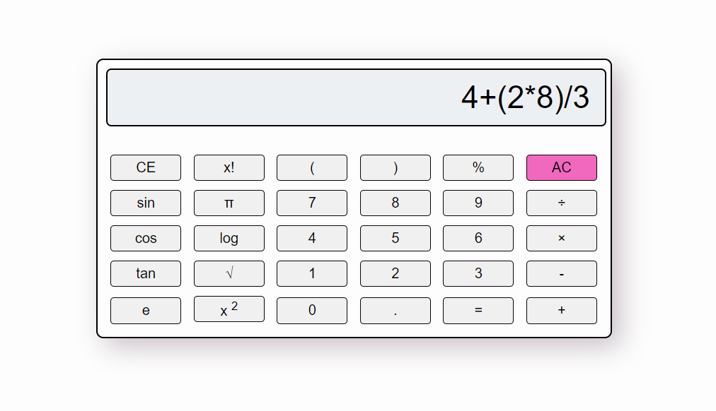
UI/UX

Slide 8
Katalon Studio
Katalon Studio is a free automation testing solution developed by Katalon LLC. The user interface is a complete integrated development environment (IDE) implemented on Eclipse rich client platform(RCP). The main scripting language is Groovy, Java, and JavaScript and can be executed against all modern browsers, iOS, and Android applications supported by Selenium and Appium.
Start Katalon Studio
Record the execution of the website for relay and capture
Modify Test cases for all possible cases
Create Test Suite for every functionality of the website
Add test cases to test Suite
Variable data binding
Run all the test suite one by one
Analyze the result

Slide 9
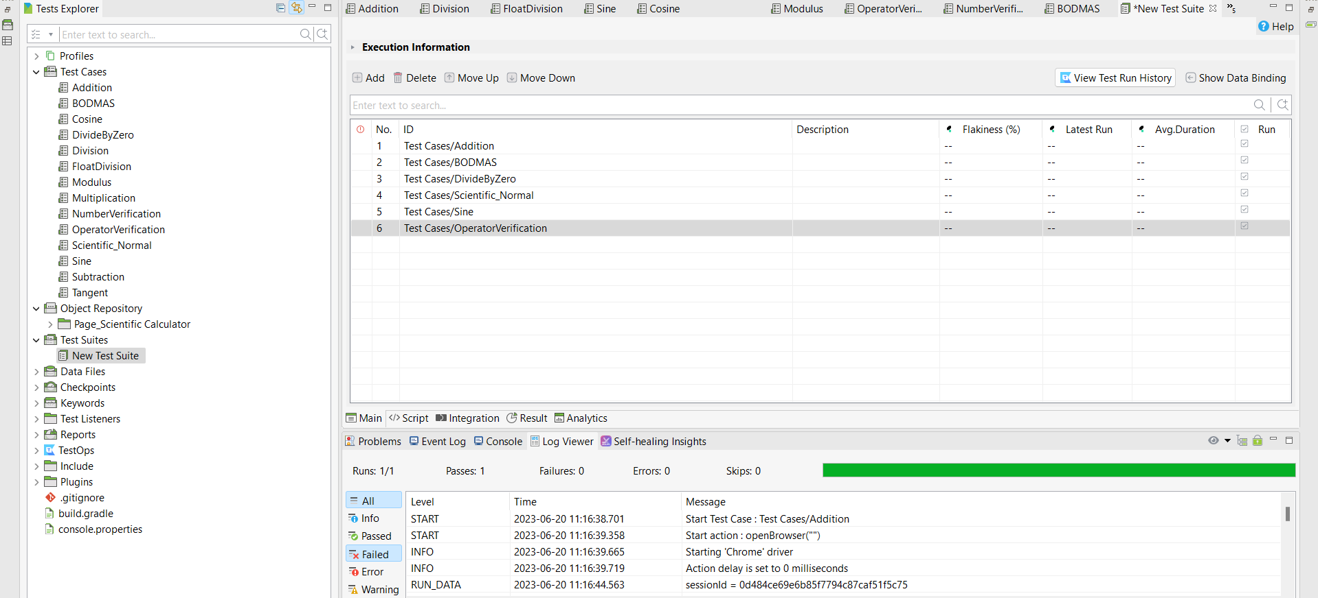
Test Suite

Slide 10
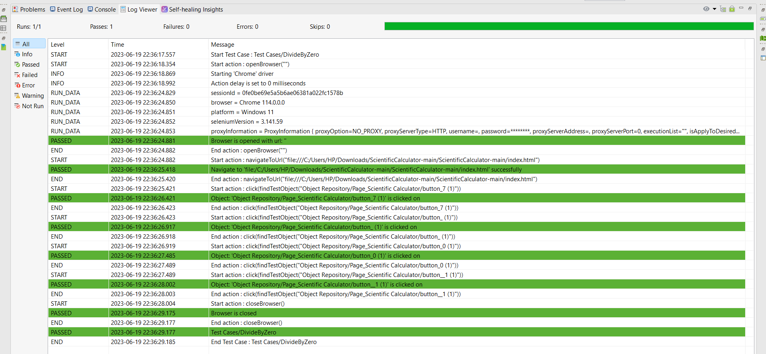
Passing Test Case

Slide 11
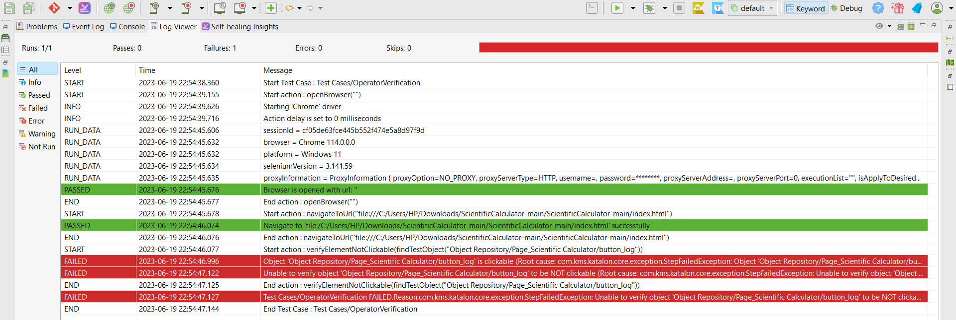
Failing Test Case

Slide 12
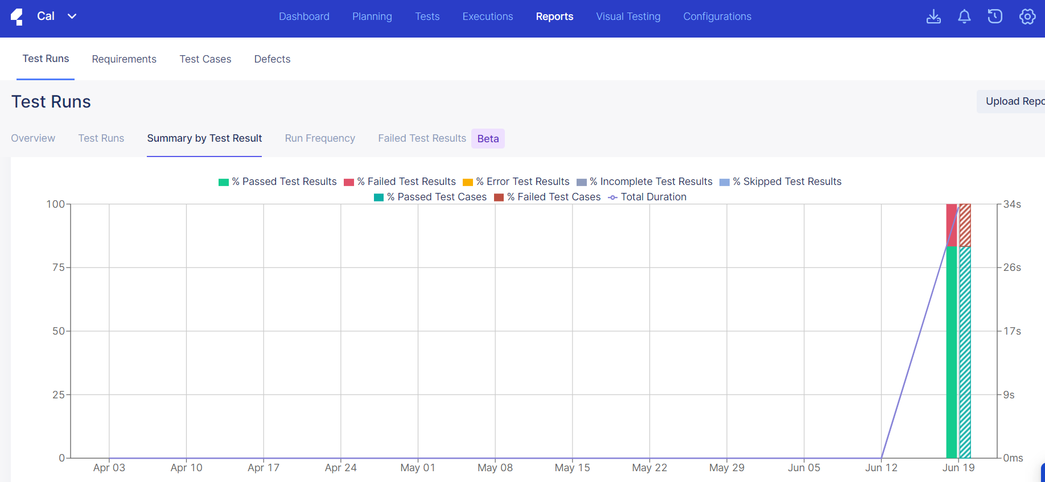
Graph

Slide 13
Thanks

