Slide 1
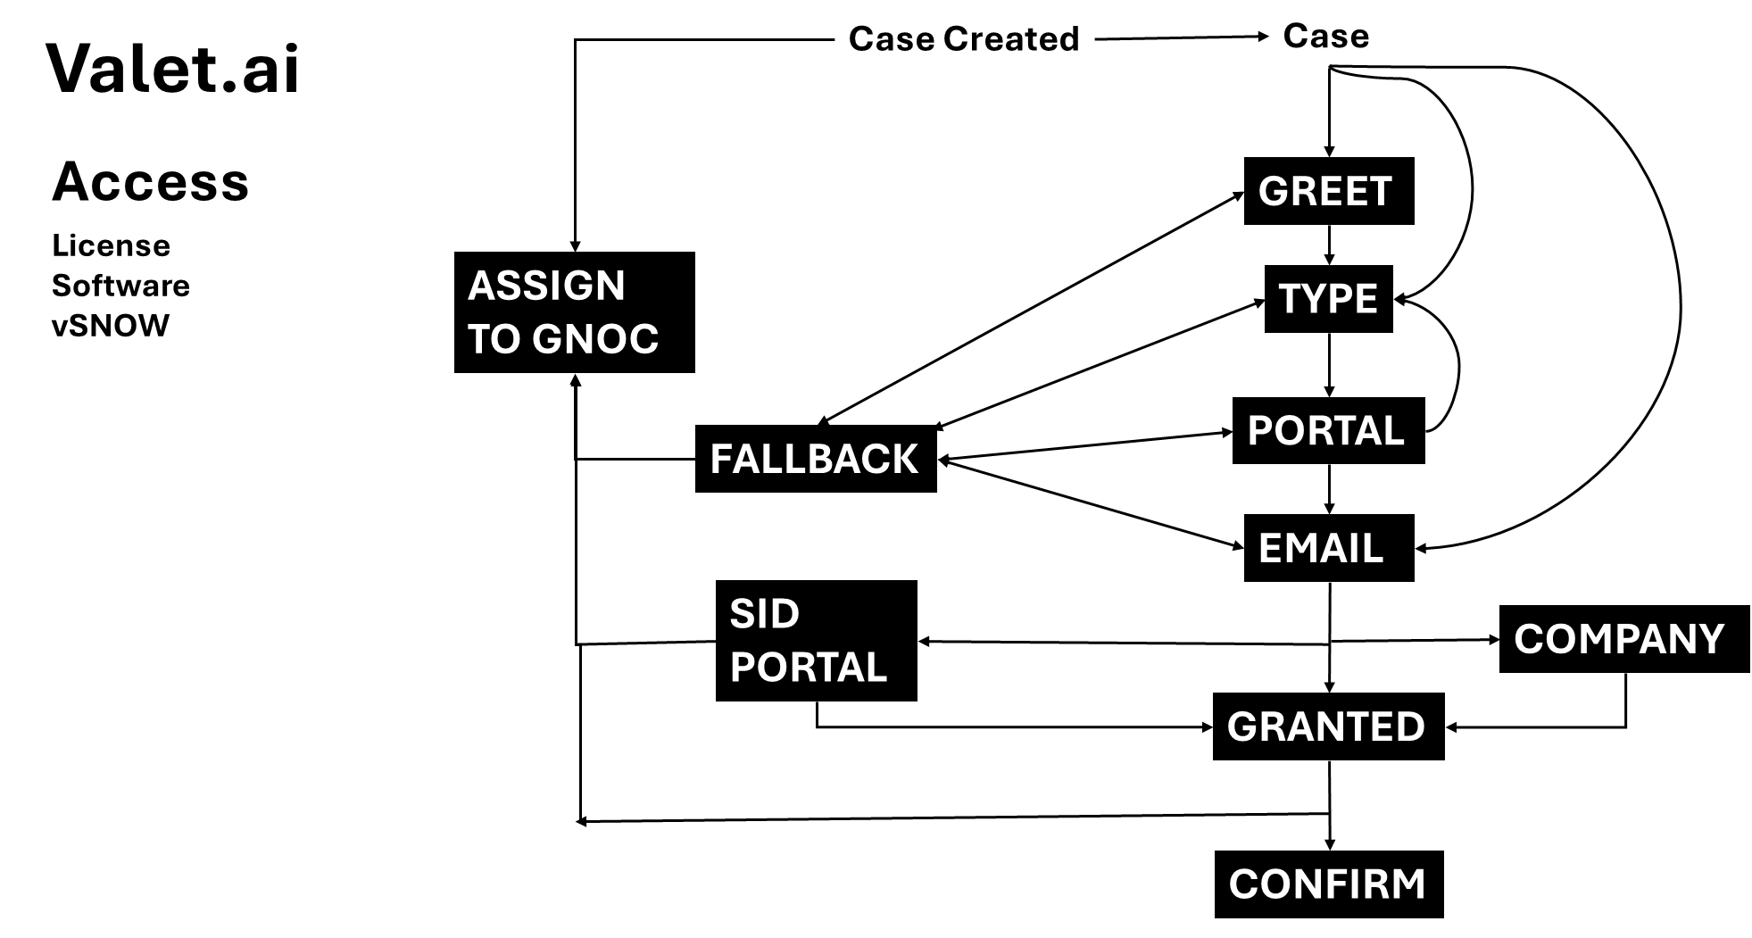

Slide 2
Temp license Case
Valet.ai
Case Created
TEMPORARY
LICENSE
GREET
ASSIGN TO GNOC
PROD?
x2
FALLBACK
HOST ID
HOST ID Added in portal?
VDCm – ask for validation key
Add host id's

