Slide 1


Slide 2
Minor 1 Presentation
3rd December, UPES-Dehradun
Project Title: Greedy Car
Submitted By: Anish Bansal

Slide 3
Introduction
Abstract
The project aims at taking a step into the field of data structures and algorithms by creating a program which consists of a car traveling in such a way that it collects maximum number of coins which are placed on three different roads of equal length with each road having equal or unequal number of coins.
When the program starts coins are randomly placed on these roads, each run of the program results in different distribution of coins rather than having fixed coin position. The car runs with certain constant velocity, move to left or right road and doesn’t accelerate or decelerate in the course of its run. It uses a certain kind of algorithm to collect maximum coins possible until it reaches the end of the track

Slide 4
How & why this idea
We all have played board games a lot in our childhood. There were smartphones but not as popularized as they are now, so we all played board games. My team always wanted to make a board game, but with the use of technology. So, this was the perfect moment when we decided to build a car racing board game but with a twist. The twist is that in this game our car will decide that which path is best for it to reach it’s final destination collecting maximum coins. Thus, we automate every process thinking around this logic and made an algorithm for maximizing coin collection which can not only be used in our game but can also be used in many other things where we have to search the required data from the 2D array.

Slide 5
Objectives
To create a GUI based application consisting of a car traveling in such a way that it collects the maximum number of coins that are present randomly on the 3 different paths.
System requirements:
Hardware: RAM: 512MB
Disk Space: 500MB
Software: Any C IDE, Glut library
Operating System: Windows, Linux
Language: C
Sub-Objectives
To make graphical interfaces for roads and placing coins randomly on them.
To make car identify the position of the coins on the roads. And change the path according to the number of coins placed in the path but Car can only switch one time from one track to another in a column.
To show the car running on certain path such that user can identify the path taken.
To show that car always select the path which has maximum coins.
To finish the track having maximum coins collected.

Slide 6
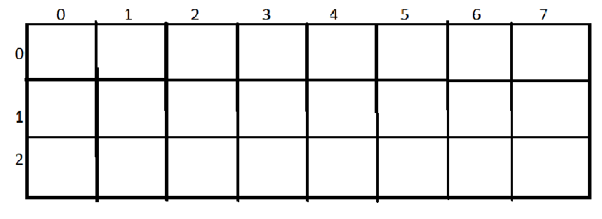
Proposed Model
For the representation of the three different tracks we will use 2D array. Each row of the 2D array will represent a track and total number of columns represents the size of each track.
We will execute “for” loop ten times. In each iteration “rand()” function will generate a random integer. The random integer generated by the rand() function must be in the range of [0,N) where N= total number of cells in the 2D array for example in the 2D array given below total number of cells is equal to 24.
Node-0 of the Linked List has address of 0th row ,0th columns cell of the 2D array and
likewise Node-1 has address of (1,0), Node-2 has address of (2,0), Node-3 has address
(0,1), Node-4 has address (1,1) cell of the 2D array. Thus, coins will be placed on the
address corresponding to the node selected of the 2D array.

Slide 7
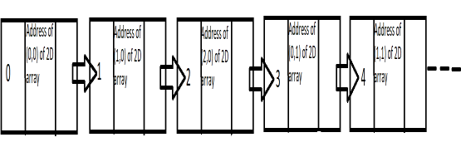
Proposed Model (Contd.)
The rand() function returns a pseudo-random number in the range of 0 to RAND_MAX. RAND_MAX: is a constant whose default value may vary between implementations but it is granted to be at least 32767. So, to limit the range up to 23 we will us modulo (%) operator. For Example: a=rand() %24.
The random numbers generated in the range of 0 to 23 will help us to select random nodes of the link list whose nodes are numbered 0 to 23, with each node also having address to one cell of the 2D array.

Slide 8
Methodology
The only Programming language that will be used to make this project is C Programming Language. Since this is a purely C programming language-based project, we will also make use of all the concepts that we know of or can learn through the resources that are available to us. The basic functions and working have already been described but this section will describe the step-by-step implementation of this project.
Create a Multidimensional (2D) Array – A 2D Array with 3 rows and N number of Columns will be created to represent 3 tracks of N length. Only 1 car will traverse through any of the rows that fulfil our scenario/condition.
Use Linked List to place coins inside the tracks – A Linked List will be used to place coins inside positions of the tracks. Each tab will have an address associated to them which corresponds to an address inside the Multidimensional array.

Slide 9
Methodology (Contd.)
rand() function to generate coins at random positions – Inside the Linked List we will use the rand() function to generate coins at random positions inside the multidimensional array.
Use a searching Algorithm to determine the position of the coins – To determine the position of the coins on the tracks, we will use Searching Algorithms column by column.
Using Computer Graphics to create interfaces for the car, tracks and coins – The last step in the coding process will be to design graphical interfaces for the car, the tracks and the coins. This will be the part that the user will be able to observe when the project is finally complete.

Slide 10
Max. Coin Collection Algorithm
2 Dimensional array is used to make 3 separate tracks on which our car travels therefore each track has a size of n. So there are 3 rows and n column in this 2dimesional array.
For searching the coins we search in every column one by one, but as our car can only switch to it’s left or right track during it’s run to collect coins and can only make one transition in every column. Therefore car can only move to next or previous row of 2d array.
As we are using searching in every column one by one therefore we should skip collecting the coins which requires the car to make 2 transition of rows in a column. This is achieved by introducing the condition that the modulus of difference between next address car position and current address position should not be equal to 2n+1(if current address is greater than the previous address) and not equal to 2n-1(if previous address is greater than the current address.
Time complexity: O(3*n) Space complexity: O(3*n) + O(3*n)
LinkedList 2D Array
Where n is input (the size of tracks)
for(int j=0;j<n;j++)
{
for(int i=0;i<3;i++)
{
if((arr+n*i+j)>prev)
flag2=1;
else if((arr+n*i+j)<prev)
flag2=0;
if(*(arr+n*i+j)!=0&&abs((arr+n*i+j)- prev)!=(2*n+1)&&flag2==1||*(arr+n*i+j)!=0&&abs((arr+n*i+j)- prev)!=(2*n-1)&&flag2==0||*(arr+n*i+j)!=0&&flag==0)
{
coinColl=coinColl+*(arr+n*i+j);
*(arr+n*i+j)=9;
prev=arr+n*i+j;
i=3;
flag=1;
}
}
}
printf("Coins COLLECTED= %d\n",coinColl);

Slide 11
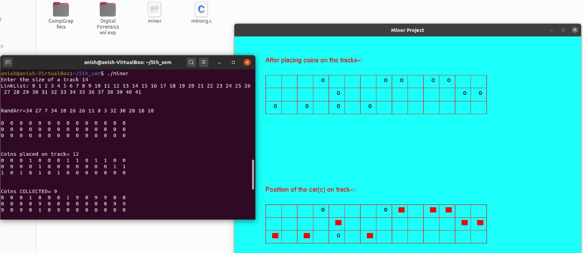
Output

Slide 12
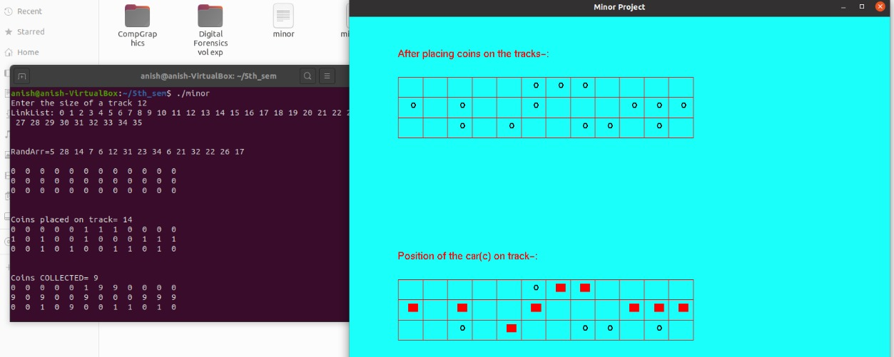
Output

Slide 13
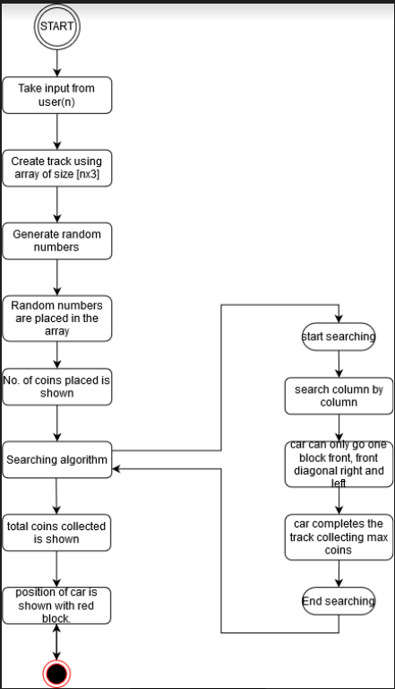
Activity Diagram

Slide 14
Applications
2D arrays, commonly known as, matrix, are used in image processing. Thus our algorithm can be used in image processing.
It can be used in speech processing, in which each speech signal is an array.
2D array are also used in representing the real-world data’s like the population of people, infant mortality rate, etc. Thus our algorithm can search the required data easily from 2D array.
Literally in every application of 2D array our algorithm can be used to search a required data from that array ex- Google map distance matrix, Image pixel matrix etc.
It can be used in many games which requires our character to collect some thing in between the path and completes the race. Ex- need for speed, temple run, subway surfer, asphalt etc.

Slide 15
Conclusion
Placed coins at the 3 different tracks at different randomly generated blocks.
Car identifies the position of the coins on the roads and changes path according to the number of coins that can be collected.
Car can only switch one time from one track to another in a column.
Showed the path on terminal as well as in GUI on which car is running so that user can identify the path taken.
Showed that car always selects the path which has maximum coins.
Car always finishes the track having maximum coins collected.

Slide 16
What we have learnt?
Made a full fledged game with the algorithm that can be used in other games and also in many other technology fields.
Wrote approx. 350+ lines of code
Learnt many things in this project like function implementation, Linked list implementation , handling of Pointers , 2Darray implementation, use of rand() function , use of abs() function , implementation of opengl, Designing and analysis of algorithm, use of Glut library to make the GUI etc.
Automated every thing using coding skills and mathematical skills.
Learnt project management and time management skills.

Slide 17
References
[1] https://www.programiz.com/c-programming/c-multi-dimensional-arrays
[Accessed: 25th Aug, 2020]
[2] https://www.edureka.co/blog/linked-list-in-c/
[Accessed: 25th Aug, 2020]
[3] https://www.techonthenet.com/c_language/standard_library_functions/stdlib_h/rand.php
[Accessed: 25th Aug, 2020]
[4]https://www.cs.cmu.edu/~ab/15-123S09/lectures/Lecture%2010%20-
%20%20Linked%20List%20Operations.pdf
[Accessed: 27th Aug, 2020]
[5] https://www.geeksforgeeks.org/multidimensional-arrays-c-cpp/
[Accessed: 28th Aug, 2020]
[6] https://www.geeksforgeeks.org/linked-list-set-1-introduction/
[Accessed: 28th Aug,2020]
[7] https://www.geeksforgeeks.org/linked-list-set-2-inserting-a-node/?ref=lbp
[Accessed: 28th Aug, 2020]
[8] https://www.geeksforgeeks.org/linked-list-set-3-deleting-node/?ref=lbp
[Accessed: 28th Aug, 2020]
[9] https://www.geeksforgeeks.org/rand-and-srand-in-ccpp/
[Accessed: 29th Aug, 2020]
[10]https://www.semanticscholar.org/paper/An-introduction-to-Linked-List-Dalal-Atri/d065c9c8bbd724d713e2b5075d85865b9905c835
[Accessed: 29th Aug, 2020]
https://www.khronos.org/registry/OpenGL-Refpages/gl2.1/xhtml/

Slide 18

Minor 1 Presentation
Project Title: Greedy Car
Submitted By: Anish Bansal

