Slide 1
1. Business Case
In Canada, around 58% of households report that they own at least a cat or a dog, and they are in a constant need to visit the Pet clinic for their pet’s health-checkup. Pet-owners, amidst their busy schedule, await a website that can assist them in addressing their pet’s well-being requirements.
Currently, pet-owners do not have any centralized repository to store their pet’s health statistics. Maintenance of these records would open a plethora of opportunities for business as we can automate certain processes that expedite an animal’s treatment.
These records can be shared globally, helping veterinarians around the world to diagnose diseases based on the similarity of symptoms found in the same breeds in another part of the world.

Slide 2
1. Business Case (cont’d)
Pet-owners are dependent on calls from the veterinary clinic to schedule timely appointments that match their routine and visit in person to get their pets examined. There is no provision to avail these services from home.
Even after scheduling an appointment, owners might forget to update their schedule and visit the clinic on time. This could play a big role in ensuring timely treatment for the animals.
Vets currently have to spend a lot of time submitting reports for the animals they examine. Automating the process with a built-in template will maximize the time-utilization and efficiency of the clinic.
In this situation, intelligent agents have a great potential in helping the owners get timely appointments and prevent deprivation of proper care and diagnosis for their pets.

Slide 3
2. System Description
The proposed E-Vet System(EVS) is a multi-agent system designed to render multiple functionalities to simplify the appointment booking process to the pet-owner(user) based on the owner’s preferences.
The clinic package is composed of a Video Interaction system, a Reminder generator, and a utility to generate medical reports.
The EVS application deals with a doctor’s multiple available schedules to find the optimum appointment window for the pet-owner, taking into consideration the related fees and severity of the symptoms.
The application has to schedule the appointment and send regular reminders for the appointment dates to the pet-owner. It also generates a medical report based upon the doctor’s feedback and stores it for future references.

Slide 4
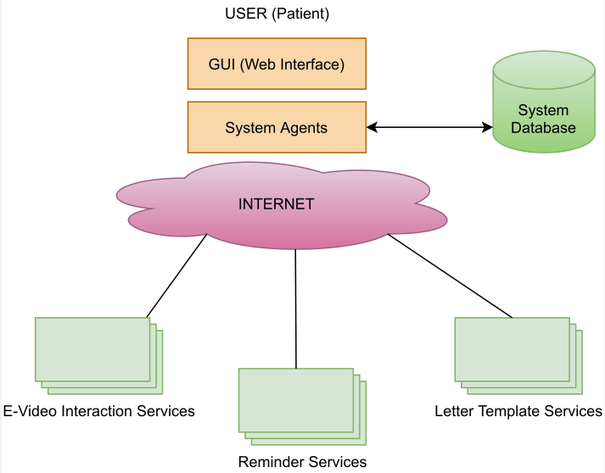
System Description (cont’d)

Slide 5
3. Assumptions
To enable video interaction between the doctor and the patient, the system will use existing video conferencing platforms (ZOOM/ Google Meet, etc.)
The user schedules their appointment using a web interface. The interface captures the user preferences and updates the available time slots in real time.

Slide 6
4. Requirements
The Video Enabled e-Vet System shall provide a web interface allowing the clients to login and register themselves.
It shall allow patients to schedule their appointments.
It shall record patient’s profile in a database and display it based on their name/id.
It shall remind patients of their appointments.
It shall send an appointment confirmation to the patient, including an invitation to the scheduled video enabled meeting
It shall provide multiple printable letter templates to doctors

Slide 7
5. Wish List (Not Implemented)
The e-vet system can send a recommendation letter to specialists on behalf of doctors.
The system should offer multiple payment options.
The system should have a mechanism to reply to instant scientific questions to physicians (similar to an encyclopedia).
The system can search in the ontology for relevant documents.
Doctors can also register themselves on the portal, giving the client freedom to choose their doctor(s).
Recording patient feedback on the doctor and doctor feedback on the patient.
E-pharmacy: customers can purchase medicines and other essentials through the portal and get them delivered to their homes.
Patients can complete a lab requisition through the portal.
Patients can communicate with the doctor via text messaging.
The system should display desired graphs and statistics based on a patient’s profile.

Slide 8
Agent Description
Clinic System Agent
The clinic system agent accesses the request sent by the patient(user) through the web interface. In our Architecture the clinic system agent handles the correspondence with all the other agents(as a mediator) and in this way, which acts as a central hub.
The clinic system agent is the main agent which has access to the database of our system.
The clinic system agent requests appointments for the patients, search for the patient’s profile in database, shows the profile of patients to the doctor (if available!). Moreover, the clinic system agent also shows the profile of the doctor to the patients.
The clinic system agent also generates a request for the appointment agent to book an appointment whether it’s a first or a consecutive appointment. It also helps to update and cancel an appointment.
The clinic system agent also triggers the Notification agent to remind the patient about the appointments at some given times.
The clinic system agent also requests template(PDF) agent to generate the required template once the physician had completed the session with the patient.

Slide 9
Agent Description (cont’d)
Appointment Agent
The appointment agent communicates with the clinic system agent to book an appointment for the patient. The clinic agent system searches the database and give the required details regarding the available slots to the appointment agent.
The appointment agent can be a new appointment for those patients who registers for the first time.
Not only for the first time, but the appointment agent will also book appointments for the patients who visits again.
The appointment agent will also interact with the notification agent to signal the sending of SMS and Email notifying the pet-owner.
This agent communicates with the video agent to share a video link for use during the online consultation.

Slide 10
Agent Description (cont’d)
Reminder(Notification) Agent
The Notification Agent communicates with the Clinic Agent at the time of booking an appointment, the Reminder Agent would be sending automated SMS messages and E-mail notifications to the user on his/her registered e-mail account and mobile number.
Instead of a receptionist logging in every time to trigger a reminder, the Agent by itself sends the message at regular intervals as chosen by the user.
In case the appointment is cancelled or updated, the Reminder Agent also intelligently updates the text message and sends an updated notification to the user.
Once the appointment is complete, the Reminder Agent directly accesses the database to update the alerting mechanism for that particular appointment.
In order to check if the registered email/phone number is valid, the Reminder Agent will trigger an acknowledgement message at the time of booking the appointment. Subsequently, the other reminder messages will be forwarded in due course.
The Agent also triggers a notification once the report has been generated, based upon the feedback from the veterinarian. In this case, it will await signal from the Template Agent.

Slide 11
Agent Description (cont’d)
Template(PDF) Agent
The Template Agent provides the doctor with letter reports. Depending upon the video interaction between the doctor and the patient, the doctor can select and use the in-built template to document their diagnosis.
The Template Agent communicates with the Clinic System Agent after the video interaction between the client and doctor is complete.
If the Template Agent receives a request from the Clinic System Agent, the doctor is requested to input their feedback through mail.
A medical report is generated based on the doctor’s feedback and sent to the Clinic System Agent, which presents it to the user.

Slide 12
Agent Description (cont’d)
VideoLink Agent
The video agent is responsible to generate a video link at the time of the appointment of the patient and send it to the registered email id as well as the registered mobile number of the patient.
The video agent directly communicates with the clinic system agent and creates the links according to the time slots selected by the patients.
To facilitate the video-based interaction between the doctor and patient, the system will use existing ZOOM video conferencing platforms.
Patients will be able to join the meeting at their scheduled appointment time and the link will expire in 30 minutes which is the maximum time for consultation.
If the consultation needs more time than 30 minutes then the patient will have to make another appointment with the clinic in order to continue it.

Slide 13
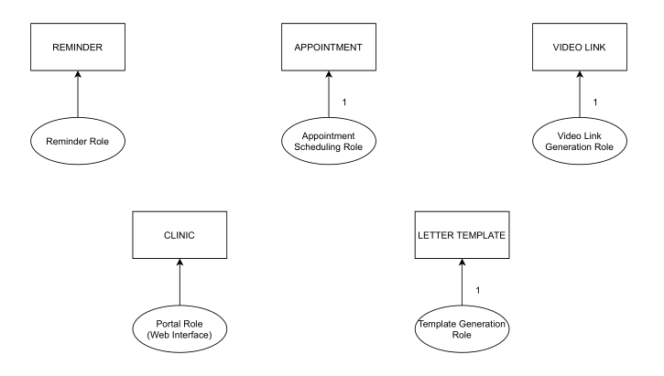
6. Design: Agent Model

Slide 14
7. Design: Service Model
Service | Input | Output | Pre – Conditions | Post Conditions
E-Video Interaction | Appointment Schedule | Link for Video Interaction | Successful connection to ZOOM/GOOGLE API | Steady connection during the meeting
Reminder | Appointment Schedule | Notifications | User email-id and mobile number required
Template | Doctor’s Feedback | Report in a PDF format | Successful completion of video interaction

Slide 15
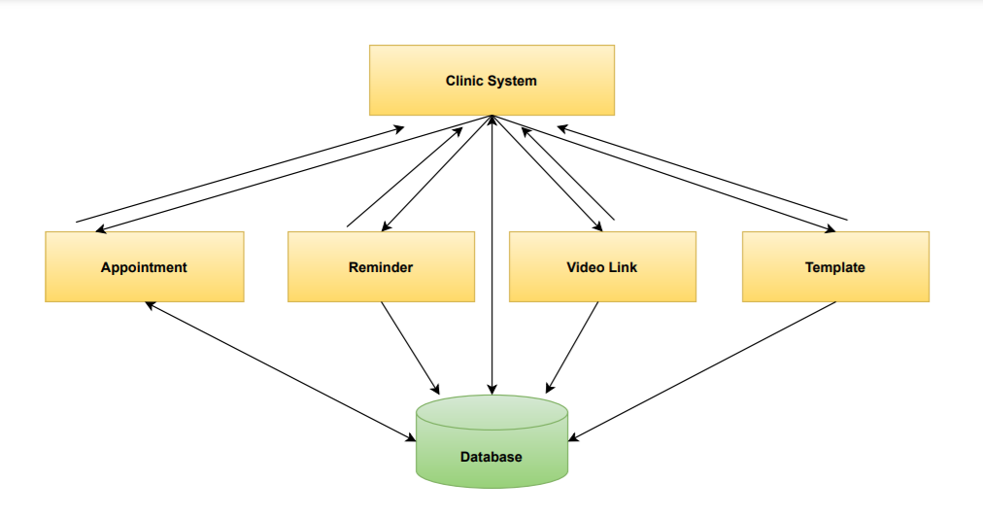
8. Design: Acquaintance Model

Slide 16
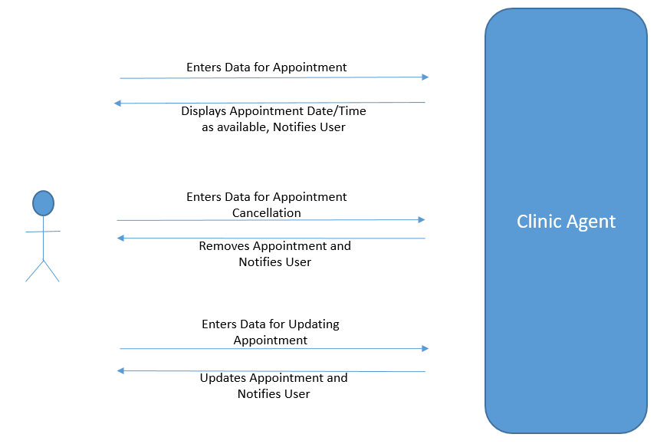
9. Use Cases : Clinic Agent

Slide 17
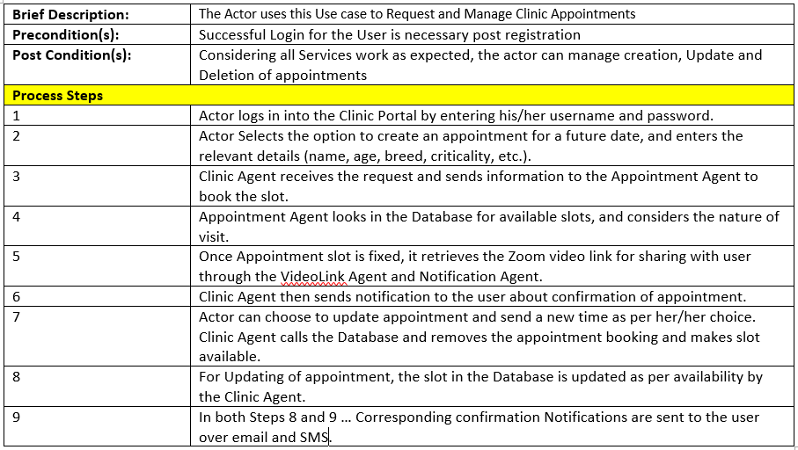
Use Case Definition : Clinic Agent

Slide 18
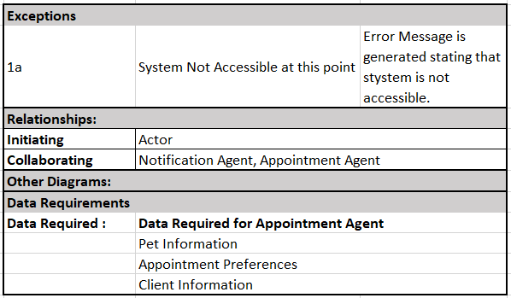
Use Case Definition : Clinic Agent

Slide 19
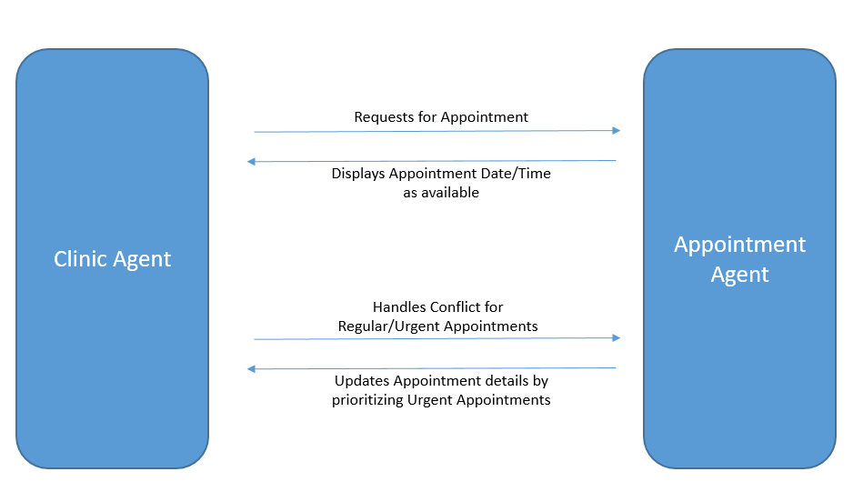
9. Use Cases : Appointment Agent

Slide 20
Use Case Definition : Appointment Agent
Brief Description: | The Clinic System uses this Use case to schedule appointment for the user
Precondition(s): | User is registered and has requested for an appointment
Post Condition(s): | Considering all Services work as expected, the appointment agent can display, update, and prioritize appointments
Process Steps
1 | The Appointment agent receives relevant user information from the clinic system agent
2 | The Appointment Agent looks in the database for available slots and considers the nature of visit to allot a time slot to the user.
3 | Information about the allotted time slot of the user is sent to the clinic system agent to display it to the user.
4 | The appointment system agent updates the appointment details by in a case when an appointment is cancelled or needs to be prioritized.

Slide 21
Use Case Definition : Appointment Agent

Slide 22
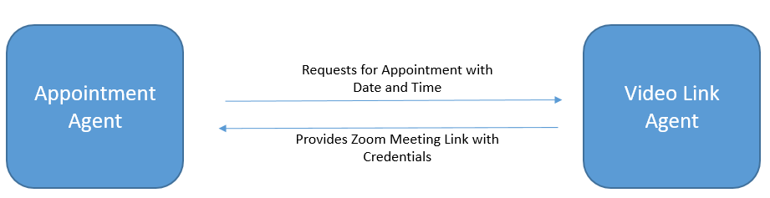
10. Use Cases : Video Link Agent

Slide 23
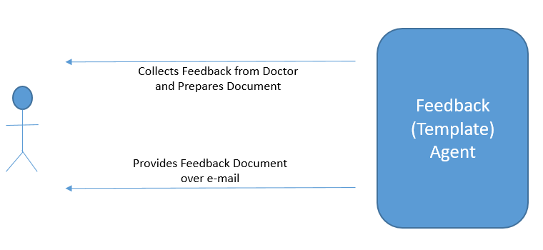
11. Use Cases : PDF(Template) Agent

Slide 24
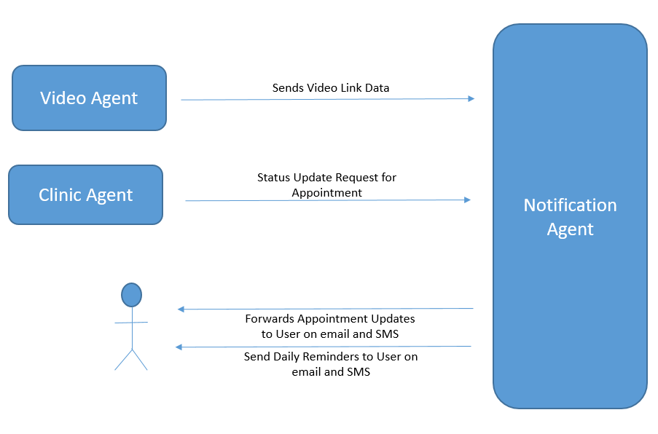
11. Use Cases : Notification Agent

Slide 25
Use Case Definition : Notification Agent
Brief Description: | The Notification Agent uses this use case to send notifications to the user
Precondition(s): | Appointment is booked and a video link has been generated
Post Condition(s): | Considering all Services work as expected, the notification agent sends appointment updates to user via email and/or SMS
Process Steps
1 | The notification agent receives user information (email-address and cell phone number) from the clinic system agent
2 | The notification agent also receives video link information from the video agent
3 | The notification agent receives status update request from the clinic system agent at regular intervals
4 | The notification agent sends out notification to the user in form of updates and daily remainders

Slide 26
Use Case Definition : Notification Agent
Exceptions
1a | System Not Accessible at this point | Error Message is generated stating that stystem is not accessible.
3a | User not reachable at this point | Error Message is generated stating that user is not reachable.
Relationships:
Initiating | Clinic System Agent
Collaborating | Video Link Agent, Clinic System Agent
Other Diagrams:
Data Requirements
Data Required : | Data Required for Notification Agent
 | Video Link
 | Email Address and Cell Phone Number of the user
 | Booked Appointment details

Slide 27
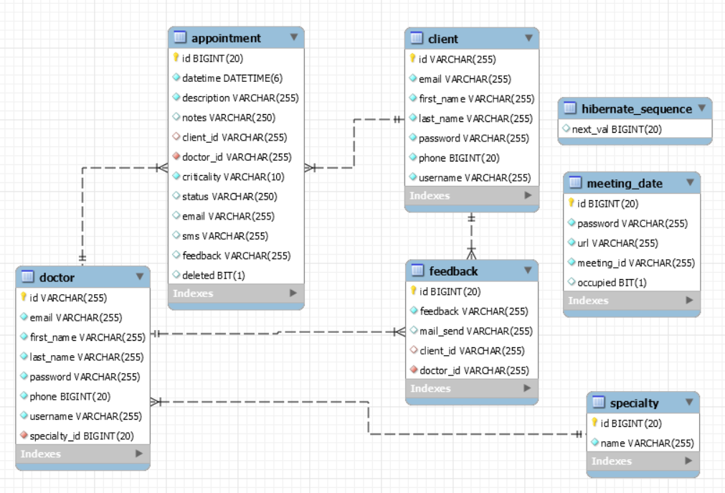
Data Specification : E-R Diagram

Slide 28
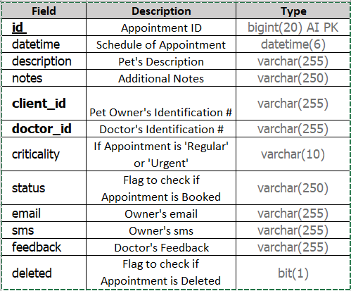
Typical Data Definition
Appointment: The appointment details(including Pet’s Symptoms and other client details) are stored in this table. This table also contains the appointment specific information such as criticality and feedback details. The table is used to keep track of the owner’s email, phone number and appointment status as well.

Slide 29
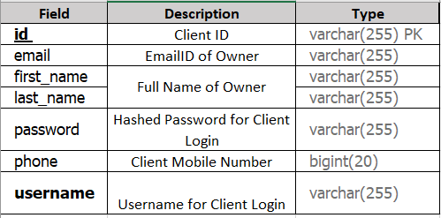
Typical Data Definition(contd.)
Client: The client details(name, contact, username, password, etc.) are stored in this table. The table is used to keep track of the owner’s information and used to auto-populate the UI after he/she logs in.

Slide 30
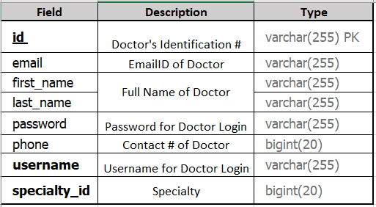
Typical Data Definition(contd.)
Doctor: The Doctor details(name, contact, specialty, username, password, etc.) are stored in this table. The table is used to keep track of the doctor’s information and used to auto-populate the UI after he/she logs in.

