Slide 1
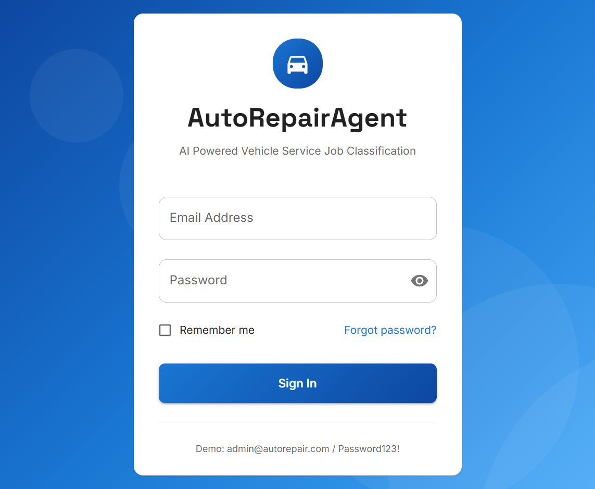
Auckland Institute of Studies | Trimester 2, 2026
AutoRepairAgent
AI-Powered Vehicle Repair Workshop
Management System
COMP902 — Advanced Information Technology Specialised Project
JWT authentication — role-based access
Student: [Your Full Name]
Student ID: [Your Student ID]
Supervisor: [Supervisor Name]
Due: 5 p.m. Wednesday 12th August 2026

Slide 2
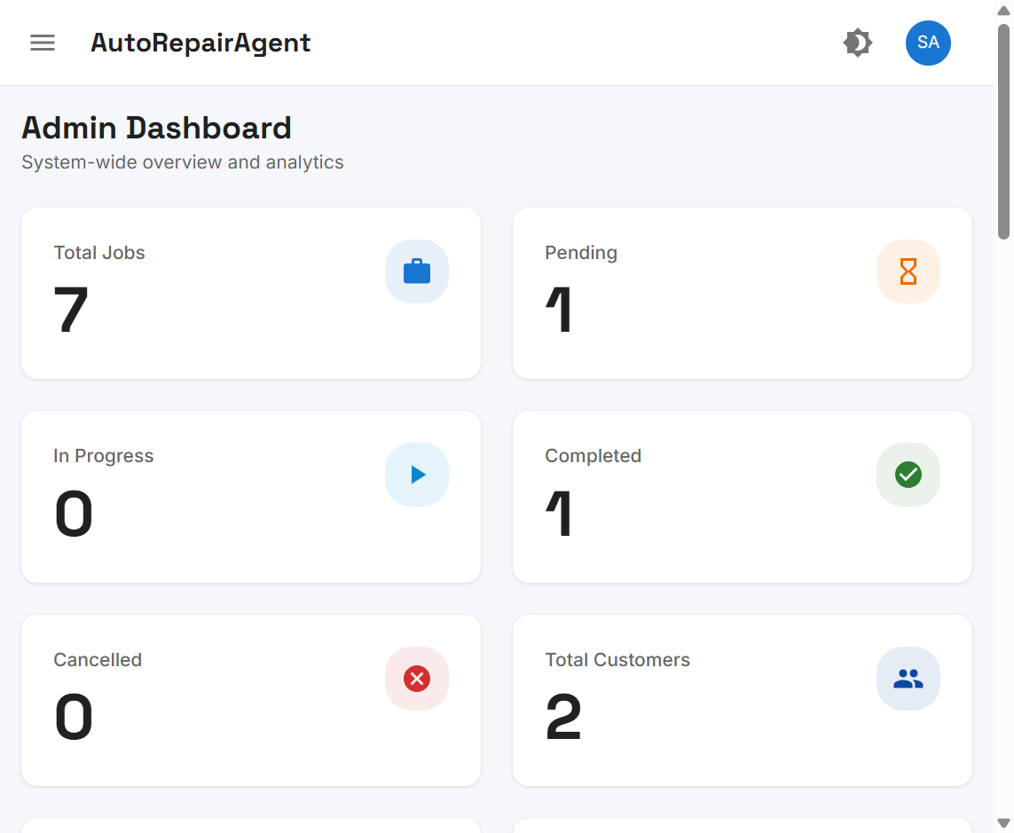
Presentation Structure
Aligned to COMP902 Final Report body sections
a
Introduction
Presentation Rubric Focus Areas:
✓ Clear purpose from the outset
✓ Logical sequence matching report body
✓ Professional visual aids (live UI screenshots)
✓ Prepared Q&A to stimulate discussion
Background, motivation, problem statement
b
Literature Review
WMS, AI/NLP, architecture, RBAC
c
Scope & Objectives
Phase 1 & 2 deliverables, boundaries
d
Methodology
Phased development, tech stack, verification
e
Results & Outcomes
UI modules, AI workflow, metrics
f
Discussion
Objective alignment, limitations, lessons
g
Conclusions & Future Work
Contributions, roadmap, Q&A
Live system — Admin KPI Dashboard
COMP902 — Advanced Information Technology Specialised Project | AutoRepairAgent Final Report | Slide 2 of 25

Slide 3
a
Introduction
Background, motivation & problem statement
COMP902 Final Report | AutoRepairAgent

Slide 4
a
Background & Motivation
Why AI-assisted workshop management matters
Vehicle repair workshops rely on manual triage and paper job cards
Inconsistent routing delays repairs and reduces transparency
Staff coordinate via phone — limited audit trail for decisions
Motivation:
• Operational — faster complaint-to-department classification
• Academic — Master's-level full-stack + AI integration
• Technical — Clean Architecture with LLM-assisted triage
Secure login — gateway to role-based system
COMP902 — Advanced Information Technology Specialised Project | AutoRepairAgent Final Report | Slide 4 of 25

Slide 5
a
Problem Statement
Four core challenges addressed by AutoRepairAgent
1
Manual complaint triage
Unstructured descriptions cause misrouting between departments
2
No AI audit trail
Classification decisions not logged or explainable
3
Fragmented access control
Eight roles need least-privilege data visibility
4
No end-to-end digital workflow
Customer → vehicle → job → completion not integrated
COMP902 — Advanced Information Technology Specialised Project | AutoRepairAgent Final Report | Slide 5 of 25

Slide 6
b
Critical Literature Review
Positioning the project in academic & industry context
COMP902 Final Report | AutoRepairAgent

Slide 7
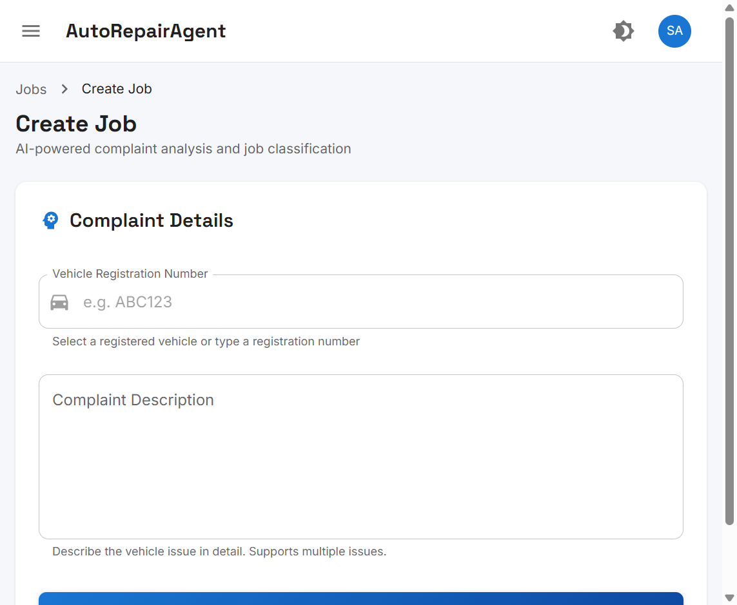
b
Literature Review — Key Themes
Five domains reviewed; research gap identified
Workshop Management Systems — digitise intake, scheduling, job tracking
AI/NLP in Service Triage — LLM complaint parsing (Amershi et al., 2019)
REST + SPA Architecture — Fielding (2000); Newman (2021)
Clean Architecture — maintainable separation of concerns (Martin, 2017)
RBAC Security — least-privilege access (Sandhu & Samarati, 1994)
Research Gap:
Affordable AI-integrated WMS
for small/medium workshops
lacking enterprise ERP budgets
6 academic references cited
(APA 7th edition)
AI complaint classification — DeepSeek integration
COMP902 — Advanced Information Technology Specialised Project | AutoRepairAgent Final Report | Slide 7 of 25

Slide 8
c
Scope & Objectives
Project goals, success criteria & boundaries
COMP902 Final Report | AutoRepairAgent

Slide 9
c
Project Objectives
Six specific objectives — core items achieved
O1
Authentication & RBAC
O2
Admin foundation
JWT + 8 roles, protected routes
Users, departments, dashboards
O3
Customer & vehicle CRUD
O4
AI job classification
Linked records for job creation
DeepSeek + keyword fallback
O5
Job lifecycle
O6
AI audit logging
Create, assign, track, complete
Confidence scores & explanations
COMP902 — Advanced Information Technology Specialised Project | AutoRepairAgent Final Report | Slide 9 of 25

Slide 10
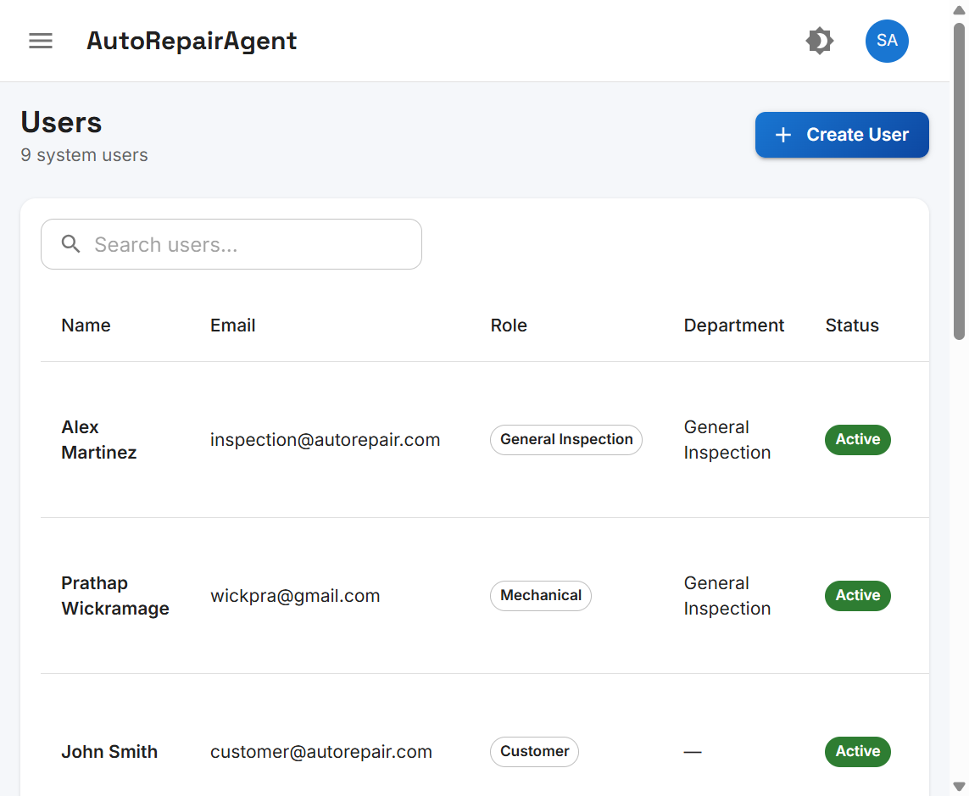
c
Project Scope
In scope vs deferred — Master's-level boundaries
In Scope:
• Full-stack web app (React + Node.js + PostgreSQL)
• 34 REST API endpoints, 10 database tables
• AI complaint classification with audit trail
• Role-based dashboards for 4 user types
Out of Scope (Deferred):
• Production cloud deployment
• Sinhala/Tamil UI localisation
• Automated unit/E2E test suite
• Inventory, invoicing, SMS notifications
9 system users — RBAC role assignments
COMP902 — Advanced Information Technology Specialised Project | AutoRepairAgent Final Report | Slide 10 of 25

Slide 11
d
Methodology
Development approach, technology & verification
COMP902 Final Report | AutoRepairAgent

Slide 12
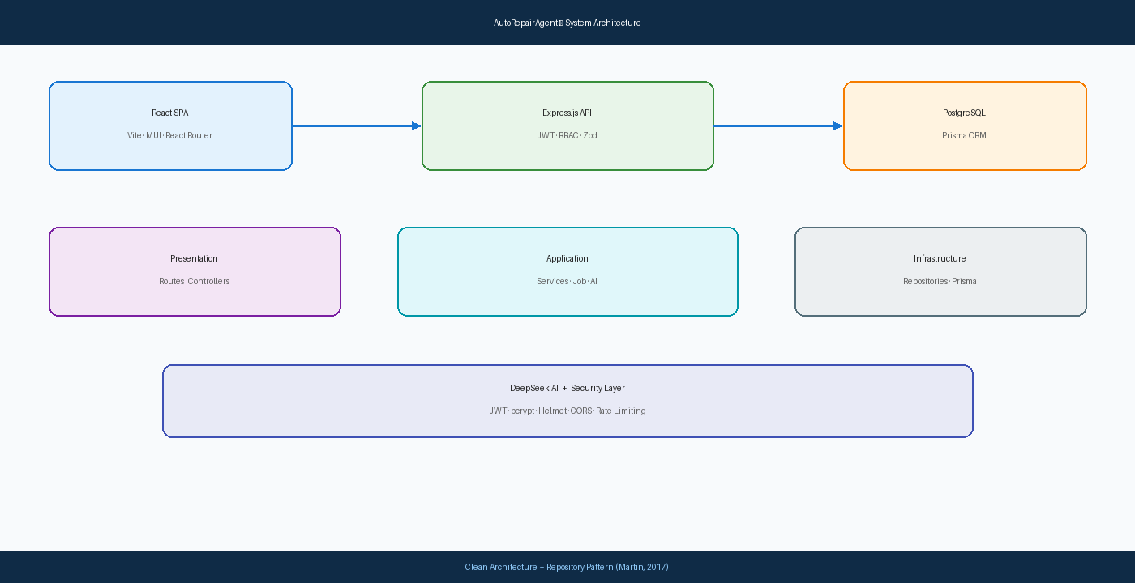
d
Development Methodology
Phased iterative — reproducible from description
Approach: Phased iterative across two progress reports
Phase 1 — Foundation:
Database, auth, admin, departments, UI design
Phase 2 — Business Modules:
Customers, vehicles, AI jobs, assignment, AI log
Verification:
Postman API tests, seed data, manual E2E workflow
Live UI screenshots captured from running system
Clean Architecture — three-tier design
COMP902 — Advanced Information Technology Specialised Project | AutoRepairAgent Final Report | Slide 12 of 25

Slide 13
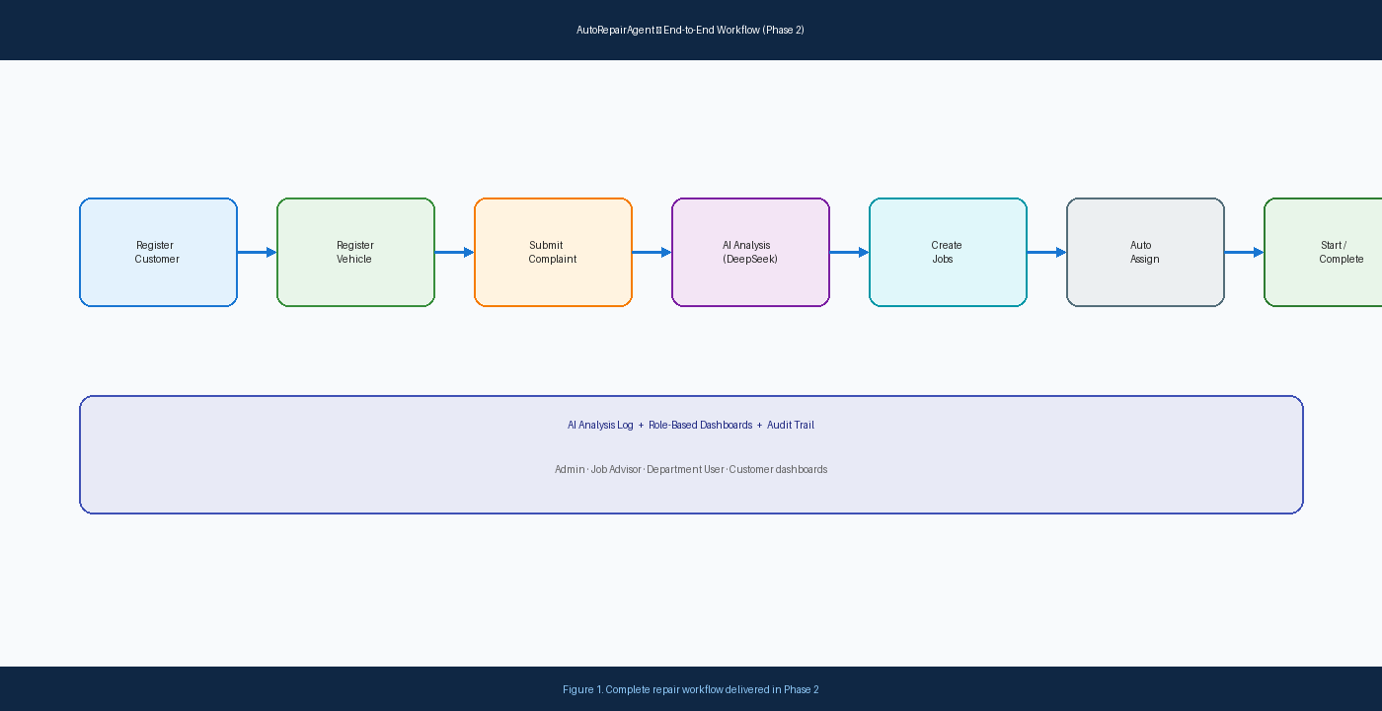
d
Technology Stack
Justified selections — full-stack monorepo
Frontend
React 18, Vite, MUI, React Router, Axios
Backend
Node.js Express, JWT + bcrypt, Zod validation
Database
PostgreSQL + Prisma ORM — 10 tables
AI
DeepSeek API with keyword fallback classifier
End-to-end workflow: complaint → AI → job → completion
Security
Helmet, CORS, rate limiting, RBAC middleware
Architecture
Clean Architecture + Repository pattern
COMP902 — Advanced Information Technology Specialised Project | AutoRepairAgent Final Report | Slide 13 of 25

Slide 14
e
Results & Outcomes
Clear, well-explained deliverables — 15 marks criterion
COMP902 Final Report | AutoRepairAgent

Slide 15
e
Results Overview — Key Metrics
All core objectives substantially achieved
34
10
8
API Endpoints
DB Tables
User Roles
5
7
15+
Departments
Test Jobs
UI Screens
Verification:
• Manual cross-role workflow testing
• Seed data: John Smith (ABC123), Maria Garcia (XYZ789)
• AI analysis log with confidence scores
Academic deliverables:
• ~20,000-word final report
• Progress Reports 1 & 2 with presentations
Admin Dashboard — 7 jobs, 2 customers tracked
COMP902 — Advanced Information Technology Specialised Project | AutoRepairAgent Final Report | Slide 15 of 25

Slide 16
e
Phase 1 — Foundation Results
Authentication, admin & user management
JWT Login — role-based authentication
User Management — 9 users, 8 roles
Admin Dashboard — system-wide KPIs
COMP902 — Advanced Information Technology Specialised Project | AutoRepairAgent Final Report | Slide 16 of 25

Slide 17
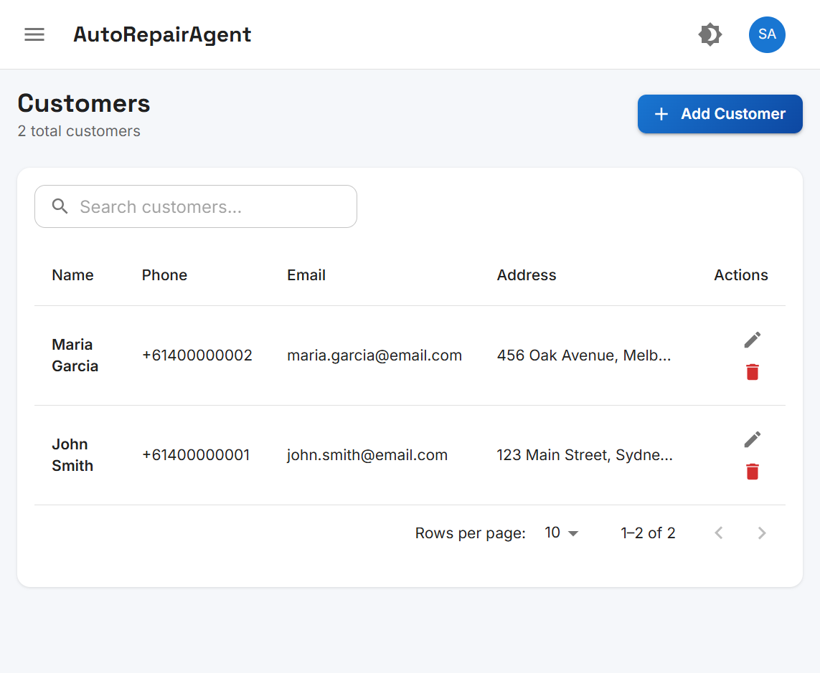
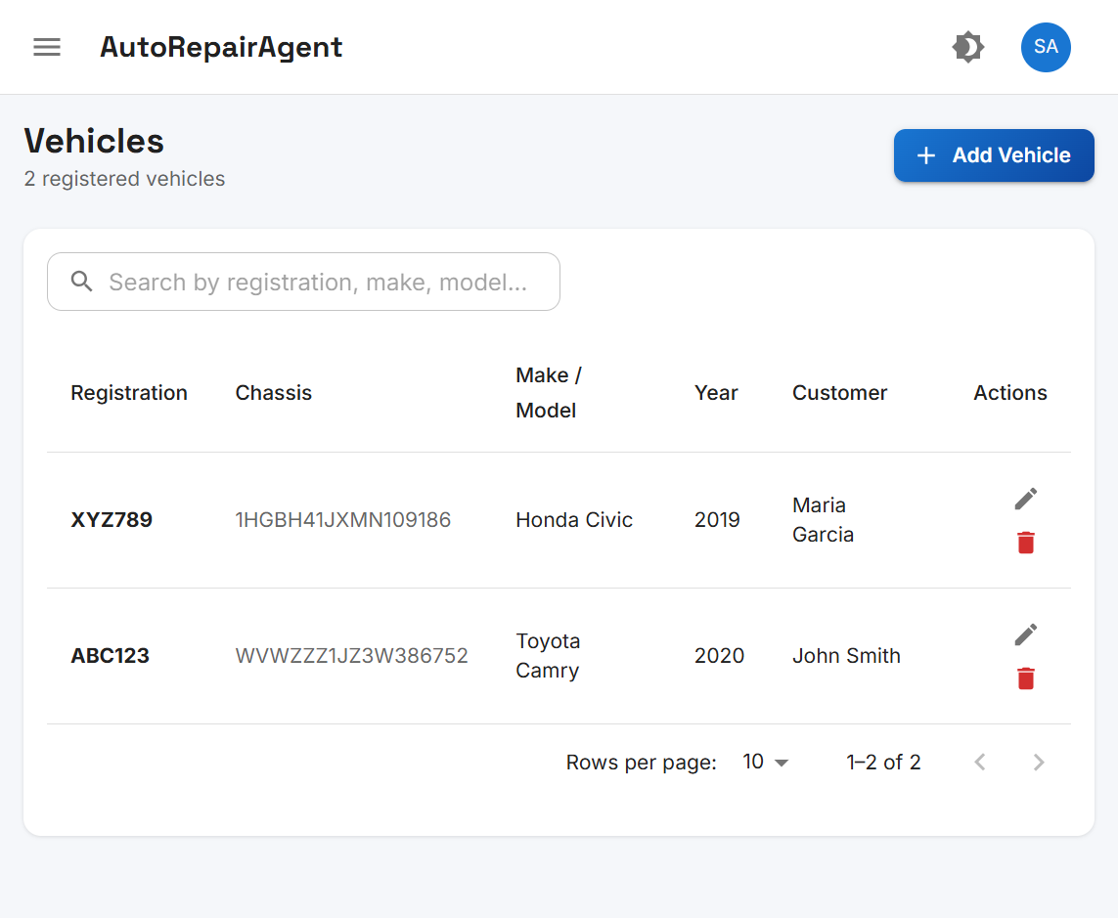
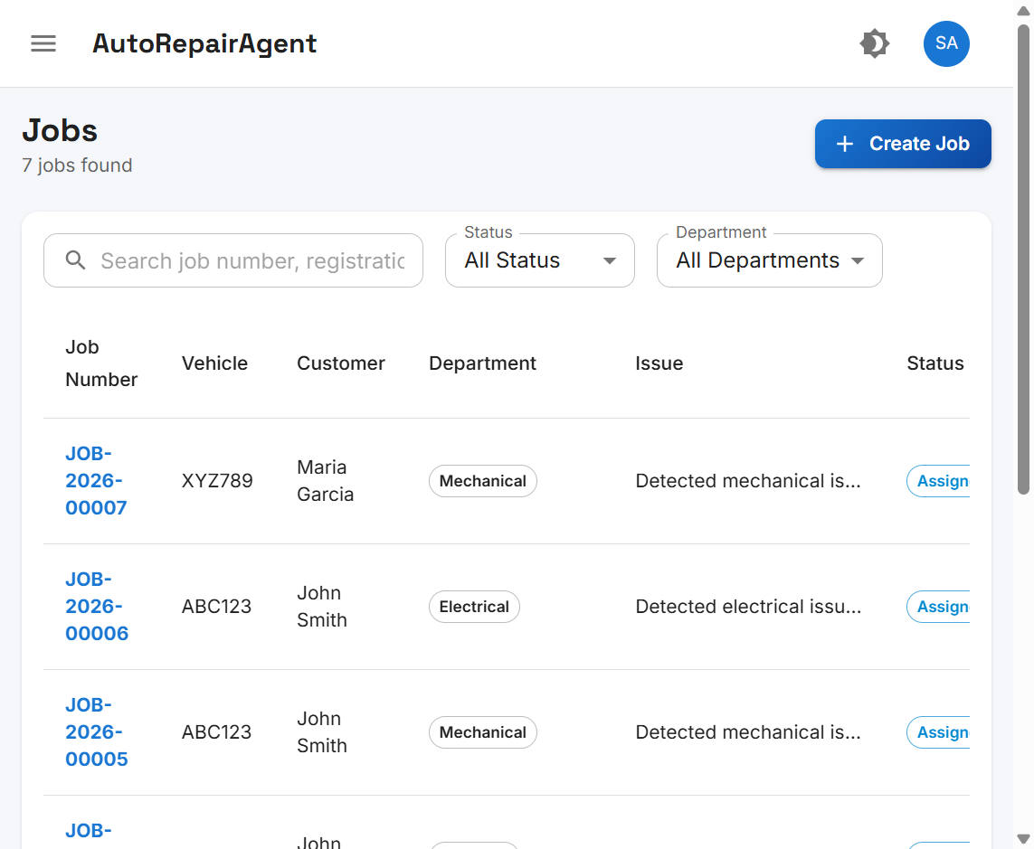
e
Phase 2 — Business Module Results
Customer, vehicle & job management
Customer CRUD — 2 registered customers
Vehicle Registration — linked to owners
Job List — department routing & assignment
COMP902 — Advanced Information Technology Specialised Project | AutoRepairAgent Final Report | Slide 17 of 25

Slide 18
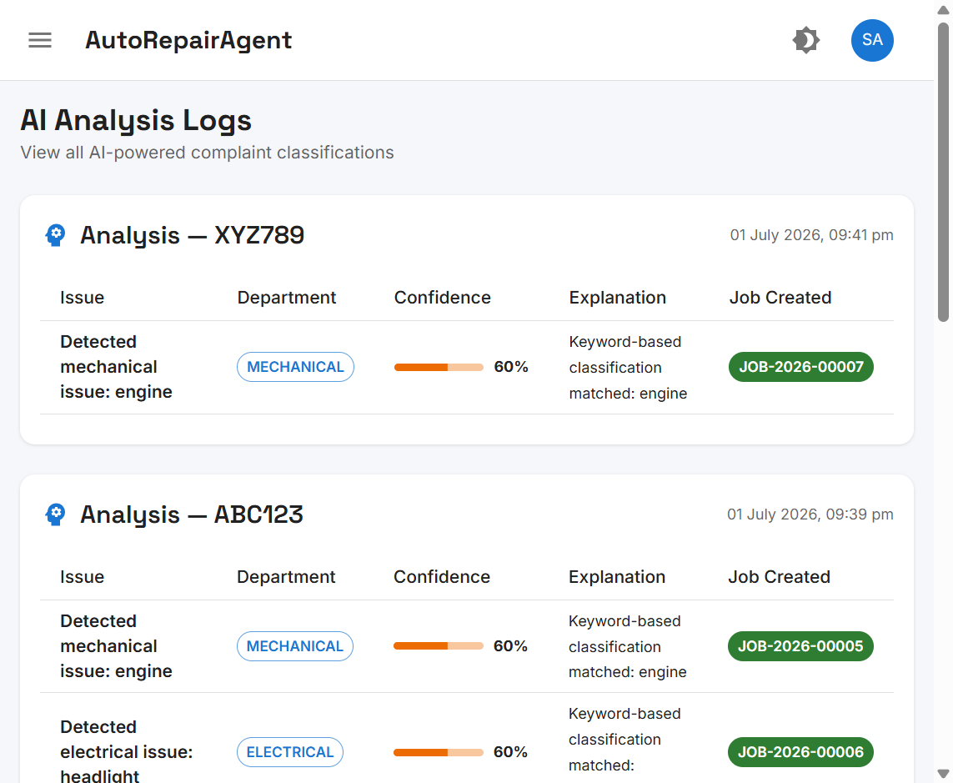
e
AI Integration — Results
DeepSeek classification with audit trail
Create Job — AI-powered complaint analysis
AI Analysis Log — confidence & explanations
POST /api/jobs/analyze — complaint + vehicle registration
DeepSeek returns: issues[], department, confidence, explanation
Fallback keyword classifier when API unavailable
Example: engine noise → Mechanical; headlight → Electrical
COMP902 — Advanced Information Technology Specialised Project | AutoRepairAgent Final Report | Slide 18 of 25

Slide 19
f
Discussion
Objective alignment, limitations & lessons learned
COMP902 Final Report | AutoRepairAgent

Slide 20
f
Discussion — Strengths & Limitations
Honest critical evaluation — criterion 9
Achievements:
• All six objectives O1–O6 substantially achieved
• Clean Architecture proved maintainable across phases
• RBAC correctly filters data by role
• AI audit trail supports accountability
Course experience:
• npm dependency conflicts during setup
• Prisma migration issues resolved iteratively
• DeepSeek API quota limitations encountered
L1
API dependence
AI accuracy tied to DeepSeek availability
L2
English-only fallback
Keyword classifier not multilingual
L3
No automated tests
Manual verification only
L4
Localhost only
Production deployment deferred
COMP902 — Advanced Information Technology Specialised Project | AutoRepairAgent Final Report | Slide 20 of 25

Slide 21
g
Conclusions & Future Work
Evidence-supported conclusions — criterion 10
COMP902 Final Report | AutoRepairAgent

Slide 22
g
Conclusions
Supported by evidence in Chapters 7 & 8
✓
AutoRepairAgent delivers a working AI-integrated workshop management prototype
✓
DeepSeek LLM + fallback classifier enables complaint-to-department routing
✓
Clean Architecture supports maintainable full-stack development
✓
RBAC enforces appropriate access across 8 workshop roles
✓
Limitations are material but do not negate core objective achievement
Evidence: AI audit trail with job linkage
✓
System is demonstrable and ready for pilot evaluation
COMP902 — Advanced Information Technology Specialised Project | AutoRepairAgent Final Report | Slide 22 of 25

Slide 23
g
Future Work Roadmap
Prioritised recommendations
F1
Cloud deployment
F2
Multilingual UI
Azure/AWS production hosting
Sinhala/Tamil localisation
F3
Automated testing
F4
SMS notifications
Jest + Playwright assertions
Job status alerts to customers
F5
Smart assignment
F6
Inventory module
Load-balanced technician routing
Parts tracking & invoicing
COMP902 — Advanced Information Technology Specialised Project | AutoRepairAgent Final Report | Slide 23 of 25

Slide 24
Questions for Discussion
Prepared to stimulate examiner discussion — Rubric criterion
Q1
How does DeepSeek compare to rule-based triage for workshop accuracy?
Q2
What automated tests would you prioritise before production deployment?
Q3
How should the system handle multilingual complaints in NZ workshops?
Q4
What privacy disclosures are needed for third-party AI processing?
Q5
How would you scale technician assignment beyond first-available routing?
Q6
What cloud architecture would you recommend for production deployment?
Rubric target: Excellent (4/4) — prepared questions that open technical discussion
COMP902 — Advanced Information Technology Specialised Project | AutoRepairAgent Final Report | Slide 24 of 25

Slide 25
Auckland Institute of Studies | Trimester 2, 2026
Thank You
Questions & Discussion Welcome
AutoRepairAgent
[Your Full Name] | [Your Student ID]
COMP902 Final Report | August 2026
6 References | ~20,000-word Report | Live UI Screenshots
AutoRepairAgent — Full System Delivery
COMP902 — Advanced Information Technology Specialised Project | Slide 25 of 25

