Slide 1
AutoRepairAgent
AI-Powered Vehicle Repair Workshop Management System
Final Presentation
[Student Name] | [Student ID] [Course / Programme] | [College Name] July 2026
AutoRepairAgent | Final Presentation
1

Slide 2
AR
Presentation Overview
AGENDA
25 Slides — Project Summary
Section | Topics
Introduction | Problem, objectives, technology stack
Architecture | Database, security, Clean Architecture
Implementation | Admin, customer, vehicle, AI modules
Demonstration | UI screenshots — 8 system screens
Results | Metrics, workflow, outcomes
Conclusion | Limitations, future work, references
AutoRepairAgent | Final Presentation
2

Slide 3
AR
Introduction
INTRO
Problem Statement & Motivation (Sommerville, 2016)
▸ Vehicle repair workshops rely on manual complaint triage and informal job routing.
▸ Misclassified jobs cause delays, rework, and poor customer visibility.
▸ AutoRepairAgent automates complaint intake using AI classification.
▸ DeepSeek LLM extracts issues and routes jobs to 5 specialist departments.
▸ Full-stack web system with 8 role-based user types and audit logging.
AutoRepairAgent | Final Presentation
Introduction
3

Slide 4
AR
Project Objectives
OBJECTIVES
All Objectives Achieved
Objective | Status
Database, authentication, admin modules (Phase 1) | Complete
Customer & vehicle management (Phase 2) | Complete
AI job creation & DeepSeek integration | Complete
Job assignment & lifecycle management | Complete
AI analysis log & role-based dashboards | Complete
Production deployment & multilingual UI | Deferred
AutoRepairAgent | Final Presentation
Introduction
4

Slide 5
AR
Technology Stack
TECH
Full-Stack Architecture (Martin, 2017)
Backend
Frontend
▸ Node.js + Express.js REST API
▸ PostgreSQL + Prisma ORM
▸ JWT + bcrypt authentication
▸ DeepSeek AI (LLM classification)
▸ Zod validation + Winston logging
▸ Clean Architecture
▸ React 18 + Vite SPA
▸ Material UI v5 components
▸ TanStack React Query
▸ React Router v6 + Axios
▸ React Hook Form + Zod
▸ Recharts dashboards
AutoRepairAgent | Final Presentation
Architecture
5

Slide 6
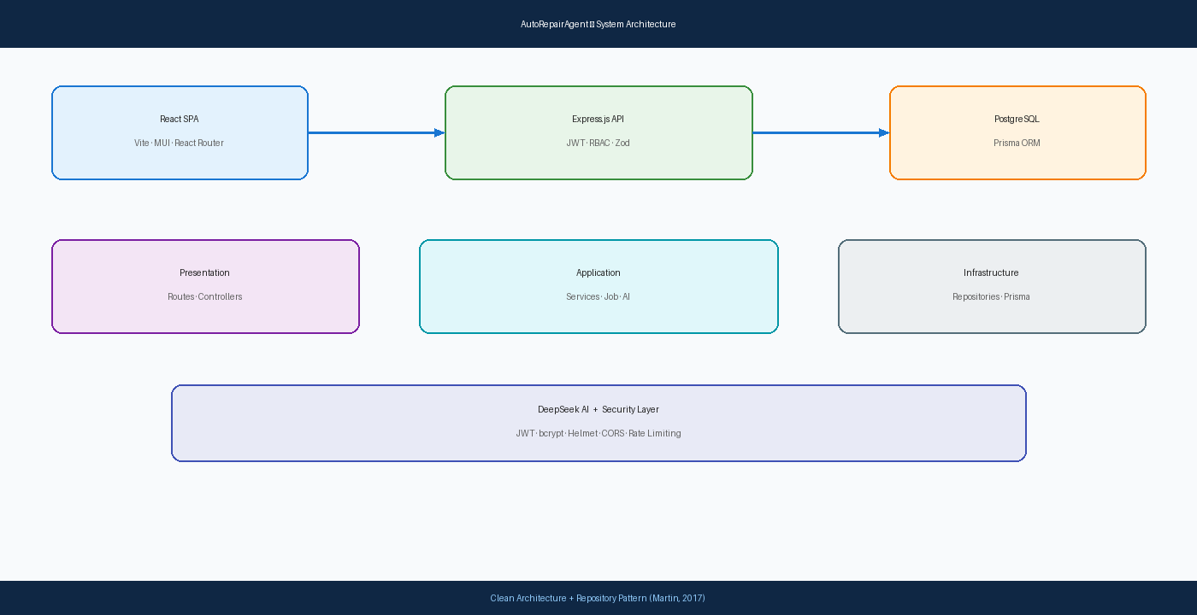
AR
System Architecture
ARCH
Three-Tier Design with Clean Architecture Layers
Figure 1. Presentation → Application → Infrastructure layers (Martin, 2017)
AutoRepairAgent | Final Presentation
Architecture
6

Slide 7
AR
Database Design
DB
PostgreSQL Schema — 10 Tables (Prisma Data, Inc., 2024)
▸ Core entities: Role, User, Department, Customer, Vehicle, Job
▸ Supporting: AIAnalysisLog, JobAssignment, JobComment, AuditLog
▸ Enums: RoleName (8 roles), JobStatus (5 states), AuditAction
▸ Foreign keys: Customer → Vehicle → Job → Department → User
▸ Audit columns: created_date, updated_date, created_by, updated_by
▸ Hosted on PostgreSQL (Neon cloud) with SSL connection
AutoRepairAgent | Final Presentation
Architecture
7

Slide 8
AR
Authentication & Security
SEC
JWT + RBAC (OWASP Foundation, 2021)
▸ POST /api/auth/login — JWT token with 24h expiry
▸ bcrypt password hashing (cost factor 12)
▸ 8 roles: Admin, Advisor, 5 Dept users, Customer
▸ Middleware chain: authenticate → RBAC → validate → handler
▸ Helmet headers, CORS, rate limiting (100 req/15 min)
▸ 34 REST API endpoints with role-based access control
AutoRepairAgent | Final Presentation
Architecture
8

Slide 9
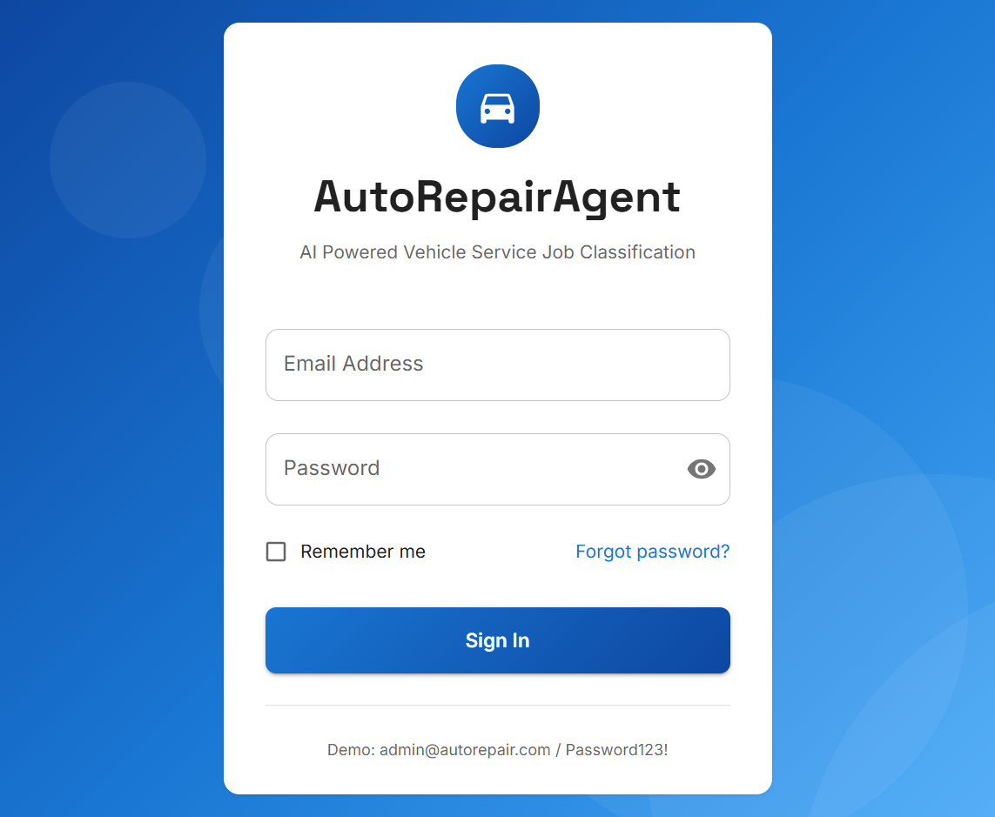
AR
Login Interface
UI
System Screenshot — Authentication
Figure 2. JWT-based login with role-based access
AutoRepairAgent | Final Presentation
Demonstration
9

Slide 10
AR
Admin Module
ADMIN
User & Department Management
▸ User CRUD: create, edit, activate/deactivate, role assignment
▸ Department CRUD: 5 default workshop departments seeded
▸ Roles: ADMIN, JOB_ADVISOR, MECHANICAL, ELECTRICAL, etc.
▸ REST API: /api/admin/users and /api/admin/departments
▸ Audit logging for all user management actions
AutoRepairAgent | Final Presentation
Implementation
10

Slide 11
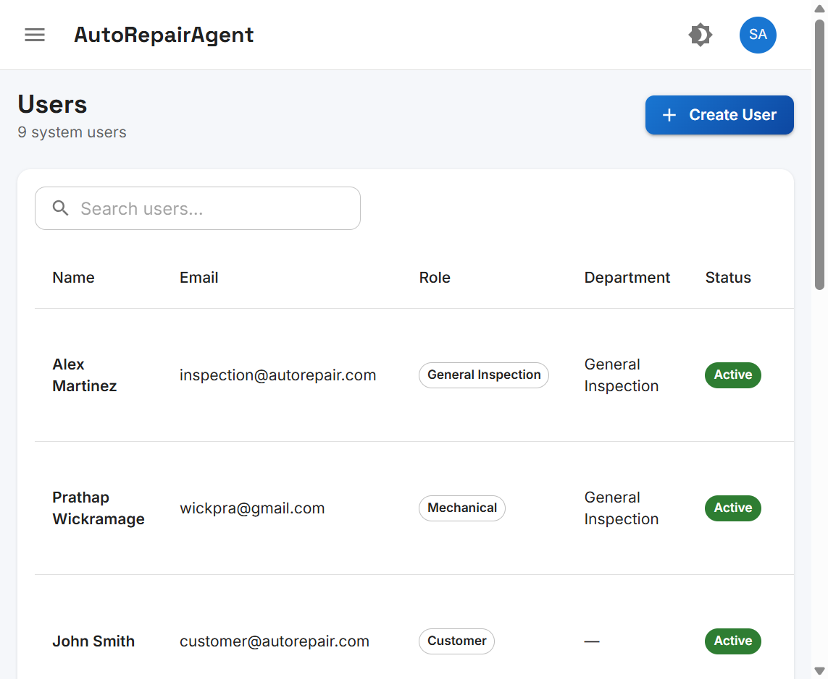
AR
User Management
UI
System Screenshot — Admin Users Page
Figure 3. User list with role, department, and status
AutoRepairAgent | Final Presentation
Demonstration
11

Slide 12
AR
Customer & Vehicle Modules
DATA
Workshop Data Management
Customers
Vehicles
▸ Customer CRUD — name, phone, email, address
▸ Linked to customer portal accounts
▸ REST: /api/customers (Admin + Advisor)
▸ Zod validation on all fields
▸ Vehicle CRUD — registration, make, model, year
▸ Unique registration number constraint
▸ Linked to customer via foreign key
▸ Required before AI job creation
AutoRepairAgent | Final Presentation
Implementation
12

Slide 13
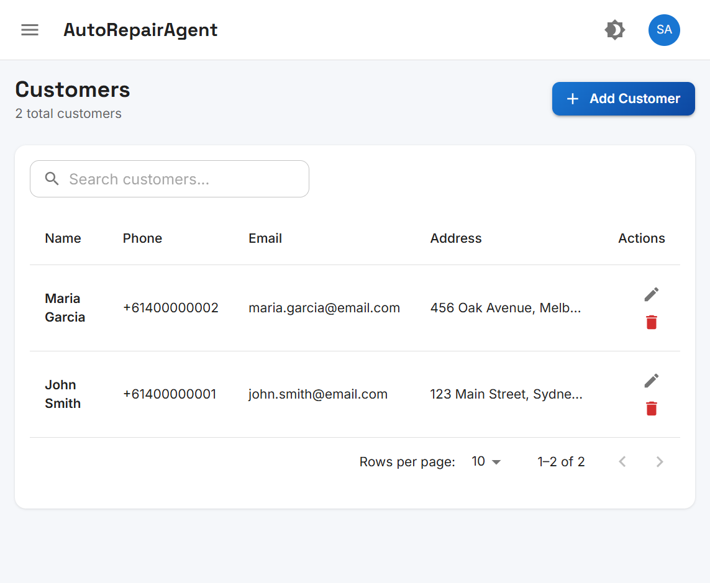
AR
Customer Management
UI
System Screenshot — Customers Page
Figure 4. Customer records with search and CRUD actions
AutoRepairAgent | Final Presentation
Demonstration
13

Slide 14
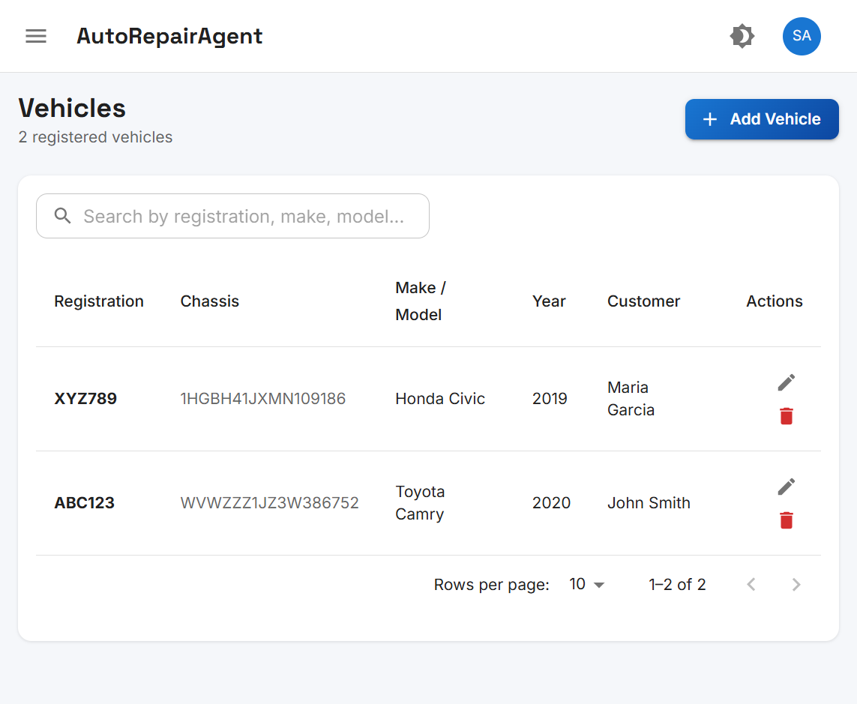
AR
Vehicle Registration
UI
System Screenshot — Vehicles Page
Figure 5. Vehicles ABC123 and XYZ789 linked to customers
AutoRepairAgent | Final Presentation
Demonstration
14

Slide 15
AR
AI Integration
AI
DeepSeek Complaint Classification (DeepSeek, 2024)
▸ POST /api/jobs/analyze — complaint text + vehicle registration
▸ DeepSeek Chat Completions API with structured JSON output
▸ Classifies into: Mechanical, Electrical, Body Repair, Paint, Inspection
▸ One job created per identified issue with confidence score
▸ Keyword fallback classifier when API unavailable (confidence 0.4–0.6)
▸ AI analysis stored in AIAnalysisLog for audit review
AutoRepairAgent | Final Presentation
Implementation
15

Slide 16
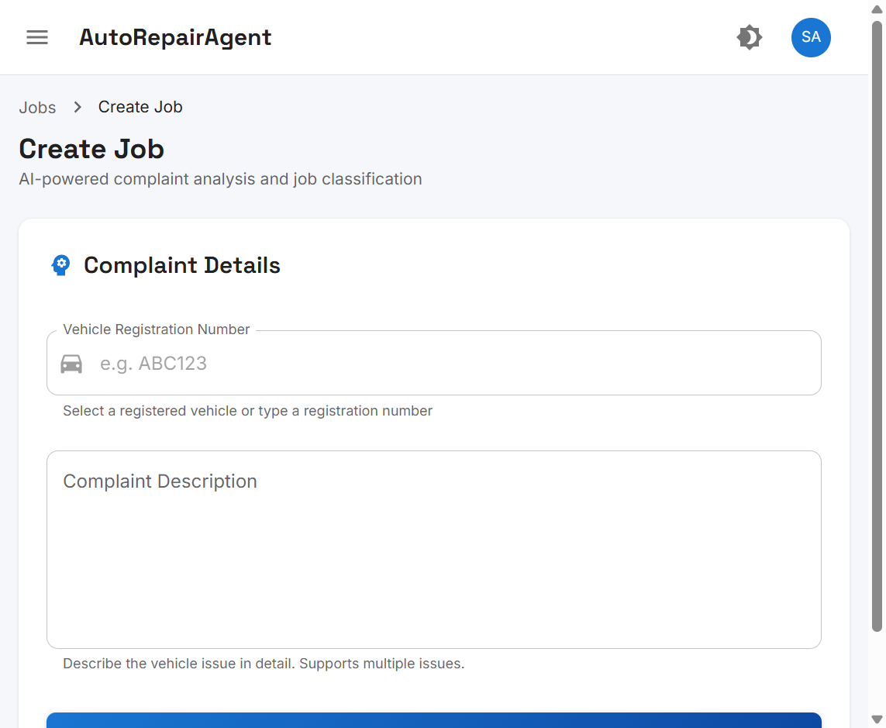
AR
AI Job Creation
UI
System Screenshot — Create Job Page
Figure 6. AI-powered complaint submission form
AutoRepairAgent | Final Presentation
Demonstration
16

Slide 17
AR
Job Lifecycle
JOBS
Assignment → Start → Complete Workflow
▸ Auto-assign to first active user in target department
▸ Status flow: PENDING → ASSIGNED → IN_PROGRESS → COMPLETED
▸ Department users: start and complete with comments
▸ Time tracking: timeTakenMinutes calculated on completion
▸ JobAdvisor/Admin: edit or delete before work starts
▸ Role-filtered job lists per department and customer
AutoRepairAgent | Final Presentation
Implementation
17

Slide 18
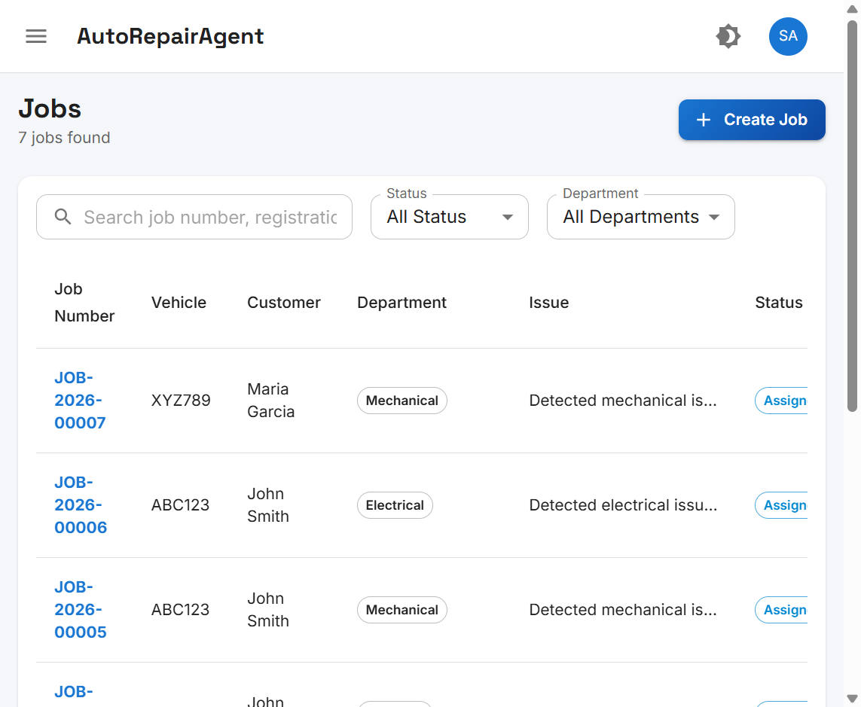
AR
Job Management
UI
System Screenshot — Jobs List
Figure 7. Jobs routed to Mechanical and Electrical departments
AutoRepairAgent | Final Presentation
Demonstration
18

Slide 19
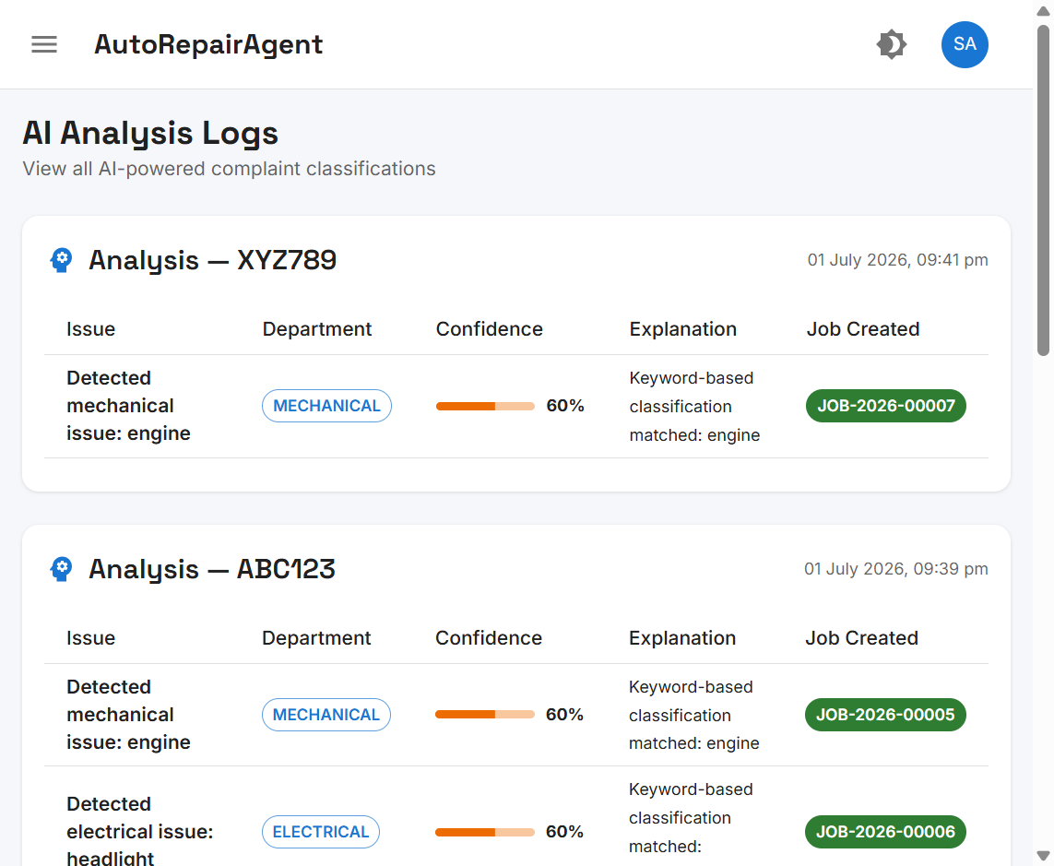
AR
AI Analysis Logs
UI
System Screenshot — AI Decision Audit Trail
Figure 8. AI classifications with confidence scores and created jobs
AutoRepairAgent | Final Presentation
Demonstration
19

Slide 20
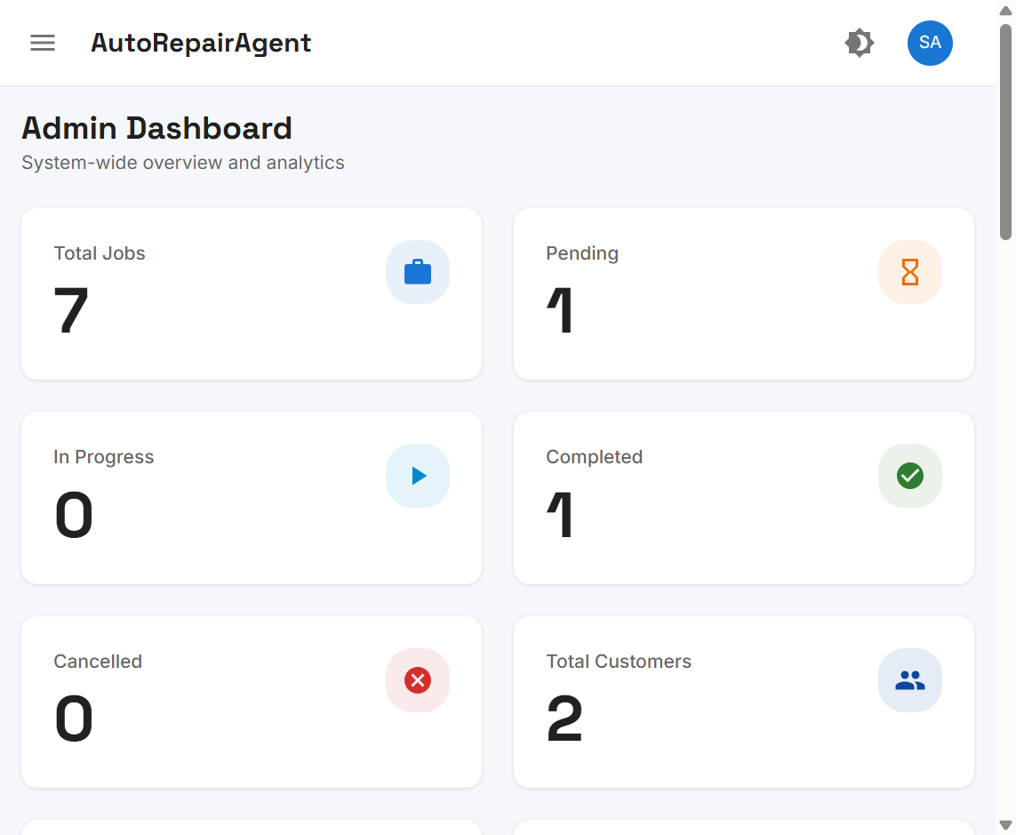
AR
Admin Dashboard
UI
System Screenshot — KPI Overview
Figure 9. Dashboard with job statistics and system metrics
AutoRepairAgent | Final Presentation
Demonstration
20

Slide 21
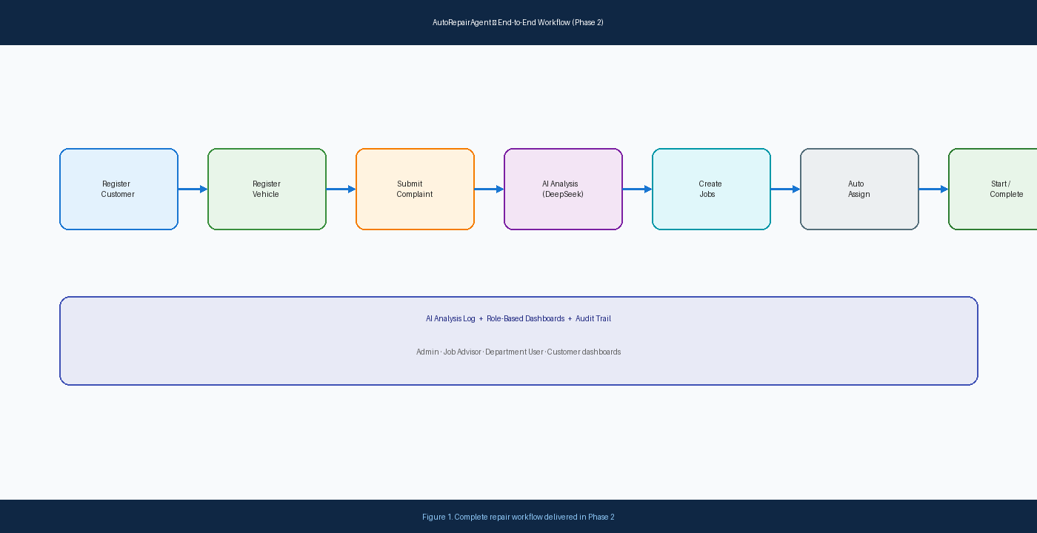
AR
End-to-End Workflow
FLOW
Complete Repair Process
Customer → Vehicle → Complaint → AI → Job → Assign → Complete
AutoRepairAgent | Final Presentation
Results
21

Slide 22
AR
Project Results
RESULTS
Quantitative Outcomes
Metric | Value
REST API endpoints | 34
Database tables | 10
User roles supported | 8
Workshop departments | 5
UI pages implemented | 15+
Development phases completed | 2
AutoRepairAgent | Final Presentation
Results
22

Slide 23
AR
Limitations & Future Work
FUTURE
Honest Assessment & Recommendations
Current Limitations
Future Work
▸ No production deployment yet
▸ No automated test suite
▸ English-only UI (no Sinhala/Tamil)
▸ Naive first-available assignment
▸ AI subscription dependency (DeepSeek quota)
▸ Cloud deployment (Docker, CI/CD)
▸ Sinhala & Tamil localisation
▸ SMS/email notifications
▸ Jest + Playwright test pipeline
▸ Load-balanced job assignment algorithm
AutoRepairAgent | Final Presentation
Conclusion
23

Slide 24
AR
Conclusions
DONE
Project Complete — Objectives Achieved
✔ ALL OBJECTIVES MET
▸ AutoRepairAgent delivers a working AI-powered workshop management system.
▸ End-to-end workflow verified: complaint → AI → multi-job → assign → complete.
▸ Clean Architecture enables maintainable, extensible codebase.
▸ Future work focuses on deployment, localisation, and automated testing.
▸ Thank you — Questions welcome.
AutoRepairAgent | Final Presentation
Conclusion
24

Slide 25
AR
References
REF
APA 7th Edition — 6 Key Sources
1. DeepSeek. (2024). DeepSeek API documentation. https://api-docs.deepseek.com
2. Martin, R. C. (2017). Clean architecture: A craftsman's guide to software structure and design. Prentice Hall.
3. Meta Platforms, Inc. (2024). React documentation. https://react.dev
4. OWASP Foundation. (2021). Authentication cheat sheet. https://cheatsheetseries.owasp.org/cheatsheets/Authentication_Cheat_Sheet.html
5. Prisma Data, Inc. (2024). Prisma ORM documentation. https://www.prisma.io/docs
6. Sommerville, I. (2016). Software engineering (10th ed.). Pearson.
AutoRepairAgent | Final Presentation
25

