Slide 1
AutoRepairAgent
AI-Powered Vehicle Repair Workshop Management System
Final Report Presentation
Based on Final Report — Master's Specialised Project
[Student Name] | [Student ID] [Course / Programme] | [College Name] July 2026
AutoRepairAgent | Final Report
1

Slide 2
AR
Presentation Agenda
AGENDA
Aligned with Final Report Chapters 1–8
Ch. | Final Report Section
1 | Introduction — background, problem, research questions
2 | Literature Review — WMS, AI/NLP, architecture, RBAC
3 | Objectives & Scope — Phase 1 & 2 deliverables
4 | Methodology — phased development, testing
5 | System Design & Implementation — architecture, modules
6 | Results & Outcomes — UI screenshots, workflow
7–8 | Discussion, Conclusions & Future Work
AutoRepairAgent | Final Report
2

Slide 3
AR
Chapter 1 — Introduction
CH 1
Background, Problem & Motivation (Sommerville, 2016)
▸ Vehicle repair workshops face manual triage and inconsistent job routing.
▸ Paper job cards and phone coordination limit visibility and auditability.
▸ AutoRepairAgent: AI-powered web system for complaint classification.
▸ Routes jobs to Mechanical, Electrical, Body Repair, Paint, Inspection.
▸ Significance: reduces misclassification delay and improves transparency.
AutoRepairAgent | Final Report
Introduction
3

Slide 4
AR
Research Questions
CH 1
Chapter 1.4 — Guiding Questions
▸ RQ1: Can LLM-based AI classify multilingual vehicle complaints into departments?
▸ RQ2: Can Clean Architecture support maintainable full-stack development?
▸ RQ3: Does RBAC enforce appropriate access across 8 workshop roles?
▸ RQ4: Can the system deliver end-to-end workflow from complaint to completion?
AutoRepairAgent | Final Report
Introduction
4

Slide 5
AR
Chapter 2 — Literature Review
CH 2
Key Themes from Final Report
Domain Literature
Technical Literature
▸ Workshop Management Systems (WMS) digitise intake & scheduling
▸ AI/NLP enables unstructured complaint parsing (Amershi et al., 2019)
▸ LLMs support multilingual symptom description analysis
▸ REST APIs + SPA architecture (Fielding, 2000; Newman, 2021)
▸ Clean Architecture separates concerns (Martin, 2017)
▸ RBAC enforces least-privilege access (Sandhu & Samarati, 1994)
AutoRepairAgent | Final Report
Literature
5

Slide 6
AR
Research Gap
CH 2
Chapter 2.5 — Synthesis
▸ Gap: affordable AI-integrated WMS for small/medium workshops.
▸ Existing ERP systems are costly; manual processes lack AI triage.
▸ AutoRepairAgent addresses: AI classification + RBAC + open architecture.
▸ Combines DeepSeek LLM with purpose-built workshop workflow.
AutoRepairAgent | Final Report
Literature
6

Slide 7
AR
Chapter 3 — Objectives
CH 3
Phase 1 & Phase 2 Deliverables
Phase | Deliverable | Status
1 | Database, auth, admin, departments, UI design | Complete
1 | JWT + RBAC (8 roles), audit logging | Complete
2 | Customer & vehicle management modules | Complete
2 | AI job creation + DeepSeek integration | Complete
2 | Job assignment, lifecycle, AI analysis log | Complete
— | Deployment, multilingual UI, automated tests | Deferred
AutoRepairAgent | Final Report
Objectives
7

Slide 8
AR
Chapter 3 — Scope
CH 3
In Scope vs Out of Scope
In Scope
Out of Scope
▸ Full-stack web application (React + Node.js)
▸ 34 REST API endpoints
▸ PostgreSQL database with 10 tables
▸ AI complaint classification
▸ Role-based dashboards for 4 user types
▸ Production cloud deployment
▸ Sinhala/Tamil UI localisation
▸ Automated unit/E2E testing
▸ Inventory & invoicing modules
▸ SMS/email notification system
AutoRepairAgent | Final Report
Objectives
8

Slide 9
AR
Chapter 4 — Methodology
CH 4
Development Approach (Sommerville, 2016)
▸ Phased iterative development across two progress reports.
▸ Requirements: functional (CRUD, AI, RBAC) + non-functional (security, usability).
▸ Design: ERD, Clean Architecture layers, REST API contract.
▸ Implementation: manual coding — backend services + React SPA.
▸ Testing: Postman API tests, seed data scenarios, manual E2E workflow.
▸ Ethics: data privacy, AI accountability, audit trail for AI decisions.
AutoRepairAgent | Final Report
Methodology
9

Slide 10
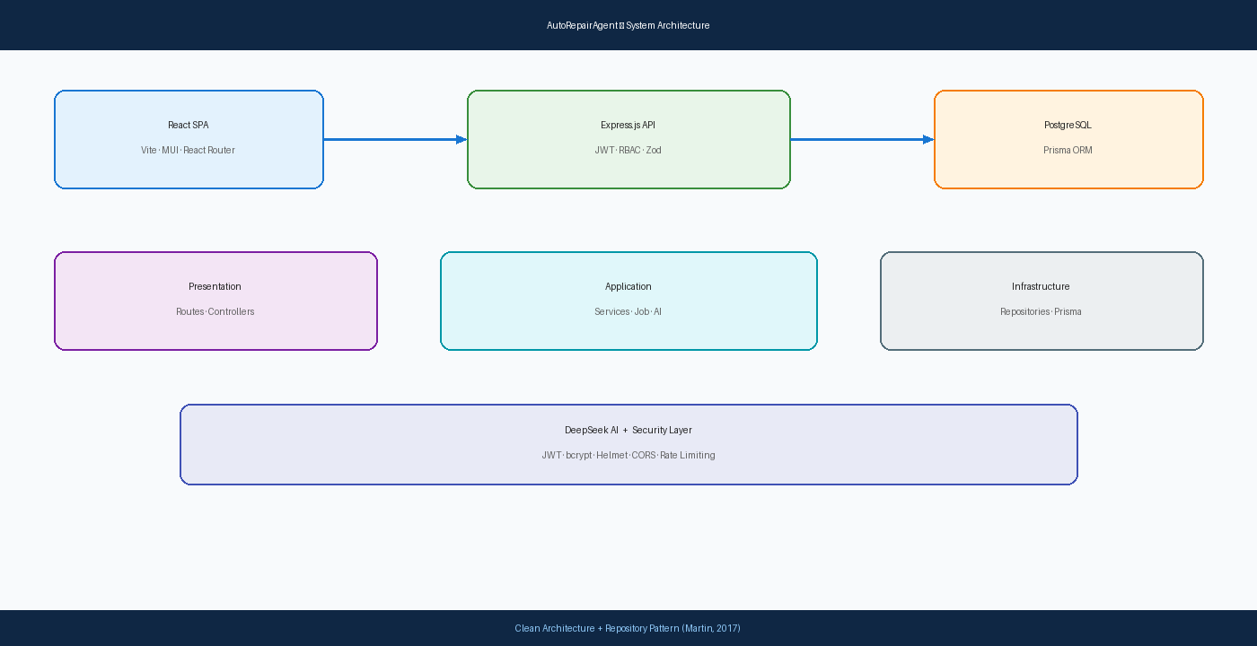
AR
Chapter 5 — Architecture
CH 5
System Design Overview (Martin, 2017)
Three-tier: React SPA → Express API → PostgreSQL + DeepSeek AI
AutoRepairAgent | Final Report
Implementation
10

Slide 11
AR
Chapter 5 — Database & Security
CH 5
Implementation Details (Prisma; OWASP, 2021)
Database
Security
▸ 10 PostgreSQL tables via Prisma ORM
▸ Enums: RoleName, JobStatus, AuditAction
▸ Relations: Customer→Vehicle→Job→Dept
▸ AIAnalysisLog stores AI responses
▸ JWT authentication (24h expiry)
▸ bcrypt hashing (cost 12)
▸ RBAC middleware on all routes
▸ Helmet, CORS, rate limiting, Zod validation
AutoRepairAgent | Final Report
Implementation
11

Slide 12
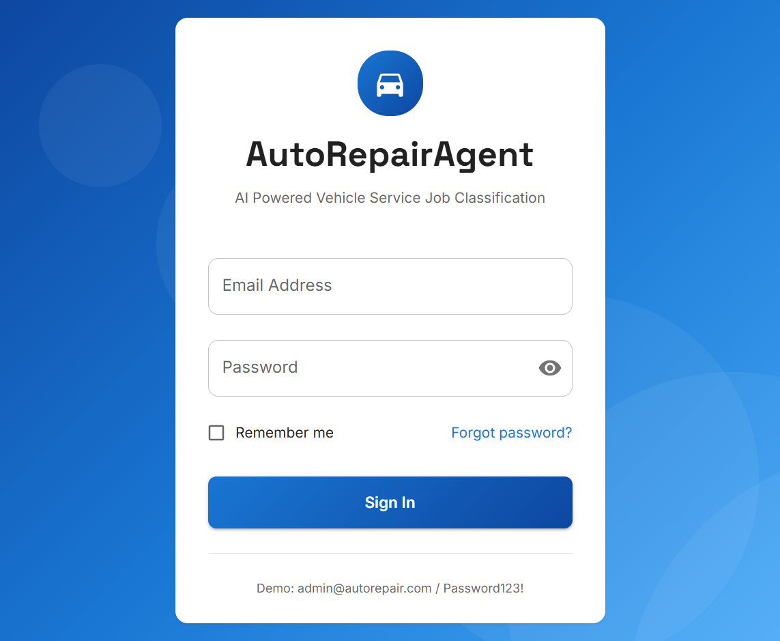
AR
UI — Authentication
UI
Chapter 6.4 — Login Interface
JWT login page — gateway to role-based system
AutoRepairAgent | Final Report
Results
12

Slide 13
AR
Phase 1 Implementation
PH 1
Admin Module — Chapter 5.4
▸ User management: CRUD, activate/deactivate, role assignment.
▸ Department management: 5 seeded workshop departments.
▸ Authentication: AuthContext, protected routes, Axios interceptors.
▸ MainLayout: sidebar navigation, light/dark theme, role-based menus.
AutoRepairAgent | Final Report
Results
13

Slide 14
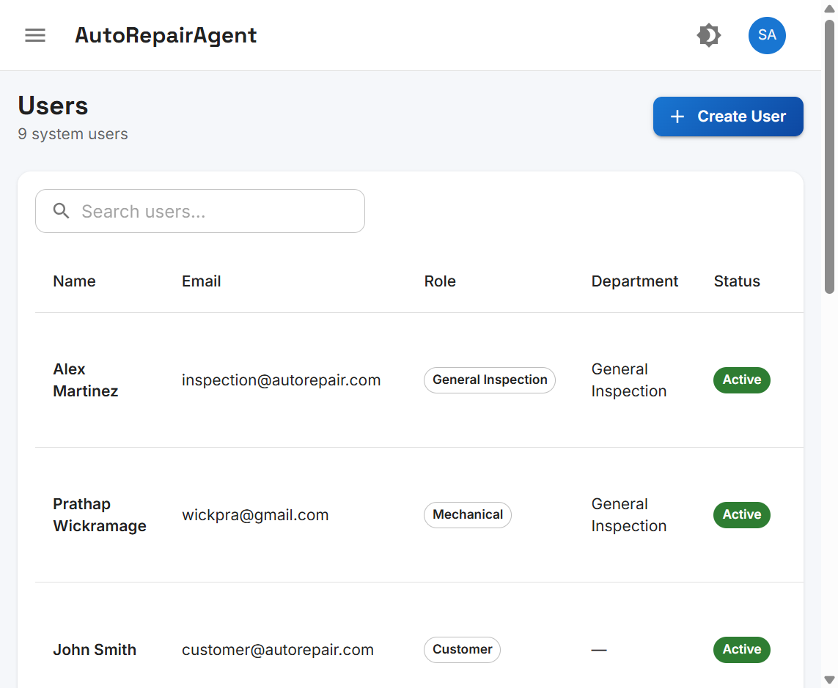
AR
UI — User Management
UI
Chapter 6.4 — Admin Users Page
9 system users with roles and department assignments
AutoRepairAgent | Final Report
Results
14

Slide 15
AR
Phase 2 — Customer & Vehicle
PH 2
Chapter 5.4 Business Modules
▸ Customer CRUD: /api/customers — Admin and Job Advisor access.
▸ Vehicle CRUD: /api/vehicles — linked to customer records.
▸ Test data: John Smith (ABC123), Maria Garcia (XYZ789).
AutoRepairAgent | Final Report
Results
15

Slide 16
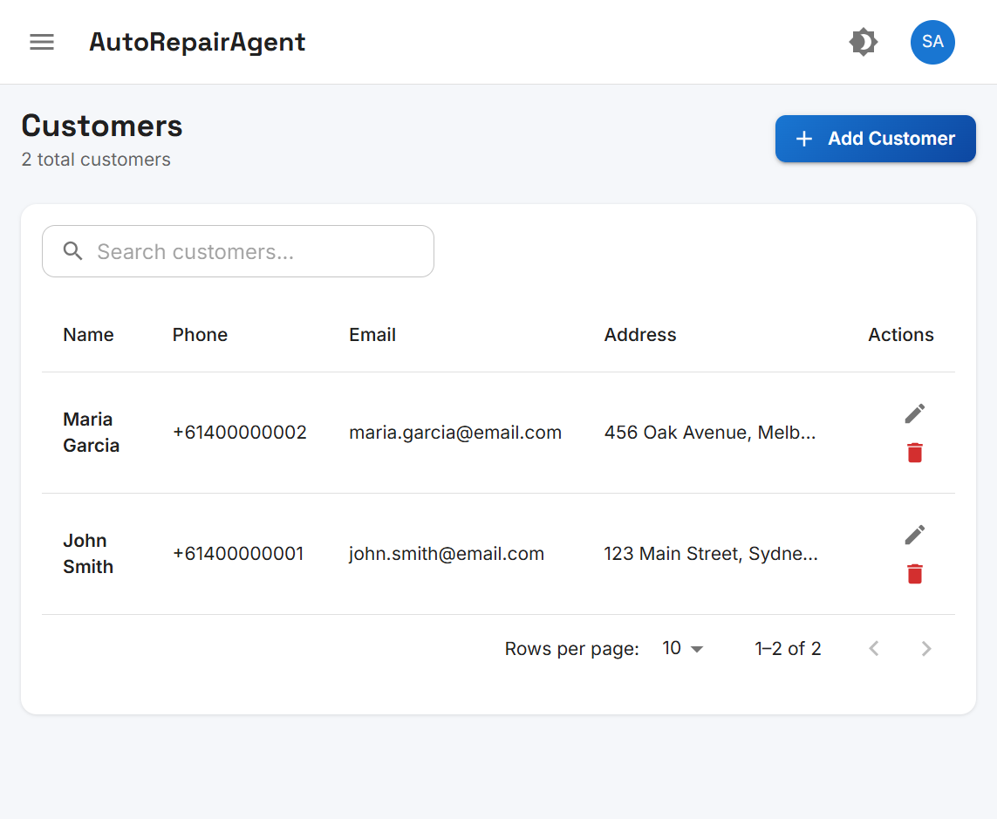
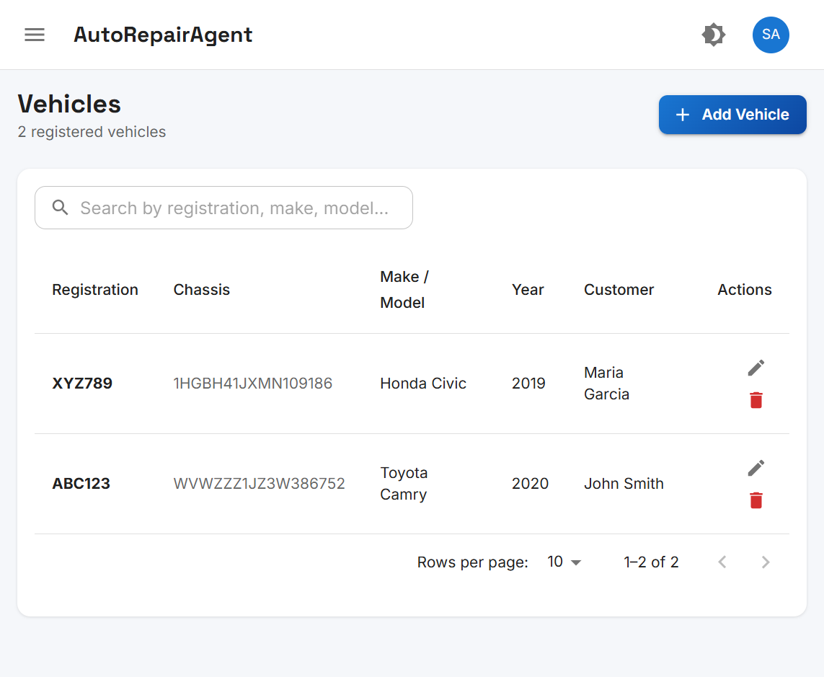
AR
UI — Customer & Vehicle
UI
Chapter 6.4 — Data Management Screens
Customer CRUD (left) and vehicle registration linked to owners (right)
AutoRepairAgent | Final Report
Results
16

Slide 17
AR
Phase 2 — AI Integration
AI
Chapter 5.5 DeepSeek (DeepSeek, 2024)
▸ POST /api/jobs/analyze — complaint + vehicle registration.
▸ DeepSeek returns JSON: issues[], department, confidence, explanation.
▸ Fallback keyword classifier when API unavailable.
▸ One job per issue; auto-assigned to department staff.
AutoRepairAgent | Final Report
Results
17

Slide 18
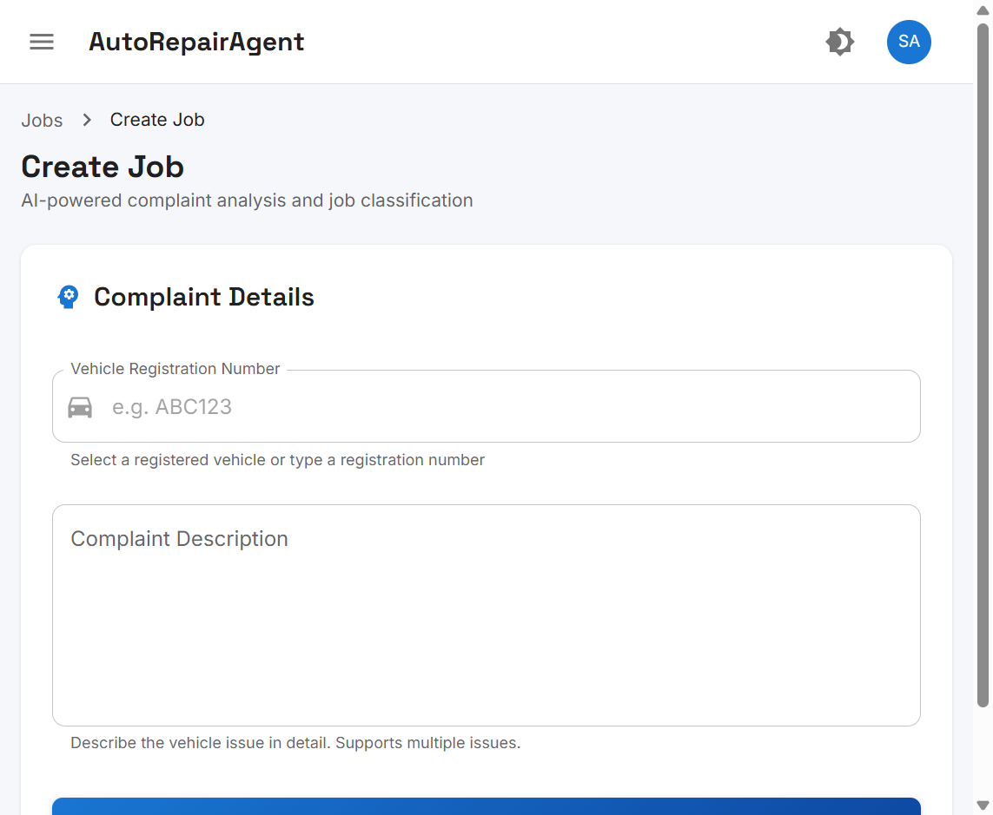
AR
UI — AI Job Creation
UI
Chapter 6.4 — Create Job Page
AI-powered complaint submission and classification
AutoRepairAgent | Final Report
Results
18

Slide 19
AR
Job Lifecycle Results
FLOW
Chapter 6.3 — Workflow Outcomes
▸ Complaint → AI analysis → multi-job creation → auto-assign.
▸ PENDING → ASSIGNED → IN_PROGRESS → COMPLETED.
▸ Example: engine noise + headlight → Mechanical + Electrical jobs.
▸ 7 jobs created in testing; confidence scores logged.
AutoRepairAgent | Final Report
Results
19

Slide 20
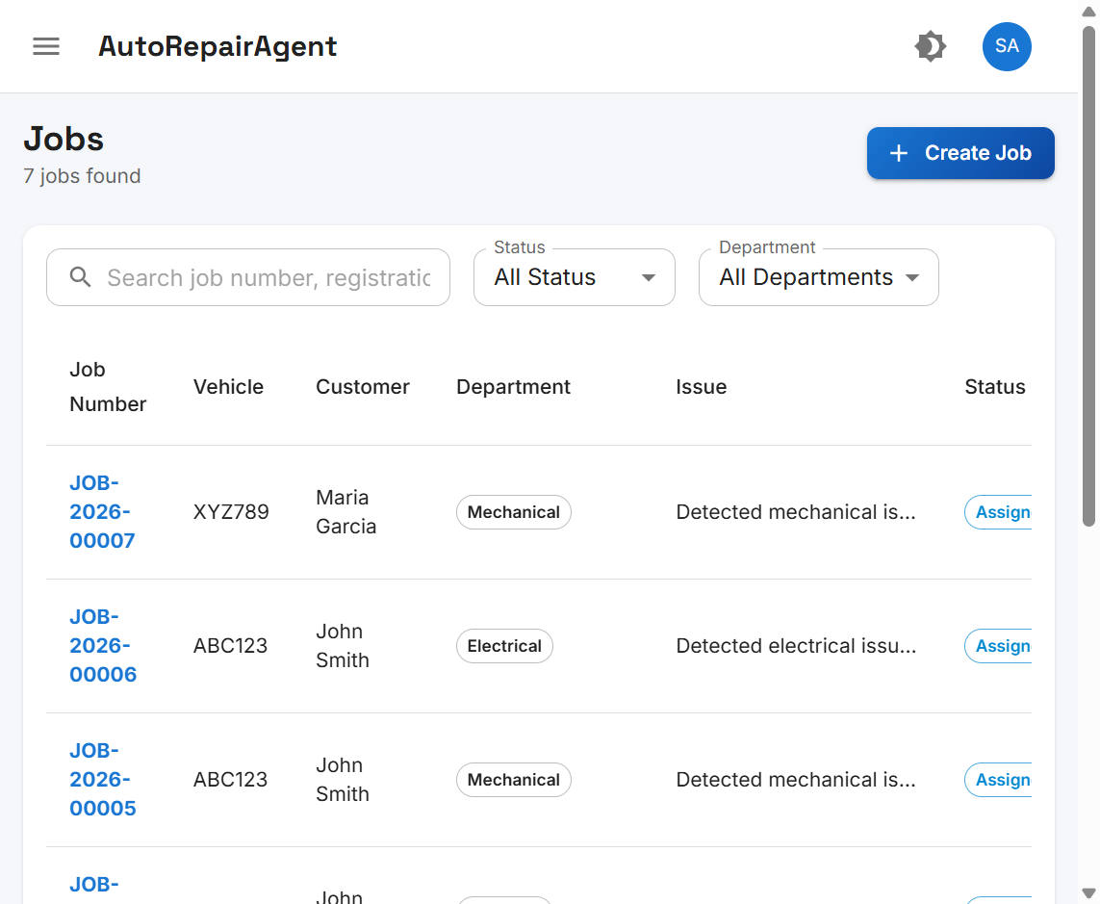
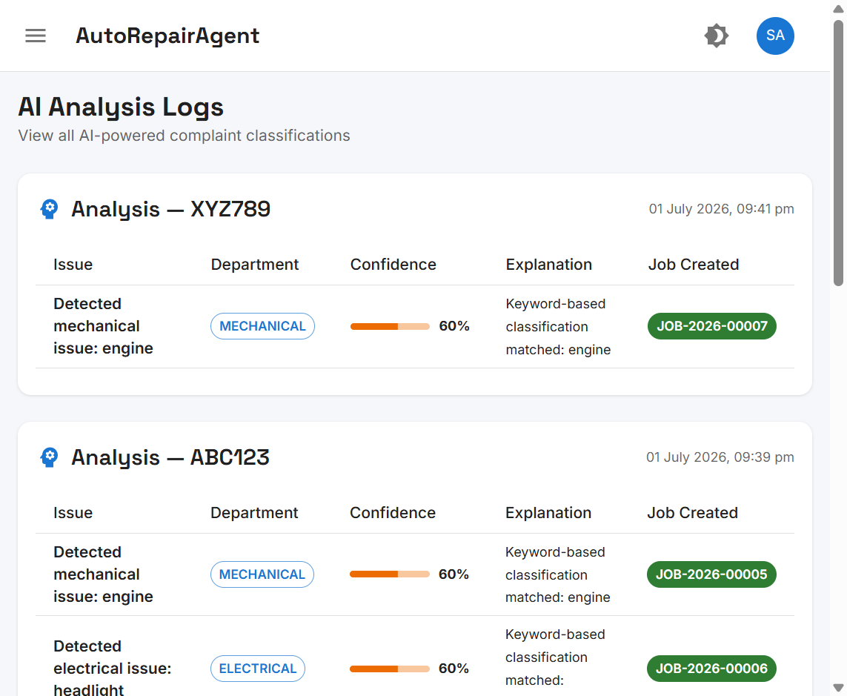
AR
UI — Jobs & AI Logs
UI
Chapter 6.4 — Job List & AI Audit Trail
Jobs routed by department (left); AI analysis log with confidence scores (right)
AutoRepairAgent | Final Report
Results
20

Slide 21
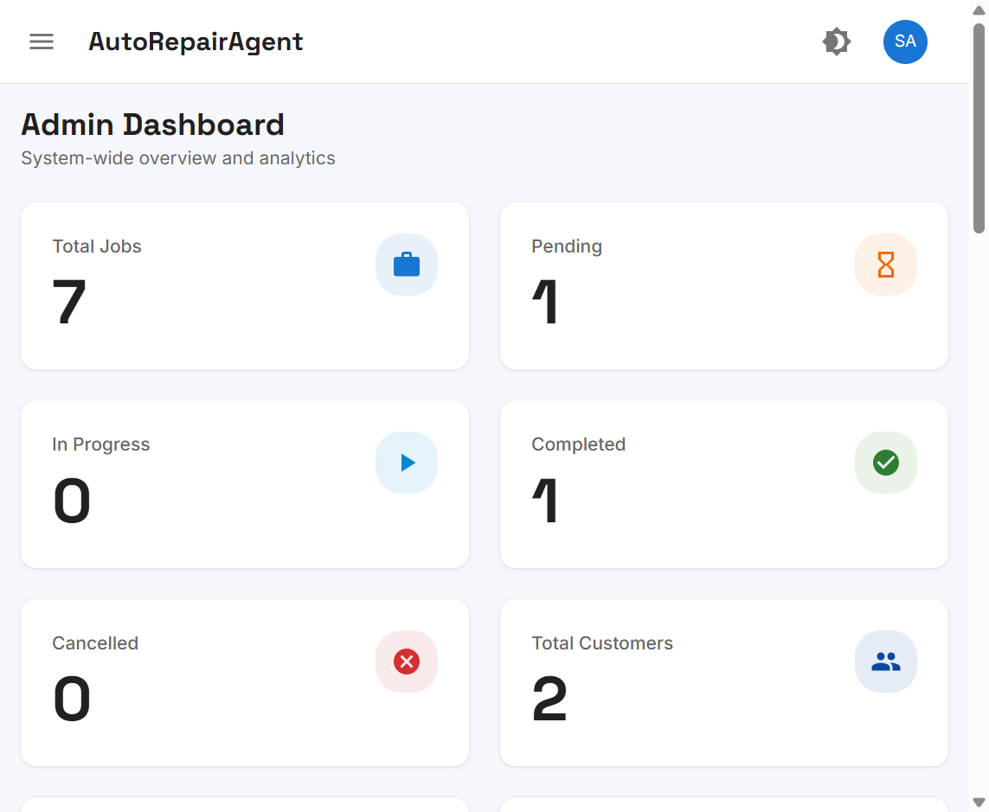
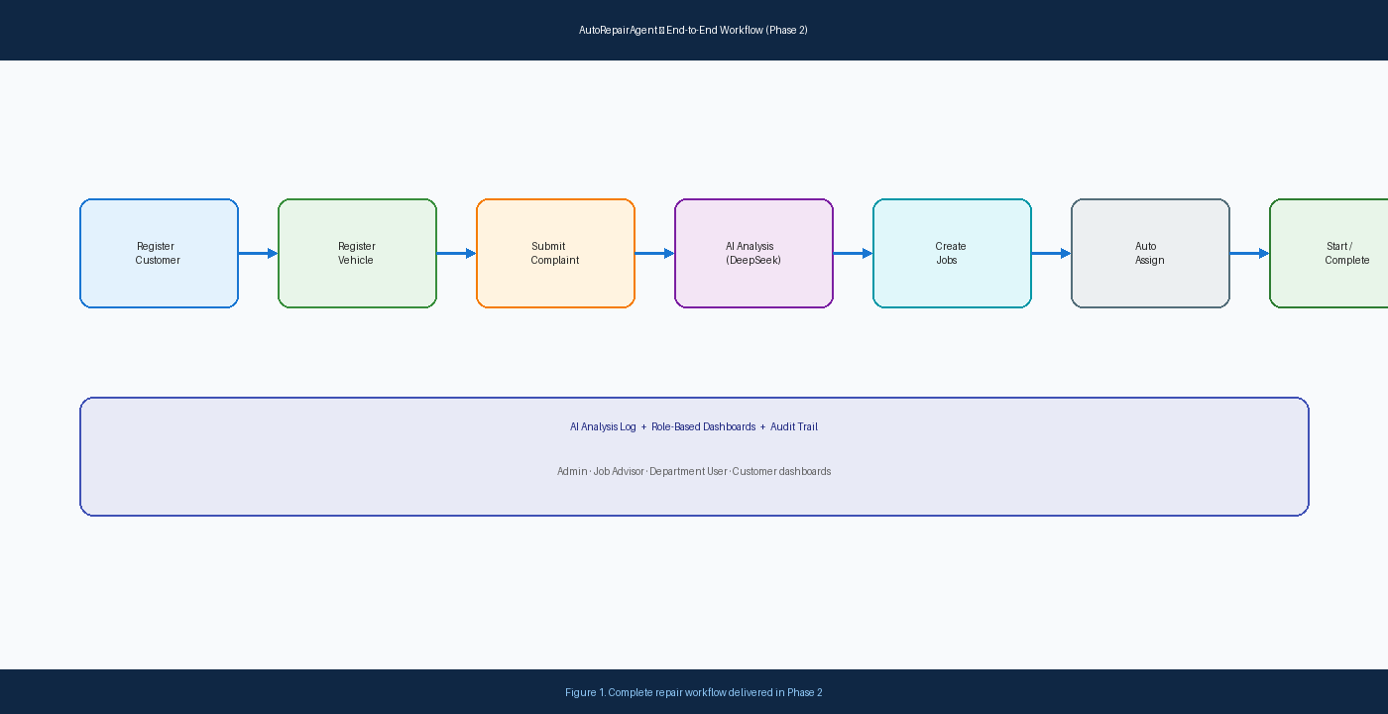
AR
UI — Dashboard & Workflow
UI
Chapter 6.4 — KPIs & End-to-End Flow
Admin KPI dashboard (left); complaint-to-completion workflow (right)
AutoRepairAgent | Final Report
Results
21

Slide 22
AR
Chapter 6 — Results Summary
CH 6
Quantitative Outcomes
Deliverable | Outcome
REST API endpoints implemented | 34
Database tables designed | 10
User roles with RBAC | 8
Workshop departments | 5
UI pages with screenshots | 15+
End-to-end workflow | Verified ✓
AutoRepairAgent | Final Report
Results
22

Slide 23
AR
Chapter 7 — Discussion
CH 7
Limitations & Critical Evaluation
Limitations
Achievements
▸ AI accuracy depends on DeepSeek API availability
▸ Fallback uses English keywords only
▸ Naive first-available technician assignment
▸ No automated test coverage
▸ English-only UI interface
▸ All primary objectives substantially achieved
▸ Clean Architecture proved maintainable
▸ RBAC correctly filters jobs by role
▸ Audit trail supports AI accountability
▸ System demonstrable on localhost
AutoRepairAgent | Final Report
Discussion
23

Slide 24
AR
Chapter 8 — Conclusions
CH 8
Final Assessment & Future Work
✔ PROJECT COMPLETE
▸ AutoRepairAgent achieves all core development objectives.
▸ Contribution: affordable AI-integrated workshop management prototype.
▸ Future: cloud deployment, Sinhala/Tamil i18n, SMS notifications.
▸ Future: Jest/Playwright tests, load-balanced assignment, inventory module.
▸ Thank you — Questions & Discussion.
AutoRepairAgent | Final Report
Conclusion
24

Slide 25
AR
References
REF
APA 7th Edition — 6 Key Sources
1. DeepSeek. (2024). DeepSeek API documentation. https://api-docs.deepseek.com
2. Martin, R. C. (2017). Clean architecture: A craftsman's guide to software structure and design. Prentice Hall.
3. Meta Platforms, Inc. (2024). React documentation. https://react.dev
4. OWASP Foundation. (2021). Authentication cheat sheet. https://cheatsheetseries.owasp.org/cheatsheets/Authentication_Cheat_Sheet.html
5. Prisma Data, Inc. (2024). Prisma ORM documentation. https://www.prisma.io/docs
6. Sommerville, I. (2016). Software engineering (10th ed.). Pearson.
AutoRepairAgent | Final Report
25

