Slide 1
AR
AutoRepairAgent
AI-Powered Vehicle Repair Workshop Management System
Progress Report 1 — Phase 1 Foundation Development
Student:
[Your Name] | ID: [Student ID]
Course:
[Course Name / Code]
College:
[College Name]
Period:
Reporting Period: [Start Date] – [End Date]
Date:
Submission Date: July 2026
AutoRepairAgent | Progress Report 1
1

Slide 2
AR
Presentation Agenda
AGENDA
Organisation of This Report — 20 Slides
Section | Topics Covered | Slides
Introduction | Project overview, objectives, technology stack | 3 – 5
Progress | Database, authentication, admin modules + screenshots | 6 – 14
Pending Work | Phase 2 modules not yet started | 15
Challenges | Problems encountered & how they were resolved | 16 – 17
Status & Plan | Project on-track assessment, next period plan | 18
AutoRepairAgent | Progress Report 1
2

Slide 3
AR
Project Introduction
01 — INTRO
Background & Purpose of AutoRepairAgent
▸ AutoRepairAgent is an all-in-one web-based system for vehicle repair work workshop monitoring.
▸ The AI-driven classification of customer complaints and job routing to departments is part of the system.
Phase 1 aimed at technical foundations: Database, Auth, Admin and UI Design. Structured software engineering practices (Sommerville, 2016) were followed in development.
▸ Development followed structured software engineering practices (Sommerville, 2016).
▸ This report provides information on the progress, problems encountered and plans for Phase 2 of the work.
AutoRepairAgent | Progress Report 1
Introduction
3

Slide 4
AR
Phase 1 Objectives
01 — INTRO
Planned Deliverables for the First Reporting Period
# | Module / Feature | Status
1 | The design of the database and using Prisma ORM with PostgreSQL. | Complete
2 | JWT authentication & bcrypt password hashing. | Complete
3 | Role Based Access Control (8 roles). | Complete
4 | Admin module — User creation & management | Complete
5 | Department creation & management | Complete
6 | Front-end UI (React + MUI) | Complete
7 | Customer, Vehicle & AI modules | Pending
AutoRepairAgent | Progress Report 1
Introduction
4

Slide 5
AR
Technology Stack
01 — INTRO
Tools & Frameworks — Phase 1 (Sommerville, 2016)
Backend
Frontend
This is the same as the runtime environment for Node.js (LTS).
▸ The Express.js REST API framework (Express.js, n.d.)
▸ Prisma ORM + PostgreSQL database (Prisma Data, Inc., 2024)
▸ JWT + bcrypt authentication (OWASP Foundation, 2021)
▸ Clean Architecture (Martin, 2017)
▸ React 18 + Vite build tool
▸ Material UI v5 components (Meta Platforms, Inc., 2024)
▸ React Router v6 navigation
▸ React Hook Form
▸ Axios HTTP client
▸ Recharts data visualisation
AutoRepairAgent | Progress Report 1
Introduction
5

Slide 6
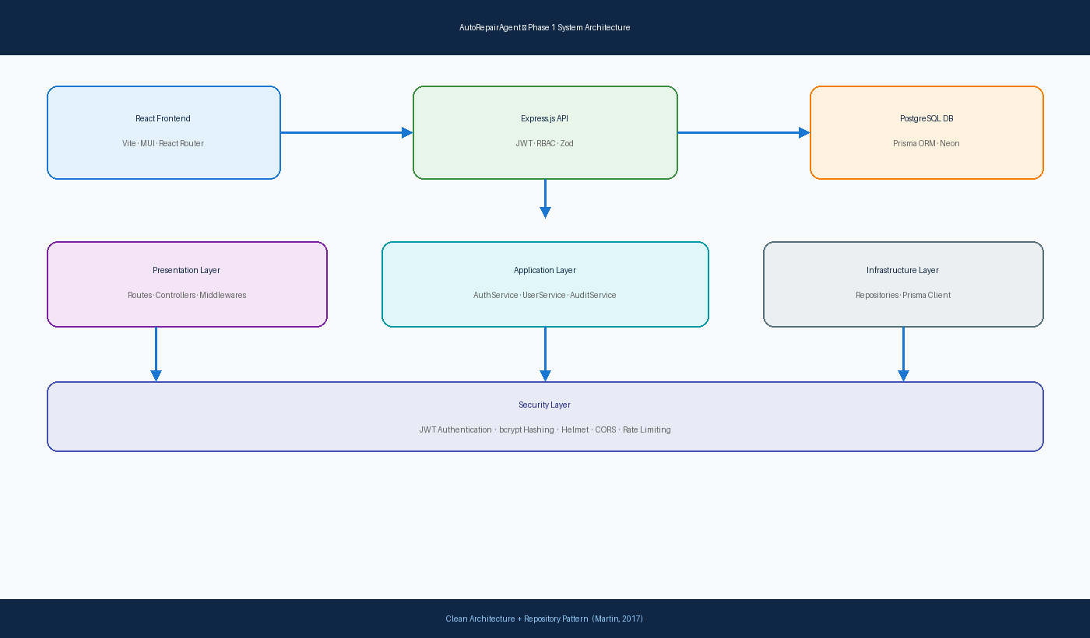
AR
System Architecture
02 — PROGRESS
Clean Architecture — 3-Layer Backend + React Frontend (Martin, 2017)
Figure 1. Phase 1 three-tier system architecture with security layer
AutoRepairAgent | Progress Report 1
Progress
6

Slide 7
AR
Database Development
02 — PROGRESS
PostgreSQL Schema & Prisma ORM (Prisma Data, Inc., 2024)
▸ Created 10 relational tables (Role, Department, User, Customer, Vehicle, Job, etc.).
Added a new table: Audits
▸ Created enums: RoleName, DepartmentCode, JobStatus, AuditAction
▸ Initial migration: prisma/migrations
▸Seed script adds 5 departments, 8 test users and sample data
▸ A foreign key relationship between the tables is already created for the Phase 2 business modules.
▸ A database that runs on PostgreSQL (Neon cloud) and is accessed via SSL connection.
AutoRepairAgent | Progress Report 1
Progress
7

Slide 8
AR
Authentication Module
02 — PROGRESS
Secure Login & Role-Based Access Control (OWASP Foundation, 2021)
▸ POST /api/auth/login —Log in to the system for authentication, returning a signed JWT token.Validates credentials, returns signed JWT.
▸ Passwords hashed before database storage
▸ JWT middleware (auth.js) used
▸ Access to endpoints is controlled by Middleware using RBAC (rbac.js).
▸ The Frontend AuthContext saves the token in localStorage.The Frontend AuthContext saves the token to localStorage.
▸ Unauthenticated users will be redirected to /login via protected routes.
▸ When an Axios interceptor is attached, it adds the token to each request and deals with the session expiration.
AutoRepairAgent | Progress Report 1
Progress
8

Slide 9
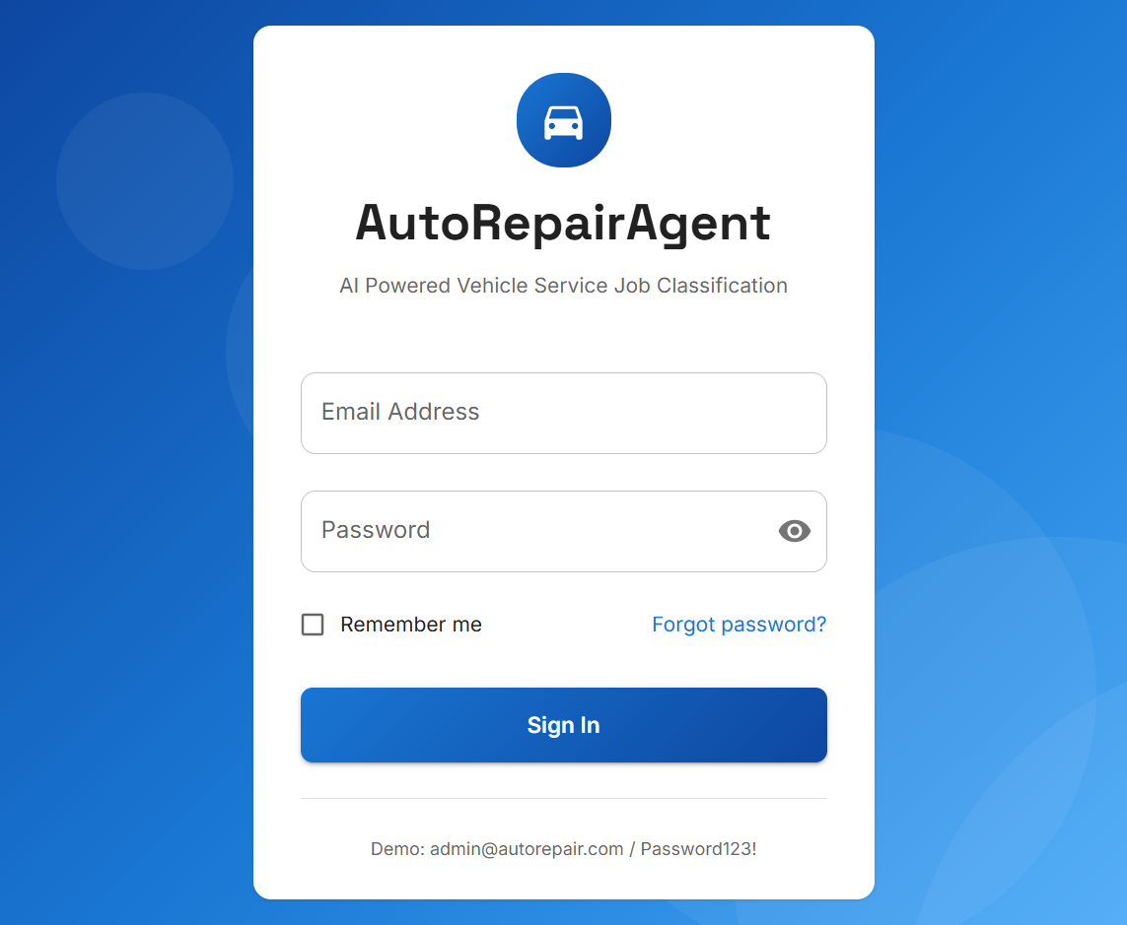
AR
Authentication — Login Interface
02 — PROGRESS
System Screenshot: Secure User Login Page
Figure 2. AutoRepairAgent login page — JWT authentication with role-based access
AutoRepairAgent | Progress Report 1
Progress
9

Slide 10
AR
Admin Module — User Management
02 — PROGRESS
Create, Edit, Activate & Deactivate System Users
▸ REST API: GET / POST / PUT / DELETE /api/admin/users
▸ Admin assigns roles: ADMIN, JOB_ADVISOR, MECHANICAL, CUSTOMER, etc.
▸ Users linked to workshop departments where applicable
▸ Activate / deactivate accounts without permanent deletion
▸ Audit logging records every user management action
AutoRepairAgent | Progress Report 1
Progress
10

Slide 11
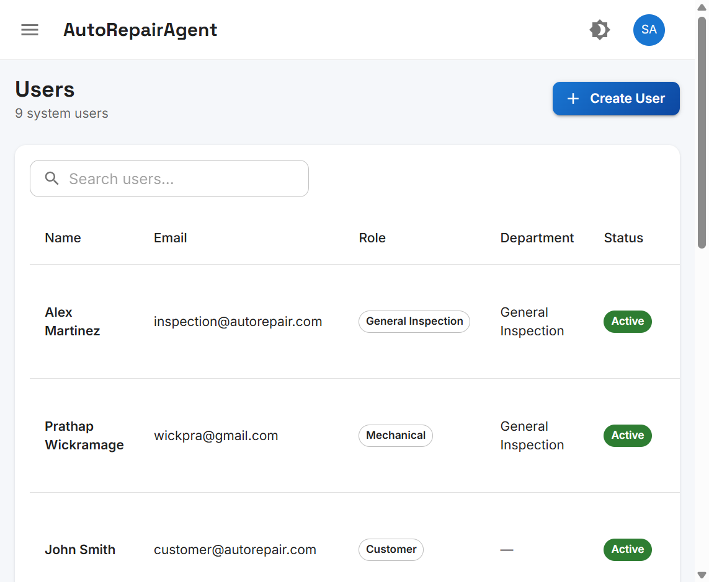
AR
User Management Interface
02 — PROGRESS
System Screenshot: Admin Users Page
Figure 3. User list showing name, email, role, department, and active status
AutoRepairAgent | Progress Report 1
Progress
11

Slide 12
AR
Department Management
02 — PROGRESS
Workshop Department Configuration & CRUD Operations
▸ REST API: GET / POST / PUT / DELETE /api/admin/departments
▸ 5 default departments seeded: Mechanical, Electrical, Body Repair, Paint, General Inspection
▸ Each department: name, unique code, description, active/inactive status
▸ Department staff linked via departmentId on User model
▸ Card-based UI layout with create, edit, and delete dialog forms
AutoRepairAgent | Progress Report 1
Progress
12

Slide 13
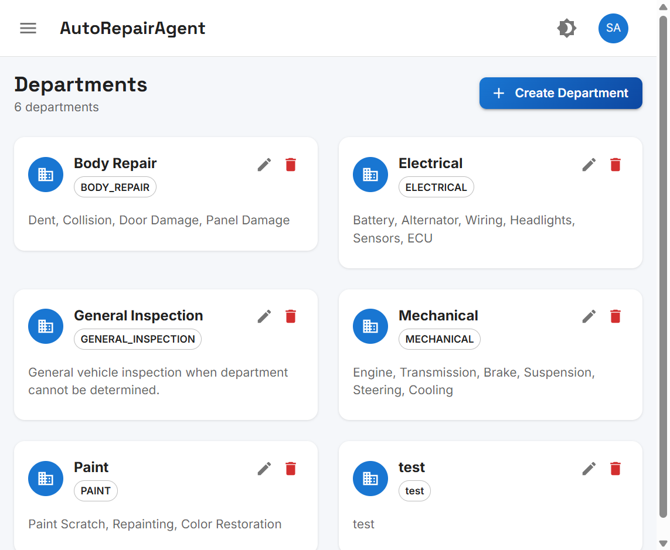
AR
Department Management Interface
02 — PROGRESS
System Screenshot: Departments Page
Figure 4. Workshop department cards with descriptions and management actions
AutoRepairAgent | Progress Report 1
Progress
13

Slide 14
AR
Front-End Design
02 — PROGRESS
React UI Layout & Reusable Components (Meta Platforms, Inc., 2024)
Layout & Theme
Data & Routing
▸ MainLayout — sidebar nav, app bar, theme toggle
▸ Role-based menu items per user role
▸ PageHeader, StatusChip, KpiCard components
▸ Light / dark mode theme support
▸ Inter + Space Grotesk typography
▸ Blue gradient professional colour scheme
▸ React Hook Form + Zod validation
▸ TanStack React Query data fetching
▸ Axios API service with interceptors
▸ React Router v6 protected routes
▸ React Toastify notifications
▸ Responsive MUI v5 grid layout
AutoRepairAgent | Progress Report 1
Progress
14

Slide 15
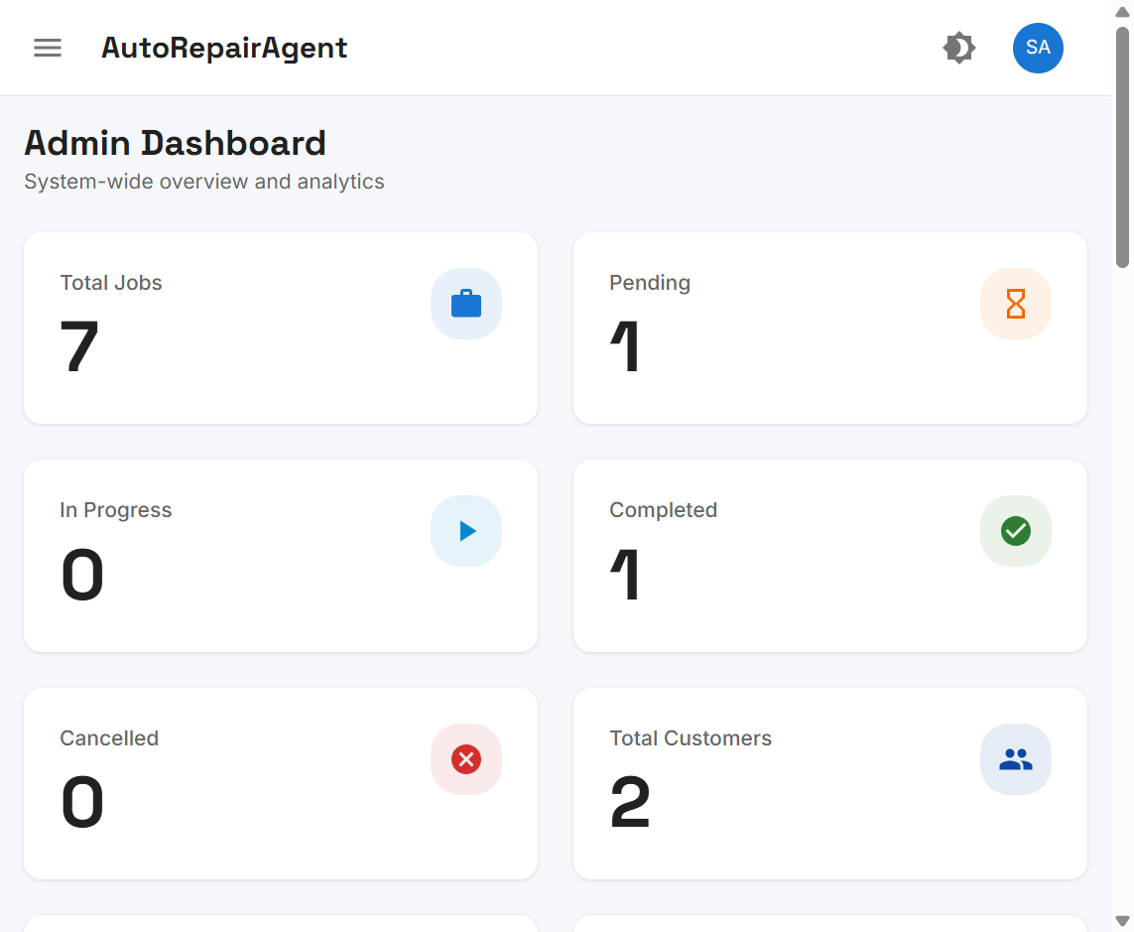
AR
Admin Dashboard
02 — PROGRESS
System Screenshot: Dashboard UI with KPI Summary Cards
Figure 5. Admin dashboard — job statistics and system-wide overview layout
AutoRepairAgent | Progress Report 1
Progress
15

Slide 16
AR
Items Not Yet Completed
03 — PENDING
Planned for Phase 2 — Next Reporting Period
Module | Description | Status
Customer Module | Register & manage workshop customers | Pending
Vehicle Module | Register vehicles linked to customers | Pending
AI Job Creation | Complaint submission & auto job generation | Pending
AI Job Assignment | DeepSeek API integration & department routing | Pending
AI Analysis Log | History of all AI classification decisions | Pending
Deployment | Cloud hosting, Docker, CI/CD pipeline | Pending
AutoRepairAgent | Progress Report 1
Pending Work
16

Slide 17
AR
Problems Encountered & Solutions
03 — CHALLENGES
Technical Challenges and How They Were Resolved (Sommerville, 2016)
Problems Encountered
Solutions Applied
▸ Node modules — separate npm install for backend & frontend
▸ Database migration failures — incorrect DATABASE_URL
▸ Missing libraries — bcrypt, jsonwebtoken, zod errors
▸ CORS errors — React (5173) ↔ Express (3000) conflict
▸ Missing .env variables blocked server startup
▸ ✅ npm install in root + UI/autorepairagent folders
▸ ✅ Corrected DATABASE_URL with sslmode=require
▸ ✅ Installed all packages; updated package.json
▸ ✅ Configured CORS + Vite proxy → localhost:3000
▸ ✅ Created .env from .env.example; added dev:all script
AutoRepairAgent | Progress Report 1
Challenges
17

Slide 18
AR
Project Status & Next Period Plan
04 — STATUS
Assessment: ON TRACK — Phase 2 Ready
✔ ON TRACK
▸ All Phase 1 targets achieved in the cycle.
▸ The database, authentication, admin and departments are ready, as are the UI design and the foundation.
▸ The second phase of the focus is customer module -- vehicle module -- AI integration.
▸ Phase 2 focus: AI job creation, assignment, and analysis log.
▸ Risk: DeepSeek API key availability — mitigated by keyword fallback classifier.
Phase 2 Timeline (Proposed)
Week 5: Customers → Week 6: Vehicles → Week 7: AI Integration → Week 8: Job Assignment & Testing
AutoRepairAgent | Progress Report 1
Status & Plan
18

Slide 19
AR
System Screenshots Summary
02 — PROGRESS
Phase 1 UI Evidence — Figures 2 to 5
Figure | Screen | Module Demonstrated
Figure 2 | Login Page | Authentication & JWT login
Figure 3 | Users Page | Admin user management
Figure 4 | Departments Page | Department creation & CRUD
Figure 5 | Admin Dashboard | Front-end design & KPI layout
AutoRepairAgent | Progress Report 1
Screenshots
19

Slide 20
AR
References
05 — REFERENCES
APA 7th Edition — Bibliography
1. Express.js. (n.d.). Express documentation. https://expressjs.com
2. Martin, R. C. (2017). Clean architecture: A craftsman's guide to software structure and design. Prentice Hall.
3. Meta Platforms, Inc. (2024). React documentation. https://react.dev
4. OWASP Foundation. (2021). Authentication cheat sheet. https://cheatsheetseries.owasp.org/cheatsheets/Authentication_Cheat_Sheet.html
5. Prisma Data, Inc. (2024). Prisma ORM documentation. https://www.prisma.io/docs
6. Sommerville, I. (2016). Software engineering (10th ed.). Pearson.
Note: In-text citations throughout this presentation follow APA 7th edition author-date format.
AutoRepairAgent | Progress Report 1
20

