Slide 1
AR
AutoRepairAgent
AI-Powered Vehicle Repair Workshop Management System
Progress Report 2 - Phase 2 Modules (Final Report)
Student:
Anish
Course:
MIT
AutoRepairAgent | Progress Report 2
1

Slide 2
AR
Presentation Agenda
AGENDA
Organisation of This Report - 20 Slides
Section | Topics Covered | Slides
Recap | Phase 2 context & objectives | 3 – 4
Progress | Customer, Vehicle, AI Jobs + UI screenshots | 5 – 14
Future Work | Deployment & enhancement recommendations | 15
Challenges | AI integration, DB & subscription problems | 16
Conclusion | Project complete - final assessment | 17 – 18
References | APA 7th Edition bibliography | 19 – 20
AutoRepairAgent | Progress Report 2
2

Slide 3
AR
Project Introduction
01 - INTRO
Phase 2 - Building on Report 1 Foundation
▸ Progress Report 1 delivered: database, auth, admin, departments, and UI design.
▸ Phase 2 focused on core business modules: customers, vehicles, and AI-powered jobs.
▸ DeepSeek AI integrated for intelligent complaint classification (OpenAI, 2024).
▸ Full end-to-end workflow now functional: complaint -> AI -> job -> assign -> complete.
▸ This is the final progress report - all development objectives are complete.
AutoRepairAgent | Progress Report 2
Introduction
3

Slide 4
AR
Phase 2 Objectives
01 - INTRO
Deliverables Completed in Second Reporting Period
# | Module / Feature | Status
1 | Customer creation & management module | Complete
2 | Vehicle registration module | Complete
3 | AI job creation & complaint analysis | Complete
4 | AI integration - DeepSeek API | Complete
5 | Automatic job assignment to departments | Complete
6 | AI analysis log & role-based dashboards | Complete
7 | Production deployment & multilingual UI | Deferred
AutoRepairAgent | Progress Report 2
Introduction
4

Slide 5
AR
Customer Management Module
02 - PROGRESS
Register & Manage Workshop Customers (Prisma Data, Inc., 2024)
▸ REST API: GET / POST / PUT / DELETE /api/customers
▸ Fields: first name, last name, phone, email, address
▸ Accessible to ADMIN and JOB_ADVISOR roles via RBAC
▸ validation on backend and React Hook Form on frontend
▸ Customers linked to vehicles and customer portal accounts
▸ Audit logging for all customer create, update, delete actions
AutoRepairAgent | Progress Report 2
Progress
5

Slide 6
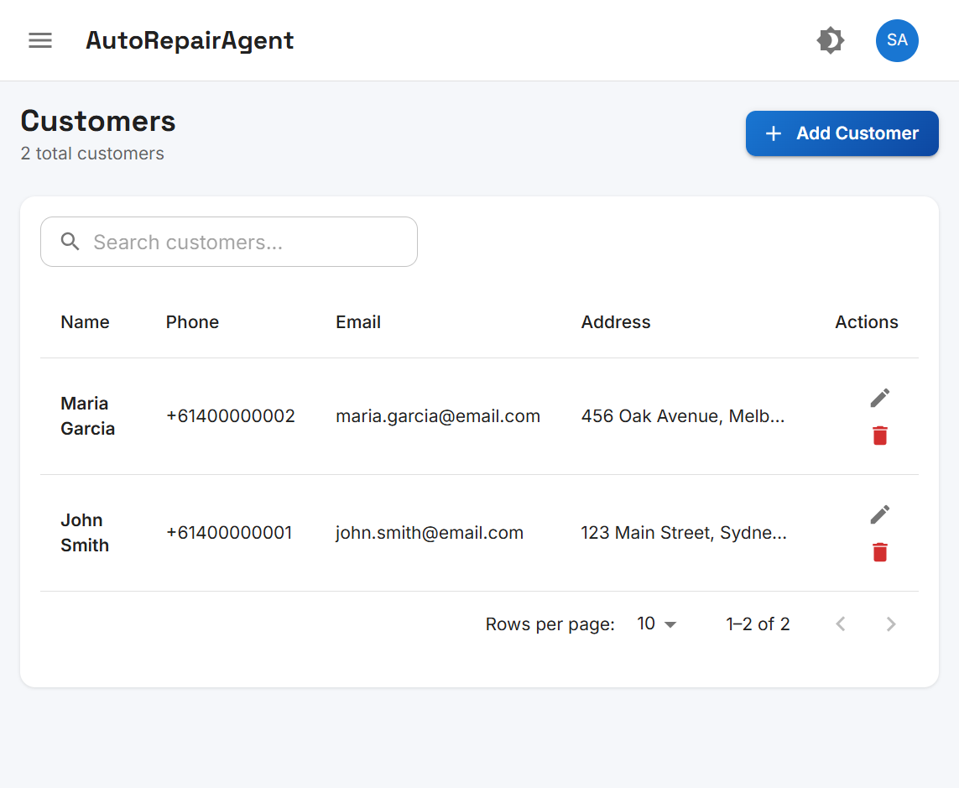
AR
Customer Management Interface
02 - PROGRESS
System Screenshot: Customers Page
Figure 2. Customer list with search, pagination, and CRUD actions
AutoRepairAgent | Progress Report 2
Progress
6

Slide 7
AR
Vehicle Registration Module
02 - PROGRESS
Register Vehicles Linked to Customers
▸ REST API: GET / POST / PUT / DELETE /api/vehicles
▸ Fields: registration number, chassis, make, model, year, customerId
▸ Unique registration number validation
▸ Customer dropdown selector on create/edit form
▸ Vehicles required before AI job creation (lookup by registration)
▸ Seed data: test vehicles ABC123 and XYZ789
AutoRepairAgent | Progress Report 2
Progress
7

Slide 8
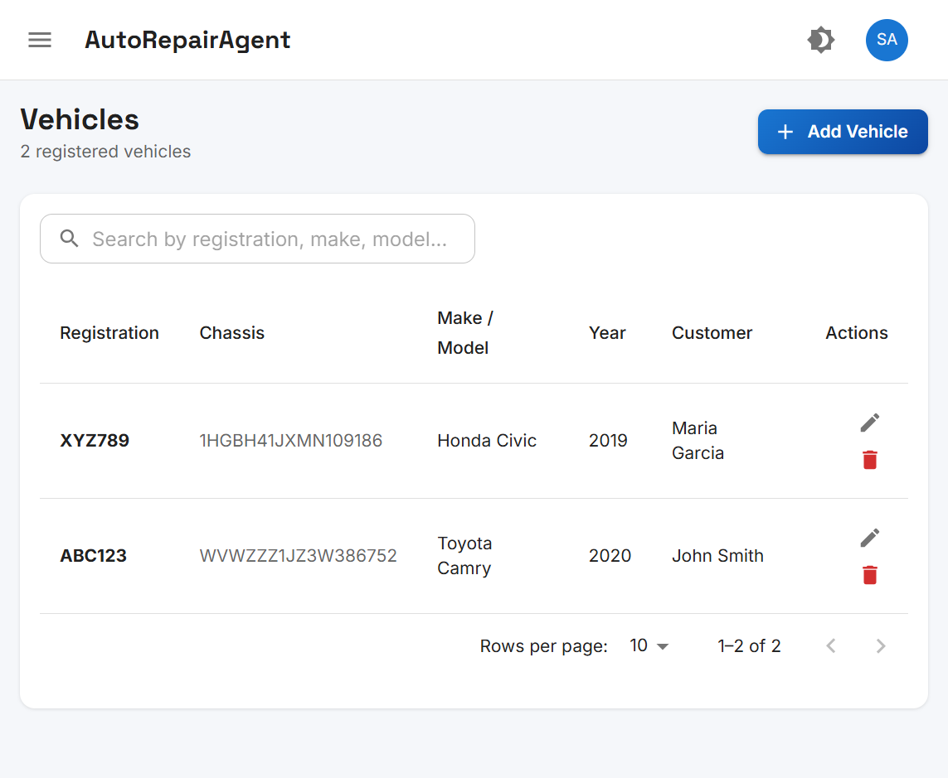
AR
Vehicle Registration Interface
02 - PROGRESS
System Screenshot: Vehicles Page
Figure 3. Vehicle list showing registration, make/model, and linked customer
AutoRepairAgent | Progress Report 2
Progress
8

Slide 9
AR
AI Job Creation & DeepSeek Integration
02 - PROGRESS
Intelligent Complaint Classification (OpenAI, 2024)
▸ POST /api/jobs/analyze - accepts vehicle registration + complaint text
▸ DeepSeekAIService calls DeepSeek Chat Completions API
▸ AI extracts individual issues and classifies into 5 departments
▸ Returns structured JSON: issue, department, confidence, explanation
▸ Keyword-based fallback classifier when API is unavailable
▸ One job created per identified issue with unique job number
AutoRepairAgent | Progress Report 2
Progress
9

Slide 10
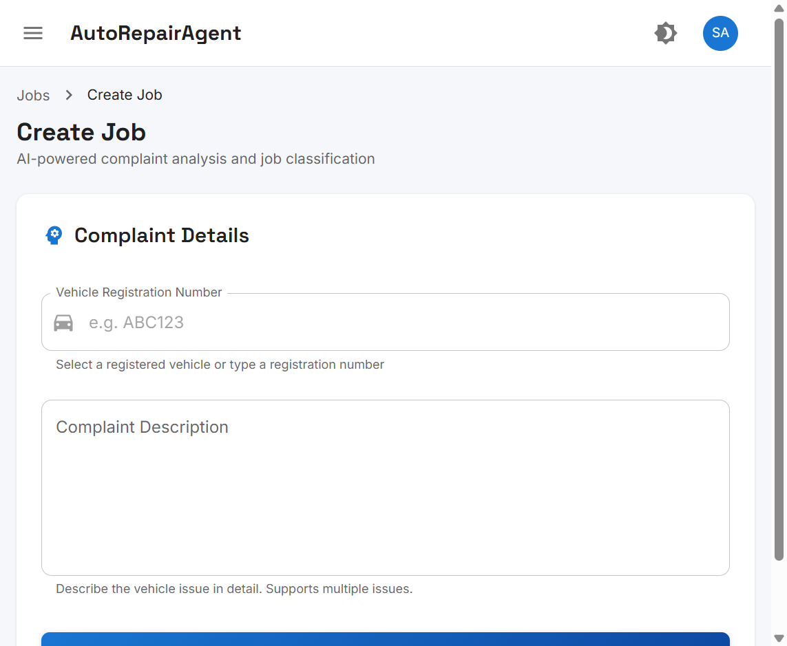
AR
AI Job Creation Interface
02 - PROGRESS
System Screenshot: Create Job Page
Figure 4. AI-powered complaint submission and job classification form
AutoRepairAgent | Progress Report 2
Progress
10

Slide 11
AR
Job Assignment & Lifecycle Management
02 - PROGRESS
Auto-Assign, Start, Complete Workflow
▸ autoAssignJob() assigns job to first active user in target department
▸ Job status flow: PENDING -> ASSIGNED -> IN_PROGRESS -> COMPLETED
▸ POST /api/jobs/:id/start and /api/jobs/:id/complete endpoints
▸ Department users see only jobs in their own department
▸ JobAdvisor and Admin can edit/delete jobs before work starts
▸ Time taken and completion comments recorded on job completion
AutoRepairAgent | Progress Report 2
Progress
11

Slide 12
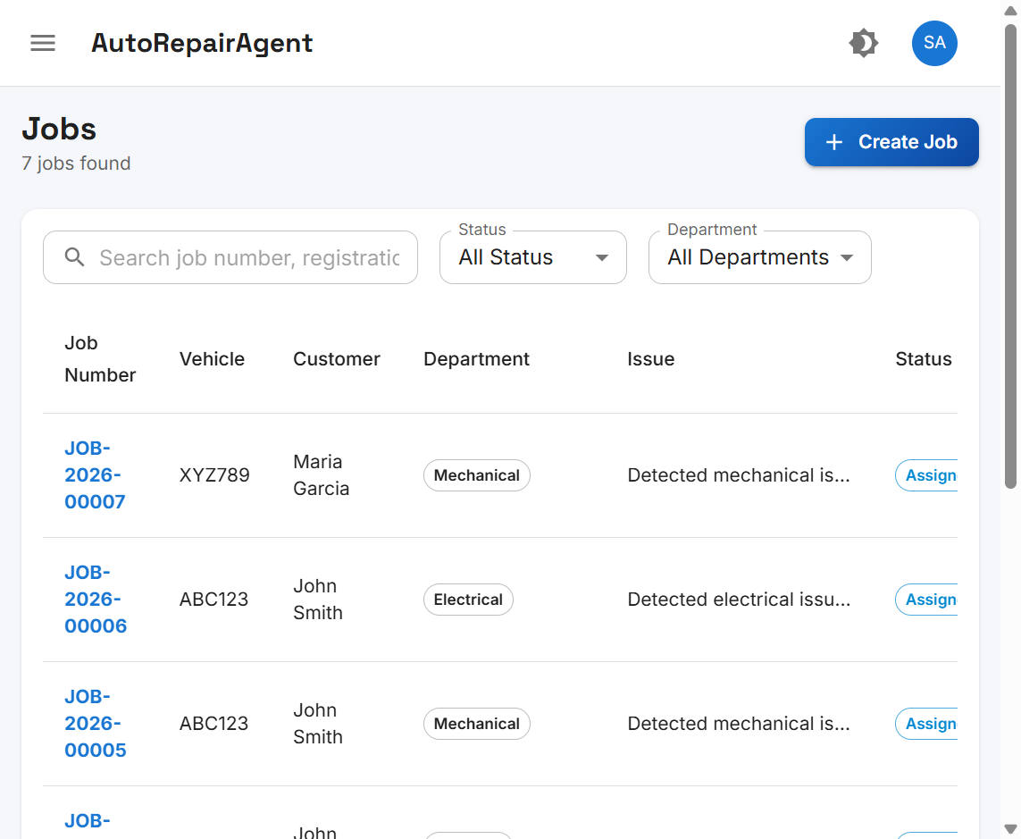
AR
Job Management Interface
02 - PROGRESS
System Screenshot: Jobs List Page
Figure 5. Job list with status filters, department badges, and assignment
AutoRepairAgent | Progress Report 2
Progress
12

Slide 13
AR
AI Analysis Log Module
02 - PROGRESS
Audit Trail of All AI Classification Decisions
▸ AIAnalysisLog model stores complaint, raw AI response, and parsed issues
▸ Log entry created automatically on every POST /api/jobs/analyze call
▸ AIAnalysisPage displays all logs with confidence score progress bars
▸ Shows linked jobs created from each analysis session
▸ Accessible to ADMIN and JOB_ADVISOR for accuracy review
▸ Four role-specific dashboards completed: Admin, Advisor, Dept, Customer
AutoRepairAgent | Progress Report 2
Progress
13

Slide 14
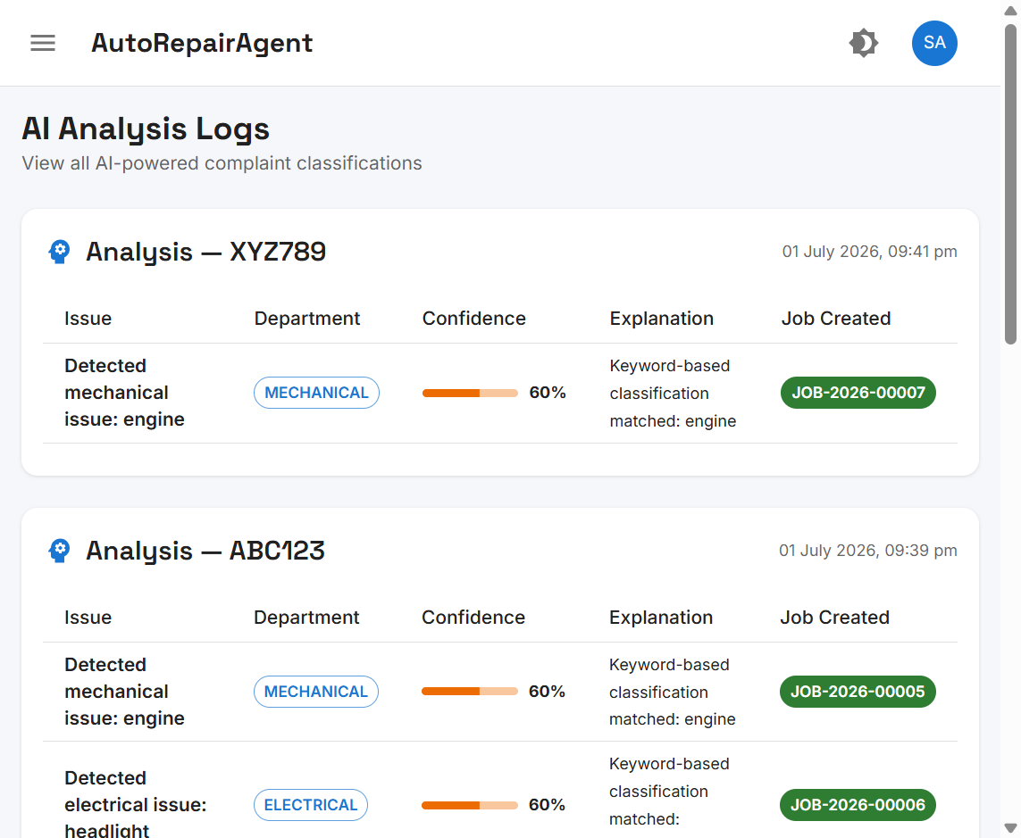
AR
AI Analysis Log Interface
02 - PROGRESS
System Screenshot: AI Analysis Logs Page
Figure 6. AI analysis history with confidence scores and created jobs
AutoRepairAgent | Progress Report 2
Progress
14

Slide 15
AR
Future Recommendations
03 - FUTURE
Items Not Completed - Post-Project Enhancements
Enhancement | Description | Status
Deployment | Cloud hosting, Docker, CI/CD pipeline | Deferred
Multilingual UI | Sinhala, Tamil & English language support | Deferred
SMS / Email Alerts | Job status notifications to customers & staff | Deferred
Automated Testing | Jest unit tests, CI/CD quality pipeline | Deferred
Inventory Management | Spare parts tracking and basic invoicing | Deferred
AutoRepairAgent | Progress Report 2
Future Work
15

Slide 16
AR
Problems Encountered & Solutions
03 - CHALLENGES
Phase 2 Technical Challenges - All Resolved (Sommerville, 2016)
Problems Encountered
Solutions Applied
▸ AI JSON parsing - markdown-wrapped responses broke JSON.parse()
▸ Invalid department codes from AI output
▸ DeepSeek API subscription quota exhausted (HTTP 402/429)
▸ Database migration sync issues during schema updates
▸ Cross-module integration bugs between new modules
▸ ✅ Added JSON cleanup + DEPARTMENT_MAP normalisation
▸ ✅ Implemented keyword fallback classifier
▸ ✅ Renewed DeepSeek subscription; updated API key
▸ ✅ Reset migrations; updated seed with test data
▸ ✅ Fixed Prisma relations and React Query cache invalidation
AutoRepairAgent | Progress Report 2
Challenges
16

Slide 17
AR
Project Status - Development Complete
04 - STATUS
Final Assessment: ALL OBJECTIVES ACHIEVED
✔ PROJECT COMPLETE
▸ All Phase 1 (Report 1) and Phase 2 (Report 2) modules delivered and tested.
▸ End-to-end workflow verified: customer -> vehicle -> complaint -> AI -> job -> complete.
▸ System demonstrable locally with seed accounts (admin@autorepair.com / Password123!).
▸ Future work (deployment, multilingual, notifications) documented as recommendations.
▸ This is the final progress report for the AutoRepairAgent college project.
Report 1 vs Report 2 Summary
Report 1: Foundation (DB, Auth, Admin, UI) -> Report 2: Business Logic (Customer, Vehicle, AI Jobs, Assignment, Logs)
AutoRepairAgent | Progress Report 2
Conclusion
17

Slide 18
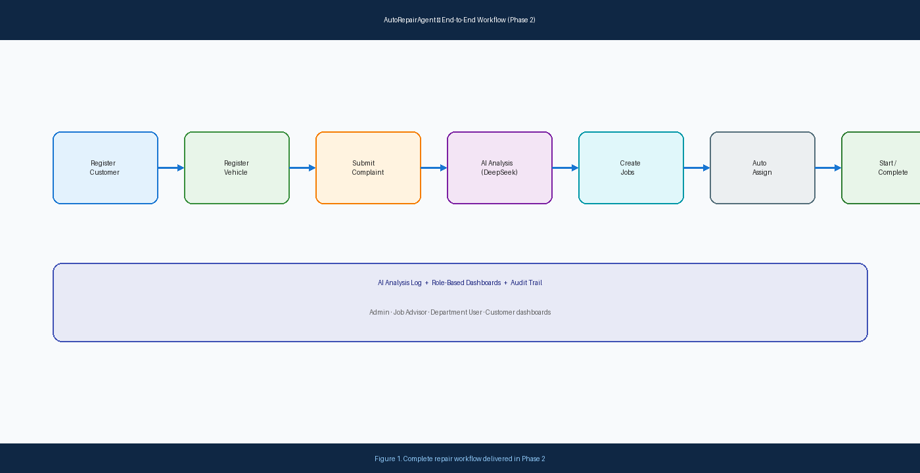
AR
End-to-End System Workflow
04 - WORKFLOW
Complete Repair Process - Phase 2 Delivered
Figure 1. Full workflow from customer registration to job completion
AutoRepairAgent | Progress Report 2
Workflow
18

Slide 19
AR
References
05 - REFERENCES
APA 7th Edition - Bibliography
1. Express.js. (n.d.). Express documentation. https://expressjs.com
2. Martin, R. C. (2017). Clean architecture: A craftsman's guide to software structure and design. Prentice Hall.
3. Meta Platforms, Inc. (2024). React documentation. https://react.dev
4. OpenAI. (2024). DeepSeek API documentation. https://api-docs.deepseek.com
5. OWASP Foundation. (2021). Authentication cheat sheet. https://cheatsheetseries.owasp.org/cheatsheets/Authentication_Cheat_Sheet.html
6. Prisma Data, Inc. (2024). Prisma ORM documentation. https://www.prisma.io/docs
7. Sommerville, I. (2016). Software engineering (10th ed.). Pearson.
Note: In-text citations follow APA 7th edition author-date format.
AutoRepairAgent | Progress Report 2
20

