Slide 1
Context based Question Answering System Natural Language Processing-CS6030
Anish Kumar C 2018103514
Ashwath Narayan 2018103517

Slide 2
Introduction
Context based Question Answering (CBQA) is a new and exciting problem that uses natural language processing.
CBQA is a task that has emerged in the last few years and has been getting a lot of attention from the machine learning community.
The task typically involves providing a paragraph to a computer and asking a question from the paragraph which the computer must answer.
The answer could be in any of the following forms: a word, a phrase,choosing out of several possible answers.
NLP techniques must be used to understand the question. Moreover, it must be used to effectively answer the question in context of the paragraph.

Slide 3
Objective
To design and develop a question answering system which generates an answer score matrix for the query given by the user based on the context of the given paragraph.
Dataset
Stanford Question Answering Dataset (SQuAD) is a reading comprehension dataset in Kaggle, consisting of questions posed by crowdworkers on a set of Wikipedia articles, where the answer to every question is a segment of text, or span, from the corresponding reading passage, or the question might be unanswerable.

Slide 4
Literature Survey
No. | Title of the paper | Issues | Approaches and Techniques
1. | Context-Aware Answer Sentence Selection With Hierarchical Gated Recurrent Neural Networks(2019) | Answer phrase extraction can be investigated. | Gated RNN, Match LSTM,SVM
2. | Knowledge Base Question Answering With a Matching-Aggregation Model and Question-Specific Contextual Relations(2018) | Answer can be extracted only from the knowledge base | SVM,CNN, LSTM
3. | SmartQ: A Question and Answer System for Supplying High-Quality and Trustworthy Answers | Context mismatch sometimes. | Naive Bayes Classifier

Slide 5
No. | Title of the paper | Issues | Approaches and Techniques
4. | Automatic Question Answering Based on Single Document-IEEE Conference(2018) | Didn’t work on context extraction | Gated RNN, Match LSTM
5. | Question answering system using web snippets(2017) | Can’t rely on the answer since websites can be misleading at times. | CNN and RNN
6. | S. Wang and J. Jiang, “Learning natural language inference with LSTM,”(2017) | Context mismatch sometimes. | Lstm with attention

Slide 6
Block Diagram
SQuAD Dataset
Tokenization
Passage
Query
Tokenization
Word Embedding By GloVE
Word co-occurrence statistic collection
Soft constraint Definition
Cost function definition
Contextual Embedding by LSTM
Define network
Compute Network
Fit Network
Evaluate Network
Passage-Query Mapping by Attention
Attention Score Generation
Attention Distribution Generation
Similarity Matrix Generation
C2Q and Q2C Attention
Mega Merge
Answer Modeling using BiLSTM
Answer Generation
Answer
Concatenation
Probability Calculation
Span Score Generation

Slide 7
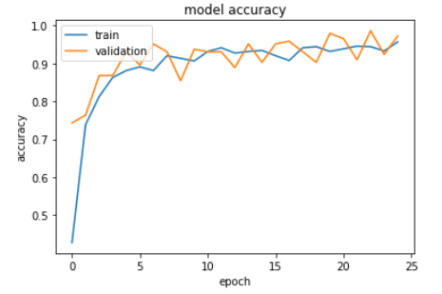
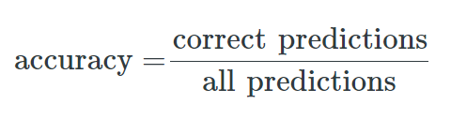
Performance
Model Accuracy : 91.4%
Model Loss : 23.7%

