Slide 1

Mini Project Presentation
Subtext: Context Based Real Time Communication App
Anish Sachdeva
DTU/2K16/MC/13
Under Prof. Dr. Sivaprasad Kumar

Slide 2

Acknowledgements & Gratitude
Gratitude to Prof. Dr. Sivaprasad Kumar – Professor at Delhi Technological University (DTU) in the Mathematics Department
Special Thanks to Delhi Technological University (DTU) for proving me and opportunity and platform to build and showcase this project
Extended Thanks to family and friends for their encouragement and support to build such a large project.

Slide 3
Aim: Things That I wanted to support
Text
Code
Markdown
LaTeX
Emojis

Slide 4
Text
Messages like this
And this
Also numbers 123456
and small case + CAPITAL
Plus special characters /*,.<>;'":}{][!@#$%^&*()_+=-

Slide 5
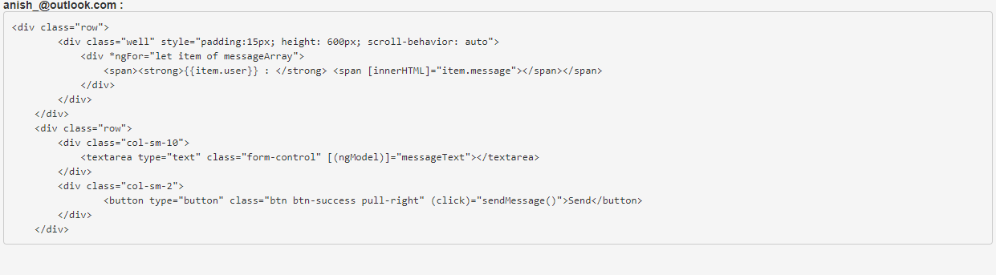
Java C/C++ C# JavaScript Swift Python …. …. And everything in between
class BinarySearchExample{
public static void binarySearch(int arr[], int first, int last, int key){
int mid = (first + last)/2;
while( first <= last ){
if ( arr[mid] < key ){
first = mid + 1;
}else if ( arr[mid] == key ){
System.out.println("Element is found at index: " + mid);
break;
}else{
last = mid - 1;
}
mid = (first + last)/2;
}
if ( first > last ){
System.out.println("Element is not found!");
}
}
public static void main(String args[]){
int arr[] = {10,20,30,40,50};
int key = 30;
int last=arr.length-1;
binarySearch(arr,0,last,key);
}
}

Slide 6
Markdown
__bold__ --> bold
_italic_ --> italics
`code` -> code
```js``` --> perfomatted code
# heading -> Main Heading etc.

Slide 7
Emojis
😀 😁 😂 🤣 😃 😄 😅 😆 😉 😊 😋 😎 😍 😘 🥰 😗 😙 😚 ☺️ 🙂 🤗 🤩 🤔 🤨 😐 😑 😶 🙄 😏 😣 😥 😮 🤐 😯 😪 😫 😴 😌 😛 😜 😝 🤤 😒 😓 😔 😕 🙃 🤑 😲 ☹️ 🙁 😖 😞 😟 😤 😢 😭 😦 😧 😨 😩 🤯 😬 😰 😱 🥵 🥶 😳 🤪 😵 😡 😠 🤬 😷 🤒 🤕 🤢 🤮 🤧 😇 🤠 🤡 🥳 🥴 🥺 🤥 🤫 🤭 🧐 🤓 😈 👿 👹 👺 💀 👻 👽 🤖 💩 😺 😸 😹 😻 😼 😽 🙀 😿 😾

Slide 8
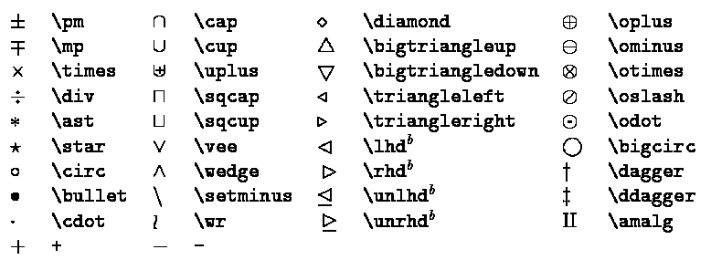
LaTeX

Slide 9
Context based real time communication app that can understand information encoded with different text markup formats
SUBTEXT

Slide 10
Current Market and Competition
Whatsapp
Facebook Messenger
Instagram
Google Allo/Messenger
Microsoft Office
Skype
Google Docs/Sheets/Slides

Slide 11
Text + Emojis
Text + Emojis + Markdown
LaTeX + Others
Whatsapp
Instagram
Facebook Messenger
Google
Microsoft etc.
Slack
Whatsapp (Italic and bold from Markdown)
None to my knowledge
‍🤷‍♀️

Slide 12
Initial Prototype
Created using AngularJS, Express and MongoDB
Has proper log in screen and text messaging facility people to people and also group chatting
Also added chatbot that announces all active participants and when they leave the group etc.
Disadvantages: does not support Markdown/LaTeX
Another Disadvantage: was built on complete server side technology hence no client side rendering and computation available

Slide 13
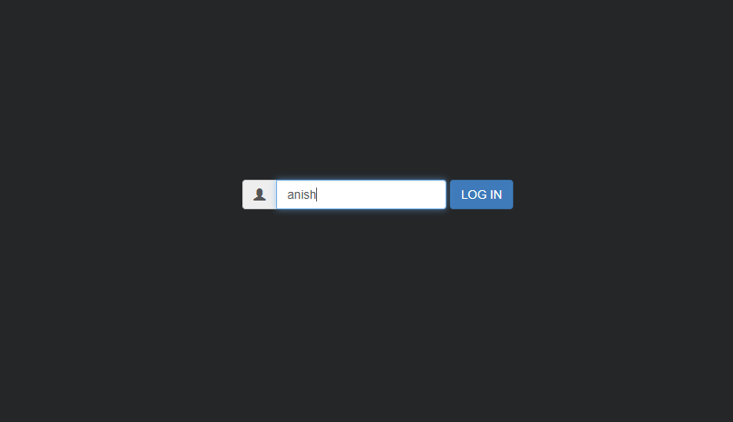
Prototype I: Login page

Slide 14
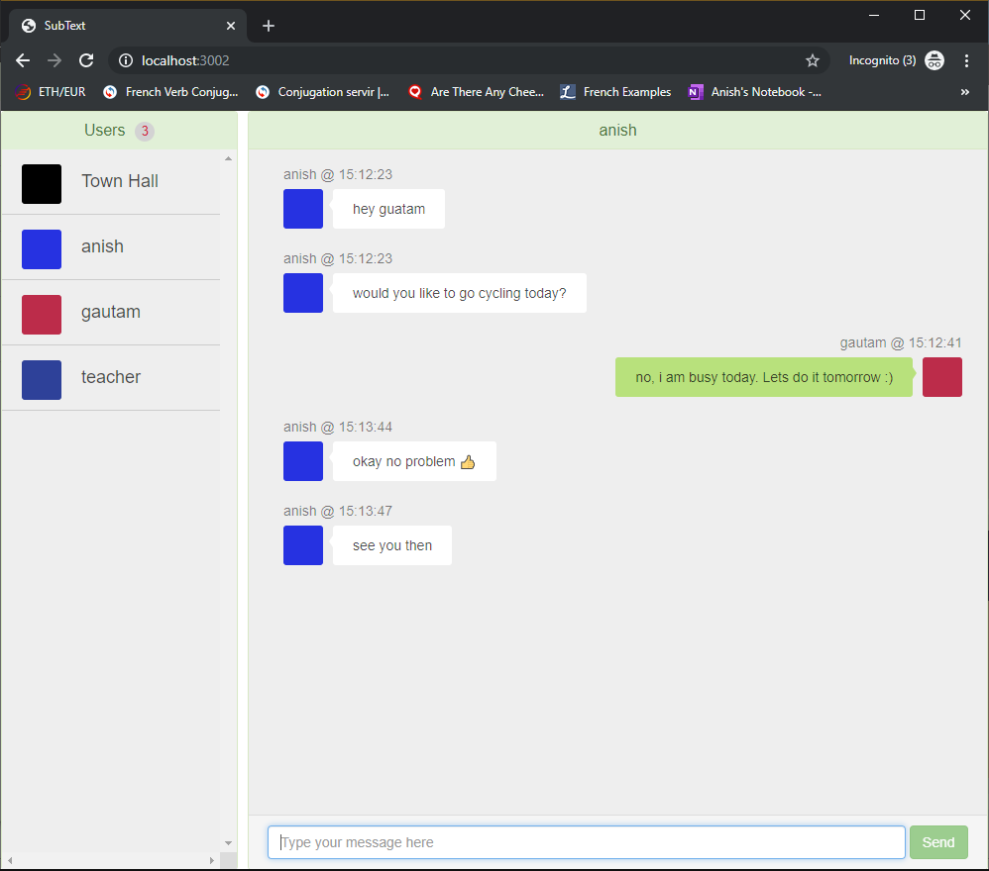
Prototype I: Chatting Person/Person

Slide 15
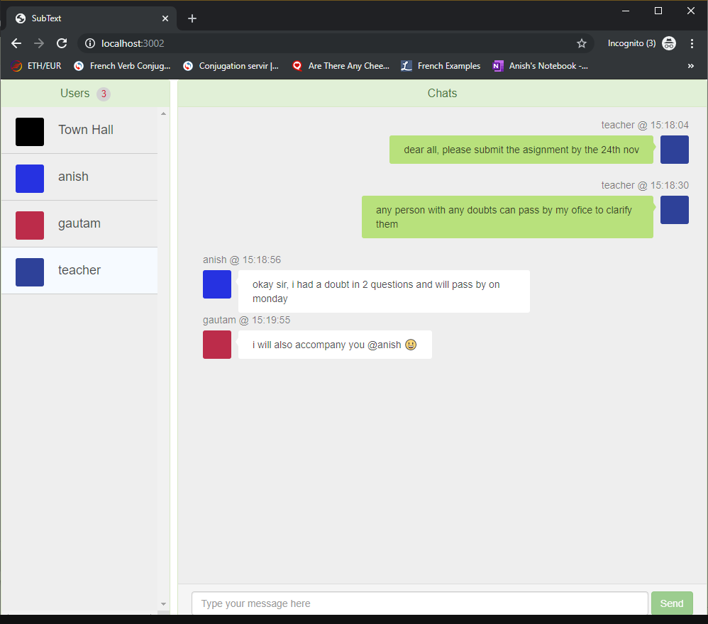
Prototype I: Person/Group

Slide 16
Prototype II
Added mark down support
Added multiple classroom support
Created markdown analyser and text parser from scratch

Slide 17
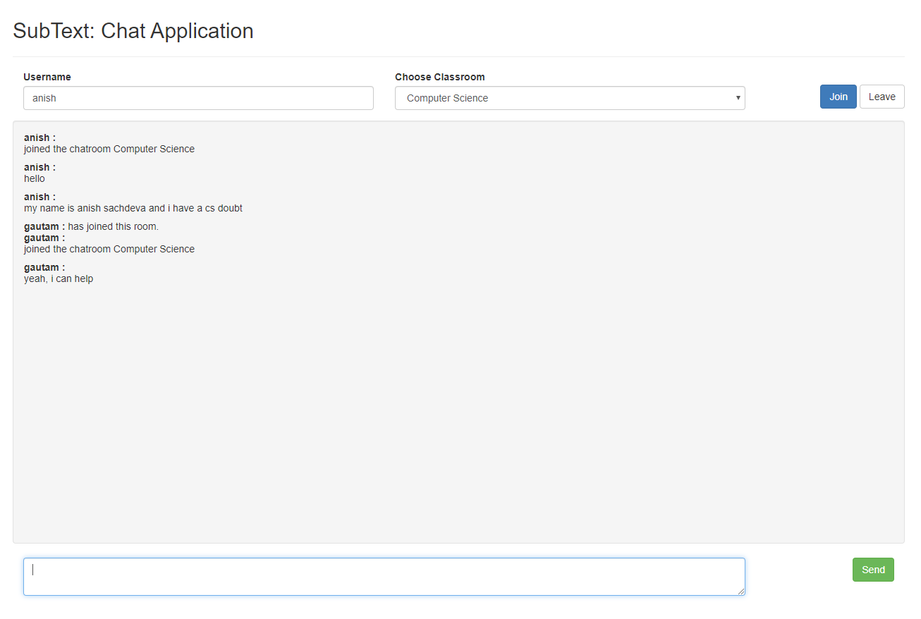
Prototype II: Text interaction

Slide 18
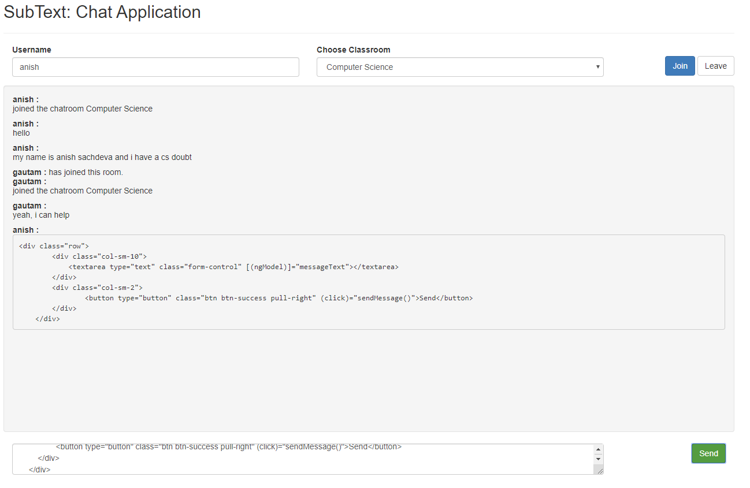
Prototype II: Markdown + Text Interaction

Slide 19
Markdown
Markdown is a lightweight markup language with plain text formatting syntax. Its design allows it to be converted to many output formats, but the original tool by the same name only supports HTML. Markdown is often used to format readme files, for writing messages in online discussion forums, and to create rich text using a plain text editor.
Developed by John Gruber and Aaron Swartz

Slide 20
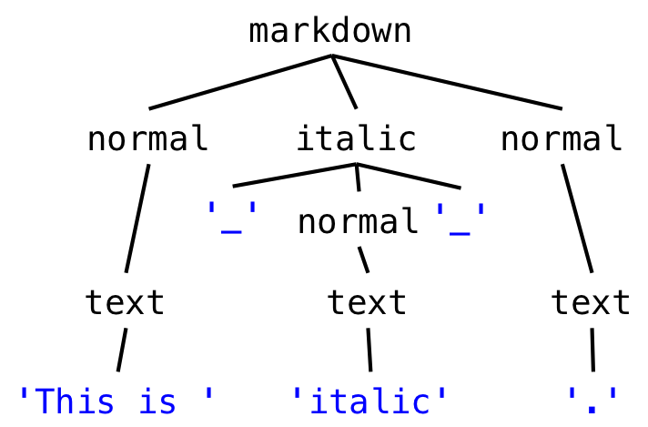
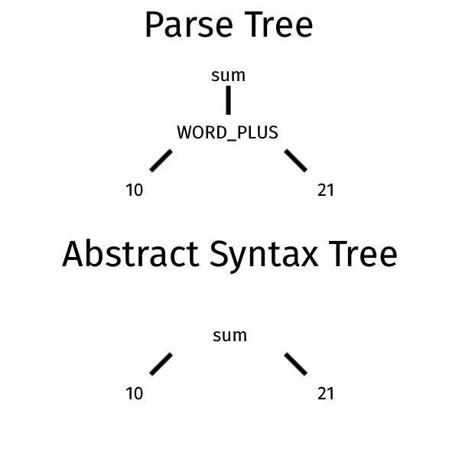
Lexical Parser

Slide 21
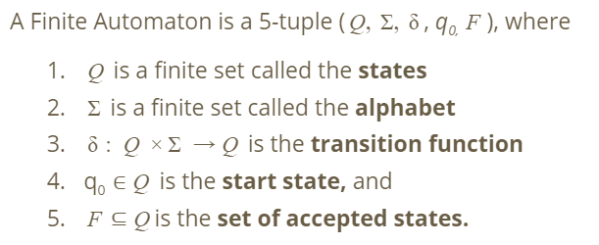
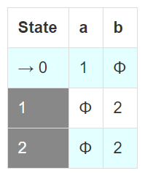
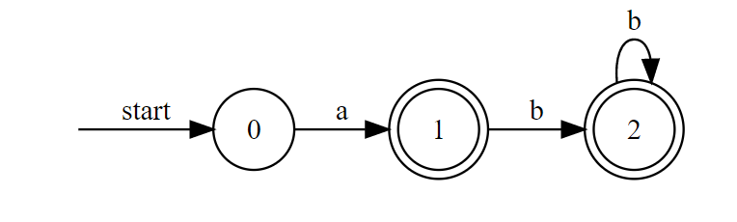
Finite Automata

Slide 22

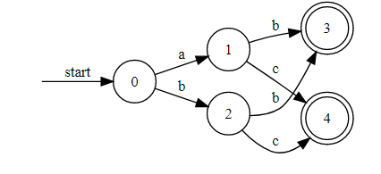
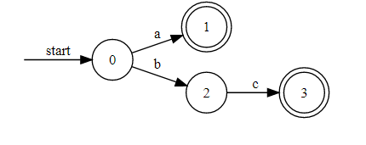
Finite State Automata Generator
See this
This is a finite state automata generation web application that builds deterministic and non-deterministic automata based on regular expressions.

Slide 23
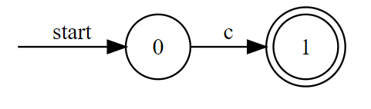
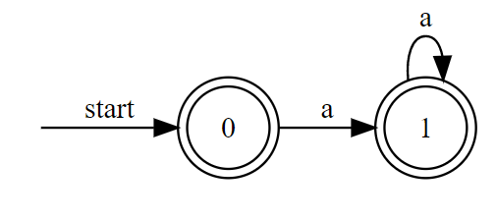
Deterministic Finite Automata (DFA)

Slide 24
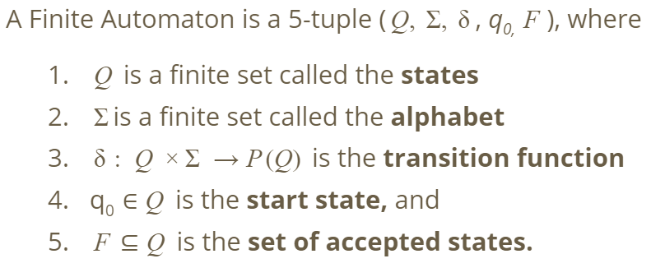
Non Deterministic Finite State Automata (NDFA)

Slide 25
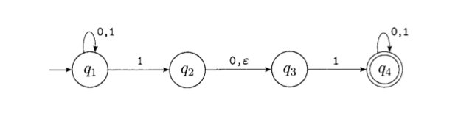
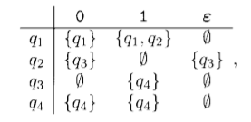

Slide 26
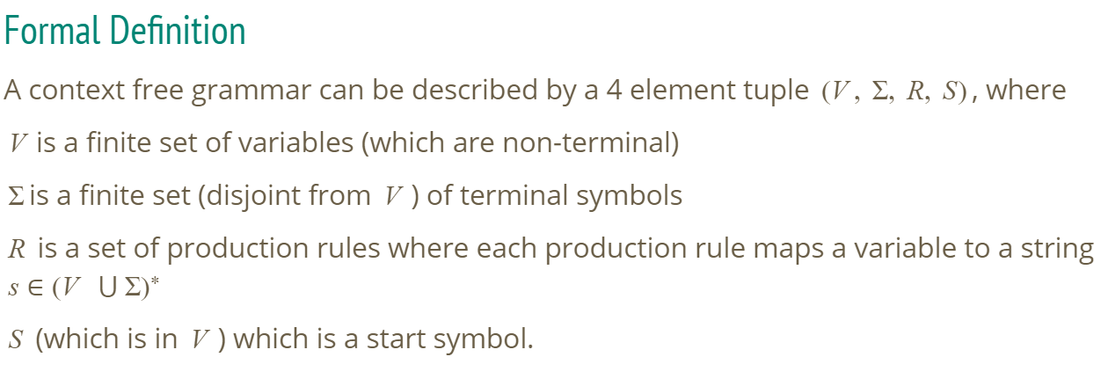
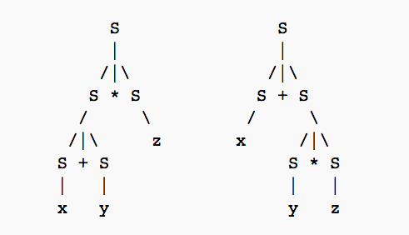
Context Free Grammars

Slide 27
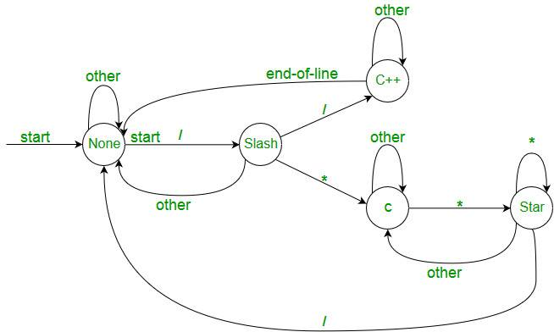
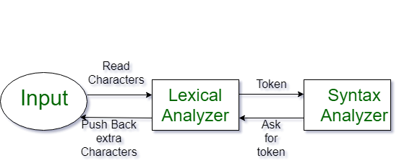
Lexical Parsing

Slide 28
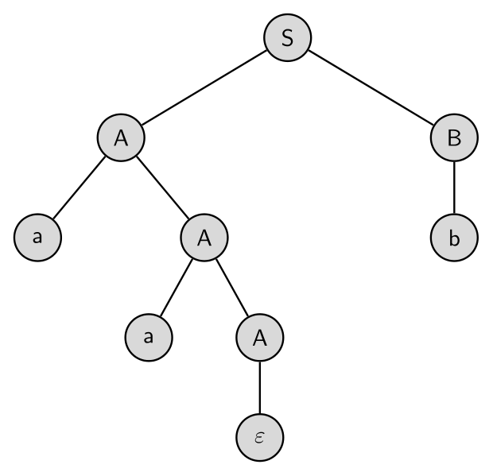
Parse Tree
A parse tree or parsing tree or derivation tree or concrete syntax tree is an ordered, rooted tree that represents the syntactic structure of a string according to some context-free grammar. The term parse tree itself is used primarily in computational linguistics; in theoretical syntax, the term syntax tree is more common.

Slide 29
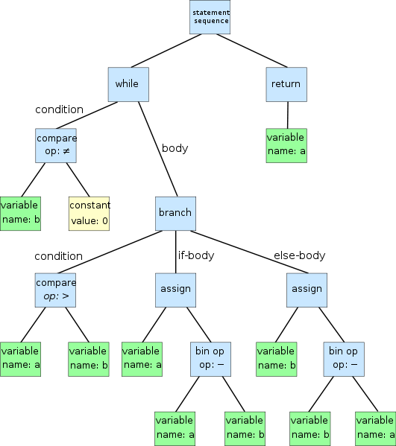
Abstract Syntax Tree
In computer science, an abstract syntax tree (AST), or just syntax tree, is a tree representation of the abstract syntactic structure of source code written in a programming language. Each node of the tree denotes a construct occurring in the source code.

Slide 30
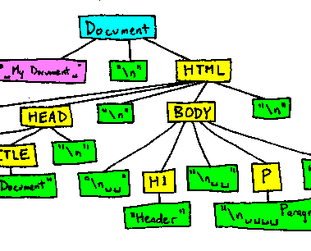
Markdown Implimentation
The entire parser consists of many functions that each individually manage the successful conversion of a single markdown construct into an HTML node. A markdown construct here is referring to one single markdown formatting rule that applies e.g bold text or italic text. Here this atomic rule is referring to a single construct and I have created a singular function to handle and manage every such singular construct.

Slide 31
Prototype III
Adds LaTeX Support
Adds Mathematical fonts to represent Mathematical symbols
Create an online compiler and parser that converts text to html based on LaTeX markup.
This compiler works without any internet connection and is faster than OverLeaf!
Also created a brand new interface for the application

Slide 32
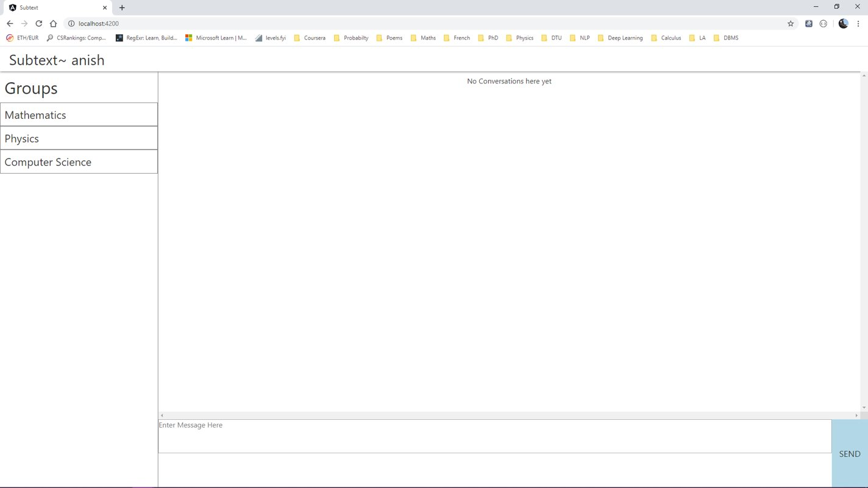
Prototype III: Dedicated Groups Panel

Slide 33
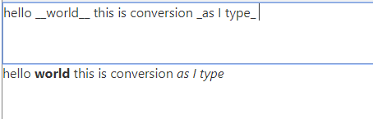
Prototype III: Hot-Reload Conversion of Markdown text into Markdown

Slide 34
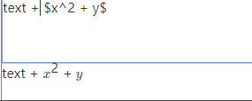
Prototype III: Conversion to LaTeX as we type

Slide 35
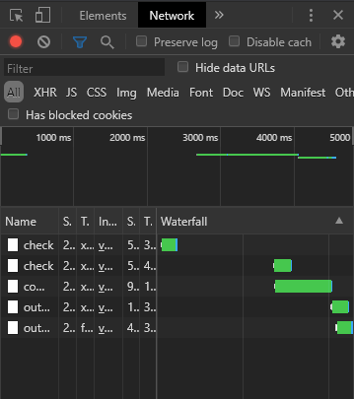
Overleaf vs. SubText LaTeX Conversion
Open Overleaf Sample Project here
SubText is 20x-400x faster!

Slide 36
Firebase Database
Firebase Database is a real time Database offered by Google.
It is very reactive and highly scalable.
Live data creation and modification can be seen here.

Slide 37
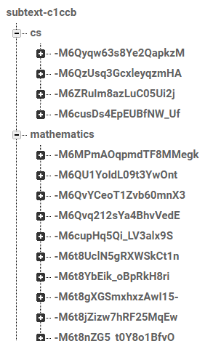
Persistent Message Store
See message database here.

Slide 38
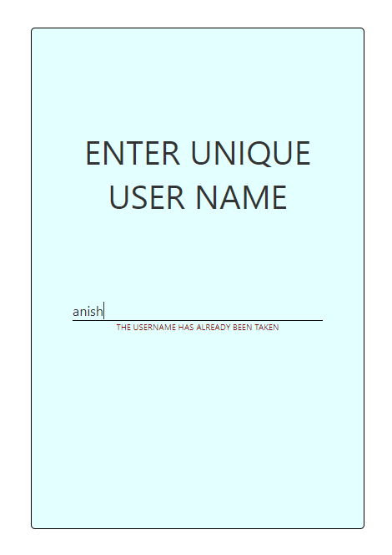
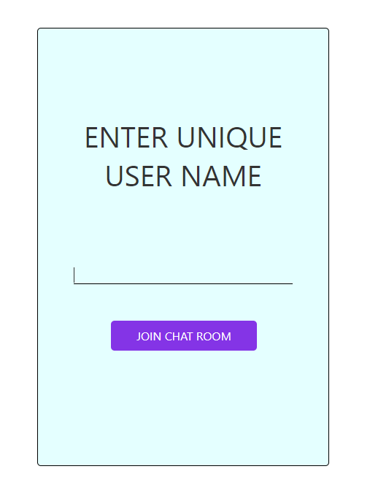
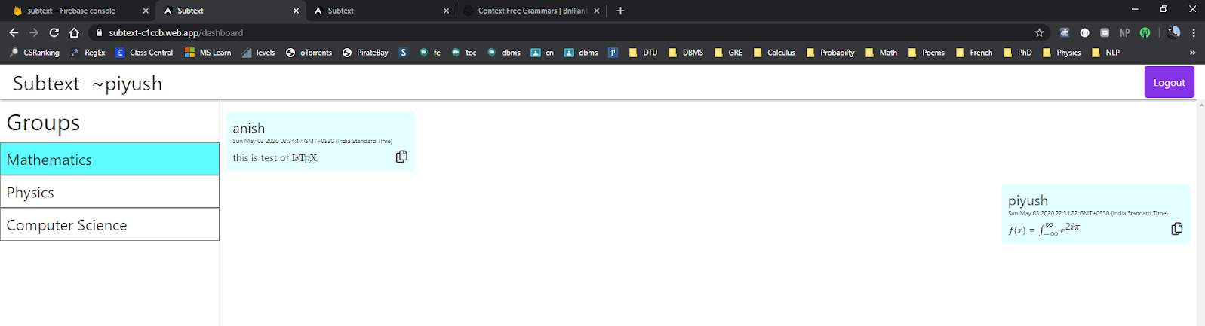
Multiple User Support + Login/Logout Screen
See database live here.

Slide 39
Future Scope – The Casual User
Persisten User Information on the desktop using Cookies
Buying a domain name like subtext.com or subtext.chat
Group creation and chat creation functionality
Adding a ML/AI keyboard agent that detects automatically whether a person wishes to type markdown or latex and then automatically switxching to that context
Adding other contexts such as Pictures, Live Code snippets, lists, quizes, calnder events etc.
Adding email and OAuth based persistent user and message storage

Slide 40
Future Scope – Businesses & Organizations

Slide 41
Future Scope - Organizations
Adding organizational capabilities and allowing organizations to create custom domain and create multiple internal teams with many groups.
An organization can register its individual name like {abc} and then access the domain like abc.subtext.chat/group-name
Inside a group, group owners will have the ability to create multiple channels for discussing and communicating on various issues and they will be able to do so individually in each channel using Markdown, LaTeX and all the other contexts that te application can automatically infer.

Slide 42
Future Scope - Organizations
For communicating inside a particular channel they can use {organization-name}.subtext.com/{group}/{channel}
And for chatting with an individual user they can use {organization-name}.subtext.com/user/{user-name}

Slide 43
Organizations - Revenue Model
Will be charged on a per user basis so larger organizations will be billed more as compared to smallr organizations.
The features required to make this production ready are feasible and minimum funding is required and with the support of DTU and the startup incubator and an additional good programmer it is very likely that the world's most powerful communication application may come out of DTU.

Slide 44
Conclusion

Slide 45
Conclusion
Users can express themselves better when they do not have to think what kind of messages they can or can't send.
They are able to better express themselves and additional markup languages such as MarkDown and LaTeX draws professionals from many different backgrounds to make this application much more attractive.
Additional features such as Lists, Quizes and Calender events will further make this application lucrative to non-technical and non-industry specific persons.
All parsers and lexical analyzers are implimeted on the client side code meaning that all transformations and rendering happens without calling the server and without need of internet.

Slide 46
Any Additional Questions?

Slide 47
Important Links
Subtext Repository
Subtext Deployed
Subtext Prototype – I Repository
Subtext Database [Firebase]
Project Report
Author's LinkedIn Profile
Author's GitHub Profile

Slide 48
Thank You :)

