Slide 1

A Novel a-Posteriori Approach For Eliminating Degradation In Images Caused By Point Spread Functions (PSF) and Restoring Images To Original State
Delhi Technological University (DTU)
Anish Sachdeva
DTU/2K16/MC/13

Slide 2
Project Details
Title: A Novel a-Posteriori Approach For Eliminating Degradation In Images Caused By Point Spread Functions (PSF) and Restoring Images To Original State
Project Supervisor 1: Dr. S. Sivaprasad Kumar (MC)
Project Supervisor 2: Dr. Rajiv Kapoor (ECE)
Candidate: Anish Sachdeva (DTU/2K16/MC/013)
Project Link: https://github.com/anishLearnsToCode/deblur-image

Slide 3
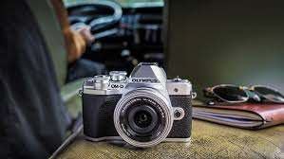

Motivation
We all take picture from our mobile phone, camera etc. And want the pictures to be sharp and clear.

Slide 4
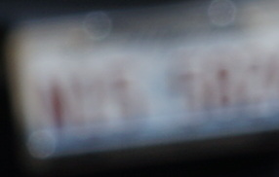
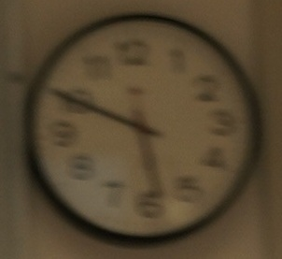
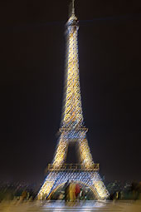

Blurry Shots (What we don't want)

Slide 5

Modelling Images in The Computer
What we visually perceive can't be stored as is In the computer. We need to quantize and sample the image. The final image is represented by

Slide 6
Techniques of Digital Image Processing
1. Image Representation / Modeling
2. Image Enhancement
3. Image Restoration
4. Image Analysis
5. Image Reconstruction
6. Image Data Compression
In this project we are performing Image Restoration

Slide 7
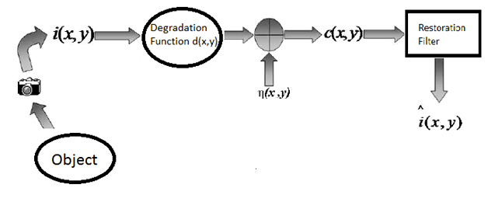
Blur Model

Slide 8

The Challenge
We can represent the blur image model as
We have c (degraded image), some information about the degradation function (blur) df , and some information about the noise η. The goal of restoration is to get an estimate of the original (actual) image. The estimate, ιˆ, is desired to be as close as possible to the original image. In fact the more the information we have about df and ιˆ, the more accurate will be the estimation.
Image restoration process refers to elimination or minimization of degradation in an image. The process of image restoration includes deblurring of images which are degraded by the various limitations of camera sensor, environment, correction of geometric distortion or non-linearity’s and noise due to camera sensors.

Slide 9
Target Definition
Image deconvolution is a process of recovering the original image from a degraded image. There are two types of image deconvolution, first is the blind image deconvolution and second is the non blind image deconvolution. Blind image deconvolution is a process of deconvolution in which both the actual image and the degradation function is unknown and only the degraded image is known.
Non blind image deconvolution is a process of deconvolution in which we have the knowledge of the degradation function ( blur function / blur kernel / point spread function).
The revival process or recovery process are of two types:
1. Non Blind Restoration
2. Blind Image Restoration

Slide 10

Non-Blind Image Restoration
The first type non blind restoration technique includes that utilizes some knowledge about the blur kernel during revival of the image while the second type blind image restoration technique tries to estimate both the original image and the degradation (blur) from the degraded/blurred image, without any knowledge of the imaging system. In the non blind restoration technique, the blur kernel or degradation function is given and the degradation/convolution process is reverted using known restoration algorithms.
In the second type that is blind image deconvolution, the degraded image c(x; y), is expected to be a two dimensional convolution of the actual image i(x; y) with the blur kernel(degradation function), also known as point spread function (PSF), d(x; y). The relation between the discussed parameters is given by:

Slide 11
Motivation For Blind Image Deblurring
Inspite of being difficult problem, the blind image deconvolution has enjoyed wide application area in most of the practical scenarios. The major motivations behind blind image deconvolution can be focused as:
1. Use of high cost adaptive-optics systems to overcome the blurring problem in astronomical imaging is impractical for analyzing some observation

Slide 12
2. Some application area such as medical imaging rely on high image quality for close diagnosis, like X-ray imaging, which in turn demands for increased incident X-ray beams intensity. But practically, this is hazardous for patient’s health and hence blurring is inevitable. Hence, BID is used to tackle with the degradation
3. Instant deblurring cannot be done by predetermining certain PSF in real-time applications such as video-conferencing.

Slide 13
4. Lastly, but not least, to predetermine any information about any scenario is practically either too costly, or dangerous and sometimes mostly impossible. Also, the degradation specified is not necessary true for deblurring. Hence, blind approach is adopted to solve the problem.

Slide 14
Deblurring Characteristics
Blind deconvolution problem is based on some assumptions. The problem of blind deconvolution of image has few characteristics as listed below:-
1. The signals that convolve to form the degraded image that is the original image and the blur kernel (PSF) are irreducible (3). It is important to have this characteristic as if the degraded image is a resultant of more than two independent components then the deconvolution is ambiguous. If true image i(x, y) = i1(x, y) · i2(x, y) and the blur kernel (PSF), d(x, y) = d1(x, y) · d2(x, y), then

Slide 15

2. Blind deconvolution process is prone to get scaled and shifted with respect to the true image. Thus
where A, b1, b2 are the arbitrary constants and ιˆ is the estimate of the original(actual) image but the blind deconvolution cannot find A, b1 and b2.
3. Techniques involved in blind deconvolution assume noiseless condition for reconstruction of the original image.

Slide 16
4. The blind deconvolution problem is an ill-posed problem. The solutions in the result may entirely differ even if very small change in the assumed data is done for reconstruction process.
5. The devices used in the imaging system may not be perfect and may add noise in the captured image. This type of system will affect the overall result of the image deconvolution process. Direct subtraction of the noise from the signal is not possible as it is statistical in nature.

Slide 17
Blind Image DeBlurring Techniques
The blind deconvolution of images are addressed by following approaches:
1. In the first approach the identification of PSF i.e. degradation function, is done first and then the true image is identified using classical restoration techniques such as Wiener filtering, inverse filtering, pseudo inverse filtering, etc. This approach requires less computation. The algorithms based on this approach are called as Priori blur identification technique.

Slide 18
2. In the second approach PSF (blur kernel) and the original image both are recovered simultaneously in the image restoration process. Thus the algorithms used in the process in such approaches are computationally complex.
Among the blind deconvolution techniques a priori blur identification technique is the simplest. The blur or the degradation function (PSF) is found and then the actual image is estimated. The results are excellent when the blurring parameters are found correctly. This technique is best suited for applications where blur parameters are known.

Slide 19
History of The Subject (Material Research)
Mariana and Mario have worked on the stopping criteria for the iterative process using whiteness measure. They presented that the performance of deblurring algorithm depends critically on the weight assigned of the regularizer and on the number of iterations for which the image is been deblurred in the algorithm.
Tao, Jinli , and Qionghai (10) presented a deblurring method to restore the blurry images scenes degraded by any camera motion of large depth range. They suggested a blur model which would take into account of camera motion in 6-degrees of freedom with a pre given scene depth map.

Slide 20
Vijay, Paramanand and Rajagopalan (11) suggested that blurring depends lot many factors such as stability of the platform, exposure time and user experience. They presented a method that takes as input differently exposed non-uniformly blurred images to recover the true deblurred sharp image. They used a transformation spread function (TSF) to model the blur i.e. point spread function. The true sharp image is then recovered by minimizing a optimization cost iteratively.
Alexandra and Andrey (12) worked on the post processing the deblurring process to recover the image if some blur still exists. They presented a method to transform the neighboring pixels of the edge in the image so that the neighboring pixels come closer to the existing edges in the image.

Slide 21
Approaches In Image Processing
1. Image Deblurring / Image Deconvolution
Solving an image deconvolution problem all comes down to its ill-posedness described in Sec.1.2.2, which, in one aspect, shows itself as zero division in the frequency domain. The simplest solution is to introduce a fixed small number in the denominator, another way is to use wiener deconvolution. In it estimates of power spectral density of noise and original image is used. Apart from this we can also use some prior knowledge of images.
The challenge with ill posed problem is that the number of possible solutions for the deconvolution problem is very large. Similar resultant images can be obtained for different images.

Slide 22
2. Blind Image DeBlurring/Deconvolution
Blind image deconvolution technique restores the actual image from the degraded image without any significant knowledge of the degradation function (PSF).
There are two ways of doing this:
1. Find the PSF (blur), and apply non blind deconvolution method.
2. Estimate the PSF (blur) and the true sharp image iteratively.

Slide 23
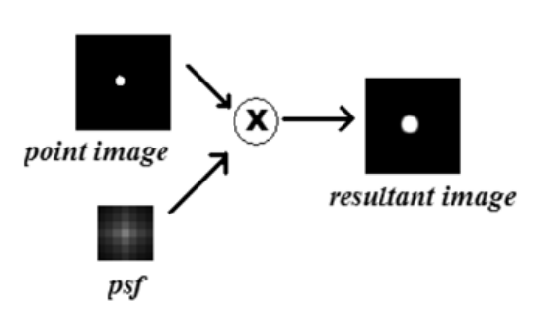
Types of PSF (Point Spread Function)
Point spread function which causes degradation is of two types:
1. Spatial-variant Blur
2. Spatial-invariant Blur

Slide 24
Space Invariant Blur
The various types of spatially invariant blur models like:
1. Motion Blur
2. Out of Focus Blur
3. Atmospheric Turbulence Blur

Slide 25
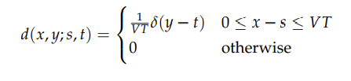
Motion Blur
When objects move during the time of capture or camera moves during time of capture then there occurs motion blur. Many types of blurs have been discussed in the literature. The various types of motion blurs are translation, scale change, rotation, or any combination of such blurs.

Slide 26
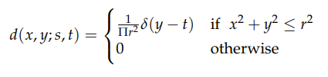
Out of Focus Blur
This type of blur can be visualized as some parts of the captured image is in focus and some is not in focus. The focal length of the lens its distance with the object causes this type of blur and finally degrades the image.

Slide 27
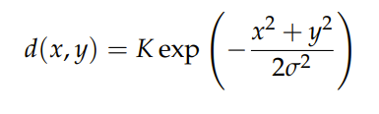
Atmospheric Turbulence Blur
The point spread function formed due to the long exposure of the camera in the atmosphere in certain cases is called as Gaussian PSF. The PSF in this case is given as:

Slide 28
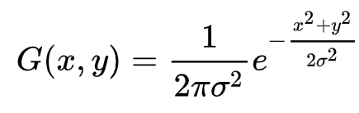
Gaussian Blur
The image degradation due to atmospheric condition is modelled by the Gaussian effect. The Gaussian blur is also a type of blur that acts as a filter and applies Gaussian distribution to each pixel in the image. Visually Gaussian blurring smoothens the image and there is an overall blur. Deconvolution techniques have been devised and are required for treating the degraded image. Method discussed in this thesis solves all such blurs.

Slide 29
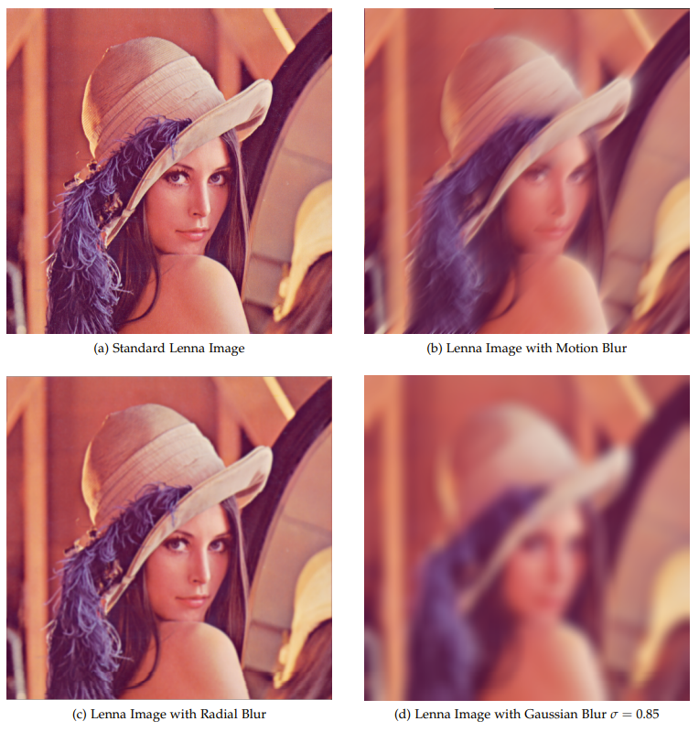
Blurring Examples

Slide 30

Blind Deconvolution Using Maximum a Posteriori
This is a single image blind deconvolution method. Its goal is to estimate the unknown degradation function (blur) from a single blurred image and reconstruct the original sharp image. We rewrite the equation showing blur degrading model:
When we see the problem from probabilistic point of view recovery of u and h iteratively equates to solving MAP (Maximum A Posteriori) estimation.

Slide 31
Mathematical Model
Lets assume that the individual variables used in the blur degradation model are discrete quantities which are indexed and denoted as ui or [u]i . Maximization of the posterior probability P(i, h|b) is equivalent to the minimization of the negative logarithm of it, i.e.
where Q(i) = log P(i) and R(h) = log P(h) are regarded as regularizers that track the optimization to the correct result and away from infinite number of other wrong and unwanted solutions.

Slide 32

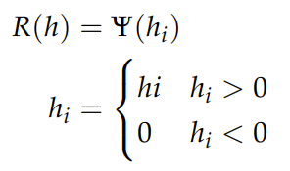
Mathematical Model (Continued...)

Slide 33


Proposed Fusion Method
Hello
Maximization of the posterior probability P(i, h|b) is equivalent to the minimization of the negative logarithm of it, i.e.,
By solving this for I and H we get an estimate of the true sharp image but the image is still not fully blur free so something else needs to be done to remove it.

Slide 34
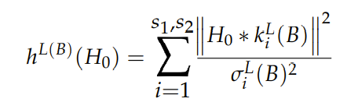

Proposed Fusion Method (Continued)
So now we take the estimate of the true sharp image is taken as the blurred image and we use the eigen value based method to solve the problem in hand. We find the blur kernel by minimizing the equation for Ho given by
Further when we have calculated the blur kernel then we iteratively minimize the given equation to finally find the true sharp image using

Slide 35
