Slide 1

Least Bit Steganography (LSB) With Higher Data Volume Transmission Inside Images
Anish Sachdeva
DTU/2K16/MC/013
Cryptography and Network Security (MC-407)
Dr. Rohit Kumar

Slide 2

Details
Project Link: https://github.com/anishLearnsToCode/lsb-image-steganography
Student Name: Anish Sachdeva
Supervisor: Dr. Rohit Kumar
Subject: Cryptography and Network Security (MC-407)
Project Title: Least Bit Steganography (LSB) With Higher Data Volume Transmission Inside Images

Slide 3
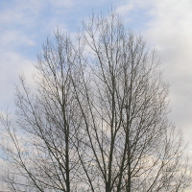
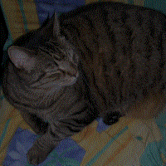
Steganography
Steganography is the practice of concealing a file, message, image, or video within another file, message, image, or video. The word steganography comes from Greek steganographia, which combines the words steganós, meaning "covered or concealed", and -graphia meaning "writing".
Image of a tree where another second image is hidden in the least 2 significant bits of the image.

Slide 4
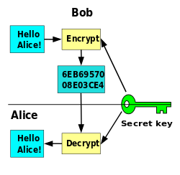
Cryptography
Cryptography, or cryptology is the practice and study of techniques for secure communication in the presence of third parties called adversaries. More generally, cryptography is about constructing and analyzing protocols that prevent third parties or the public from reading private messages; various aspects in information security such as data confidentiality, data integrity, authentication, and non-repudiation are central to modern cryptography.

Slide 5

Kirchoff's Law
The system must be practically, if not mathematically, indecipherable;
It should not require secrecy, and it should not be a problem if it falls into enemy hands;
It must be possible to communicate and remember the key without using written notes, and correspondents must be able to change or modify it at will;
It must be applicable to telegraph communications;
It must be portable, and should not require several persons to handle or operate;
Lastly, given the circumstances in which it is to be used, the system must be easy to use and should not be stressful to use or require its users to know and comply with a long list of rules.

Slide 6
Least Significant Bit (LSB) Steganography In Images
Take the plaintext message
Plaintext = 'hello'
Take the ASCII values of the message,
'hello' = {104, 101, 108, 108, 111}
Converting the message to binary so that we can store it at a bit wise level:
'hello' = {104, 101, 108, 108, 111} = {01101 000, 0110 0101, 0110 1100, 0110 1100, 0110 1111}

Slide 7
We will now create a bit stream which we need to embed in the image
S = {01101 000, 0110 0101, 0110 1100, 0110 1100, 0110 1111}
We will now take a RGB Image of dimensions (w, h, 3) and extract the 3 channels R, G and B
We will convert each channel which has dimension (w, h) into a row vector by unravelling the values and obtain a single vector of dimension (wh, 1)
We will then store the bit stream S into the channels B, R and G by changing the least significant bit in the channels.

Slide 8
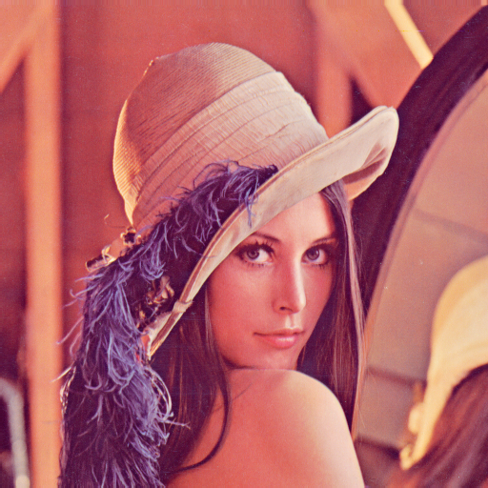
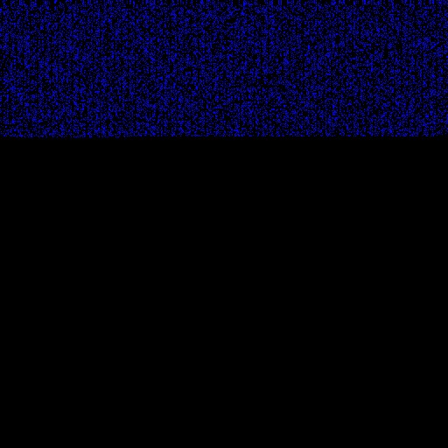
Results of LSB Steganography
Standard Lenna Image
Lenna Image with hidden Plaintext of length 10,000 characters
Difference Between the original and Steganographic Image, where the pixels modified are the Blue Channel pixels only.

Slide 9
Using More Number of Bits
Current number of bits offered by the LSB Method
#bits(LSB) = 3wh
Number of characters we can store in the Image (or Data Volume of Image) given that a single character will require a byte (8 bits) of space
#characters(LSB) = floor(3wh/8)
So, maximum length of plaintext message we can store is |P| = floor(3wh/8)
We will need lg(floor(3wh/8)) bits to store the length of the message with the message.
So total message length |M| = |P| + lg(floor(3wh/8))

Slide 10

Image To Grayscale
There are several techniques of converting an image t grayscale. Simplest is to take average of 3 RGB channels.
G = (R + G + B) / 3

Slide 11
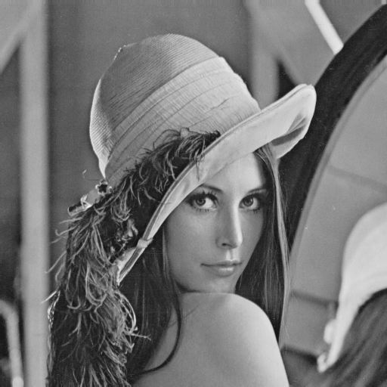
Better Method For Grayscale
Our eyes do not perceive the channels Red, Green and Blue equally, so the standard method of taking grayscale is a weighted average
G = 0.2126 * R + 0.7152 * G + 0.0722 * B
Original Color Image
Grayscale Image using averaging
Grayscale Image Using Weighted Average

Slide 12
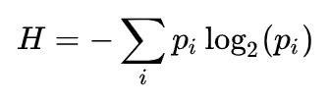
Entropy For Higher Bit Image Hiding
Using the weighted average gives considerably better results
This shows that not all channels contribute equally to an image perception and contribute different amounts ~ 21.26%R, 71.52%G and 7.22% B
If we store b bits of data in either the Red, Blue or green channels we will have different information entropy
Shannon's Entopy is defined as :

Slide 13
When storing the least significant bit the probability that we will cause any change is:
Pb = 2⁰ / 2⁸ – 1 = 3.92 x 10⁻³, but the probbility weigts for perception are not the same, so probability for changing one bit per channel becomes
P_{B} = 0.0722 * P_{b}
P_{R} = 0.2126 * P_{b}
P_{G} = 0.7152 * P_{b}
The Entropies of a single bit represented in these channels (LSB) is:
H_{B} = - P_{B} log₂(P_{B}) = 3.33 x 10⁻³
H_{R} = -P_{R} log₂(P_{R}) = 8.52 x 10⁻³
H_{G} = -P_{G} log₂(P_{G}) = 2.37 x 10⁻²

Slide 14
So entropy if we store data in the entire image in the least significant bits will be:
H_{B(b)} = wh 3.33 x 10⁻³
H_{R(b)} = wh 8.52 x 10⁻³
H_{G(b)} = wh 2.37 x 10⁻²
Total entropy with LSB Steganography for entire Image
HI = H_{B(b)} + H_{R(b)} + H_{G(b)} = wh 3.533 x 10⁻²

Slide 15
If we store data in the 2nd least significant bit, the bit change probability for that will be: P_{b} = 2¹ / 2⁸ – 1 = 2/255.
Respectively the probabilities will be:
P_{B} = 0.0722 * P_{b} = 5.66 x 10⁻⁴
P_{R} = 0.2126 * P_{b} = 1.66 x 10⁻³
P_{G} = 0.7152 * P_{b} = 5.60 x 10⁻³
The entropies for a single secondleast significant bit will be:
H_{B} = - P_{B} log₂(P_{B}) = 6.10 x 10⁻³
H_{R} = - P_{R} log₂(P_{R}) = 1.53 x 10⁻²
H_{G} = - P_{G} log₂(P_{G}) = 4.19 x 10⁻²

Slide 16

The total Entropy of the Image if we store in the second Least Significant bit will be:
H_{I}(b₂) = wh (H_{B} + H_{R} + H_{G}) = wh 6.33 x 10⁻²
If we use both least significant bits to store the data, the message entropy will be:
H_{l}(b₁ + b₂) = H_{I}(b₂) + H_{I}(lsb)
= wh (6.33 x 10⁻² + 3.533 x 10⁻²)
= wh 9.863 x 10⁻²

Slide 17

Conclusion
We can easily store messages inside Images using the last 2 significant bits without changing the entropy of the Image drastically.
Storing an encrypted message inside the Image makes it very secure as then the attacker will first need to figure out that:
A) There is a message stored inside the image
B) The message bits are stored using which algorithm and
C) Then dcrypt the extracted message using the secret key
Encoding the channels in a particular sequence can minimize entropy and store more data with lower entropy.

