Slide 1
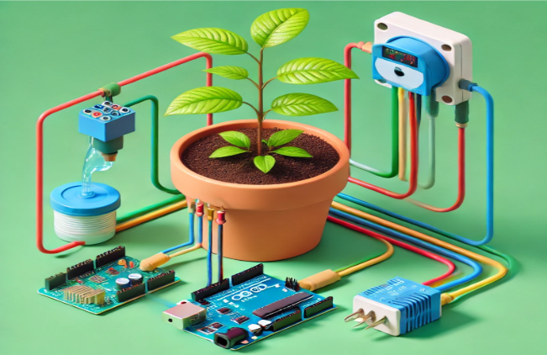
ECOFLOW AUTOMATED GARDEN IRRIGATION SYSTEM
Presented by :
Anisha Datta 20JE0137
Nahush Lele 20JE0519
Priyanshu Maurya 20JE0728
Satyam 20JE0871

Slide 2

PROBLEM STATEMENT
Manual watering of plants often leads to under-watering or over-watering, affecting plant growth and health. This is especially problematic for individuals who are busy or frequently away from home. With the increasing need for water conservation, an automated system can provide a solution that optimally manages plant watering by measuring soil moisture and delivering water only when required. The system should also have an app interface for users to manually control the watering of the plants.

Slide 3
OBJECTIVES
To develop an automated irrigation system for potted plants or small gardens using soil moisture sensors.
To minimize water wastage and ensure plants receive adequate water based on soil conditions
To allow manual and automated control of plant watering via an app.
To be able to view the history of the soil moisture status and the pump status.

Slide 4

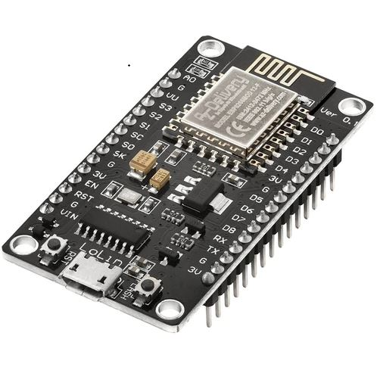
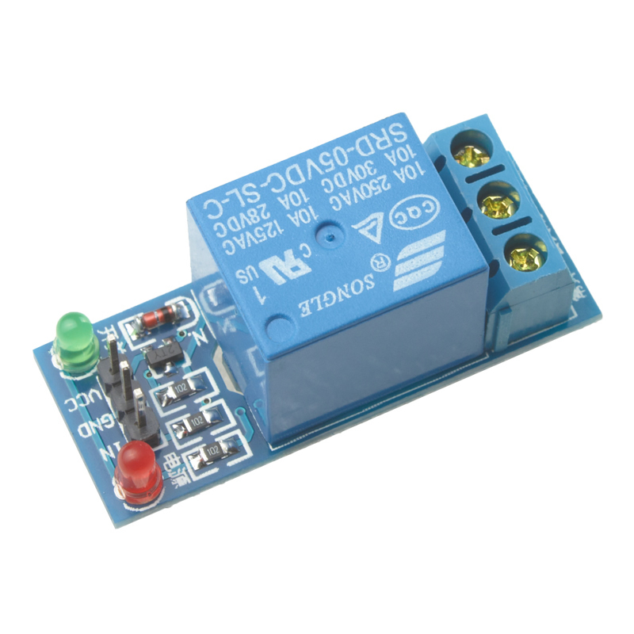
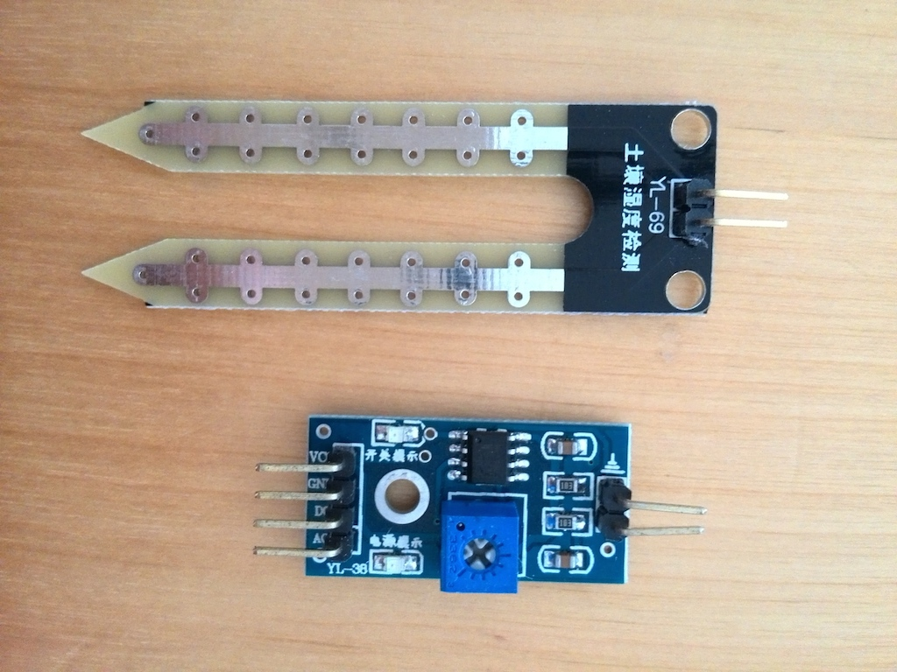
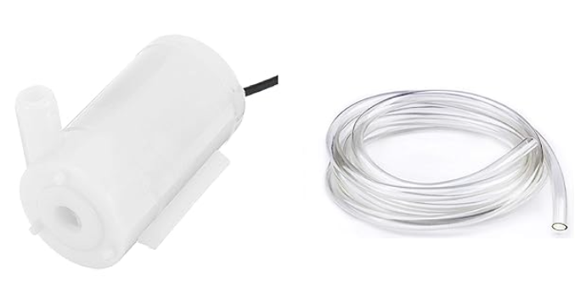
Components Required
ESP8266
5V Relay Module
Water Pump & Pipe
Soil Moisture Sensor

Slide 5
Components Required
Purpose: Detects the moisture level in the soil and outputs an analog voltage proportional to that moisture level
.Connection Needs: Requires a power source (5V), a ground connection, and an analog output pin to send the moisture data to the Arduino.
Soil Moisture Sensor
Purpose: Delivers water to the garden when activated.
Connection Needs: Is connected to the relay’s switching mechanism to receive power only when the relay is activated.
Water Pump & Pipe

Slide 6
Components Required
Purpose: Acts as the brain of the system. It reads the sensor data, decides whether watering is needed, and then sends a control signal.
Connection Needs: Has analog inputs (for reading sensor data) and digital outputs (for controlling the relay).
ESP8266
Purpose: Functions as a switch to control the water pump. Since the water pump may require more current than the Arduino can directly provide, the relay safely isolates and controls the higher-power circuit.
Connection Needs: Receives a digital control signal from the Arduino and connects to both the power source and the water pump circuit.
5V Relay Module

Slide 7
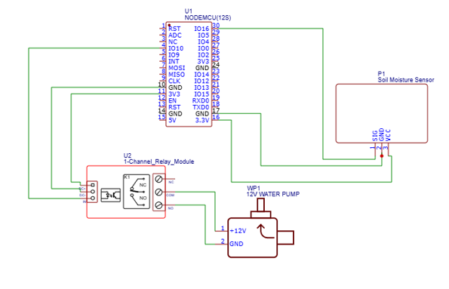
Circuit Diagram

Slide 8
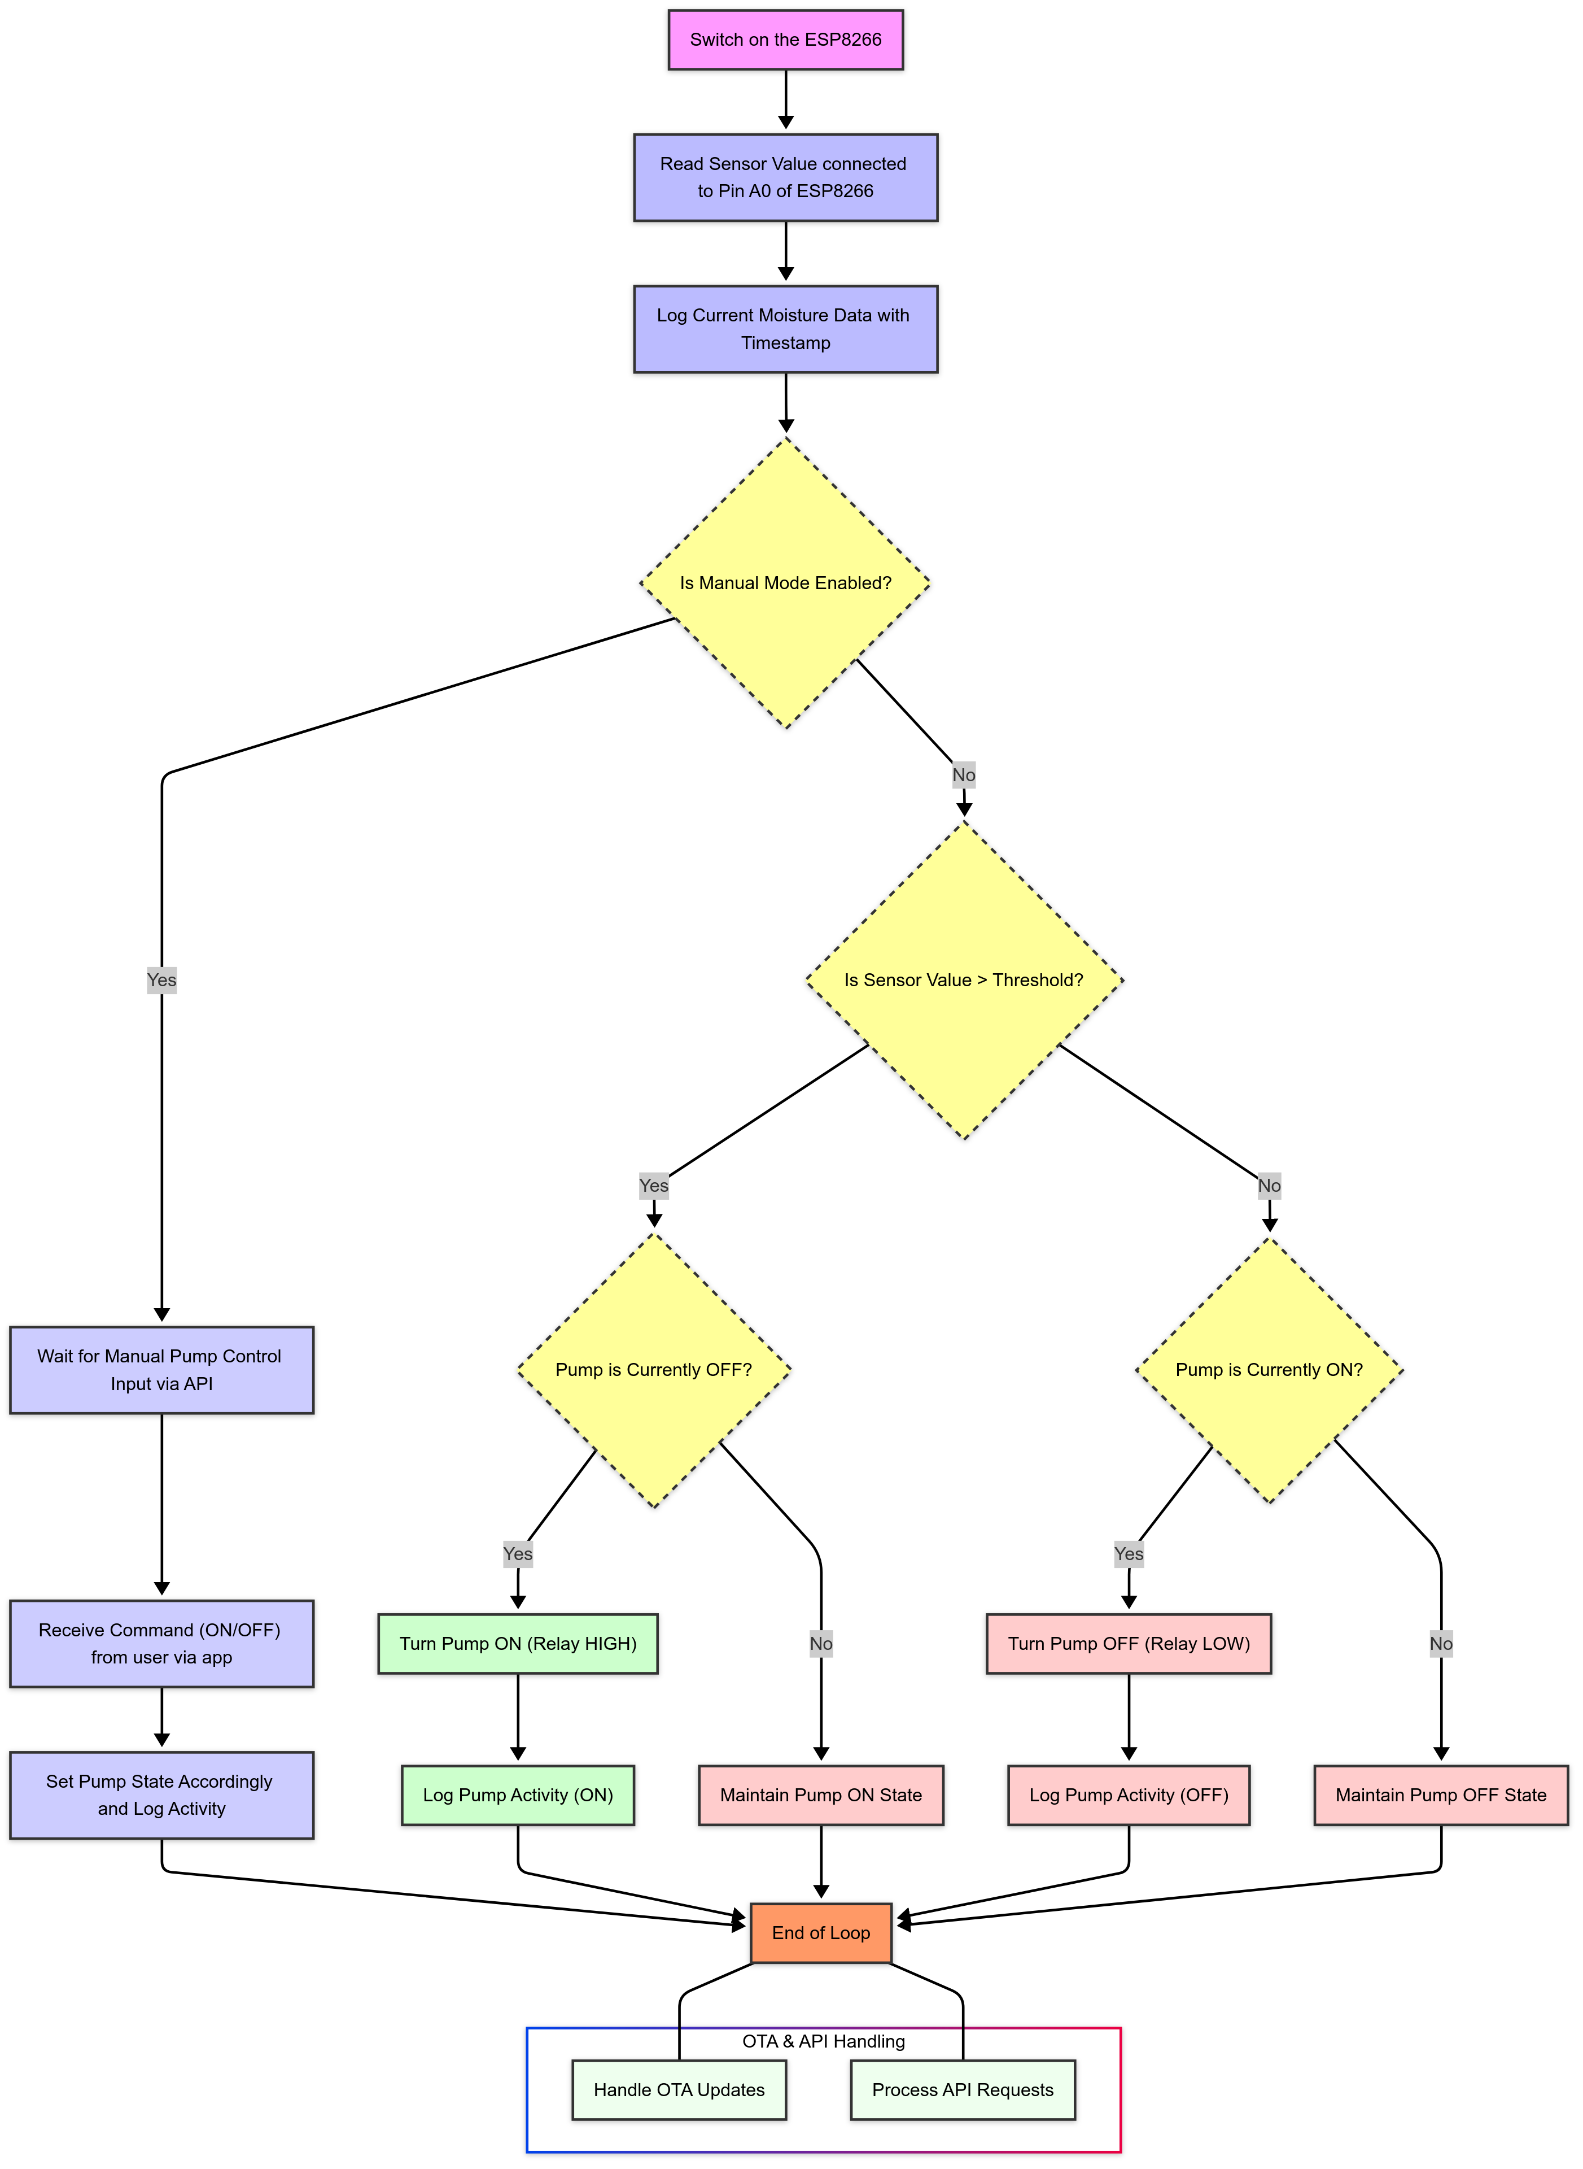
Flowchart

Slide 9

THANK YOU

