Slide 1






RapidResQ
"Instant Detection. Immediate Action."
AI-Powered Accident Detection & Emergency Response Coordination System
TEAM MEMBERS
Anisha
Chidambar
Shivaraj
Ay an

Slide 2





INTRODUCTION & PROBLEM STATEMENT
Road accidents often become fatal because emergency services arrive too late.
Delayed Response
No Alert System
Victims unable to contact help during unconsciousness
Critical minutes lost before emergency units arrive
Slow Coordination
Golden Hour Missed
Emergency services lack real-time incident data
Medical window of survival often exceeded

Slide 3


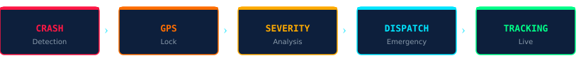

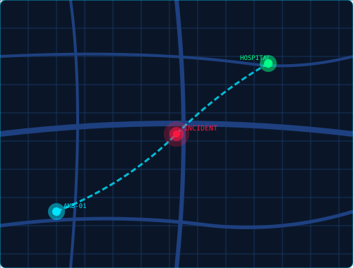

RAPIDRESQ SOLUTION
Detects Accidents
AUTOMATED WORKFLOW
AI-powered crash sensor analysis
Locks GPS Location
Precise real-time coordinates
Analyzes Severity
Triage classification in seconds
Alerts Emergency
Instant dispatch to all units
Notifies Family
Automatic loved-one alerts

Slide 4





PROJECT OBJECTIVES
Reduce Response Time
Improve Coordination
Automate
Com m uni ca t i on
Cut emergency arrival time by automating detection & dispatch
Seamless communication between hospitals, ambulances & police
Zero manual intervention — fully automated alert pipeline
Real-Time Tracking
Smart Emergency Ecosystem
Multi-Vehicle Support
Live GPS tracking of victims and emergency units
Integrated city-wide emergency intelligence network
Compatible with two-wheelers and four- w heel ers

Slide 5
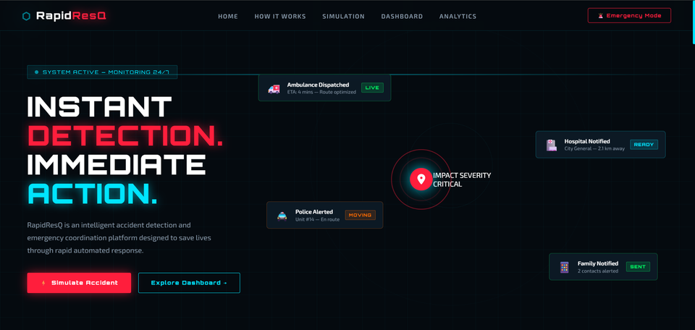

LANDING PAGE DESIGN
⬡
RapidResQ
KEY UI
FEATURES
Live Animated Map
Real-time incident overlay
Dispatch Status Cards
Unit tracking dashboard
Real-time alert system

Slide 6
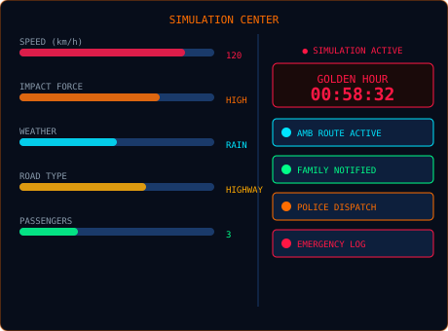

INTERACTIVE SIMULATION CENTER
SIMULATE VARIABLES
Vehicle Speed
km/h threshold triggers
Impact Intensity
Collision force analysis
Weather Conditions
Rain, fog, clear, storm
Road Type
Highway, city, rural
Passenger Count
Occupancy-based triage

Slide 7
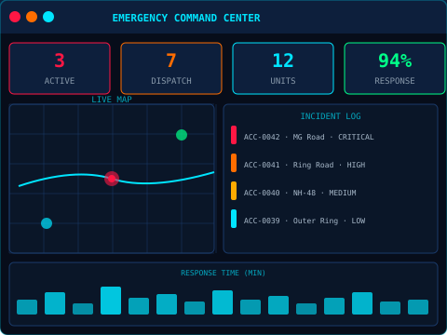

EMERGENCY COMMAND DASHBOARD
USED BY
Ambulance Services
Route optimization & dispatch
H o spitals
Pre-arrival patient data
Police Departments
Incident coordination
DASHBOARD FEATURES
• • • • •
Active Incident Tracking Emergency Unit Monitoring Severity Indicators Response Status Updates Recent Incident Logs

Slide 8
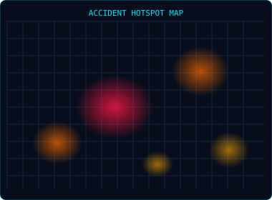
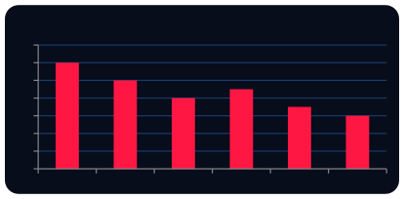


ANALYTICS & EMERGENCY MODE
Response Time Trend (Minutes)
14 12 10 8 6 4 2 0
Jan
Feb
Mar
Apr
May
Jun
◉
⚡
EMERGENCY MODE ACTIVE
Red Alert Overlay
⚡
Dispatch Controls
MONTHLY SEVERITY ANALYSIS
⚡
Emergency Notifications
⚡
Live System Monitor
CRI TI CA L
HIGH 32%
MEDIUM 35%
LOW 15%
18%

Slide 9
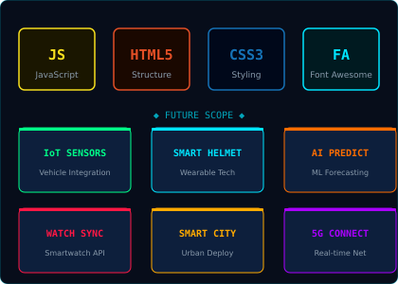

TECHNOLOGIES & FUTURE SCOPE
CURRENT STACK
JavaScript
Core application logic
HTM L 5
Semantic structure
CSS3
Styling & animations
Font Awesome
Icon system

Slide 10


CONCLUSION
RapidResQ demonstrates how intelligent automation and real-time coordination
can transform emergency response — improving outcomes and potentially saving
lives.
↓ 40%
✓
A U TO
360°
Response Time
Di spat c h
Monitoring
"Every second matters during an emergency."
THANK YOU

