Slide 1
ASSIGNMENT 2 · PROTOTYPE
Veridian IT Assist
An AI service-desk agent that resolves what is safe, routes what needs authority, and escalates what is risky.
4
11
15
10
decision outcomes
policy sources
employee requests
historical tickets
Standalone HTML prototype · Deterministic decision engine · Full session audit trail
Anisha Boken
Notes:
Introduce the prototype: a single-file HTML IT service-desk agent built on the supplied Assignment 2 data pack.

Slide 2
The problem, and the Stance we took
Why a classifier that only answers questions would be the wrong build
The problem
Our stance
Employee requests arrive as free text, not as clean categories
Some are self-service; some need approval; some are security events
Policies overlap and occasionally conflict (KB-03 vs AMP)
Tickets raised for self-service issues are pure queue noise
The agent decides an action, it does not just write a reply
Authority is checked before any outcome is issued
A ticket is a deliberate output, never a default
Every decision names the policy it came from
Design principle
Resolve what is safe. Route what requires authority. Escalate what is risky. Ask when information is missing.
No ticket for self-service
Ticket only where work exists
Nothing invented
Password reset, guest Wi-Fi, mailbox archiving and VPN renewal close without touching the queue.
Route and Escalate produce a structured ticket with a named owner and a next action.
If the supplied pack does not cover it, the agent clarifies or escalates instead of guessing.
02
Notes:
The framing: this is a decision agent, not a chatbot. The four-outcome model follows directly from that.

Slide 3
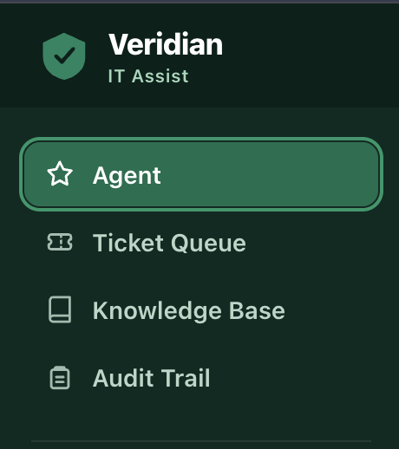
Architecture of the Complete Solution
Five layers, one self-contained HTML artefact — no backend, no external calls at runtime
01
Presentation layer
Standalone HTML/CSS/JS single file. Four views: Agent, Ticket Queue, Knowledge Base, Audit Trail.
02
Request analyzer
Normalises free text, extracts intent signals and entities (device age, failed attempts, employment type).
03
Knowledge layer
Supplied policy pack KB-01 to KB-10 plus the Asset Management Policy, held as structured records.
04
Decision engine
Policy match → authority check → risk check → one of Resolve, Clarify, Route, Escalate.
Why single-file
05
Output layer
Runs anywhere by opening the file — no install, no server, no data leaving the machine. The whole decision path is inspectable in one place.
Structured ticket for Route and Escalate only, plus an append-only session audit trail.
03
Notes:
Walk down the five layers. Emphasise that knowledge and decision logic are separate concerns.

Slide 4
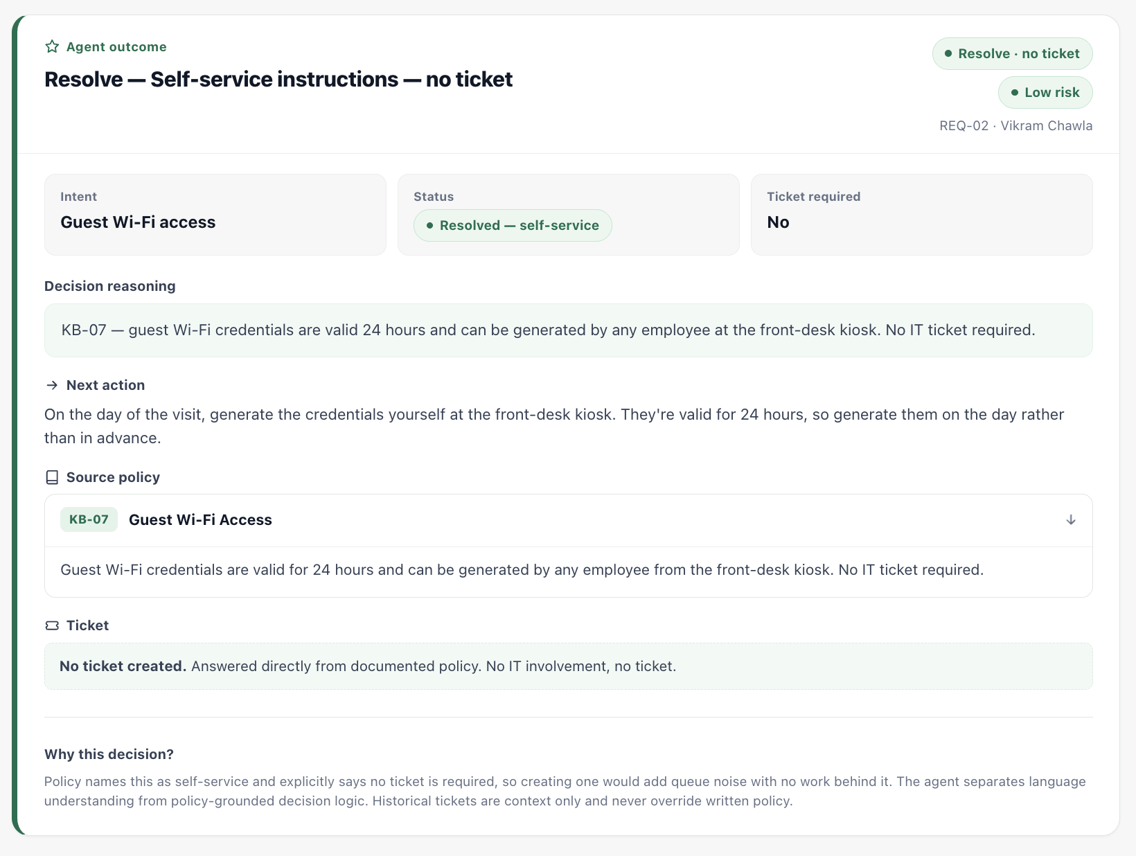
Process Flow: Request to Outcome
Every request travels the same five stages before any outcome is issued
1
Capture
Employee request received as free text through the agent composer.
2
Understand
Intent classified; entities extracted — age, attempts, employment type.
3
Retrieve
Relevant policy located in the supplied pack; the source ID is recorded.
4
Check authority
Who may act? Self-service, IT, manager, Finance or Security.
5
Decide
Resolve, Clarify, Route or Escalate — with reasoning attached.
Outcome handling
What the output carries
Resolve
Clarify
Route
Escalate
Intent, status and ticket requirement up top; then the policy finding, the next action, the source KB article, and the reasoning behind the decision — visible to the employee, not hidden.
No ticket
No ticket
Ticket raised
Ticket raised
Only Route and Escalate create a ticket. Every Resolve carries a named escalation trigger, so the path back into the queue stays defined.
04
Notes:
The five stages are fixed; only the outcome varies. Ticket creation is an output of the decision, not a side effect of receiving a message.

Slide 5
The Four-Outcome Decision Framework
What triggers each outcome, and what the employee gets back
Resolve
Policy fully answers it and the action sits with the employee.
Clarify
Policy branches, and the request does not say which branch applies.
Typical cases
Typical cases
Password reset · Guest Wi-Fi · Mailbox archiving · VPN renewal · Printer first-line steps
VPN without employment type · Software without catalog status · Vague requests
No ticket · answer plus escalation trigger
No ticket · one targeted question
Route
Genuine work for a named human owner, or an approval gate to clear.
Escalate
Security-sensitive or privileged; delay or self-service increases risk.
Typical cases
Typical cases
Account unlock · Contractor VPN · Quota increase · Laptop verification · WFH shipping
Phishing and malware reports · Non-catalog software · Privileged admin access
Structured ticket · owner and next action
Immediate ticket · routed past the desk
05
Each outcome also records intent, policy finding, authority check, risk level and status — the full reasoning is visible to the employee, not hidden.
Notes:
Four outcomes, two of which produce tickets. The distinguishing question is always: who holds the authority to act?

Slide 6
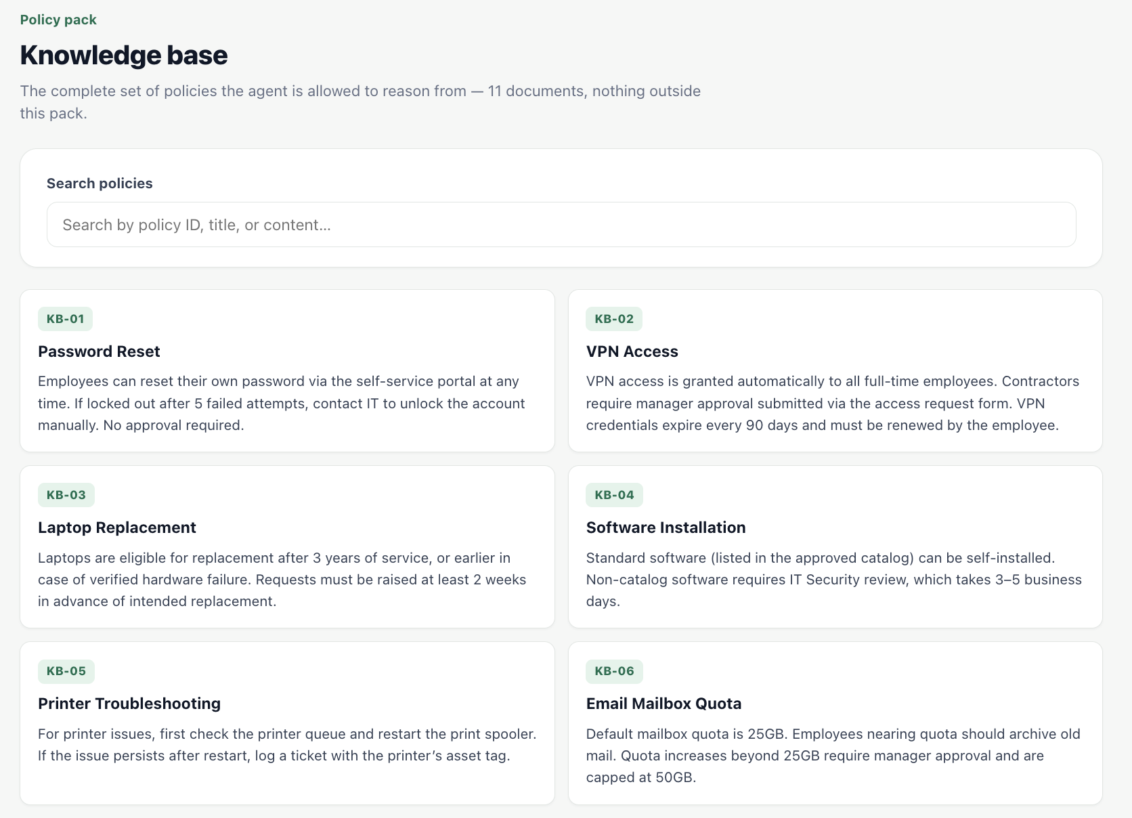
Inputs and Sources
Everything the agent knows comes from the supplied Assignment 2 data pack
11
Policy documents
KB-01 Password Reset · KB-02 VPN · KB-03 Laptop Replacement · KB-04 Software · KB-05 Printer · KB-06 Mailbox Quota · KB-07 Guest Wi-Fi · KB-08 Expense Tool · KB-09 Security Incidents · KB-10 WFH Equipment · Asset Management Policy
15
Employee requests
REQ-01 to REQ-15, spanning clear requests, ambiguous ones, conflicting policy cases, out-of-scope asks and one deliberately vague message.
10
Historical tickets
TK-1042 to TK-1051, used as precedent and context only — for example TK-1050, an admin request rejected for missing justification.
Data boundary
The agent answers only from this pack. Ticket history gives context but is never treated as policy, and nothing is inferred from outside sources.
06
Notes:
Three input sources with different standing: policy is authoritative, requests are the workload, history is context only.

Slide 7
Assumptions Made
Stated openly, because each one shapes how a request is handled
1
Policy conflicts need a human
2
Urgency is not authorisation
KB-03 allows replacement at 3 years; the AMP sets a 4-year refresh cycle. A 3.5-year device sits between them, so the agent routes with both policies cited rather than picking a winner.
A stated deadline never substitutes for a business justification or an owner's approval — the month-end admin-access request is clarified, not raised.
3
Self-reported facts are provisional
4
Silence means ask, not assume
Device age, employment type and approval status are taken as stated for classification, but flagged for verification in the ticket.
If eligibility cannot be established from the pack, the outcome is Clarify — a wrong path costs more than one extra question.
5
Ownership boundaries are strict
6
One decision per request
Where Finance or Security owns the decision (expense access, WFH allowance, phishing), IT does not take it on.
Each analysis produces exactly one outcome with one owner, keeping the audit trail unambiguous.
07
Notes:
Assumptions are design decisions. Each one can be traced to a specific request in the pack.

Slide 8
AI tools used, and how
Where AI was applied across the build — and where judgement stayed with us
C
Claude — Reasoning and build partner
How they were used
Interpreted the policy pack, stress-tested the four-outcome model against each of the 15 requests, and generated the decision-engine logic and the HTML/CSS interface.
Prompted with the policy pack as the only source of truth
Asked to justify each classification against a KB reference
Output reviewed request by request before it was accepted
Hallucinated policy rejected, never patched in
C
ChatGPT — Cross-checking and drafting
Second opinion on ambiguous cases, alternative phrasing for employee-facing responses, and quick sanity checks on edge-case coverage.
G
GitHub Copilot — In-editor assistance
What stayed human
Autocompletion while refactoring the analyzer functions and the rendering helpers in the prototype.
The outcome model, the authority rules, the conflict handling between KB-03 and AMP, and the final decision on every one of the 15 requests. AI accelerated the build; it did not set the policy.
Note: adjust the tool list above to match exactly what you used.
08
Notes:
Be specific about the division of labour: AI for speed and coverage, human judgement for authority and policy interpretation.

Slide 9
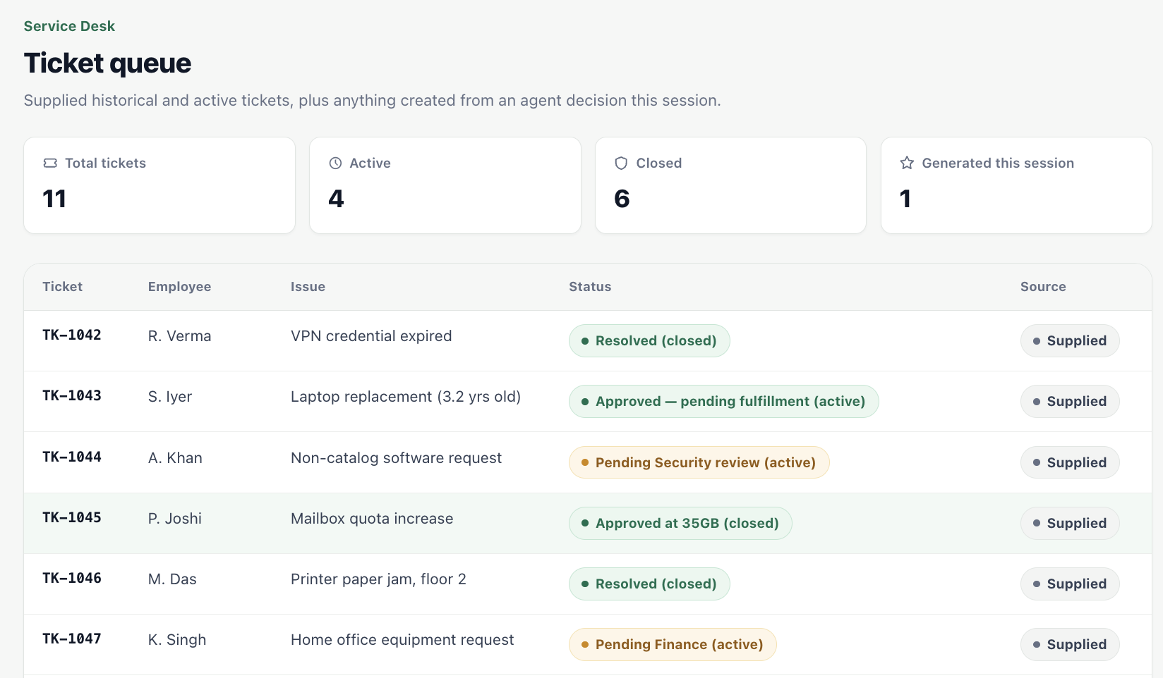
Worked examples from the Request Set
Four requests, four different outcomes — same pipeline
REQ-02
Resolve
Self-service at the front-desk kiosk, valid 24 hours. No ticket raised.
Guest Wi-Fi for a visitor
KB-07
REQ-01
Route
Past the 3-year threshold but inside the 4-year cycle — verify, loan a device, send for Finance sign-off.
Laptop dead at 3.5 years
KB-03 + AMP
REQ-08
Escalate
Report to Security immediately; stop forwarding, which widens the blast radius.
Phishing email being forwarded
KB-09
REQ-10
Clarify
No policy grants this. Justification and owner approval required before anything is raised.
Urgent admin access, month-end
TK-1050 precedent
09
Notes:
Pick two of these to demo live: one Resolve and one Escalate, so the contrast in handling is obvious.

Slide 10
What the prototype demonstrates
And where it would go next
Traceable decisions
A queue that stays clean
Next steps
Every outcome names its policy source, authority check and risk level.
Tickets exist only where a human genuinely has to act.
Connect to the live ITSM system so tickets are raised for real
Add identity verification before any privileged action
Feed resolved outcomes back in to tune the clarify threshold
Extend the policy pack, keeping the strict data boundary
Safe failure modes
A complete audit trail
Uncertainty produces a question or an escalation, never a guess.
Each analysis is logged in sequence for review after the session.
Resolve what is safe. Route what requires authority. Escalate what is risky. Ask when information is missing.
Veridian IT Assist · Assignment 2 prototype
Thank you
Notes:
Close on the design principle — it is the single sentence that explains every decision in the build.

