Slide 1
TEAM SQUARE
TEAM MEMBERS:
ANISHA MOHANTY
PRAVEEN SAHADEV
TANUJA LAVU
SHAIK HUSSAIN

Slide 2

PROBLEM STATEMENT-
DIGITAL SUPPLY CHAIN – PRODUCT DATA MANAGEMENT

Slide 3
WHAT IS SUPPLY CHAIN?
Supply chain is the process related to the flow of goods from raw materials to the end user.

Slide 4
TOOLS USED-
HTML
CSS
JQUERY
BOOTSTRAP
PHP
MYSQL

Slide 5
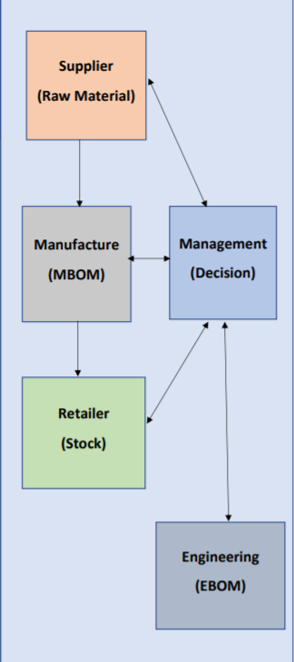
FLOW-CHART

Slide 6
LET’S LOOK AT SOME CODE SNIPPETS

Slide 7
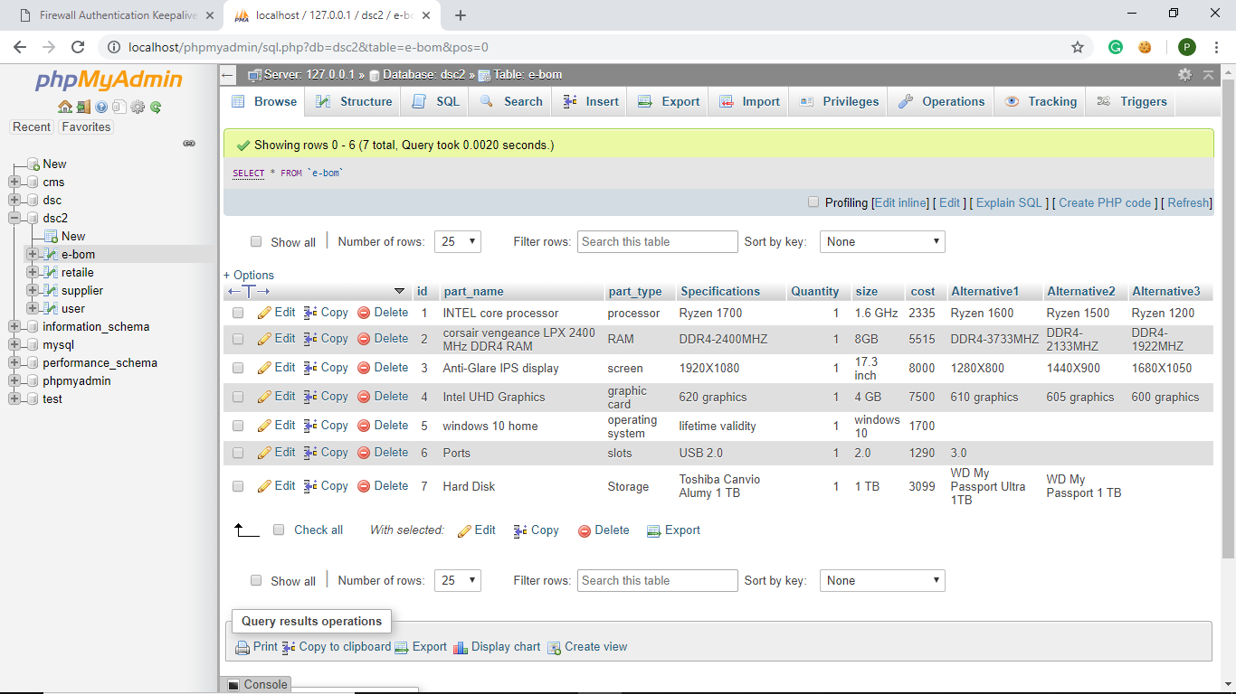
DATABASE

Slide 8
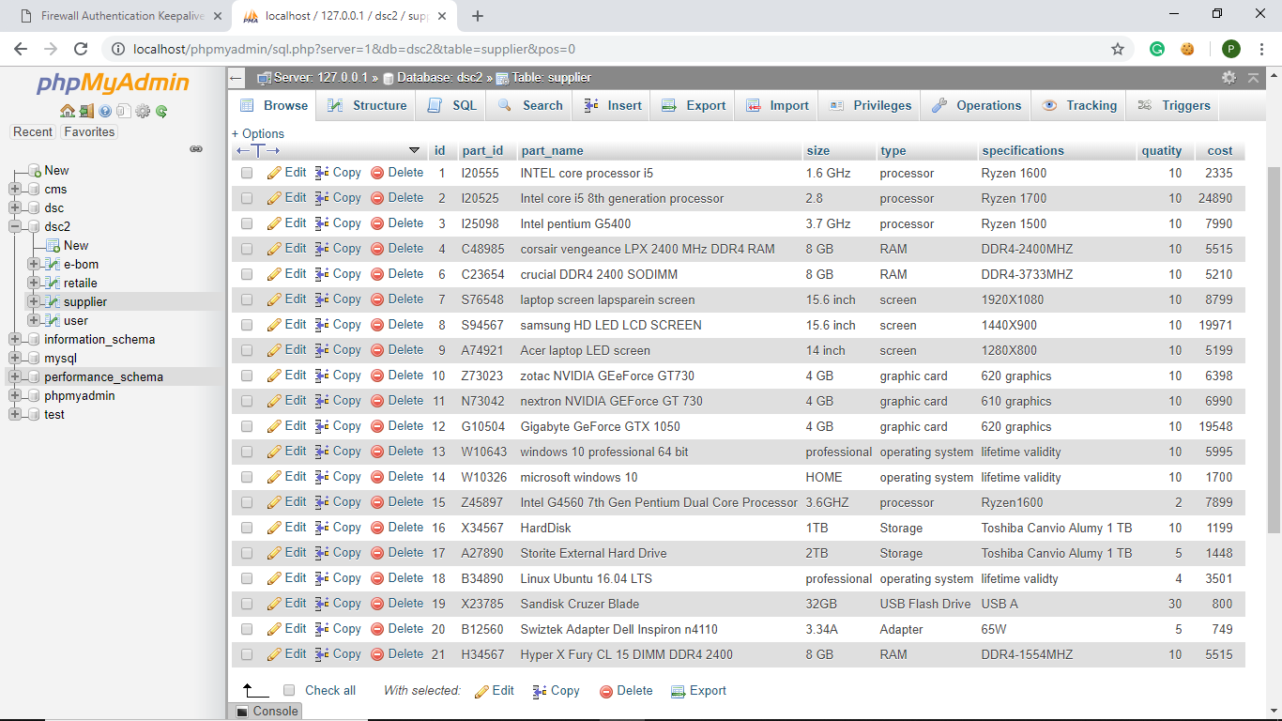

Slide 9
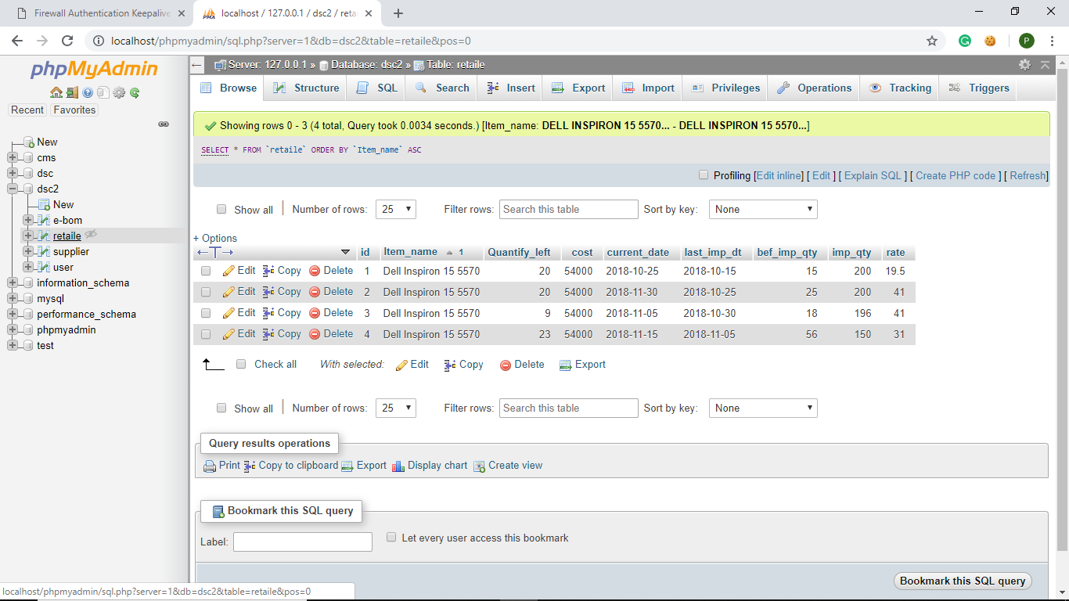

Slide 10
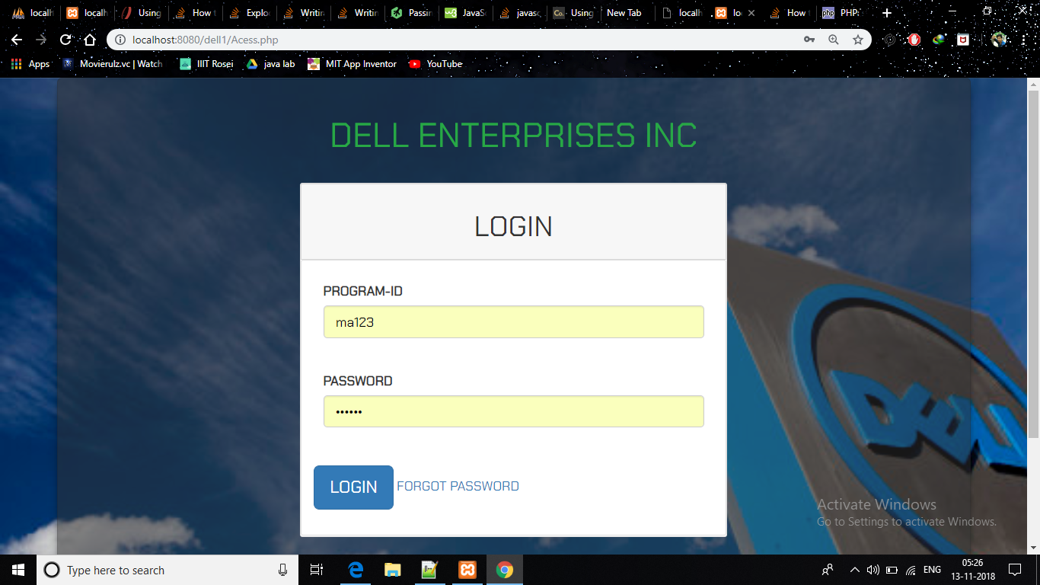
UI

Slide 11
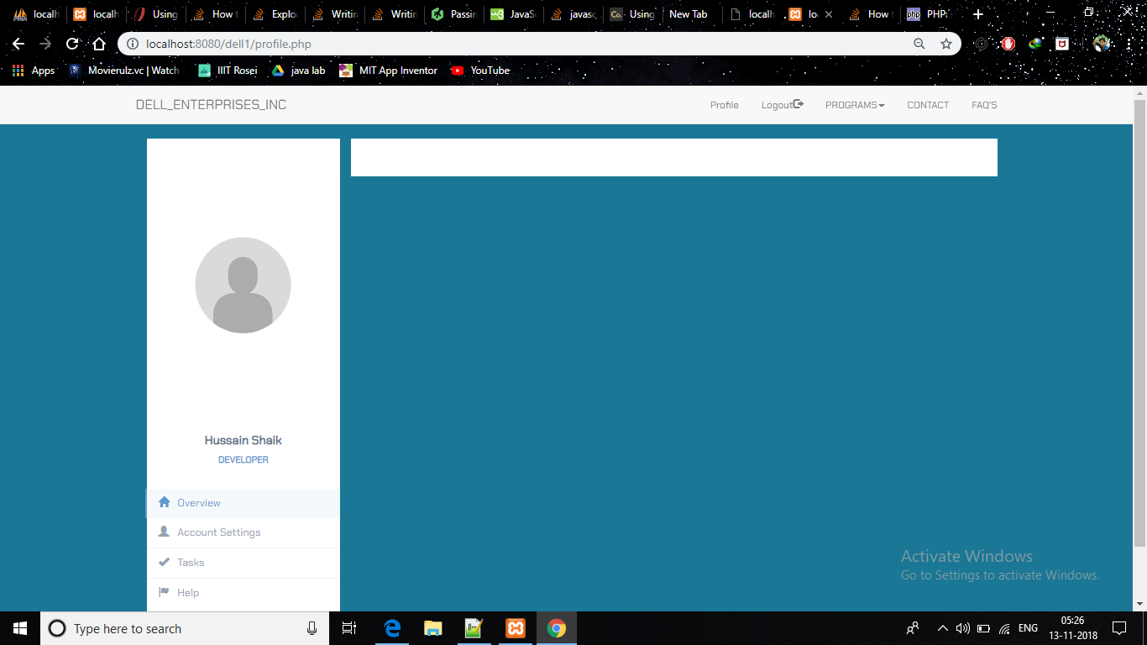

Slide 12
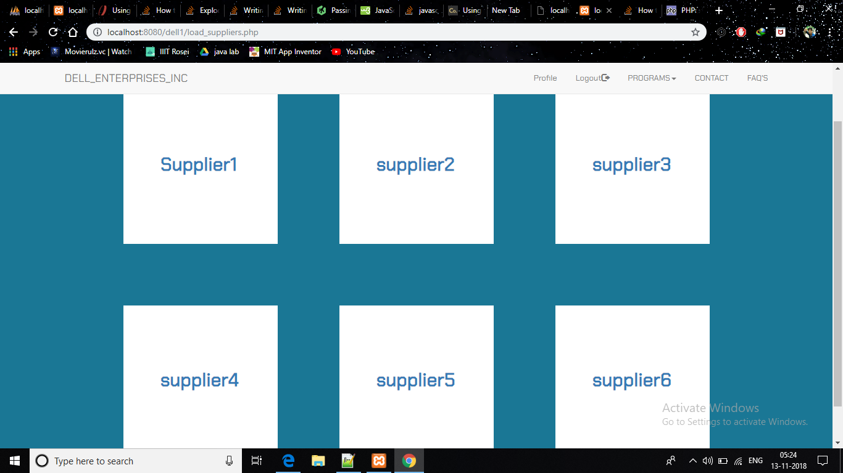

Slide 13
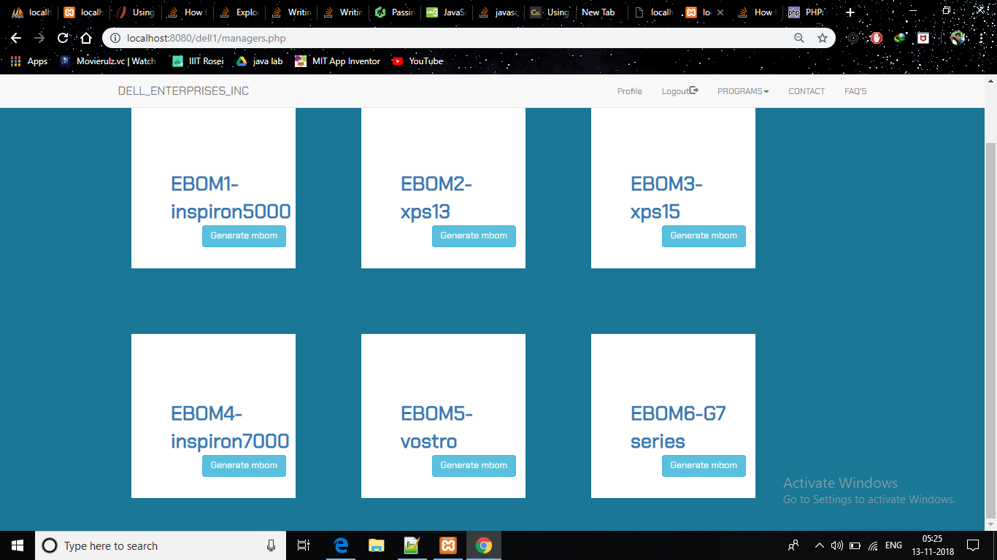

Slide 14
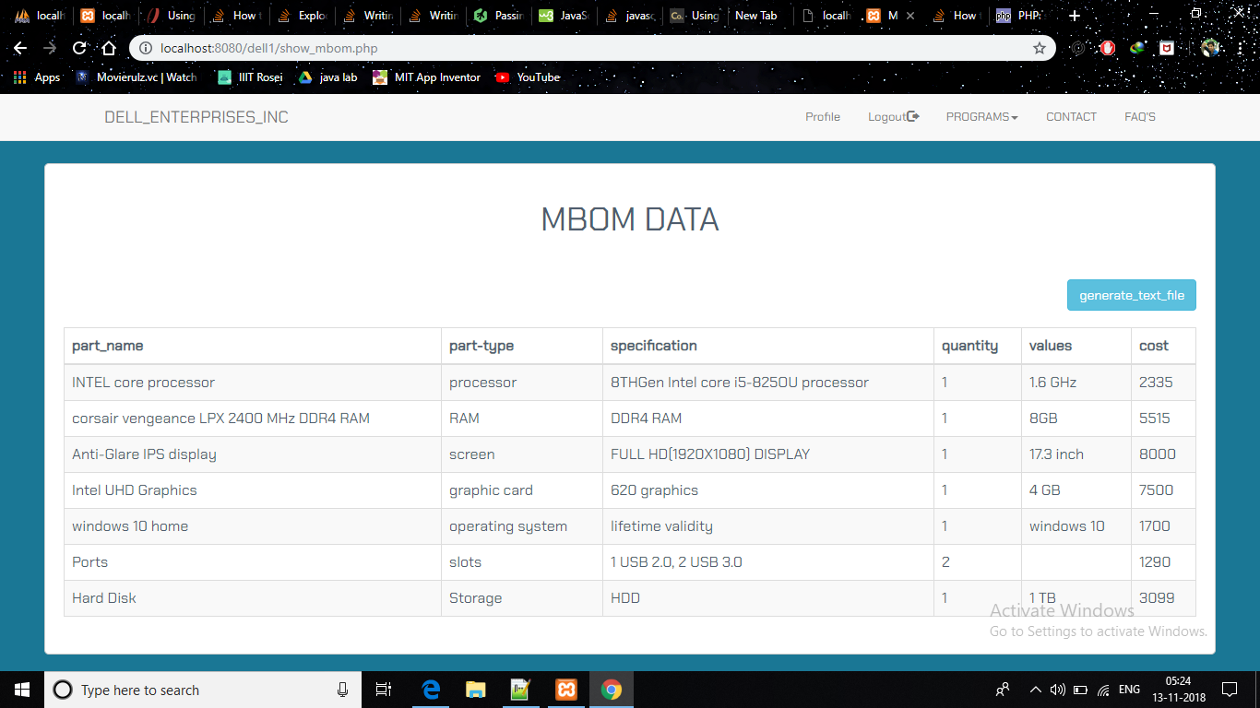

Slide 15
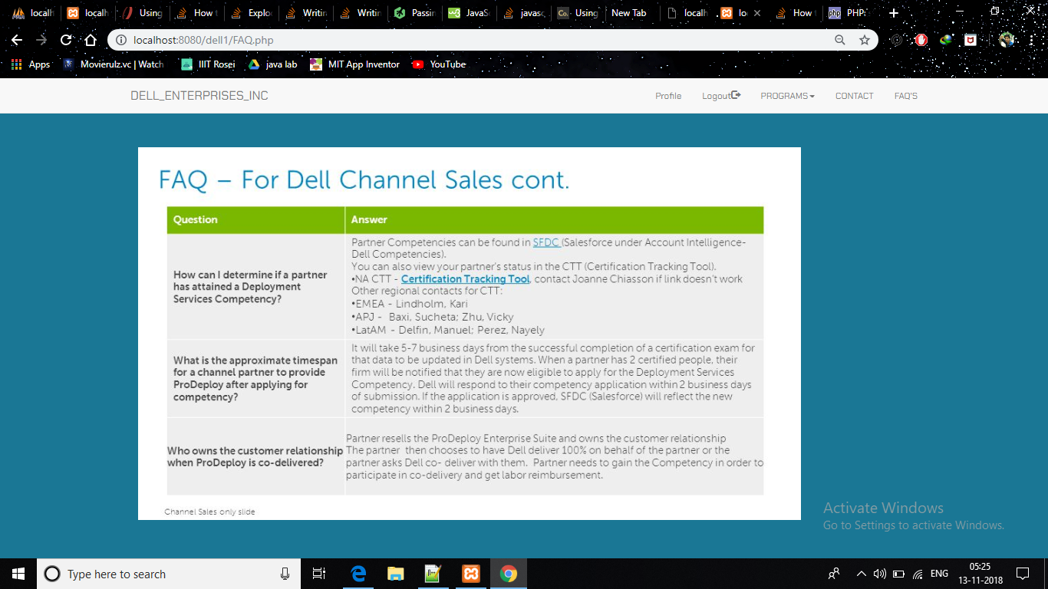

Slide 16
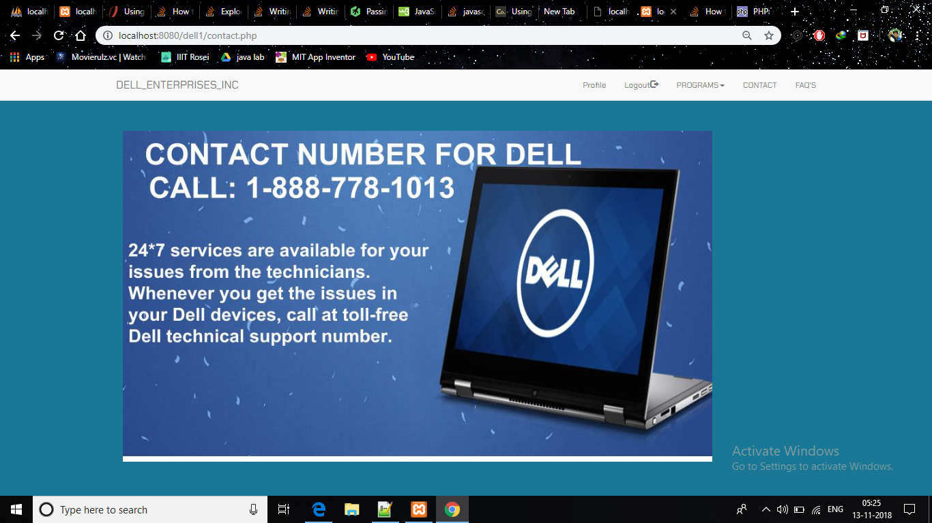

Slide 17
CODE DEMO

Slide 18
CONCLUSION
Main features :
Part_type
Specification
More features:
Cost and Size

Slide 19
Advanced Features
1)Analysing Statistical data
2)Demand Driven Planning
3)Automate communication between supplier and retailer
4)Adaptive Supply chain

Slide 20
Thank you

