Slide 1
Project Summary
Face and Eye Detection

Slide 2

Objectives...
Introduction of Computer Vision, Haar Cascade Classifier
Applications of the Haar Cascade Classifiers
How does face and eye detection works ?
What is the need of face and detection?

Slide 3
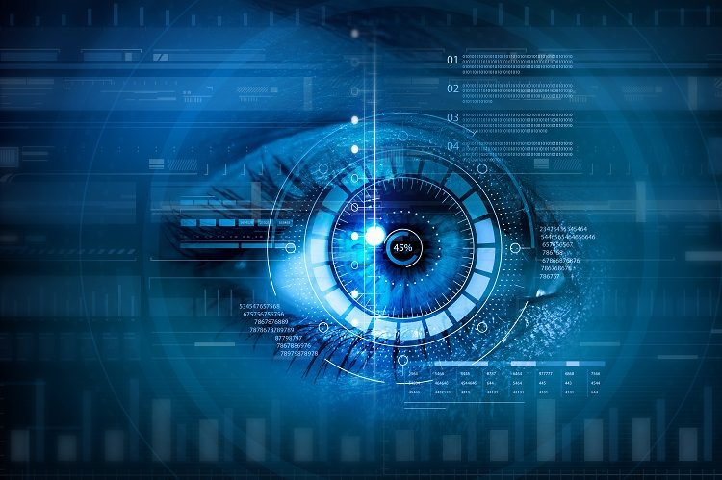
What is Computer Vision ?
Computer vision is a field of artificial intelligence that trains computers to understand the visual world using digital images from cameras and videos.
Computer vision involves seeing or sensing a visual stimulus, make sense of what it has seen and also extract complex information that could be used for other machine learning activities.

Slide 4
So what is Haar Cascade Classifier ?

Slide 5

Object Detection using Haar feature-based cascade classifiers is an effective object detection method proposed by Paul Viola and Michael Jones, "Rapid Object Detection using a Boosted Cascade of Simple Features" in 2001. It is a machine learning based approach where a cascade function is trained from a lot of positive and negative images. It is then used to detect objects in other images.
A Haar Cascade is basically a classifier which is used to detect the object for which it has been trained for, from the source. The Haar Cascade is trained by superimposing the positive image over a set of negative images. The training is generally done on a server and on various stages.

Slide 6
Where could it be used ?

Slide 7
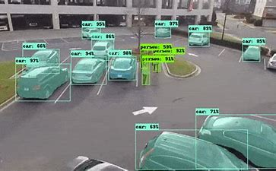
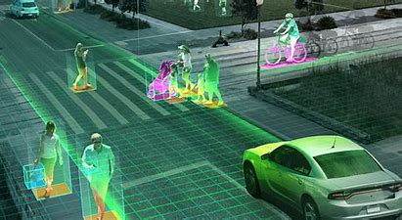
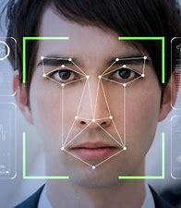
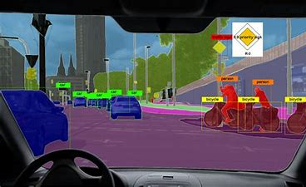
Vehicle Detection from Streaming Video
Human Detection from Streaming Video
APPLICATIONS
Face and Eye Detection
Object Detection by Autonomous Cars

Slide 8
So how does Face and Eye Detection and eye actually work ?

Slide 9
First load the image and convert it into grayscale.
Although why do we have to convert it ?
Generally the images that we see are in the form of RGB channel(Red, Green, Blue). So, when OpenCV reads the RGB image, it usually stores the image in BGR (Blue, Green, Red) channel. For the purposes of image recognition, we need to convert this BGR channel to gray channel. The reason for this is gray channel is easy to process and is computationally less intensive as it contains only 1-channel of black-white.
Now after converting the image from RGB to Gray, we will now try to locate the exact features in our face.
We usually find out the x-coordinate, y-coordinate, width and height of the detected feature of the face.
Based on these 4 values we draw a rectangle around the face.
Now our region of interest will be our face for eye detection and we draw a rectangle around the eyes.
For the Haar Cascade Classifier to work, the face should be clearly visible.

Slide 10
What is the need of face and eye detection?

Slide 11
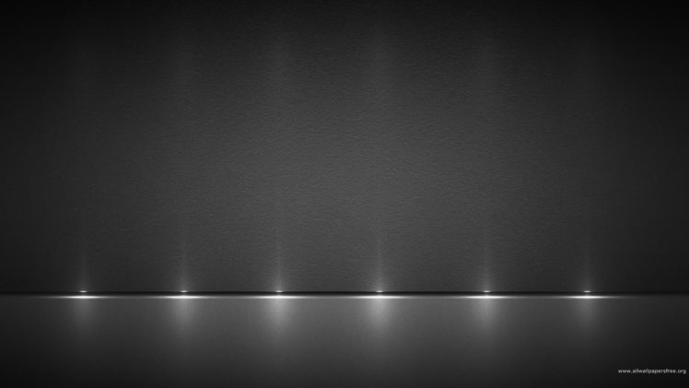
Face Detection is the first and essential step for face recognition.
It is used to capture face motion.
Digital cameras use face detection for autofocus.

Slide 12
Thank
You

