Slide 1

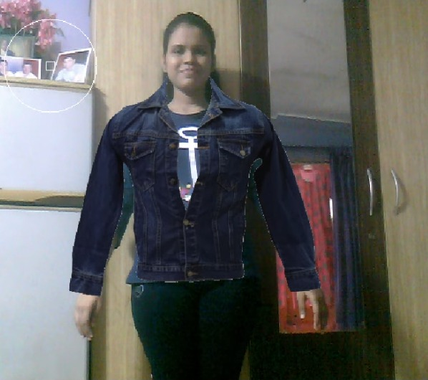
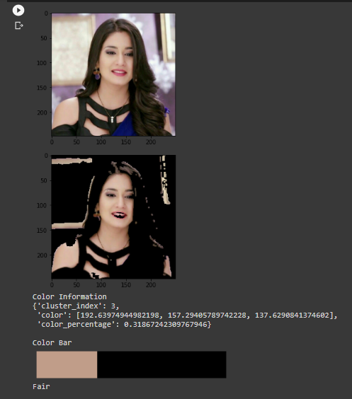
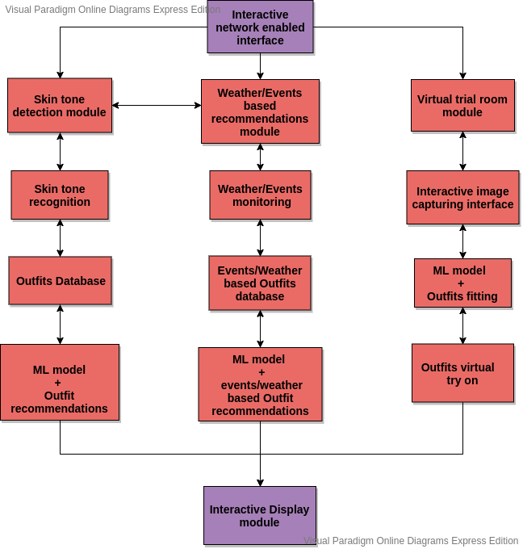
Sardar Patel Institute of Technology
Department of Computer Engineering
Academic Year 2020-21
Title: Pocket Fashionista-A Complexion Based Outfit Color
Advisor using Neural Networks
Names : Anisha Gharat, Tejashri Wagh, Siddesh Sonawane, B.E.(Comp.)
Project Guide : Prof. Reeta Koshy
Abstract
We encounter various posts related to fashion and outfits on social media, online portals etc. Thus there is perplexity in figuring out perfect outfits just by looking at the photos on social media. So the solution to this is a system which recommends the user a list of color combinations according to the user's skin tones. The model also provides a virtual trial and even occasion/weather based recommendations.
Methodology/Algorithms
Color segmentation is used for skin detection-using HSV and YCbCr based on threshold. For this techniques like Python3 and OpenCV are used. The system classifies the person’s skin tone from the Indian skin tones meter using OpenCV. The feature extraction techniques are applied to give similar recommendations based on Complexion. The event-specific outfits from the dataset are segregated. The images are transformed to feature vectors to get similarity index. The ongoing season is determined by using DarkSky API. Virtual trial room is implemented using haar-cascades object detection technique and OpenCV.
Results
The virtual try on and Skin tone detection results have been achieved. The system seems to give 85% accuracy with respect to the Virtual trial room and 95% for the Skin tone classification module so far.
Conclusion
The proposed system recommends outfits and their color combination to users based on the skin tone of the user. The system also considers weather and events for best suited outfits recommendations. A virtual trial room is also provided for the user to try on the recommended outfits. Thus this system is a full proof “Fashion Advisor” for people who are worried about what to wear and lack fashion sense. This will serve as a real-time system that satisfies customer demands.
References
1. L. Hao and M. Hao, "Design of Intelligent Clothing Selection System Based on Neural Network," 2019 IEEE 3rd Information Technology, Networking, Electronic and Automation Control Conference (ITNEC), Chengdu, China, 2019, pp. 1789-1792, doi: 10.1109/ITNEC.2019.8729417.
2. K. Ayush, S. Jandial, A. Chopra and B. Krishnamurthy, "Powering Virtual Try-On via Auxiliary Human Segmentation Learning," 2019 IEEE/CVF International Conference on Computer Vision Workshop (ICCVW), Seoul, Korea (South), 2019, pp. 3193-3196, doi: 10.1109/ICCVW.2019.00397.
3. N. Ramesh and T. Moh, "Outfit Recommender System," 2018 IEEE/ACM International Conference on Advances in Social Networks Analysis and Mining (ASONAM), Barcelona, 2018, pp. 903-910, doi: 10.1109/ASONAM.2018.8508656.
Introduction
There is always a case where we get a perfect coloured tshirt but can’t figure out suitable pants on it. Or the outfit does not match customers complexion but matches with models skin color, while shopping online. This is a system which recommends the user a list of color combinations according to the user's skin tones. The model especially focuses on Indian skin tones.
Objective(s)
To provide the most suitable color combination.
To provide suitable recommendations of fashion and outfits.
To minimise time and energy required to select among
options and give a live virtual trial.
To provide a personalised experience in relation to recommendations for various events and variable factors like weather.
Problem Definition
Skin Detection and Classification into Indian skin tones
Weather and Event Based recommendations
Color recommendation Module
Virtual Try On
Contribution
OpenCV is used for image processing task and also for object detection. Color Segmentation is done using thresholding in different color spaces basically HSV. Clustering algorithms like K-Means Clustering Algorithm with the help of the sklearn python package have been used for grouping unlabeled data. Finding the Dominant skin tone out of the Indian skin tones meter is the major contribution by our system.
Design

