Slide 1

Bachelor of Technology
Phase-II Project Presentation
Department of Computer Engineering
Sardar Patel Institute of Technology
(Autonomous Institute Affiliated to Mumbai University)
Munshi Nagar, Andheri(W), Mumbai-400058
2020-2021

Slide 2
A PRESENTATION ON
“Pocket Fashionista - A Complexion based Outfit Color Advisor using Neural Networks”
By
Tejashri Wagh - 2018230077
Anisha Gharat - 2018230071
Siddesh Sonawane - 2017130059
Under the guidance of
Prof. Reeta Koshy

Slide 3
Introduction
Fashion is a popular aesthetic expression at a particular time, place and in a specific context, especially in clothing.
There is always a case where we get the perfect T-shirt with the perfect color but can’t match the pants with that color.
Or the cloth color does not match our complexion but it did match the model's skin tone.
The conventional invention is focused on the coordination or sale of the product while the user directly dresses, and thus does not really help users who lack color sense or do not fully utilize the clothes they own.
So the solution to this is a program which recommends the user a list of color combinations according to the user's skin tones. The model especially focuses on Indian skin tone.
It can be a personal fashion advisor on the basis of users' complexion.

Slide 4
Literature Survey
Sr. No. | Paper Name | Methodology | Drawbacks | Conference
1. | Design of Intelligent Clothing Selection System Based on Neural Network | Applied SOM(self-organizing map) neural network to the classification function of the clothing recommendation system based on season, occasion, posture and skin color of the user. | Database is formed using user’s information and recommendations are only based on that. | 2019 IEEE 3rd Information Technology,Networking,Electronic and Automation Control Conference (ITNEC 2019)
2. | Powering Virtual Try-On via Auxiliary Human Segmentation Learning | Used CP-VTON and warping technique to provide virtual trials of clothes on the model’s body in a 2D image. | As 2D images are used, clothes are simply added onto the model’s body. | 2019 IEEE/CVF International Conference on Computer Vision Workshop (ICCVW)
3. | Outfit Recommender System | Faster RCNN(Region-based Convolutional Neural Network) is used for recommendation by identifying the type of event through object detection from the user’s uploaded picture. | Event identification leads to increased modules and efforts. | 2018 IEEE/ACM International Conference on Advances in Social Networks Analysis and Mining (ASONAM)

Slide 5
Literature Survey
Sr. No. | Paper Name | Methodology | Drawbacks | Conference
4. | Applying Image Warping Technique to Implement Real-Time Virtual Try-on Based on Person’s 2D Image | Using Image Warping Algorithm, i.e ,by calculating mapping functions and resampling algorithm , feature points are decided on a 2-D image | Very few features points are considered | Second International Symposium on Information Science and Engineering
5. | Smart Closet -Statistical-based apparel recommendation system | On the basis of statistical frequency and history viewing module, the recommendations are provided. | Recommendations are not given spontaneously , but by studying the previous choices | 2014 Third ICT International Student Project Conference (ICT-ISPC2014)
6. | Skin Segmentation based on Improved Thresholding Method | Using RGB color space with Kovac’s Method for segmentation of skin colour and outfit is obtained | Facial elements are like eyes nose are also segmented as outfit. | 15th International Conference on Electrical Engineering/Electronics, Computer, Telecommunications and Information Technology (ECTI-NCON2018)

Slide 6
Gaps/Issues Identified
Sr. No. | Paper Name | Gaps/Issues
1. | Design of Intelligent Clothing Selection System Based on Neural Network | The Skin tone classification done here is only restricted to Black and White. The recommendations are based only on the database created from previous user inputs.
2. | Powering Virtual Try-On via Auxiliary Human Segmentation Learning | Only 2D images are used for trials. The clothes images are pasted over the existing model image. Proper fitting of clothes on the model’s body is not shown as per the physical measurements.
3. | Outfit Recommender System | Event identification is automated with object detection which is time consuming. Clothes recommendation is restricted to only 53 categories.

Slide 7
Literature Survey
Sr. No. | Paper Name | Methodology | Drawbacks | Conference
7. | Personalized Clothing Recommendation Based on Knowledge Graph | By constructing knowledge graph of user, clothing and context, utilize Apriori algorithm to capture correlations between clothing and context attributes. match the established KG according to the user's requirements and combine the Top-N algorithm to generate the recommendation results | It does not consider the similarity in different dimensions , and the accuracy of attribute weights is not considered comprehensively. | 2018 International Conferences on Audio Language and Image Processing(ICALIP)
8. | Personalized Clothing-Recommendation System based on a Modified Bayesian Network | Considering user’s personal preference and history of clothing items. Using Bayesian networks and the feedback of recommendation output evaluation by the user, recommend clothing combination from users wardrobe. | Need to keep track on history of clothing items. User need to give the feedback every time. | 2012 IEEE/IPSJ 12th International Symposium on Applications and the Internet
9. | Weather-to-garment: Weather-oriented Clothing Recommendation | To learn the weather-oriented clothing recommendation model, define a scoring function. The function includes three potential terms to model the relationships. Use multi-class Support Vector Machine(SVM) / CNN to learn clothing attributes recognition. | The system is only restricted o weather based and pair match outfit. No consideration of other factor. | Proceedings of the IEEE International Conference on Multimedia and Expo (ICME) 2017

Slide 8
Gaps/Issues Identified
Sr. No. | Paper Name | Gaps/Issues
4. | Applying Image Warping Technique to Implement Real-Time Virtual Try-on Based on Person’s 2D Image | Very few feature points are considered , resulting in vague fitting There isn’t any recommendation involved, output is provided only on the basis of users input. Total 13 body marks are mentioned whereas feature points are implemented on just 5 marks
5. | Smart Closet -Statistical-based apparel recommendation system | Recommendations aren’t spontaneous but only on the basis of user previous choices. There is no processing on the basis of color recommendations. Static Recommendations in terms of colors are provided
6. | Skin Segmentation based on Improved Thresholding Method | Skin colour detection is negligible. Facial Elements such as eyes , nose are not segmented properly

Slide 9
Gaps/Issues Identified
Sr. No. | Paper Name | Gaps/Issues
7. | Personalized Clothing Recommendation Based on Knowledge Graph | Need to construct knowledge graph for user, clothing and context. Used basic apriori algorithm which not give maximum accuracy as compare to other algorithm.
8. | Personalized Clothing-Recommendation System based on a Modified Bayesian Network | User need to give the preferences and feedback for every time. Clothes item information is taken by RFID. The Internet or refer to magazines to learn a user’s preferences without direct user input,
9. | Weather-to-garment: Weather-oriented Clothing Recommendation | The system only restricted to weather condition so many time can not gives best recommendation. Weather dataset need to update every time. Used Alexnet & Normalized Discounted Cumulative Gain (NDCG) that is extra technology needed.

Slide 10
Problem Statement
People usually find it difficult to get the best clothing color combinations that suit their skin tone well and go well with the existing fashion trends.
The aim is to develop a complexion based clothing color recommendation system that will help to choose the best possible clothes color combinations.
It will also allow the users to virtually visualize how they will look in the recommended color combinations.
The application will allow users to make best choices with their clothes color combinations and thus saving their time and energy in even trying out the clothes.
Easy for merchants to master the real-time demand of consumers.

Slide 11
Motivation
Constant confusion in selection of suitable color of outfit.
Perplexity in figuring out perfect outfits just by looking at the photos on social media.
Recapturing the essence of Fashion.
Temporal clothing functions (weather, social activity, practicality, mood, and physical self).
Constant factors such as clothing orientation and personality dimensions

Slide 12
Objectives
To study current consumer trends and identify target demographics.
To provide the most suitable color combination.
To promote an understanding of fashion and outfits .
To minimise time and energy required to select among options and try it on mobile screen.
To provide a personalised experience in relation to various events and variable factors like weather.

Slide 13
Expected Outcomes
Skin Detection and Classification Module
Weather and Event Based recommendation Module
Color recommendation Module
Virtual Try On Module

Slide 14
Functional and Non-functional requirements
Functional
Non-Functional
The system needs to be interactive and provide real time features.
Precise recommendations are required to be given by the system.
The system needs to analyze the customers wishlist to give personalized recommendations.
It has to provide precise weather details over locations.
The user's preferences have to be given priority.
The system needs a strong security mechanism in place so that unauthorized users are not allowed access.
A user should get the required data during the fetch request easily.
Responses to queries shall be quick after the user submits the query.
The system should have 24/7 availability.
The system should work on real time data.
Better component design to get better performance during peak time.

Slide 15
Proposed Solution to Problem Statement
Skin Detection and skin tone classification
Complexion Detection
Reviewing User’s Wishlist+Wardrobe
Color segmentation will be used for skin detection-using HSV and YCbCr based on threshold.
For this techniques like Python3 and OpenCV are needed.
After detection of skin we will use our own technique for classification of skin tone.
That will be based on Indian skin tones.
Based on skin tone classification outfits colors will be recommended.
The user will upload his/her picture.
The system will classify the person’s skin tone from the Indian skin tones meter using OpenCV.
The skin complexion which best suits the user will be further used to determine the color combination of the outfits to be recommended.
The feature extraction techniques will be applied to give similar recommendations.
The user’s wishlist will now be checked.
The color combination of shirt and pant that suits the most according to his/her skin tone will be recommended.
The existing clothes in the wardrobe of the user can also be shuffled so as to give different combinations.
Notes:
The main steps of skin detection in the image are:
1. download the input image;
2. convert image to HSV color space;
3. generate the image histogram;
4. apply classiﬁer to determine the probability of a given pixel being skin-
colored;

Slide 16
Proposed Solution to Problem Statement
Event based recommendations
Weather based recommendations
Virtual Trial Room
The user will be prompted to enter an event/occasion in his life.
The dataset from E-commerce giants like Amazon will be used to classify clothes according to images.
The event-specific outfits from the dataset will be segregated.
Then images will be transformed to feature vectors to get similarity index.
After this, Euclidean similarity technique will be used to find similar outfits specific to the event.
The Google Maps API can be used to get the current geolocation or city for which weather information has to be gained.
The ongoing season will be determined by the system using Darksky API.
This weather information will be now used to recommend clothes that will be best suited to the weather-oriented trend and will be comfortable for the user.
Based on the recommended outfits the user will get a live demo trial on his own live picture through a webcam/camera.
This way the user will be able to try out the suggested outfit without even trying it on.
The user will also be able to try out different combinations of clothes.
This will be done using haar-cascades object detection technique and OpenCV.

Slide 17
Feasibility Study of Solution
A. Technical Feasibility:
Studied complete functionality to be provided in the system.
Check if everything is possible using different type of ML algorithms, frontend and backend platform.
Outfits recommendation systems available in the market are dependent on the closets dataset, provide recommendation of outfits only based on past history of user, etc.
They do not provide recommendation based on skin tone for color combo. also not provide services such as virtual try-on, etc. to be solved with the proposed system.
As we using Python language and ML algorithm, Django framework, SQLite database, flask server and OS - Windows 10, Ubuntu, etc
This all Tech stack is feasible for project Development.
Project can be undertaken by two possibilities 1) Mobile App, 2)Website

Slide 18
Feasibility Study of Solution
B. Operational Feasibility :
The project will be implemented in a way that it will allow the functioning of recommendations smoothly.
It will provide a user-friendly user interface in a modular fashion.
Proposed system is fully GUI based that will be very user friendly.
User guide will be provide so that they feel comfortable to use with new application.
C. Economical Feasibility
It’s very important aspect for project development.
We decided the technology based on minimum possible cost factor.
The above mention technology is economically feasible.
Cost will be needed for weather API, and Internet cost will added.

Slide 19
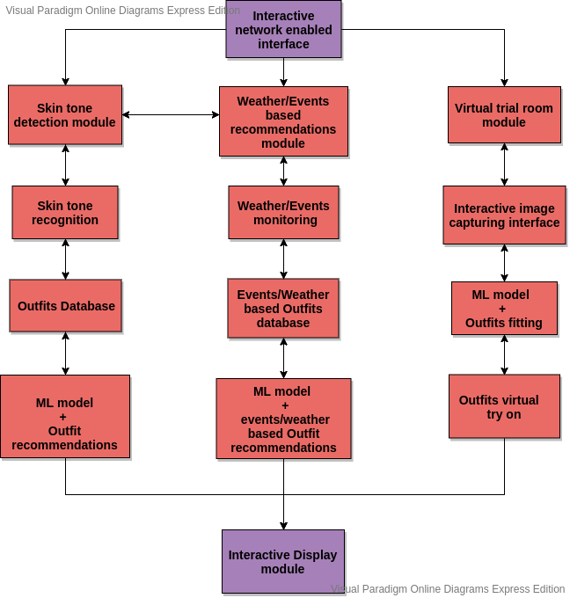
System
Diagram -

Slide 20
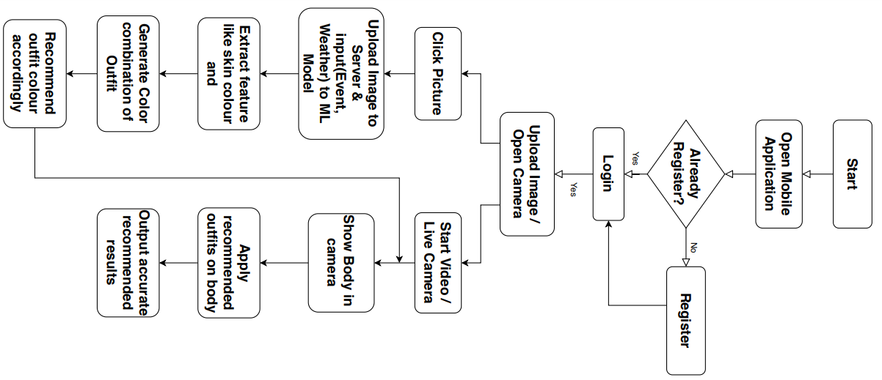
Method Flowchart

Slide 21
Conclusion
The proposed system recommends outfits and their color combination to users based on the skin tone of the user.
The system also considers weather and events for best suited outfits recommendations.
A virtual trial room is also provided for the user to try on the recommended outfits.
Thus this system is a full proof “Fashion Advisor” for people who are worried about what to wear and lack fashion sense.
This will serve as a real-time system that satisfies customer demands.

Slide 22
References
L. Hao and M. Hao, "Design of Intelligent Clothing Selection System Based on Neural Network," 2019 IEEE 3rd Information Technology, Networking, Electronic and Automation Control Conference (ITNEC), Chengdu, China, 2019, pp. 1789-1792, doi: 10.1109/ITNEC.2019.8729417.
K. Ayush, S. Jandial, A. Chopra and B. Krishnamurthy, "Powering Virtual Try-On via Auxiliary Human Segmentation Learning," 2019 IEEE/CVF International Conference on Computer Vision Workshop (ICCVW), Seoul, Korea (South), 2019, pp. 3193-3196, doi: 10.1109/ICCVW.2019.00397.
N. Ramesh and T. Moh, "Outfit Recommender System," 2018 IEEE/ACM International Conference on Advances in Social Networks Analysis and Mining (ASONAM), Barcelona, 2018, pp. 903-910, doi: 10.1109/ASONAM.2018.8508656.

Slide 23
References
4. X. Zeng, Y. Ding and S. Shao, "Applying Image Warping Technique to Implement Real-Time Virtual Try-On Based on Person's 2D Image," 2009 Second International Symposium on Information Science and Engineering, Shanghai, 2009, pp. 383-387, doi: 10.1109/ISISE.2009.9.
5. C. Limaksornkul, D. N. Nakorn, O. Rakmanee and W. Viriyasitavat, "Smart Closet: Statistical-based apparel recommendation system," 2014 Third ICT International Student Project Conference (ICT-ISPC), Nakhon Pathom, 2014, pp. 155-158, doi: 10.1109/ICT-ISPC.2014.6923240.
6. N. Dwina, F. Arnia and K. Munadi, "Skin segmentation based on improved thresholding method," 2018 International ECTI Northern Section Conference on Electrical, Electronics, Computer and Telecommunications Engineering (ECTI-NCON), Chiang Rai, 2018, pp. 95-99, doi: 10.1109/ECTI-NCON.2018.8378289.

Slide 24
References
7. Y. Wen, X. Liu and B. Xu, "Personalized Clothing Recommendation Based on Knowledge Graph," 2018 International Conference on Audio, Language and Image Processing (ICALIP), Shanghai, 2018, pp. 1-5, doi: 10.1109/ICALIP.2018.8455311.
8. L. Yu-Chu, Y. Kawakita, E. Suzuki and H. Ichikawa, "Personalized Clothing-Recommendation System Based on a Modified Bayesian Network," 2012 IEEE/IPSJ 12th International Symposium on Applications and the Internet, Izmir, 2012, pp. 414-417, doi: 10.1109/SAINT.2012.75.
9. Y. Liu, Y. Gao, S. Feng and Z. Li, "Weather-to-garment: Weather-oriented clothing recommendation," 2017 IEEE International Conference on Multimedia and Expo (ICME), Hong Kong, 2017, pp. 181-186, doi: 10.1109/ICME.2017.8019476.

Slide 25
THANK YOU

