Slide 1

Bachelor of Technology
ESE Project Presentation
Department of Computer Engineering
Sardar Patel Institute of Technology
(Autonomous Institute Affiliated to University of Mumbai)
Munshi Nagar, Andheri(W), Mumbai-400058
2020-21

Slide 2
A PRESENTATION ON
“Pocket Fashionista - A Complexion based Outfit Color Advisor using Neural Networks”
By
Tejashri Wagh - 2018230077
Anisha Gharat - 2018230071
Siddesh Sonawane - 2017130059
Under the guidance of
Prof. Reeta Koshy

Slide 3
Introduction
Fashion is a popular aesthetic expression at a particular time, place and in a specific context, especially in clothing.
There is always a case where we get the perfect T-shirt with the perfect color but can’t match the pants with that color.
Or the cloth color does not match our complexion but it did match the model's skin tone.
There is perplexity with finding the outfits that match our style preferences.

Slide 4
Introduction
The conventional invention is focused on the coordination or sale of the product while the user directly dresses, and thus does not really help users who lack color sense or do not fully utilize the clothes they own.
So the solution to this is a program which recommends the user a list of color combinations according to the user's skin tones. The model especially focuses on Indian skin tone.
It can be a personal fashion advisor on the basis of users' complexion.

Slide 5
Motivation
Constant confusion in selection of suitable color of outfit.
Perplexity in figuring out perfect outfits just by looking at the photos on social media.
Recapturing the essence of Fashion.
Temporal clothing functions (weather, social activity, practicality, mood, and physical self).
Constant factors such as clothing orientation and personality dimensions

Slide 6
Objectives
To study current consumer trends and identify target demographics.
To provide the most suitable color combination.
To promote an understanding of fashion and outfits .
To minimise time and energy required to select among options and try it on mobile screen.
To provide a personalised experience in relation to various events and variable factors like weather.

Slide 7
Literature Survey
Sr. No. | Paper Name | Methodology | Drawbacks | Conference
1. | Design of Intelligent Clothing Selection System Based on Neural Network | Applied SOM(self-organizing map) neural network to the classification function of the clothing recommendation system based on season, occasion, posture and skin color of the user. | Database is formed using user’s information and recommendations are only based on that. | 2019 IEEE 3rd Information Technology,Networking,Electronic and Automation Control Conference (ITNEC 2019)
2. | Powering Virtual Try-On via Auxiliary Human Segmentation Learning | Used CP-VTON and warping technique to provide virtual trials of clothes on the model’s body in a 2D image. | As 2D images are used, clothes are simply added onto the model’s body. | 2019 IEEE/CVF International Conference on Computer Vision Workshop (ICCVW)
3. | Outfit Recommender System | Faster RCNN(Region-based Convolutional Neural Network) is used for recommendation by identifying the type of event through object detection from the user’s uploaded picture. | Event identification leads to increased modules and efforts. | 2018 IEEE/ACM International Conference on Advances in Social Networks Analysis and Mining (ASONAM)

Slide 8
Literature Survey
Sr. No. | Paper Name | Methodology | Drawbacks | Conference
4. | Applying Image Warping Technique to Implement Real-Time Virtual Try-on Based on Person’s 2D Image | Using Image Warping Algorithm, i.e ,by calculating mapping functions and resampling algorithm , feature points are decided on a 2-D image | Very few features points are considered | Second International Symposium on Information Science and Engineering
5. | Smart Closet -Statistical-based apparel recommendation system | On the basis of statistical frequency and history viewing module, the recommendations are provided. | Recommendations are not given spontaneously , but by studying the previous choices | 2014 Third ICT International Student Project Conference (ICT-ISPC2014)
6. | Skin Segmentation based on Improved Thresholding Method | Using RGB color space with Kovac’s Method for segmentation of skin colour and outfit is obtained | Facial elements are like eyes nose are also segmented as outfit. | 15th International Conference on Electrical Engineering/Electronics, Computer, Telecommunications and Information Technology (ECTI-NCON2018)

Slide 9
Gaps/Issues Identified
Sr. No. | Paper Name | Gaps/Issues
1. | Design of Intelligent Clothing Selection System Based on Neural Network | The Skin tone classification done here is only restricted to Black and White. The recommendations are based only on the database created from previous user inputs.
2. | Powering Virtual Try-On via Auxiliary Human Segmentation Learning | Only 2D images are used for trials. The clothes images are pasted over the existing model image. Proper fitting of clothes on the model’s body is not shown as per the physical measurements.
3. | Outfit Recommender System | Event identification is automated with object detection which is time consuming. Clothes recommendation is restricted to only 53 categories.

Slide 10
Gaps/Issues Identified
Sr. No. | Paper Name | Gaps/Issues
4. | Applying Image Warping Technique to Implement Real-Time Virtual Try-on Based on Person’s 2D Image | Very few feature points are considered , resulting in vague fitting There isn’t any recommendation involved, output is provided only on the basis of users input. Total 13 body marks are mentioned whereas feature points are implemented on just 5 marks
5. | Smart Closet -Statistical-based apparel recommendation system | Recommendations aren’t spontaneous but only on the basis of user previous choices. There is no processing on the basis of color recommendations. Static Recommendations in terms of colors are provided
6. | Skin Segmentation based on Improved Thresholding Method | Skin colour detection is negligible. Facial Elements such as eyes , nose are not segmented properly

Slide 11
Problem Statement
People usually find it difficult to get the best clothing color combinations that suit their skin tone well and go well with the existing fashion trends.
The aim is to develop a complexion based clothing color recommendation system that will help to choose the best possible clothes color combinations.
It will also allow the users to virtually visualize how they will look in the recommended color combinations.
The application will allow users to make best choices with their clothes color combinations and thus saving their time and energy in even trying out the clothes.
Easy for merchants to master the real-time demand of consumers.

Slide 12
Contribution
The system will contribute a lot of value to the online shopping businesses, E-commerce websites and various small businesses as well.
Individual sellers can also opt for the system to set it up in their stores.
People will get a better choice of outfits and apparels thus saving time and wipe out indecisiveness and gain a confidence level.

Slide 13
Proposed Design/ Method/ Mathematical Model
Skin Tone Detection
HSV and YCbCr Color Space - These are two different color model used to determine the image pixel and separate defined threshold pixel. This we used for skin detection. It will separate skin and non-skin pixels in a given image.
K-Means Clustering Algorithm - This is unsupervised learning algorithm used to cluster group of data points with similar features in the given data set. We used it to cluster pixel data based on their threshold values.
openCV - for image processing.

Slide 14
Proposed Design/ Method/ Mathematical Model
2. Similar Outfits Recommendations
Feidegger dataset - composed of dress images and related textual descriptions of 8732 high-resolution images.
Transfer Learning is used for content based recommendations.
We utilize the pre-trained VGG16 model to extract relevant features from our dress images and build a similarity score on them.
We pass a dress image to our system, we compute the similarity with all our dresses stored in ‘train’ and then we select the most similar (with the highest similarity scores).

Slide 15
Proposed Design/ Method/ Mathematical Model
3. Virtual - Try On
The live video stream is captured on the user side using OpenCV.
Then all clothes to be tried on are read.
The person in the video stream is detected using Object detection.
Then the HoughCircles formula is used for estimating the size of the clothes for further resizing.
The user can move back or forward to check out different clothes.
If the user wants to save a screenshot then he/she can also do so.

Slide 16
Proposed Design/ Method/ Mathematical Model
4. Weather based recommendations
DeepFashion dataset - 280K fashion images across 46 categories.
Seasons considered - Winter, Summer, Spring, Autumn.
For recommendations, Convolutional Neural Networks(CNN) with transfer learning from ResNet and approximate nearest neighbors algorithm is used.
We then pass a set of season-wise images to the model for generating similar recommendations.
Centroid embeddings will then merge all the seed images into one representation by averaging the values across all dimensions.
Finally, Approximate nearest neighbors is applied to return outfits closest to the representation.

Slide 17
Implementation
Skin Tone Detection
Implemented using Python, numpy, matplotlib, sklearn, etc.
openCV is used to read the given images.
First we detect skin by using HSV & YCbCr color space.
RGB image is converted into HSV and YCbCr value
HSV (Hue, Saturation, Value) and YCbCr (Luminance, Chrominance) color models.
We use this two models combined to improve recognition of skin pixel.
The HSV and YCbCr value of each pixel compare to standard values of skin pixel.

Slide 18
Implementation
Skin Tone Detection
The ranges for a skin pixel used in this algorithm are as follows:
0 <= H <= 17 and 15 <= S <= 170 and 0 <= V <= 255
and
0 <= Y <= 255 and 135 <= Cr <= 180 and 85 <= Cb <= 135
Find the Dominant Colors - We used the K-Mean Clustering Algorithm. KMeans Clustering is used to cluster the pixel data based on their threshold values.
Further skin tone will be classified by particular threshold values.
Defined five skin tones - Fair, Wheatish, Medium Brown, Brown, Dark Brown.

Slide 19
Implementation
2. Outfit Color Recommendation
Skin tone classification module pass the tone to this module.
Based on that we defined specific outfit colors to particular skin tone.
Used “men-formal-shirts.csv” dataset.
In the dataset we considered attributes like “Description & Color” to get the color name from this column.
Accordingly outfits will be shown to the user by getting images from the dataset and using matplotlib images will be plotted.

Slide 20
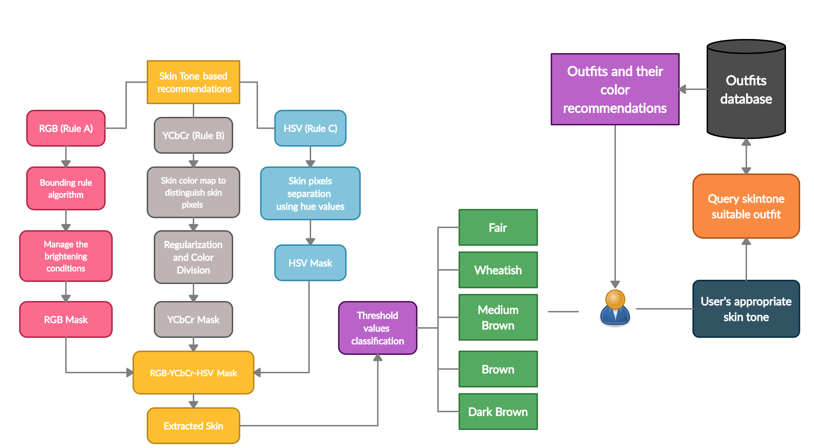

Slide 21
Implementation
3. Similar Outfits Recommendations
This is a Content based recommendation system wherein we use Transfer learning.
The pretrained VGG16 model is used here to extract the relevant features from our dress images and build a similarity score on them.
We ‘cut’ the VGG at the second-last layer, so we obtain for every single image a vector of dimension 1x4096.
The train test split is of 80-20%. The training data is used for building a similarity score matrix.

Slide 22
Implementation
3. Similar Outfits Recommendations
Then we make the prediction on data by using the CNN models.
Then we stored the model in a pickle format.
We then compute the similarity matrix for the other clothes in the dataset.
Finally we plot the most similar outfits as per the user’s input of clothes as per his choice.

Slide 23
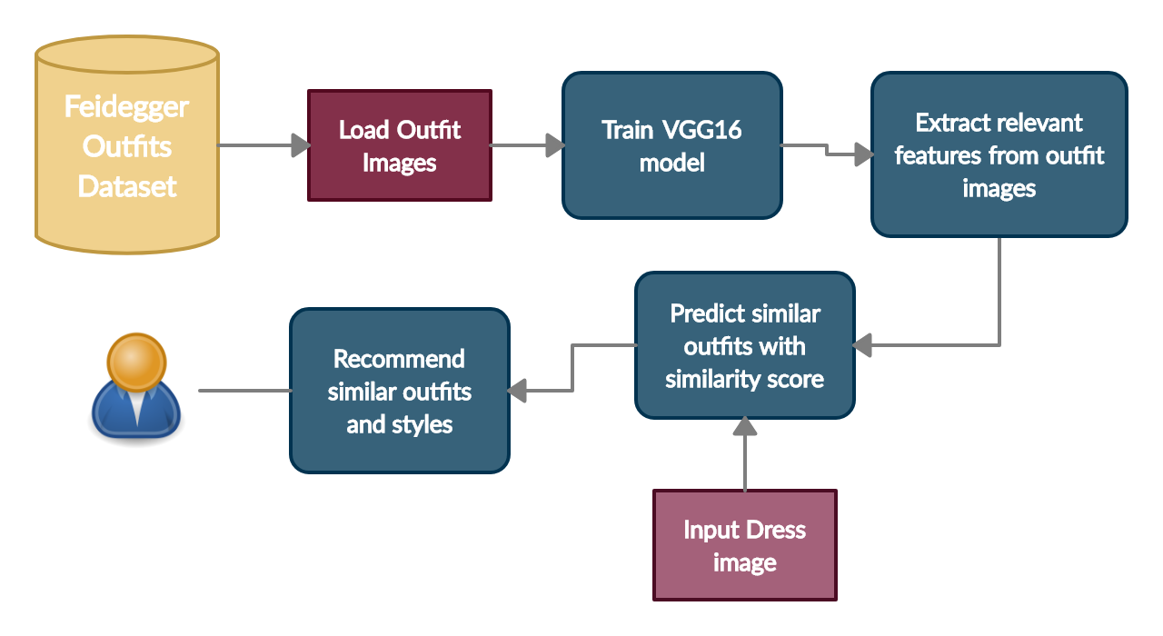

Slide 24
Implementation
4. Virtual - Try On
We have used the OpenCV library of Python for capturing the live video stream.
From the images that the user can try on, we are resizing them to fit on the user’s body.
We have used HoughCircles() to determine the area in which the user is standing in front of the frame.
According to the obtained measurements of the radius, we then use the resize() function of the imutils library to resize the clothes.
Resizing takes place by increase/decrease of either the height/width of the clothes.

Slide 25
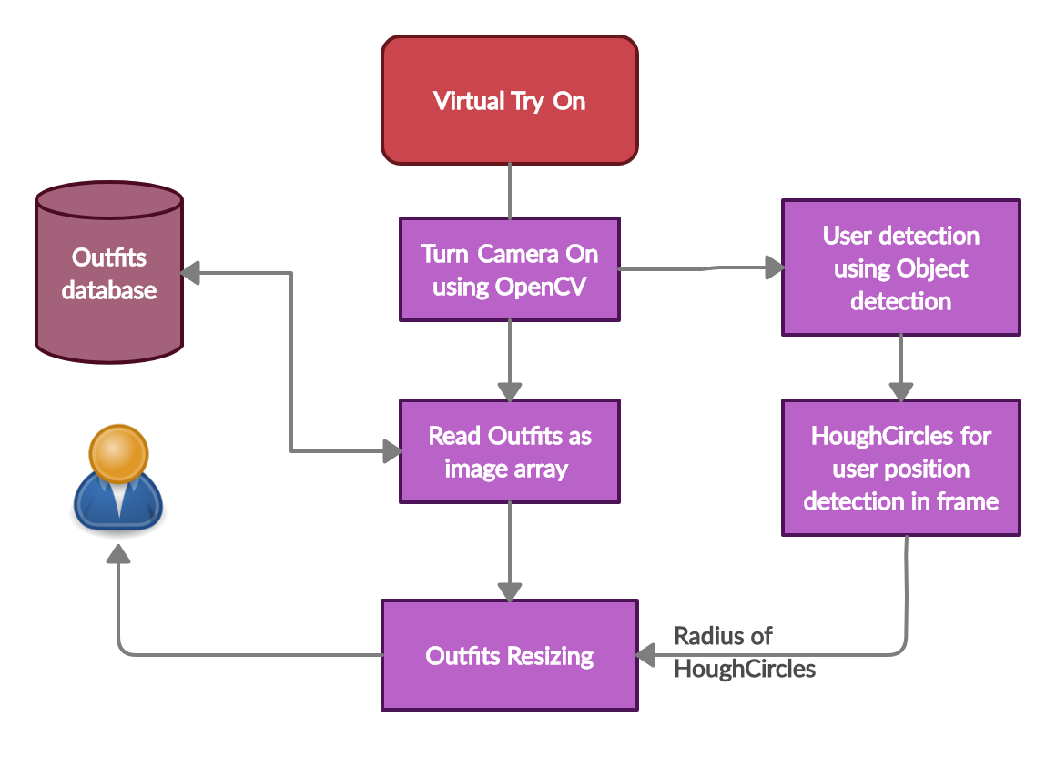

Slide 26
Implementation
5. Weather based recommendations
We have used the DeepFashion dataset for giving recommendations for four seasons - Spring, Autumn, Summer, Winter.
We selected 24 outfits for each season. They will act as the seed images for Seasonal Collections.
We only pass images into the model; the model does not ingest additional attributes/descriptions/product details; this is because we want the model to automatically learn and detect the style of fashion images passed into it without further human/machine labeling.
Seasonal recommendations have been built on Convolutional Neural Networks, with transfer learning from ResNet and approximate nearest neighbors.

Slide 27
Implementation
5. Weather based recommendations
After the train-test split, we extracted the different categories of clothes that the dataset consists of.
Later, we converted the images into these categorical embeddings.
We used the Resnet 18/50 layers for training the CNN model.
Then we saved the model to import it conveniently later.
We finally used Approximate Nearest Neighbors algorithm for generating the similar clothing recommendations.
Centroid embeddings in ANN will then merge all the seed images into one representation by averaging the values across all dimensions.
Thus the group of similar images as per the season passed are recommended to the user.

Slide 28
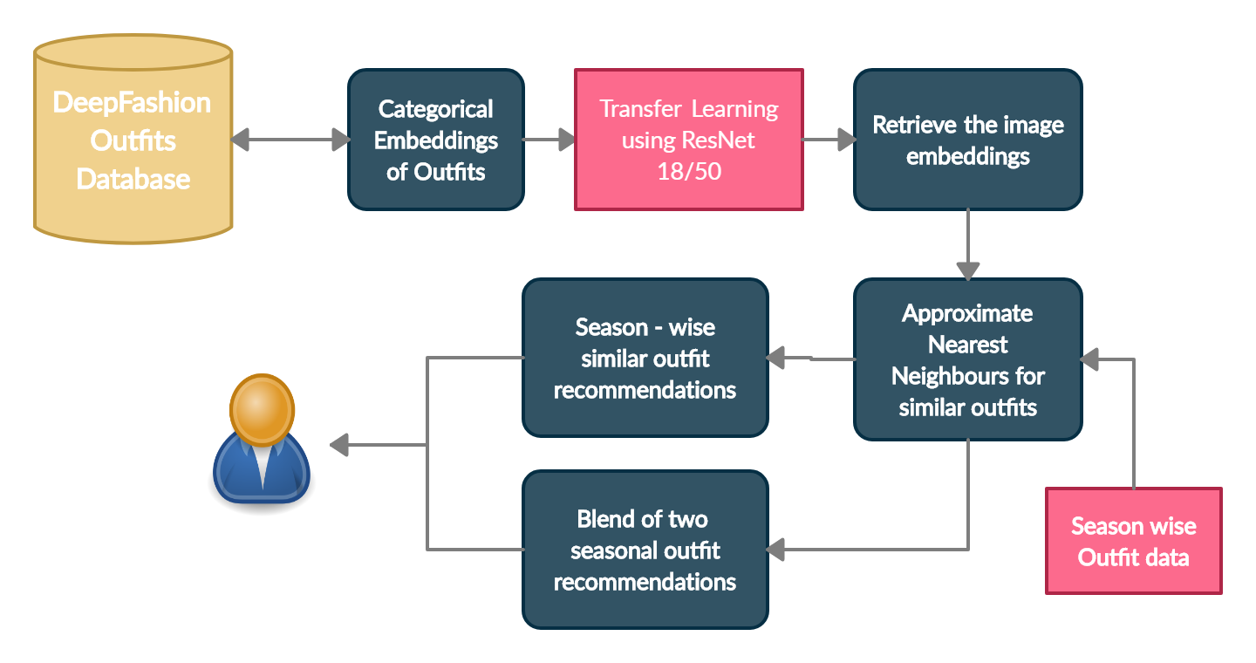

Slide 29
User
Skin Tone based Recommendations
HSV and YCbCr Color spaces
Skin segmentation
Threshold Values
Outfits and their Color recommendations
CNN pretrained VGG16 model
Similar Outfit recommendations
Seasonal Outfits recommendations
Approximate Nearest Neighbor
Similarity score matrix
Transfer Learning
Weather oriented Recommendations
Images Sets
CNN ResNet 18/50 model
Outfits resizing
OpenCV
Live Video Capture
Virtual Try On

Slide 30
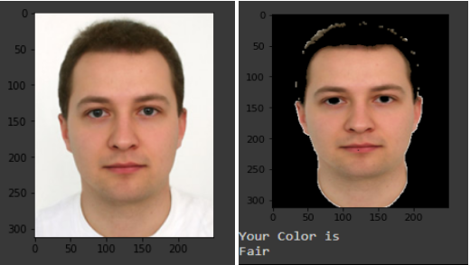
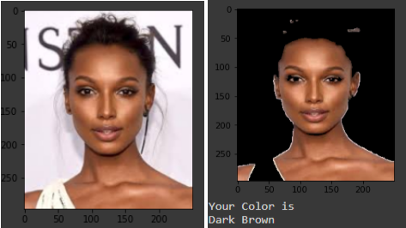
Results and Discussions
Skin Tone Detection

Slide 31
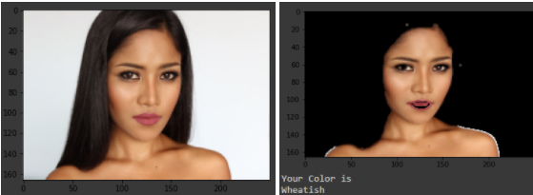
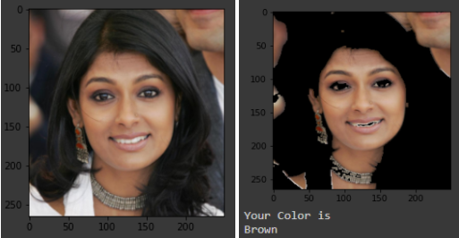
Results and Discussions
Skin Tone Detection

Slide 32
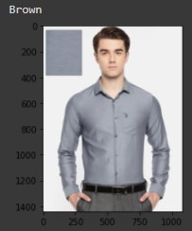
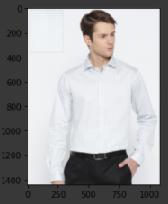
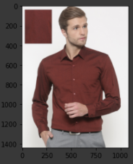
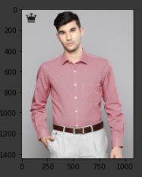
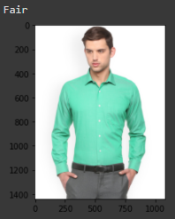
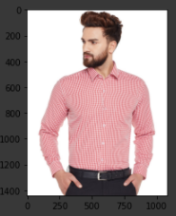
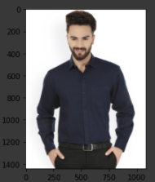
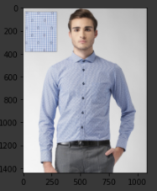
Results and Discussions
2. Outfit Color Recommendation

Slide 33
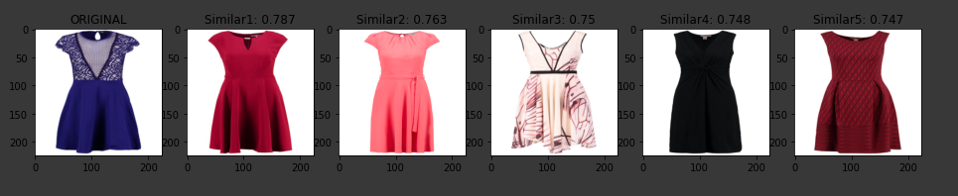
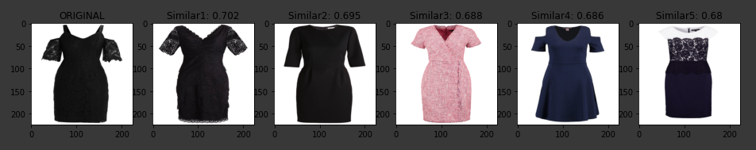
Results and Discussions
3. Similar Outfit Recommendation

Slide 34
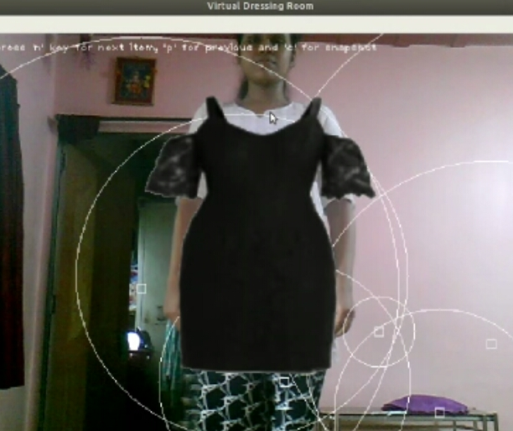
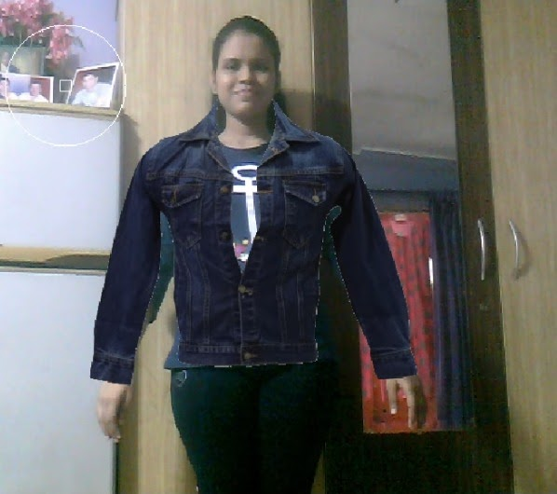
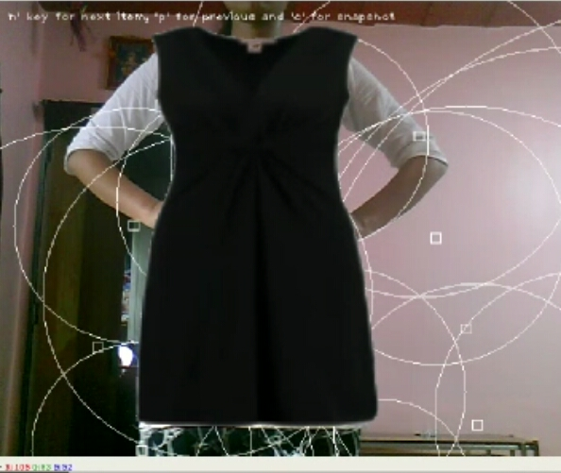
Results and Discussions
4. Virtual Try-On

Slide 35
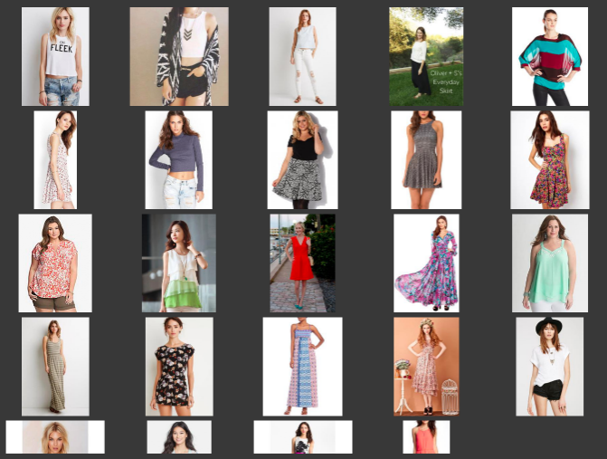
Results and Discussions
5. Weather oriented outfit recommendations
Spring season-
Classification
Accuracy -
100%
Prediction
Accuracy -
92.61%

Slide 36
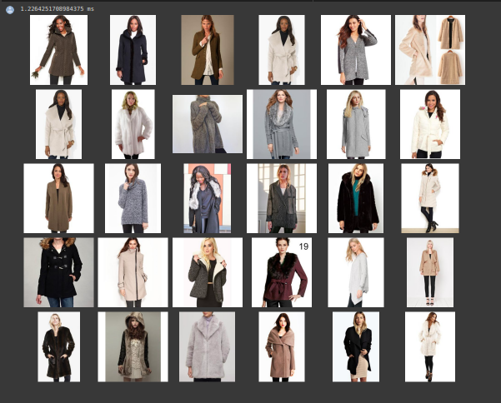
Results and Discussions
5. Weather oriented outfit recommendations
Winter &
Spring season-

Slide 37
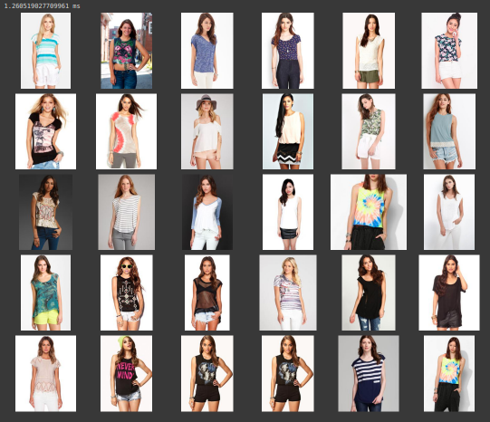
Results and Discussions
5. Weather oriented outfit recommendations
Summer &
Autumn season-

Slide 38
Conclusion
The proposed system recommends outfits and their color combination to users based on the skin tone of the user.
The system also considers weather for best suited outfits recommendations.
A virtual trial room is also provided for the user to try on the recommended outfits.
Thus this system is a full proof “Fashion Advisor” for people who are worried about what to wear and lack fashion sense.
This will serve as a real-time system that satisfies customer demands.

Slide 39
Future Scope
We can recommend accessories based on the selected outfits like watches for men.
The concept and technology can be adapted by established online platforms.
Further we can implement one more module that is based event and Occasion based.
User can pre-plan his/her outfits according to the upcoming event, as per the calendar application.

Slide 40
References
L. Hao and M. Hao, "Design of Intelligent Clothing Selection System Based on Neural Network," 2019 IEEE 3rd Information Technology, Networking, Electronic and Automation Control Conference (ITNEC), Chengdu, China, 2019, pp. 1789-1792, doi: 10.1109/ITNEC.2019.8729417.
K. Ayush, S. Jandial, A. Chopra and B. Krishnamurthy, "Powering Virtual Try-On via Auxiliary Human Segmentation Learning," 2019 IEEE/CVF International Conference on Computer Vision Workshop (ICCVW), Seoul, Korea (South), 2019, pp. 3193-3196, doi: 10.1109/ICCVW.2019.00397.
N. Ramesh and T. Moh, "Outfit Recommender System," 2018 IEEE/ACM International Conference on Advances in Social Networks Analysis and Mining (ASONAM), Barcelona, 2018, pp. 903-910, doi: 10.1109/ASONAM.2018.8508656.

Slide 41
References
4. X. Zeng, Y. Ding and S. Shao, "Applying Image Warping Technique to Implement Real-Time Virtual Try-On Based on Person's 2D Image," 2009 Second International Symposium on Information Science and Engineering, Shanghai, 2009, pp. 383-387, doi: 10.1109/ISISE.2009.9.
5. C. Limaksornkul, D. N. Nakorn, O. Rakmanee and W. Viriyasitavat, "Smart Closet: Statistical-based apparel recommendation system," 2014 Third ICT International Student Project Conference (ICT-ISPC), Nakhon Pathom, 2014, pp. 155-158, doi: 10.1109/ICT-ISPC.2014.6923240.
6. N. Dwina, F. Arnia and K. Munadi, "Skin segmentation based on improved thresholding method," 2018 International ECTI Northern Section Conference on Electrical, Electronics, Computer and Telecommunications Engineering (ECTI-NCON), Chiang Rai, 2018, pp. 95-99, doi: 10.1109/ECTI-NCON.2018.8378289.

Slide 42
References
7. Y. Wen, X. Liu and B. Xu, "Personalized Clothing Recommendation Based on Knowledge Graph," 2018 International Conference on Audio, Language and Image Processing (ICALIP), Shanghai, 2018, pp. 1-5, doi: 10.1109/ICALIP.2018.8455311.
8. L. Yu-Chu, Y. Kawakita, E. Suzuki and H. Ichikawa, "Personalized Clothing-Recommendation System Based on a Modified Bayesian Network," 2012 IEEE/IPSJ 12th International Symposium on Applications and the Internet, Izmir, 2012, pp. 414-417, doi: 10.1109/SAINT.2012.75.
9. Y. Liu, Y. Gao, S. Feng and Z. Li, "Weather-to-garment: Weather-oriented clothing recommendation," 2017 IEEE International Conference on Multimedia and Expo (ICME), Hong Kong, 2017, pp. 181-186, doi: 10.1109/ICME.2017.8019476.

Slide 43
THANK YOU

