Slide 1



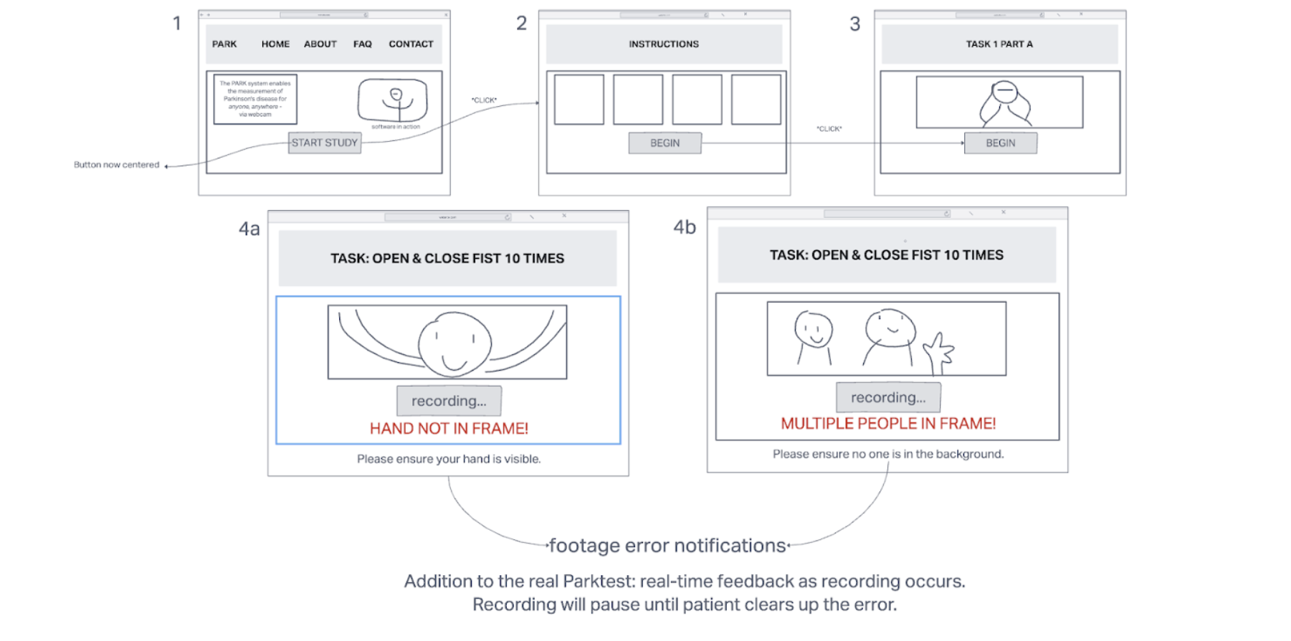

PARKTEST IMPROVEMENT
Team KANGS
University of Rochester
Introduction
The Team
Tools Used
Problem:
Parkinson’s disease (or simply Parkinson’s) is a long-term degenerative disorder of the central nervous system that mainly affects the motor system. Given that Parkinson’s is long-term, the symptoms take a very long time to fully develop. For that reason, it is necessary to diagnose early so that specialists have a better chance of treating Parkinson’s at its earliest stages. However, unfortunately, we do not currently have a specific test to diagnose Parkinson’s.
Our Solution:
The further improvement of ParkTest, a pre-existing framework that helps in detecting Parkinson’s symptoms early on by having users perform a series of neurological tests such as opening/closing their hands, tapping their fingers, etc
Anisha Bhattacharya:
CSC Major, Class of 2023
Godbless Chile :
CSC Major, Class of 2023
Nilsu Duran:
CSC Major, Class of 2023
Katherine Lentz:
CSC Major, Class of 2023
Syed Shihan:
CSC Major, Class of 2024
Needfinding
Prototyping
Survey:
Roughly 34% of participants knew someone with Parkinson’s or were personally afflicted with the disease
95% of participants graded the site navigation a 3 or higher on a scale of 1-4
Common (3+ responses) complaints with the platform included overt simplicity and the video feedback
Common recommendations included streamlining the feed and adding more neurological tasks
Interviews:
In order to educate both the patient and possible caregivers on Parkinson’s, the platform should offer a page with other resources and tools that patients may want to look into alongside general information to contextualize the disease for anyone who may not be acquainted with it
Arrange neurological tasks by degree of difficulty, the easier the task that user fails the more at risk the user is at having Parkinsons and the more encouragement they should be given to reach out to their healthcare provider
Paper Prototype: https://drive.google.com/file/d/15Pznvsj4s5567L2Y0FCkYP179a8wRl14/view?resourcekey
Wireframe Prototype:

