Slide 1

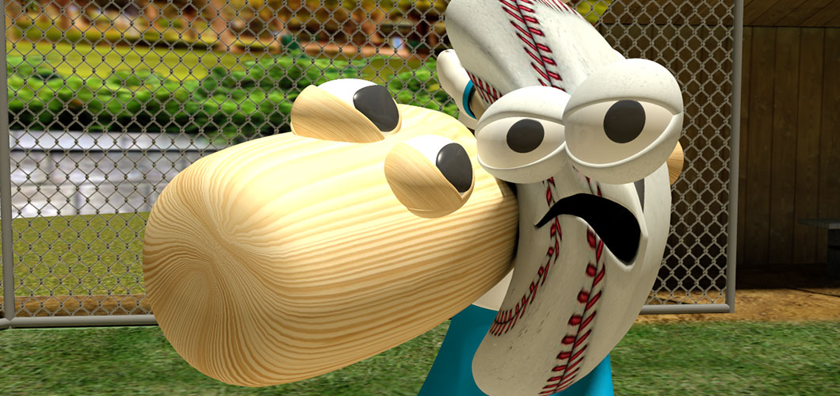
Baseball ? Moneyball? Statistics?
Anisha and Haritha Stattleship xCase
Level Core Sillicon Valley Cohort

Slide 2
Sabermetrics
Science of Sports through Statistical Analysis.
Micro Level
Macro Level
To Understand the team winning edge and the performances of the Players
To Evaluate the Metrics that maximizes winning potential, market inefficiencies and creates internal organizational process

Slide 3
Goal
Assess the influence of offensive and defensive statistics
on the probability of winning a baseball game Develop a balanced model to predict upcoming league
performance of the teams

Slide 4
Methodology
Extracting baseball season 2016 data from Stattleship API
Exploring the data using descriptive statistics
Choosing and computing the appropriate metrics to assess team performance
Building and improving the Statistical Model

Slide 5
Metrics used
Wins Percentage – Response variable, wins/games played
Predictors/Independent Variables:
Offence Statistics:
On Base Percentage – Percentage of time the player reached base when up to bat
Slugging Percentage – measure of power of the batter. Total bases/At bats
Stolen Bases - Measures the teams ability to utilize its speed and base running skill .
Defensive Statistics:
Fielding Percentage – percentage of quality fielding and throwing handled without an error.
K/9IP – Average no.of strike outs per std 9 inning game .Evaluates the team’s pitching ability.
Whip – pitching metric, measures how successful the pitchers are keeping the opposing batter off base.
Salary
Payroll Amount : Teams Budget of the Players.

Slide 6
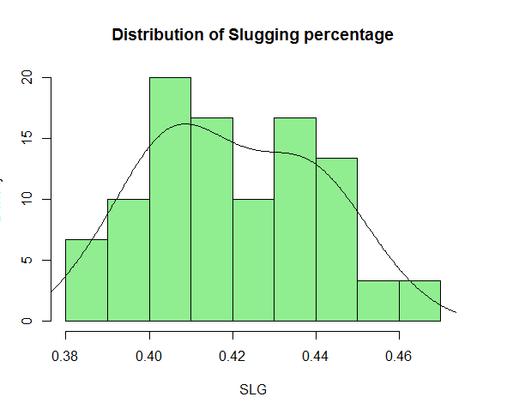
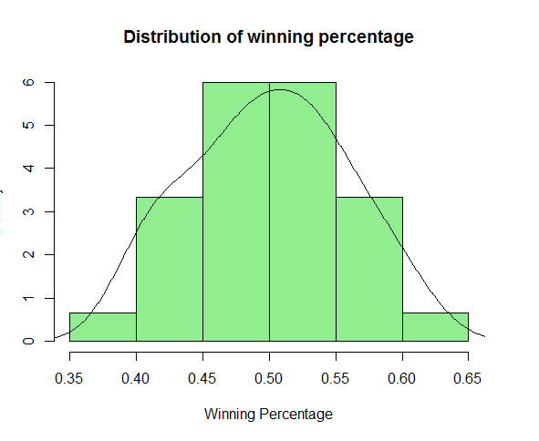
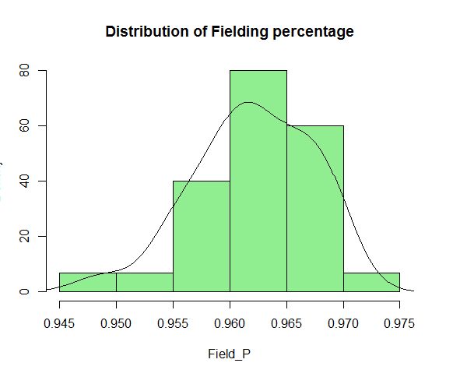
Exploring the Data

Slide 7
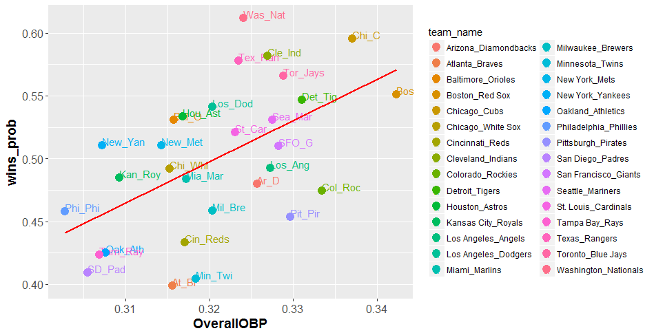
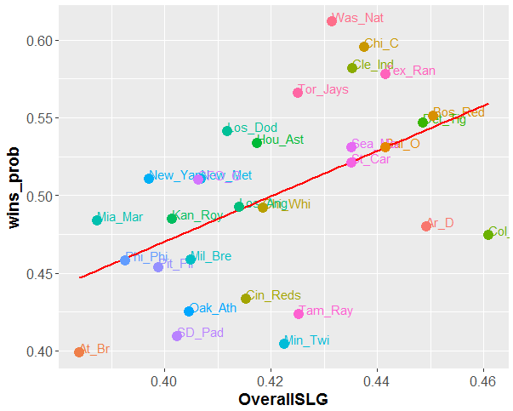
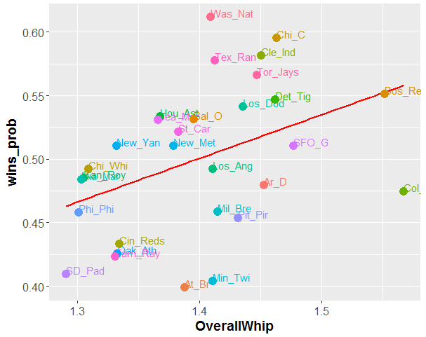
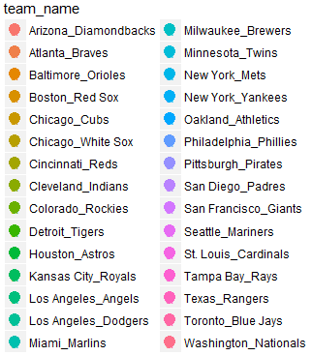
On Base Percentage
wins_prob vs
Slugging Percentage
WHIP

Slide 8
Descriptive statistics
 | Wins% | On Base% | Slugging % | Fielding% | K9/IP | WHIP
Median | 0.501 | 0.320 | 0.418 | 0.962 | 8.554 | 1.403
Mean | 0.500 | 0.321 | 0.420 | 0.962 | 8.512 | 1.397
SE Mean | 0.011 | 0.002 | 0.004 | 0.001 | 0.141 | 0.013
Variance | 0.003 | 0.0001 | 0.0004 | 0.00002 | 0.595 | 0.005
Std.Deviation | 0.059 | 0.009 | 0.021 | 0.005 | 0.772 | 0.071
Coef.Variation | 0.117 | 0.031 | 0.049 | 0.005 | 0.091 | 0.050

Slide 9
Hypotheses
H0 : There is no significant prediction of winning percentage by predictor/response variables
H0 : β 1 = β 2 =…= β 7 = 0
H1: There is significant prediction of winning percentage by predictor/response variables
H1 : β ≠ 0 for at least one β’s
Assumptions of the Model:
1. Independence
2.Homoscadacity of Variance
3.Normality
4.Linearity

Slide 10
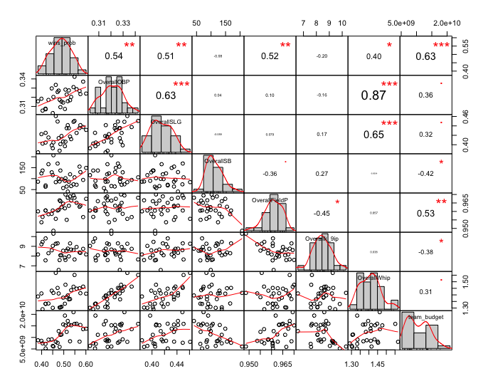
Model v1.0
install.packages("PerformanceAnalytics")
library(PerformanceAnalytics)
chart.Correlation(stats)

Slide 11
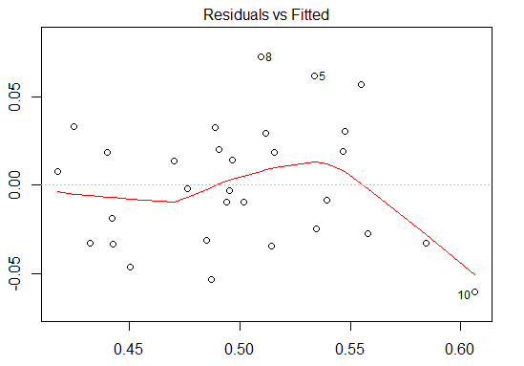
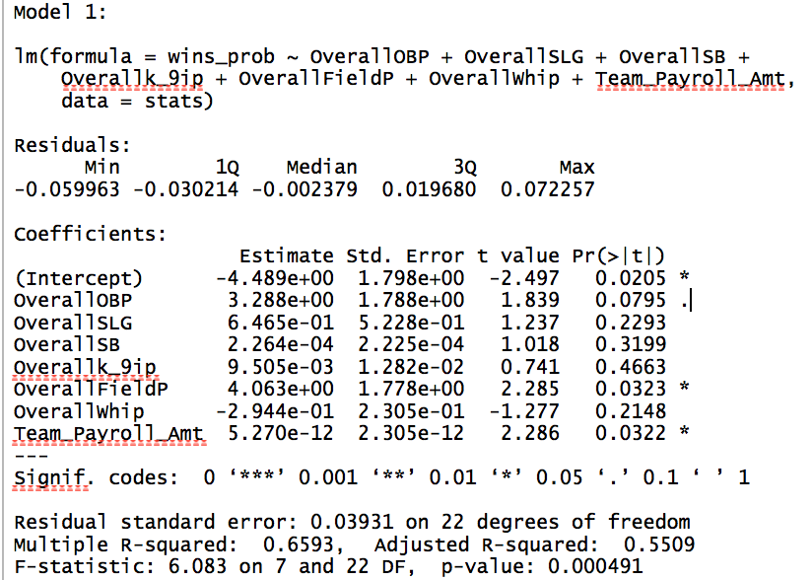
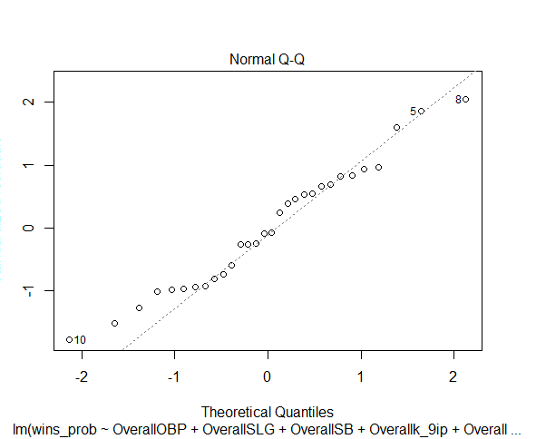
Model v1.0
As p value < default level of significance 0.05, there is no evidence to accept the null hypothesis that all β’s are equal to zero. The R square of 66% is decent to explain the variation of win % due to predictor variables.

Slide 12
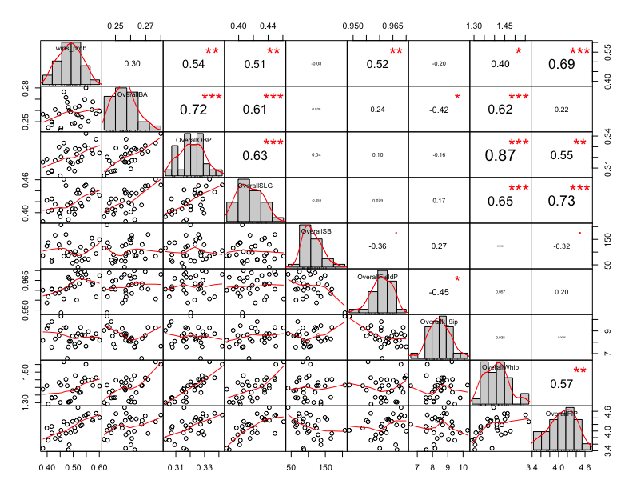
Model v1.0
Introducing two more variables
Batting Average (BA)
– Percentage of time, a player scores
a hit when at bat vs recording an out
Fielding Independent Pitching (FIP)
- Measures the pitcher performance
events that are directly under a pitcher's
control: strikeouts, walks, and home runs included in terms of weights.

Slide 13
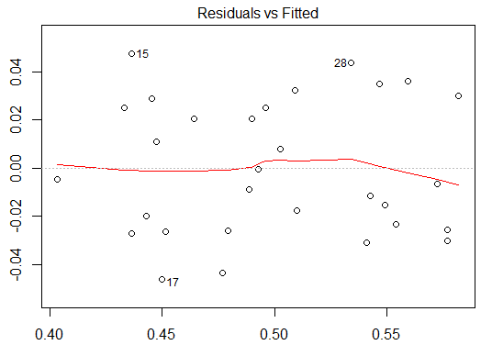
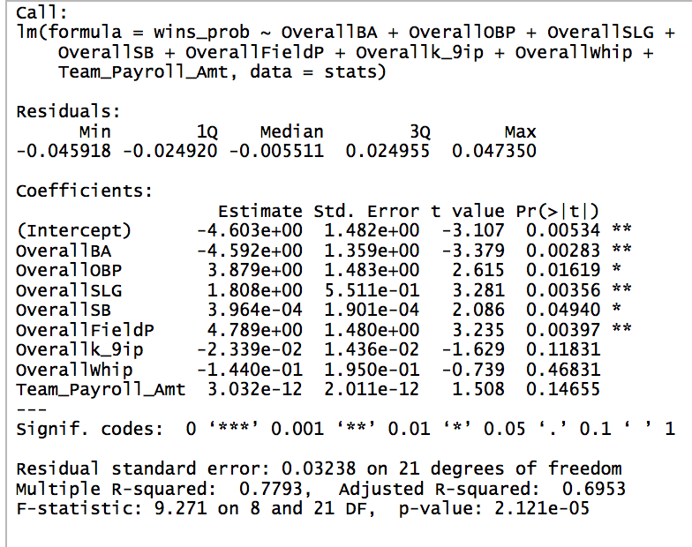
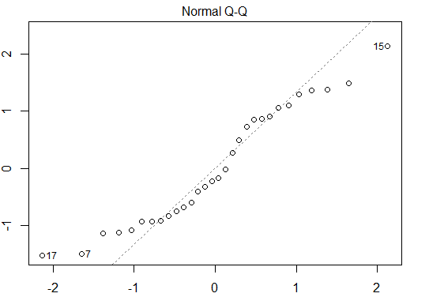
Model v2.0

Slide 14
Interpretation:
P value is almost equal to zero. There is no evidence to accept the null hypothesis that all β’s are equal to zero i.e there is a significant relationship b/w winning % and team’s predictor variables.
After the model improvement r square gives 78% ,which would be considered as a good fit and the correlation coefficient r is 0.88 which shows there is strong relationship b/w the winning % and team’s predictor variables.
Even though each variable doesn’t show significant correlation to the team’s winning %, this is not surprising since the team’s success is dependent on execution of all the fundamentals of the baseball.

