Slide 1
Block Coordinate Geometric Median Descent*
Anish Acharya
University of Texas at Austin
Facebook Ads ML Modeling
November 19, 2021
* Robust SGD in High Dimensions via Block Coordinate Geometric Median Descent.
Anish Acharya, Abolfazl Hashemi, Sujay Sanghavi, Inderjit Dhillon, Prateek Jain, Ufuk Topcu

Slide 2
TL;DR
Geometric Median (GM) is a well studied rotation and translation invariant robust estimator with optimal breakdown point of 1/2 even under gross corruption.
However high computational cost makes it infeasible for robust optimization in high dimensional settings.
We show that by applying GM to only a judiciously chosen block of coordinates at a time and using a memory mechanism, one can retain the breakdown point of ½ while attaining the same non-asymptotic convergence rate as SGD with GM. We call the resulting algorithm BGMD.
Empirically, BGMD can be up to 3x more efficient to train than GM-SGD while still ensuring similar test accuracy and maintaining same level of robustness.
In clean setting, BGMD reaches similar accuracy as SGD while constrained to compute budget (see Fig. 2, 3, 4) indicating BGMD is a practical robust optimization approach in large scale settings.

Slide 3
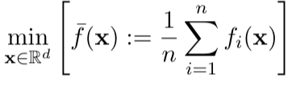
Large Scale Optimization
Training Deep Neural Network requires optimizing over highly over-parameterized , non-convex loss landscape.
ERM Formulation - Finite Sum Structure
Each function corresponds to loss over one sample

Slide 4
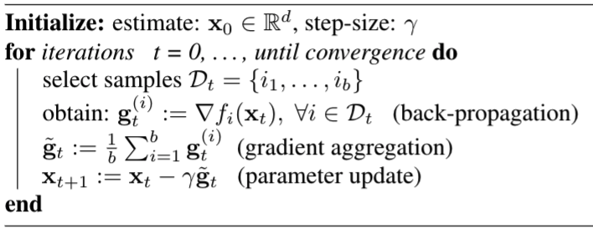
Stochastic Gradient Descent (SGD)
Mini-batch SGD is the de-facto method for optimizing such functions

Slide 5
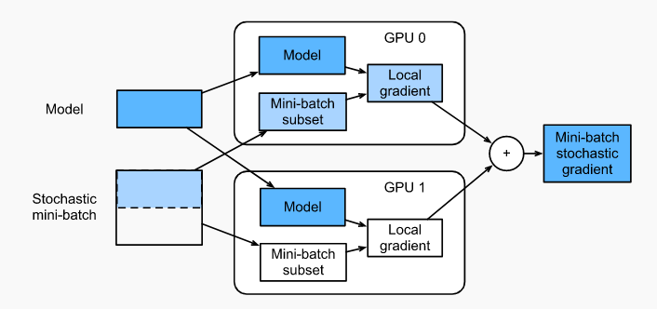
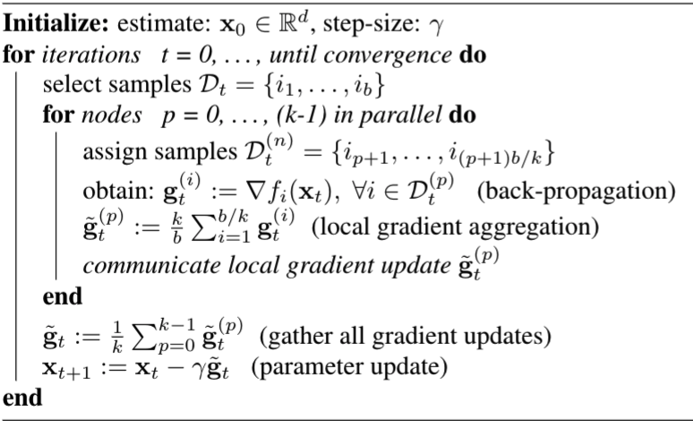
Distributed SGD
Training happens over multiple compute nodes (e.g. GPU) in parallel
Distributed Data Parallel
source: d2I.ai

Slide 6
A new paradigm – Federated Learning
collaboratively train a ML model
keep the data decentralized
synchronous update scheme that proceeds in rounds of communication
McMahan, H. Brendan, Eider Moore, Daniel Ramage, and Seth Hampson. "Communication-efficient learning of deep networks from decentralized data." AISTATS, 2017

Slide 7



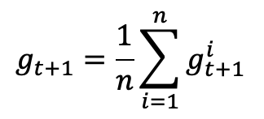


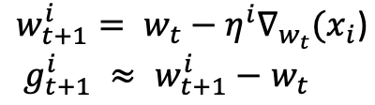
Federated Averaging
Fed-avg
Server
Clients / Edge Devices
Notes:
First, lets understand how the current F training works.
In FL setup there is one master/server node and several client nodes (mostly edge devices like mobile phone).
The data resides on the clients and is not visible to the server.

Slide 8
Vulnerability of Distributed Training
Byzantine Client
Byzantine failure in a distributed ML system occurs when one of the components in such a system behaves arbitrarily
e.g. This could be the result of software bugs, hardware defects, communication loss (information dropout)
Adversarial Attack
Goal of the attacker is to simultaneously train on the main task and backdoor task by manipulating a subset of clients through adversarial trigger injection.
e.g. force a word predictor to complete certain sentences with an attacker-chosen word, have search engine recommend adversary chosen product for a given query.

Slide 9
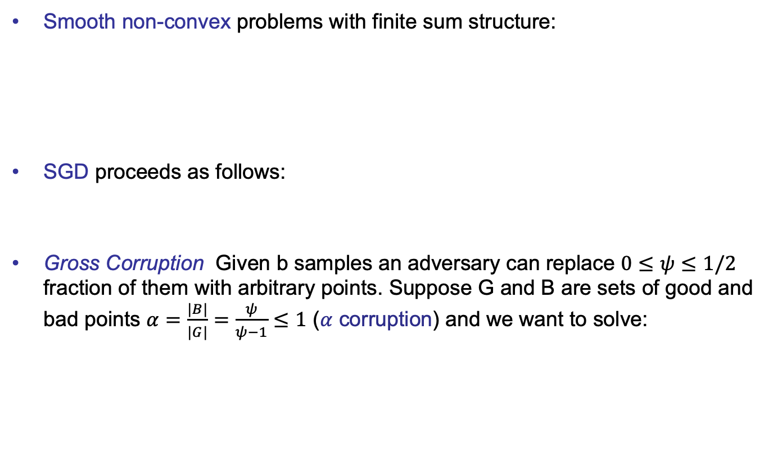


Recall : SGD
Smooth non-convex problems with finite sum structure:
SGD proceeds as follows:
Gross Corruption Given b samples an adversary can replace $0≤ψ≤1/2$ fraction of them with arbitrary points. Suppose G and B are sets of good and bad points $α=\frac{|B|}{|G|}=\frac{ψ}{ψ−1}≤1$ ($α$ corruption) and we want to solve:

Slide 10
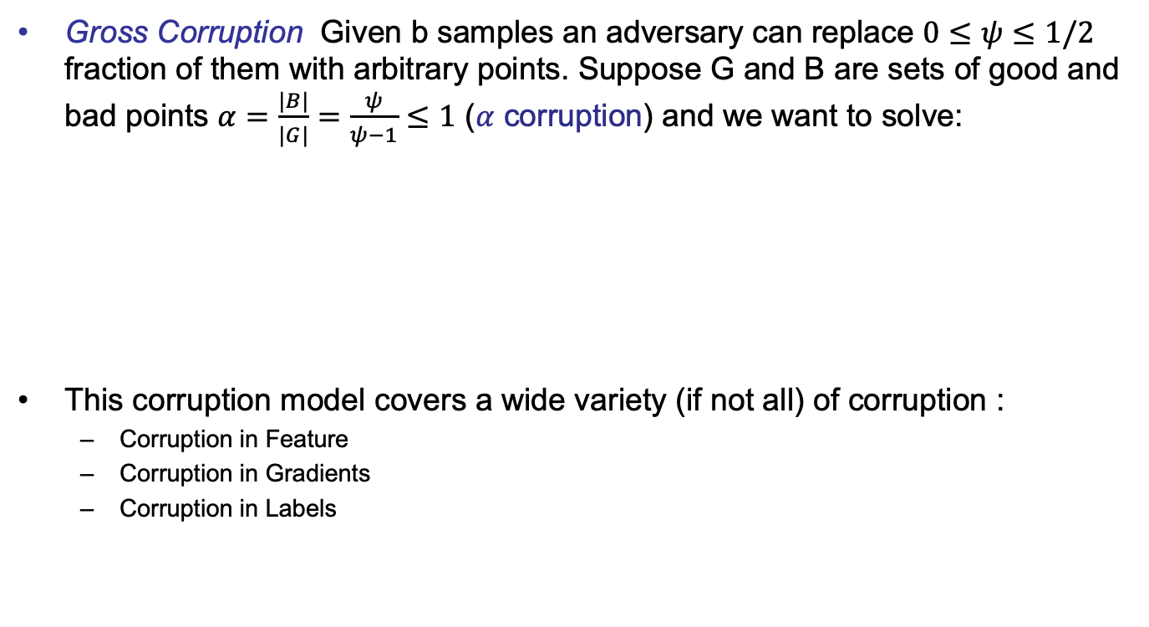
Corruption Model
Gross Corruption Given b samples an adversary can replace $0≤ψ≤1/2$ fraction of them with arbitrary points. Suppose G and B are sets of good and bad points $α=\frac{|B|}{|G|}=\frac{ψ}{ψ−1}≤1$ ($α$ corruption) and we want to solve:
This corruption model covers a wide variety (if not all) of corruption :
Corruption in Feature
Corruption in Gradients
Corruption in Labels

Slide 11




Gradient Aggregation
Given : b gradient estimates
When $ψ$ = 0 : empirical mean is common measure of center.
MSE minimization:

Slide 12

Robust Gradient Aggregation
Breakdown Point : smallest fraction of contamination that must be introduced to cause an estimator to break i.e. produce arbitrarily wrong estimates. Finite Sample breakdown point
No linear gradient aggregation (e.g. mean in SGD) strategy can tolerate even a single such corrupted point. Consider the following sample:
Mean has finite sample breakdown point of 1/b i.e. asymptotic breakdown 0
Make SGD Robust: Replace Mean with Robust Mean Estimator.

Slide 13


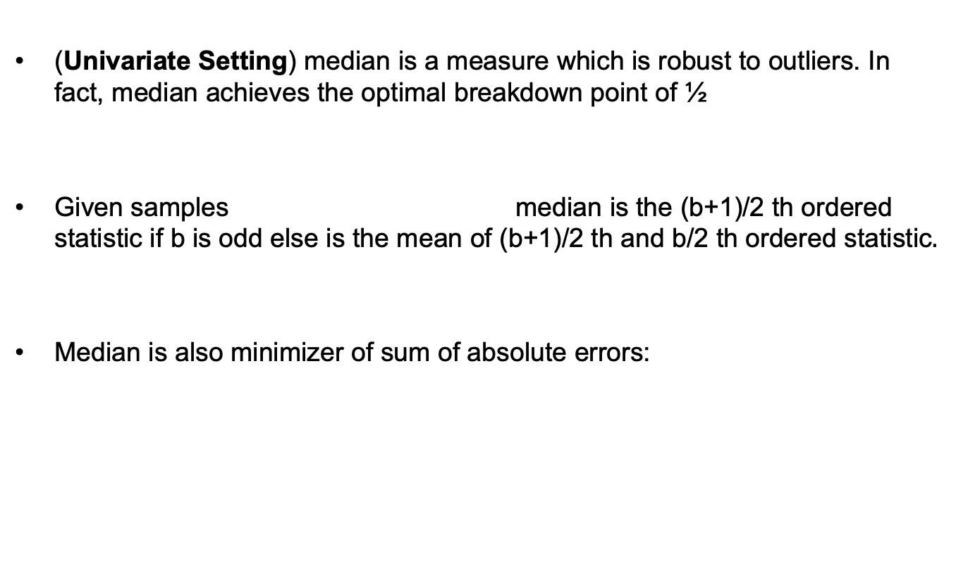
Univariate Robust Gradient Aggregation
(Univariate Setting) median is a measure which is robust to outliers. In fact, median achieves the optimal breakdown point of ½
Given samples median is the (b+1)/2 th ordered statistic if b is odd else is the mean of (b+1)/2 th and b/2 th ordered statistic
Median is also minimizer of sum of absolute errors:

Slide 14
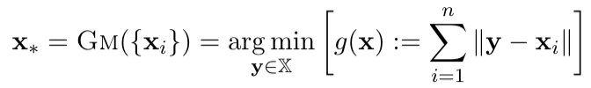
Multivariate Robust Gradient Aggregation
Coordinate wise Median (CM)
When d > 2 CM need not lie in the convex hull of the samples and are not orthogonal equivariant i.e. do not commute with co-ordinate transform
Geometric Median (GM)

Slide 15
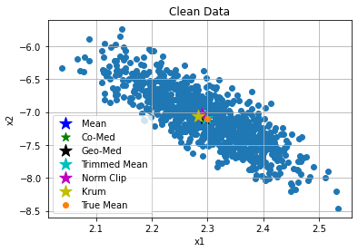
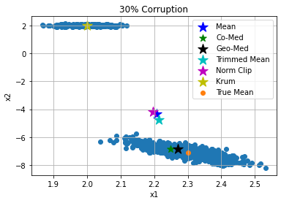
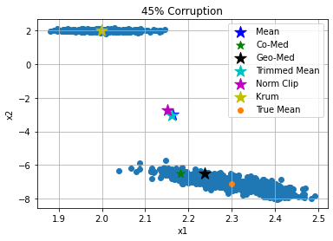
Multivariate Robust Gradient Aggregation
This Toy example in 2 dimensions demonstrates
the superior robustness properties of GM for estimating the
aggregated gradient in presence of heavy corruption.

Slide 16
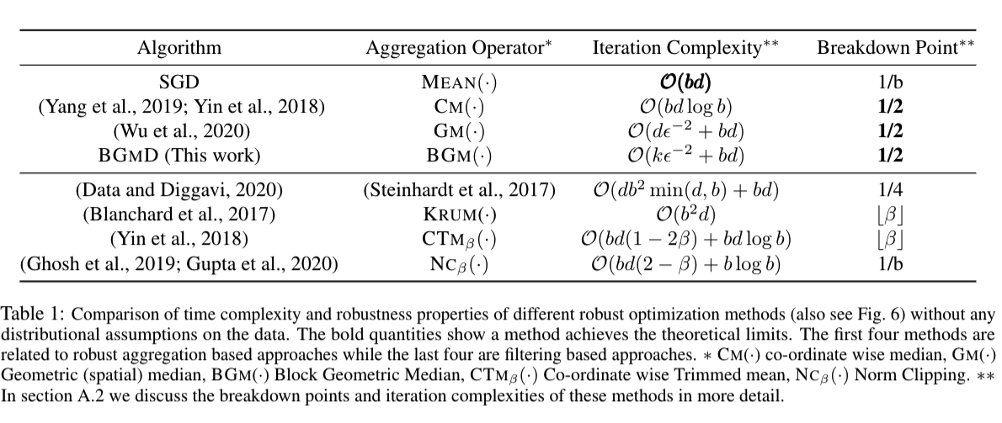
Robust SGD in High Dimension

Slide 17
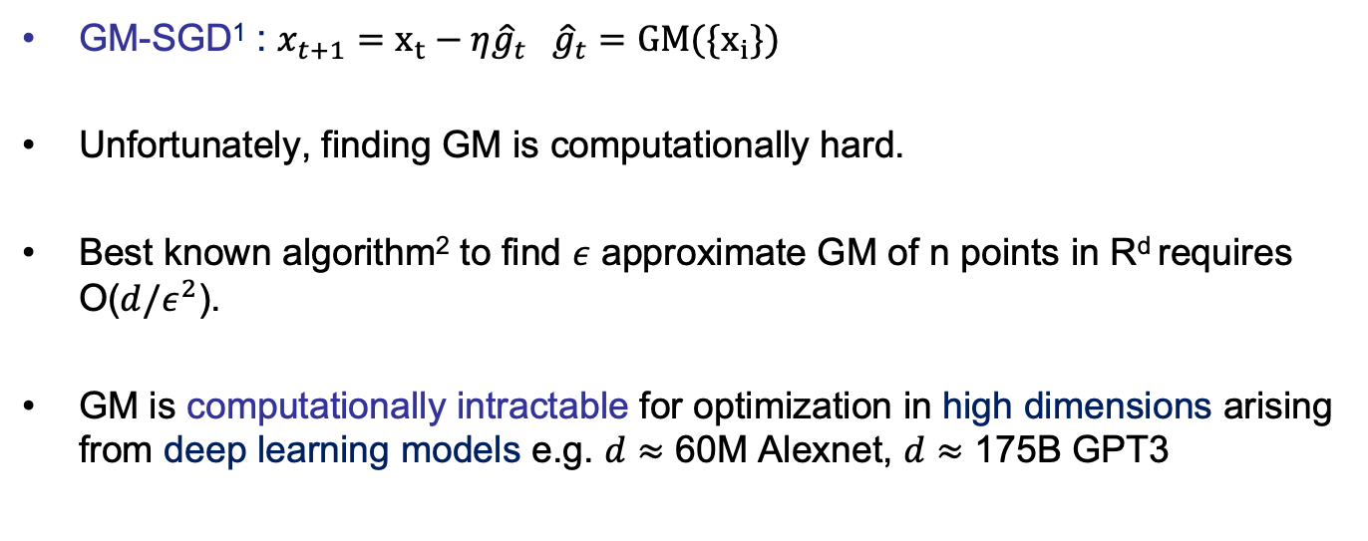
GM in High Dimension
GM-SGD¹ : $x_{t+1}=x_{t}−η{\hat{g}}_{t} {\hat{g}}_{t}=GM(\{x_{i}\})$
Unfortunately, finding GM is computationally hard.
Best known algorithm² to find $ε$ approximate GM of n points in R^{d} requires O($d/ε^{2}$).
GM is computationally intractable for optimization in high dimensions arising from deep learning models e.g. $d≈$ 60M Alexnet, $d≈$ 175B GPT3
1. Dan Alistarh, Zeyuan Allen-Zhu, and Jerry Li. Byzantine stochastic gradient descent. In Advances in Neural Information Processing Systems, pages 4613–4623,2018
2. Michael B Cohen, Yin Tat Lee, Gary Miller, Jakub Pachocki, and Aaron Sidford. Geometric median in nearly linear time. In Proceedings of the forty-eighth annual ACM symposium on Theory of Computing, pages 9–21, 2016.

Slide 18
GM over low dimensional subspace
Gradient distribution is often long tailed especially in case of over-parameterized deep learning settings.
Intuition: Performing gradient aggregation in a low dimensional subspace might have little impact in the downstream optimization task.
BGMD (proposed) judiciously subsets a block of k dimensions (k << d) and performs GM in R^{k} (Algorithm 1). Note this strategy is biased. BGMD introduces a memory mechanism to fix this bias and maintain same non-asymptotic convergence rate as SGD with GM in R^{d}.
Notes:
Why select coordinates proportional to probability and not just take Top-k ?
They are approximately equivalent. Sort + Top k => O(d log d + 1) vs sampling based on norm distribution (Norm of dim i / total Norm). This is O(d).

Slide 19
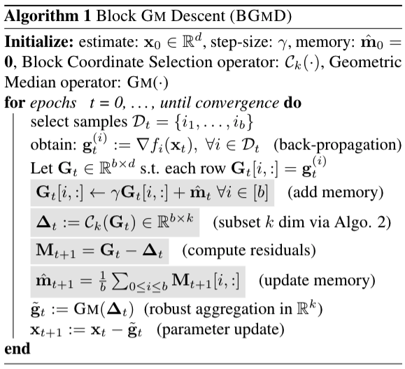
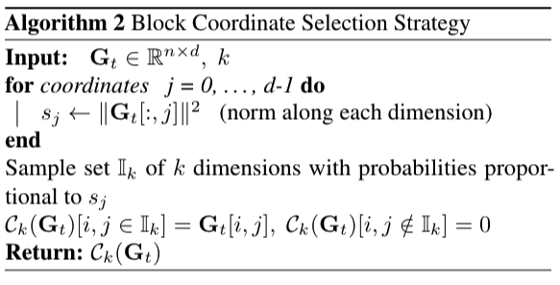
Block coordinate GM Descent

Slide 20


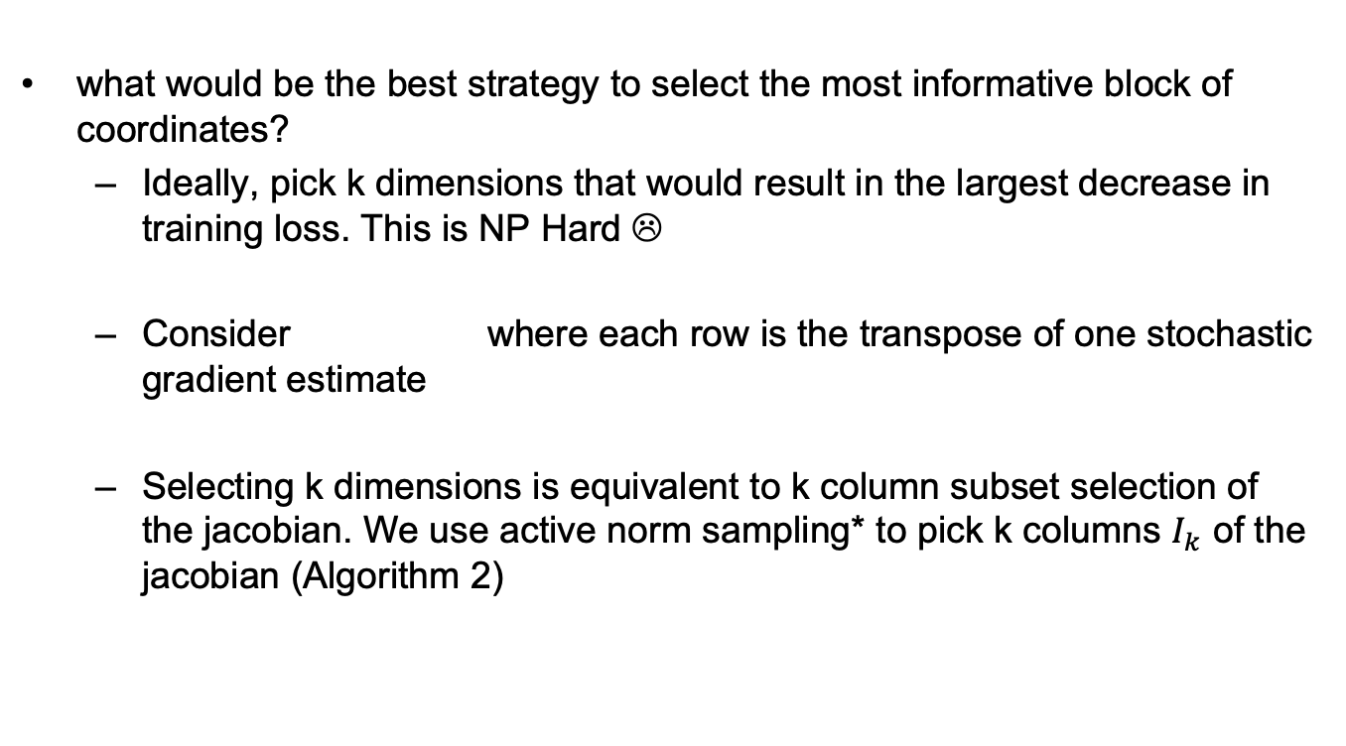
Block Selection Strategy
what would be the best strategy to select the most informative block of coordinates?
Ideally, pick k dimensions that would result in the largest decrease in training loss. This is NP Hard ☹
Consider where each row is the transpose of one stochastic gradient estimate
Selecting k dimensions is equivalent to k column subset selection of the jacobian. We use active norm sampling* to pick k columns $I_{k}$ of the jacobian (Algorithm 2)
Notes:
Why select coordinates proportional to probability and not just take Top-k ?
They are approximately equivalent. Sort + Top k => O(d log d + 1) vs sampling based on norm distribution (Norm of dim i / total Norm). This is O(d).

Slide 21
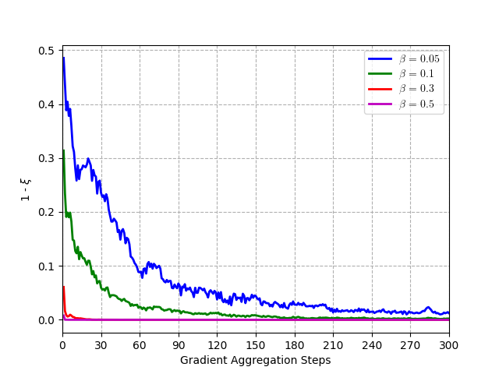


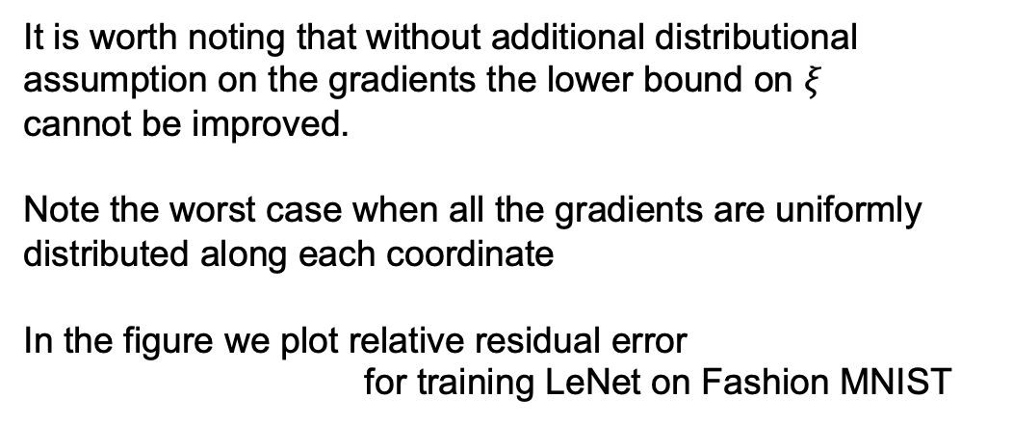
Block Selection Strategy
It is worth noting that without additional distributional assumption on the gradients the lower bound on $ξ$
cannot be improved.
Note the worst case when all the gradients are uniformly distributed along each coordinate
In the figure we plot relative residual error
for training LeNet on Fashion MNIST
Notes:
Why select coordinates proportional to probability and not just take Top-k ?
They are approximately equivalent. Sort + Top k => O(d log d + 1) vs sampling based on norm distribution (Norm of dim i / total Norm). This is O(d).

Slide 22
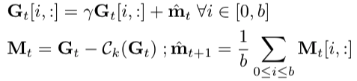
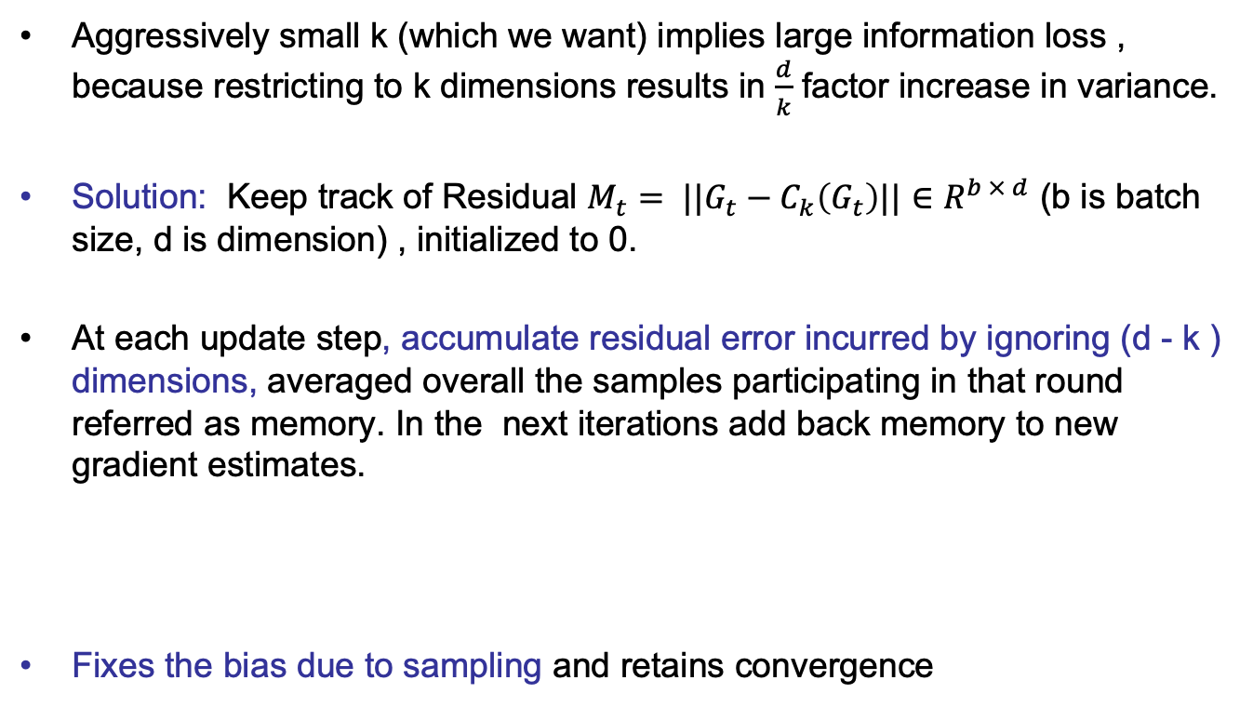
Memory
Aggressively small k (which we want) implies large information loss , because restricting to k dimensions results in $\frac{d}{k}$ factor increase in variance.
Solution: Keep track of Residual $M_{t}= ||G_{t}−C_{k}\left(G_{t}\right)||∈R^{b × d}$ (b is batch size, d is dimension) , initialized to 0.
At each update step, accumulate residual error incurred by ignoring (d - k ) dimensions, averaged overall the samples participating in that round referred as memory. In the next iterations add back memory to new gradient estimates.
Fixes the bias due to sampling and retains convergence

Slide 23
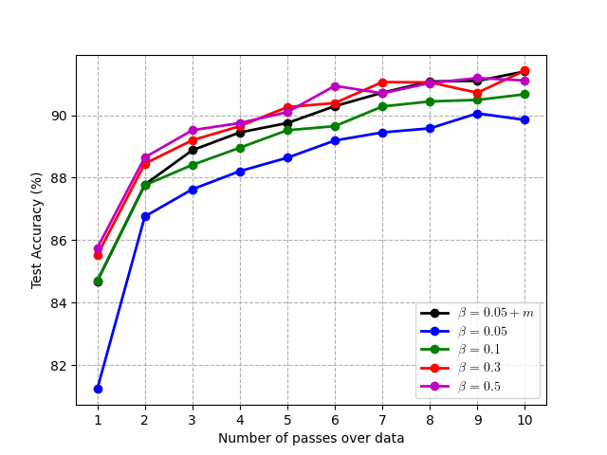
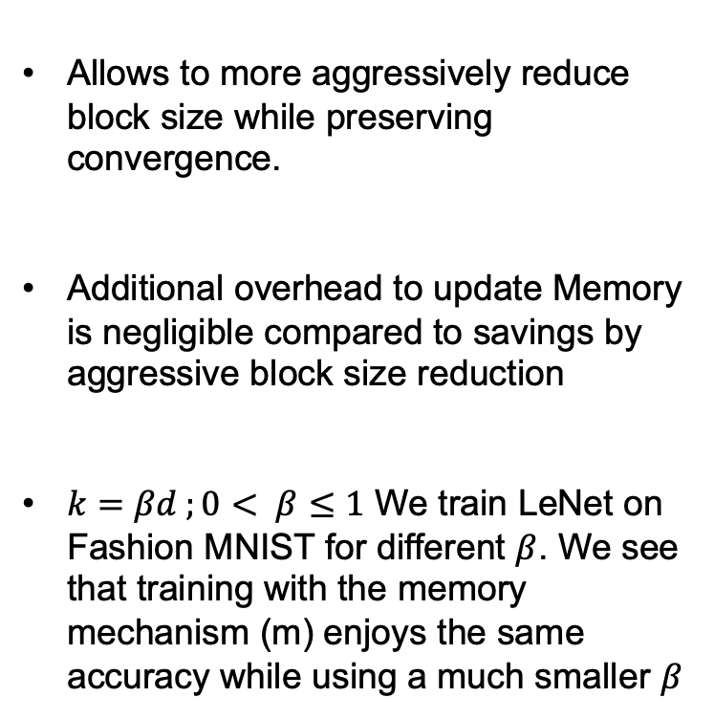
Benefit of Memory
Allows to more aggressively reduce block size while preserving convergence.
Additional overhead to update Memory is negligible compared to savings by aggressive block size reduction
$k=βd ;0< β≤1$ We train LeNet on Fashion MNIST for different $β$. We see that training with the memory mechanism (m) enjoys the same accuracy while using a much smaller $β$

Slide 24
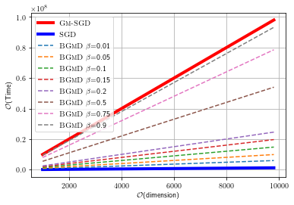

Computational Complexity
Consider solving optimization problem with finite sum structure with parameters $∈R^{d}$ and batch size $b$ using SGD like iterations.
Computational Upper Bound
Notes:
Note, the difference between the iterations of SGD, GM-SGD and BGMD is primarily in the aggregation step.

Slide 25
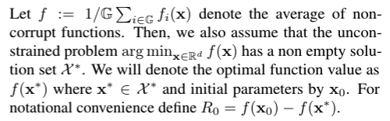
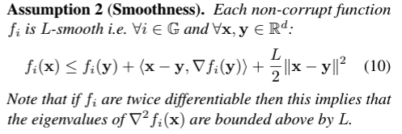
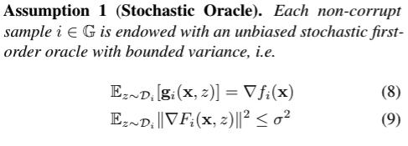
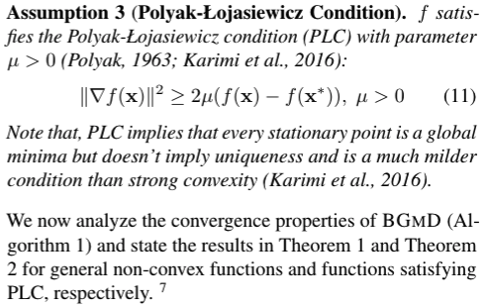
Theory: Assumptions

Slide 26
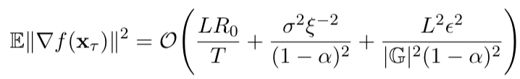
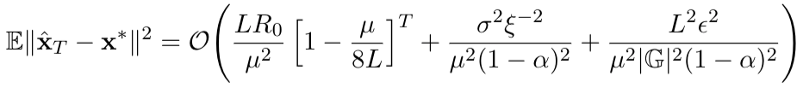

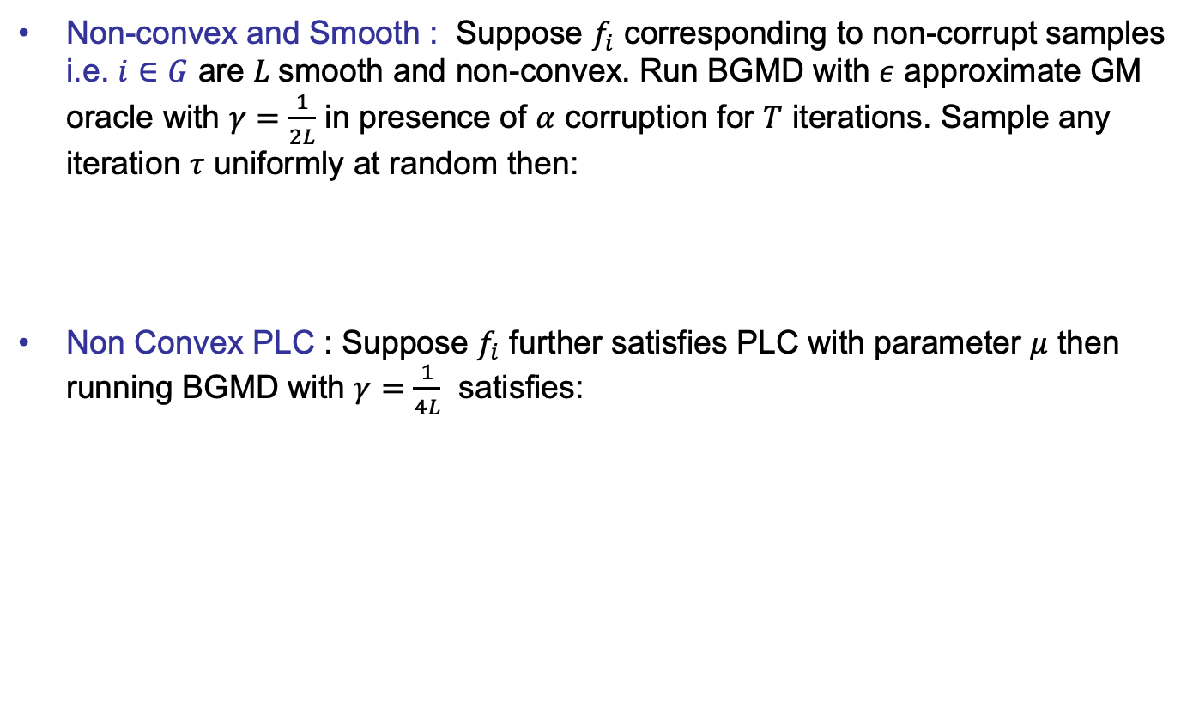
Convergence Guarantees
Non-convex and Smooth : Suppose $f_{i}$ corresponding to non-corrupt samples i.e. $i∈G$ are $L$smooth and non-convex. Run BGMD with $ε$ approximate GM oracle with $γ=\frac{1}{2L}$ in presence of $α$ corruption for $T$ iterations. Sample any iteration $τ$ uniformly at random then:
Non Convex PLC : Suppose $f_{i}$ further satisfies PLC with parameter $μ$ then running BGMD with $γ=\frac{1}{4L}$ satisfies:

Slide 27
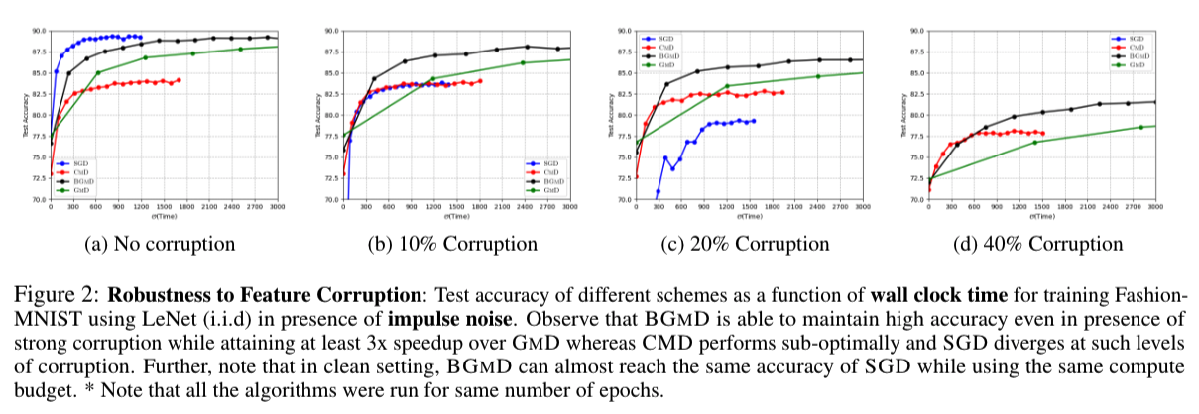
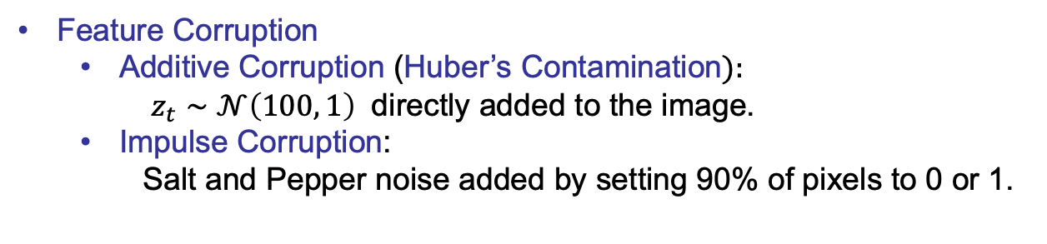
Empirical Evidence: Feature Corruption
Feature Corruption
Additive Corruption (Huber’s Contamination$):$
$z_{t}∼𝒩\left(100, 1\right)$ directly added to the image.
Impulse Corruption:
Salt and Pepper noise added by setting 90% of pixels to 0 or 1.

Slide 28
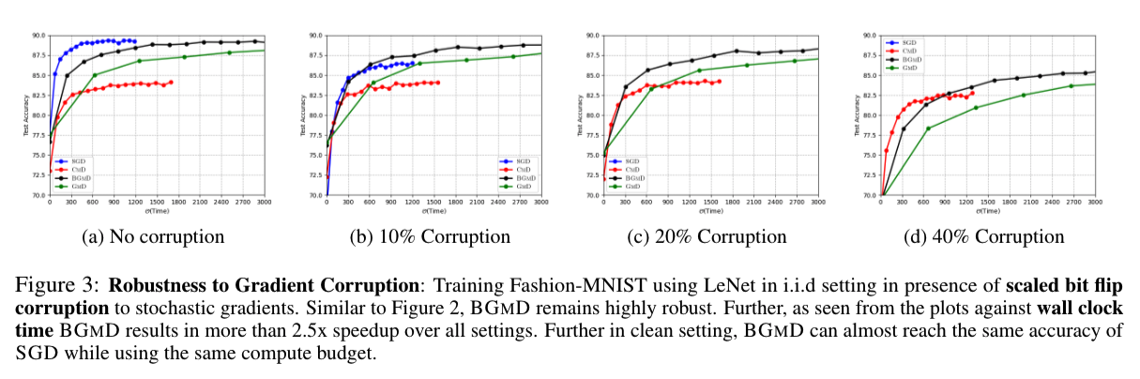
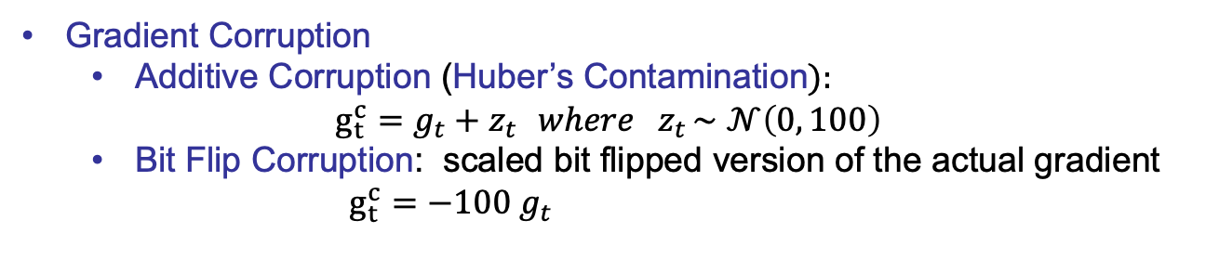
Empirical Evidence: Gradient Corruption
Gradient Corruption
Additive Corruption (Huber’s Contamination$):$
$$g_{t}^{c}=g_{t}+z_{t} { where z}_{t}∼𝒩\left(0, 100\right)$$
Bit Flip Corruption: scaled bit flipped version of the actual gradient $g_{t}^{c}={−100 g}_{t}$

Slide 29
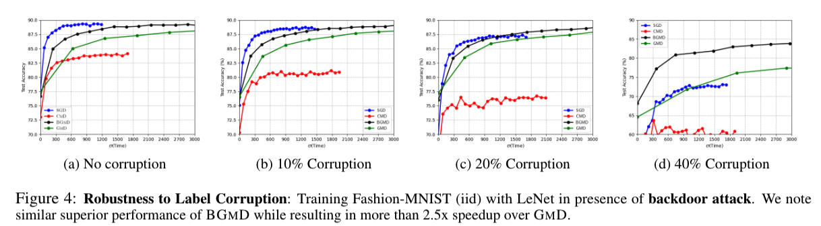
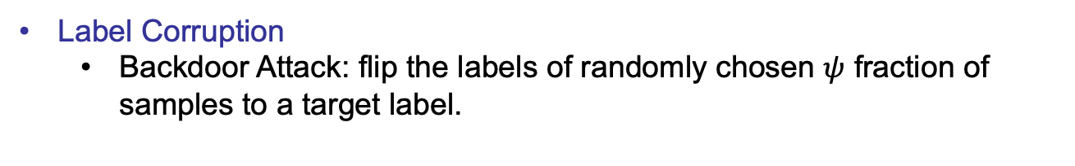
Empirical Evidence: Label Corruption
Label Corruption
Backdoor Attack: flip the labels of randomly chosen $ψ$ fraction of samples to a target label.

Slide 30
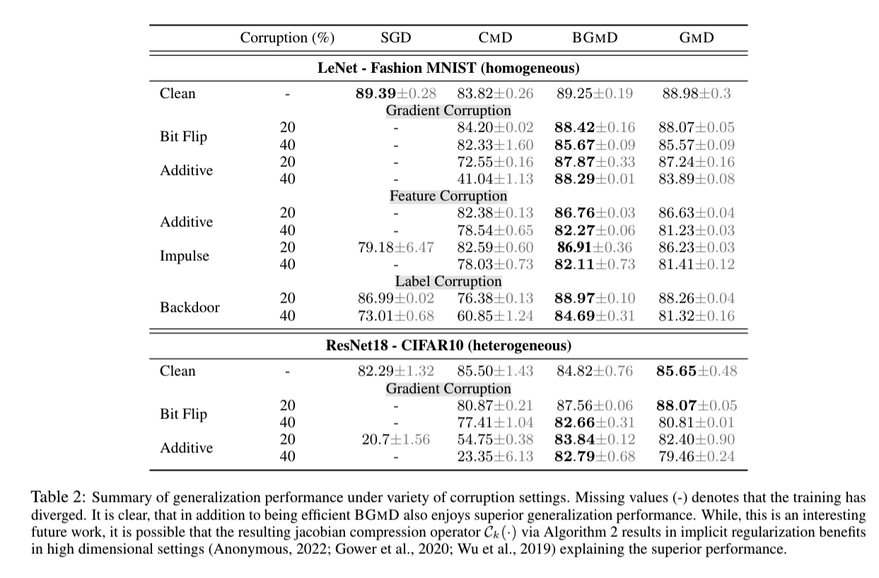
Empirical Evidence: Generalization

Slide 31
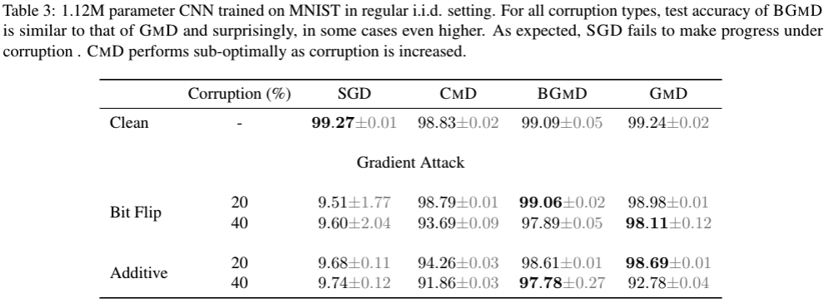
Empirical Evidence: Generalization

Slide 32
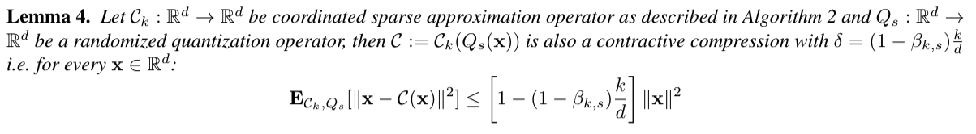
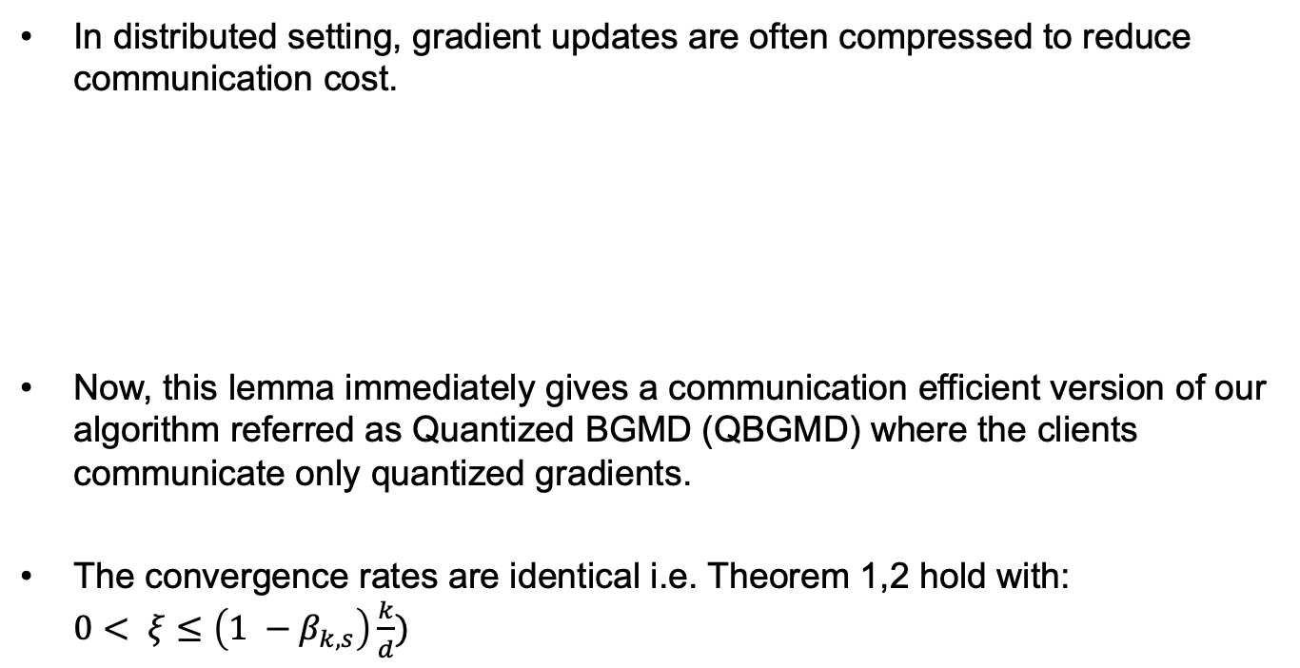
Extension: QBGMD
In distributed setting, gradient updates are often compressed to reduce communication cost.
Now, this lemma immediately gives a communication efficient version of our algorithm referred as Quantized BGMD (QBGMD) where the clients communicate only quantized gradients.
The convergence rates are identical i.e. Theorem 1,2 hold with: $0< ξ≤\left(1 −β_{k,s}\right)\frac{k}{d})$

Slide 33
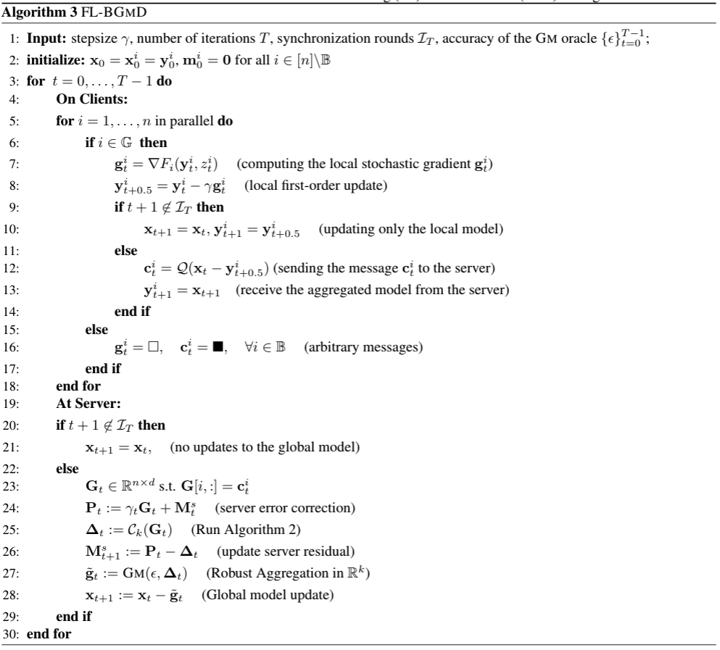
Extension: FedBGMD

Slide 34
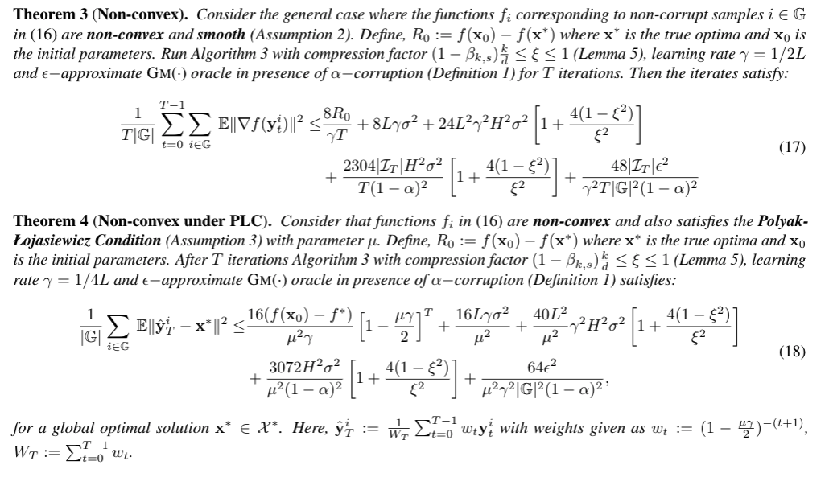
Convergence Guarantee FedBGMD

