Slide 1
Robust and Efficient Collaborative Optimization for Deep Learning
Anish Acharya*
* University of Texas at Austin
COMP 4600 Graduate Seminar
Ritchie School of Engineering and Computer Science
University of Denver
November 12, 2021

Slide 2
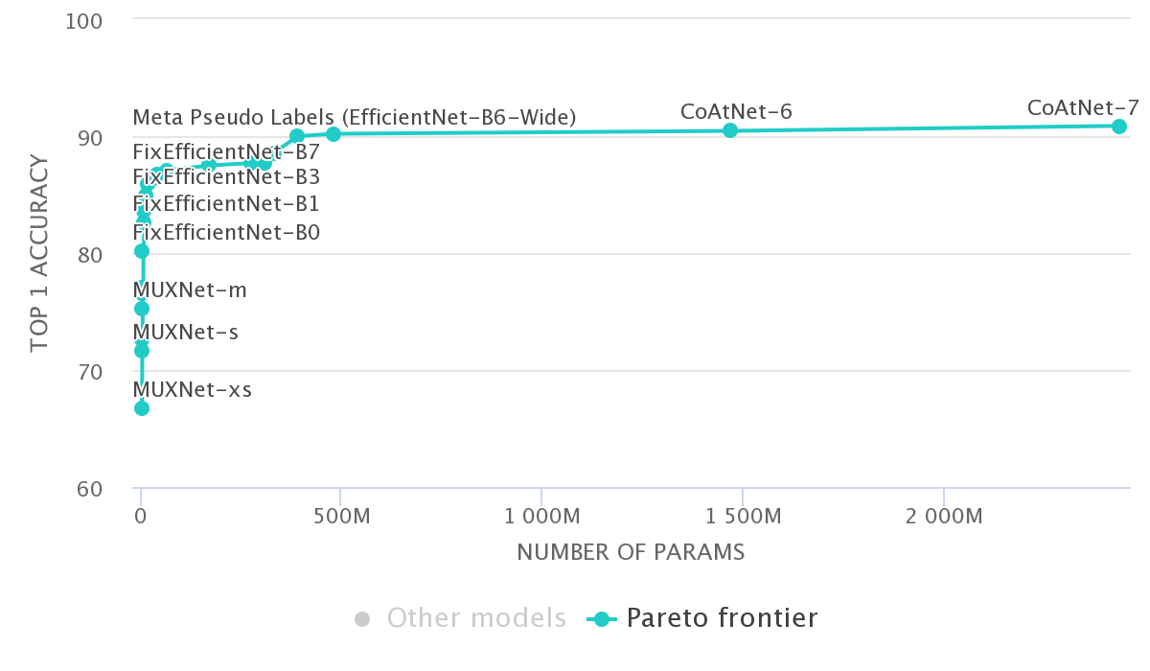
Modern ML Models
Deep Nets are overparameterized ~ e.g. GPT3 uses 175 B parameters.
ImageNet Leaderboard
source: paperswithcode.com

Slide 3
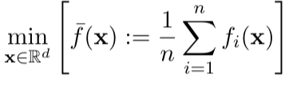
Large Scale Optimization
Training Deep Neural Network requires optimizing over highly over-parameterized , non-convex loss landscape.
ERM Formulation - Finite Sum Structure
Each function corresponds to loss over one sample

Slide 4
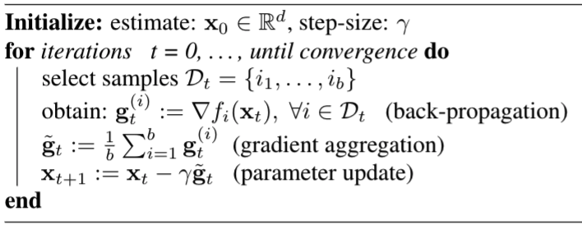
Stochastic Gradient Descent (SGD)
Mini-batch SGD is the de-facto method for optimizing such functions

Slide 5
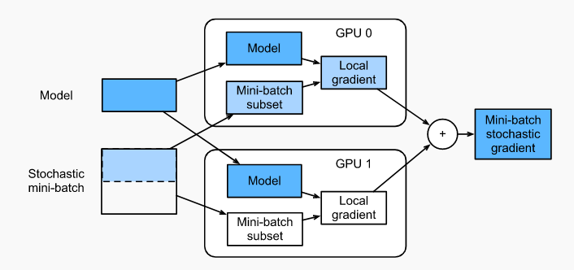
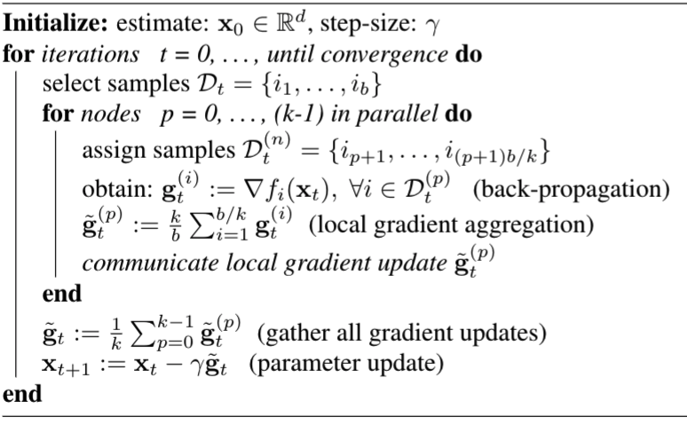
Distributed SGD
Training happens over multiple compute nodes (e.g. GPU) in parallel
Distributed Data Parallel
source: d2I.ai

Slide 6
Issues with centralized data
Distributed SGD requires storing the data centrally
Imagine training a joint recommendation model trained over user data ~ storing the data in a central server is a huge privacy concern
In some cases communicating data to central server is too expensive e.g. self-driving cars generate several TB data per day

Slide 7
Let each node learn separately
One Naïve solution : Let each node learn a separate model with its own local data
Poor generalization performance ~ overfitting
Biased ~ One model doesn’t fit all

Slide 8
A new paradigm – Federated Learning
collaboratively train a ML model
keep the data decentralized
synchronous update scheme that proceeds in rounds of communication
McMahan, H. Brendan, Eider Moore, Daniel Ramage, and Seth Hampson. "Communication-efficient learning of deep networks from decentralized data." AISTATS, 2017

Slide 9



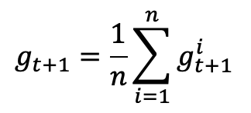


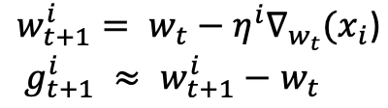
Federated Averaging
Fed-avg
Server
Clients / Edge Devices
Notes:
First, lets understand how the current F training works.
In FL setup there is one master/server node and several client nodes (mostly edge devices like mobile phone).
The data resides on the clients and is not visible to the server.

Slide 10
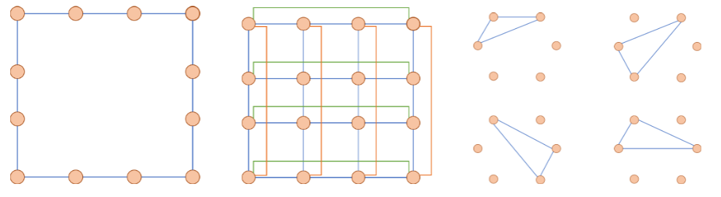
Decentralized Federated Learning
The nodes are not connected to a central server ~ Instead they are connected to each other via some topology
Fed-Avg is a special case with Star Topology
Ring
Torus
Time varying
Abolfazl Hashemi, Anish Acharya, Rudrajit Das, Haris Vikalo, Sujay Sanghavi, Inderjit Dhillon; On the Benefits of
Multiple Gossip Steps in Communication Constrained Decentralized Federated Learning ; Preprint

Slide 11
Decentralized Federated Learning
The data stays at the nodes (clients) and never communicated
the clients periodically communicate gradients / params (gossip) over the network among each other
During each gossip step the local parameters at each client are synchronized via consensus

Slide 12
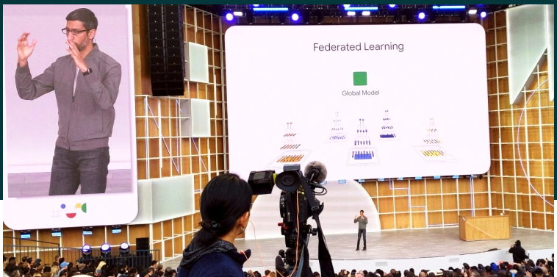
Challenges and Research Directions
source: VentureBeat

Slide 13
Communication Bottleneck
Modern ML models are overparameterized e.g. GPT3 has 175 B parameters.
Communicating gradients / params is expensive over network
Network delay due to slow communication channel
Straggler nodes

Slide 14


Compressed periodic communication
communicate compressed gradients
Popular Compression Operators:
Sparse Approximation
Quantization
Lemma 1. The compression operator is a contractive mapping
Communicate only periodically after some local steps

Slide 15
Research Questions
Information Theoretic Results: Characterize Information loss incurred due to compression (lower bounds on compression)
Optimization Results : Can we maintain convergence rate (i.e. same as w/o compression)
Memory Mechanism, Local Momentum, Global Momentum
1. Sai Praneeth Karimireddy, Quentin Rebjock, Sebastian Stich, Martin Jaggi; Error Feedback Fixes
SignSGD and other Gradient Compression Schemes ; ICML 2019
2. Rudrajit Das , Anish Acharya , Abolfazl Hashemi, Sujay Sanghavi , Inderjit S. Dhillon, and Ufuk Topcu ;
Faster Non-Convex Federated Learning via Global and Local Momentum Preprint

Slide 16
Vulnerability of FL
Byzantine Client
Byzantine failure in a distributed ML system occurs when one of the components in such a system behaves arbitrarily
e.g. This could be the result of software bugs, hardware defects, communication loss (information dropout)
Adversarial Attack
Goal of the attacker is to simultaneously train on the main task and backdoor task by manipulating a subset of clients through adversarial trigger injection.
e.g. force a word predictor to complete certain sentences with an attacker-chosen word, have search engine recommend adversary chosen product for a given query.

Slide 17

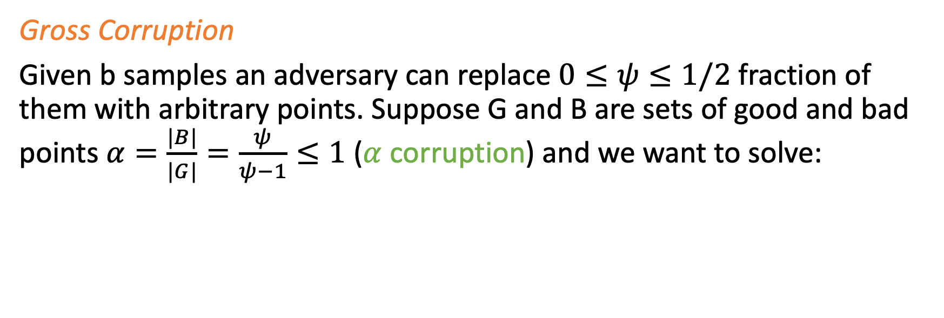
Corruption Model
Gross Corruption
Given b samples an adversary can replace $0≤ψ≤1/2$ fraction of them with arbitrary points. Suppose G and B are sets of good and bad points $α=\frac{|B|}{|G|}=\frac{ψ}{ψ−1}≤1$ ($α$ corruption) and we want to solve:

Slide 18

Robust Gradient Aggregation
Breakdown Point. smallest fraction of contamination that must be introduced to cause an estimator to break i.e. produce arbitrarily wrong estimates. Finite Sample breakdown point
No linear gradient aggregation (e.g. mean in SGD) strategy can tolerate even a single such corrupted point. Consider the following sample:
Mean has finite sample breakdown point of 1/b i.e. asymptotic breakdown 0
Make SGD Robust: Replace Mean with Robust Mean Estimator.

Slide 19


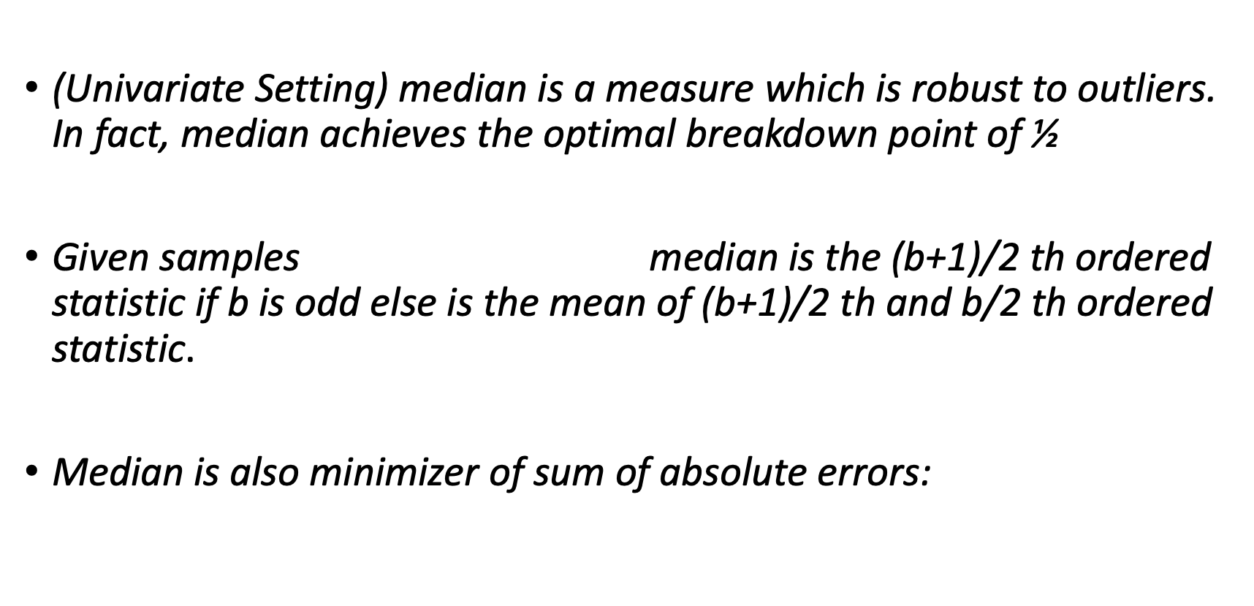
Univariate Robust Gradient Aggregation
(Univariate Setting) median is a measure which is robust to outliers. In fact, median achieves the optimal breakdown point of ½
Given samples median is the (b+1)/2 th ordered statistic if b is odd else is the mean of (b+1)/2 th and b/2 th ordered statistic
Median is also minimizer of sum of absolute errors:

Slide 20
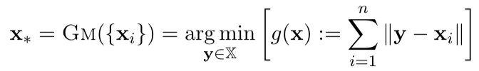
Multivariate Robust Gradient Aggregation
Coordinate wise Median (CM)
When d > 2 CM need not lie in the convex hull of the samples and are not orthogonal equivariant i.e. do not commute with co-ordinate transform
Geometric Median (GM)

Slide 21
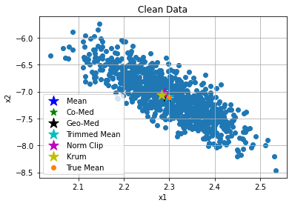
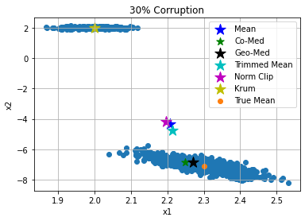
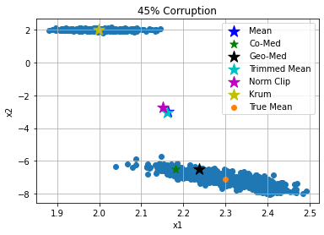
Multivariate Robust Gradient Aggregation
This Toy example in 2 dimensions demonstrates
the superior robustness properties of GM for estimating the
aggregated gradient in presence of heavy corruption.

Slide 22
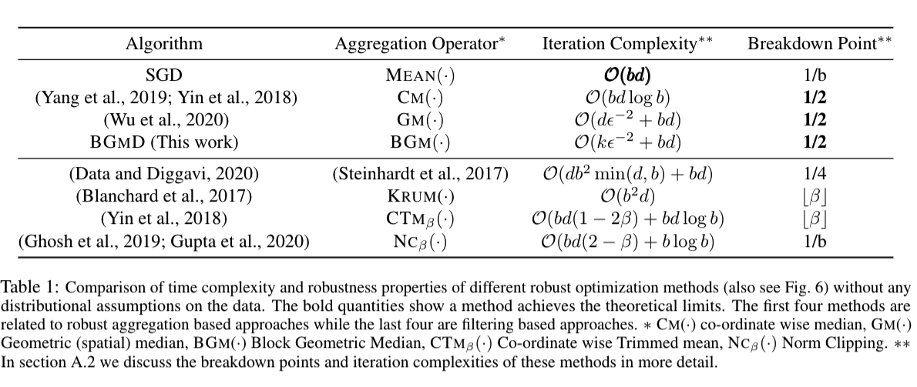
Robust SGD in High Dimension

Slide 23
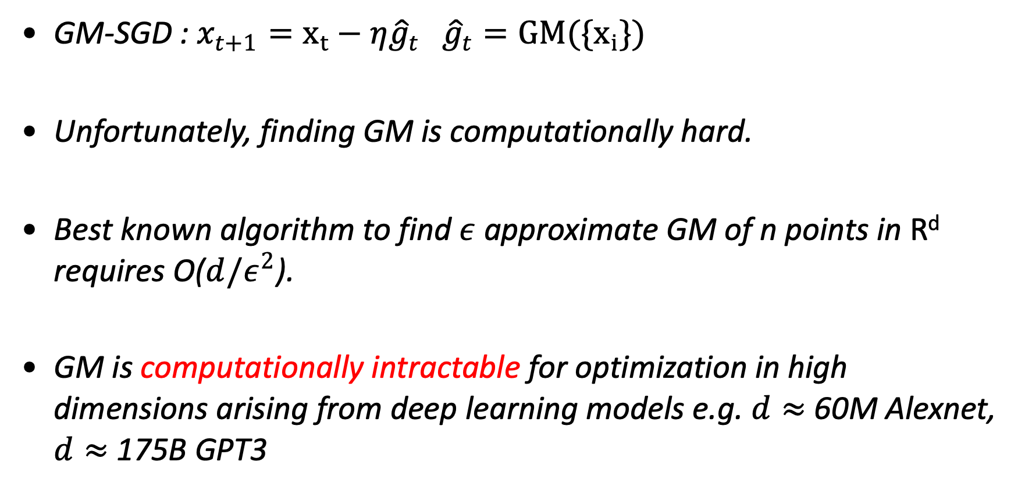
GM in High Dimension
GM-SGD : $x_{t+1}=x_{t}−η{\hat{g}}_{t} {\hat{g}}_{t}=GM(\{x_{i}\})$
Unfortunately, finding GM is computationally hard.
Best known algorithm to find $ε$ approximate GM of n points in R^{d} requires O($d/ε^{2}$).
GM is computationally intractable for optimization in high dimensions arising from deep learning models e.g. $d≈$ 60M Alexnet, $d≈$ 175B GPT3

Slide 24
GM over low dimensional subspace
Gradient distribution is often long tailed especially in case of over-parameterized deep learning settings.
Intuition: Performing gradient aggregation in a low dimensional subspace might have little impact in downstream optimization task.
Notes:
Why select coordinates proportional to probability and not just take Top-k ?
They are approximately equivalent. Sort + Top k => O(d log d + 1) vs sampling based on norm distribution (Norm of dim i / total Norm). This is O(d).

Slide 25
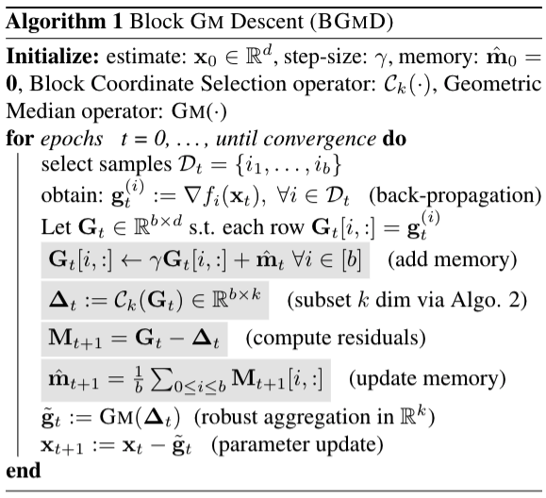
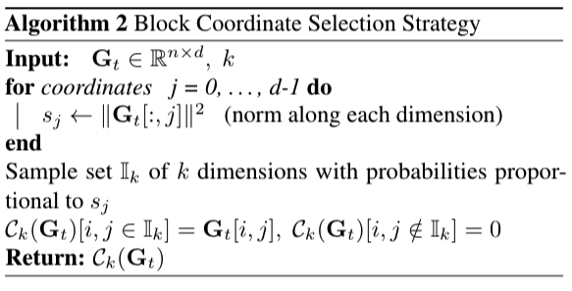
Block coordinate GM Descent
Anish Acharya, Abolfazl Hashemi, Prateek Jain,
Sujay Sanghavi, Inderjit Dhillon, Ufuk Topcu ; Robust Training
In High Dimensions using Block Coordinate Geometric
Median Descent Preprint

Slide 26
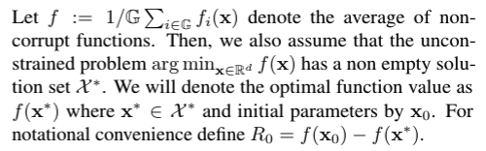
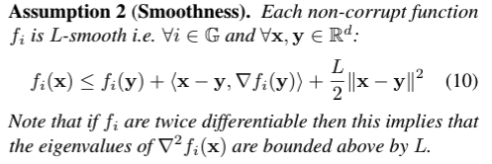
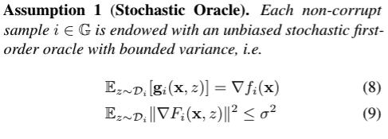
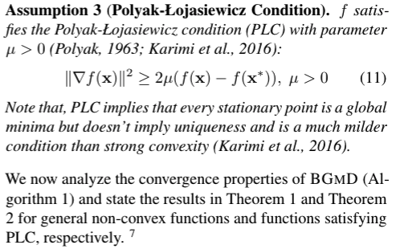
Theory: Assumptions

Slide 27
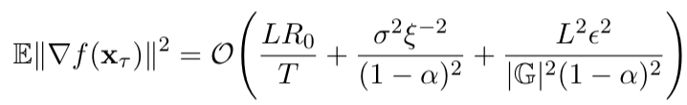
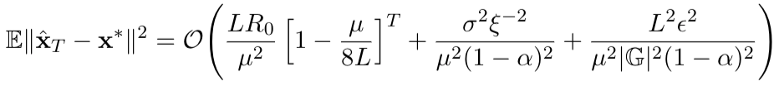

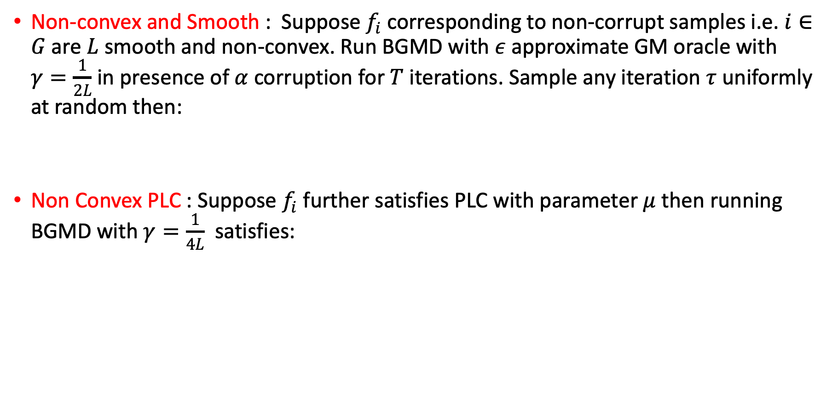
Convergence Guarantees
Non-convex and Smooth : Suppose $f_{i}$ corresponding to non-corrupt samples i.e. $i∈G$ are $L$smooth and non-convex. Run BGMD with $ε$ approximate GM oracle with $γ=\frac{1}{2L}$ in presence of $α$ corruption for $T$ iterations. Sample any iteration $τ$ uniformly at random then:
Non Convex PLC : Suppose $f_{i}$ further satisfies PLC with parameter $μ$ then running BGMD with $γ=\frac{1}{4L}$ satisfies:

Slide 28
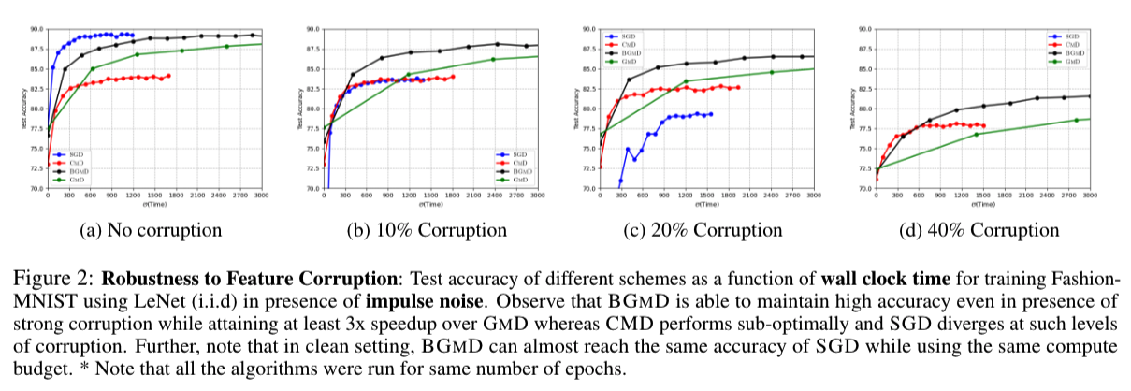
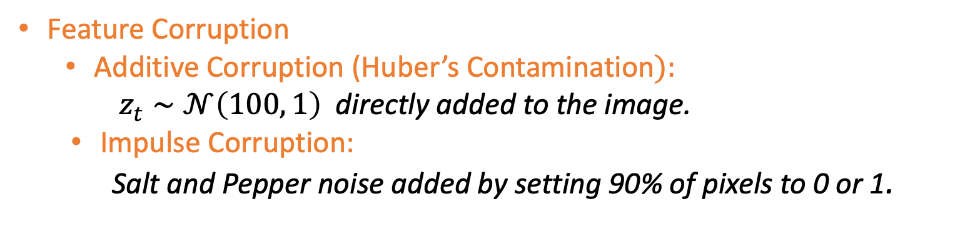
Empirical Evidence: Feature Corruption
Feature Corruption
Additive Corruption (Huber’s Contamination$):$
$z_{t}∼𝒩\left(100, 1\right)$ directly added to the image.
Impulse Corruption:
Salt and Pepper noise added by setting 90% of pixels to 0 or 1.

Slide 29
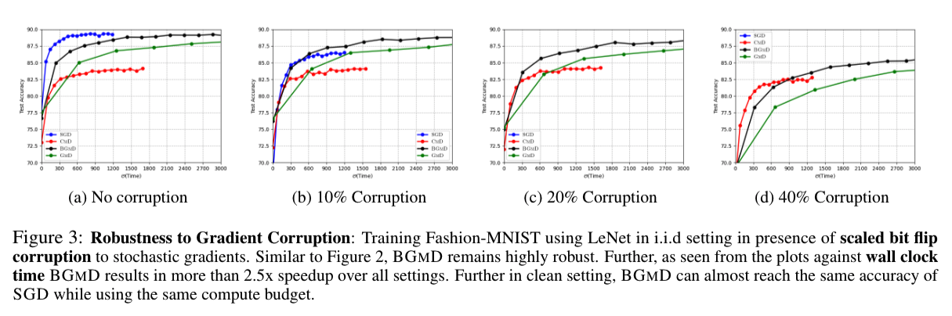
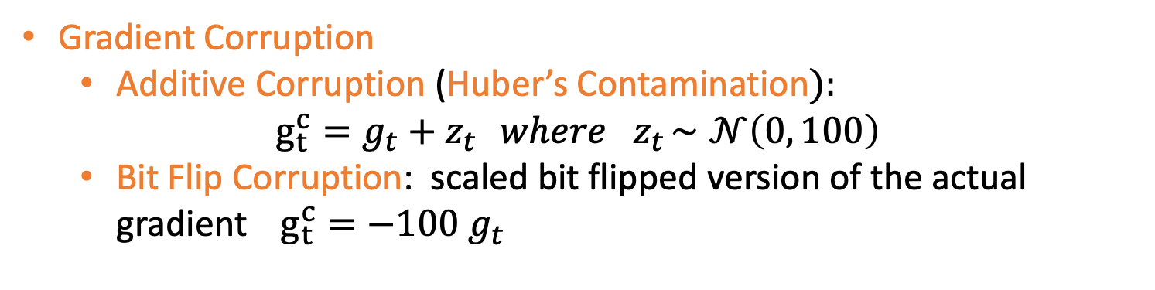
Empirical Evidence: Gradient Corruption
Gradient Corruption
Additive Corruption (Huber’s Contamination$):$
$$g_{t}^{c}=g_{t}+z_{t} { where z}_{t}∼𝒩\left(0, 100\right)$$
Bit Flip Corruption: scaled bit flipped version of the actual gradient $g_{t}^{c}={−100 g}_{t}$

Slide 30
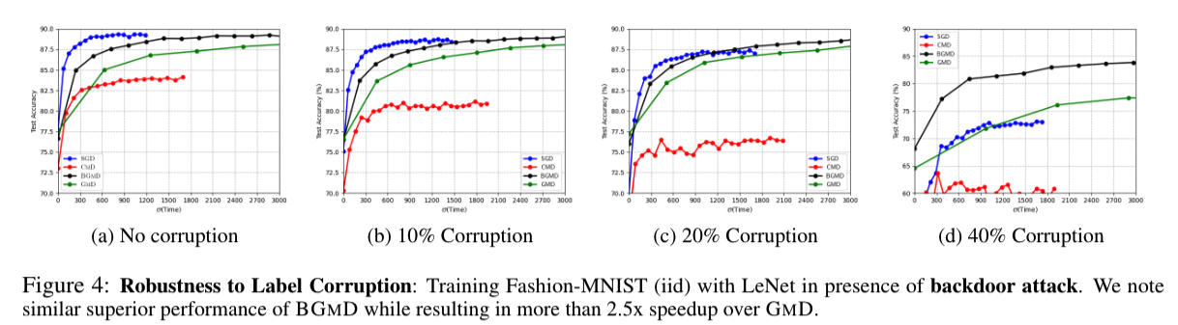
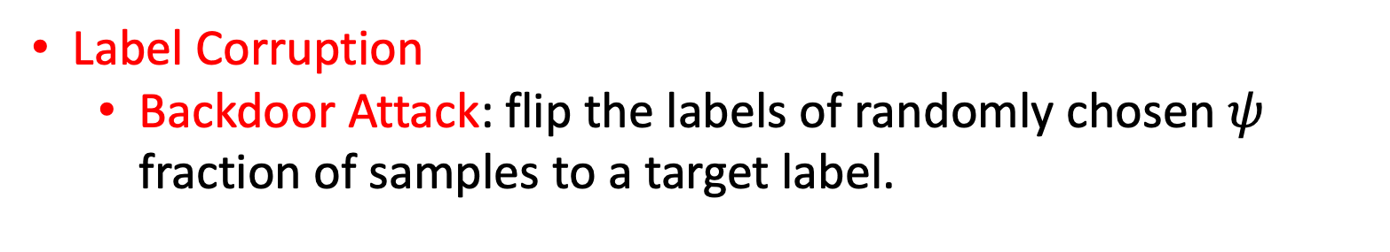
Empirical Evidence: Label Corruption
Label Corruption
Backdoor Attack: flip the labels of randomly chosen $ψ$ fraction of samples to a target label.

Slide 31
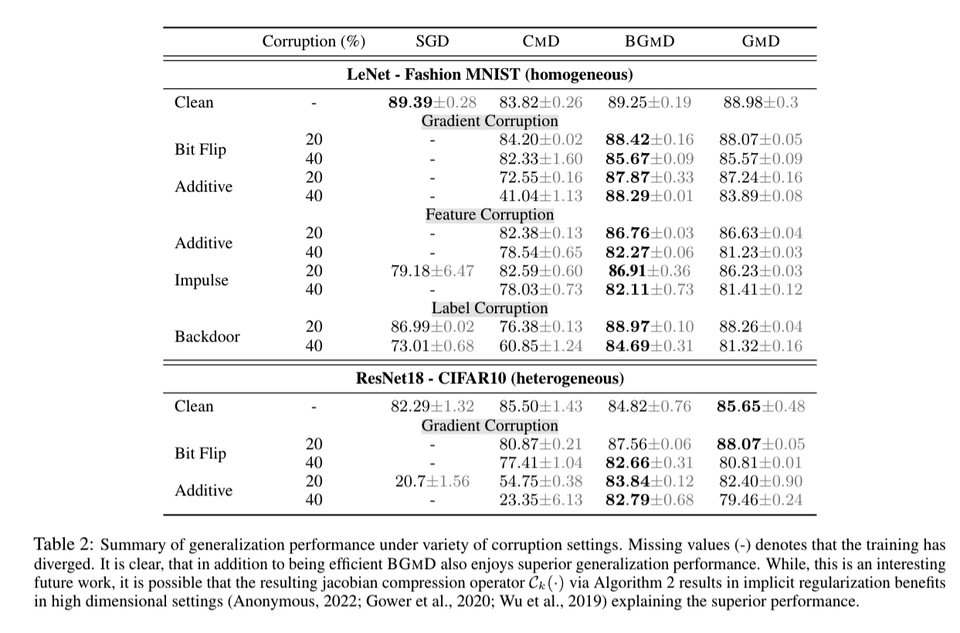
Empirical Evidence: Generalization

Slide 32
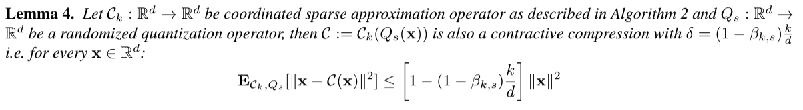
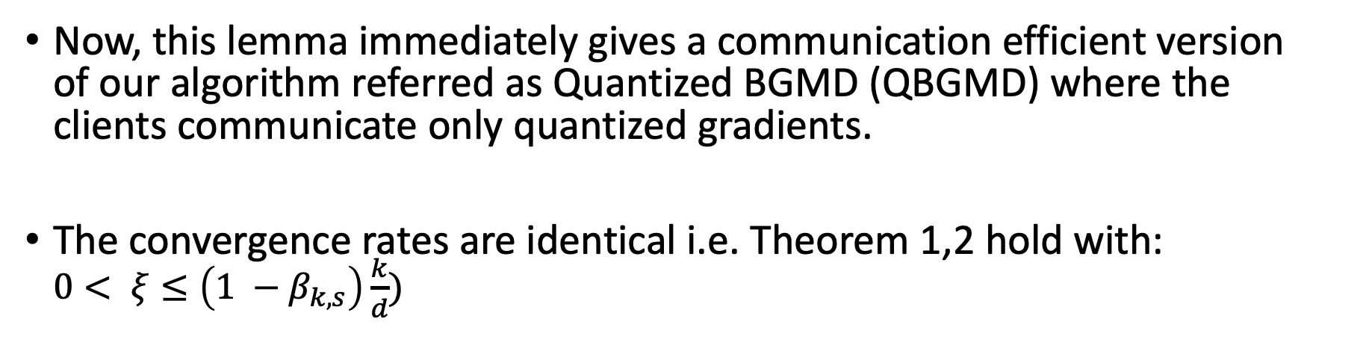
Quantized BGMD
Now, this lemma immediately gives a communication efficient version of our algorithm referred as Quantized BGMD (QBGMD) where the clients communicate only quantized gradients.
The convergence rates are identical i.e. Theorem 1,2 hold with: $0< ξ≤\left(1 −β_{k,s}\right)\frac{k}{d})$

Slide 33
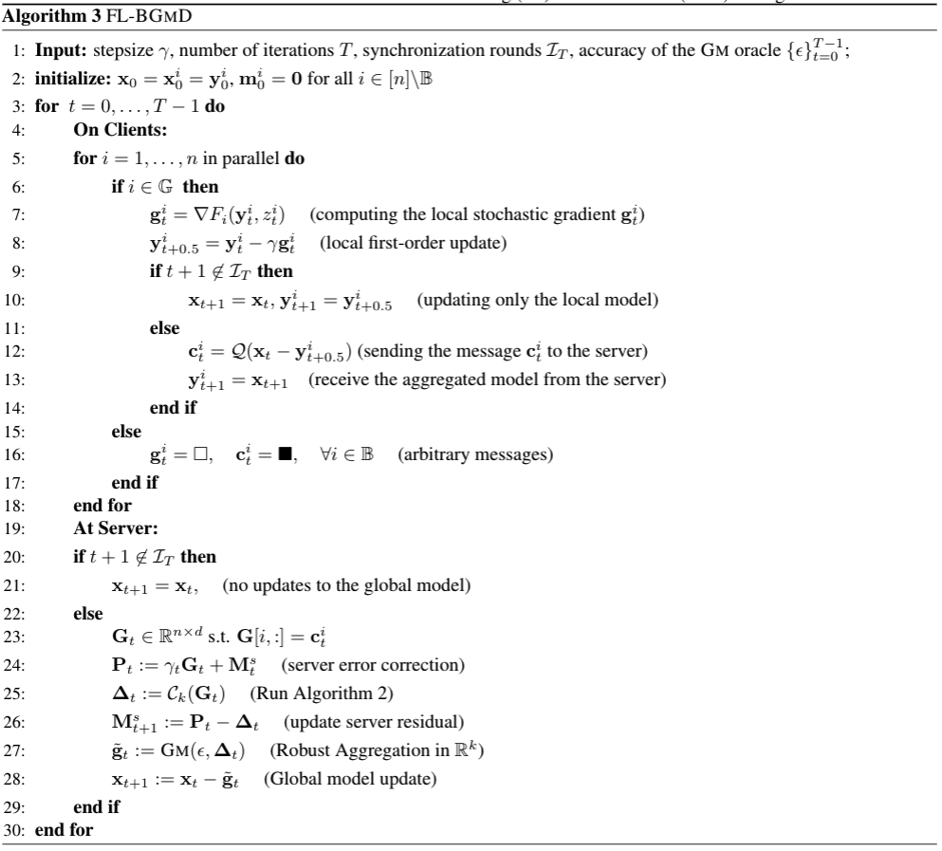
FedBGMD: Robust and Communication Efficient

Slide 34
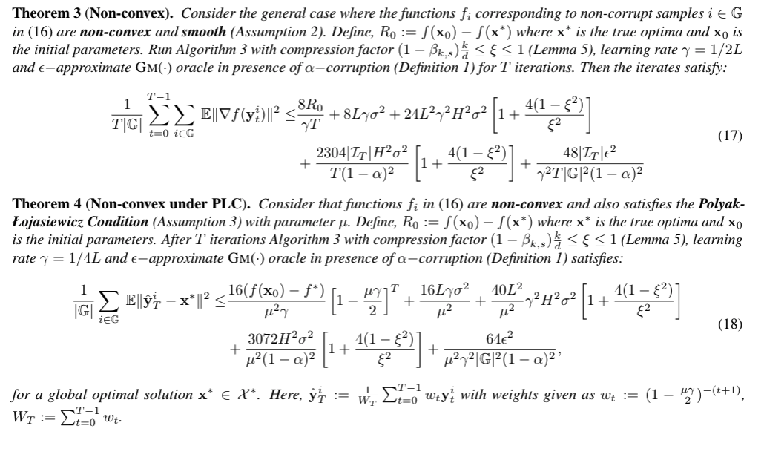
Convergence Guarantee FedBGMD

