Slide 1
WORD PREDICTION APPLICATION
TEAM MEMBERS:
185017 (ABHISHEK CHAUHAN)
185039 (ANISH AGGARWAL)

Slide 2
INTRODUCTION
Technology is being developed each day to increase the efficiency and extend the potency. In this front, word predictor is a minor step which helps in increases our efficiency multifold times.
Word predictor has applications in varied fields like texting, search engine and so on. It helps students to enhance their reading, writing and listening skills. It also helps in building the vocabulary for people of all age groups.
Autocomplete increases the time efficiency and decreases the buffer time of human-computer interactions by predicting the words that the user intends to enter after a few initial characters of the desired word are input.
Many autocomplete algorithms also learn new words once the user has written them several times, and thus can suggest alternatives based on the learned habits of the individual user.

Slide 3
DATA STRUCTURE USED [TRIE]
In this program code, Trie data structure is being implemented to search the data in an ordered fashion.
In the field of computer science, a trie, which is also referred to as a digital tree or sometimes a radix tree or prefix tree (as they can be searched by prefixes), is a type of search tree.
A search tree is an ordered tree data structure that is implemented in storing a dynamic set or an associative array, where the keys are usually strings. It works unlike the case of a binary search tree.
Here, not a single node in the tree stores the key that it is associated with that node. Instead of this, the position of the node in the tree defines the key to which it is associated to.

Slide 4
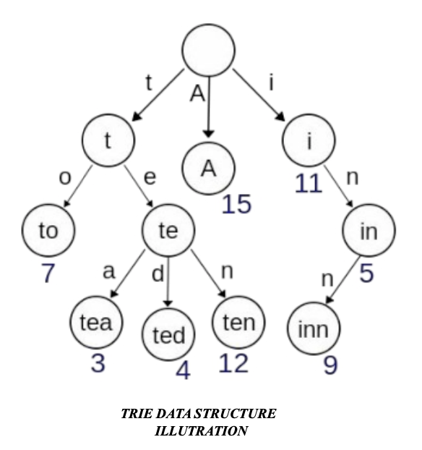
EXAMPLE OF TRIE
In the above example displayed, the keys are shown within the nodes and their values are shown below them. For every complete english word in the file, there is an arbitrary integer value associated with it. Thus, a trie data structure can be seen as a tree- shaped deterministic finite automaton. So, we see that each finite language is generated by a trie data structure automaton, and each trie data structure can be compressed into a deterministic acyclic finite state automaton.

Slide 5
LANGUAGE, AND RESOURCES USED
C++ It is one of the fastest languages compared to java and python.
It is powerful, has lot if built in functions like STL and is object oriented.It is portable.
C++ is scalable.
It can run programs that has small as well as large data.
Since word predictor is resource intensive, C++ would be the best suited language.
A .txt file with 1000 most used words in English.

Slide 6
WORKING PRINCIPLE
Autocomplete or word completion works in such a way that when the writer writes the initial few letters of a word, the program code predicts one or more possible words as options.
The program code of word prediction utilises language modelling, where within a collection of vocabulary the words, the one ones that are most likely to appear are calculated.
In conjunction with language modelling, basic level word prediction on AAC devices is often combined with a recency model, where words used more frequently by the AAC user are more likely to be predicted and displayed in the list.
The word prediction software also permits the user to enter their own words into the word prediction dictionaries either directly, or by "learning" words that have been written.

Slide 7
ADVANTAGES
Writing with a word processor has a number of potential advantages over writing by hand.It is easy to revise text produced on a word processor, as ideas can easily be added, modified, deleted, and moved. Word processing enhances students’ motivation to write.
Support to the writer includes spelling and grammar checkers, software for formatting text, speech synthesis (typed text is converted to speech), speech recognition (writers’ speech is converted to typed text), planning and outlining software, along with a modern software that provides us with detailed feedback on specific aspects of our written text.
The obvious implication of these findings is that weaker writers/readers should use word processing as their primary tool for composing, since it increases such students’ motivation to write and produces superior writing outcomes when compared to writing by hand.

Slide 8
REAL LIFE APPLICATION OF THE PROJECT
E-mail programs.
In search engines
In source code editors
In database query tools
In word processors
Future scope - Assistive technology for people with physical and cognitive disabilities.

Slide 9
DEMONSTRATION OF PROJECT

Slide 10
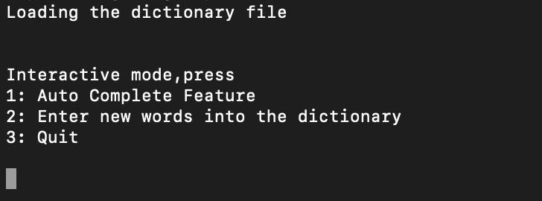
When we initially load the app
The dictionary file is loaded as displays the options

Slide 11
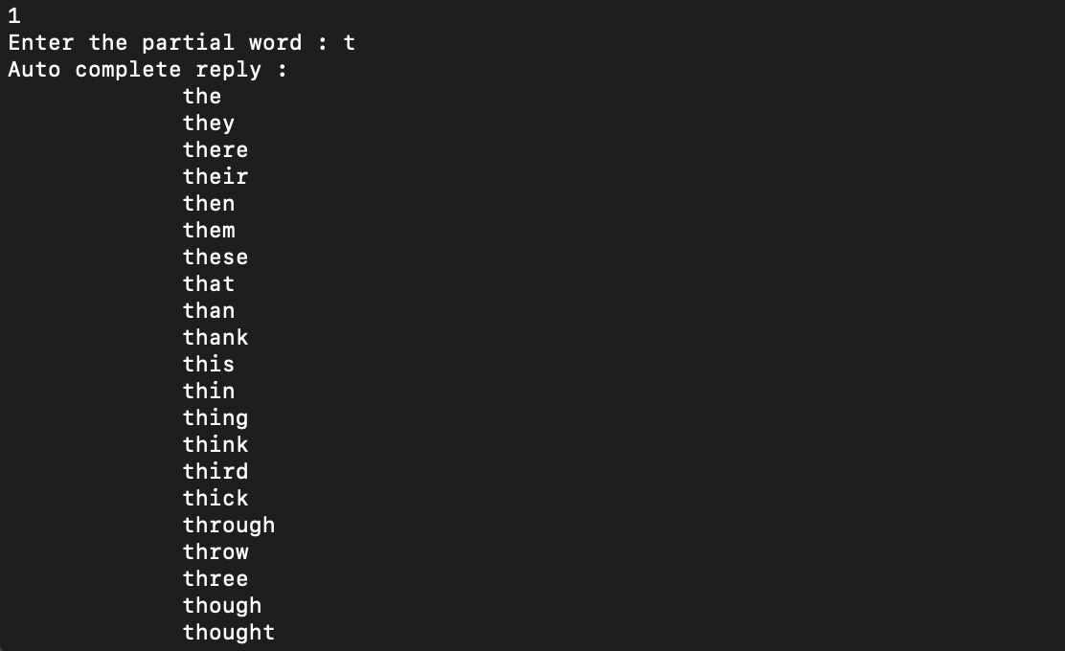
When option 1 was used and partial word was “t”

Slide 12
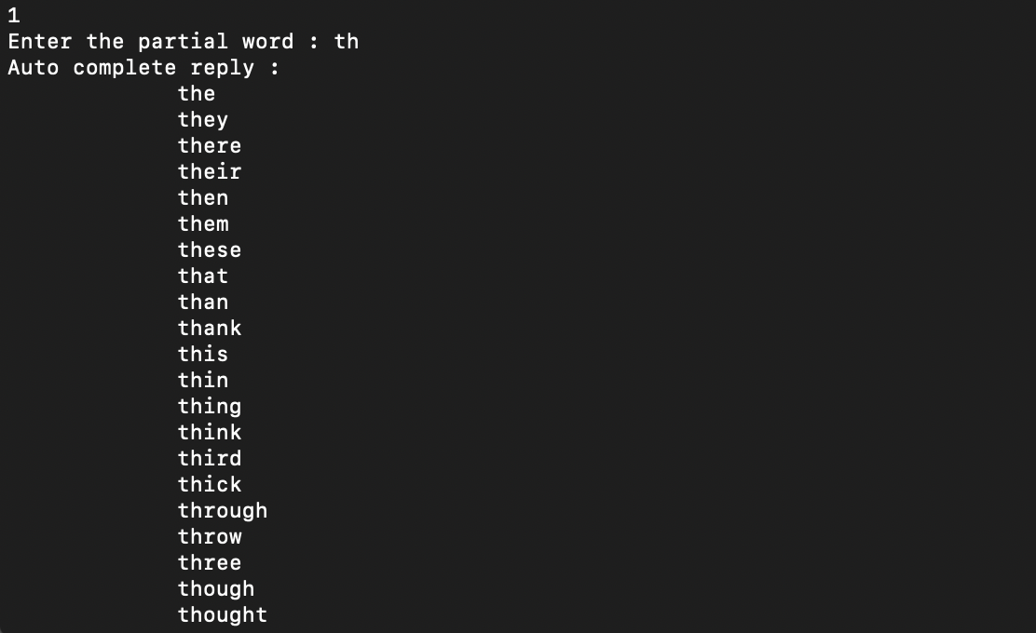
When option 1 was chosen and partial word was “th”

Slide 13
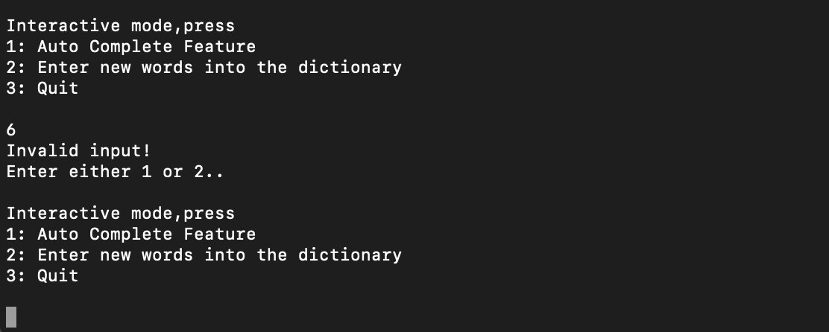
When option other than 1,2,3 was pressed

Slide 14
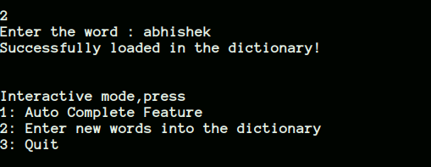
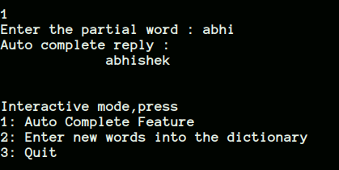
Entering new word into dictionary
Checking if the word was added

Slide 15
CONCLUSION
Word predictor is utilised in messaging applications like WhatsApp, Web Search Engines, Word processors, command like interpreters and so on.
The original need or purpose of the word prediction software was to help people of all ages, children, students and adults, who are suffering with physical disabilities in increasing their typing speed.
It also helps them in decreasing the number of keystrokes needed in order to complete a word or a sentence.
Thus, in this manner, we developed our own program using Trie data structures to implement the concept of word predictor, which definitely increases efficiency of the user by at least 10%.

Slide 16
THANK YOU!
SUBMITTED TO
PROF. NITIN GUPTA

