Slide 1

TRIPOLIA BAZAR • JAIPUR • SINCE 1970
SUNITA TRADERS
Premium Carpets & Door Mats — Retail Shop
31 Carpet Designs • 14 Door Mat Designs • Ready Stock
📞 +91 7976943373
Shop No. 228, Badi Choupad, Tripolia Bazar, Biseswarji, Jaipur 302002
Best Price • Genuine Quality • All-India Delivery
Sunita Traders • Since 1970 • Shop No. 228, Badi Choupad, Tripolia Bazar, Biseswarji, Jaipur 302002 • +91 7976943373

Slide 2

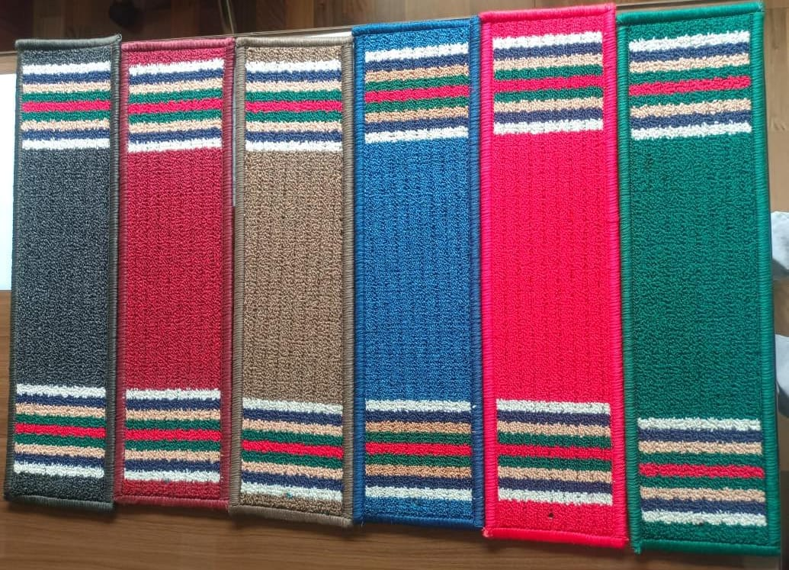
ABOUT THE SHOP
A neighbourhood store with event-grade stock
• Serving customers since 1970, delivering all over India
• Wedding / event red carpets & designer prints
• Home carpets, floral & modern weaves
• Anti-skid, washable door mats
• Bulk orders: weddings, hotels, offices
• WhatsApp your SKU screenshot to +91 7976943373
Open Daily: 9 AM – 9 PM
Real ready-stock photos
Sunita Traders • Since 1970 • Shop No. 228, Badi Choupad, Tripolia Bazar, Biseswarji, Jaipur 302002 • +91 7976943373

Slide 3
HOW TO ORDER ON WHATSAPP
3 easy steps
1. Choose a category — Carpets or Door Mats (next slide: tap a button to jump)
2. Note the design code — e.g. ST-C07 or ST-D03
3. Send it on WhatsApp to +91 7976943373 — get price & delivery time
Jaipur same / next-day • All-India by transport / courier
Sunita Traders • Since 1970 • Shop No. 228, Badi Choupad, Tripolia Bazar, Biseswarji, Jaipur 302002 • +91 7976943373

Slide 4
FULL CATALOGUE
Choose a category
Tap a button — that section opens. (Links work in Slide Show ▶)
Carpets — 31 Designs
Door Mats — 14 Designs
Wedding • Home • Event
Anti-skid • Washable
Open Carpets →
Open Door Mats →
Sunita Traders • Since 1970 • Shop No. 228, Badi Choupad, Tripolia Bazar, Biseswarji, Jaipur 302002 • +91 7976943373

Slide 5
FULL CATALOGUE — CATEGORY 1
CARPETS
31 Designs • Wedding / Home / Event • Trusted since 1970
Screenshot lekar WhatsApp par bhejein — price turant milega
← Back to categories
Sunita Traders • Since 1970 • Shop No. 228, Badi Choupad, Tripolia Bazar, Biseswarji, Jaipur 302002 • +91 7976943373

Slide 6



Carpets (1–4 of 31)
ST-C-01 • Carpet • +91 7976943373
ST-C-02 • Carpet • +91 7976943373
ST-C-03 • Carpet • +91 7976943373
ST-C-04 • Carpet • +91 7976943373
Sunita Traders • Since 1970 • Shop No. 228, Badi Choupad, Tripolia Bazar, Biseswarji, Jaipur 302002 • +91 7976943373

Slide 7

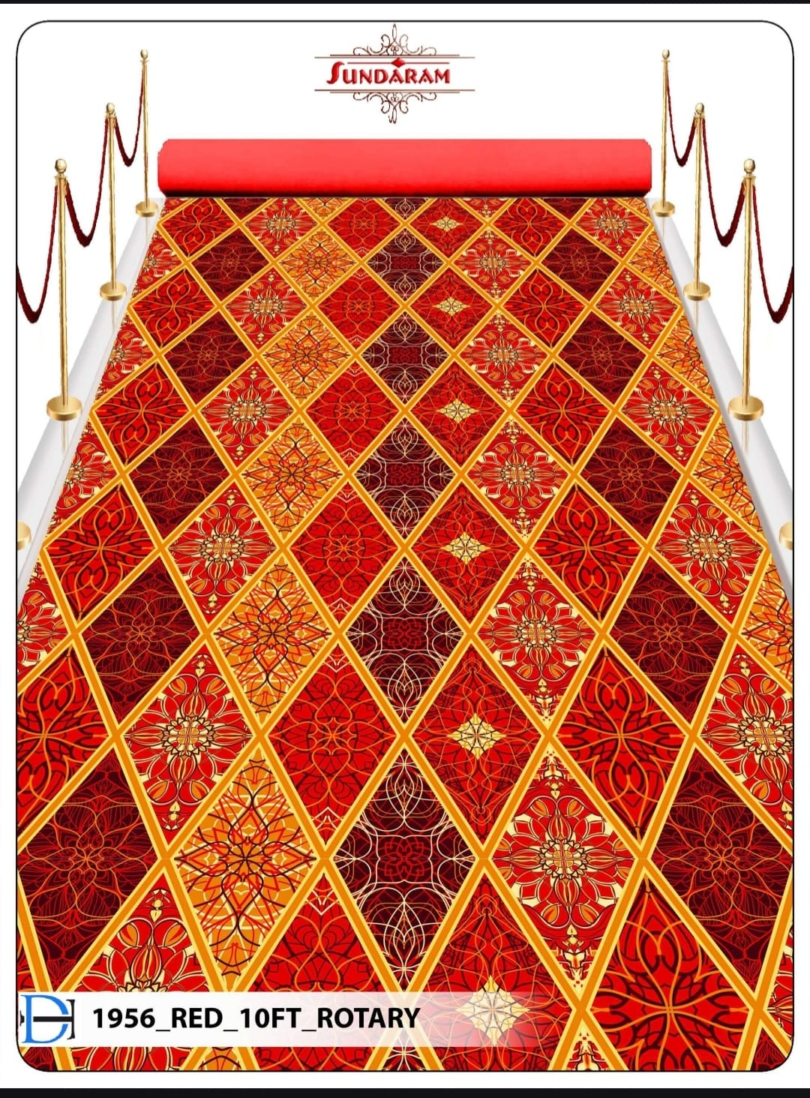

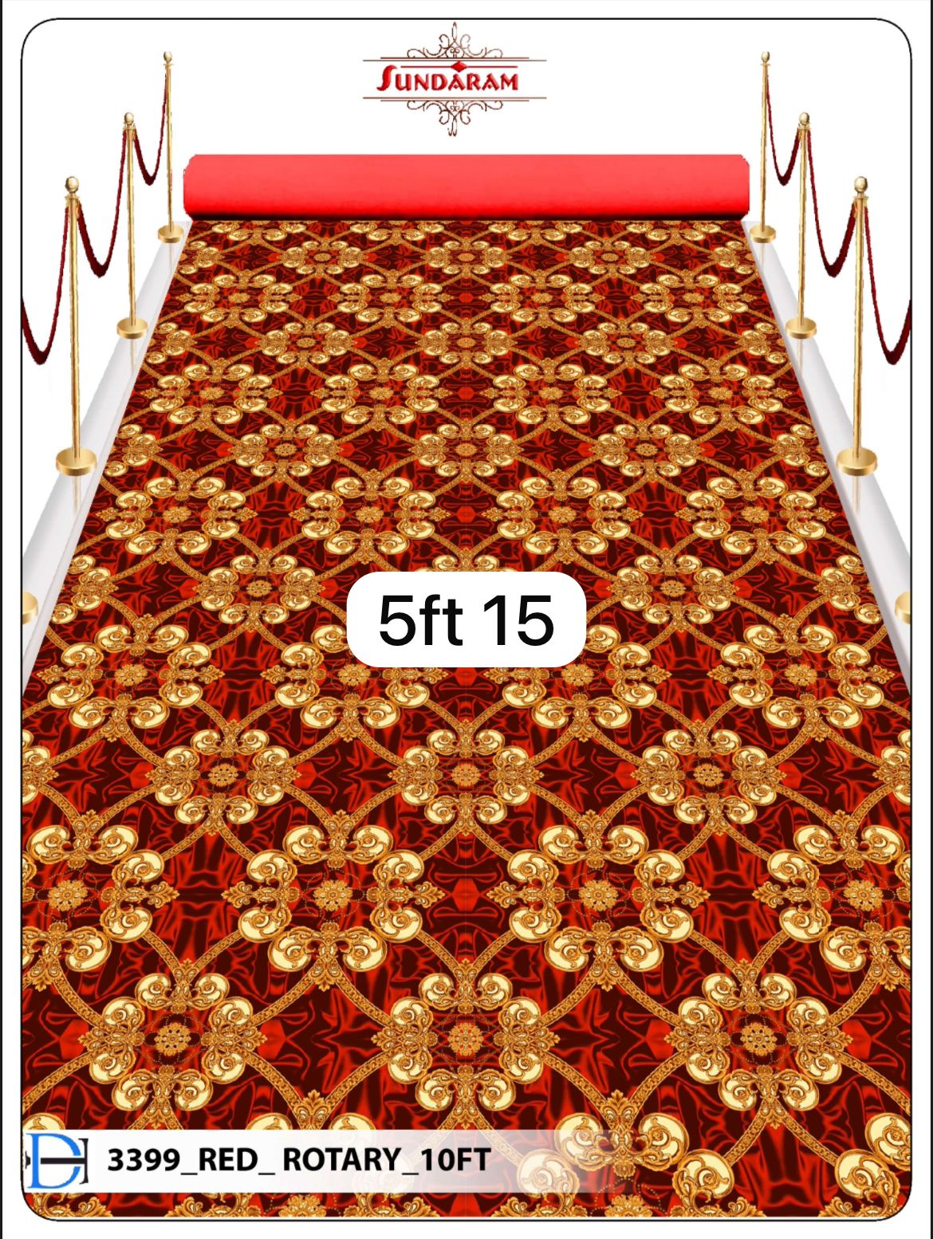
Carpets (5–8 of 31)
ST-C-05 • Carpet • +91 7976943373
ST-C-06 • Carpet • +91 7976943373
ST-C-07 • Carpet • +91 7976943373
ST-C-08 • Carpet • +91 7976943373
Sunita Traders • Since 1970 • Shop No. 228, Badi Choupad, Tripolia Bazar, Biseswarji, Jaipur 302002 • +91 7976943373

Slide 8


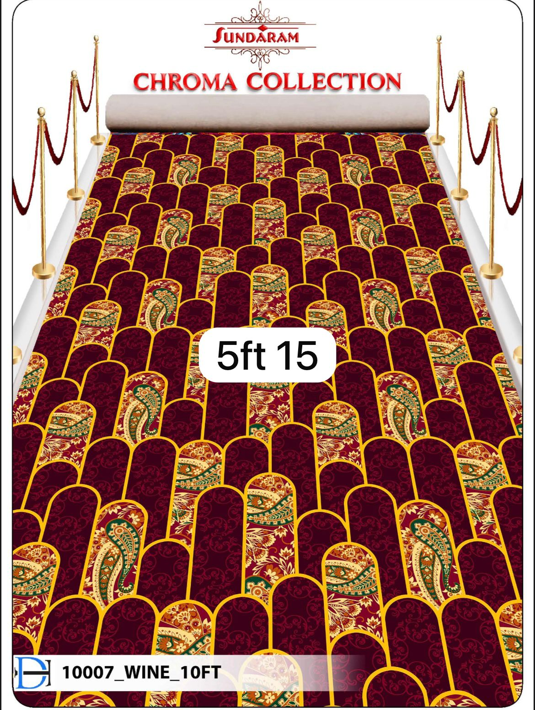

Carpets (9–12 of 31)
ST-C-09 • Carpet • +91 7976943373
ST-C-10 • Carpet • +91 7976943373
ST-C-11 • Carpet • +91 7976943373
ST-C-12 • Carpet • +91 7976943373
Sunita Traders • Since 1970 • Shop No. 228, Badi Choupad, Tripolia Bazar, Biseswarji, Jaipur 302002 • +91 7976943373

Slide 9
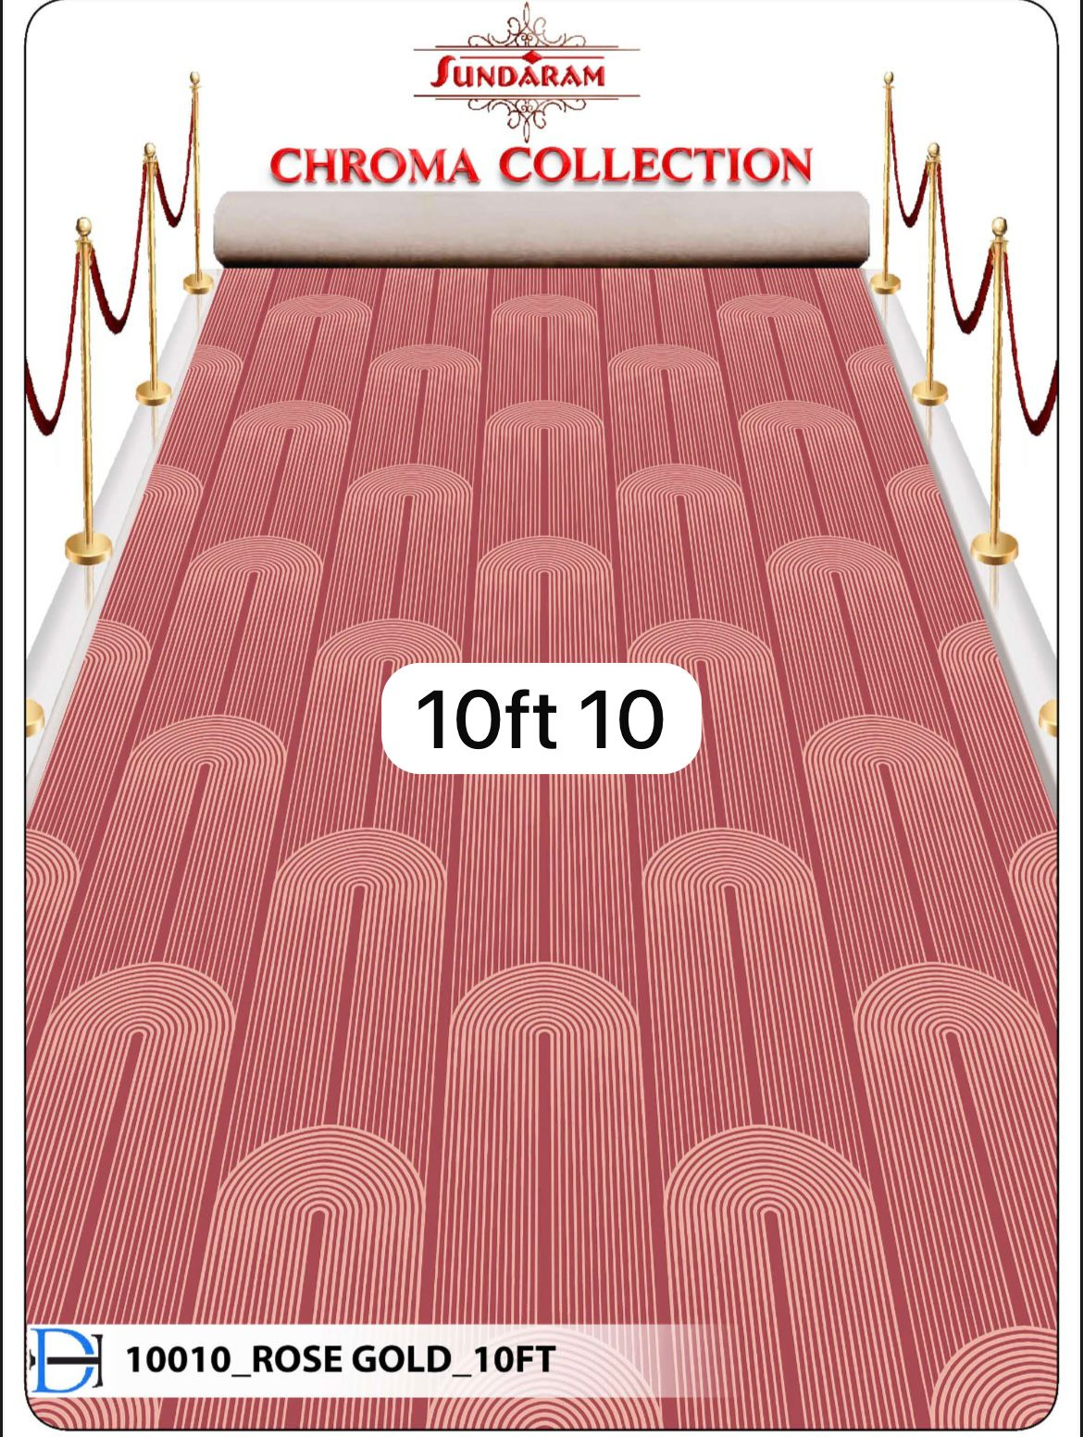
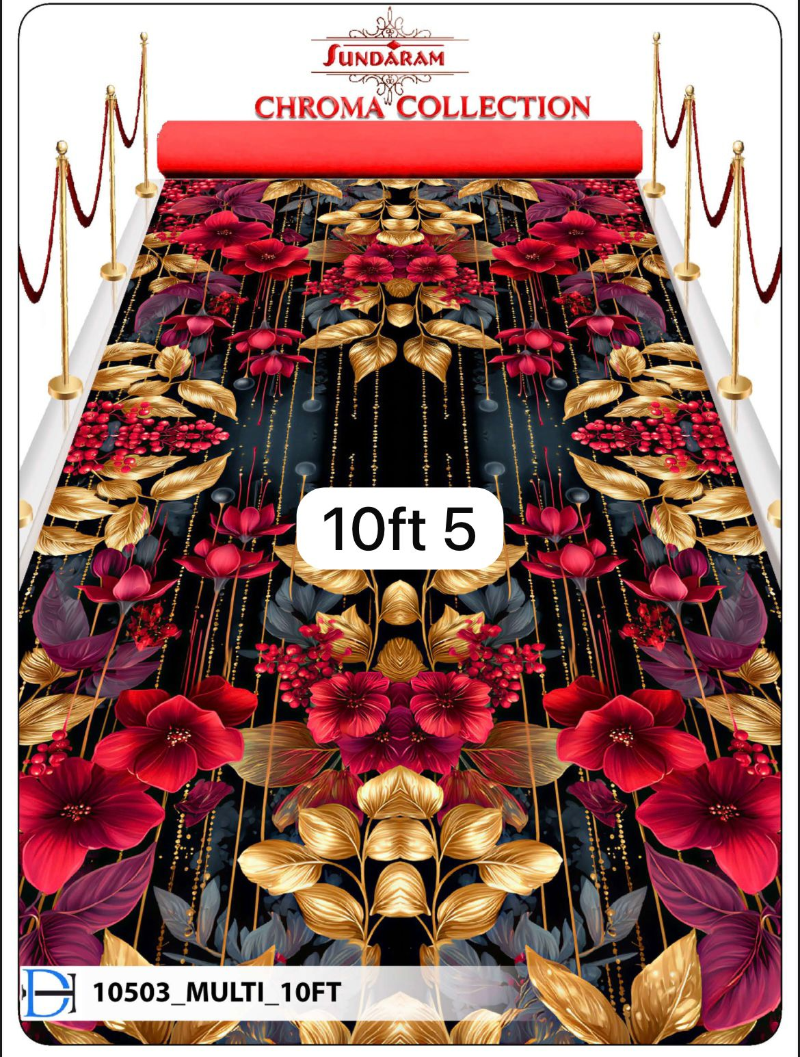


Carpets (13–16 of 31)
ST-C-13 • Carpet • +91 7976943373
ST-C-14 • Carpet • +91 7976943373
ST-C-15 • Carpet • +91 7976943373
ST-C-16 • Carpet • +91 7976943373
Sunita Traders • Since 1970 • Shop No. 228, Badi Choupad, Tripolia Bazar, Biseswarji, Jaipur 302002 • +91 7976943373

Slide 10

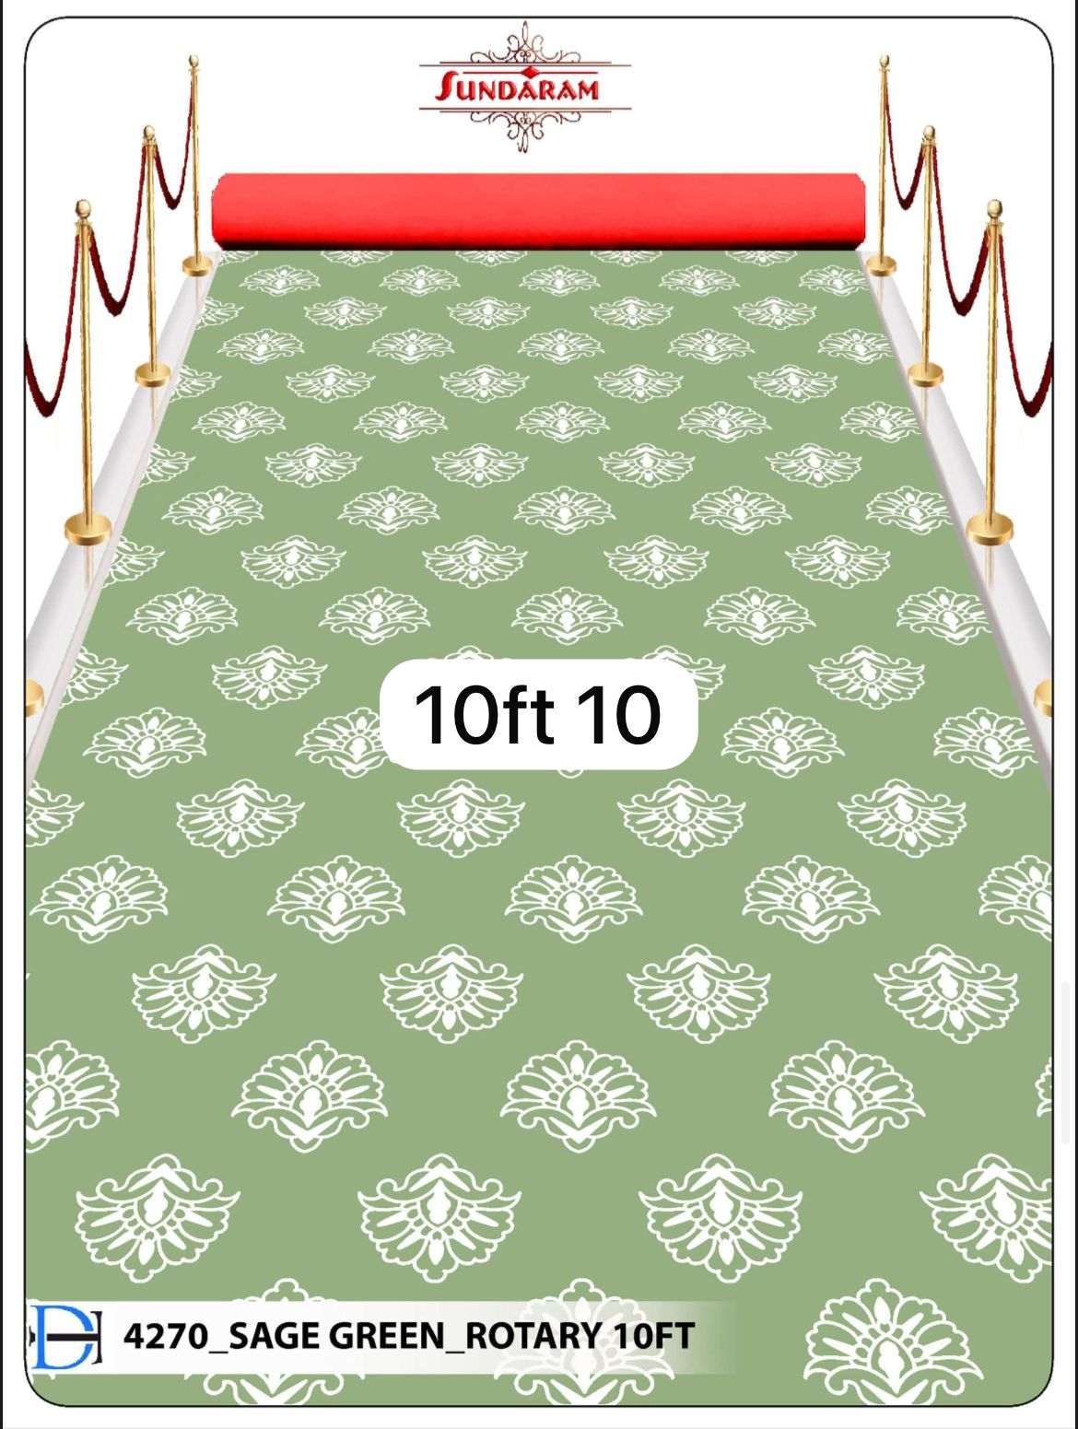
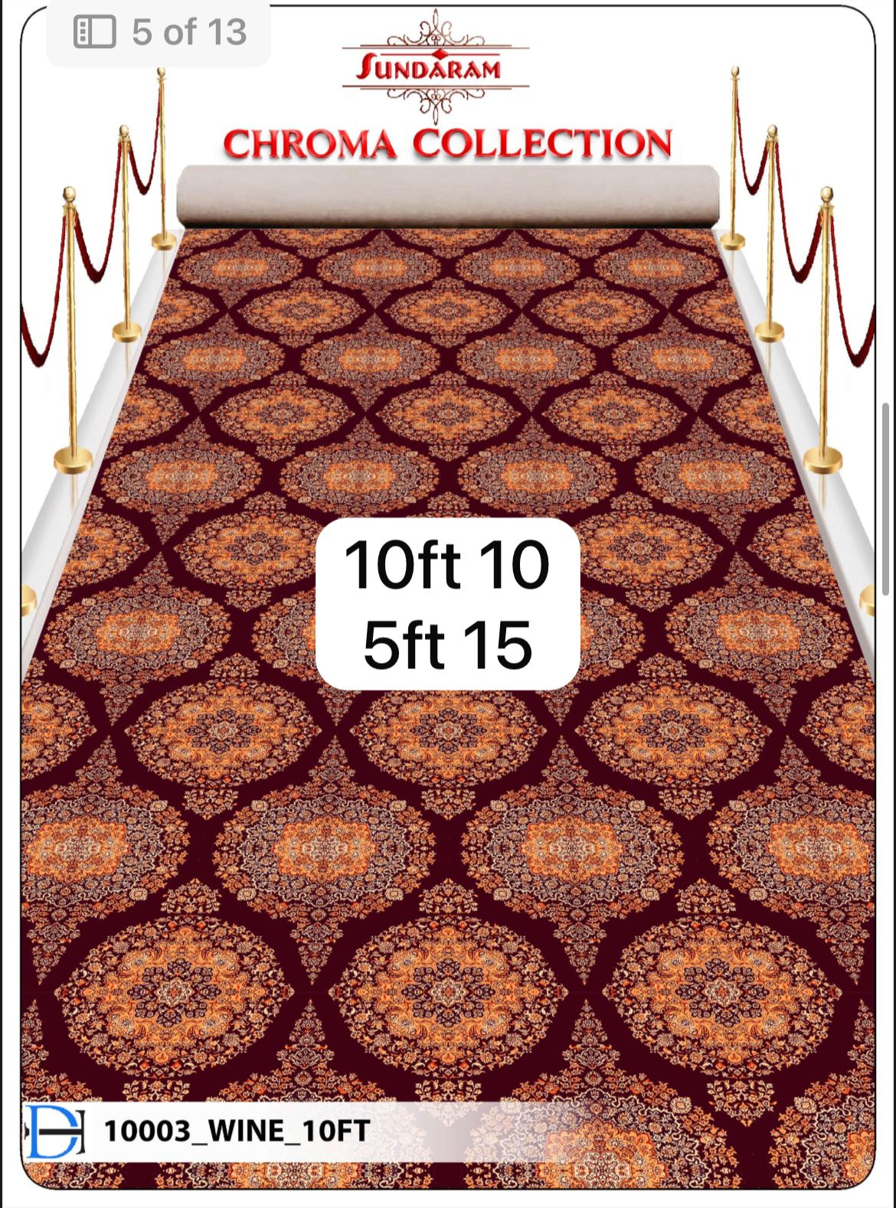

Carpets (17–20 of 31)
ST-C-17 • Carpet • +91 7976943373
ST-C-18 • Carpet • +91 7976943373
ST-C-19 • Carpet • +91 7976943373
ST-C-20 • Carpet • +91 7976943373
Sunita Traders • Since 1970 • Shop No. 228, Badi Choupad, Tripolia Bazar, Biseswarji, Jaipur 302002 • +91 7976943373

Slide 11




Carpets (21–24 of 31)
ST-C-21 • Carpet • +91 7976943373
ST-C-22 • Carpet • +91 7976943373
ST-C-23 • Carpet • +91 7976943373
ST-C-24 • Carpet • +91 7976943373
Sunita Traders • Since 1970 • Shop No. 228, Badi Choupad, Tripolia Bazar, Biseswarji, Jaipur 302002 • +91 7976943373

Slide 12
Carpets (25–28 of 31)
ST-C-25 • Carpet • +91 7976943373
ST-C-26 • Carpet • +91 7976943373
ST-C-27 • Carpet • +91 7976943373
ST-C-28 • Carpet • +91 7976943373
Sunita Traders • Since 1970 • Shop No. 228, Badi Choupad, Tripolia Bazar, Biseswarji, Jaipur 302002 • +91 7976943373

Slide 13
Carpets (29–31 of 31)
ST-C-29 • Carpet • +91 7976943373
ST-C-30 • Carpet • +91 7976943373
ST-C-31 • Carpet • +91 7976943373
Sunita Traders • Since 1970 • Shop No. 228, Badi Choupad, Tripolia Bazar, Biseswarji, Jaipur 302002 • +91 7976943373

Slide 14
FULL CATALOGUE — CATEGORY 2
DOOR MATS
14 Designs • Anti-skid • Washable • Trusted since 1970
Screenshot lekar WhatsApp par bhejein — price turant milega
← Back to categories
Sunita Traders • Since 1970 • Shop No. 228, Badi Choupad, Tripolia Bazar, Biseswarji, Jaipur 302002 • +91 7976943373

Slide 15


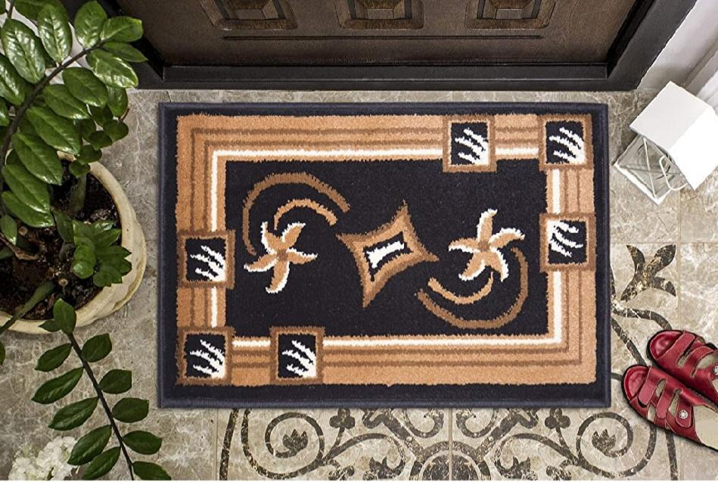
Door Mats (1–4 of 14)
ST-D-01 • Door Mat • +91 7976943373
ST-D-02 • Door Mat • +91 7976943373
ST-D-03 • Door Mat • +91 7976943373
ST-D-04 • Door Mat • +91 7976943373
Sunita Traders • Since 1970 • Shop No. 228, Badi Choupad, Tripolia Bazar, Biseswarji, Jaipur 302002 • +91 7976943373

Slide 16
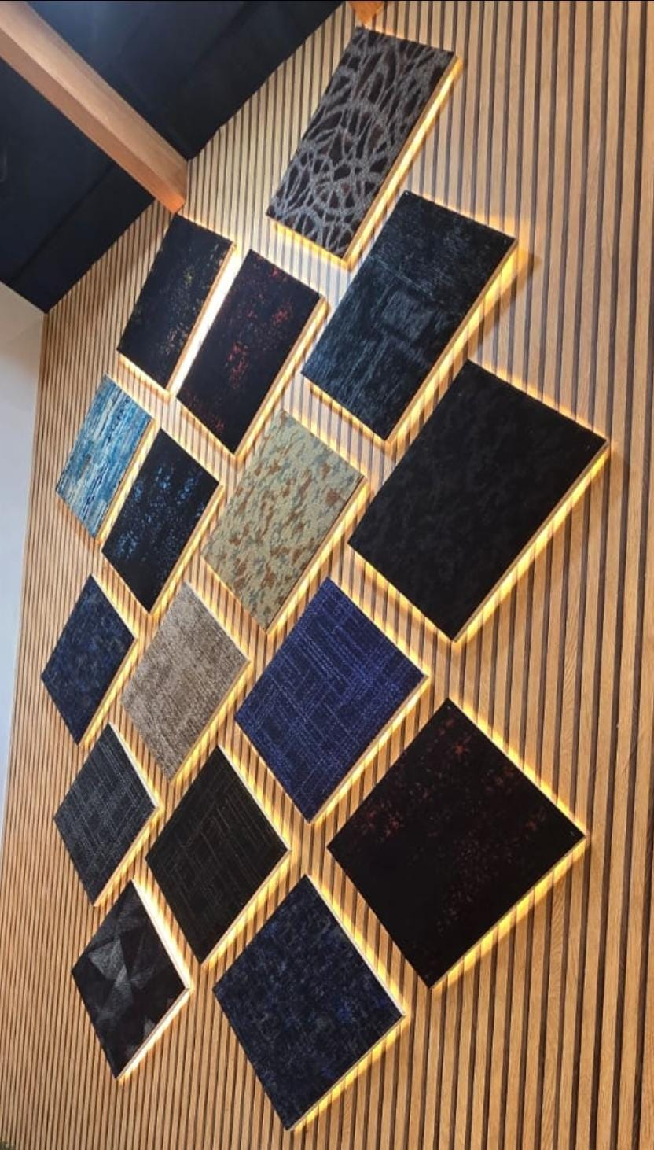


Door Mats (5–8 of 14)
ST-D-05 • Door Mat • +91 7976943373
ST-D-06 • Door Mat • +91 7976943373
ST-D-07 • Door Mat • +91 7976943373
ST-D-08 • Door Mat • +91 7976943373
Sunita Traders • Since 1970 • Shop No. 228, Badi Choupad, Tripolia Bazar, Biseswarji, Jaipur 302002 • +91 7976943373

Slide 17
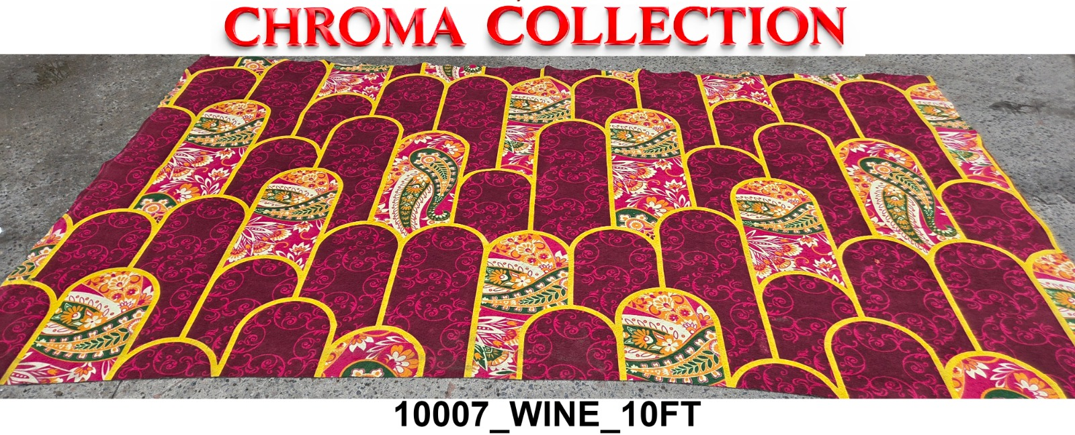

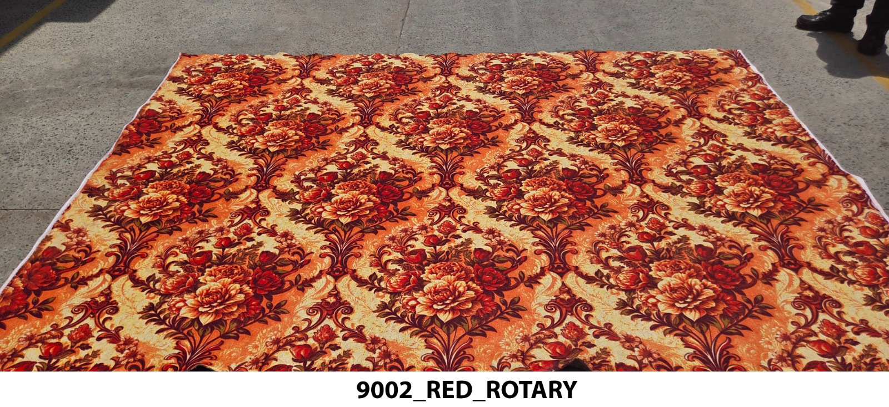

Door Mats (9–12 of 14)
ST-D-09 • Door Mat • +91 7976943373
ST-D-10 • Door Mat • +91 7976943373
ST-D-11 • Door Mat • +91 7976943373
ST-D-12 • Door Mat • +91 7976943373
Sunita Traders • Since 1970 • Shop No. 228, Badi Choupad, Tripolia Bazar, Biseswarji, Jaipur 302002 • +91 7976943373

Slide 18
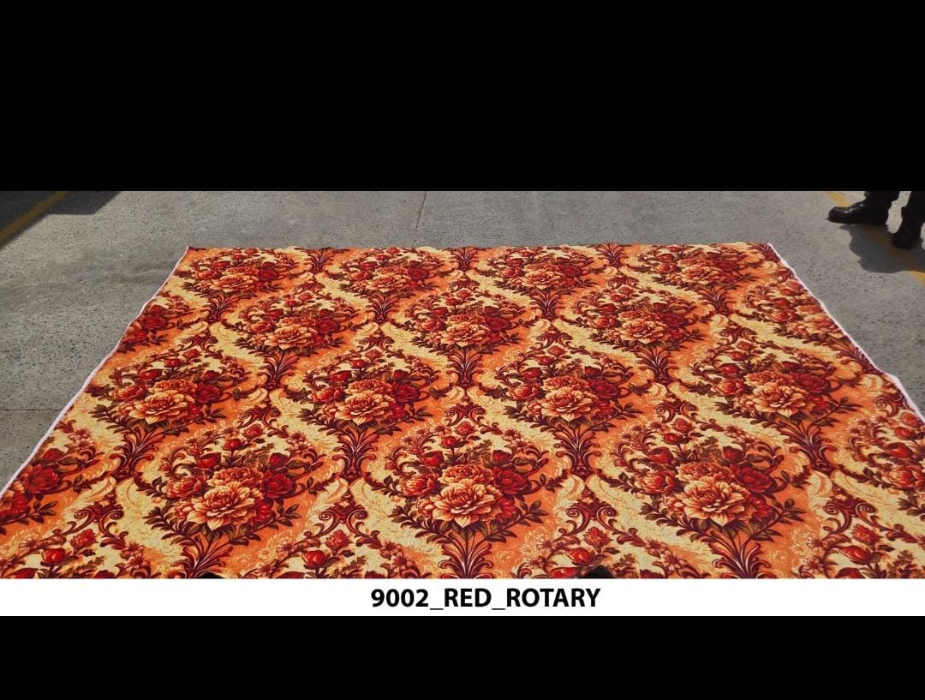
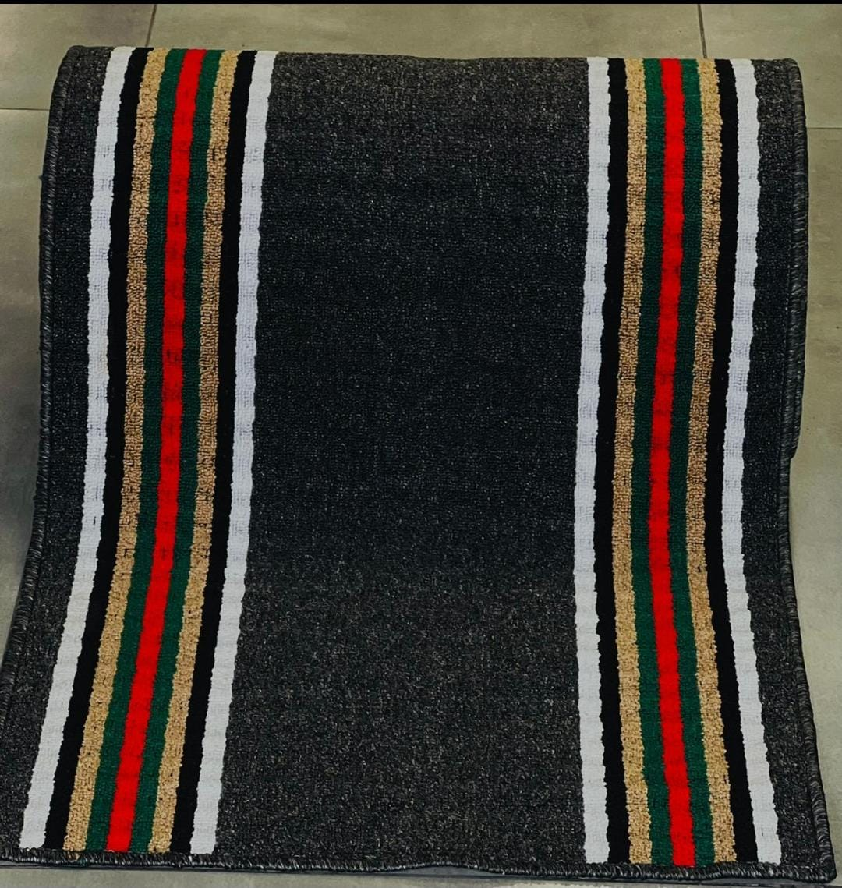
Door Mats (13–14 of 14)
ST-D-13 • Door Mat • +91 7976943373
ST-D-14 • Door Mat • +91 7976943373
Sunita Traders • Since 1970 • Shop No. 228, Badi Choupad, Tripolia Bazar, Biseswarji, Jaipur 302002 • +91 7976943373

Slide 19
WHY BUY FROM US • GOOD TO KNOW
Simple, honest retail
◈ True wholesale pricing — no middlemen
▣ Ready stock — 45+ designs in shop
✆ WhatsApp ordering — send SKU photo
⬣ All-India delivery — homes & events
Q: Carpet by the metre for events?
A: Yes — share length × width.
Q: All-India delivery?
A: Yes, transport/courier on actuals.
Q: Exact colours?
A: Real-stock photos; slight lot variation.
Open Daily 9 AM – 9 PM • Serving Since 1970
Sunita Traders • Since 1970 • Shop No. 228, Badi Choupad, Tripolia Bazar, Biseswarji, Jaipur 302002 • +91 7976943373

Slide 20
VISIT • CALL • WHATSAPP
Sunita Traders
Shop No. 228, Badi Choupad, Tripolia Bazar, Biseswarji, Jaipur 302002
📞 +91 7976943373
WhatsApp: wa.me/917976943373 • Hours: Mon–Sun, 9 AM – 9 PM
Serving Since 1970 • All-India Delivery • Thank You! 🙏
Sunita Traders • Since 1970 • Shop No. 228, Badi Choupad, Tripolia Bazar, Biseswarji, Jaipur 302002 • +91 7976943373

