Slide 1
Introduction to Programming using Python
July 17th, 2020

Slide 2
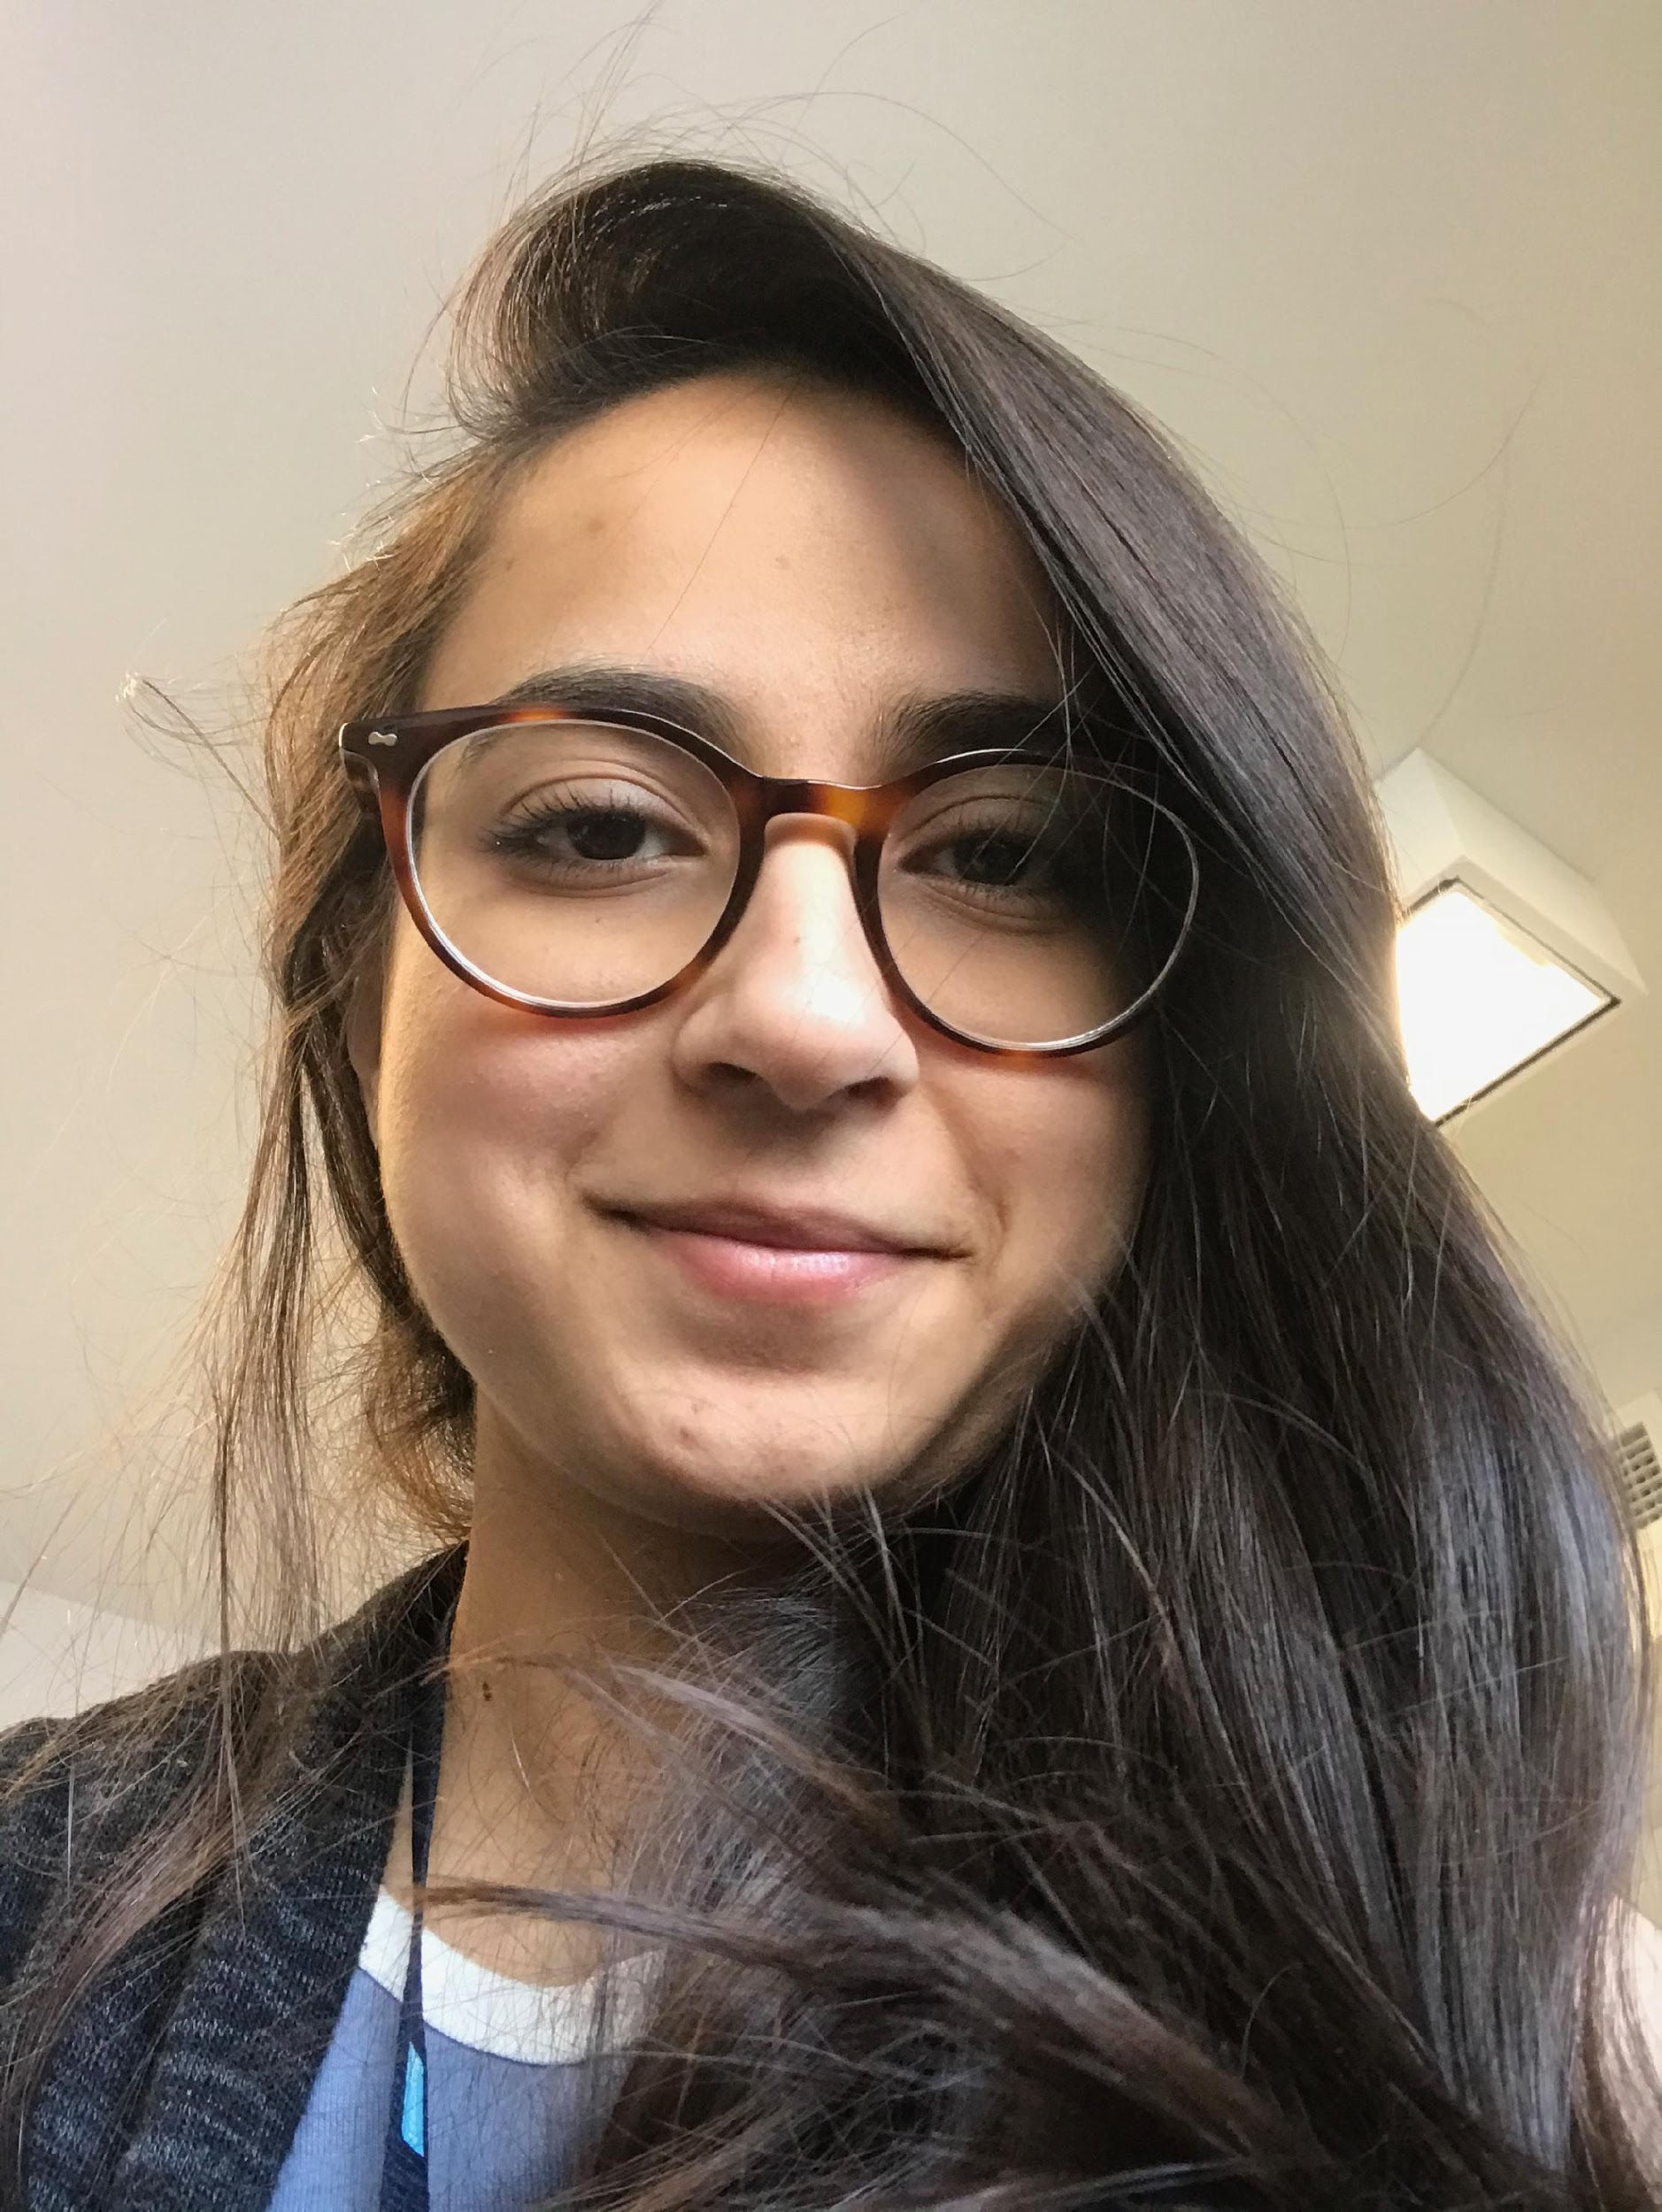


Who are we?
Anisha Khosla
PhD student at UofT with Jen Ryan and Morris Moscovitch
Outreach, Python & R workshop instructor
Instructor for today’s workshop
akhosla@research.baycrest.org
@khosla_anisha

Slide 3
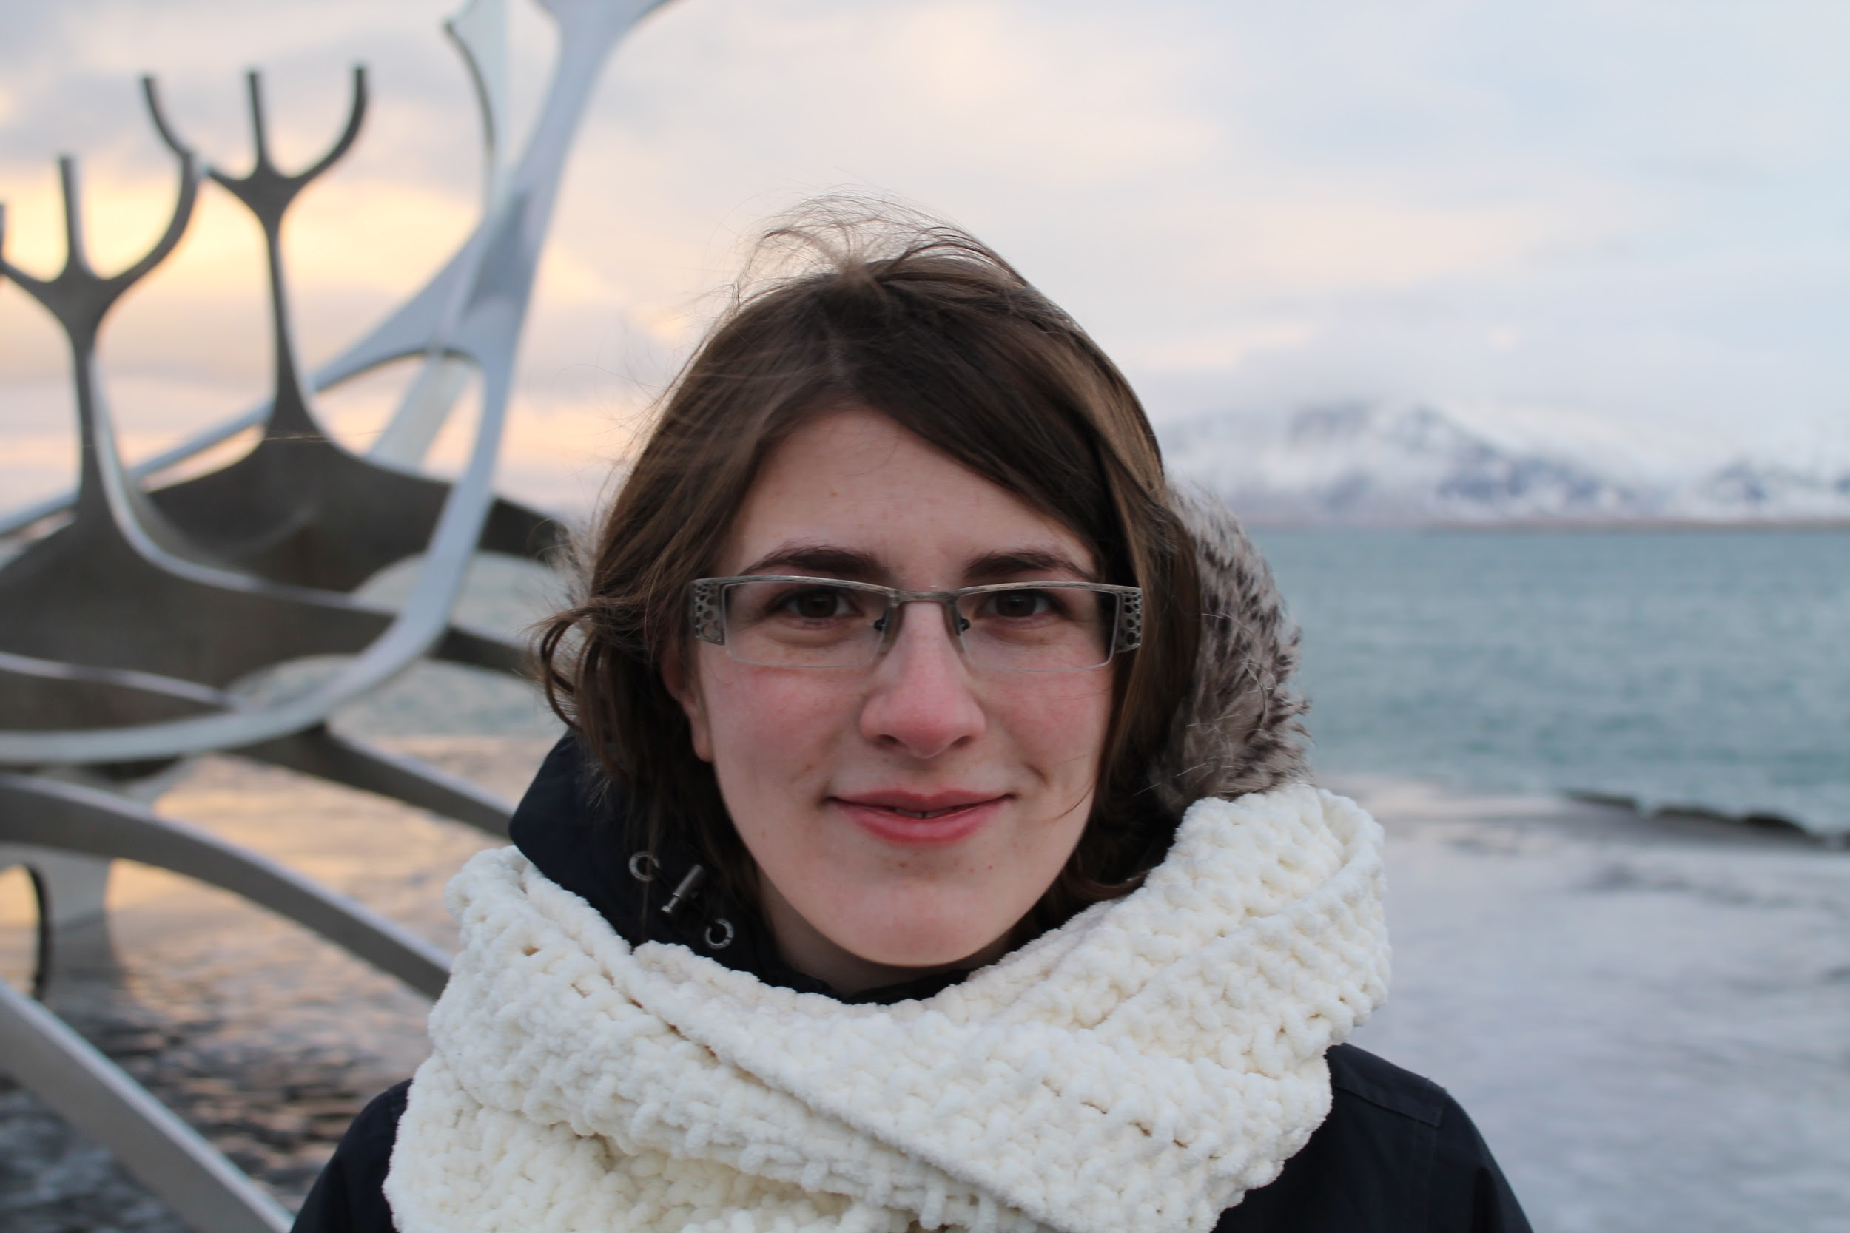
Who are we?
Sarah Faber
PhD student at UofT with Randy McIntosh
Studies neural correlates of music with age and neurodegeneration
Moderator for today’s workshop
sfaber@research.baycrest.org
@sciencebanshee

Slide 4

Workshop Overview
Why python?
Nuts and Bolts
Control Flow
Working with Data
Sheet data (pandas)
Plots (seaborn)

Slide 5

Workshop Schedule
11 – 12:30pm – Nuts & Bolts, Control Flow
12:30 – 1pm – Lunch Break / Q & A
1 – 2 pm – DataFrames & Plots

Slide 6
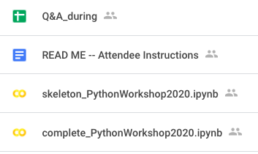
Google Drive
Link to Google Form to submit question
Answers displayed here (Sarah)
*check before asking question
*don’t type Qs on Zoom chat
code with me
follow along (answers here)

Slide 7
Thanks To
Sarah Faber for moderating Q & A
Iris Gottheil for organizing the workshop
And to you for your attention
Notes:
Let's get started

Slide 8

Designated Q & A (12:30-1pm)
Two Options:
Type the question in Zoom chat
To unmute, type your name in Zoom chat
Questions will be answered in the order they are received

