Slide 1
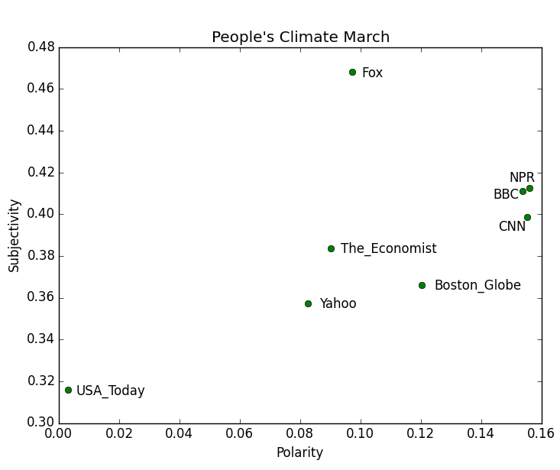
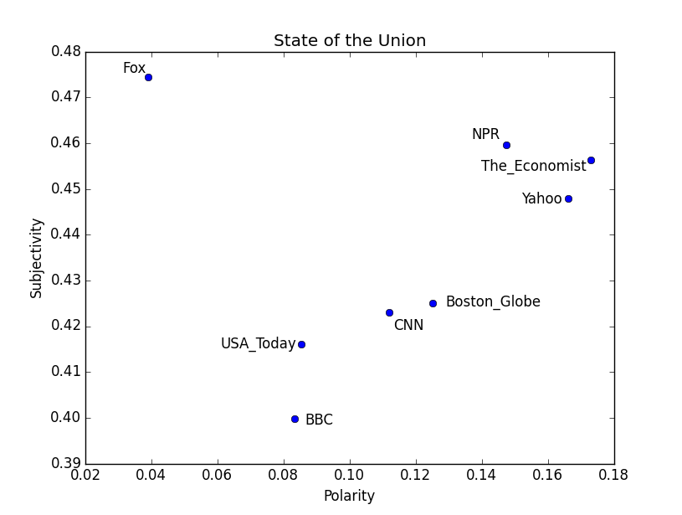
People’s Climate March
State of the Union
Large marches to advocate for action against climate change
September 2014
Annual address by the president
January 2015

