Slide 1
“ONLINE JOB PORTAL WITH LARAVEL FRAMEWORK”

Slide 2
Laravel Framework
Laravel is a free, open-source PHP web framework, created by Taylor Otwell and intended for the development of web applications following the model–view–controller (MVC) architectural pattern and based on Symfony. Its latest version is Laravel 5.8, released on February 26, 2019. Some of the features of Laravel are a modular packaging system with a dedicated dependency manager, different ways for accessing relational databases, utilities that aid in application deployment and maintenance, and its orientation toward syntactic sugar.

Slide 3
Administrative features
Administrator can manage whole website:
Manage complete jobseeker section. Like: activate/deactivate/delete/ edit jobseeker’s information.
Admin user can view the jobseeker’s applications for each job.
Manage complete employer section. Admin user can activate/deactivate/delete/ edit company information.
Manage posted jobs. Like: activate/deactivate/delete/edit posted job.
Manage whole website content. Dynamic CMS is included to manage the content of the website.

Slide 4
Job provider / company features
After registration job provider can perform following action:
Add / Edit company’s profile
Post new job vacancies
Edit / Deactivate posted jobs
Job provider can see the list of jobseekers who has applied for the job
Job provider can search jobseekers
Job provider can send message to any job seeker

Slide 5
Job seeker features
After registration job seeker can perform following actions:
Search for jobs
Apply Online for desire job
Add/Edit profile information including qualification, experience, and skills.

Slide 6


Slide 7
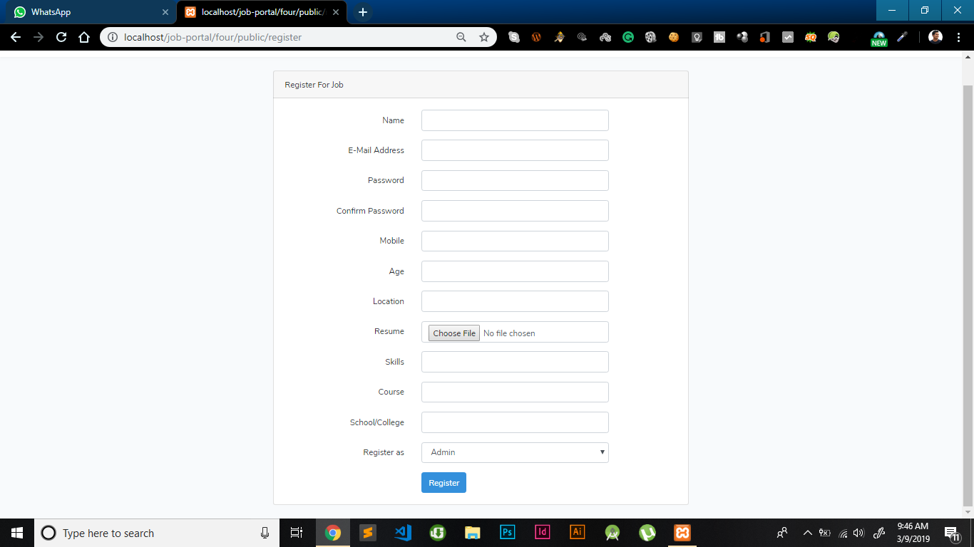

Slide 8
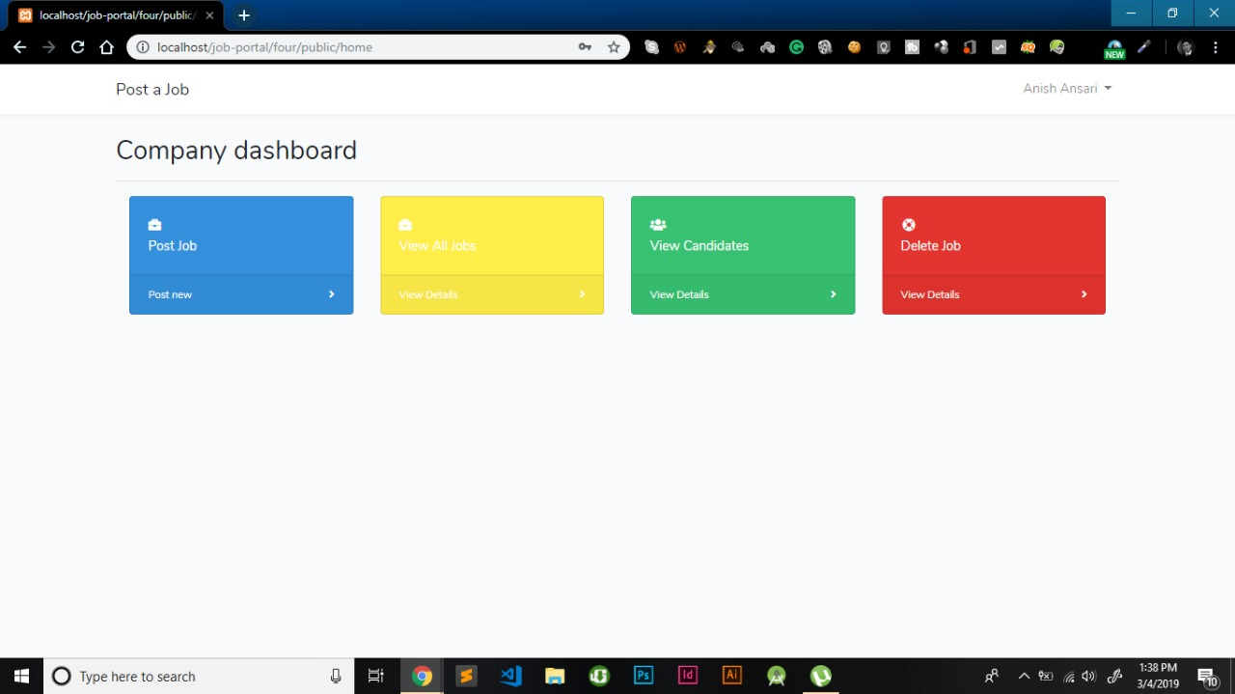

Slide 9
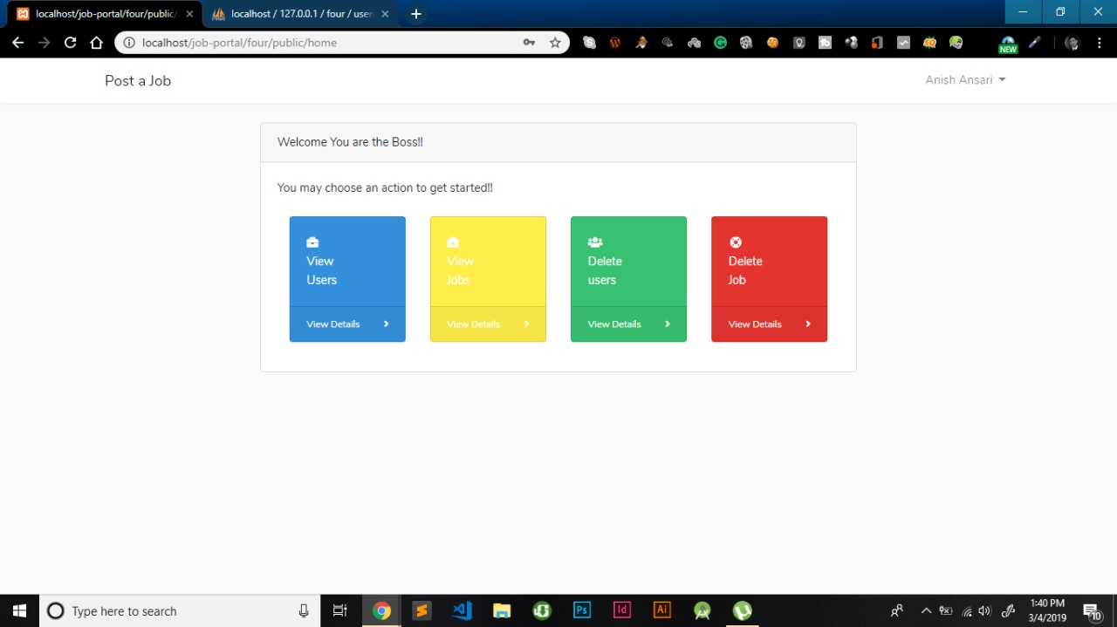

Slide 10
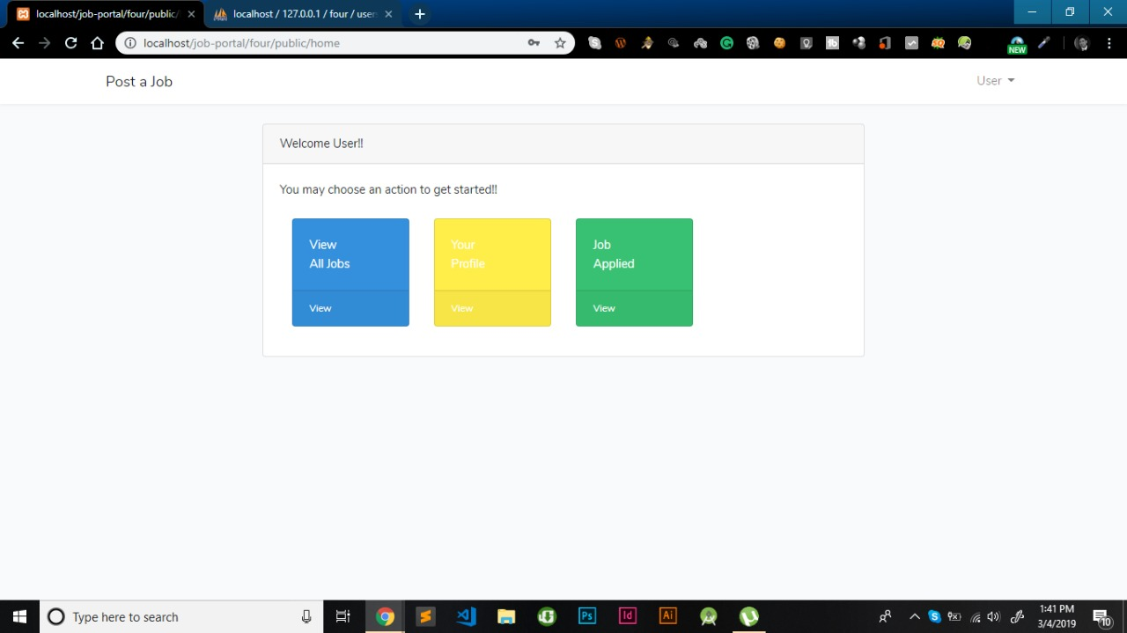

Slide 11
CONCLUSION The wider areas of job searching facilitate the quick and easy access to opportunities. The increasing job opportunities and changing scenario of the business environment today has made more people to search for better career and employers to search for better potential.

