Slide 1
MLAB
A Complete Labour Management Solution

Slide 2
WE CAN RESOLVE
Verify Contractors and Labours
Eliminates Middle Level Contractors
Right Labourer Right work
Eliminate Language barrier
Rate Contractors and Labours
Labourer can choose the best work he deserves
Verification data secured with blockchain
Can create dynamic contracts
Contractors can create condition for contracts
Agreement between labour and contractor done via blockchain
Guarantee market wage for each labourer
Used Module architecture

Slide 3
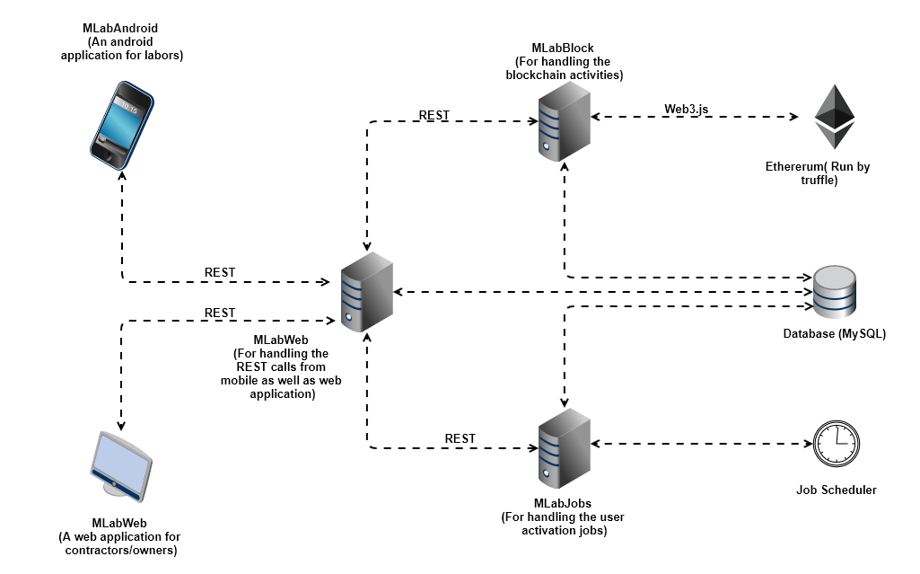
ARCHITECTURE

Slide 4
LABOURER APPLICATION
We created the labourer side application as a mobile application because easy of access.

Slide 5


Done a manual verification of his mobile and facebook accounts
SIGNUP
Create an etherium account for him
Create a verification token and save it into the blockchain
Activate the account

Slide 6
USER VERIFICATION TOCKEN
Account: 0xa5fa31264e2ccdb3d15d44980b87d3caa81a2bc9
Mobile No: 9496461474
Name: ANISH ANTONY
Social Verified: YES
Rating: 10.0
Start Date: 16-12-2017

Slide 7

JOB CERTIFICATE
SOURCE: 0xa5fa31264e2ccdb3d15d4498
DESTINATION: 0x43ec7072bf85ac0fbc99
SOURCE TYPE: LABOURER
TYPE: REQUEST
CONTRACT CODE: MY_CONTRACT
JOB CERTIFICATE
SOURCE: 0x43ec7072bf85ac0fbc99
DESTINATION:0xa5fa31264e2ccdb3d15d4498
SOURCE TYPE: CONTRACTOR
TYPE: APPROVE
CONTRACT CODE: MY_CONTRACT

Slide 8
JOB CERTIFICATE
SOURCE: 0x43ec7072bf85ac0fbc99
DESTINATION:0xa5fa31264e2ccdb3d15d4498
SOURCE TYPE: CONTRACTOR
TYPE: REQUEST
CONTRACT CODE: MY_CONTRACT
JOB CERTIFICATE
SOURCE: 0xa5fa31264e2ccdb3d15d4498
DESTINATION: 0x43ec7072bf85ac0fbc99
SOURCE TYPE: LABOURER
TYPE: APPROVE
CONTRACT CODE: MY_CONTRACT

