Slide 1

Angular 5 Training
Created By: Anish Antony

Slide 2
SINGLE PAGE APPLICATION

Slide 3
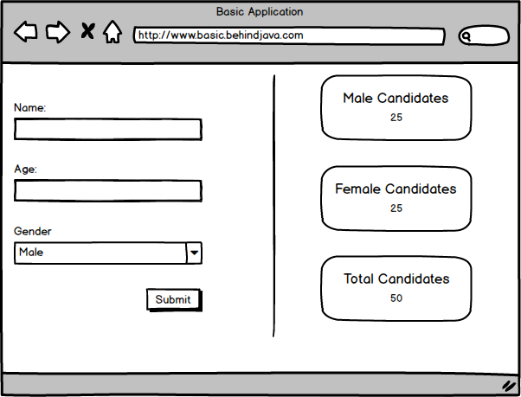
BASIC HTML FORM SUBMISSION

Slide 4
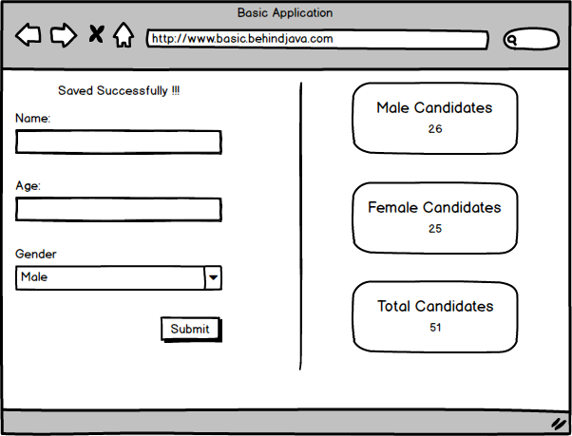
BASIC HTML FORM SUBMISSION

Slide 5

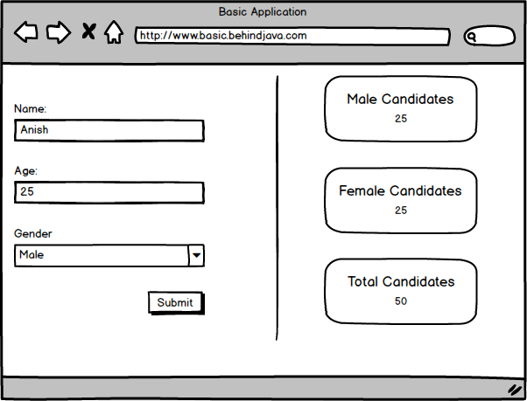
BASIC HTML FORM SUBMISSION
FORM REQUEST

Slide 6
BASIC HTML FORM SUBMISSION
PROCESS DATA
PROCESS DATA
GET WIDGET RESULT
PROCESS DATA
CREATE RESPONSE HTML
PROCESS DATA
FIND DEPENDENT JS AND CSS
PROCESS DATA
SEND RESPONSE
PROCESS DATA

Slide 7
BASIC HTML FORM SUBMISSION
FORM REQUEST

Slide 8
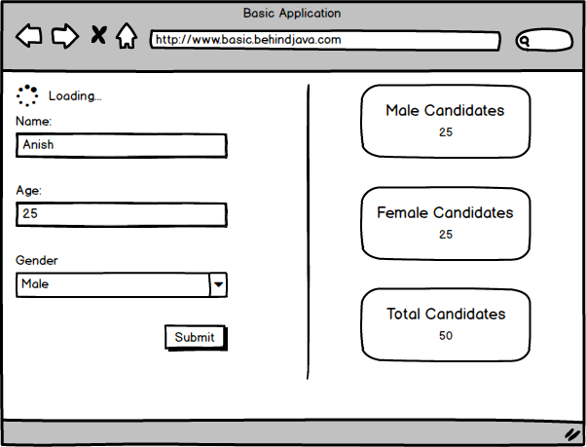
AJAX FORM SUBMISSION
FORM REQUEST

Slide 9
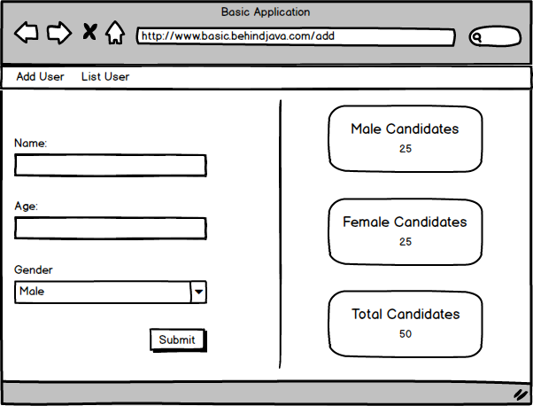
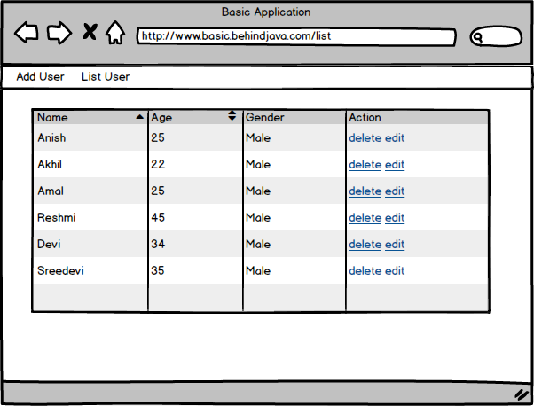
PAGE REDIRECTION

Slide 10
In an SPA, either all necessary code – HTML, JavaScript, and CSS – is retrieved with a single page load, or the appropriate resources are dynamically loaded and added to the page as necessary, usually in response to user actions.
The model breaks the browser's design for page history navigation using the Forward/Back buttons.
Analytics tools such as Google Analytics rely heavily upon entire new pages loading in the browser, initiated by a new page load. SPAs do not work this way.

Slide 11







SPA FRAMEWORKS

Slide 12




WHY ANGULAR
Developed and maintained by Google
Angular can program in different languages such as typescript, javascript and dart

Slide 13
ANGULAR HISTORY

Slide 14
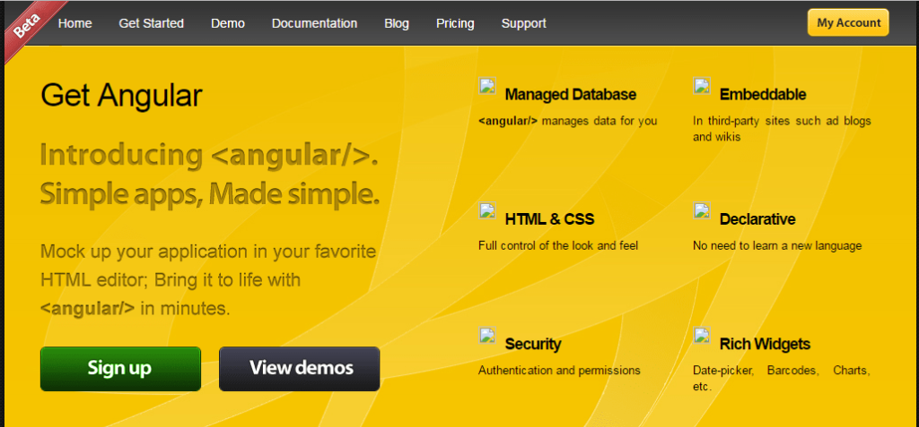


2009
Misko hevery (a developer at Google) working on a part time project to simplify web application development.
Adam abrons friend of Misko, who working with him on this project named it as Angular as its HTML and HTML contains angular brackets.
http://www.angularjswiki.com/angularjs/history-of-angularjs/

Slide 15
2012

Slide 16
2014
2015
https://en.wikipedia.org/wiki/Angular_(application_platform)
https://www.uruit.com/blog/2017/07/04/angular-1-vs-2-migrate/
https://stackoverflow.com/questions/34114593/angular-vs-angular-2
2016
2017

Slide 17
ECMA SCRIPT

Slide 18
https://en.wikipedia.org/wiki/ECMAScript

Slide 19
TYPESCRIPT

Slide 20
https://www.infoq.com/articles/Angular2-TypeScript-High-Level-Overview
https://stackoverflow.com/questions/30807612/should-i-use-typescript-or-i-can-just-use-es6
https://blog.thoughtram.io/angular/2015/05/09/writing-angular-2-code-in-es5.html

Slide 21
WORKSPACE SETUP

Slide 22




VISUAL STUDIO CODE
NODE JS
LATEST VERSION OF CHROME OR FIREFOX

