Slide 1
House Price Predictions

Slide 2
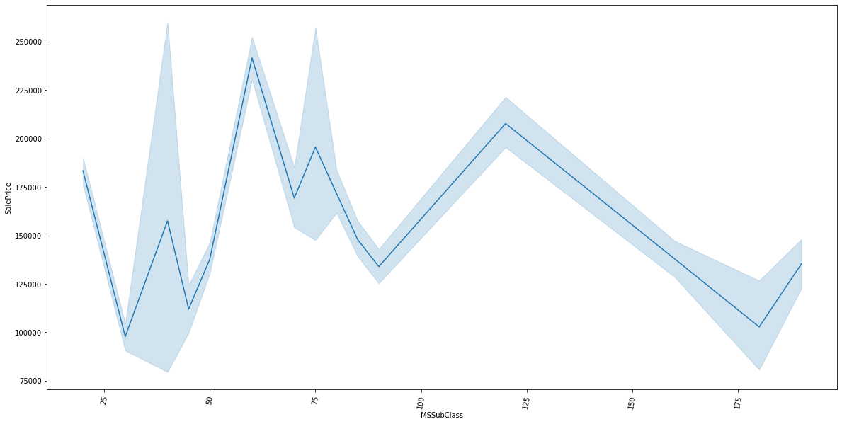
MSSubclass vs SalePrice

Slide 3
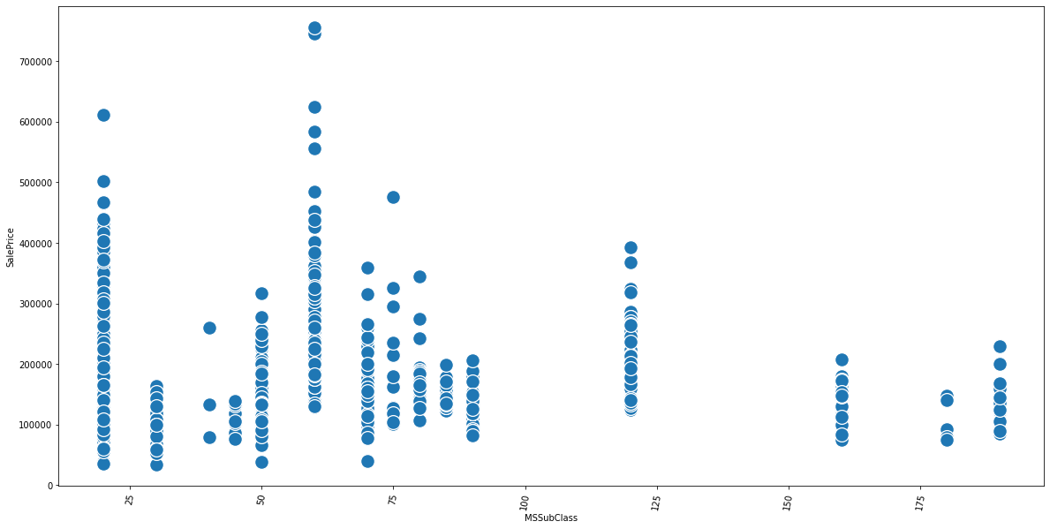
MSSubclass vs SalePrice

Slide 4
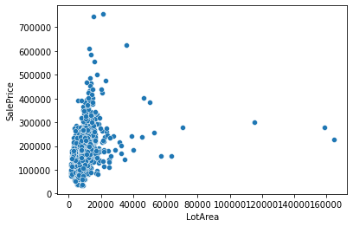
LotArea vs SalePrice

Slide 5
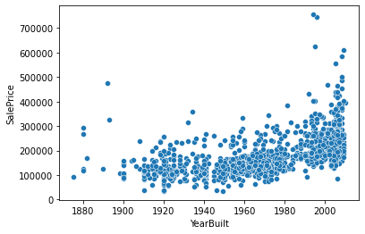
YearBuilt vs SalePrice

Slide 6
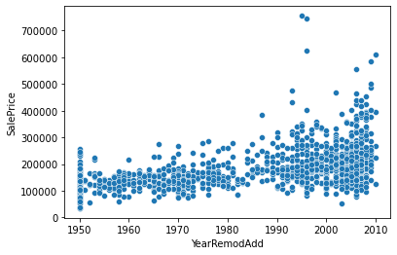
YearRemodelDate vs SalePrice

Slide 7
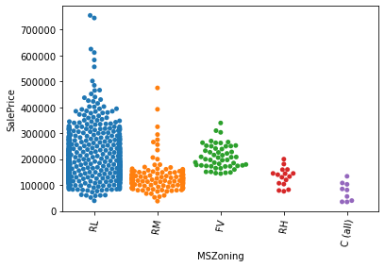
MSZoning vs SalePrice

Slide 8
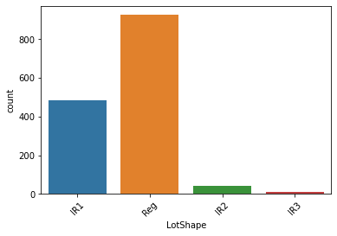
LotShape

Slide 9
MSZoning

Slide 10
LotShape

Slide 11
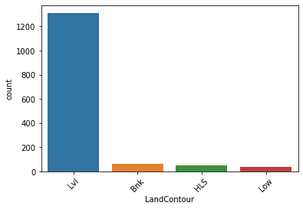
LandContour

Slide 12
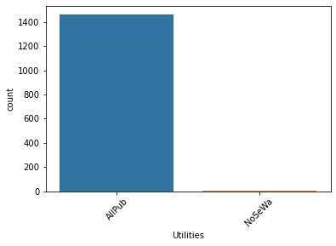
Utlities

Slide 13
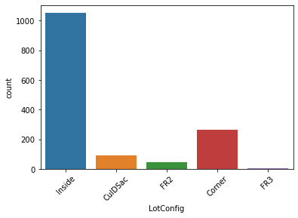
LotConfig

Slide 14
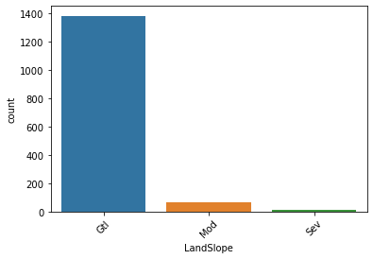
LandSlope

Slide 15
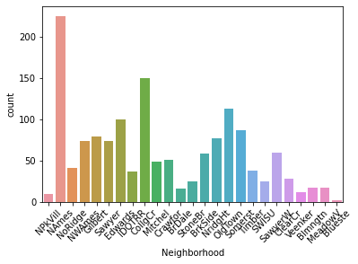
Neighborhood

Slide 16
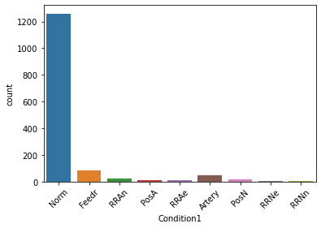
Condition1

Slide 17
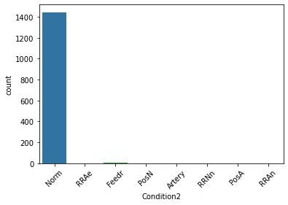
Condition2

Slide 18
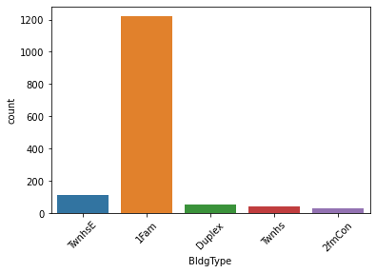
BldgType

Slide 19
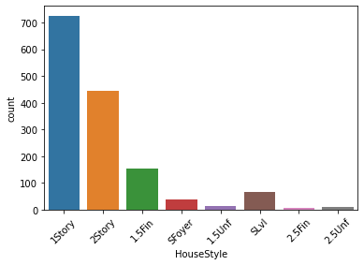
Housestyle

Slide 20
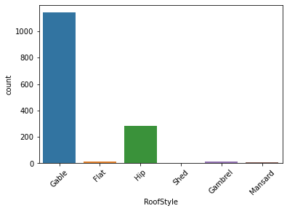
RoofStyle

Slide 21
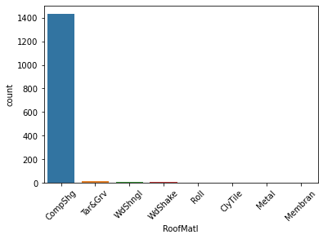
RoofMatl

Slide 22
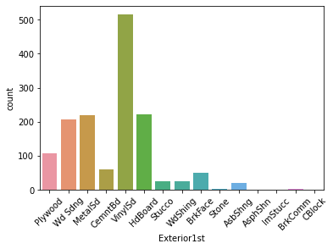
Exterior1st

Slide 23
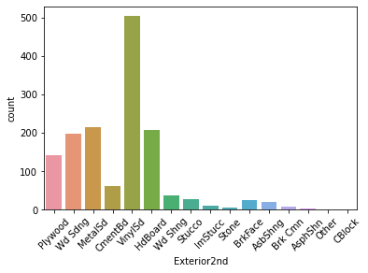
Exterior2nd

Slide 24
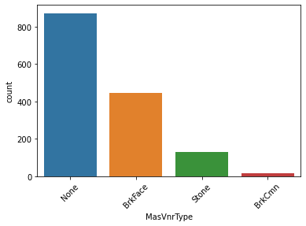
MasVnrType

Slide 25
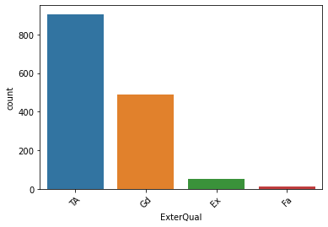
ExterQual

Slide 26
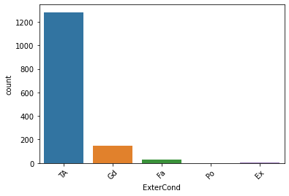
ExterCond

Slide 27
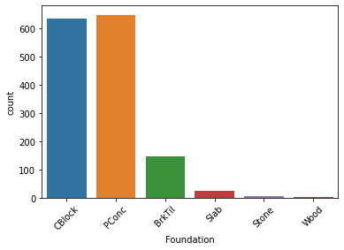
Foundation

Slide 28
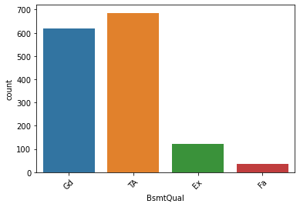
BsmtQual

Slide 29
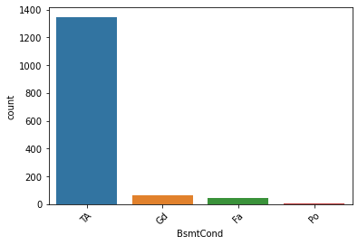
BsmtCond

Slide 30
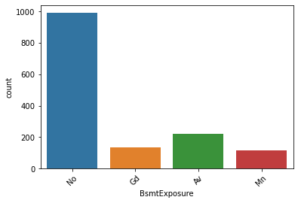
BsmtExposure

Slide 31
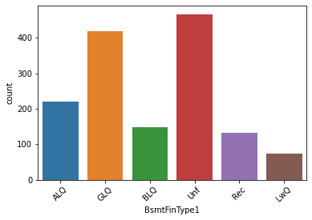
BsmtFinType1

Slide 32
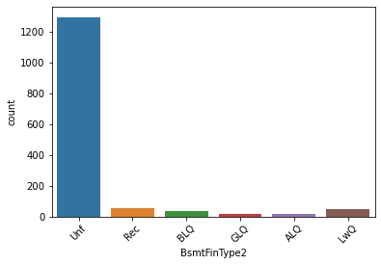
BsmtFinType2

Slide 33
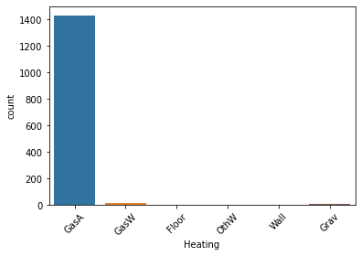
Heating

Slide 34
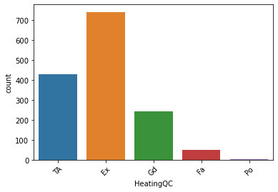
HeatingQC

Slide 35
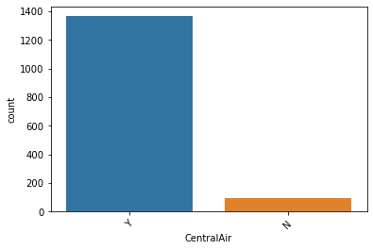
CentralAir

Slide 36
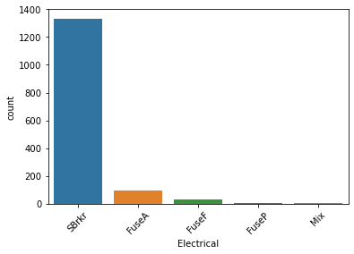
Electrical

Slide 37
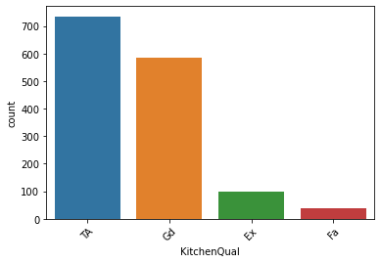
KitchenQual

Slide 38
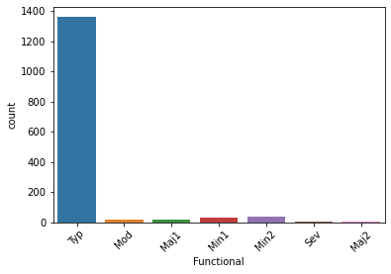
Functional

Slide 39
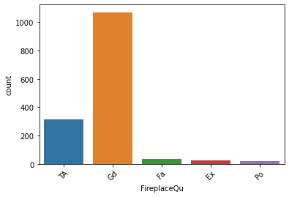
FireplaceQu

Slide 40
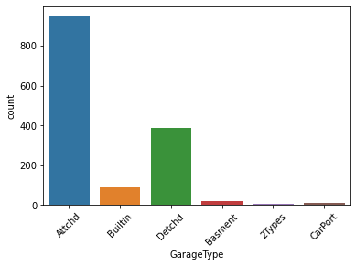
GarageType

Slide 41
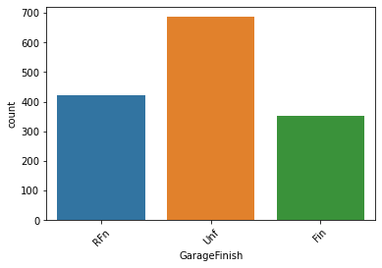
GarageFinish

Slide 42
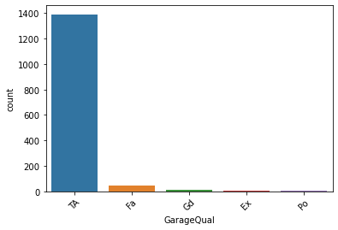
GarageQual

Slide 43
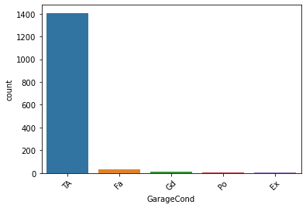
GarageCond

Slide 44
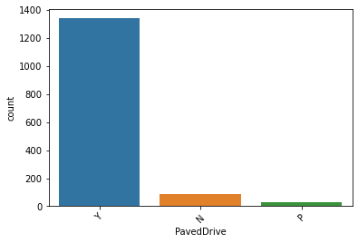
PaveDrive

Slide 45
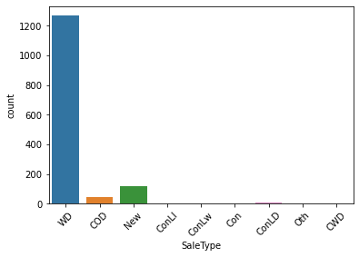
SaleType

Slide 46
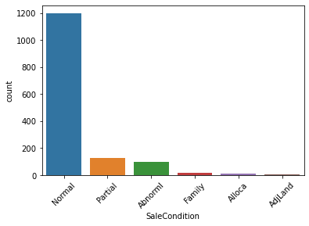
SaleCondition

Slide 47
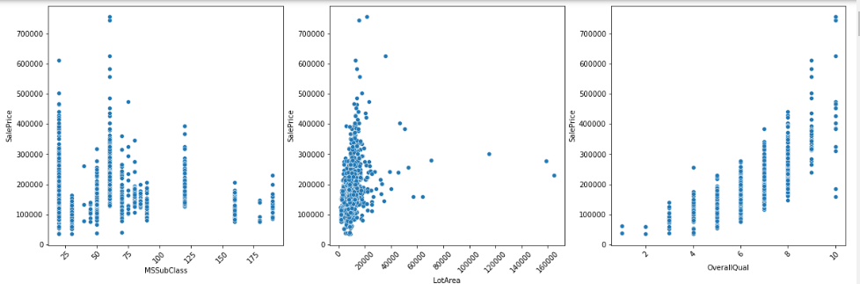
MSSubClass ,LotArea,OverallQual vs SalePrice

Slide 48
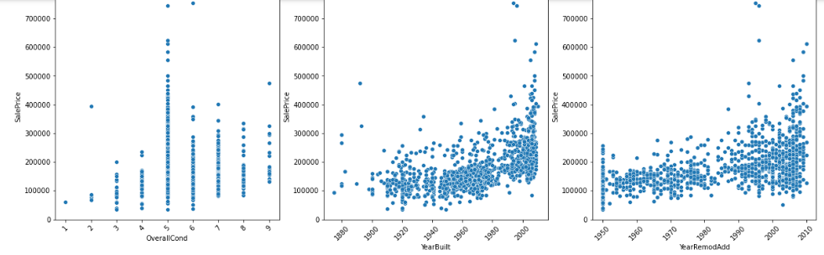
OverallCond,Yearbuilt,YearRemodel vs SalePrice

Slide 49
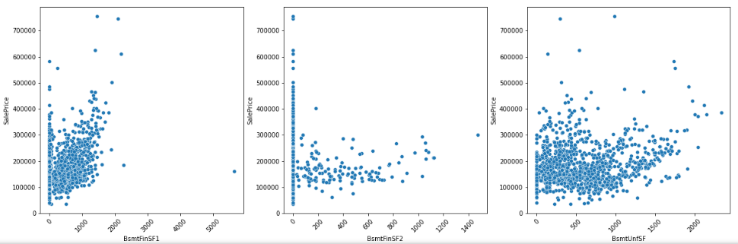
BsmtFinSF1,BsmtSF2,BsmntSF vs SalePrice

Slide 50
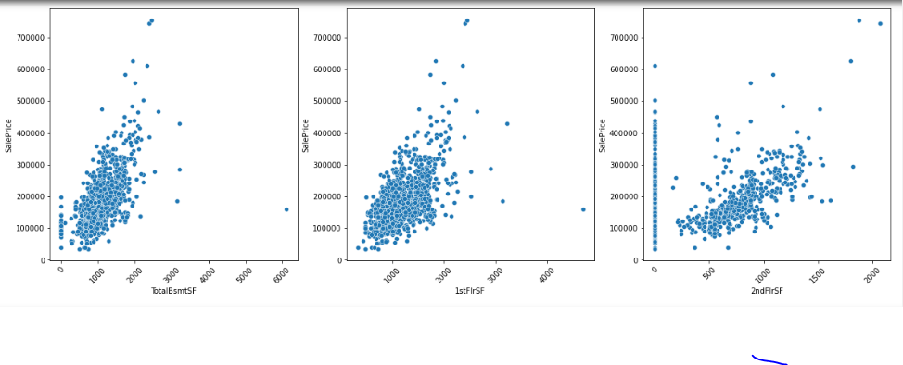
TotalBsmtsf,1stFirst,2ndFisrtSF vs SalePrice

Slide 51
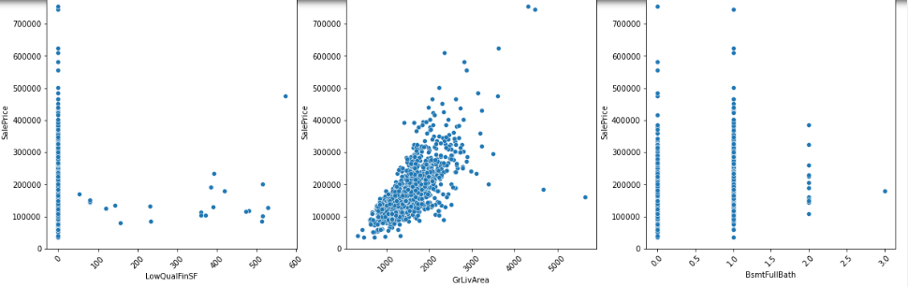
LowQualFinSF,GrLivArea,BsmntFullBath vs SalePrice

Slide 52
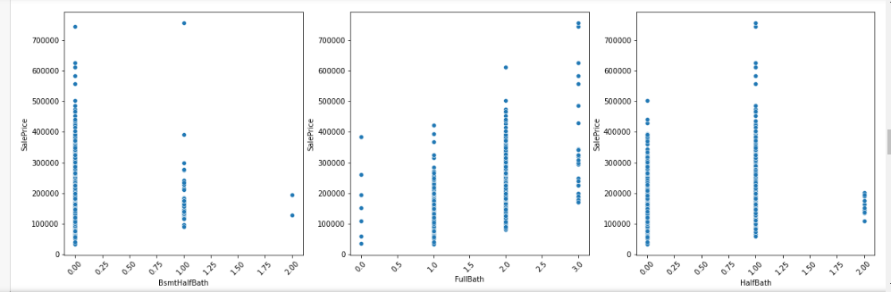
BsmntYBath,FullBath,HalfBath vs SalePrice

Slide 53
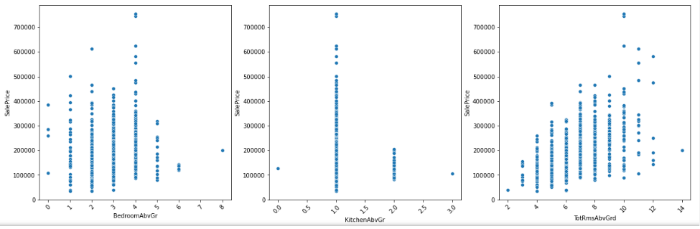
BedroomAbvGr,KitchenAbvGr,TotRmsAbvGrd vs SalePrice

Slide 54

Fireplaces,GarageCars,GarageArea vs SalePrice

Slide 55

WoodDeckSF,OpenPorchSF,EnclosedPorch vs SalePrice

Slide 56

3SnPorch,ScreenPorch,PoolArea vs SalePrice

Slide 57

MiscVal,MoSold,YrSold vs SalePrice

Slide 59

LotShape,LotConfig,Neighborhood vs SalePrice

Slide 60

BldgType,HouseStyle,RoofStyle vs SalePrice

Slide 61

Exterior1st,2nd,MasVnrType vs SalePrice

Slide 62

ExterQual,Foundation,BsmtQual vs SalePrice

Slide 63

BsmtExposure,BmtFinType1,HeatingQC

Slide 64

KitchenQual,FireplaceQu,GarageType vs SalePrice

Slide 65

GarageFinish,SaleCondition vs SalePrice

Slide 66

HeatingQC vs SalePrice vs BldgType

Slide 67

Neighborhood vs SalePrice vs YearBuilt

Slide 68

BsmtFinType1 vs SalePrice vs BsmtQUal

Slide 69

SalePrice vs KitchenQual vs SaleCondition

Slide 70

SalePrice vs ExterQual vs GarageFinish

Slide 71

OverallCond vs SalePrice vs MSSubclass

Slide 72

OverallCond vs SalePrice vs TotalRmsAbcGrd

Slide 73

OverallCond vs SalePrice vs BedroomAbvGrd

Slide 74

GarageFinish vs GarageArea vs SalePrice

Slide 75

YearBuilt vs YearRemodel vs SalePrice

Slide 76

SalePrice vs OverallQual vs SalePrice

Slide 77

SalePrice vs BsmtQual vs 1stFlr

Slide 78

OverallQual vs SalePrice vs FullBath

Slide 79

Fireplaces vs SalePrice vs HeatingQC

