Slide 1
Decode NOAA signals using GNURadio

Slide 2
Introduction
There are three different types of weather satellites: low earth orbiters (LEO), medium earth orbiters (MEO) and geostationary orbiters (GEO). Low earth orbiting satellites range from a few hundreds to a thousand kilometers in altitude. Medium earth orbiting satellites orbit at about 10,000 km above the earth. On the other hand, geostationary orbiting satellites are at approximately 40,000 kilometers in altitude.
The GEO satellites move at the same speed as the earth’s rotational speed and hence they appear to be suspended above one point. LEO satellites constantly move with respect to the earth’s surface and are lower orbiting satellites so they tend to achieve sharper pictures. In this case, LEO satellites are used to receive the signal. This is mainly due to the better image quality and also due to the fact that LEO satellites orbit from pole to pole, implying that they are bound to pass over a particular region at least twice a day. Their orbits are 840 kilometers in altitude and they circle the planet once every 104 minutes. The US National Oceanographic and Atmospheric Administration (NOAA) have both GEO and LEO satellites.

Slide 3
Currently, there are 4 operational NOAA satellites that orbit and send signals: NOAA-15, NOAA-17, NOAA-18 and NOAA-19. The basic operation of the satellite uses cameras that scan the visible spectrum as well as the infrared spectrum and take strips of images that would span approximately 3000 km. This is done repeatedly to make a continuous image. This image is then transmitted at 137 MHz right away and not stored on the satellite. This signal can be received through the antenna while the satellite is overhead, which can last up to 16 minutes.
Although, the signal can be detected for up to 16 minutes, it tends to be noisy for the first and last minutes. The best signal to noise ratio can be achieved when the satellite pass is directly overhead the antenna. Once the signal arrives at the antenna it is amplified immediately using a pre-amplifier to achieve a better noise figure for the entire system. Once the signal is amplified it can be FM demodulated using a receiver operating at 137 MHz. The receiver demodulates the FM carrier and leaves an AM sub-carrier data signal at 2400 Hz that is processed to display an image.

Slide 4
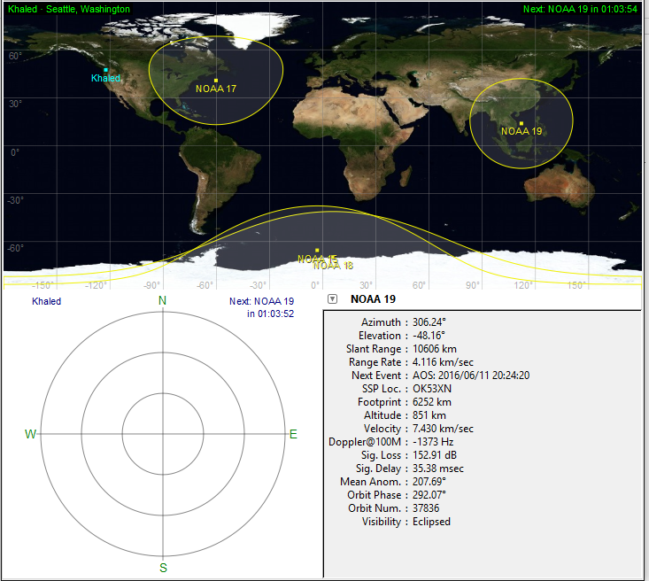
NOAA satellites orbits the earth 24- hours and there exist plenty of different software that can be used to track the satellites. The main advantage of tracking the satellite is to know exactly which satellite is going to pass over to turn your receiver to the correct frequency. Also, it gives a detailed information about when the satellite is going to pass over and the detailed angles, velocity, visibility and more. For this project gpreict can be used to track NOAA satellite as it gives more options on whether the satellite is in LOS or not to the receiver, figure 1. There is a GNURadio Companion (GRC) file on github that can be used to record these signals.
Figure 1: Main window of gpredict software used to track NOAA Satellite.

Slide 5
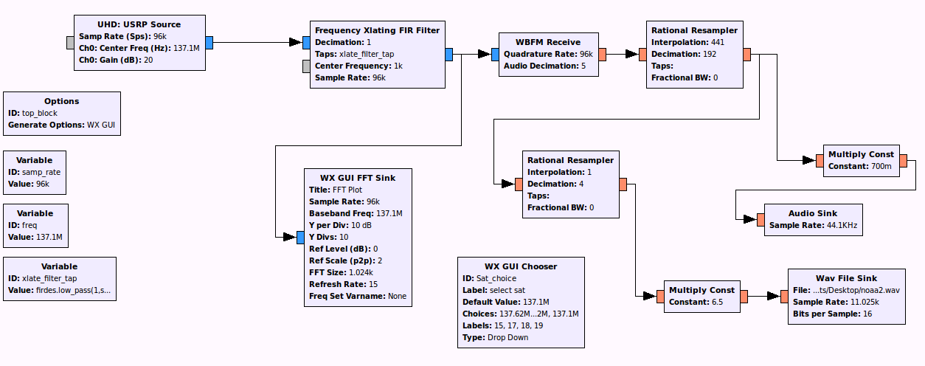
Figure 2: NOAA Satellite Receiver

Slide 6
Demodulation and display of images
Once the signal is received, the audio tones must be converted or demodulated to represent varying levels of visible and inferred energy as processed by the satellite radiometer. At the receiver, the satellite transmissions are detected as 2400 Hz AM modulated signal transmitted at 2 lines per second. The detected signal is not the exact original image signal as created by the satellite’s imaging systems but an analog representation of it. The subcarrier, the 2400 Hz tone, carries the original image signal as a function of its amplitude. Before we are able to access the original image, we need to carry two critical process: we have to remove the 2400 Hz subcarrier signal and we have to convert the varying voltages into relative digital values. There are two ways this could be accomplished: using GNURADIO or using Python. The Python file NOAA.py can be found on the Github repository.

Slide 7
Using GNU Radio to decode
GNU Radio is an open-source software development toolkit that provides signal processing blocks to implement software radios. For this project, we use the GNU Radio Companion tool. It provides a graphic model for assembling a set of signal processing modules.
Install GNU Radio (from http://gnuradio.org/redmine/projects/gnuradio/wiki/InstallingGR ) and open GRC by typing ‘gnuradio-companion’ on the terminal.
Decoding process - After recording the satellite signal, the recorded wave file itself is an AM modulated signal. The AM subcarrier on 2400 Hz modulates image data, as amplitude variation along a gray scale. Each word is sampled using 8 bits/pixel along one row, which lasts exactly 0.5 seconds. The sampling rate of the recorded wav file is 11025 Hz.

Slide 8
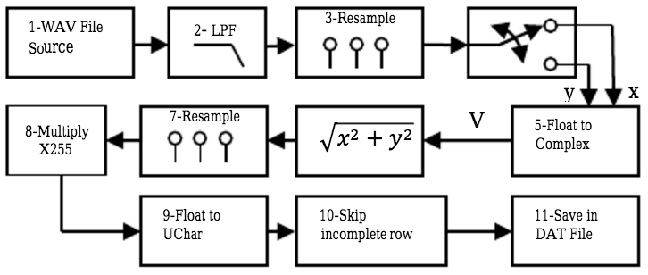
At this point, read through the research paper at https://www.researchgate.net/publication/247957486_NOAA_Signal_Decoding_And_Image_Processing_Using_GNU-Radio to get a complete understanding.
Try to explore GNU Radio and build the system shown below (taken from research paper).

Slide 9
The following blocks can be found on GRC to construct the decoder.
WAV file source: On GRC, find this block and choose ‘090729 1428 noaa-18.wav’ as the file – this is a recorded file that can be found on github. Under ’Repeat’ option, select No.
LOW PASS Filter: The recorded wave file is first passed through a low pass filter to remove the higher frequency components that could affect the quality of the decided image. The cutoff frequency is chosen such that it would pass the components around 2.4 KHz, the carrier frequency. [Decimation = 1, Gain = 1, Sample rate = 11025, Cut-off frequency – 4200, Transition width = 200]
Rational Resampler 1: After that, rational resampler block is used to resample the filtered signal to 9.6 KHz. The 9.6 KHz signal represents four samples for each word of the AM 2.4 KHz signal. Therefore, we have four samples/period and the samples come with 90-degree phase shift. [Interpolation = 9600, Decimation = 11025]
Note: Connect two WX GUI FFT Sink blocks at the input and output of the low pass filter to visualize the operation in real-time.

Slide 10
Float to Complex, skip head, Keep 1 in N: Using two consecutive samples we can detect the instantaneous amplitude of the AM 2.4 KHz signal at a rate of 4.8 KHz. The amplitude will be A = sqrt (x² + y²), if every pair of two consecutive samples is converted to a complex number V = x + iy, where x and y are float variables. The real and imaginary parts are interleaved as float variables in the signal, use Skip Head and Keep 1 in N blocks to obtain these parts. This will be fed to the Complex to Mag block.
Complex to Mag: The block Complex to Magnitude acts like an AM demodulator and thus the signal caring the useful data about the image is present at the output of the block.
Rational Resampler 2: The demodulated signal is not yet ready for saving because the true symbol rate in APT format is 4.16 KHz. The second ration resampler is used to resample it to 4.16 KHz. [Interpolation = 4160, Decimation = 4800]
Multiply constant: This block is used to expand the range of the signal between 0 and 255 to make it ready for saving. This range happens to be equal to the number we can render using eight bits. [Constant = 255]

Slide 11
Float to UCHar: This block is used to convert float numbers to unsigned char which is appropriate for saving the data file at the end.
Skip head: To skip the first row of the data which is usually not a complete row. [Num items = 1750]
File Sink: Finally, the signal is saved as is, in a .dat file, by this last block.
[Github instruction - The .dat file must be converted to png format to view the image. This can be done on the terminal via
convert -size 2080x1024 -depth 8 gray:output.dat output.png]
Now you can use this to decode live images over Hyderabad!

Slide 12
Designing an FM receiver using GNU radio
Now that you have used GNU radio, you must be able to design an FM receiver on your own!
Try using the fm_receiver.pyc on github. Is it noisy? The objective is to design a good FM receiver.
What do you need to know about FM signals?
Read up - http://www.arrl.org/files/file/Technology/tis/info/pdf/8506025.pdf

Slide 13
Search online about the basics –
What is VHF? What is the frequency range of FM signals? Will the daughterboard on the USRP be capable of tuning to this range?
Bandwidth of FM channels – What is narrowband FM? What is wideband FM? Where are they used?
Now, you need a ‘USRP source’ block on GNU radio. What is its center frequency and sampling rate? If WBX daughterboard is being used, the ‘Ch0: Antenna’ port should be set to “RX2” or “TX/RX”. This is physically written on the daughterboard (check!)
What are the ‘FM receive’ blocks in GNU radio? Based on narrowband and wideband FM, what should be the rate of samples being passed to the FM block?

Slide 14
How do we resample the signal from the USRP to the FM block?
The PC speakers require 48k sample rate – this is usually a default rate that sound cards use. Choose the Audio Sink block for this. Set ‘OK to Block’ to No. ‘Device Name’ can be blank.
After answering the above questions and setting up an FM receiver - is it still noisy? What is the gain of the USRP block? Should there be a low pass filter included?
Once you are satisfied with your FM receiver, can you rig up an AM receiver?!

