Slide 1
CSC 553
Advanced Database Concepts
Lecture 10
Alexander Rasin
College of CDM, DePaul University
March 7th, 2012

Slide 2
Evaluations!
Fill out evaluation forms
  http://my.cdm.depaul.edu/myCDM
  You have until March 12th
Next week
  Still no final!
  Office hours?

Slide 3
Tonight
Project
Streaming databases
Column-store databases
NoSQL/Key-value stores/MapReduce

Slide 4
Project
Available for your perusal
Similar to homework
Preliminary due date
  Monday March 19th
  Preliminary submission March 14th?

Slide 5
Project Components
Five parts
  A: Indexes
  B: Materialized Views
  C: MVs + Indexes
  D: Full fledged designs
  E: Something else
    Only need to take one option
    Can get extra credit
    Can propose other things (check with me)

Slide 6
Indexes
Only index large tables (lineorder)
Covering indexes most common
How do we design a “shared” index?
  Identify all relevant attributes
  Remember the foreign keys
  Determine the per-attribute selectivity
  Consider join benefit (transitive selectivity)

Slide 7
Materialized Views
Preemptively compute the join
Otherwise, same principle
  Identify all relevant attributes
Also allows for multi-table indexes!

Slide 8
Pre-aggregated MVs
Group aggregation attributes separately
Predicates have to be
  Pre-filtered
  Or included in group-by
Can mix and match grouping/predicates
Different aggregate function?
  May have to pre-compute several

Slide 9
Indexed MVs
Typically with regular (lossless) MVs
Same principle as with regular indexing
  Select relevant attributes
  Order by combined selectivity
  One clustering index may be chosen

Slide 10
Design
Add together multiple structures given a disk budget
Can use or revise structures from preceding parts

Slide 11
Design Principles
Greedy addition
  Generate some number of MVs, Indexes and MV+Index combinations
  Pick the “best” one until disk budget is used up
Divide and conquer
  Split up the workload and budget
  e.g., 13 queries, 1Gig=>3+3+4+3 Qs, 250MB each
Merge
  Start with individual MV+Index for each query
  Merge (pairwise) until design fits into budget

Slide 12
Stream DBMS
Query data from a stream
  A data feed with a schema
  You can also query conventional relations
Examples
  Sensor data, stock market quotes, network monitoring
Querying a stream forces changes to the DBMS
  Push-based rather than pull-based operators
  Must be able to provide partial answers
    You never finish the query
  One-pass
    You cannot (in general) rewind the stream.

Slide 13
Stream Processing
U
Σ
μ
Data
Sources
Client
Apps
U
μ
Σ
Data sources push tuples continuously
Operators process windows of tuples

Slide 14
Operators: Select
Filter the stream (temperature > 100)
Needs an input buffer
Blocking operator?
Projection works the same way

Slide 15
Operators: Aggregation
Aggregate the stream
  E.g., average sensor temperature
  # of cars that entered a garage
Blocking operator?
  How do you know when to send an answer?
  Windows!
Average temperature over the last 5 minutes
# of cars entered per hour (1pm-2p, 2p-3p, …)

Slide 16
Operators: Join
Join 2 streams
  Detect when 2 planes are too close to each other
  Match up “buy” and “sell” requests
Blocking operator?
  Need 2 input buffers
  And specify windows on each side
  Time-stamp windows
  Join only the relevant tuples

Slide 17
Distributed Stream Processing
Node 1
Node 2
U
Σ
μ
Data
Sources
Client
Apps
Node 3
Node 4
U
μ
Σ
Data sources push tuples continuously
Operators process windows of tuples

Slide 18
Fault-Tolerance through Replication
Goal: Tolerate node and network failures
Node 3
U
μ
s₃
Node 1
Node 2
U
Σ
μ
s₁
s₂
s₄
Node 1’
Node 2’
U
Σ
μ
Node 3’
U
μ
s₃’

Slide 19
Correlation-based Load Distribution
Goal: Minimize end-to-end latency
Key ideas:
  Balance load across nodes to avoid overload
  Group boxes with small load correlation together
  Maximize load correlation among nodes
r
A
B
r
A
B
S1
2cr
S1
2r
C
D
2r
C
D
S2
4cr
S2
3cr
3cr

Slide 20
Local Load Shedding
Goal:
Minimize
total loss
Node A
Node B
r₁
4C
r₂’
C
25%
r₂
App₁
r₁
C
r₂
3C
58%
App₂
CPU Load = 5Cr₁, Cap = 4Cr₁
CPU Load = 4Cr₂, Cap = 2Cr₂
No overload
CPU Load = 3.75Cr₂, Cap = 2Cr₂
No overload
A must shed 20%
B must shed 50%
A must shed 20%
A must shed 20%
B must shed 47%
Plan | Loss
Local | App₁: 25% App₂: 58%

Slide 21
Distributed Load Shedding
Goal:
Minimize
total loss
Node A
Node B
r₁
4C
r₂’
C
9%
r₂
App₁
r₁
C
r₂’’
3C
64%
r₂
App₂
CPU Load = 5Cr₁, Cap = 4Cr₁
CPU Load = 4Cr₂, Cap = 2Cr₂
No overload
No overload
A must shed 20%
B must shed 50%
A must shed 20%
A must shed 20%
Plan | Loss
Local | App₁: 25% App₂: 58%
Distributed | App₁: 9% App₂: 64%
smaller
total loss!

Slide 22
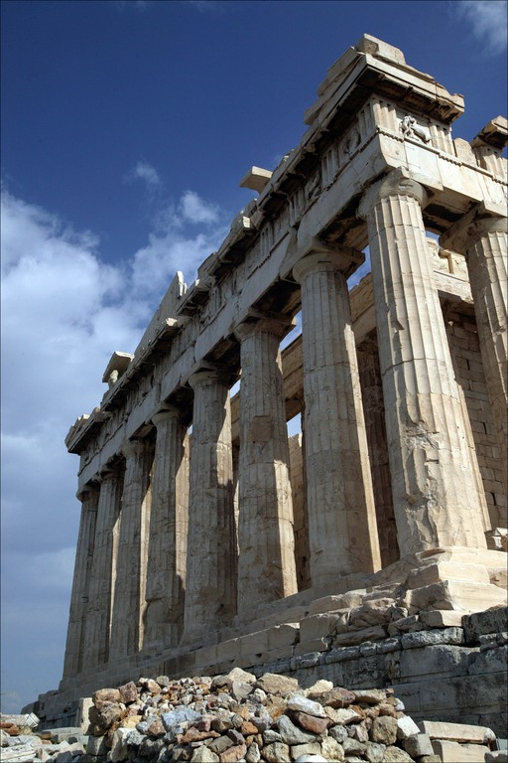

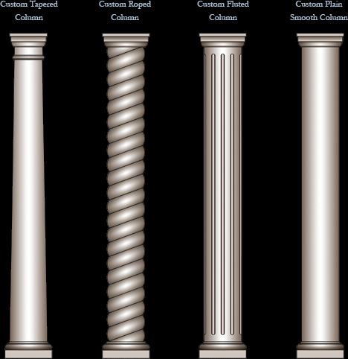

Slide 23
Column-store DBMSes
Also know as column-oriented DBMS
Resurfacing of the same idea
  20 year cycle
The principle
  Store every column in a separate file!
  Otherwise (most implementation) support regular RDBMS interface

Slide 24
Row Store vs Column Store DB
RID Name Position FavoriteTown
1
Stan
Professor
Westwood
2
Ugur
Professor
Providence
3
Tom
Professor
Providence
4
Alex
Student
Providence
5
Stan
Professor
Cambridge
Logical
6
Andy
Student
Providence
Physical
Column Store
Row Store
#1
1
Stan
Professor
Westwood
Page 1
Page 2
Page 3
Page 4
2
Ugur
Professor
Providence
1
Stan
Professor
Westwood
2
Ugur
Professor
Providence
Disk
Pages
#2
3
Tom
Professor
Providence
3
Tom
Professor
Providence
4
Alex
Student
Providence
4
Alex
Student
Providence
5
Stan
Professor
Cambridge
5
Stan
Professor
Cambridge
#3
6
Andy
Student
Providence
6
Andy
Student
Providence

Slide 25
Differences in Accessing the Data
SELECT Name
FROM People
WHERE Position = ‘Professor’;
1
Stan
Professor
Westwood
1
Stan
Professor
Westwood
2
Ugur
Professor
Providence
2
Ugur
Professor
Providence
3
Tom
Professor
Providence
3
Tom
Professor
Providence
4
Alex
Student
Providence
4
Alex
Student
Providence
5
Stan
Professor
Cambridge
5
Stan
Professor
Cambridge
6
Andy
Student
Providence
6
Andy
Student
Providence
#1
Page 1
Page 2
Page 3
Page 4
#2
#3

Slide 26
Sorting/Indexing Data for Queries
SELECT Name
FROM People
WHERE Position = ‘Professor’;
Row Store
Column Store
Clustered
Index
Sort Order
Professor
1
Stan
Westwood
Professor
1
Stan
Westwood
Professor
2
Ugur
Providence
Professor
2
Ugur
Providence
Professor
3
Tom
Providence
Professor
3
Tom
Providence
Professor
5
Stan
Cambridge
Professor
5
Stan
Cambridge
Student
4
Alex
Providence
Student
4
Alex
Providence
Student
6
Andy
Providence
Student
6
Andy
Providence
All data columns
sorted the same way

Slide 27
Clustered Column Store (CCS) Compression
Professor
Stan
1
Westwood
Professor
Ugur
2
Providence
Professor
Tom
3
Providence
Professor
Stan
5
Cambridge
Student
Alex
4
Providence
Student
Andy
6
Providence
1
+1
+1
+2
-1
+2
Professor,4
Student,2
Delta Enc.
{West. :0, Prov. :1,
Camb. :2}
Run Length Encoding
Dictionary Enc
0
1
1
2
1
1
RLE
LZO

Slide 28
Example Dictionary Compression: City
1000 values
Log(1000) = ~10bits/val
Sorted by State
Log(30) = ~5bits/val
Year City
State City
…
…
…
1000
City names
RI
SC
31
City names
Page
Page
1000
City names
31
City names
1000
City names
28
City names
1000
City names
28
City names
Notes:
Compare to the baseline LZO compression that uses a sample estimate.
PER PAGE compression!!!

Slide 29
Fragmentation: Row vs Column
A
B
C
D
A
B
C
D
RLE-d
2 Pages of Data
½ Page
½ Page
½ Page
2 Pages of Data
½ Page
½ Page
½ Page
Seeks
2 Pages of Data
½ Page
½ Page
½ Page
Can not read
less than
1 Page!!
2 Pages of Data
½ Page
½ Page
½ Page
1*(Seek+Page) + 3* (4 seeks + 4 Pages)
= 13 Seeks + 13 Pages
4 Seeks + 8 Pages

Slide 30
Dedicated MV in Row Store
MV = Column Set + Index
SELECT B, Y
FROM Fact, Dim₁
WHERE A in (1,2,3)
AND X in (‘b’,’c’)
Sort and Index
by A,X
Sort and Index
by X,A
A X B Y
X A B Y
Row #1
1
Row #1
a
a
a
a
1
2
3
4
a
b
c
1
1
2
a
b
c
#4M
0.75
2
b
b
b
b
1
2
3
4
2
3
a
b
c
3
0.66
#9M
3
c
c
c
c
1
2
3
4
Usually, only the 1st
sort column can be used
i.e. Sort A,X ≡ Sort A
4
a
b
c
4
Row #12M
4
Row #12M
Notes:
sort order = subset of column subset
Fundamental problem that needs to be addressed and isn’t obvious in a column store

Slide 31
Dedicated MV in Column Store
SELECT B, Y
FROM Fact, Dim₁
WHERE A in (1,2,3)
AND X in (‘b’,’c’)
Sort and Index
by A,X
Sort and Index
by X,A
A X B Y
X A B Y
Row #1
1
Row #1
a
b
c
#1M
a
a
a
a
1
2
3
4
1
1
#3M
2
a
b
c
#4M
#4M
2
b
b
b
b
1
2
3
4
2
#6M
3
a
b
c
#7M
#7M
3
3
#8M
4
#9M
c
c
c
c
1
2
3
4
a
b
c
4
Row #12M
4
#11M
Row #12M
Notes:
Complicated problem that needs to be addressed.
Range of rows.

Slide 32
Column-store Tradeoffs
Benefits
  Restricted read
  Projection operator is free!
  Compression
Penalties
  Columns must be re-joined
  Scattered data (1 row = X values)
  Updates

Slide 33
Hybrid Storage Solution
Store some data in a row-oriented format
Other data in column-oriented format
How to split it up?
  Current/recent data in row-store
    Updates are expensive
  Old/historical data in a column-store
    Compression is great
    Old data rarely changes

Slide 34

BREAK

Slide 35
In-Memory Databases
Main Memory database system (MMDB)
Data resides permanently on main physical memory
Backup copy on disk
Disk Resident database system (DRDB)
Data resides on disk
Data may be cached into memory for access
Main difference is that in MMDB, the primary copy lives permanently in memory

Slide 36
Questions about MMDB
Is it reasonable to assume that the entire database fits in memory?
  Yes, for some applications
  100 machines x 32GB RAM = 3.2TB RAM
What is the difference between a MMDB and a DRDB with a very large cache?
  In DRDB, even if all data fits in memory, the structures and algorithms are designed for disk access.

Slide 37
Differences in properties of main memory and disk
The access time for main memory is orders of magnitude less than for disk storage
Main memory is normally volatile, while disk storage is not
The layout of data on disk is much more critical than the layout of data in main memory

Slide 38
Copy-based Recovery
Other copies guaranteed to exist
Can recover without relying on persistent storage
  Poll other machines
Doesn’t protect from rack/power failures

Slide 39
Brewer’s Conjecture
Source: Eric Brewer’s July 2000 PODC Keynote
Main points:
  Classic “Distributed Systems”
    Focus on computation, not data
    Distributing computation (relatively) easy, distributing data is hard
  DBMS research is about ACID (mostly)
    But we forfeit “C” and “I” for availability, graceful degradation and performance
    This tradeoff is fundamental
  BASE
    Basically Available
    Soft-state
    Eventual Consistency

Slide 40
Brewer’s Conjecture
ACID
  Strong consistency
  Isolation
  Focus on “commit”
  Nested transactions
  Availability
  Difficult evolution (e.g. schema)
BASE
  Weak consistency
    stale data OK
  Availability first
  Best effort
  Approximate answers OK
  Simpler!
  Easier evolution

Slide 41
What is NoSQL?
Stands for Not Only SQL
Class of non-relational data storage systems
Usually do not use a fixed table schema or use joins much
All NoSQL offerings relax one or more of the ACID properties

Slide 42
Kinds of NoSQL: Document store
MongoDB
CouchDB
FirstName:"Bob", Address:"5 Oak St.", Hobby:"sailing".
FirstName:"Jonathan", Address:"15 Wanamassa Point Road", Children:[{Name:"Michael",Age:10}, {Name:"Jennifer", Age:8}, {Name:"Samantha", Age:5}, {Name:"Elena", Age:2}].

Slide 43
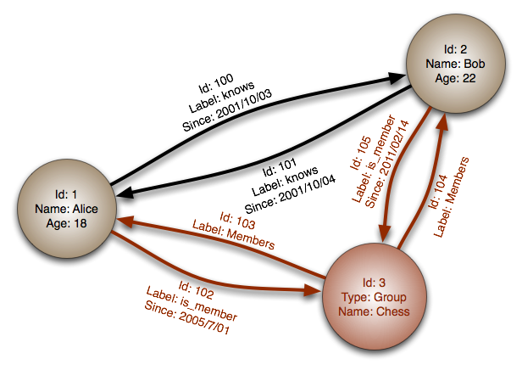
Kinds of NoSQL: Graph DB
Neo4j
InfinityGraph

Slide 44
Kinds of NoSQL: Key-value store
Apache Cassandra
BigTable
MongoDB

Slide 45
What is MapReduce?
Parallel programming model meant for large clusters
  User implements Map() and Reduce()‏
Parallel computing framework
  Libraries take care of EVERYTHING else
    Parallelization
    Fault Tolerance
    Data Distribution
    Load Balancing
Useful model for many practical tasks (large data)

Slide 46
Conceptual Underpinnings
Programming model from Lisp and other functional languages
  (map square '(1 2 3 4)) ⇒ (1 4 9 16)
  (reduce + '(1 4 9 16)) ⇒ 30
Easy to distribute
Nice failure/retry semantics

Slide 47
Example: Counting Words
Map()‏
  Input <filename, file text>
  Parses file and emits <word, count> pairs
    eg. <”hello”, 1>
Reduce()‏
  Sums values for the same key and emits <word, TotalCount>
    eg. <”hello”, (3 5 2 7)> => <”hello”, 17>

Slide 48
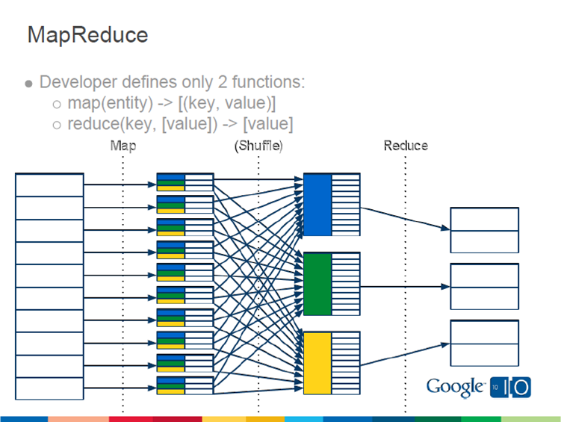
MapReduce Flow

Slide 49
Example: Index words in docs
Input: Crawler yields (url, content) pairs
Map function:
  map (key = url, value = content)
    For each word w in content, emit (w, [url, offset])
  reduce(key = word, values = list of [url, offset])
    Sort values
    Emit (word, sorted list of [url, offset])

Slide 50
Implementation Steps
Split key/value pairs into M chunks, run a map task on each chunk in parallel
Partition the output of map tasks into R regions
Once map processing is done
  Run a reduce task on each (of R) regions

Slide 51
Fault Tolerance
Problem Detection
  Heartbeat
Remedy
  Find another copy of data
  Re-compute what had been lost

Slide 52
Redundant (Speculative) Execution
Slow workers significantly delay completion time
  Other jobs consuming resources on machine
  Bad disks may transfer data slowly
Solution: Near end of phase, spawn backup tasks
  Whichever one finishes first "wins"
Dramatically shortens job completion time

Slide 53
Observations
No reduce can begin until map is complete
Tasks scheduled based on location of data
If map worker fails any time before reduce finishes, task must be completely rerun
Master must communicate locations of intermediate files
MapReduce library does most of the hard work for us!

Slide 54
Top-layer tools
Hive
  SQL-like interface for Hadoop
Pig/Pig Latin
  Platform for programming on top of Hadoop
Mahout
  Data mining library for Hadoop

Slide 55
RDBMS vs MapReduce?
Setup
Performance
Scalability
Recovery

Slide 56


FIN

