Slide 1
CSC 553
Advanced Database Concepts
Lecture 6
Alexander Rasin
College of CDM, DePaul University
February 8th, 2012

Slide 2
Tonight
Feedback
Discuss the Project
  SSBM Benchmark
  Physical Design
Transactions
Concurrency control algorithms

Slide 3

Feedback

Slide 4
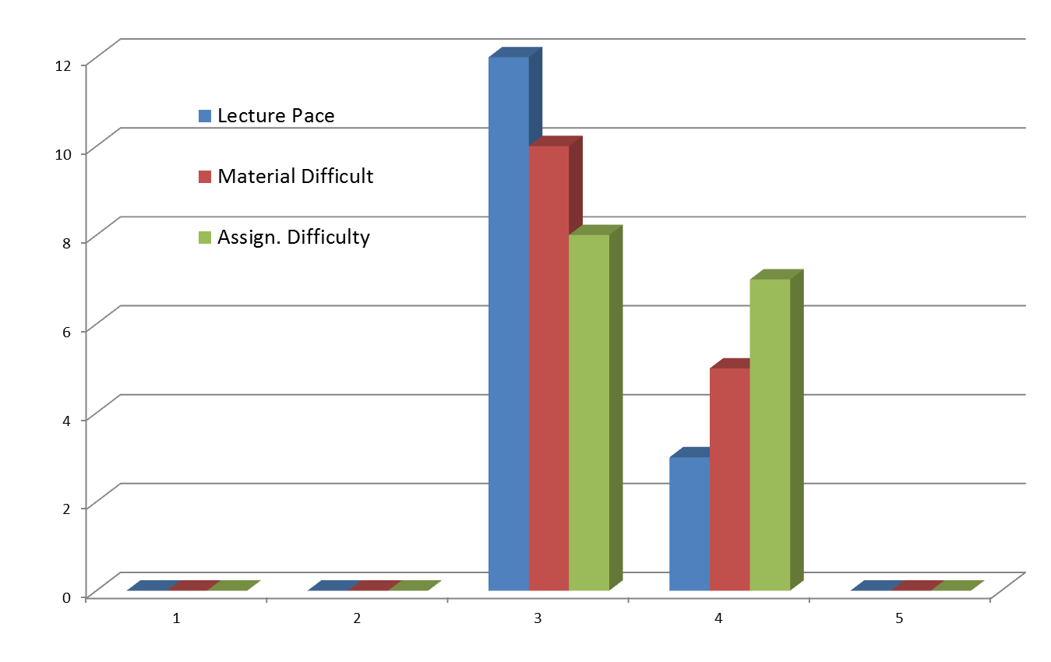
General Results (15)

Slide 5
Specific Comments
Lecture/book mismatches
  Not using in-book examples is good
  Will verify formulas/etc.
Additional text books?
  Doubt anyone wants to buy more books
  Introduction to Database Management System (ISBN: 9788131807248)
  Very high-level, but available in 24x7 library

Slide 6
Specific Comments
Final project not detailed
  Homework will help along
  Discuss more today
Assignment due dates
  Final exams March 13-19th
  Will aim to align homework Monday-Monday
    Feb 13 (out already), Feb 20, Feb 27, March 5 (?)

Slide 7
Specific Comments
An online student reported difficulties reading whiteboard
  I will pay closer attention
  Definitely keep me informed!
Work out examples in class
  We’ll do that

Slide 8
Estimation of the Size of Joins
Compute size estimates for UserLogs ⋈ IpToHost
  UserLogs (Name, Date, IPVisited)
  IpToHost(IPAddress, WebSiteHosted)
  V(IPVisited, UserLogs) = 100
  n_{UL} = 1000
  V(IPAddress, WebSiteHosted) = 1000
  n_{ITH} = 3000
Notes:
1000 / 100 * 3000 = 30,000
3000/ 1000 * 1000 = 3,000

Slide 9
Course Project
Optimize a database benchmark (SSBM)
  And write a report/discussion
We will
  Test a few physical designs (different budgets)
  Evaluate update cost with different batching
  Produce at least a couple of your own designs
    Something you learn in the class (we will discuss possibilities in class)
Extra
  Competition for a best performing design

Slide 10
Star-Schema Benchmark
A simplification of an industrial TPCH benchmark
  Schema significantly simplified (Star-Schema)
  Queries are simplified

Slide 11


Star-Schema
“Dimension” table
Part
“Fact” table
pid
name
desc
1
Transactions
2
3
4
LCD Monitor
…
“Dimension” table
tid cid pid date amount
Customer
1
3
4
01-01-10
200.00
cid
name
address
2
1
10
01-01-10
45.95
3
3
9
01-02-10
110.00
1
…
2
…
3
Alex
“Dimension” table
Date
date
day
holiday

Slide 12
SSBM Schema
4 Dimension tables
  Part: manufacturer, name, size, ...
  Supplier: name, address, phone, …
  Customer: name, address, …
  Date: month, year, dayofweek, …
1 Fact table: lineorder
  Composite key (orderkey+linenumber)
  4 foreign keys (one per dimension)
  Orderpriority, quantity, discount, tax, …

Slide 13
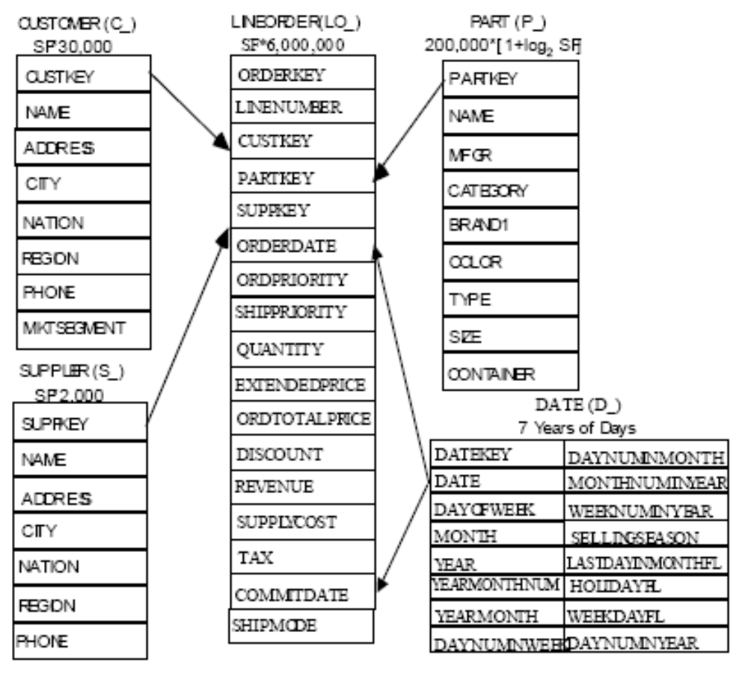


Slide 14
Data Contents
Fact/Lineorder table
  Large (increments of 6M rows)
Customer, Part
  Medium: 120K and 30K row increments
Supplier, dwdate
  Small: 10K increments and 2.5K
How big are the joins?

Slide 15
Queries
13 Different queries
Separated into groups or “flights”
  1.1, 1.2, 1.3
Represent “similar” queries issued by users
We will define a few scenarios
  Varying query frequency
  Update rate

Slide 16
Indexes: An Exercise
select min(lo_revenue)
from lineorder
where lo_extendedprice < 100000;
select max(lo_revenue)
From lineorder
Where lo_discount = 5 and lo_quantity > 33;
Notes:
120K-130K (326 values at 100K, 3000 values at 125K?)
Cost = 1875
CI – 79
REV = 679

Slide 17
Query Optimization
select sum(lo_extendedprice) as revenue
from lineorder, dwdate
where lo_orderdate = d_datekey
and d_year = 1993
and lo_discount between 1 and 3
and lo_quantity < 25;

Slide 18
Query Optimization
select c_nation, s_nation, d_year, sum(lo_revenue) as revenue
from customer, lineorder, supplier, dwdate
where lo_custkey = c_custkey
and lo_suppkey = s_suppkey
and lo_orderdate = d_datekey
and c_region = 'ASIA'
and s_region = 'ASIA'
and d_year between 1992 and 1997
group by c_nation, s_nation, d_year
order by d_year asc, revenue asc;

Slide 19
Update Batching
Individual row-inserts are expensive
  Query plan per insert
  Read cost for every page touched
Batch the inserts
  B+-trees can be bulk-updated
  Similarly, MVs can be bulk-updated
  Order the inserts
    At the very least save on overlap

Slide 20
Compression in MVs/Indexes
Save on I/O costs
Compression
  Per-page
  Per-row
Downsides?

Slide 21
Physical Design/Tuning
  Intuition
    Start with “best” answer (MVs and Indexes) to every workload query
    Merge the views
    Combine the indexes
  Indexes depend on MVs!

Slide 22
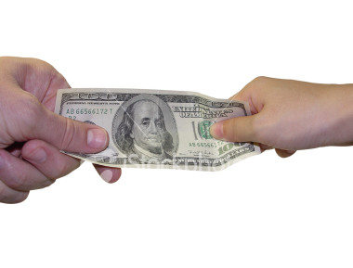

Transaction Processing

Slide 23
Updates in SQL
An example:
UPDATE account
SET balance = balance - 50
WHERE acct_no = A102
What takes place:
memory
…
Disk
Dntn: A102: 300
(1) Read
Dntn: A15: 500
(2) update
account
…
Transaction:
Read(A)
A <- A -50
Write(A)
(3) write
Mian: A142: 300

Slide 24
The Threat to Data Integrity
Consistent DB
Name Acct bal
-------- ------ ------
Joe A-102 300
Joe A-509 100
Joe’s total: 400
Inconsistent DB
Name Acct bal
-------- ------ ------
Joe A-102 250
Joe A-509 100
Joe’s total: 350
transaction
Consistent DB
Name Acct bal
-------- ------ ------
Joe A-102 250
Joe A-509 150
Joe’s total: 400
What a Xaction should
look like to Joe
What actually happens
during execution

Slide 25
Transactions
What?:
  A unit of work
  Can be executed concurrently
Why?:
(1) Updates can require multiple reads/writes in db
e.g., transfer $50 from A-102 to A-509
= read(A)
A ← A -50
write(A)
read(B)
B←B+50
write(B)
(2) For performance reasons, databases permit updates to be executed concurrently.
Concern: concurrent access/updates of data can compromise data integrity

Slide 26

ACID Properties
Properties that a Xaction needs to have:
Atomicity: either all operations in a Xaction take effect, or none

Slide 27

ACID Properties
Properties that a Xaction needs to have:
Consistency: operations, taken together preserve database consistency

Slide 28

ACID Properties
Properties that a Xaction needs to have:
Isolation: intermediate, inconsistent states must be concealed from other Xactions

Slide 29

ACID Properties
Durability. If a Xaction successfully completes (“commits”), changes made to db must persist, even if system crashes

Slide 30
Demonstrating ACID
Transaction to transfer $50 from account A to account B:
  1. read(A)
  2. A := A – 50
  3. write(A)
  4. read(B)
  5. B := B + 50
  6. write(B)
FAILURE!
Consistency: total value A+B, unchanged by Xaction
Atomicity: if Xaction fails after 3 and before 6, 3 should not affect db
Durability: once user notified of Xaction commit, updates to A,B should not be undone by system failure
Isolation: other Xactions should not be able to see A, B between steps 3-6

Slide 31
Threats to ACID
1. Programmer Error
e.g.: $50 substracted from A, $30 added to B
→ threatens consistency
2. System Failures
e.g.: crash after write(A) and before write(B)
→ threatens atomicity
e.g.: crash after write(B)
→ threatens durability
3. Concurrency
e.g.: concurrent Xaction reads A, B step 3-6
→ threatens isolation

Slide 32
Isolation
Simplest way to guarantee: forbid concurrent Xactions!
But, concurrency is desirable:
(1) Achieves better throughput (TPS: transactions per second)
  one Xaction can use CPU while another is waiting for disk to service request
(2) Achieves better average response time
short Xactions don’t get stuck behind long ones
Prohibiting concurrency is not an option

Slide 33
Isolation
Approach to ensuring Isolation:
  Distinguish between “good” and “bad” concurrency
  Prevent all “bad” (and sometime some “good”) concurrency from happening OR
  Recognize “bad” concurrency when it happens and undo its effects (abort some transactions)
  Pessimistic vs Optimistic CC
Both approaches require distinguishing between good and bad concurrency
How: concurrency characterized in terms of possible Xaction “schedules”

Slide 34
Schedules
Schedules – sequences that indicate the chronological order in which instructions of concurrent transactions are executed
  a schedule for a set of transactions must consist of all instructions of those transactions
  must preserve the order in which the instructions appear in each individual transaction
T1
1
2
3
T2
A
B
C
D
T1
1
2
3
T2
A
B
C
D
one possible schedule:

Slide 35
Example Schedules
Transactions:
T1: transfers $50 from A to B
T2: transfers 10% of A to B
Example 1: a “serial” schedule
T1
read(A)
A <- A -50
write(A)
read(B)
B<-B+50
write(B)
T2
read(A)
tmp <- A*0.1
A <- A – tmp
write(A)
read(B)
B <- B+ tmp
write(B)
Constraint: The sum of A+B
must be the same
Before: 100+50
After: 45+105
=150, consistent

Slide 36
Example Schedule
Another “serial” schedule:
T1
read(A)
A <- A -50
write(A)
read(B)
B<-B+50
write(B)
T2
read(A)
tmp <- A*0.1
A <- A – tmp
write(A)
read(B)
B <- B+ tmp
write(B)
Before: 100+50
After: 40+110
Consistent but not the
same as previous schedule..
Either is OK!
=150, consistent

Slide 37
Example Schedule (Cont.)
Another “good” schedule:
T1
read(A)
A <- A -50
write(A)
read(B)
B<-B+50
write(B)
T2
read(A)
tmp <- A*0.1
A <- A – tmp
write(A)
read(B)
B <- B+ tmp
write(B)
Effect: Before After
A 100 45
B 50 105
Same as one of the serial schedules
Serializable!

Slide 38
Example Schedules (Cont.)
A “bad” schedule
T1
read(A)
A <- A -50
write(A)
read(B)
B<-B+50
write(B)
T2
read(A)
tmp <- A*0.1
A <- A – tmp
write(A)
read(B)
B <- B+ tmp
write(B)
Before: 100+50 = 150
After: 50+60 = 110 !!
Not consistent

Slide 39
Serializability
How to distinguish good and bad schedules?
→ previous example: any schedule leaving A+B = 150 is good
Q: could we express good schedules in terms of integrity constraints?
No. In general, won’t know A+B, can’t check value of A+B at given time for consistency
Alternative: Serializability

Slide 40

A Break!

Slide 41
Serializability
Serializable: A schedule is serializable if its effects on the db are equivalent to some serial schedule.
Hard to ensure; more conservative approaches are used in practice
All schedules
Serializable schedules
“view serializable” schedules
“conflict serializable” schedules

Slide 42
Conflict Serializability
Conservative approximation of serializability
(conflict serializable ➔ serializable but not serializable ➔ conflict serializable)
Idea: can we swap the execution order of consecutive non-conflicting operations without affecting state of database?
Execute Xactions so as to leave a serial schedule?

Slide 43
What operations can be swapped?
A. Reads and writes of different data elements
e.g.: T1 T2 T1 T2
write(A) read(B)
=
read(B) write(A)
OK because: value of B unaffected by write of A
( read(B) has same effect )
write of A is not undone by read of B
( write(A) has same effect)
Note : T1 T2 T1 T2
write(A) read(A)
=
read(A) write(A)
Why? In the first case, T1 reads value of A written by T2. May be different value than previous value of A

Slide 44
Swaps
T1 T2 T1 T2
write(A) read(A)
=
read(A) write(A)
How would the above swap affect the database?
Suppose what follows read(A) in T1 is:
read(C)
C ←C+A
write(C)
Unless T2 writes the same value to A,
the first schedule will leave a different value for C compared to the second case

Slide 45
Conflict Serializability (Cont.)
If a schedule S can be transformed into a schedule S´ by a series of swaps of non-conflicting instructions, we say that S and S´ are conflict equivalent.
We say that a schedule S is conflict serializable if it is conflict equivalent to a serial schedule
e.g.
T1
….
read(A)
T2
….
read(A)
.
.
.
T1
….
read(A)
T2
….
read(A)
.
.
.
can be rewritten
to equivalent
schedule

Slide 46
Conflict Serializability (Cont.)
Example:
T1
1. Read(A)
2. A ← A -50
3. Write(A)
4.Read(B)
5. B ← B + 50
6. Write(B)
T2
a. Read(A)
b. tmp ← A * 0.1
c. A ← A - tmp
d.Write(A)
e. Read(B)
f. B ← B + tmp
g. Write(B)
Swaps:
4 <->d
4<->c
4<->b
4<->a
5<->d
5<->c
5<->b
5<->a
6<->d
6<->c
6<->b
6<->a
Conflict serializble
T1, T2

Slide 47
Conflict Serializability (Cont.)
The effects of swaps
T1
read(A)
A <- A -50
write(A)
read(B)
B<-B+50
write(B)
T2
read(A)
tmp <- A*0.1
A <- A – tmp
write(A)
read(B)
B <- B+ tmp
write(B)
Because example schedule could
be swapped to this schedule (<T1, T2>)
example schedule is
conflict serializable

Slide 48
The Swaps we Made
A. Reads and writes of different data elements
4 <-> d
6 <-> a
B. Reads of different data elements: 4 <-> a
C. Writes of different data elements: 6 <-> d
D. Any operation with a local operation
OK because local operations don’t go to disk. Therefore, unaffected by other operations:
4 <-> b 5 <-> a ....
4 <-> c
To simplify, local operations are omitted from schedules

Slide 49
Conflict Serializability (Cont.)
Previous example without local operations:
T1
1. Read(A)
2. Write(A)
3. Read(B)
4. Write(B)
T2
a. Read(A)
b. Write(A)
c. Read(B)
d. Write(B)
Swaps:
3 <->b
3<->a
4<->b
4<->a
T1, T2

Slide 50
Swappable Operations
Swappable operations:
  Any operation on different data element
  Reads of the same data (Read(A))
  (regardless of order of reads, the same value for A is read)
Conflicts:
T2: Read(A) T2: Write(A)
T1: Read (A)
T1: Write (A)
OK
R/W Conflict
W/R Conflict
W/W Conflict

Slide 51
Conflicts
(1) READ/WRITE conflicts:
conflict because value read depends on whether write has occurred
(2) WRITE/WRITE conflicts:
conflict because value left in database depends on which write occurred last
(3) READ/READ : no conflict

Slide 52
Conflict Serializability
Q: Is the following schedule conflict serializable? If so, what’s its equivalent
serial schedule? If not, why?
T₁ T₂
(1) read(Q)
write(Q) (a)
(2) write(Q)
Ans: No. Swapping (a) with (1) is a R/W conflict, and
swapping (a) with (2) is a W/W conflict.
Not equivalent to <T1, T2> or <T2, T1>

Slide 53
Conflict Serializability
Q: Is the following schedule conflict serializable? If so, what’s its equivalent
serial schedule? If not, why?
T1
(1) Read(A)
(2) Write(S)
T2
(a) Write(A)
(b) Read(B)
T3
(x) Write(B)
(y) Read(S)
Ans.: NO.
All possible serial schedules are
not conflict equivalent.
<T1, T2, T3>
<T1, T3, T2>
<T2, T1, T3>
. . . . . .

Slide 54
Conflict Serializability
Testing: too expensive to test a schedule by swapping operations (schedules are big!)
Alternative: “Precedence Graphs”
  vertices = Xactions
  edges = conflicts between Xactions
E.g.: Ti → Tj if:
  (1) Ti, Tj have a conflicting operation, and
  (2) Ti executed its operation in conflict first

Slide 55
Precedence Graph
An example of a “Precedence Graph”:
T1
Read(A)
T2
Write(A)
Read(B)
T3
Write(B)
Read(S)
T1
R/W(A)
T2
R/W(B)
T3
Q: When is a schedule not
conflict serializable?

Slide 56
Precedence Graph
Another example:
T1
Read(A)
Write(S)
T2
Write(A)
Read(B)
T3
Write(B)
Read(S)
T1
R/W(A)
T2
R/W(S)
R/W(B)
T3
Not conflict serializable!!
Because there is a cycle in the PG,
the cycle creates contradiction

Slide 57
Example Schedule (Schedule A)
T₁ T₂ T₃ T₄ T₅
read(X)
read(Y)
read(Z)
read(V)
read(W)
read(Y)
write(Y)
write(Z)
read(U)
read(Y)
write(Y)
read(Z)
write(Z)
read(U)
write(U)

Slide 58
Precedence Graph for Schedule A
R/W (Y)
T₁
T₂
R/W(Z)
R/W(y), R/W(Z)
R/W(Y)
R/W(Z) , W/W(Z)
T₄
T₃
T₅

Slide 59
Test for Conflict Serializability
A schedule is conflict serializable if and only if its precedence graph is acyclic.
Cycle-detection algorithms exist which take order n² time, where n is the number of vertices in the graph.
  Better alg-s take order n + e where e is the number of edges
If precedence graph is acyclic, the serializability order can be obtained by a topological sorting of the graph.
For example, a serializability order for Schedule A would be
T₅ → T₁ → T₃ → T₂ → T₄ .

Slide 60
View Serializability
“View Equivalence”:
Scheduled S and S´ are view equivalent if the following three conditions are met:
  1. For each data item Q, if transaction T_{i} reads the initial value of Q in schedule S, then transaction T_{i} must, in schedule S´, also read the initial value of Q.
  2. For each data item Q, if transaction T_{i} reads the value of Q written by T_{j} in S, it also does in S’
  3. For each data item Q, the transaction (if any) that performs the final write(Q) operation in schedule S must perform the final write(Q) operation in schedule S´.
As can be seen, view equivalence is also based purely on reads and writes alone.

Slide 61
View Serializability (Cont.)
A schedule S is view serializable if it is view equivalent to a serial schedule.
Example:
T1
Read(A)
Write(A)
T2
Write(A)
T3
Write(A)
Is this schedule
view serializable?
conflict serializable?
VS: Yes. Equivalent to <T1, T2, T3>
CS: No. PG has a cycle.
Every view serializable schedule that is not conflict serializable has blind writes

Slide 62
We Have Stopped Here
Next week we’ll talk about the remaining slides

Slide 63
Example
T1: W(X), T2: R(Y), T1: R(Y), T2: R(X)
T1: W(X), T2:R(Y), T1:R(Y), T2: R(X) T1: W(X)

Slide 64
Other Notions of Serializability
Equivalent to the serial schedule < T₁, T₂ >, yet is not conflict equivalent or view equivalent to it
T1
Read(A)
A ← A -50
Write(A)
Read(B)
B ← B + 50
Write(B)
T2
Read(B)
B ← B - 10
Write(B)
Read(A)
A ← A + 10
Write(A)
Determining such equivalence
requires analysis of operations
other than read and write.
Addition and subtraction
are commutative.

Slide 65
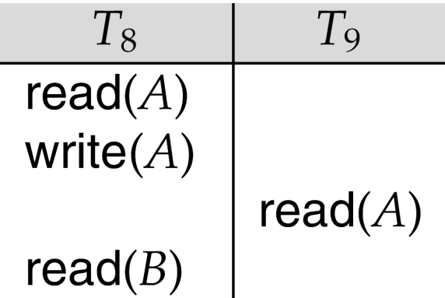
Recoverable Schedules
Need to address the effect of transaction failures on concurrently running transactions.
Recoverable schedule — if a transaction T_{j} reads a data item previously written by a transaction T_{i} , then the commit operation of T_{i} appears before the commit operation of T_{j}.
The following schedule is not recoverable if T₉ commits immediately after the read
If T₈ should abort, T₉ would have read (and possibly shown to the user) an inconsistent database state. Database must ensure that schedules are recoverable

Slide 66

Cascading Rollbacks
Cascading rollback – a single transaction failure leads to a series of transaction rollbacks. Consider the following schedule where none of the transactions has yet committed (so the schedule is recoverable)
If T₁₀ fails, T₁₁ and T₁₂ must also be rolled back
Can lead to the undoing of a significant amount of work!

Slide 67
Cascadeless Schedules
Cascadeless schedules — cascading rollbacks cannot occur if for each pair of transactions T_{i} and T_{j} such that T_{j} reads a data item previously written by T_{i}, the commit operation of T_{i} appears before the read operation of T_{j}.
Every cascadeless schedule is also recoverable
It is desirable to restrict the schedules to those that are cascadeless

Slide 68
Concurrency Control
A database must provide a mechanism that will ensure that all possible schedules are
  either conflict or view serializable, and
  are recoverable and preferably cascadeless
A policy in which only one transaction can execute at a time generates serial schedules, but provides a poor degree of concurrency
  Are serial schedules recoverable/cascadeless?
Testing a schedule for serializability after it has executed is a little too late!
Need conc. control protocols that assure serializability

Slide 69
Concurrency Control vs. Serializability Tests
Concurrency-control protocols allow concurrent schedules, but ensure that the schedules are conflict/view serializable, and are recoverable and cascadeless
Concurrency control protocols generally do not examine the precedence graph as it is being created
  Instead a protocol imposes a discipline that avoids nonseralizable schedules.
  We will talk about such protocols next week
Different concurrency control protocols provide different tradeoffs between the amount of concurrency they allow and the amount of overhead that they incur
Tests for serializability help us understand why a concurrency control protocol is correct

Slide 70
Weak Levels of Consistency
Some applications are willing to live with weak levels of consistency, allowing schedules that are not serializable
  E.g. a read-only transaction that wants to get an approximate total balance of all accounts
  E.g. database statistics computed for query optimization can be approximate.
  Such transactions need not be serializable with respect to other transactions
Tradeoff accuracy for performance

Slide 71
Transaction Definition in SQL
Data manipulation languages include a construct for specifying the set of actions that comprise a transaction.
  In SQL, a transaction begins implicitly
A transaction in SQL ends by:
  Commit commits current transaction + begins a new one
  Rollback causes the current transaction to abort.
In some database systems, by default, every SQL statement also commits implicitly if it executes successfully
  Implicit commit can be turned off by a database directive
    E.g. in JDBC, connection.setAutoCommit(false);

Slide 72
Next Time:
Concurrency control algorithms
Recovery and fault tolerance
Read: Chapter 21: Introduction to Transaction Processing Concepts and Theory
(Assignment 4 to be posted Monday, Feb. 13th)

