Slide 1
CSC 553
Advanced Database Concepts
Lecture 8
Alexander Rasin
College of CDM, DePaul University
February 22nd, 2012

Slide 2
Tonight
HW3 and HW4
More physical design
Transactions and recovery
Distributed Databases

Slide 3
HW3: External Sort
Given
  Relation r of 40 disk blocks
  5 memory blocks
Regular sort
  200 block transfers
How can we improve it?

Slide 4
HW3: Joins
Given
  Relation r that takes 40 blocks
  And relation s that takes 60 blocks
  And 8 memory blocks
BNLJ: 460 regardless of outer/inner choice
Sort r + merge-join s/r: 300 + 100
Sort s + merge-join s/r: 120 + 100
Merge-join s/r: 100

Slide 5
HW3: Join Size Estimation
Given
  Nr = 1000 and V(YearOfBirth, r) = 37
  Ns = 500 and V(Year, s) = 10
Estimate 1:
  1000 * 500 / 37 = 13,514
Estimate 2:
  500 * 1000 / 10 = 50,000
Why is 13,514 a better estimate?

Slide 6
Physical Design
select sum(lo_extendedprice) as revenue
from lineorder, dwdate
where lo_orderdate = d_datekey and d_year = 1993
and lo_discount between 1 and 3 and lo_quantity < 25;
select sum(lo_extendedprice) as revenue
from lineorder, dwdate
where lo_orderdate = d_datekey and d_yearmonth = 'Jan1994'
and lo_discount between 4 and 6 and lo_quantity between 26 and 35;
select sum(lo_extendedprice) as revenue
from lineorder, dwdate
where lo_orderdate = d_datekey and d_weeknuminyear = 6 and d_year = 1994 and lo_discount between 5 and 7 and lo_quantity between 36 and 40;

Slide 7
HW4
CREATE INDEX Q123_INDEX1 ON LINEORDER (lo_extendedprice, lo_orderdate, lo_discount, lo_quantity)
  Does it help?
  Why does performance improve by ~70%?
  Why does it help?
  Can we do better?

Slide 8
HW4
CREATE INDEX Q123_INDEX2 ON LINEORDER (lo_discount, lo_quantity, lo_orderdate, lo_extendedprice)
  Performance improves further
  Where does the improvement come from?
  Is that the best ordering?
What about CREATE INDEX Q123_INDEX2 ON LINEORDER (lo_orderdate, lo_discount, lo_quantity, lo_extendedprice)
Notes:
695 orign (1800 total)

Slide 9
Shared Physical Design
select sum(lo_extendedprice) as revenue
from lineorder, dwdate
where lo_orderdate = d_datekey and d_year = 1993
and lo_discount between 1 and 3 and lo_quantity < 25;
select sum(lo_extendedprice) as revenue
from lineorder, dwdate
where lo_orderdate = d_datekey and d_yearmonth = 'Jan1994'
and lo_discount between 4 and 6 and lo_quantity between 26 and 35;
select sum(lo_extendedprice) as revenue
from lineorder, dwdate
where lo_orderdate = d_datekey and d_weeknuminyear = 6 and d_year = 1994 and lo_discount between 5 and 7 and lo_quantity between 36 and 40;
0.14
0.27
0.5
0.01
0.27
0.20
0.0025
0.14
0.27
0.10

Slide 10
HW4
What about reverse ordering?
CREATE INDEX Q123_INDEX2 ON LINEORDER (lo_quantity, lo_discount, lo_orderdate, lo_extendedprice)
  Trade-off query to query
  Compromise
Notes:
695 orign (1800 total)

Slide 11
HW4
T1: R(X); T3: R(X); T1: W(X); T2: R(X); T3: W(X)
T1: R(X); T3: R(X); T3: W(X); T1: R(X); T2: R(X)
T3: R(X); T2: R(X); T3: W(X); T1: R(X); T1: W(X)
T3: R(X); T2: R(X); T1: R(X); T3: W(X); T1: W(X)

Slide 12
Query Optimization
select c_nation, s_nation, d_year, sum(lo_revenue) as revenue
from customer, lineorder, supplier, dwdate
where lo_custkey = c_custkey
and lo_suppkey = s_suppkey
and lo_orderdate = d_datekey
and c_region = 'ASIA'
and s_region = 'ASIA'
and d_year between 1992 and 1997
group by c_nation, s_nation, d_year
order by d_year asc, revenue asc;

Slide 13
Physical DB Design
select c_nation, s_nation, d_year, sum(lo_revenue) as revenue
from customer, lineorder, supplier, dwdate
where lo_custkey = c_custkey
and lo_suppkey = s_suppkey
and lo_orderdate = d_datekey
and c_region = 'ASIA'
and s_region = 'ASIA'
and d_year between 1992 and 1997
group by c_nation, s_nation, d_year
order by d_year asc, revenue asc;

Slide 14
Timestamp-Based Protocols
Idea:
  Decide in advance ordering of xctions
  Ensure concurrent schedule serializes to serial order decided
Timestamps
  TS(T_{i}) is time T_{i} entered the system
  Data item timestamps:
    W-TS(Q): Largest timestamp of any xction that wrote Q
    R-TS(Q): Largest timestamp of any xction that read Q
Timestamps -> serializability order

Slide 15
Example Use of the Protocol
A partial schedule for several data items for transactions with initial timestamps 1, 2, 3, 4, 5
T₁
T₂
T₃
T₄
T₅
T₆
write(X)
read(Y)
T₇
read(Y)
write(Y)
write(Z)
read(Z)
read(X)
abort
read(Y)
T₈
read(X)
abort
write(Z)
abort
write(Y)
abort
write(Z)
read(X)

Slide 16

Cascading Rollbacks
Cascading rollback – a single transaction failure leads to a series of transaction rollbacks. Consider the following schedule where none of the transactions has yet committed (so the schedule is recoverable)
If T₁₀ fails, T₁₁ and T₁₂ must also be rolled back
Can lead to the undoing of a significant amount of work!

Slide 17
Cascadeless Schedules
Cascadeless schedules — cascading rollbacks cannot occur if for each pair of transactions T_{i} and T_{j} such that T_{j} reads a data item previously written by T_{i}, the commit operation of T_{i} appears before the read operation of T_{j}.
Every cascadeless schedule is also recoverable
It is desirable to restrict the schedules to those that are cascadeless

Slide 18

Crash Recovery

Slide 19
Review: The ACID properties
A tomicity: All actions in the Xaction happen, or none happen.
C onsistency: If each Xaction is consistent, and the DB starts consistent, it ends up consistent.
I solation: Execution of one Xaction is isolated from that of other Xacts.
D urability: If a Xaction commits, its effects persist.
CC guarantees Isolation and Atomicity.
The Recovery Manager guarantees Atomicity & Durability.

Slide 20
Why is recovery system necessary?
Transaction failure :
  Logical errors: application errors (e.g. div by 0, segmentation fault)
  System errors: deadlocks
System crash: hardware/software failure causes the system to crash.
Disk failure: head crash or similar disk failure destroys all or part of disk storage
Lost data can be in main memory or on disk

Slide 21
Recovery Algorithms
Recovery algorithms are techniques to ensure database consistency and transaction atomicity and durability despite failures
Recovery algorithms have two parts
  Actions taken during normal transaction processing to ensure enough information exists to recover from failures
  Actions taken after a failure to recover the database contents to a state that ensures atomicity, consistency and durability

Slide 22
buffer
Buffer Block A
input(A)
X
Buffer Block B
A
Y
output(B)
B
read(X)
write(Y)
x₂
disk
x₁
y₁
work area
of T₁
work area
of T₂
memory

Slide 23
Recovery and Atomicity (Cont.)
To ensure atomicity, first output information about modifications to stable storage without modifying the database itself.
We study two approaches:
  log-based recovery, and
  shadow-paging

Slide 24
Log-Based Recovery
Simplifying assumptions:
  Transactions run serially
  logs are written directly on the stable storage
Log: a sequence of log records; maintains a record of updates on the database. (Write Ahead Log)
Log records for transaction T_{i}:
  <T_{i} start >
  <T_{i} , X, V₁, V₂>
  <T_{i} commit >
Two approaches using logs
  Deferred database modification
  Immediate database modification

Slide 25
Log example
Transaction T1
Read(A)
A =A-50
Write(A)
Read(B)
B = B+50
Write(B)
Log
<T1, start>
<T1, A, 1000, 950>
<T1, B, 2000, 2050>
<T1, commit>

Slide 26
Deferred Database Modification
T_{i} starts: write a <T_{i} start> record to log.
T_{i} write(X)
  write <T_{i}, X, V> to log: V is the new value for X
  The write is deferred
    Note: old value is not needed for this scheme
T_{i} partially commits:
  Write <T_{i} commit> to the log
DB updates by reading and executing the log:
  <T_{i} start> …… <T_{i} commit>

Slide 27
Deferred Database Modification
How to use the log for recovery after a crash?
Redo: if both <T_{i} start> and <T_{i} commit> are in the log
Crashes can occur while
  the transaction is executing the original updates, or
  while recovery action is being taken
example transactions T₀ and T₁ (T₀ executes before T₁):
T₀: read (A) T₁ : read (C)
A: - A - 50 C:- C- 100
Write (A) write (C)
read (B)
B:- B + 50
write (B)

Slide 28
Deferred Database Modification (Cont.)
Below we show the log as it appears at three instances of time.
<T₀, start>
<T₀, A, 950>
<T₀, B, 2050>
(a)
<T₀, start>
<T₀, A, 950>
<T₀, B, 2050>
<T₀, commit>
<T₁, start>
<T₁, C, 600>
(b)
<T₀, start>
<T₀, A, 950>
<T₀, B, 2050>
<T₀, commit>
<T₁, start>
<T₁, C, 600>
<T₁, commit>
(c)
What is the correct recovery action in each case?

Slide 29
Immediate Database Modification
Database updates of an uncommitted transaction are allowed
Tighter logging rules are needed to ensure transaction are undoable
  Write records must be : <T_{i}, X, V_{old}, V_{new} >
  log record must be written before database item is written
  Output of DB blocks can occur:
    Before or after commit
    In any order

Slide 30
Immediate Database Modification (Cont.)
Recovery procedure :
  Undo : <T_{i}, start > is in the log but <T_{i} commit> is not. Undo:
    restore the value of all data items updated by T_{i} to their old values, going backwards from the last log record for T_{i}
  Redo: <T_{i} start> and <T_{i} commit> are both in the log.
    sets the value of all data items updated by T_{i} to the new values, going forward from the first log record for T_{i}

Slide 31
Immediate Database Modification (Cont.)
Recovery procedure :
  Undo : <T_{i}, start > is in the log but <T_{i} commit> is not. Undo:
  Redo: <T_{i} start> and <T_{i} commit> are both in the log.
Both operations must be idempotent:
  even if the operation is executed multiple times the effect is the same as if it is executed once
Undo operations are performed first, then redo operations. Why?

Slide 32
Immediate Database Modification Example
Log Write Output
<T₀ start>
<T₀, A, 1000, 950>
<T_{o}, B, 2000, 2050>
A = 950
B = 2050
<T₀ commit>
<T₁ start>
<T₁, C, 700, 600>
C = 600
B_{C}, B_{B}
<T₁ commit>
B_{A}
Note: B_{X} denotes block containing X.

Slide 33
I M Recovery Example
<T₀, start>
<T₀, A, 1000, 950>
<T₀, B, 2000, 2050>
(a)
<T₀, start>
<T₀, A, 1000, 950>
<T₀, B, 2000, 2050>
<T₀, commit>
<T₁, start>
<T₁, C, 700, 600>
(b)
<T₀, start>
<T₀, A, 1000, 950>
<T₀, B, 2000, 2050>
<T₀, commit>
<T₁, start>
<T₁, C, 700, 600>
<T₁, commit>
(c)
Recovery actions in each case above are:
(a) undo (T₀): B is restored to 2000 and A to 1000.
(b) undo (T₁) and redo (T₀): C is restored to 700, and then A and B are
set to 950 and 2050 respectively.
(c) redo (T₀) and redo (T₁): A and B are set to 950 and 2050
respectively. Then C is set to 600

Slide 34
Checkpoints
Problems in recovery procedure as discussed earlier :
  searching the entire log is time-consuming
  we might unnecessarily redo transactions which have already output their updates to the database.
How to avoid redundant redoes?
  Put marks in the log indicating that at that point DB and log are consistent. Checkpoint!

Slide 35
Checkpoints
At a checkpoint:
Output all log records currently residing in main memory onto stable storage.
Output all modified buffer blocks to the disk
Write a log record <checkpoint> onto stable storage

Slide 36
Checkpoints (Cont.)
  Recovering from log with checkpoints:
  Scan backwards from end of log to find the most recent <checkpoint> record
  Continue scanning backwards till a record <T_{i} start> is found.
  Need only consider the part of log following above start record. Why?
  After that, recover from log with the rules that we had before.

Slide 37
Example of Checkpoints
T_{c}
T_{f}
T₁
T₂
T₃
T₄
checkpoint
checkpoint
system failure
T₁ can be ignored (updates already output to disk due to checkpoint)
T₂ and T₃ redone.
T₄ undone

Slide 38
Shadow Paging
Shadow paging: alternative to log-based recovery; works mainly for serial execution of transactions
Keeps “clean” data (the shadow pages) untouched during transaction (in stable storage)
Writes to a copy of the data
Replace the shadow page only when the transaction is committed and output to the disk

Slide 39
Shadow Paging
Maintain two page tables during the lifetime of a transaction –the current page table, and the shadow page table
Store the shadow page table in nonvolatile storage,
  Shadow page table is never modified during execution
To start with, both the page tables are identical. Only current page table is used for data item accesses during execution of the transaction.
Whenever any page is about to be written for the first time
  A copy of this page is made onto an unused page.
  The current page table is then made to point to the copy
  The update is performed on the copy

Slide 40

Sample Page Table

Slide 41

Example of Shadow Paging
Shadow and current page tables after write to page 4

Slide 42
Shadow Paging
To commit a transaction :
  1. Flush all modified pages in main memory to disk
  2. Output current page table to disk
  3. Make the current page table the new shadow page table, as follows:
    keep a pointer to the shadow page table at a fixed (known) location on disk.
    to make the current page table the new shadow page table, simply update the pointer to point to current page table on disk
  Once pointer to shadow page table has been written, transaction is committed.
No recovery is needed after a crash! — new transactions
can start right away, using the shadow page table.

Slide 43
Shadow Paging
Advantages
  no overhead of writing log records
  recovery is trivial
Disadvantages :
  Copying the entire page table is very expensive
  Data gets fragmented
  Hard to extend for concurrent transactions

Slide 44

A Break!

Slide 45
Recovery With Concurrent Transactions
To permit concurrency:
  All transactions share a single disk buffer and a single log
  Concurrency control: Strict 2PL :i.e. Release eXclusive locks only after commit.
  Logging is done as described earlier.
The checkpointing technique and actions taken on recovery have to be changed
  since several transactions may be active when a checkpoint is performed.

Slide 46
Recovery With Concurrent Transactions (Cont.)
Checkpoints for concurrent transactions:
< checkpoint L>
L: the list of transactions active at the time of the checkpoint
  We assume no updates are in progress while the checkpoint is carried out
Recovery for concurrent transactions, 3 phases:
  Initialize undo-list and redo-list to empty
  Scan the log backwards from the end, stopping when the first <checkpoint L> record is found.
  For each record found during the backward scan:
    if the record is <T_{i} commit>, add T_{i} to redo-list
    if the record is <T_{i} start>, then if T_{i} is not in redo-list, add T_{i} to undo-list
  For every T_{i} in L, if T_{i} is not in redo-list, add T_{i} to undo-list
ANALYSIS

Slide 47
Recovery With Concurrent Transactions
Scan log backwards
  Perform undo(T) for every transaction in undo-list
  Stop when reach <T, start> for every T in undo-list.
Locate the most recent <checkpoint L> record.
  Scan log forwards from the <checkpoint L> record until the end of the log.
  perform redo for each log record that belongs to a transaction on redo-list
UNDO
REDO

Slide 48
Example of Recovery
Redo-list{T3}
Undo-list{T1, T2}
:
<T₀ start>
<T₀, A, 0, 10>
<T₀ commit>
<T₁ start>
<T₁, B, 0, 10>
<T₂ start>
<T₂, C, 0, 10>
<T₂, C, 10, 20>
<checkpoint {T₁, T₂}>
<T₃ start>
<T₃, A, 10, 20>
<T₃, D, 0, 10>
<T₃ commit>
Undo:
Set C to 10
Set C to 0
Set B to 0
Redo:
Set A to 20
Set D to 10
DB A B C D
Initial 0 0 0 0
At crash 20 10 20 10
After rec. 20 0 0 10

Slide 49
Recovery Algorithm
So far: we covered key concepts
Now: we present the components of the basic recovery algorithm

Slide 50
Recovery Algorithm
Logging (during normal operation):
  <T_{i} start> at transaction start
  <T_{i}, X_{j}, V₁, V₂> for each update, and
  <T_{i} commit> at transaction end
Transaction rollback (during normal operation)
  Let T_{i} be the transaction to be rolled back
  Scan log backwards from the end, and for each log record of T_{i} of the form <T_{i}, X_{j}, V₁, V₂>
    perform the undo by writing V₁ to X_{j},
    write a log record <T_{i} , X_{j}, V₁>
  Once the record <T_{i} start> is found stop the scan and write the log record <T_{i} abort>

Slide 51
Recovery Algorithm (Cont.)
Recovery from failure: Two phases
  Redo phase: replay updates of all transactions, whether they committed, aborted, or are incomplete
  Undo phase: undo all incomplete transactions
Redo phase:
  Find last <checkpoint L> record, and set undo-list to L.
  Scan forward from above <checkpoint L> record
    Whenever a record <T_{i}, X_{j}, V₁, V₂> is found, redo it by writing V₂ to X_{j}
    Whenever a log record <T_{i} start> is found, add T_{i} to undo-list
    Whenever a log record <T_{i} commit> or <T_{i} abort> is found, remove T_{i} from undo-list

Slide 52
Recovery Algorithm (Cont.)
Undo phase:
  Scan log backwards from end
    For log record <T_{i}, X_{j}, V₁, V₂> where T_{i} is in undo-list perform same actions as for transaction rollback:
      perform undo by writing V₁ to X_{j}.
      write a log record <T_{i} , X_{j}, V₁>
    Whenever a log record <T_{i} start> is found where T_{i} is in undo-list,
      Write a log record <T_{i} abort>
      Remove T_{i} from undo-list
    Stop when undo-list is empty
      i.e. <T_{i} start> has been found for every transaction in undo-list
After undo phase completes, normal transaction processing can commence

Slide 53

Example of Recovery

Slide 54
Log Record Buffering
Log record buffering: log records are buffered in main memory, instead of being output directly to stable storage.
  Log records are output to stable storage when a block of log records in the buffer is full, or a log force operation is executed.
Log force is performed to commit a transaction by forcing all its log records (including the commit record) to stable storage.
Several log records can thus be output using a single output operation, reducing the I/O cost.

Slide 55
Log Record Buffering (Cont.)
The rules below must be followed if log records are buffered:
  Log records are output to stable storage in the order in which they are created.
  Transaction T_{i} enters the commit state only when the log record
  <T_{i} commit> has been output to stable storage.
  Before a block of data in main memory is output to the database, all log records pertaining to data in that block must have been output to stable storage.
    This rule is called the write-ahead logging or WAL rule

Slide 56
Database Buffering (Cont.)
If a block with uncommitted updates is output to disk, log records with undo information for the updates are output to the log on stable storage first
  (Write ahead logging)
No updates should be in progress on a block when it is output to disk. Can be ensured as follows.
  Before writing a data item, transaction acquires exclusive lock on block containing the data item
  Lock can be released once the write is completed.
To output a block to disk
  First acquire an exclusive lock on the block
  Then perform a log flush
  Then output the block to disk
  Finally release the latch on the block

Slide 57
Failure with Loss of Nonvolatile Storage
So far we assumed no loss of non-volatile storage
Technique similar to checkpointing used to deal with loss of non-volatile storage
  Periodically dump the entire content of the database to stable storage
  No transaction may be active during the dump procedure; a procedure similar to checkpointing must take place
    Output all log records currently residing in main memory onto stable storage.
    Output all buffer blocks onto the disk.
    Copy the contents of the database to stable storage.
    Output a record <dump> to log on stable storage.

Slide 58
Recovering from Failure of Non-Volatile Storage
To recover from disk failure
  restore database from most recent dump.
  Consult the log and redo all transactions that committed after the dump

Slide 59
Definition of DDB/DDBMS
A distributed database (DDB) is a collection of multiple, logically interrelated databases distributed over a computer network
A distributed database management system (DDBMS) is the software that manated DDB and provides an access mechanism that makes this distributio transparent to users

Slide 60
Implicit Assumptions
Data stored at a number of sites (each site logically cosists of a single processor)
Processors at different sites are interconnected by a computer network (ignoring multi-processor systems)
DDBS is a relational database (not a map-reduce-like system, close to HDFS)

Slide 61
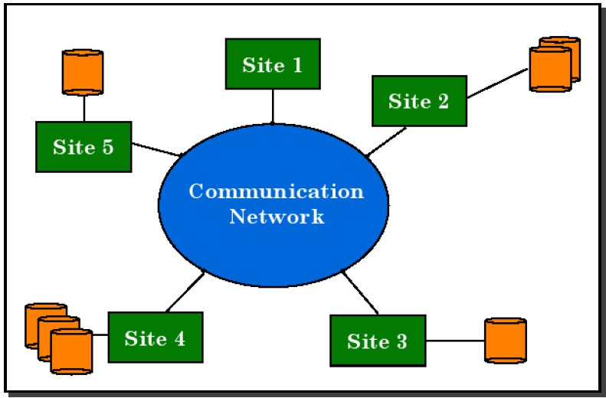

Conceptual DDBS

Slide 62
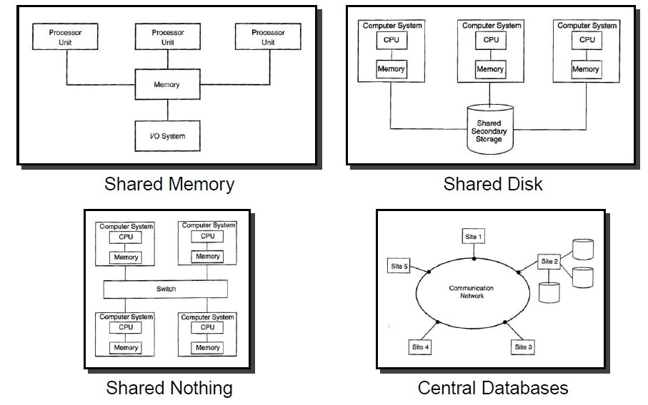

Slide 63
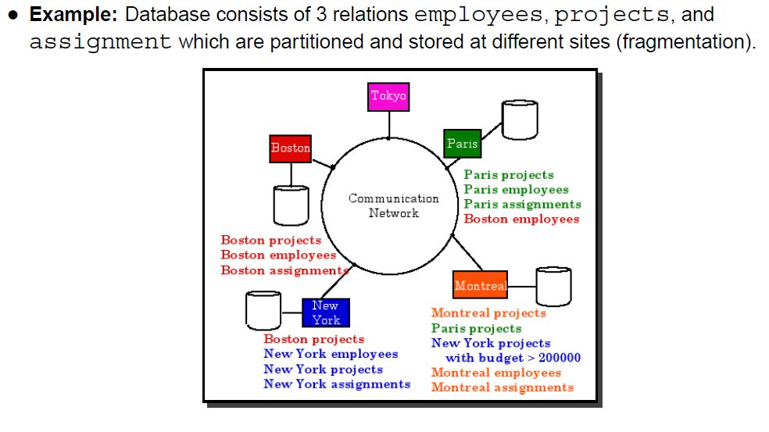
DDBMS
Implications for queries/transactions/concurrency

Slide 64
Higher Reliability
Replication of components
No single point of failure
  Broken communication link
  Machine failure
Distributed transaction processing (hopefully) guarantees the consistency of the database and concurrency

Slide 65
Improved Performance
Proximity of data to point of use
  Remote access delay
  Support for fragmentation (and replication)
Parallelism in execution
  Inter-query parallelism
  Intra-query parallelism
Scaling
Replication
  If mostly read-only: replicate as much as possible
  Writing becomes complex with replicated data

Slide 66
Query Optimization: Decision
Centralized
  Single site determines the “best” answer
  Full database knowledge is needed
Distributed
  Multiple sites cooperate to make decisions
  Only local info is needed
  Overhead cost/inaccuracies
Hybrid
  One site (any) determines the global execution
  Each site optimizes the local sub-query

Slide 67
Distributed Cost Model
Two different approaches
Reduce total time
  Improve every cost component, i.e. minimize the amount of work
  Optimize the utilization of resources (throughput)
Reduce response time
  Increase parallelization as much as possible
  May increase total cost

Slide 68
Distributed Cost Model
Total time: Transfer_{x} + Transfer_{y}
Response time: Max(Transfer_{x} + Transfer_{y})
SITE 1
X Blocks
SITE 3
SITE 1
Y Blocks

Slide 69
Database Statistics
Size of intermediate relations
  Major cost factor
  Particularly because of possible over the network transfers (expensive)
Computing size of intermediate relations accurately is very hard
Instead compute fragment statistics and approximate overall statistics

Slide 70
Database Statistics
Let R(A₁, A₂, … A_{k}) be a relation fragmented into R₁, R₂, … R_{r}
Relation statistics
  Min and max values of each attr: min{A_{i}}, max{A_{i}}
  Length of each attr: length(A_{i})
  Distinct values in each attr: card(A_{i}), card(dom(A_{i}))
Fragment statistics
  Cardinality of the fragment: card(R_{i})
  Card. of each attr in each fragment: card(π_{Ai}(R_{j}))

Slide 71
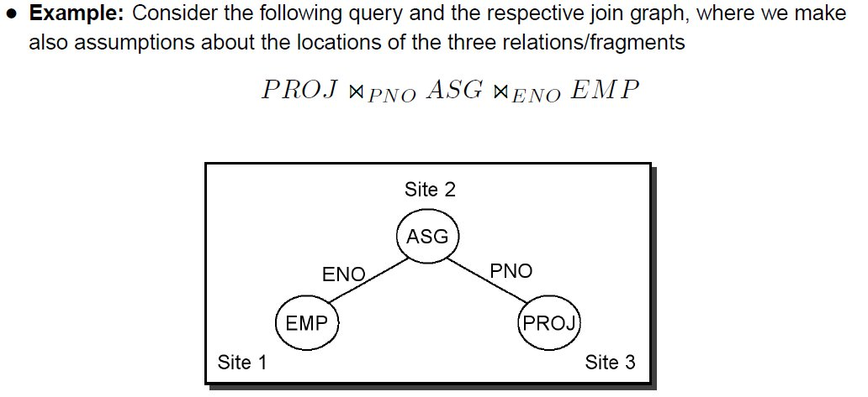
Distributed Join

Slide 72
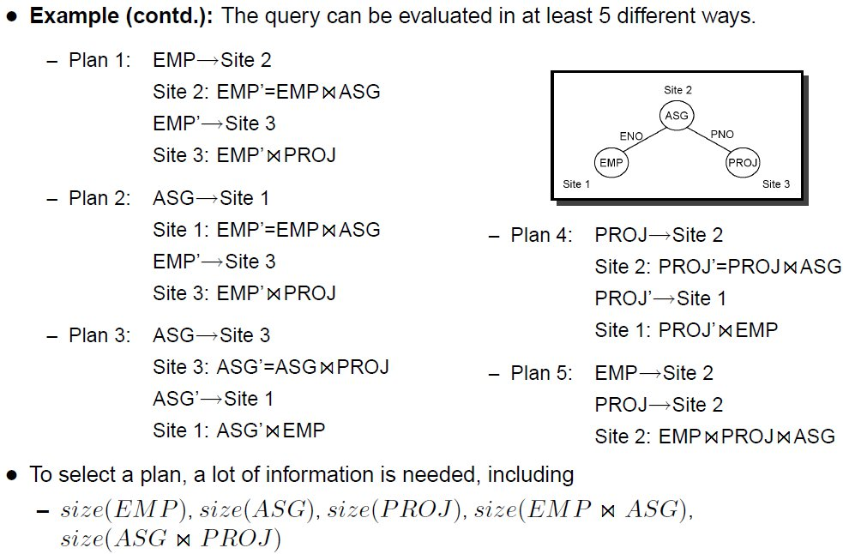
Distributed Join (cont.)

Slide 73
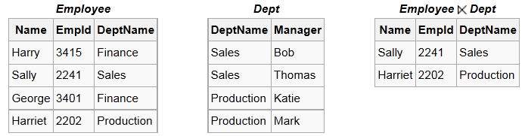
Semijoin to the Rescue
Semijoin (⋉) can be used to efficiently implement joins
  Allows us to reduce the size of transferred data
Semijoin:

Slide 74
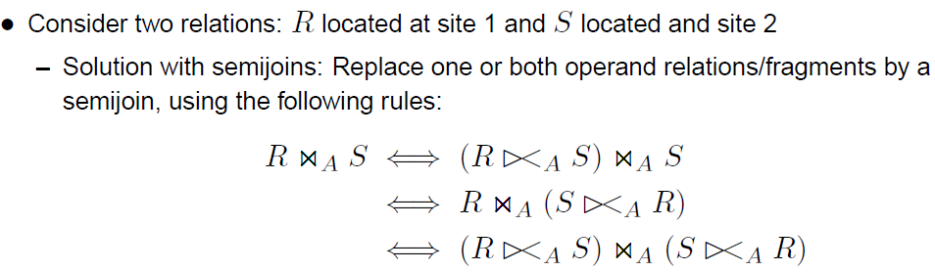
Semijoin (cont.)
Beneficial if relatively few things join
  List of “what matched”

Slide 75
Next Time:
Physical design (MVs)
Distributed databases and high availability
Streaming databases/Column Stores
Read: Chapter 23: Recovery Techniques
(Assignment 5 posted by tomorrow, due February 29th)

