Slide 1
CSC 553
Advanced Database Concepts
Lecture 9
Alexander Rasin
College of CDM, DePaul University
February 29nd, 2012

Slide 2
Tonight
Physical design
Distributed Query Processing/High availability
Streaming Databases

Slide 3
Evaluation Time
Please fill out evaluation forms
http://my.cdm.depaul.edu/myCDM

Slide 4
Query Optimization
select c_nation, s_nation, d_year, sum(lo_revenue) as revenue
from customer, lineorder, supplier, dwdate
where lo_custkey = c_custkey
and lo_suppkey = s_suppkey
and lo_orderdate = d_datekey
and c_region = 'ASIA'
and s_region = 'ASIA'
and d_year between 1992 and 1997
group by c_nation, s_nation, d_year
order by d_year asc, revenue asc;

Slide 5
Physical DB Design
select c_nation, s_nation, d_year, sum(lo_revenue) as revenue
from customer, lineorder, supplier, dwdate
where lo_custkey = c_custkey
and lo_suppkey = s_suppkey
and lo_orderdate = d_datekey
and c_region = 'ASIA'
and s_region = 'ASIA'
and d_year between 1992 and 1997
group by c_nation, s_nation, d_year
order by d_year asc, revenue asc;

Slide 6
Parallelism in Databases
Data can be partitioned across multiple disks for parallel I/O
Individual relational operations (e.g., sort, join, aggregation) can be executed in parallel
  data can be partitioned and each processor can work independently on its own partition.
Queries are expressed in high level language (SQL, translated to relational algebra)
  makes parallelization easier.
Different queries can be run in parallel with each other. (Concurrency control takes care of conflicts)

Slide 7
I/O Parallelism
Reduce the time required to retrieve relations from disk by partitioning the relations on multiple disks
Horizontal partitioning – tuples of a relation are divided among disks
Partitioning techniques (number of disks = n):
  Round-robin:
    Send the i^{th} tuple inserted in the relation to disk i mod n.
  Hash partitioning:
  Choose one or more attributes as the partitioning attributes.
  Choose hash function h with range 0…n - 1
  Send tuple to disk i, where has function produces “i”

Slide 8
I/O Parallelism (Cont.)
Partitioning techniques (cont.):
Range partitioning:
  Choose an attribute as the partitioning attribute.
  A partitioning vector [v_{o}, v₁, ..., v_{n-2}] is chosen.
  Let v be the partitioning attribute value of a tuple. Tuples such that v_{i} ≤ v_{i+1} go to disk I + 1. Tuples with v < v₀ go to disk 0 and tuples with v ≥ v_{n-2} go to disk n-1.
  E.g., with a partitioning vector [5,11], a tuple with partitioning attribute value of 2 will go to disk 0, a tuple with value 8 will go to disk 1, while a tuple with value 20 will go to disk2.

Slide 9
Comparison of Partitioning Techniques
Evaluate how well partitioning techniques support the following types of data access:
1. Scanning the entire relation.
2. Locating a tuple – point queries.
  E.g., r.A = 25.
3. Locating all tuples such that the value of a given attribute lies within a specified range – range queries.
  E.g., 10 ≤ r.A < 25.

Slide 10
Comparison of Partitioning Techniques (Cont.)
Round robin:
Advantages
  Best suited for sequential scan of entire relation on each query.
  All disks have almost an equal number of tuples; retrieval work is thus well balanced between disks.
Range queries are difficult to process
  No clustering -- tuples are scattered across all disks

Slide 11
Comparison of Partitioning Techniques(Cont.)
Hash partitioning:
Good for sequential access
  Assuming hash function is good, and partitioning attributes are good, tuples will be equally distributed
  Retrieval work is then well balanced between disks
Good for point queries on partitioning attribute
  Can lookup single disk, leaving others available for answering other queries.
  Index on partitioning attribute can be local to disk, making lookup and update more efficient
No clustering, so difficult to answer range queries

Slide 12
Comparison of Partitioning Techniques (Cont.)
Range partitioning
  Provides data clustering by partitioning attribute value
  Good for sequential access
  Good for point queries on partitioning attribute: only one disk needs to be accessed.
For range queries on partitioning attribute, one to a few disks may need to be accessed
  Remaining disks are available for other queries.
  Good if result tuples are from one to a few blocks.
  If many blocks are to be fetched, they are still fetched from one to a few disks, and potential parallelism in disk access is wasted
    Example of execution skew

Slide 13
Partitioning a Relation across Disks
If a relation contains only a few tuples which will fit into a single disk block, then assign the relation to a single disk.
Large relations are preferably partitioned across all the available disks.
If a relation consists of m disk blocks and there are n disks available in the system, then the relation should be allocated min(m,n) disks.

Slide 14
Handling of Skew
The distribution of tuples to disks may be skewed — that is, some disks have many tuples, while others may have fewer tuples
Types of skew:
  Attribute-value skew.
    Some values appear in the partitioning attributes of many tuples; all the tuples with the same value for the partitioning attribute end up in the same partition
    Can occur with range-partitioning and hash-partitioning
  Partition skew.
    With range-partitioning, badly chosen partition vector may assign too many tuples to some partitions and too few to others
    Less likely with hash-partitioning if a good hash-function is chosen

Slide 15
Interquery Parallelism
Queries/transactions execute in parallel with one another.
Increases transaction throughput; used primarily to scale up a transaction processing system to support a larger number of transactions per second
Easiest form of parallelism to support, particularly in a shared-memory parallel database, because even sequential database systems support concurrent processing.
More complicated to implement on shared-disk or shared-nothing architectures
  Locking and logging must be coordinated by passing messages between processors.
  Data in a local buffer may have been updated at another processor.
  Cache-coherency has to be maintained — reads and writes of data in buffer must find latest version of data.

Slide 16
Intraquery Parallelism
Execution of a single query in parallel on multiple processors/disks; important for speeding up long-running queries.
Two complementary forms of intraquery parallelism
  Intraoperation Parallelism – parallelize the execution of each individual operation in the query.
  Interoperation Parallelism – execute the different operations in a query expression in parallel.
the first form scales better with increasing parallelism because the number of tuples processed by each operation is typically more than the number of operations in a query

Slide 17
Parallel Processing of Relational Operations
Our discussion of parallel algorithms assumes:
  read-only queries
  shared-nothing architecture
  n processors, P₀, ..., P_{n-1}, and n disks D₀, ..., D_{n-1}, where disk D_{i} is associated with processor P_{i}.
Shared-nothing architectures can be simulated on shared-memory and shared-disk systems
N processors may be viewed as N machines connected by local area network

Slide 18
Parallel Sort
Range-Partitioning Sort
Choose processors P₀, ..., P_{m} to do sorting
Create range-partition on the sorting attributes
Redistribute the relation using range partitioning
  all tuples that lie in the i^{th} range are sent to processor P_{i}
  This step requires I/O and communication overhead.
Each processor P_{i} sorts its partition locally
Each processor executes same operation without any interaction with the others (data parallelism).
Final merge operation is trivial (overheads)

Slide 19
Parallel Sort (Cont.)
Parallel External Sort-Merge
Assume the relation has already been partitioned among disks D₀, ..., D_{n-1}
Each processor P_{i} locally sorts the data on disk D_{i}.
The sorted runs on each processor are then merged to get the final sorted output.
Parallelize the merging of sorted runs as follows:
  The sorted partitions at each processor P_{i} are range-partitioned across the processors P₀, ..., P_{m-1}.
  Each processor P_{i} performs a merge on the streams as they are received, to get a single sorted run.
  The sorted runs on processors P₀,..., P_{m-1} are concatenated to get the final result.

Slide 20
Parallel Join
The join operation requires pairs of tuples to be tested to see if they satisfy the join condition, and if they do, the pair is added to the join output
Parallel join algorithms split the pairs to be tested over several processors. Each processor then computes part of the join locally
In a final step, the results from each processor can be collected together to produce the final result.

Slide 21
Partitioned Join
For equi- and natural joins, partition the input relations across the processors, and compute the join locally
Let r and s be the input relations, and we want to compute r _{r.A=s.B} s
r and s each are partitioned into n partitions, denoted r₀, r₁, ..., r_{n-1} and s₀, s₁, ..., s_{n-1}
Can use either range or hash partitioning
r and s must be partitioned on their join attributes r.A and s.B, using the same partitioning mechanism
Partitions r_{i} and s_{i} are sent to processor P_{i}
Each processor P_{i} locally computes r_{i} _{ri.A=si.B} s_{i}

Slide 22
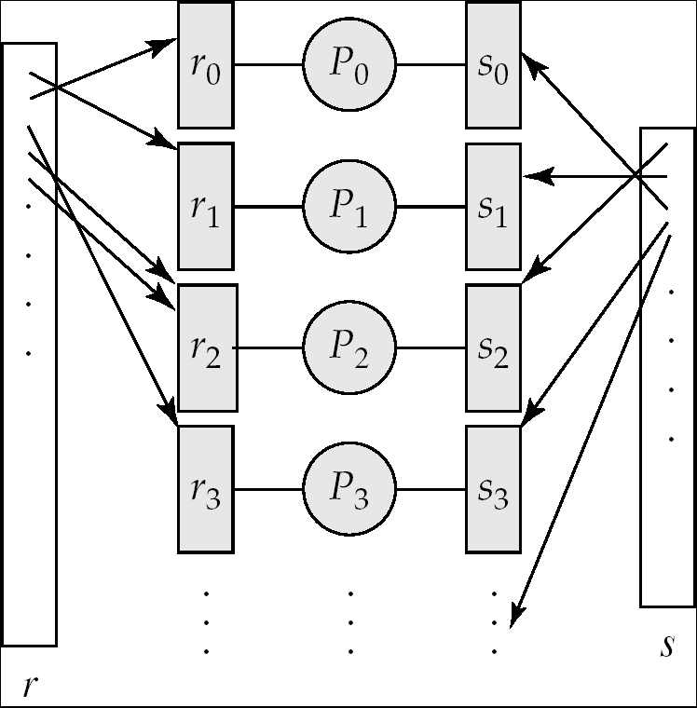
Partitioned Join (Cont.)

Slide 23
Fragment-and-Replicate Join
Partitioning not possible for some join conditions
  e.g., non-equijoin conditions, such as r.A > s.B.
For joins where partitioning is not applicable, parallelization can be accomplished by fragment and replicate technique
  Very typical in data warehousing
  Large fact table + small dimension tables!
Special case – asymmetric fragment-and-replicate:
  One of the relations, say r, is partitioned; any partitioning technique can be used.
  The other relation, s, is replicated across all the processors.
  Processor P_{i} then locally computes the join of r_{i} with all of s using any join technique.

Slide 24
Parallel Nested-Loop Join
Assume that
  relation s is much smaller than relation r and that r is stored by partitioning.
  there is an index on a join attribute of relation r at each of the partitions of relation r.
Each processor P_{j} where a partition of relation s is stored reads the tuples of relation s stored in D_{j}, and replicates the tuples to every other processor P_{i}.
  At the end of this phase, relation s is replicated at all sites that store tuples of relation r.
Each processor P_{i} performs an indexed nested-loop join of relation s with the i^{th} partition of relation r.

Slide 25
Other Relational Operations
Selection σ_{θ}(r)
If θ is of the form a_{i} = v, where a_{i} is an attribute and v a value
  If r is partitioned on a_{i} the selection is performed at a single processor
If θ is of the form l <= a_{i} <= u (i.e., θ is a range selection) and the relation has been range-partitioned on a_{i}
  Selection is performed at each processor whose partition overlaps with the specified range of values
In all other cases: the selection is performed in parallel at all the processors

Slide 26
Other Relational Operations (Cont.)
Duplicate elimination
  Perform by using either of the parallel sort techniques
    eliminate duplicates as soon as they are found during sorting
  Can also partition the tuples (using either range- or hash- partitioning) and perform duplicate elimination locally at each processor
Projection
  Projection without duplicate elimination can be performed as tuples are read in from disk in parallel
  If duplicate elimination is required, any of the above duplicate elimination techniques can be used

Slide 27
Grouping/Aggregation
Partition the relation on the grouping attributes and then compute the aggregate values locally
Reduce cost of transferring tuples during partitioning by pre-computing aggregate values
Consider the sum aggregation operation:
  Perform aggregation operation at each processor P_{i} on those tuples stored on disk D_{i}
    results in tuples with partial sums at each processor
  Result of the local aggregation is partitioned on the grouping attributes, and the aggregation performed again at each processor P_{i} to get the final result
Fewer tuples need to be sent during partitioning

Slide 28
Interoperator Parallelism
Pipelined parallelism
  Consider a join of four relations
    r₁ r₂ r₃ r₄
  Set up a pipeline that computes the three joins in parallel
    Let P1 be assigned the computation of
    temp1 = r₁ r₂
    And P2 be assigned the computation of temp2 = temp1 r₃
    And P3 be assigned the computation of temp2 r₄
  Each of these operations can execute in parallel, sending result tuples it computes to the next operation even as it is computing further results
    Provided a pipelineable join evaluation algorithm (e.g. indexed nested loops join) is used

Slide 29
Distributed Database System
A distributed database system consists of loosely coupled sites that share no physical component
Database systems that run on each site are independent of each other
Transactions may access data at one or more sites

Slide 30
Data Replication
A relation or fragment of a relation is replicated if it is stored redundantly in two or more sites
Full replication of a relation is the case where the relation is stored at all sites
Fully redundant databases are those in which every site contains a copy of the entire database

Slide 31
Data Replication (Cont.)
Advantages of Replication
  Availability: failure of site containing relation r does not result in unavailability of r is replicas exist
  Parallelism: queries processed by several nodes in parallel
  Reduced data transfer: relation r is available locally at each site containing a replica of r
Disadvantages of Replication
  Cost of updates: each replica of relation r must be updated
  Increased complexity of concurrency control
    One solution: choose one copy as primary copy and apply concurrency control operations on primary copy

Slide 32
Data Fragmentation
Division of relation r into fragments r₁, r₂, …, r_{n} which are sufficient to reconstruct relation r
Horizontal fragmentation: each tuple of r is assigned to one or more fragments
Vertical fragmentation: the schema for relation r is split into several smaller schemas
  All schemas must contain a common candidate key (or superkey) to ensure lossless join property.
  A special attribute, the tuple-id attribute may be added to each schema to serve as a candidate key.
Example : relation account with following schema
Account = (account_number, branch_name, balance )

Slide 33
Horizontal Fragmentation of account Relation
account_number
branch_name
balance
A-305
A-226
A-155
Hillside
Hillside
Hillside
500
336
62
account₁ = σ_{branch_name=“Hillside”} (account )
account_number
branch_name
balance
A-177
A-402
A-408
A-639
Valleyview
Valleyview
Valleyview
Valleyview
205
10000
1123
750
account₂ = σ_{branch_name=“Valleyview”} (account )

Slide 34
Vertical Fragmentation of employee_info Relation
branch_name
customer_name
tuple_id
Hillside
Hillside
Valleyview
Valleyview
Hillside
Valleyview
Valleyview
Lowman
Camp
Camp
Kahn
Kahn
Kahn
Green
1
2
3
4
5
6
7
deposit₁ = Πbranch_name, customer_name, tuple_id (employee_info )
account_number
balance
tuple_id
A-305
A-226
A-177
A-402
A-155
A-408
A-639
500
336
205
10000
62
1123
750
1
2
3
4
5
6
7
deposit₂ = Πaccount_number, balance, tuple_id (employee_info )

Slide 35
Advantages of Fragmentation
Horizontal:
  allows parallel processing on fragments of a relation
  allows a relation to be split so that tuples are located where they are most frequently accessed
Vertical:
  allows tuples to be split so that each part of the tuple is stored where it is most frequently accessed
  tuple-id attribute allows efficient joining of vertical fragments
Vertical and horizontal fragmentation can be mixed.
Replication and fragmentation can be combined

Slide 36
Data Transparency
Data transparency: Degree to which system user may remain unaware of the details of how and where the data items are stored in a distributed system
Naming of data items: criteria
  Every data item must have a system-wide unique name.
  It should be possible to find the location of data items efficiently.
  It should be possible to change the location of data items transparently.
  Each site should be able to create new data items autonomously.

Slide 37
Centralized Scheme - Name Server
Structure:
  name server assigns all names
  each site maintains a record of local data items
  sites ask name server to locate non-local data
Advantages
  satisfies naming criteria 1-3
Disadvantages
  does not satisfy naming criterion 4
  name server is a performance bottleneck
  name server is a single point of failure

Slide 38
Use of Aliases
Alternative to centralized scheme: each site prefixes its own site identifier to any name that it generates i.e., site 17.account.
  Fulfills having a unique identifier, and avoids problems associated with central control.
  However, fails to achieve network transparency.
Solution: Create a set of aliases for data items; Store the mapping of aliases to the real names at each site.
The user can be unaware of the physical location of a data item, and is unaffected if the data item is moved from one site to another.

Slide 39
Distributed Transactions
Transaction may access data at several sites.
Each site has a local transaction manager for
  Maintaining a log for recovery purposes
  Participating in coordinating the concurrent execution of the transactions executing at that site.
Each site has a transaction coordinator for
  Starting the transactions that originate at the site.
  Distributing sub-transactions at appropriate sites
  Coordinating the termination of each transaction that originates at the site, which may result in the transaction being committed at all sites or aborted at all sites.

Slide 40
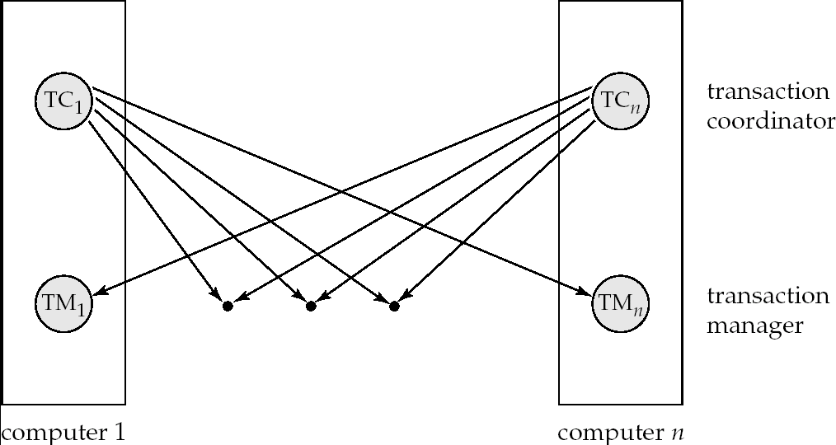
Transaction System Architecture

Slide 41
System Failure Modes
Failures unique to distributed systems:
  Failure of a site
  Loss of messages
    Handled by network transmission control protocols such as TCP-IP
  Failure of a communication link
    Handled by network protocols, by routing via alternative links
  Network partition
    A network is said to be partitioned when it has been split into two or more subsystems that lack any connection between them
      Note: a subsystem may consist of a single node
Network partitioning and site failures are generally indistinguishable

Slide 42
Commit Protocols
Commit protocols are used to ensure atomicity across sites
  a transaction which executes at multiple sites must either be committed at all the sites, or aborted at all the sites.
  not acceptable to have a transaction committed at one site and aborted at another
The two-phase commit (2PC) protocol is widely used
The three-phase commit (3PC) protocol is more complicated and more expensive, but avoids some drawbacks of two-phase commit protocol. This protocol is not used in practice.

Slide 43
Two Phase Commit Protocol (2PC)
Assumes fail-stop model – failed sites simply stop working, and do not cause any other harm, such as sending incorrect messages
Execution of the protocol is initiated by the coordinator after the last step of the transaction has been reached.
The protocol involves all the local sites at which the transaction executed
Let T be a transaction initiated at site S_{i}, and let the transaction coordinator at S_{i} be C_{i}

Slide 44



Why Fail-Stop Model?

Slide 45
Phase 1: Obtaining a Decision
Coordinator asks all participants to prepare to commit transaction T_{i}.
  C_{i} adds the records <prepare T> to the log and forces log to stable storage
  sends prepare T messages to all sites at which T executed
Upon receiving message, transaction manager at site determines if it can commit the transaction
  if not, add a record <no T> to the log and send abort T message to C_{i}
  if the transaction can be committed, then:
  add the record <ready T> to the log
  force all records for T to stable storage
  send ready T message to C_{i}

Slide 46
Phase 2: Recording the Decision
T can be committed of C_{i} received a ready T message from all the participating sites: otherwise T must be aborted.
Coordinator adds a decision record, <commit T> or <abort T>, to the log and forces record onto stable storage. Once the record stable storage it is irrevocable (even if failures occur)
Coordinator sends a message to each participant informing it of the decision (commit or abort)
Participants take appropriate action locally

Slide 47
Handling of Failures - Site Failure
When site S_{i} recovers, it examines log to determine the fate of transactions active at the time of the failure
Log contains <commit T> record: site executes redo(T)
Log contains <abort T> record: site executes undo (T)
Log contains <ready T> record: site must consult C_{i} to determine the fate of T.
  If T committed, redo (T)
  If T aborted, undo (T)
The log contains no control records concerning T
  implies that S_{k} failed before responding to the prepare T message from C_{i}
  S_{k} must execute undo (T)

Slide 48
Handling of Failures - Network Partition
If the coordinator and all participants remain in one partition, failure has no effect on the commit protocol
If the coordinator and its participants belong to several partitions:
  Sites that are not in the partition containing the coordinator think the coordinator has failed, and execute the protocol to deal with failure of the coordinator.
    No harm results
The coordinator and the sites are in the same partition as the coordinator think that the sites in the other partition have failed, and follow the usual protocol
    Again, no harm results

Slide 49
Alternative Models of Transaction Processing
Single transaction spanning multiple sites is inappropriate for many applications
  E.g. transaction crossing organizational boundary
  No organization would like to permit an externally initiated transaction to block local transactions for an indeterminate period
Alternative models carry out transactions by sending messages
  Code to handle messages must be designed to ensure atomicity and durability for updates
    Isolation cannot be guaranteed
    must ensure no inconsistent states result due to concurrency

Slide 50
Alternative Models (Cont.)
Motivating example: transfer between two banks
  Two phase commit would have the potential to block updates on the accounts involved in funds transfer
  Alternative solution:
    Debit money from source account and send a message to other site
    Site receives message and credits destination account
  Messaging has long been used for distributed transactions (even before computers were invented!)
Atomicity issue
  once transaction sending a message is committed, message must guaranteed to be delivered
    Guarantee as long as destination site is up and reachable, code to handle undeliverable messages must also be available
      e.g. credit money back to source account.
  If sending transaction aborts, message must not be sent

Slide 51
Concurrency Control
Modify concurrency control schemes for use in distributed environment.
We assume that each site participates in the execution of a commit protocol to ensure global transaction automicity.
We assume all replicas of any item are updated
  Will see how to relax this in case of site failures later

Slide 52
Single-Lock-Manager Approach
System maintains a single lock manager that resides in a single chosen site, say S_{i}
When a transaction needs to lock a data item, it sends a lock request to S_{i} and lock manager determines whether the lock can be granted immediately
  If yes, lock manager sends a message to the site which initiated the request
  If no, request is delayed until it can be granted; then a message is sent to the initiating site

Slide 53
Single-Lock-Manager Approach (Cont.)
The transaction can read the data item from any one of the sites at which a replica of the data item resides.
Writes must be performed on all replicas of a data item
Advantages of scheme:
  Simple implementation
  Simple deadlock handling
Disadvantages of scheme are:
  Bottleneck: lock manager site becomes a bottleneck
  Vulnerability: system is vulnerable to manager site failure

Slide 54

BREAK

Slide 55
Distributed Lock Manager
In this approach, functionality of locking is implemented by lock managers at each site
  Lock managers control access to local data items
Advantage: work is distributed and can be made robust to failures
Disadvantage: deadlock detection is more complicated
  Lock managers cooperate for deadlock detection
Several variants of this approach
  Primary copy
  Majority protocol
  Biased protocol
  Quorum consensus

Slide 56
Primary Copy
Choose one replica of data to be the primary copy
  Site containing the replica is called the primary site for that data item
  Different data items can have different primary sites
When a transaction needs to lock a data item Q, it requests a lock at the primary site of Q.
  Implicitly gets lock on all replicas of the data item
Benefit
  Concurrency control for replicated data handled similarly to unreplicated data - simple implementation.
Drawback
  If the primary site of Q fails, Q is inaccessible even though other sites containing a replica may be accessible.

Slide 57
Majority Protocol
Local lock manager at each site administers lock and unlock requests for data items stored at that site.
When a transaction wishes to lock an unreplicated data item Q residing at site S_{i}, a message is sent to S_{i} ‘s lock manager.
  If Q is locked in an incompatible mode, then the request is delayed until it can be granted.
  When the lock request can be granted, the lock manager sends a message back to the initiator indicating that the lock request has been granted.

Slide 58
Majority Protocol (Cont.)
In case of replicated data
  If Q is replicated at n sites, then a lock request message must be sent to more than half of the n sites in which Q is stored.
  The transaction does not operate on Q until it has obtained a lock on a majority of the replicas of Q.
  When writing the data item, transaction performs writes on all replicas.
Benefit
  Can be used even when some sites are unavailable
Drawback
  Requires 2(n/2 + 1) messages for handling lock requests, and (n/2 + 1) messages for handling unlock requests.
  Potential for deadlock even with single item - e.g., each of 3 transactions may have locks on 1/3rd of the replicas of a data.

Slide 59
Biased Protocol
Local lock manager at each site as in majority protocol, however, requests for shared locks are handled differently than requests for exclusive locks.
Shared locks. When a transaction needs to lock data item Q, it simply requests a lock on Q from the lock manager at one site containing a replica of Q.
Exclusive locks. When transaction needs to lock data item Q, it requests a lock on Q from the lock manager at all sites containing a replica of Q.
Advantage - less overhead on read operations.
Disadvantage - additional overhead on writes

Slide 60
Quorum Consensus Protocol
A generalization of majority and biased protocols
Each site is assigned a weight.
  Let S be the total of all site weights
Choose two values read quorum Q_{r} and write quorum Q_{w}
  Such that Q_{r} + Q_{w} > S and 2 * Q_{w} > S
  Quorums can be chosen separately for each item
Each read must lock enough replicas that the sum of the site weights is >= Q_{r}
Each write must lock enough replicas that the sum of the site weights is >= Q_{w}

Slide 61
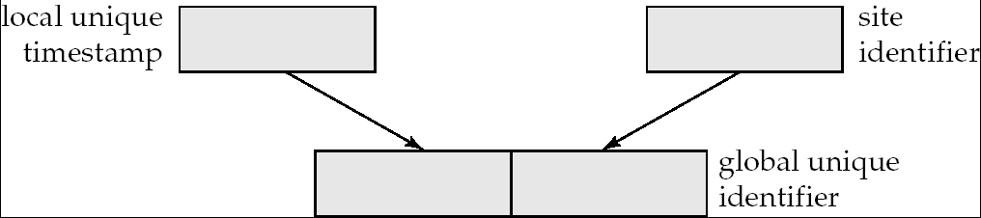
Timestamping
Timestamp based concurrency-control protocols can be used in distributed systems
Each transaction must be given a unique timestamp
How to generate a TS in a distributed fashion?
  Each site generates a unique local timestamp using either a logical counter or the local clock.
  Global unique timestamp is obtained by concatenating the unique local timestamp with the unique identifier.

Slide 62
Timestamping (Cont.)
A site with a slow clock will assign smaller timestamps
  Still logically correct: serializability not affected
  But: “disadvantages” transactions
To fix this problem
  Define within each site S_{i} a logical clock (LC_{i}), which generates the unique local timestamp
  Require that S_{i} advance its logical clock whenever a request is received from a transaction Ti with timestamp < x,y> and x is greater that the current value of LC_{i}.
  In this case, site S_{i} advances its logical clock to the value x + 1.

Slide 63
Replication with Weak Consistency
Many commercial databases support replication of data with weak degrees of consistency (I.e., without a guarantee of serializabiliy)
  Master-slave replication: updates are performed at a “master” site, and propagated to “slave” sites
  Propagation is decoupled from the update transaction
    May be immediately after transaction commits
    May be periodic
  Data may only be read at slave sites, not updated
    No need to obtain locks at any remote site
  Particularly useful for distributing information
    E.g. from central office to branch-office
  Also useful for running read-only queries offline from the main database

Slide 64
Replication with Weak Consistency (Cont.)
Replicas should see a transaction-consistent snapshot of the database
  That is, a state of the database reflecting all effects of all transactions up to some point in the serialization order, and no effects of any later transactions.
E.g. Oracle provides a create snapshot statement to create a snapshot of a relation or a set of relations at a remote site
  snapshot refresh either by recomputation or by incremental update
  Automatic refresh (continuous or periodic) or manual refresh

Slide 65
Deadlock Handling
Consider the following two transactions and history, with item X and transaction T₁ at site 1, and item Y and transaction T₂ at site 2:
T₁: write (X)
write (Y)
T₂: write (Y)
write (X)
X-lock on X
write (X)
X-lock on Y
write (Y)
wait for X-lock on X
Wait for X-lock on Y
Result: deadlock which cannot be detected locally at either site

Slide 66
Centralized Approach
A global wait-for graph is constructed in a single site; the deadlock-detection coordinator
  Real graph: Real, but unknown, state of the system.
  Constructed graph:Approximation generated by the controller during the execution of its algorithm .
the global wait-for graph can be constructed when:
  a new change occurs in a local wait-for graph
  the coordinator needs to invoke cycle-detection.
If the coordinator finds a cycle, it selects a victim and notifies all sites. The sites roll back the victim transaction

Slide 67
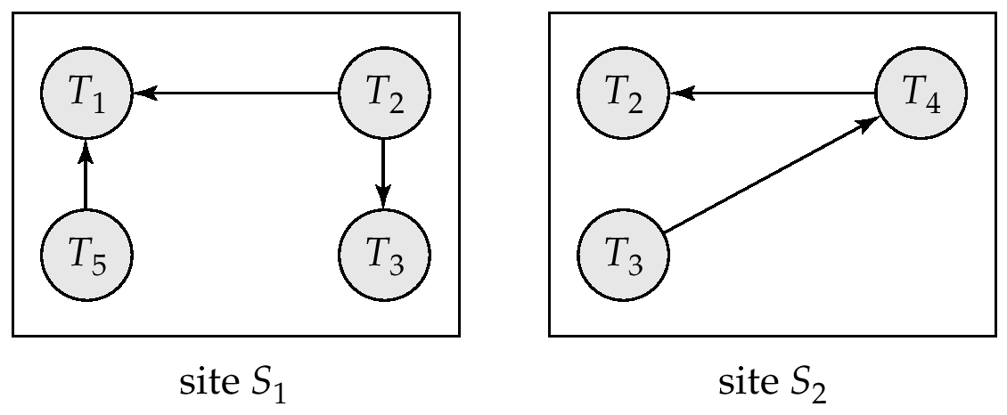
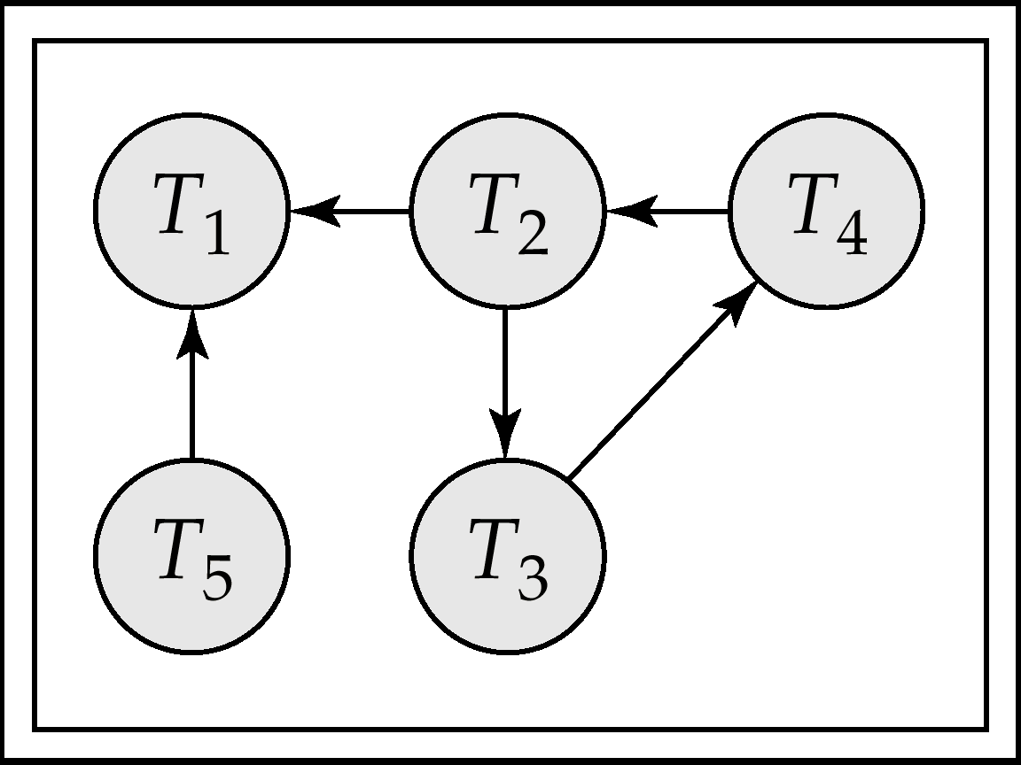
Local and Global Wait-For Graphs
Local
Global

Slide 68
Availability
High availability: time for which system is not usable should be extremely low (e.g. 99.999% availability)
Robustness: ability of system to function despite failures of components
Failures are more likely in large distributed systems
To be robust, a distributed system must
  Detect failures
  Reconfigure the system so computation may continue
  Recovery/reintegration when a site or link is repaired
Failure detection: distinguishing link failure from site failure is hard
  Heartbeat

Slide 69
Reconfiguration
Reconfiguration:
  Abort transactions that were active at a failed site
    Making them wait could interfere with other transactions since they may hold locks on other sites
  If replicated data items were at failed site, update system catalog to remove from list of replicas
    This should be reversed when failed site recovers, but have to be careful bringing values up to date
  If a failed site was a central server for some subsystem, an election is held to replace it
    E.g. name server, concurrency coordinator, global deadlock detector

Slide 70
Reconfiguration (Cont.)
Since network partition may not be distinguishable from site failure, the following situations must be avoided
  Two central servers elected in distinct partitions
  More than one partition updates a replicated data
Updates must be able to continue even if some sites are down
Solution: majority based approach

Slide 71
Site Reintegration
When failed site recovers, it must catch up with all updates that it missed while down
  Problem: updates may be happening to items whose replica is stored at the site while the site is recovering
  Solution 1: halt all updates on system while reintegrating a site
    Unacceptable disruption
  Solution 2: lock all replicas of all data items at the site, update to latest version, then release locks

Slide 72

Streaming Databases

Slide 73
Data-Stream Management
Traditional DBMS
  Data stored in finite, persistent data sets
Data streams
  Distributed, continuous, unbounded, time-varying
Data-Stream Management
  Network monitoring
  Data security
  Sensor network
  Financial applications

Slide 74
Stream Databases for Network Measurements
Continuing need to measure and monitor networks
  Router configuration, debugging, detect network attacks, verify service agreements, ….
Very large amounts of data
  We’d like to query every packet flowing in the network
  And in real time
Data arrives in streams
  IP streams, NetFlow streams, SNMP streams, ..
Special queries : grouping by subsequences
  IP packets forming a flow, forming a TCP/IP session, forming a user’s interactions, …

Slide 75
What is a stream database?
Query data from a stream
  A data feed with a schema
  You can also query conventional relations
Examples
  Sensor data, stock market quotes
  Network monitoring data …
Querying a stream forces changes to the DBMS
  Must use push-based rather than pull-based operators
  Must be able to provide partial answers
    E.g., you never finish the query
  One-pass
    E.g., you cannot (in general) rewind the stream.

Slide 76
Stream Processing
U
Σ
μ
Data
Sources
Client
Apps
U
μ
Σ
Data sources push tuples continuously
Operators process windows of tuples

Slide 77
Operators: Select
Filter the stream (temperature > 100)
Needs an input buffer
Blocking operator?
Projection works the same way

Slide 78
Operators: Aggregation
Aggregate the stream
  E.g., average sensor temperature
  # of cars that entered a garage
Blocking operator?
  How do you know when to send an answer?
  Windows!
Average temperature over the last 5 minutes
# of cars entered per hour (1pm-2p, 2p-3p, …)

Slide 79
Operators: Join
Join 2 streams
  Detect when 2 planes are too close to each other
  Match up “buy” and “sell” requests
Blocking operator?
  Need 2 input buffers
  And specify windows on each side
  Time-stamp windows
  Join only the relevant tuples

Slide 80
Distributed Stream Processing
Node 1
Node 2
U
Σ
μ
Data
Sources
Client
Apps
Node 3
Node 4
U
μ
Σ
Data sources push tuples continuously
Operators process windows of tuples

Slide 81
Fault-Tolerance through Replication
Goal: Tolerate node and network failures
Node 3
U
μ
s₃
Node 1
Node 2
U
Σ
μ
s₁
s₂
s₄
Node 1’
Node 2’
U
Σ
μ
Node 3’
U
μ
s₃’

Slide 82
Correlation-based Load Distribution
Goal: Minimize end-to-end latency
Key ideas:
  Balance load across nodes to avoid overload
  Group boxes with small load correlation together
  Maximize load correlation among nodes
r
A
B
r
A
B
S1
2cr
S1
2r
C
D
2r
C
D
S2
4cr
S2
3cr
3cr

Slide 83
Local Load Shedding
Goal:
Minimize
total loss
Node A
Node B
r₁
4C
r₂’
C
25%
r₂
App₁
r₁
C
r₂
3C
58%
App₂
CPU Load = 5Cr₁, Cap = 4Cr₁
CPU Load = 4Cr₂, Cap = 2Cr₂
No overload
CPU Load = 3.75Cr₂, Cap = 2Cr₂
No overload
A must shed 20%
B must shed 50%
A must shed 20%
A must shed 20%
B must shed 47%
Plan | Loss
Local | App₁: 25% App₂: 58%

Slide 84
Distributed Load Shedding
Goal:
Minimize
total loss
Node A
Node B
r₁
4C
r₂’
C
9%
r₂
App₁
r₁
C
r₂’’
3C
64%
r₂
App₂
CPU Load = 5Cr₁, Cap = 4Cr₁
CPU Load = 4Cr₂, Cap = 2Cr₂
No overload
No overload
A must shed 20%
B must shed 50%
A must shed 20%
A must shed 20%
Plan | Loss
Local | App₁: 25% App₂: 58%
Distributed | App₁: 9% App₂: 64%
smaller
total loss!

Slide 85
Next Time:
Column Stores
NoSQL Databases
Read: Chapter 24: Distributed Databases
(Assignment 5 posted today, due March 7th)

