Slide 1
Online Agro Village

Slide 2
Presented By
Idrak,Muntakim Islam 17-35784-3
Tanmoy, Tanvir Mahmud 16-31767-1
Tasnim, Anisha 17-33675-1
Aziz, MD. Siydol 16-

Slide 3
Context
Introduction
Present system vs Our system
Function Requirements
Prototype
Use case diagram
As-Is Process Flow diagram
To-Be Process Flow Diagram
Conclusion

Slide 4
Introduction

Slide 5
Online Argo village is a system where farmers can sell their fruits, vegetable and other agricultural things.
People can buy these fresh fruits, vegetable from online using our system and get home delivery .

Slide 6
Our system vs Other Current System
In our system, we ensure that the vegetables we collect are fresh. And we collect it from the farmers directly which other online system may not ensure.
We can see that because of many third party between farmers and customers ,there is always a complain that farmers do not get enough payment on the other hand customer buy it with high price. As we collect vegetable directly from farmers and sell it by our system, there is a little chance of rising this scenario.

Slide 7
Benefits
By using our system, farmer will get expected price for their product.,
Customer will get fresh vegetable as field examiner will examine the vegetables and then the vegetables are collected.
Different payment methods are introduced here for farmers as well as customers.
Home delivery system is available for customers.
We use Bengali and English language for make our system user friendly.

Slide 8
Function Requirement

Slide 9
Farmers
Registration - The farmers shall be able to register themselves in the system
Request for Sell – The User shall request to the shop to buy his products.
View as Customer – The farmer shall be able to enter as a customer in the system.
Financials – The farmer shall be able to manage payments including withdraw policy and balance check.
Notifications – The user shall be able to get notified whenever there are decisions taken about his products .

Slide 10
Customer
Registration - The customer shall be able to register himself in the system
Login – The user shall be able to enter the system.
Search Product-The customer shall be able to search for any specific product.
Add to cart – The customer shall be able to select product for shopping .
Check Out – The system shall confirm a delivery list to deliver to that customer.
View Profile- The user shall be able to see his or her details .

Slide 11
Customer
Set Address – The user shall be able to set a home address as well as another addresses listed as work.
Change Password - The system shall allow the user to change their password.
History – The system shall have list of user’s all orders.
Select Payment Method – The system shall allow user to select payment method.

Slide 12
Admin
Review – The system shall allow the user to review product verification report given by FE . It enables him to give clearance from his side and send the report for confirmation of CEO .
Add Product – The admin shall be able to add new products.
Manage Product – The system shall allow the admin to change product’s price , available quantity .
Delete Product –The admin shall be able to delete product from the available product list .

Slide 13
Field examiner
Check List - The field examiner shall be able to see the list of products with details which he has to examine and give a review of the product .

Slide 14
Delivery Men
Order List –The system shall give the delivery man an order list that has to be delivered.

Slide 15
Store In Charge
Store Confirmation - The store in charge shall confirm product’s inventory list.
Edit Inventory – The system shall allow user to confirm QIC’s request to make a change in Database for specific product due to quality . It includes a notification to the Admin about the changes .

Slide 16
Quality In Charge
Product Review –The user shall be able to make “change request” of a specific product due to quality.

Slide 17
HR
Add Staff – The HR shall be able to add staff that will be confirmed by CEO.
Delete Staff - The HR shall be able to delete staff that will be confirmed by CEO.
Change Staff Details –The user shall be able to change or modify other staff details.

Slide 18
Accountant
Pay Seller – The accountant shall clear payment after getting clearance from CEO for any buying request.
Staff Payment – The user shall clear payment of the staff’s salary.

Slide 19
CEO
Add Staff – The CEO shall confirm adding staff .
Delete Staff - The CEO shall confirm removing staff .
Change Staff Details - The user shall be able to change or modify other staff details.
Order Confirmation – The user shall confirm the order to buy product from farmer and give payment clearance order to the Accountant
Financials – The user shall see Shop account details and option of withdraw from the benefited portion.
Staff Payment – The user shall confirm to clear payment request of the staff’s salary .

Slide 20
System Assistant
View Customer – The system assistant shall see customer details.
View Order – The user shall see order details .

Slide 21
Prototypes

Slide 22
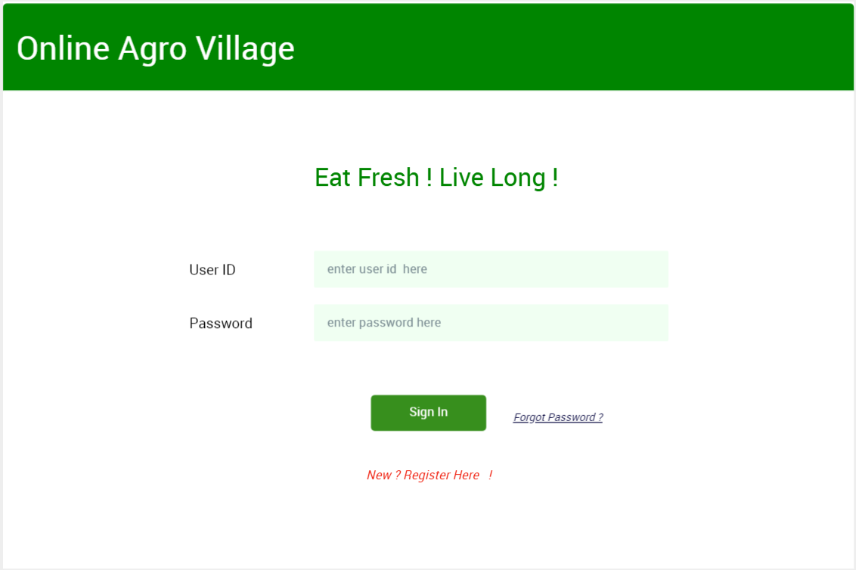
Log In

Slide 23
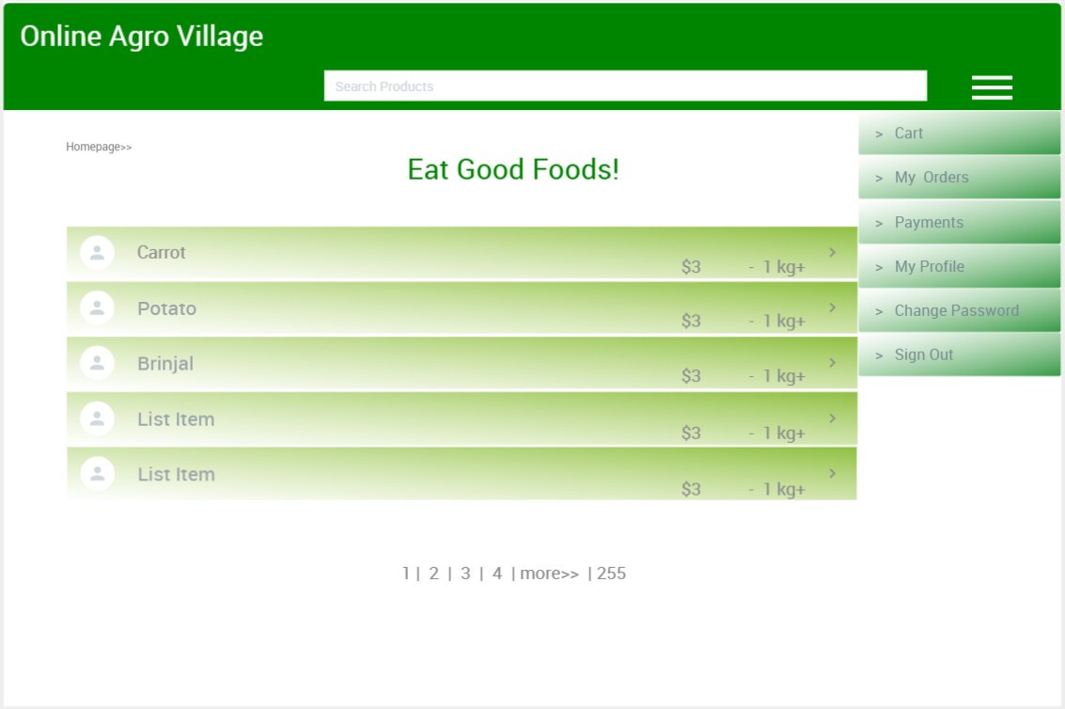
Customer Home

Slide 24
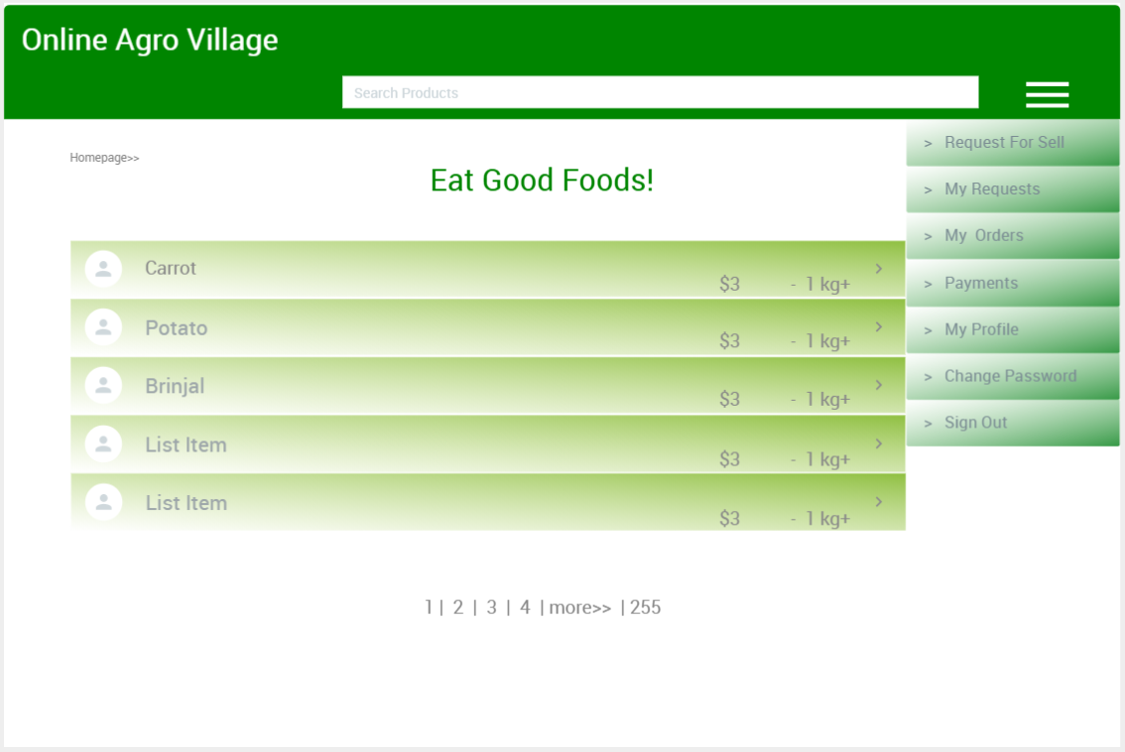
Farmer Home

Slide 25
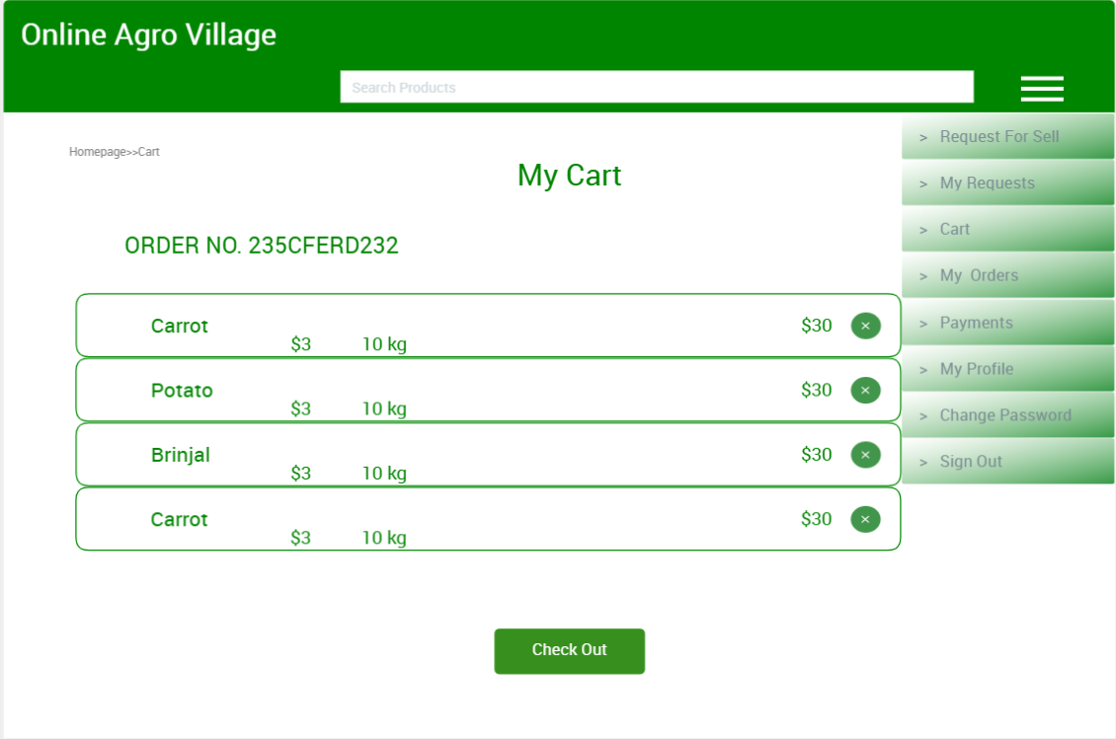
Cart

Slide 26
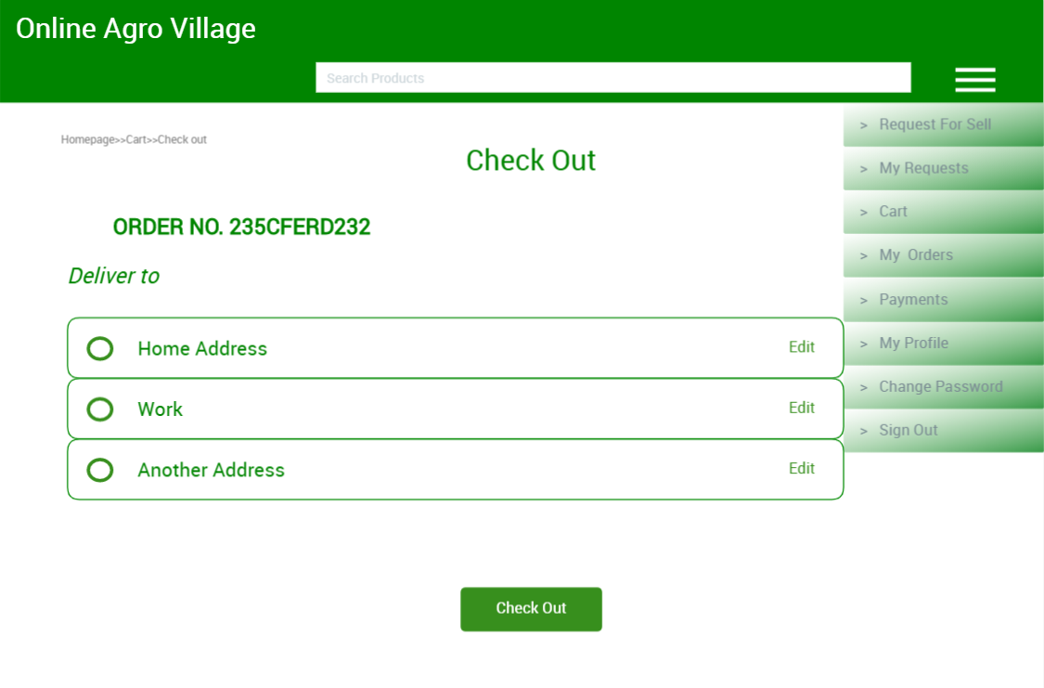
Check Out

Slide 27
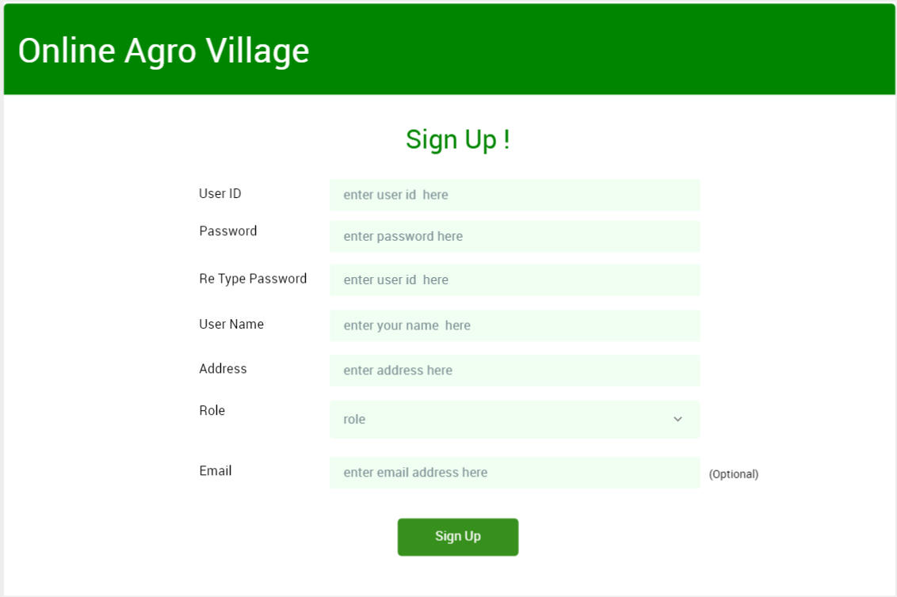
Sign Up

Slide 28
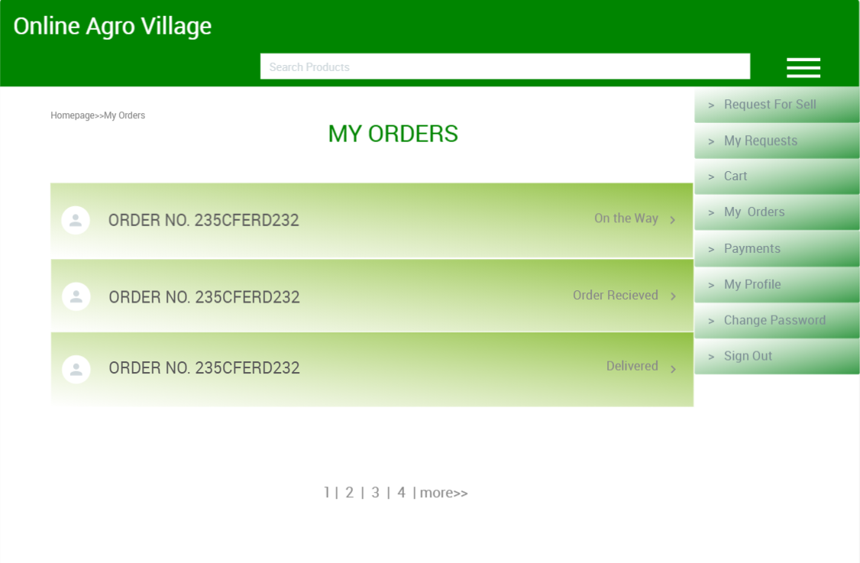
My Orders

Slide 29
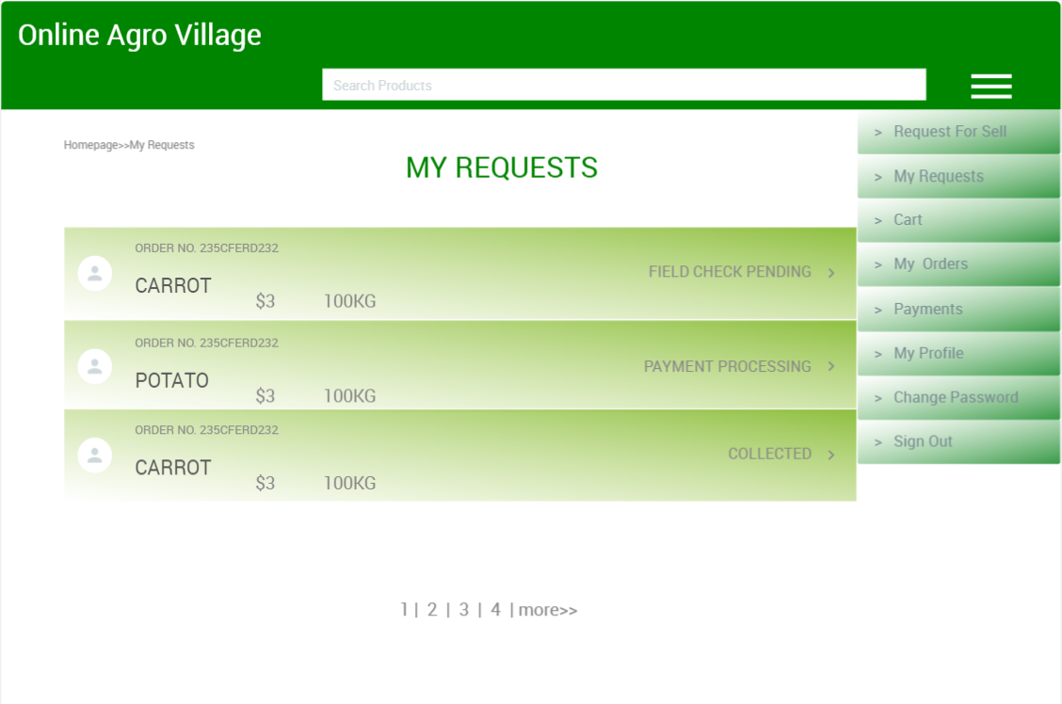
My Requests

Slide 30
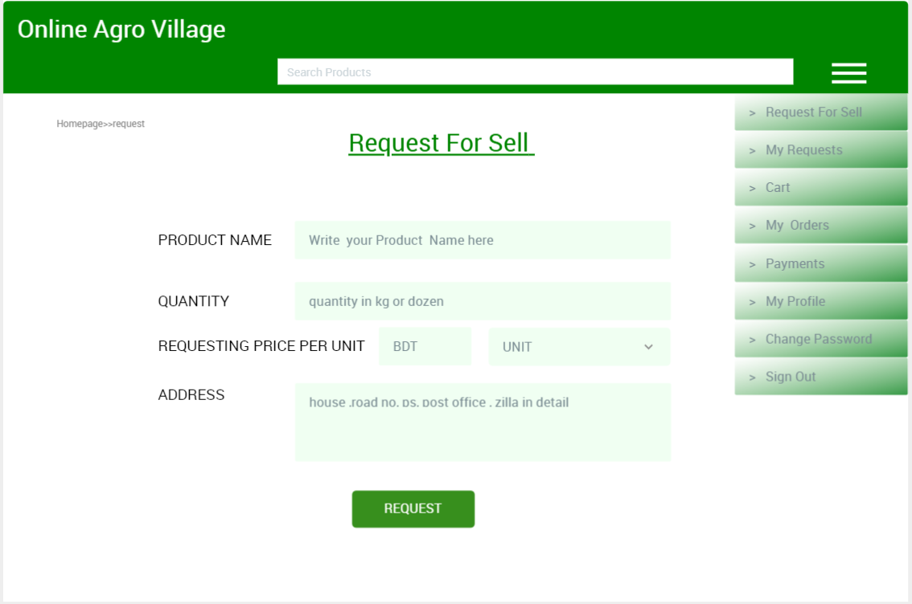
Request For Sell

Slide 31
Logical Data Model

Slide 32
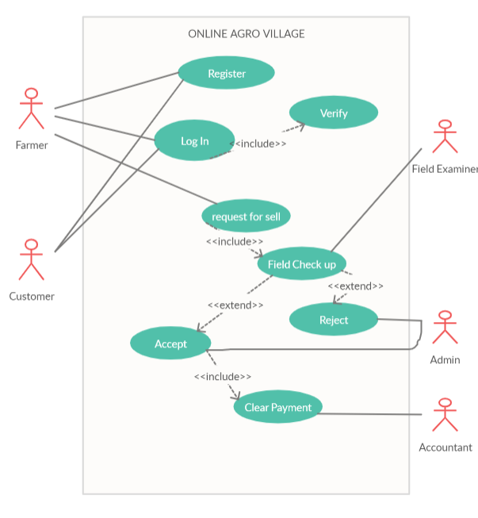
Use Case Diagram

Slide 33
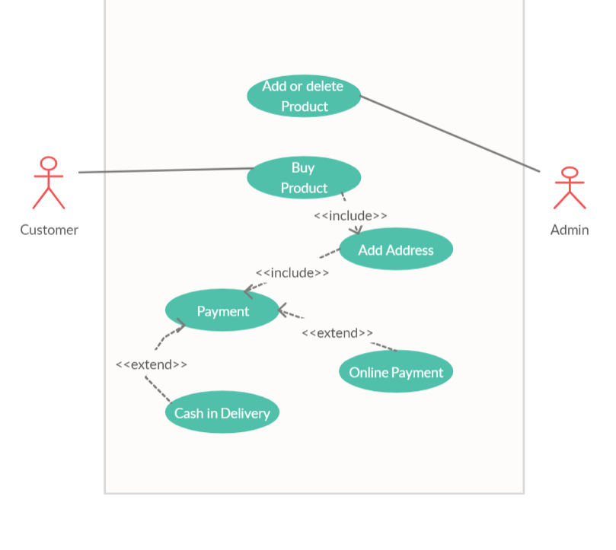
Use Case Diagram

Slide 34
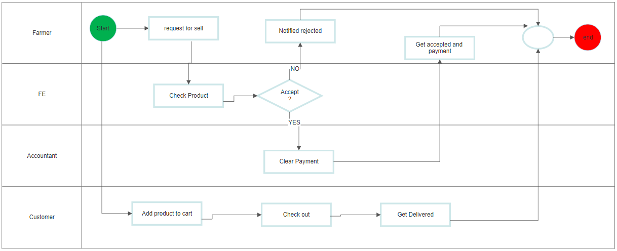
AS-IS Process Flow Diagram

Slide 35
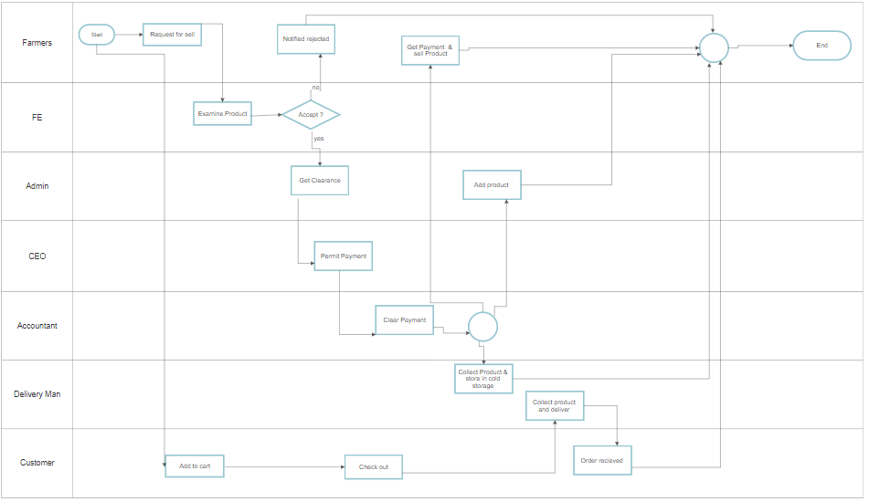
To-BE Process Flow Diagram

Slide 36
Improvements
We’ve missed out automated feedback and help center feature for the customers that is currently being assisted by the SA
We’ve missed out Discount offer which will be added in version 1.0.2

Slide 37
Conclusion

Slide 38
As a Bangladeshi , we have to serve the nation as well as we have to do our job as a software developer .
This software will help us to make a contribution in National Economy and Digitalization of the country . Besides This software will help the poor farmers to make profits as well as the customers to buy fresh vegetables and fruits at a lower cost maintaining Government policy .

Slide 39
Any Questions ?

Slide 40
Thank You !

