Slide 1
DIGITAL PORTFOLIO
STUDENT NAME: ANISHA.V
REGISTER NO AND NMID: 24131131805222001\ asnm11324131131805222001
DEPARTMENT: B.sc(data science)
COLLEGE NAME AND UNIVERSITY: 113-VALLALAR ARTS AND SCIENCE COLLEGE
ANNAMALAI UNIVERSITY

Slide 2
DESIGN. DEVELOP. DELIVER
WELCOME TO MY DIGITAL PORTFOLIO

Slide 3
AGENDA
INTRODUCTION
PROBLEM STATEMENT
PROJECT OVERVIEW
END USER
TOOLS AND TECHNOLOGY
PORTFOLIO DEVELOP DELIVER
FEATURES AND FUNCTIONALITY
RESULT AND SCREENSHOTS
CONCULSION

Slide 4
PROBLEM STATEMENT
In today’s fast-paced and competitive environment, organizations and individuals often struggle to transform abstract ideas into tangible, impactful outcomes. The lack of a structured approach leads to unclear requirements, inefficient development, and delayed or poor-quality delivery.

Slide 5
PROJECT OVERVIEW
1. Design – Understand requirements, research ideas, and create the blueprint (planning + creativity).
2. Develop – Build, code, or construct the solution based on the design.
3. Deliver – Test, refine, and hand over the final outcome to the client/audience.

Slide 6
END USER
Clients / Customers – The ones who request the project and use the final outcome.
Internal Teams – Stakeholders, managers, and team members who benefit from the process.
Target Audience / Users – The people who will directly interact with the product or service.
Business / Organization – Gains efficiency, growth, or reputation from the project delivery.
Community / Society – If the project has a wider social, cultural, or environmental impact.

Slide 7
TOOLS AND TECHNOLOGY
Design Figma, Adobe XD, Photoshop Miro, Lucid chart Trello, Notion
Develop Python, JavaScript, Java React, Node.js, Django MySQL, Mongo DB Git, GitHub
Deliver Jenkins, GitHub Actions Docker, Kubernetes, AWS Google Analytics, Grafana Slack, Confluence

Slide 8
PORTFOLIO DEVELOP DELIVER
Develop :Skills (coding, tools, frameworks)Case studies / projects under develop Problem-solving approach
Deliver :Final project show DEVELOPMENT & outcomes Client feedback / impact

Slide 9
FEATURES AND FUNCTIONALITY
Design :(Plan & Create)Feature Requirement gathering & analysis Wireframes & /UX design tools (Figma, Sketch, Adobe XD)Branding elements (logo, typography, color palette)Information architecture (sitemap, navigation flow)
Functionalities :Interactive proto types Feedback & review system Version control for designs Collaboration dashboard Accessibility compliance check
2. Develop : (Build & Implement)Features Frontend & backend development Database integration API development & integration CMS setup (WordPress, Drupal, custom CMS)Security and authentication
Functionalities :Responsive design (mobile, tablet, desktop)Real-time data updates Automated testing & debugging Performance optimization Continuous integration & deployment (CI/CD
Deliver : (Launch & Support)Features Deployment on cloud or hosting platform SEO & analytics setup Marketing integration (social, email, campaigns)Training & documentation support & maintenance
Functionalities :Automated deployment pipelines Backup & recovery system User feedback & issue tracking Performance monitoring dashboards Updates & feature enhancements)

Slide 10
RESULT AND SCREENSHOT
Design :Understand requirement twire frames & prototypes Define architecture & specifications
Develop :Write clean, scalable rate tools, frameworks, APIs Test & debug
Deliver: Deploy final solution/product Provide documentation & training Gather feedback & improve

Slide 11
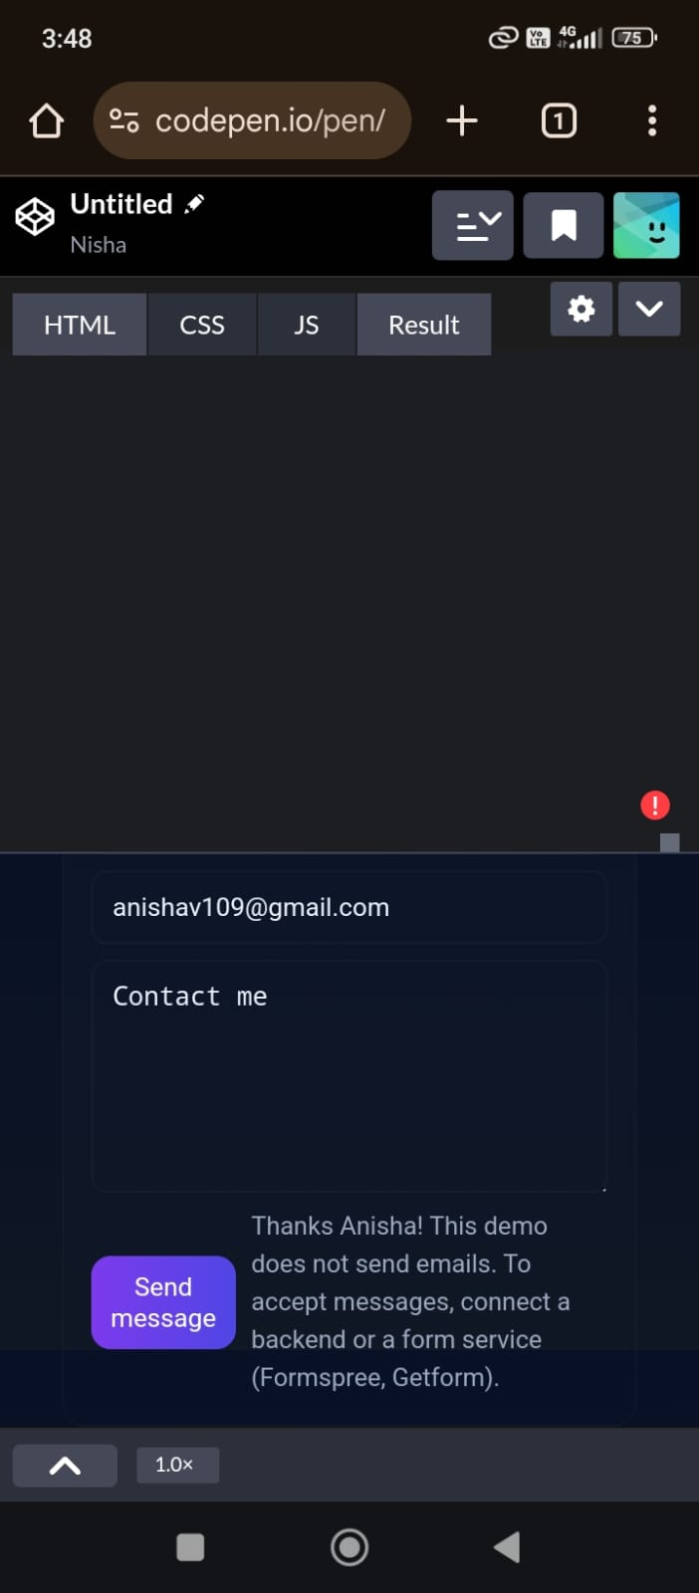

Slide 12
CONCLUSION
Design • Develop • Deliver ensures ideas are transformed into practical solutions and delivered with purpose, impact, and value.

