Slide 1

Customer Segmentation Classification
Presented by : Ishan Pradhan

Slide 2

Customer Segmentation
Customer segmentation is the practice of categorizing a customer base into distinct groups based on shared characteristics, behaviors, or preferences.
Customer segmentation allows businesses to tailor their marketing efforts, products, and services to specific customer groups, leading to more effective and person
In today's data-driven world, customer segmentation plays a crucial role in optimizing marketing strategies and enhancing customer experiences.

Slide 3
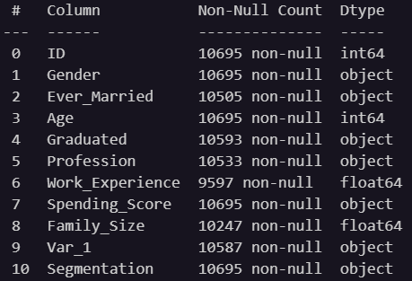
Dataset Information
7 columns of object type.
(Gender, Ever_Married, Graduated, Profession, Spending_Score, Var_1 and Segmentation)
4 columns of numeric type.
(ID, Age, Work_Experience and Family_Size)

Slide 4

EDA Performed in Data Analysis
Data Summary
Checked dataset shape and data types.
Handling Missing Values
Counted and removed missing values.
Handling Duplicates
Identified and removed duplicate rows.
Label Encoding
Converted categorical data to numerical.
Correlation Analysis
Visualized numerical variable relationships with a heatmap.

Slide 5
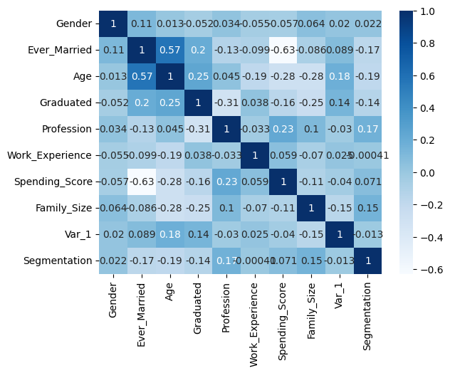
Visualization
A heatmap is used to visualize data relationships.
Dark Blue: Strong positive correlation (values closer to +1)
Light Blue: Weaker or no significant correlation (values closer to 0)

Slide 6
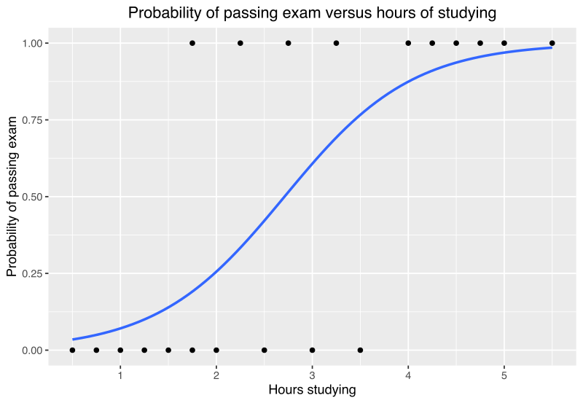
Why Choose Logistic Regression for Classification?
Simplicity: Logistic Regression is a straightforward and easy-to-understand algorithm.
Interpretable Results: It helps you understand which factors are important in making predictions.
Quick and Efficient: It's fast and doesn't require lots of computer power.
Stable and Reliable: It's less likely to make wild guesses or overcomplicate things.

Slide 7
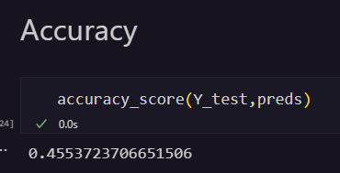
Accuracy
The accuracy score we obtained is approximately 0.455, indicating that the model's predictions were correct for about 45.54% of the test data.
The accuracy score that we obtained can be increased by trying out more complex algorithms and better data preprocessing.

Slide 8

THANK YOU

