Slide 1
Car Price 3
By: Garima Maharjan

Slide 2
Table of contents
01
02
03
04
05
06
Introduction
Objective
About
Image Output
Visual Output
Conclusion

Slide 3
Introduction: Car Prices 3
Car price prediction uses a variety of methodologies and algorithms to calculate an automobile's value based on its unique qualities and previous market patterns. This predictive research is helpful for both buyers and sellers since it sheds light on how many aspects affect a car's pricing, enabling buyers to make educated choices and sellers to set fair prices.

Slide 4
1. The primary objective of this project is to develop a trustworthy predictive model capable of accurately anticipating car pricing. 2. It allows consumers to make more educated decisions, helps dealerships set competitive rates, and helps manufacturers analyze market trends and demand dynamics.
Objectives

Slide 5
About Car Price Prediction
Dataset Information
- The dataset includes 7 columns of numeric type and 5 columns of string/object type.
-This dataset was chosen due to its relevance to predicting car prices.
Exploratory Data Analysis (EDA)
EDA techniques were employed to gain insights into the dataset.
Data Preprocessing Steps:
Duplicate Removal: Checked for duplicates and found duplicate rows, which were removed.
Train-Test Split: The dataset was split into a training set (80%) and a testing set (20%)

Slide 6
Visualizations
- A scatter plot was created to visualize the relationship between engine size and car price.
- Findings: Engine size seems to have a positive correlation with car price.
Model Selection
- Linear Regression algorithm is chosen for this task.
- Reason: Linear Regression is a suitable choice for predicting acontinuous target variable based on multiple features.

Slide 7
Model Training and Evaluation
- Features selected for training: car length, car width, engine size, horsepower, highway mpg.
- The data was split into training and testing sets.
- Linear Regression model was trained using the training data.
- Predictions were made on the test data.
Evaluation Metrics
- Mean Absolute Error (MAE): This metric represents the average absolute difference between the predicted and actual prices.
- Mean Squared Error (MSE): This metric measures the average squared difference between predicted and actual prices.
- Root Mean Squared Error (RMSE): This is the square root of MSE and provides a more interpretable estimate of the error.

Slide 8
Model Performance
- MAE: 3281.64
- MSE: 10769188.42
- RMSE: 3281.64
- The model's performance indicates that the predicted prices are, on average, around 3281.64 away from the actual prices.
Interpretation: These metrics indicate how much our model's predictions deviate from the actual car prices. Lower values of MAE, MSE, and RMSE are desired, suggesting better model performance.
Increasing Accuracy: We could potentially increase accuracy by including more relevant features, applying advanced preprocessing techniques, or experimenting with different algorithms.

Slide 9
Real-World Applicability
- While the Linear Regression model provides insights into the relationship between features and car prices, its simplicity might not capture complex non-linear patterns.
- To enhance real-world applicability, we might need to explore more advanced algorithms or feature engineering techniques.

Slide 10
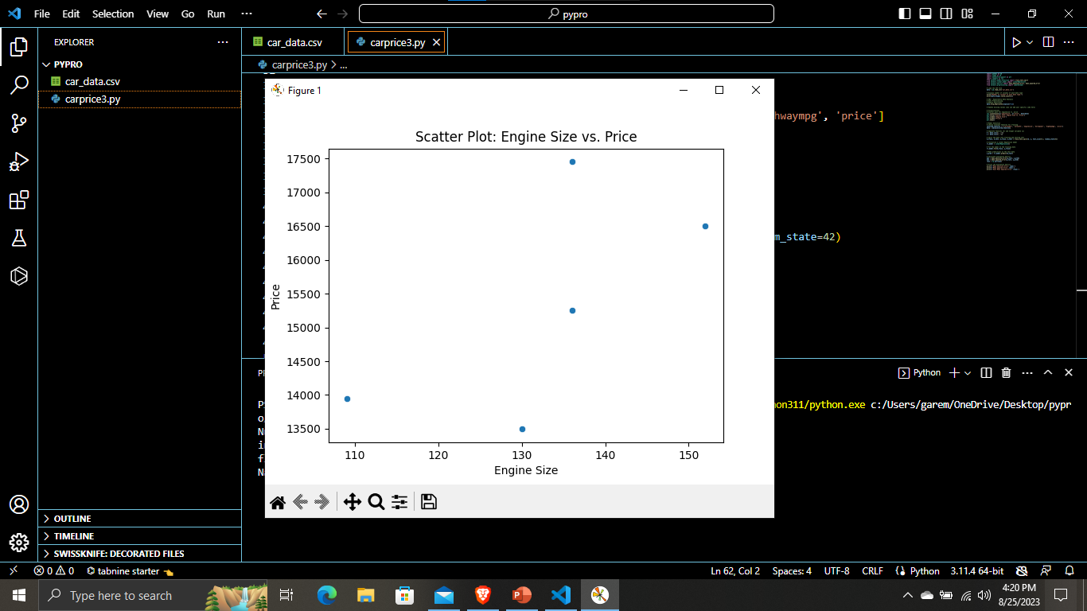

Slide 12
Conclusion
Our study emphasizes the importance of utilizing technology to acquire insights and make knowledgeable choices in the constantly shifting environment of data-driven decision-making. Understanding the delicate interplay of characteristics that drive pricing decisions is essential for car price prediction..

Slide 13
Thank You.

